Slide 1
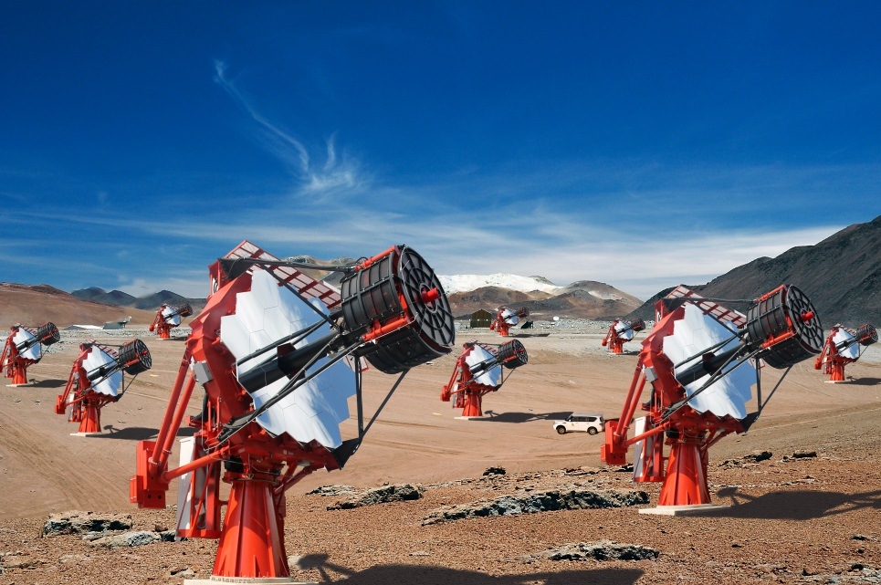
CCF/CTA Calibration Meeting
Universidade de São Paulo
Instituto de Astronomia, Geofisica
e Ciencias Atmosferica
Pre-selection of muons: image statistics
Teresa Mineo, Cettina Maccarone
INAF/IASF-Palermo, Italy
for the ASTRI Collaboration & the CTA Consortium
T. Mineo– CCF/CTA Meeting, Barcelona, 26-28 October 2015

Slide 2
Simulations
CORSIKA |  | Proton | Muon
 | Site | Paranal | Paranal
 | spectral index | 2.7 | 2.0
 | energy range | 2-100 TeV | 6 GeV-1 TeV
 | Pointing | Zenith | Zenith
 | Viewcone | 4 deg | 4 deg
 | Max Distance | 400 m | 2.1 m
 | Starting altitude | free | 500 m above M1
 | N. Event | 100 000 | 200 000 (μ+, μ-)
 | Background | 20x10⁶ ct/s/pixel | 20x10⁶ ct/s/pixel
ASTRI-SIMULATOR: | includes the mirror reflectivity, the SiPM PDE, the PMMA window transmission, some of the mounting structure over the mirror
ANALYSIS SOFTWARE | IDL code
T. Mineo – CCF/CTA Meeting, Barcelona, 26-28 October 2015

Slide 3
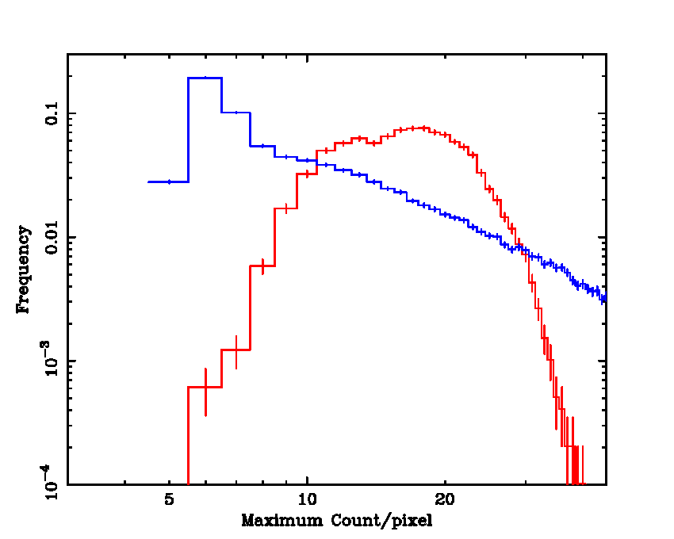
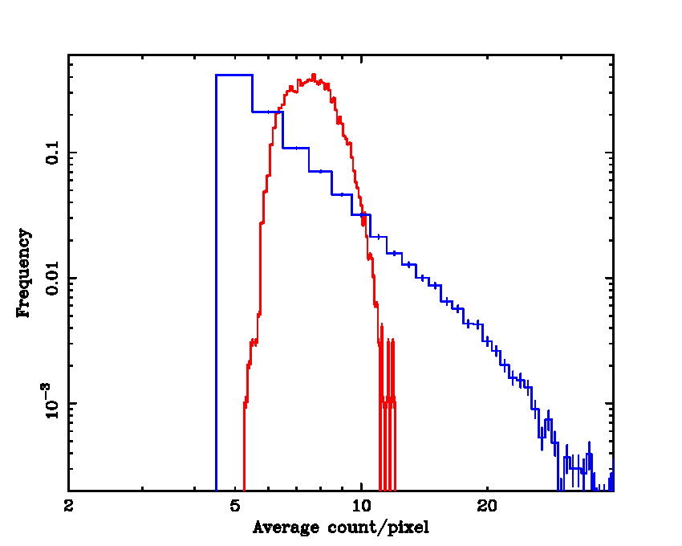
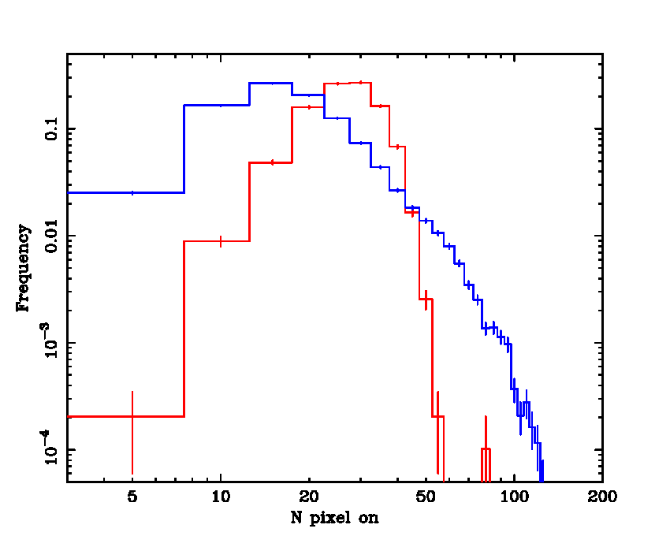
Steps of the Analysis
We produced the histograms over all analysed events of the following variable:
the maximum count in the pixels of each image
the average of count left after the cuts.
Proton
Muon
the number of pixel left after a given cut
2) We computed the percentage of protons and muons contained in the interval where the muon distribution is higher than the proton one.
T. Mineo – CCF/CTA Meeting, Barcelona, 26-28 October 2015

Slide 4
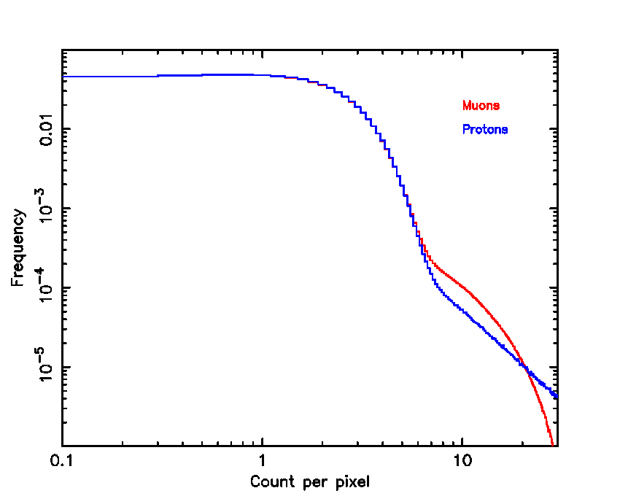
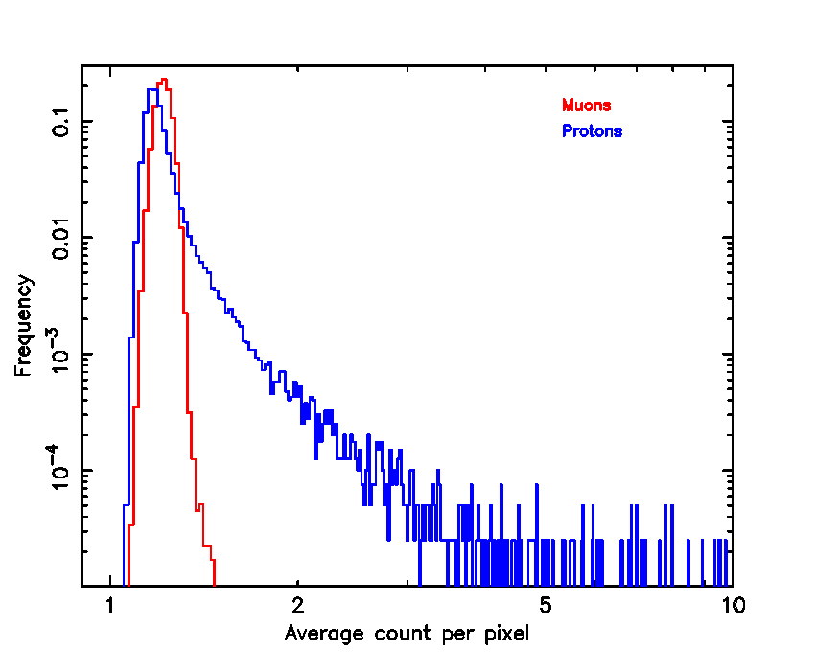
Cuts
Proton
Muon
1)Cut with fixed number of count:
5, 7 and 10 counts
2)Cut with a number of count equal to 5xAverage, 7xAverage and 10xAverage.
This cut depends on the image statistics
T. Mineo – CCF/CTA Meeting, Barcelona, 26-28 October 2015

Slide 5
Results and Conclusion
Selection on the maximum count
Proton | Muon
36% | 92%
Selection on the average count after cut
Selection on the number of pixel after cut
Cut | Proton | Muon
5 count | 32% | 91%
7 count | 42% | 92%
10 count | 37% | 92%
5xAverage | 37% | 92%
7xAverage | 39% | 93%
10xAverage | 31% | 84%
Cut | Proton | Muon
5 count | 33% | 84%
7 count | 30% | 90%
10 count | 35% | 89%
5xAverage | 30% | 86%
7xAverage | 31% | 88%
10xAverage | 27% | 72%
The investigated statistical parameters are not good for the pre-selection
T. Mineo – CCF/CTA Meeting, Barcelona, 26-28 October 2015

