Slide 1
Two slides about the muon method for CTA
Markus Gaug
markus.gaug@uab.cat

Slide 2
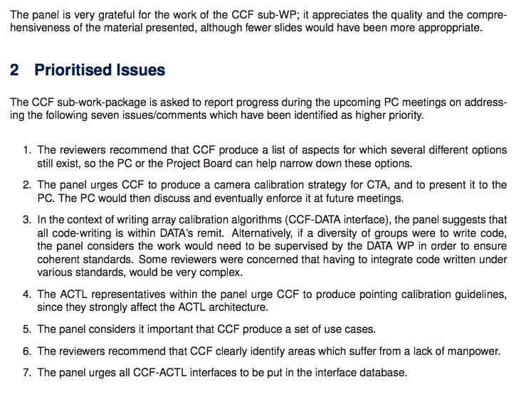
Main conclusions

