Slide 1
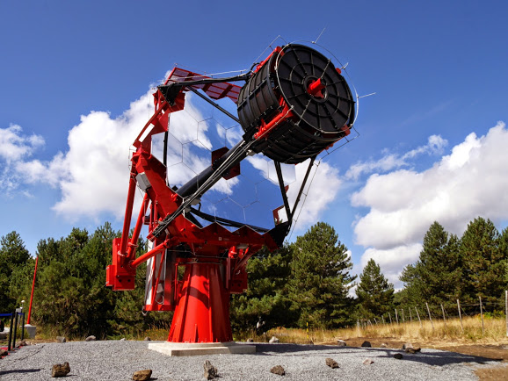
CTA Calibration Meeting
Universidade de São Paulo
Instituto de Astronomia, Geofisica
e Ciencias Atmosferica
The ASTRI SST-2M Illuminator
Segreto, G. La Rosa
INAF Palermo
for the ASTRI Collaboration & the CTA Consortium

Slide 2
the illuminator and the ASTRI-SST-2M calibration strategy
In support to the ASTRI SST-2M end-to-end calibration, a portable ground light source has been designed to illuminate the whole telescope aperture from several hundred meters distance
The ground light source will be used during the commissioning phase to measure the telescope actual spectral, temporal, spatial and linearity of the end-to-end response
Results will be used to:
fine tuning the physical parameters of the ASTRI SST-2M Montecarlo code
obtain, for each camera pixel, the end-to-end corrective factor for the flat fielding of sky images

Slide 3
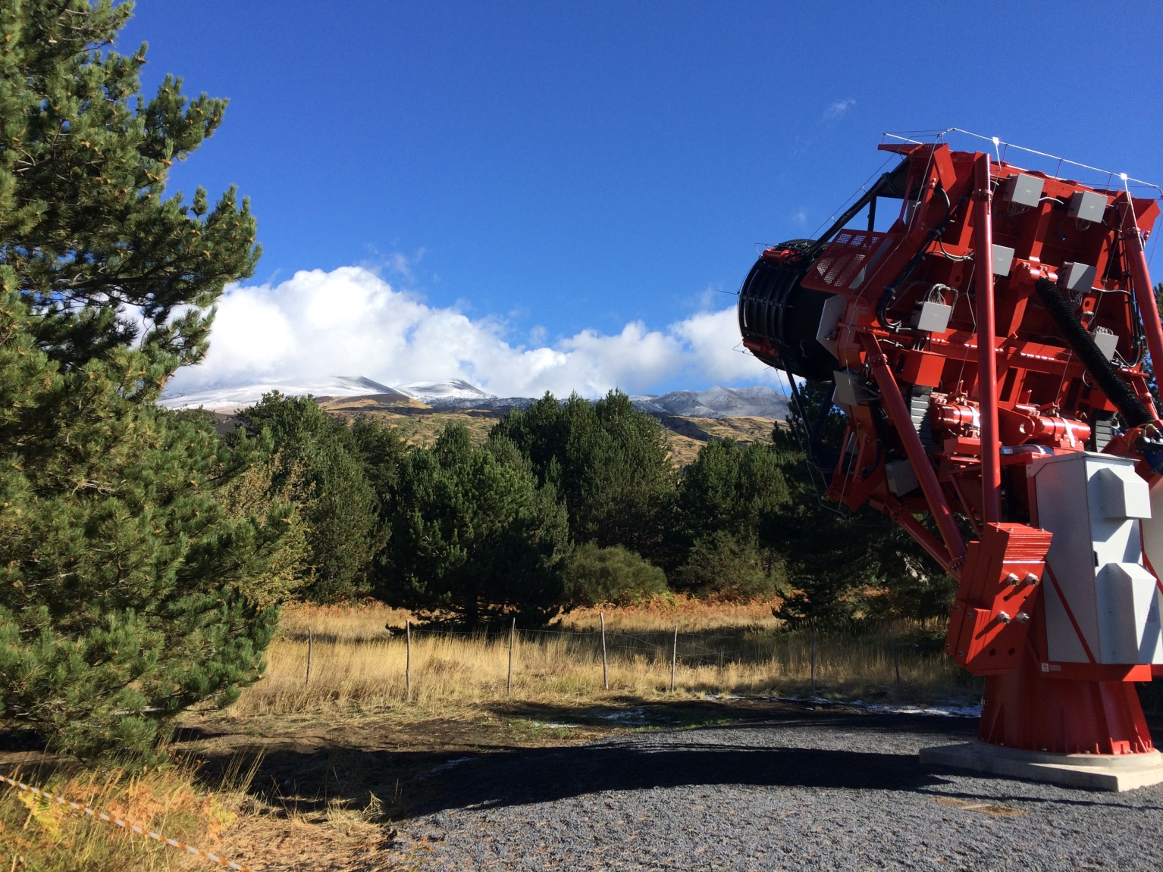
Illuminator position
2.1 km
The Illuminator will be positioned on the slopes of Mt. Etna, at $\sim 2$ km distance from the ASTRI SST 2M telescope location (Serra La Nave)

Slide 4
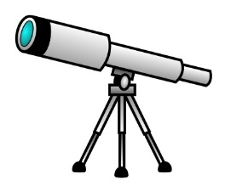
The Illuminator
Time
Projection-box
optical fiber
from NIST photodiode
auxiliary telescope (UVScope)
Light generation and control box
Light is generated inside the control box and delivered to the projection box through an optical fiber
A NIST calibrated photodiode inside the projection box is used to monitor the ouput light flux
A calibrated auxiliary telescope (UVscope) placed near the telescope aperture, allows to completely eliminate the uncertainty due to the atmospheric transmission

Slide 5
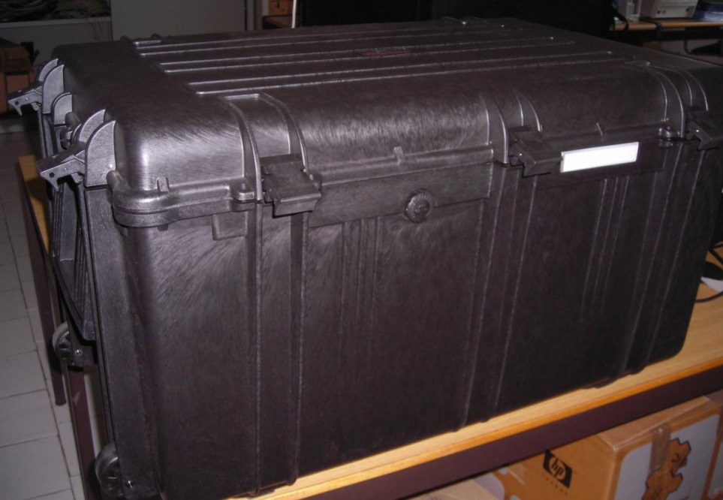
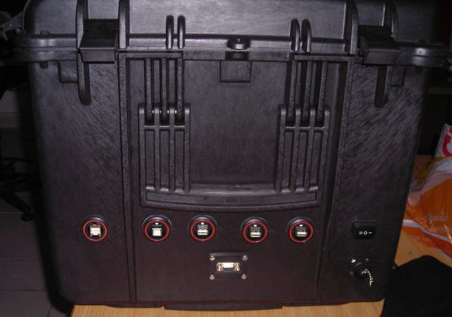
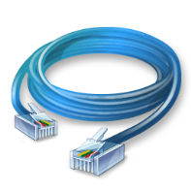
The Control Box
56 cm
86 cm
43 cm
heavy duty, waterproof (IP67),
polypropylene case
Ethernet
Control box interfaces

Slide 6
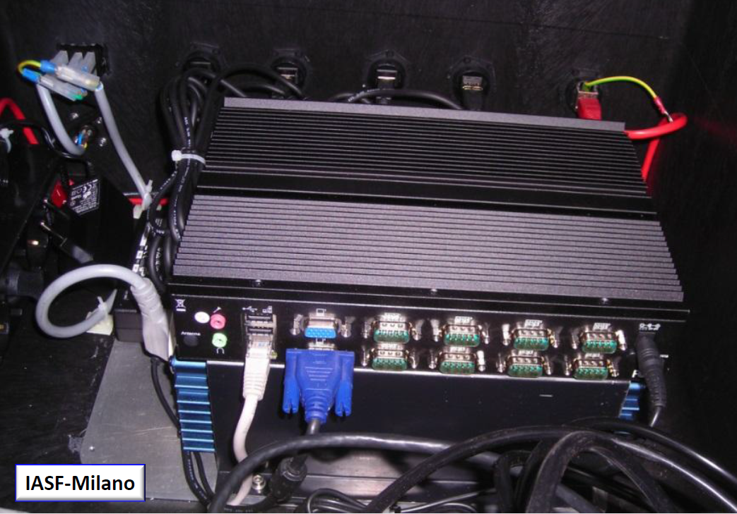
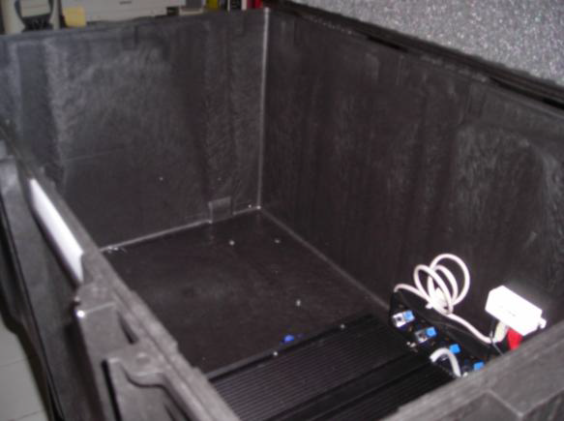
Inside the control box
Local PC
RS232: 8
USB: 4
… plenty of room for:
battery pack
Wi-fi system
Optical generation devices
….
DC/AC inverter

Slide 7
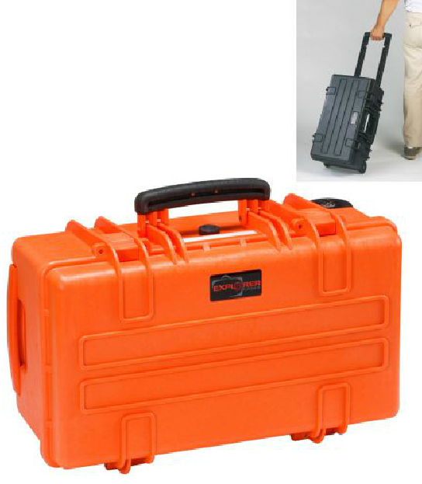
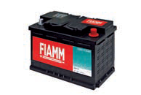
The power box
USB
Projection box
CC
CC 12 V
Light generation and control box
Power box
fiber optic
Type: AGM (Absorbent Glass Mat)
12V/100 AH
323x170x214 mm
32.8 Kg
The battery, currently installed inside the control box, makes it quite heavy and difficult to transport
Battery will be moved on dedicated IP67 trolley-box
DC Power Supply
AC Power Supply

Slide 8
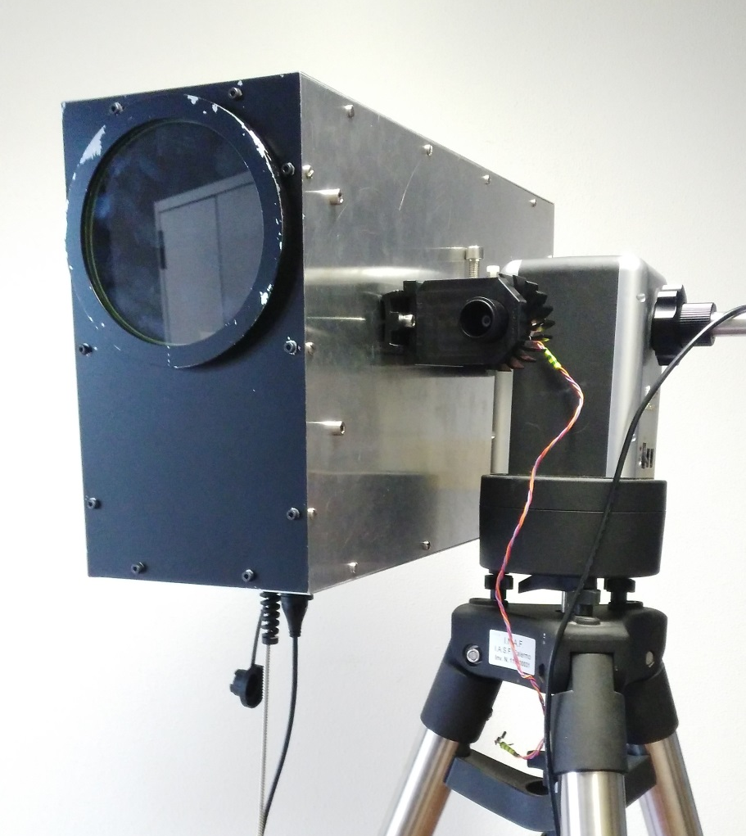
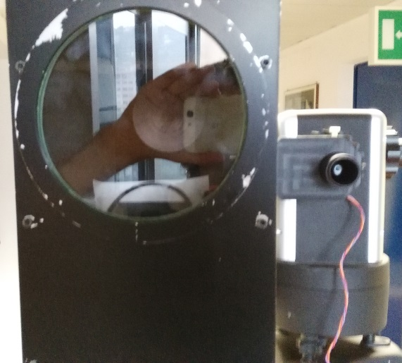
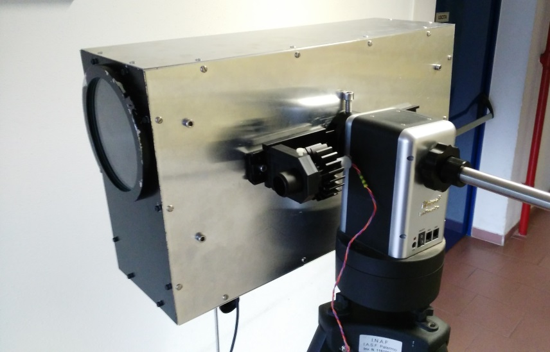
The light projection box
18 cm
55 cm
32 cm
The optical system is contained in a lightweight aluminium case that can be mounted on any common (manual or motorized) telescope mount for pointing

Slide 9
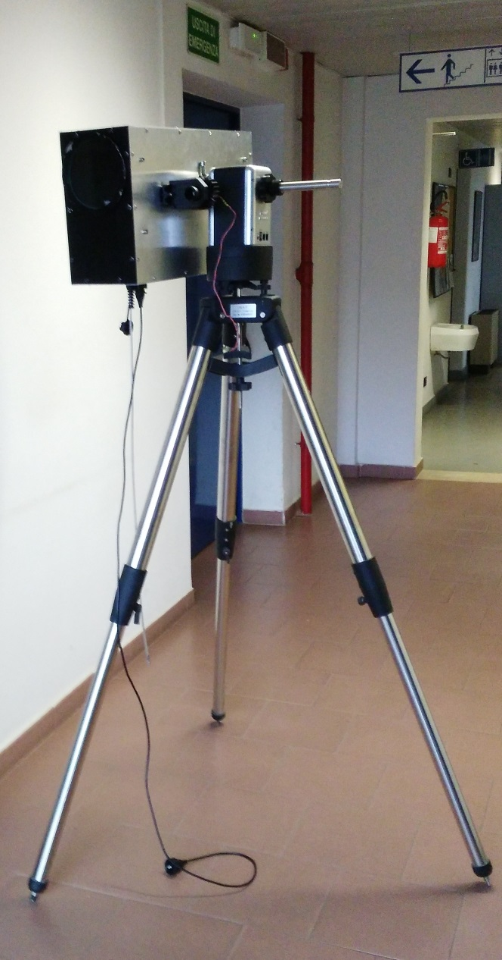
Illuminator status
The projection box of the Illuminator has been installed on a motorized mount ready to start laboratory tests on the projected beam
To be done before open-air nightly measurments:
Water-tight box sealing
Thermal insulation
Heaters to prevent condensation
Motorized Alt-Azimuthal mount
Fiber optic
USB cable signals:
NIST sensor measurements
Photodiode Temperature
Humidity
Entrance window Temperature

Slide 10
Multicolor CW LED sources
Light
(fiber optic)
low noise (rms <1‰)
current generator
(2 A/15 V)
High Brightness LEDs
Relay array
Current control
LED selection
Light intensity
LED current (rms <1‰) will be finely adjusted in order to keep the output light flux at the pre-selected level (<1‰)

Slide 11
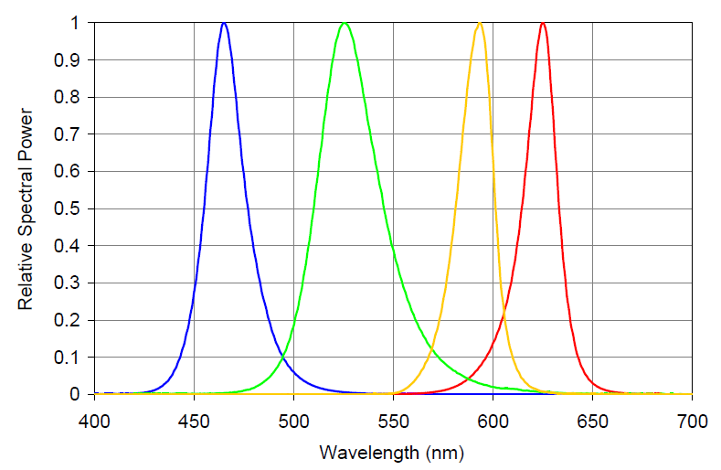
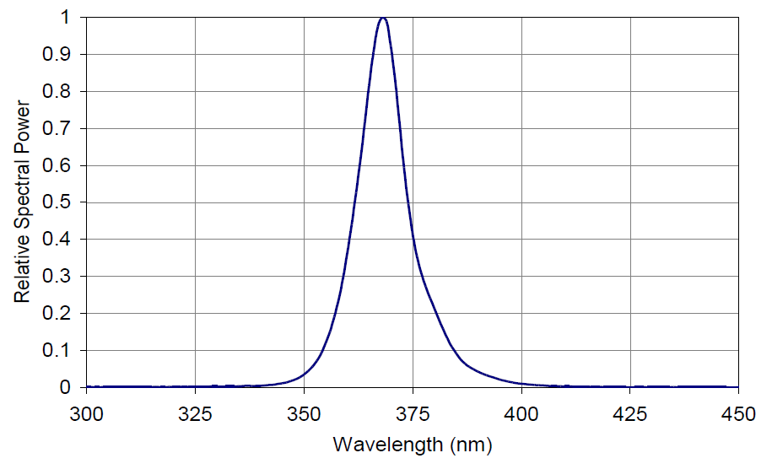
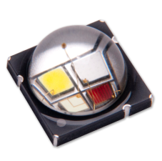
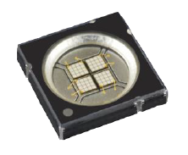
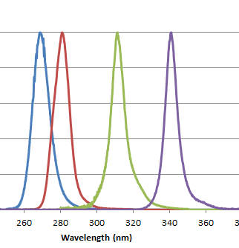
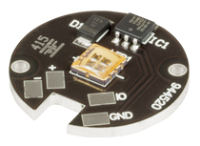
Multicolor LED sources
Visible: P >>1 W (<< 100 €)
UV-A (P > 1W) (100 €)
365 nm
385 nm
395 nm
405 nm
The visible and the UV-A (>365 nm) spectral region are rather well covered by High Brightness LEDs ( > 1W/die).
265 nm 10 mW: 1k€
280 nm 25 mW: 1k€
310 nm 25 mW: 1k€
340 nm 10 mW: 880 €
LED emitters are also available in the spectral region below 365 nm but it is TBV if their brightness (<25 mW/die) is enough for their use as light sources for the illuminator.

Slide 12
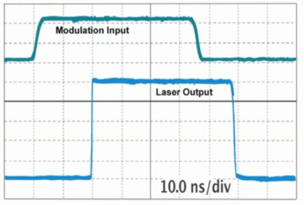
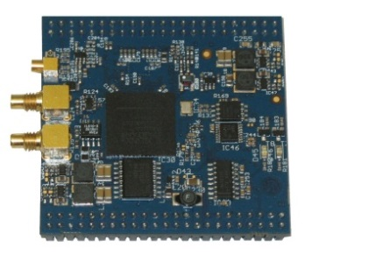
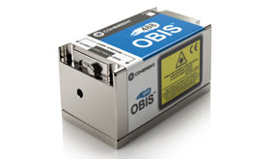
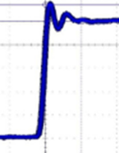
The ns-pulsed source
ns-pulser
Variable pulse width:
from 2 ns in 1 ns step
USB 2.0 control
laser diode
Analog and digital modulation
Rise and fall time: < 2ns
Thermoelectric cooler (TEC)
Optical power: up to 200 mW
USB 2.0 and RS-232 control
Input Trigger
Laser output
Control of:
Pulse width
Repetition rate
Control of Laser current
2 ns
2 ns
Variable pulse length will allow to calibrate the camera timing response

Slide 13
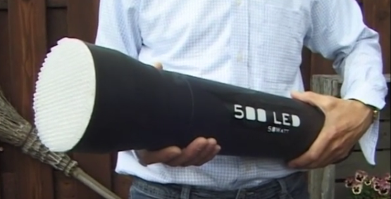
Requirements for additional light sources
The first Illuminator prototype will be equipped with:
- a single CW/ns pulsed laser light source (405 nm)
- a multi color HB LEDs CW/pulsed (obtainable pulse length TBV)
Other optical sources can be accommodated inside the illuminator control box provided they have:
Compact and reasonable size
Standard connector for fiber optic (e.g. SMA)
Computer control via USB (or RS232)
Precisely adjustable power
Input for external trigger
Standalone GUI (for Windows)
Communication protocol manual (!)

Slide 14
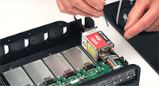
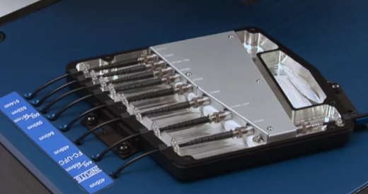
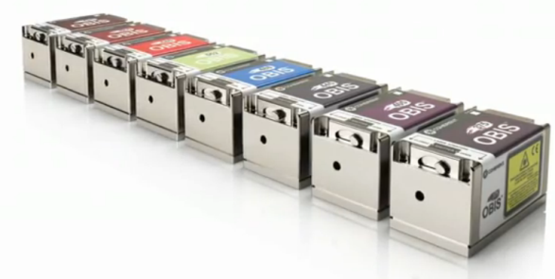
Possible ns-pulsed/multi-wavelength lasers system
Integrated 5 laser bay mount
Analog and digital control
USB and RS-232 interface for control from host computer
Fiber optic Beam combiner
8 input – 1 output
Example of available wavelengths:
375 nm 50 mW: 10k €
405 nm 100 mW: 5k €
445 nm 75 mW: 7k €
488 nm 50 mW: 6k €
640 nm 40 mW: 2k €

Slide 15
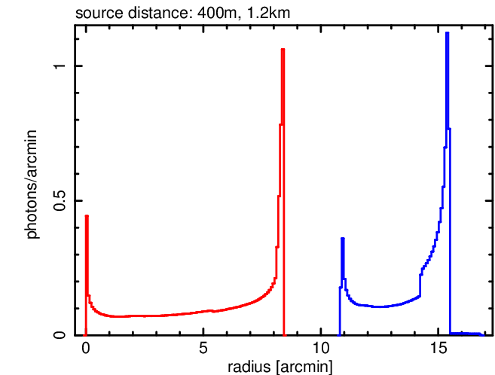
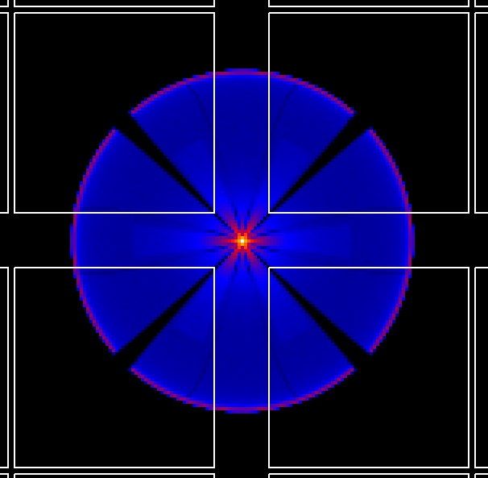
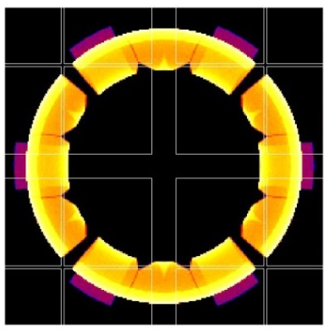
ASTRI PSF vs. distance
On-axis PSF at 1200 m
On-axis PSF at 400 m
(Logarithmic- scalee)
(Logarithmic- scalee)
PSF images and the relative radial distributions for an on-axis point sources placed at 400 m and 1.2 km from the ASTRI telescope aperture.
To limit the influence of the variable atmospheric attenuation, the illuminator could be placed at ≈ 1 km distance from ASTRI telescope aperture, obtaining a PSF good enough for an accurate verification of its Montecarlo model.

Slide 16
Calibration of the projected beam
light intensity $\left(mW\right)$
photon flux:$Φ \left(R\right)=\frac{S_{NIST}}{A_{pupil}}\left(\frac{phot}{m^{2}}\right)$
R
Precision Pinhole
Motorized Mount
«Reference» NIST sensor
A NIST calibrated photodiode inside the illuminator light-box continuosly monitor the light intensity at the entrance of its optical system
The projected light beam will be calibrated, as a function of wavelenght, by means of a 2nd NIST sensor (or a calibrated PMT), with a precision entrance pupil, placed at certain distance from the illuminator
To verify the spatial uniformity of the light beam, a 2D Azimuth/Elevation scanning will be performed by means of a motorized mount

Slide 17
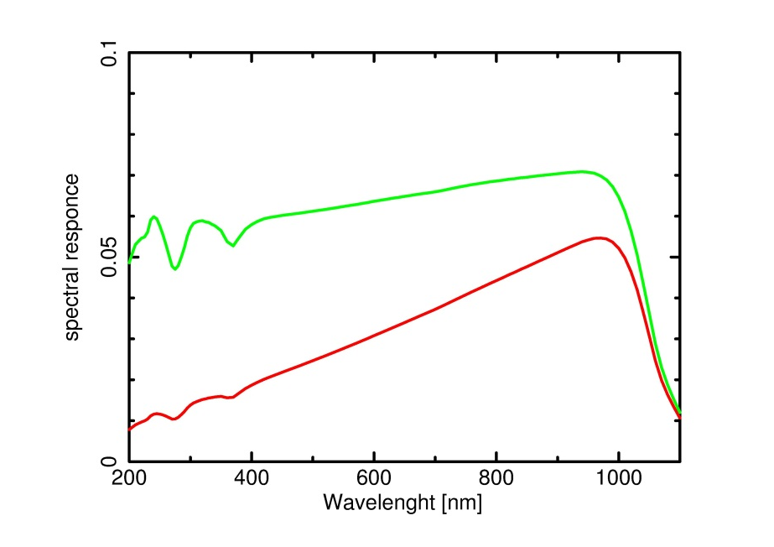
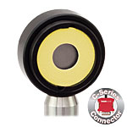
NIST reference
NIST-calibrated
Si Photodiode
Ø 9.5 mm
λ: 200 nm – 1100 nm
50 nW – 50 mW
resolution: 1 nW
NTC Thermistor
Response Time: < 1 μs
Linearity: ± 0.5%
Measurement Uncertainty
±5% 200 – 450 nm
±3% 451 – 1000 nm
Quantum efficiency
Responsivity (A/W)
Spectral responce of the Si-photodiode used for the absolute calibration of the illuminator

Slide 18
Summary
The ASTRI-SST 2M portable illuminating system
Projection box:
Light weight, for easy installation on elevated (fixed or motorized) mounts
output flux monitored by a NIST calibrated photodiode
uniform far-field illumination pattern
Control box:
battery powered
computer with local control interfaces
wireless system for remote control
generation of ns-pulsed and CW light at several wavelengths
adjustable pulse length (from 2ns in step of 1ns)
continuously adjustable flux intensity

