Slide 1
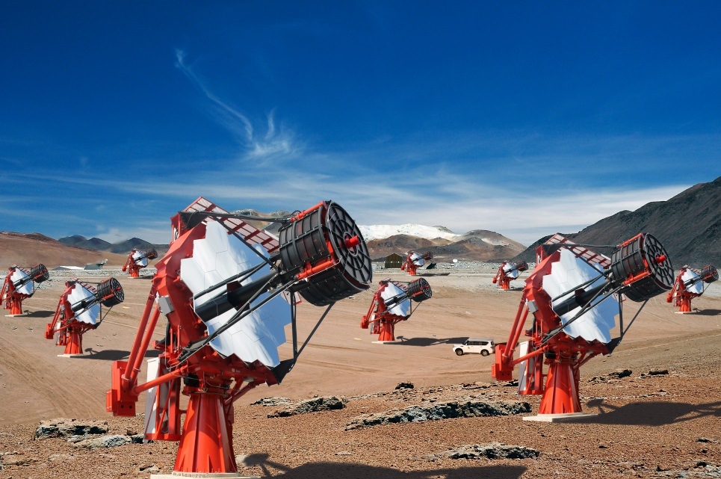
CCF/CTA Calibration Meeting
Universidade de São Paulo
Instituto de Astronomia, Geofisica
e Ciencias Atmosferica
Pre-selecting muons with ASTRI telescopes:
image morphology analysis.
M.C. Maccarone, T. Mineo – INAF/IASF-Palermo, Italy
for the ASTRI Collaboration & the CTA Consortium
M.C. Maccarone – CCF/CTA Meeting, Barcelona, 26-28 October 2015

Slide 2
Pre-selecting muon images in the camera (server)
Preface
Extracted from “Muons for CTA”, COM-CCF/150310, Vers.4.7
During a dedicated interface meeting between ACTL and the telescope cameras in May 2015 in Heidelberg, the cameras committed to accept a common clock distribution and trigger timestamping (UCTS) board, and to provide an input trigger signal to that board for time-stamping of stereo triggers. The timestamp is then provided to the SoftWare Array Trigger (SWAT) which takes the ultimate trigger decision.
The camera server has however the option to force readout and storage of an individual event. This is the case for local muon images which need to be recognized as such in the camera server (from un-calibrated events) at high efficiency while keeping the number of mis-identified events as low as not to saturate the readout.
This task may be challenging for the SSTs, given the relatively small size of their muon images. That's why the ASTRI telescope has started to develop an efficient and fast algorithm to recognize muons in the camera server.
Pre-selection based on:
X
image statistics
image morphology
M.C. Maccarone – CCF/CTA Meeting, Barcelona, 26-28 October 2015

Slide 3
Pre-selecting muon images in the camera (server)
Important Notes
The pre-selection
aims to ‘identify’ those events (triggered in the camera) that could be considered generated by muons and then ‘usable’ as calibrators
it does not require deep analysis of the muon ring
It must be fast and efficient
the algorithm must satisfy the new suggested level B-requirement:
B-M/SST-1300 The camera must be able to trigger on, and flag from pre-calibration data, fully contained muon rings impacting the mirror with an energy >20 GeV with an efficiency greater than 90%, even if visible in only one telescope camera.
M.C. Maccarone – CCF/CTA Meeting, Barcelona, 26-28 October 2015

Slide 4
ASTRI SST-2M – Muon pre-selection method
Muon morphological pre-selection based on Taubin method
0) … on the cleaned image:
Selection on the ring geometrical parameters (ring radius, ring center distance, ring width)
(a,b)
R
Taubin method: The coordinate of the center (X_{c} , Y_{c}) and the radius (R) are computed minimizing the function ξ given by :
G. Taubin, IEEE Trans. PAMI, (1991)
2
where X and Y are the image coordinates of the pixels survived to the cleaning.
The width of the reconstructed ring is here defined as RingWidth = RMS(Radius).
Main selection criteria:
0.5°≤Radius ≤1.5° .and. CenterDistance<4.5° .and. RingWidth<0.2°
as agreed in “Muons for CTA”, COM-CCF/150310 plus “ “
M.C. Maccarone – CCF/CTA Meeting, Barcelona, 26-28 October 2015

Slide 5
ASTRI SST-2M – Simulation/Analysis parameters
Yesterday
CORSIKA - Site Aar, Obslev 1640 m asl, Atmosphere 24
 | PRMPAR | ERANGE | ESLOPE | VIEWCONE | CSCAT | FIXCHI g/cm^2
Muons+ | 5 | 6 GeV – 1 TeV | -2 | 0 – 4 deg | 2.153 m | 802.45
Muons- | 6 | 6 GeV – 1 TeV | -2 | 0 – 4 deg | 2.153 m | 802.45
Protons | 14 | 2 – 100 TeV | -2.72 | 0 – 4 deg | 400 m | ---
Gamma Crab-like | 1 | 1.5 – 100 TeV | -2.49 | 0° | 400 m | ---
500 m above Obslev
Telescope Simulation – by means of the Palermo ASTRI simulator
Trigger – standard: (no dedicated trigger is required for muons in ASTRI) at least 5 adjacent pixels in a PDM, each pixel with at least 4 pe
Night Sky Background – not present (the image is considered well-cleaned)
Analysis – at least 20 pixels fired-on
Taubin selection cuts – 0.5°≤Radius ≤1.5°, RingWidth<0.2°, CenterDistance<4.5°
Results - > 99% muons selected (no difference between mu+ and mu-, as expected) while > 98% protons rejected
M.C. Maccarone – CCF/CTA Meeting, Barcelona, 26-28 October 2015

Slide 6
ASTRI SST-2M – Simulation/Analysis parameters
Today
CORSIKA - Site Paranal, Obslev 2150 m asl, Atmosphere 26 (1000000 Muons+, 98815 Protons)
 | PRMPAR | ERANGE | ESLOPE | VIEWCONE | CSCAT | FIXCHI g/cm^2
Muons+ | 5 | 6 GeV – 1 TeV | -2 | 0 – 4 deg | 2.153 m | 753.59
Protons | 14 | 2 – 100 TeV | -2.72 | 0 – 4 deg | 400 m | ---
500 m above Obslev
Telescope Simulation – by means of the Palermo ASTRI simulator
Night Sky Background:
nsb_0 (no inclusion, images used as reference ⬅ ‘well-cleaned’)
nsb_1 (~ 1 pe/pixel every 50 ns, ~ 20 MHz per pixel) ➔ cleaning is required)
Trigger – standard: (no dedicated trigger is required for muons in ASTRI) at least 5 adjacent pixels in a PDM, each pixel with at least 4 pe
Analysis – at least ‘Npixon’ pixels remaining fired-on after cleaning
Selection cuts – as before plus a further selection parameter
M.C. Maccarone – CCF/CTA Meeting, Barcelona, 26-28 October 2015

Slide 7
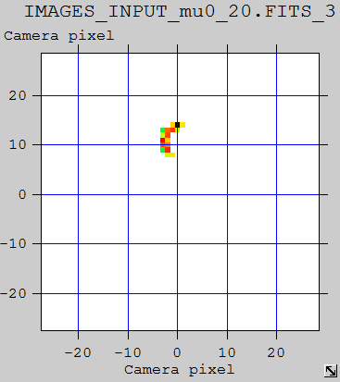
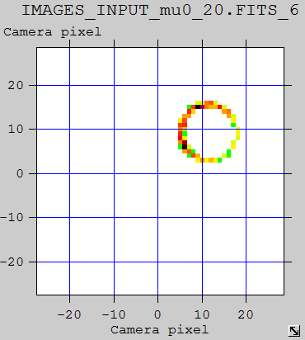
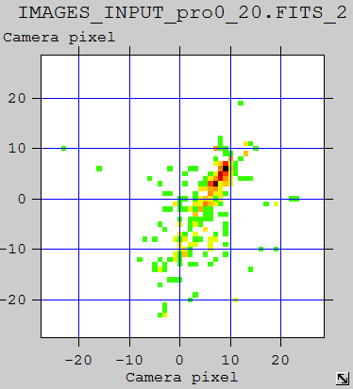
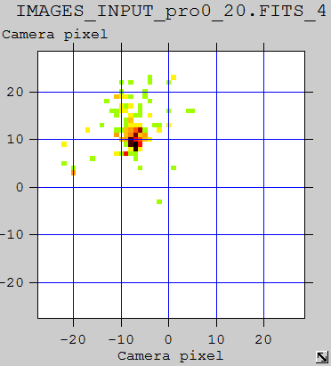
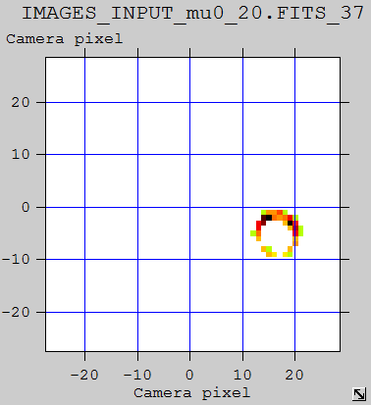
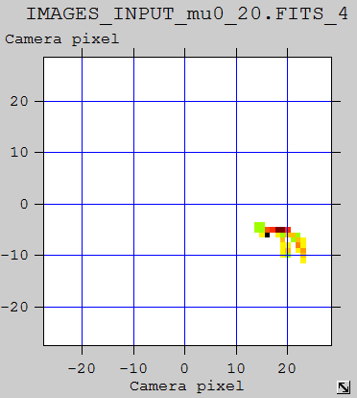
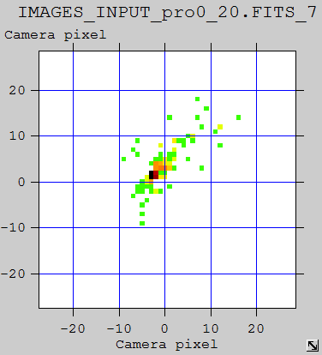
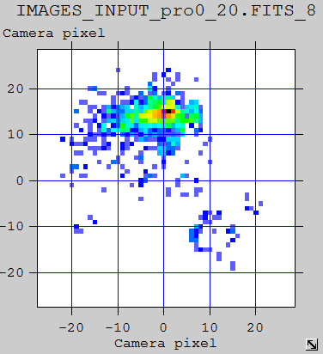
ASTRI SST-2M – Pre-selecting parameters
Case nsb_0 (no NSB inclusion) – few examples of simulated input images
Muons
Protons
M.C. Maccarone – CCF/CTA Meeting, Barcelona, 26-28 October 2015

Slide 8
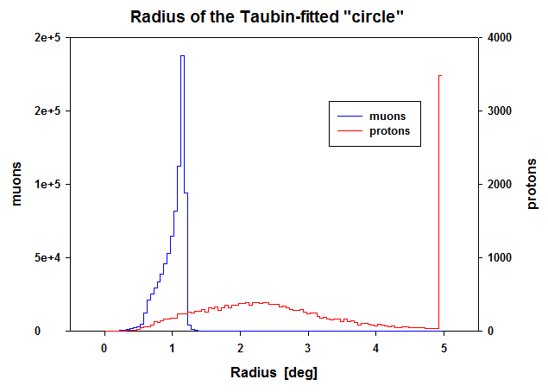
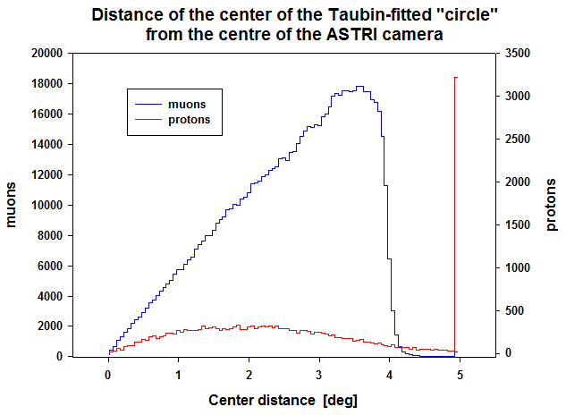
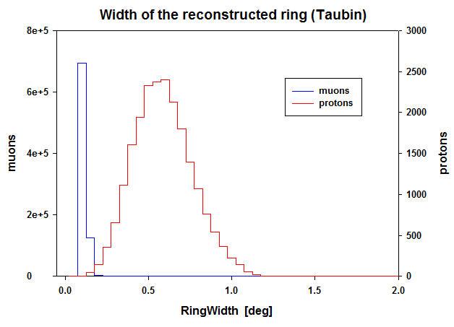
ASTRI SST-2M – Pre-selecting parameters
Case nsb_0 (no NSB inclusion, no cleaning, Npixon=4, images ‘well-cleaned’ as ref.
Selection_0: iok_circle=1 (Taubin method found the circle parameters)
Selection_1: iok_circle=1 .and. 0.5°≤Radius ≤1.5° .and. CenterDistance<4.5° .and. RingWidth<0.2°
 | Events triggered | Events remaining after Selection_1 | Percentage remaining after Selection_1
Muons+ | 826650 | 814450 | 98.5%
Protons | 21502 | 93 | 0.4 %
B-M/SST-1300:
OK
OK
M.C. Maccarone – CCF/CTA Meeting, Barcelona, 26-28 October 2015

Slide 9
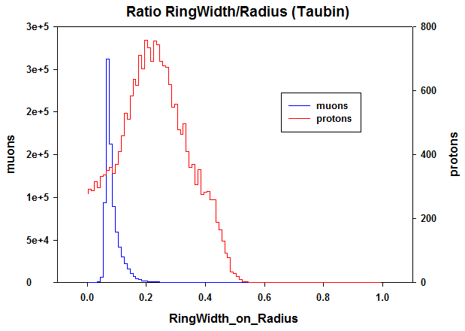
ASTRI SST-2M – Pre-selecting parameters
… a further parameter from Taubin:
RingWidth/Radius
0
1
empty
full
Selection_2: iok_circle=1 .and. 0.5°≤Radius ≤1.5° .and. CenterDistance<4.5° .and. RingWidth<0.2° . and. RingWidth/Radius<0.2°
 | Events triggered | Percentage remaining after Selection_1 | Percentage remaining after Selection_2
Muons+ | 826650 | 98.5% | 98.2%
Protons | 21502 | 0.4% | 0.2 %
B-M/SST-1300:
OK
OK
M.C. Maccarone – CCF/CTA Meeting, Barcelona, 26-28 October 2015

Slide 10
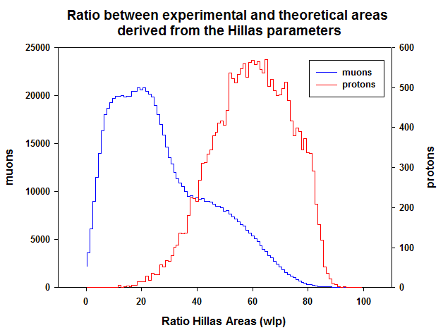
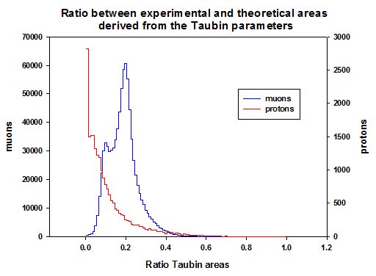
ASTRI SST-2M – Pre-selecting parameters
Further useful selection parameters from Taubin and Hillas? … maybe …
→ 1
full
… under study …
… not discussed today …
Area_{exp}/Area_{theor} =
→ 0
empty
M.C. Maccarone – CCF/CTA Meeting, Barcelona, 26-28 October 2015

Slide 11
ASTRI SST-2M – Pre-selecting muons in NSB
But … what happens in the ‘natural’ case of signal embedded in the Night Sky Background?
To successfully apply the pre-selection procedure,
as for all analysis procedures in general,
the image must be cleaned
and the pre-selection results depend on its ‘correct cleanness’
Just an example with a simple and fast image cleaning method:
Night Sky Background:
nsb_1 (~ 1 pe/pixel every 50 ns, ~ 20 MHz per pixel)
Cleaning mode: bi-level threshold on each pixel w.r.t. its neighbors within a 3x3 window; thresholds w.r.t. the RMS(NSB), evaluated from the image.
M.C. Maccarone – CCF/CTA Meeting, Barcelona, 26-28 October 2015

Slide 12
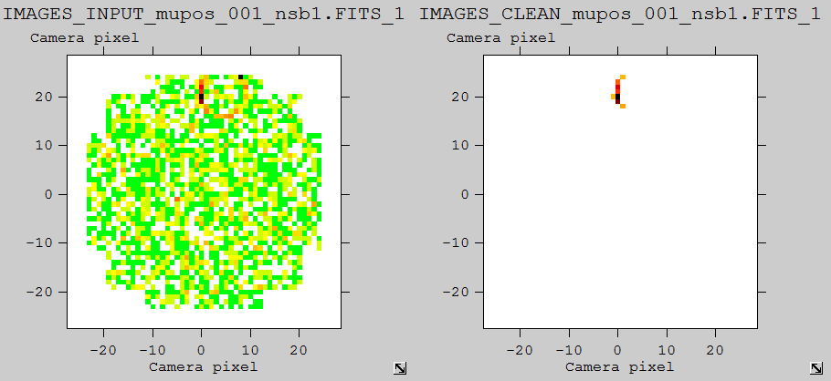
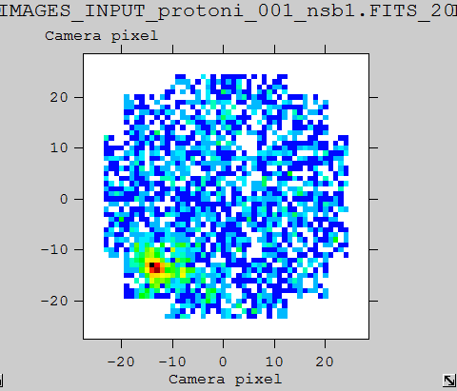
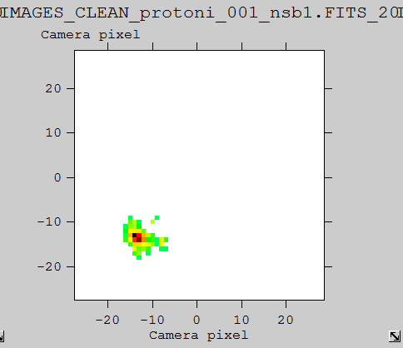
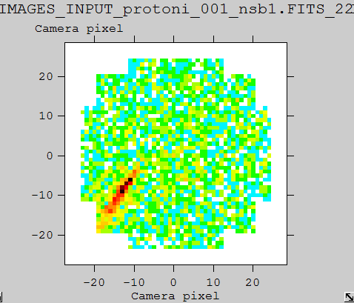
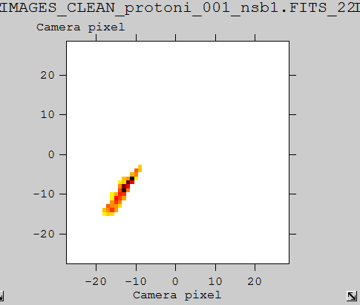
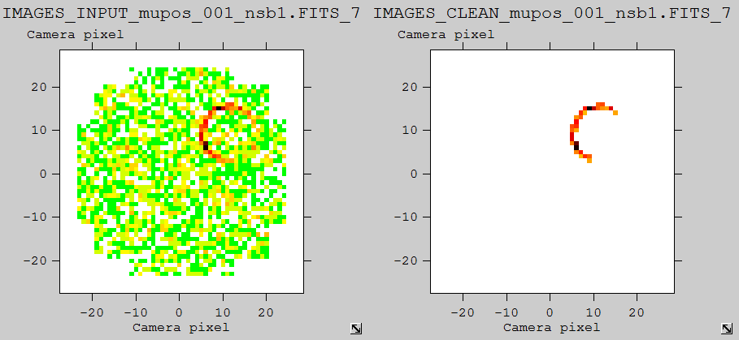
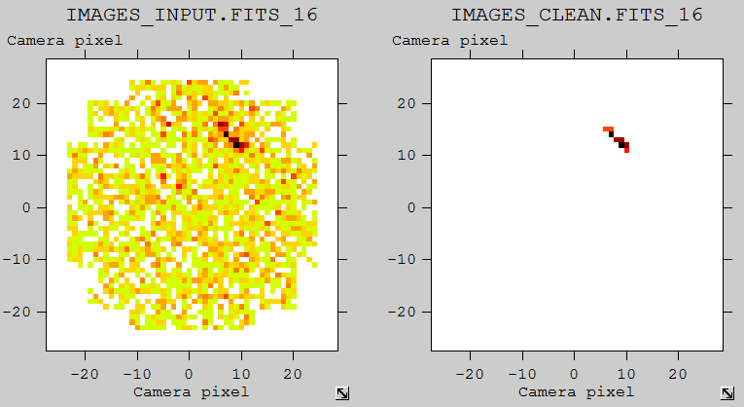
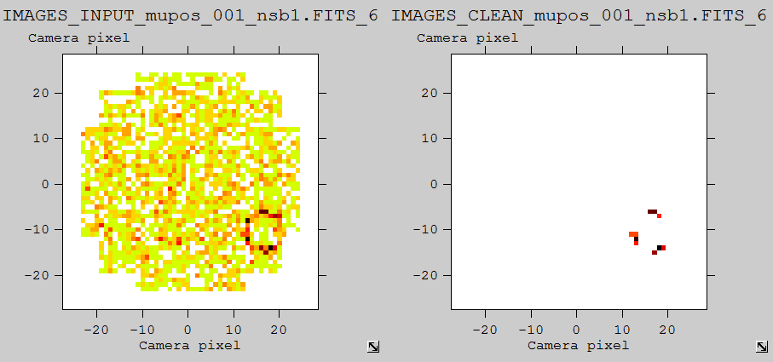
ASTRI SST-2M – Pre-selecting muons in NSB
Case nsb_1: ~ 1 pe/pixel every 50 ns, standard CTA bi-level cleaning, 4/8 RMS(NSB)
Muons
Protons
Input
Cleaned
Input
Cleaned
rejected
selected
rejected
selected
selected
selected
M.C. Maccarone – CCF/CTA Meeting, Barcelona, 26-28 October 2015

Slide 13
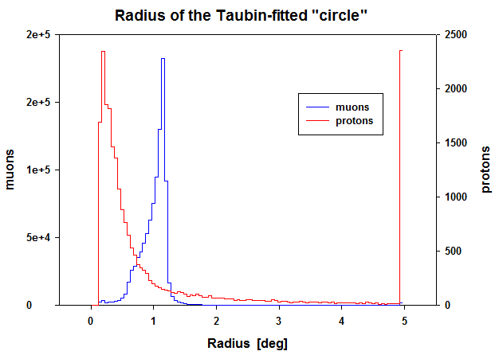
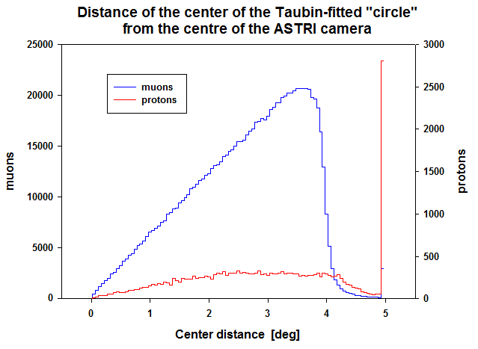
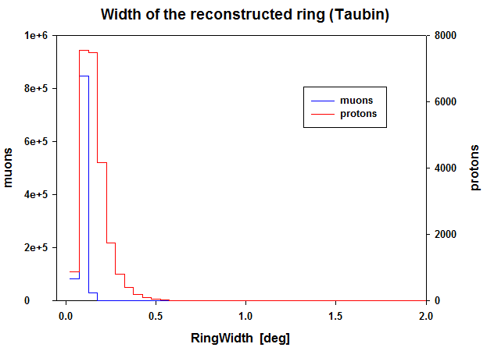
ASTRI SST-2M – Pre-selecting muons in NSB
Case nsb_1: ~ 1 pe/pixel every 50 ns, standard CTA bi-level cleaning, 4/8 RMS(NSB)
Selection_0: iok_circle=1 (Taubin method found the circle parameters)
Selection_1: iok_circle=1 .and. 0.5°≤Radius ≤1.5° .and. CenterDistance<4.5° .and. RingWidth<0.2°
 | Events triggered | Events remaining after Selection_1 | Percentage remaining after Selection_1
Muons+ | 972670 | 928011 | 95.4%
Protons | 41186 | 4021 | 9.7 %
B-M/SST-1300:
OK
Not so good !!!
M.C. Maccarone – CCF/CTA Meeting, Barcelona, 26-28 October 2015

Slide 14
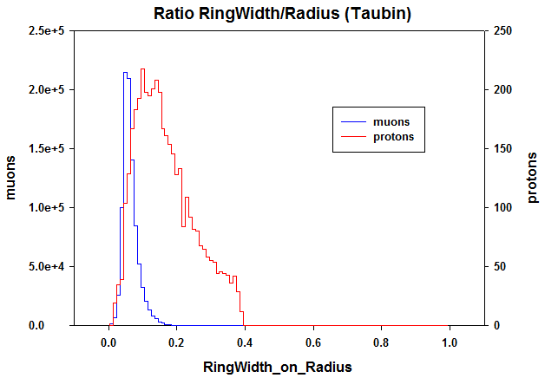
ASTRI SST-2M – Pre-selecting muons in NSB
How to improve the muons pre-selection without acting on the cleaning?
What further parameters could be investigated?
What about RingWidth/Radius?
Selection_2: iok_circle=1 .and. 0.5°≤Radius ≤1.5° .and. CenterDistance<4.5° .and. RingWidth<0.2° .and. RingWidth/Radius<0.2°
 | Events triggered | Remaining percentage after Selection_1 | Remaining percentage after Selection_2
Muons+ | 972670 | 95.4% | 95.3%
Protons | 41186 | 9.7 % | 6.5 %
B-M/SST-1300:
OK
Not sufficient !!!
The problem seems to be the cleaning !
M.C. Maccarone – CCF/CTA Meeting, Barcelona, 26-28 October 2015

Slide 15
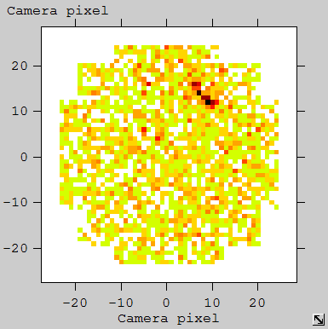
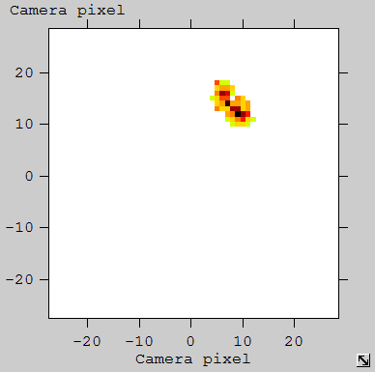
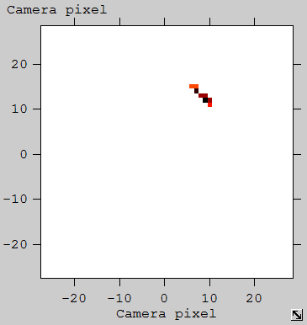
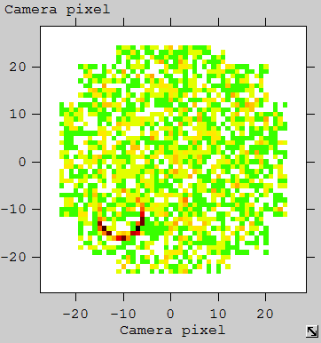
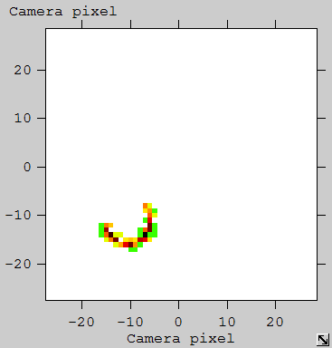
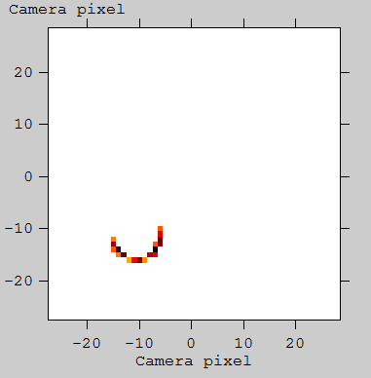
ASTRI SST-2M – Cleaning to pre-select muons
The cleaning method does not have to be too much strong; it must maintain memory of the morphology of the signal. Any suggestion?
The fuzzy mathematical morphology, MMFuzzy, [1] could be a solution. The method is based on the combination of morphological operators (erosion, dilation). Its feasibility for Cherenkov images is under investigation together with the proper optimization.
proton
rejected
selected
MMFuzzy cleaning
bi-level cleaning
selected
selected
muon
[1] M.C. Maccarone, Vistas in Astronomy, 40,4, 1996.
M.C. Maccarone – CCF/CTA Meeting, Barcelona, 26-28 October 2015

Slide 16
ASTRI SST-2M – Muons pre-selection method
Conclusions
Image Statistics: cuts based on the number of pixels in the cleaned image, or the average count per pixel are not good (see T.Mineo presentation).
Morphological Analysis: Taubin Method: OK, simple, fast, ‘potentially’ highly efficient (see cleaning). Selection parameters: Radius, CenterDistance, RingWidth, RingWidth/Radius seems to be more than sufficient (further parameters under study, if Hillas method is required).
Morphological Analysis: Hillas Method: fast, not deeply considered here, but it could be not-necessary in the pre-selection procedure.
Cleaning Method: the bi-level algorithm is OK for muons but not for protons: need to optimize for both of them or to define a different method that does not have to be too much strong; it must maintain memory of the signal’ morphology.
M.C. Maccarone – CCF/CTA Meeting, Barcelona, 26-28 October 2015

Slide 17
Pre-selecting muons with ASTRI SST-2M
ToDoList :
Optimize image cleaning (different cuts, other methods, MMFuzzy, …?)
Inclusion of higher levels of the Night Sky Background
Statistically significant simulation dataset (protons)
Investigation of the effect on the zenith angle other than vertical
Study of further parameters, if needed (Hillas, Area_{exp}/Area_{theor} , …)
Pre-selecting muons
in Camera Server
… work is in progress …
M.C. Maccarone – CCF/CTA Meeting, Barcelona, 26-28 October 2015

Slide 18
Pre-selecting muons with ASTRI SST-2M
Back-up slides
M.C. Maccarone – CCF/CTA Meeting, Barcelona, 26-28 October 2015

Slide 19
ASTRI SST-2M – Pre-selecting parameters
Case nsb_0 (no NSB inclusion, no cleaning, Npixon=4, images ‘well-cleaned’ as ref
Case nsb_1: ~ 1 pe/pixel every 50 ns, standard CTA bi-level cleaning, 4/8 RMS(NSB)
M.C. Maccarone – CCF/CTA Meeting, Barcelona, 26-28 October 2015

Slide 20
ASTRI SST-2M – Pre-selecting parameters
Case nsb_0 (no NSB inclusion, no cleaning, Npixon=4, images ‘well-cleaned’ as ref
Case nsb_1: ~ 1 pe/pixel every 50 ns, standard CTA bi-level cleaning, 4/8 RMS(NSB)
M.C. Maccarone – CCF/CTA Meeting, Barcelona, 26-28 October 2015

Slide 21
ASTRI SST-2M – Pre-selecting parameters
Case nsb_0 (no NSB inclusion, no cleaning, Npixon=4, images ‘well-cleaned’ as ref
Case nsb_1: ~ 1 pe/pixel every 50 ns, standard CTA bi-level cleaning, 4/8 RMS(NSB)
M.C. Maccarone – CCF/CTA Meeting, Barcelona, 26-28 October 2015

