Slide 1
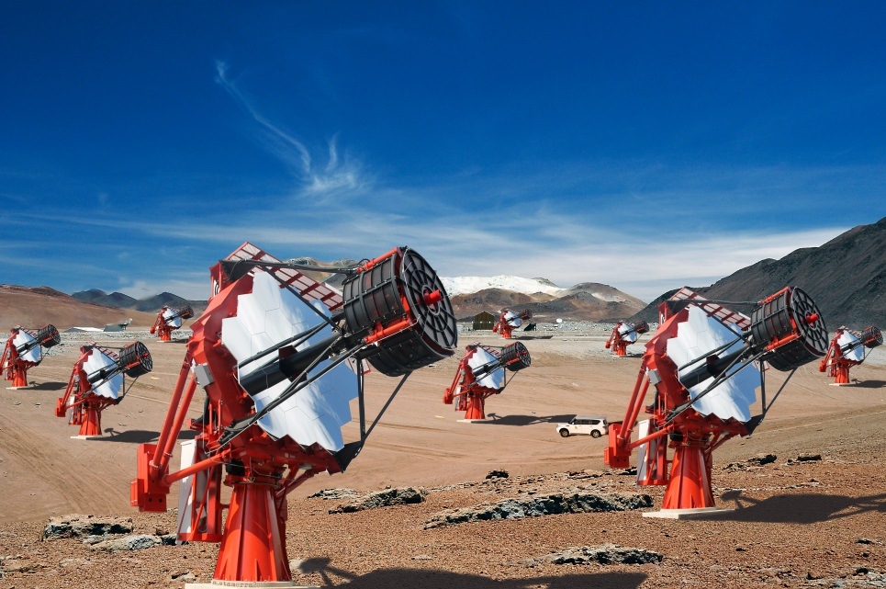
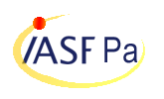
CCF/CTA Calibration Meeting
Universidade de São Paulo
Instituto de Astronomia, Geofisica
e Ciencias Atmosferica
Muons for ASTRI
Teresa Mineo, Cettina Maccarone
– INAF/IASF-Palermo, Italy
for the ASTRI Collaboration & the CTA Consortium
T. Mineo– CCF/CTA Meeting, Barcelona, 26-28 October 2015

Slide 2
Simulations
CORSIKA | N. Event | 2000000 (μ+, μ-)
 | Site | Paranal
 | Viewcone | 4 deg
 | Pointing | Zenith
 | spectral index | 2.0
 | energy range | 6 GeV-1 TeV
 | Max Distance | 2.1 m
 | Starting altitude | 500 m above M1
 | Background | 20x10⁶ ct/s/pixel
ASTRI-SIMULATOR: | includes the mirror reflectivity, the SiPM PDE, the PMMA window transmission, some mounting structure over the mirror
ANALYSIS SOFTWARE | Fortran + IDL code
T. Mineo – CCF/CTA Meeting, Barcelona, 26-28 October 2015

Slide 3
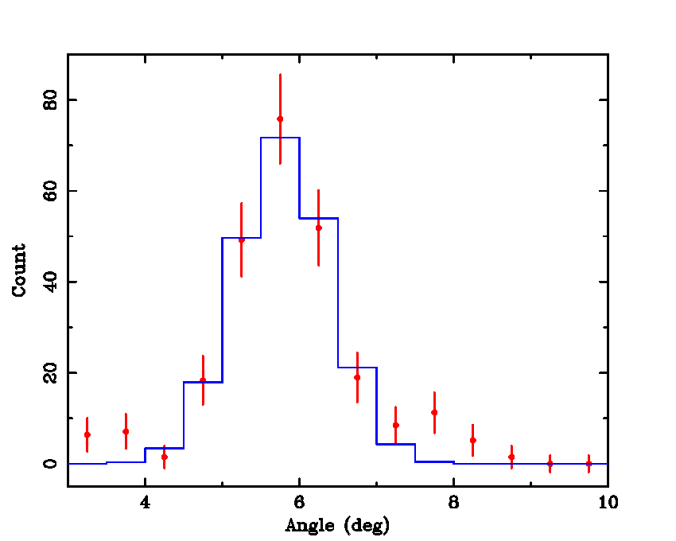
Steps of the analysis
For all events, cut pixels below 0.5xMaximum or 5xRMS of the background; cut isolated pixels
2) If more than 4 pixels are left, the centre and the radius are obtained with Taubin method, minimizing the displayed function. This step cut ~20% of the events
(a,b)
R
3) Clean the raw image with a constant value equal to the 1xRMS of the background
4) Compute the radial profile (ArcWidth) and fit it with a Gaussian
T. Mineo – CCF/CTA Meeting, Barcelona, 26-28 October 2015

Slide 4
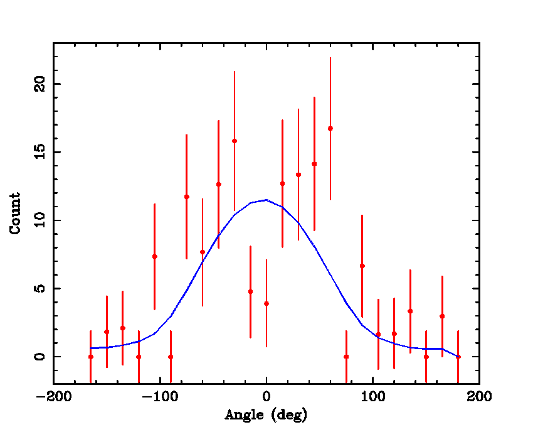
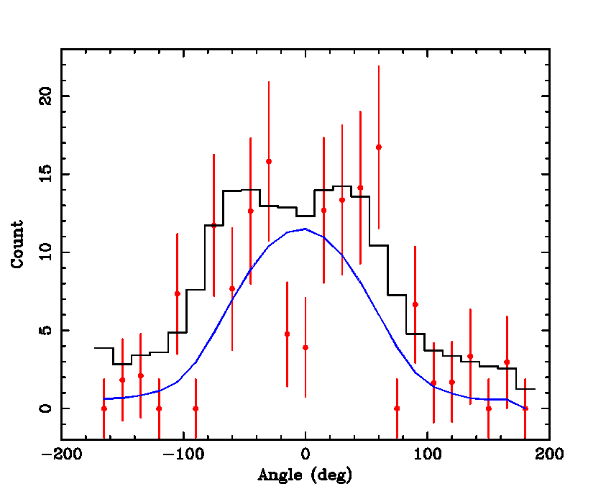
Steps of the analysis
5) Compute the intensity profile along the ring; Fit it with the Vacanti function
low statistics
It makes the fitting faster
it provides values of the impact parameter sufficiently adequate for the first iteration
The second iteration will consider the correct
functions, investigating in a range close to the value given by the fit with Vacanti.
6) Compute the reconstruction errors on the muon parameters after a selection on ξ and on the ring radius (ξ<0.05 & R>0.8º). This cut 94% of the events
T. Mineo – CCF/CTA Meeting, Barcelona, 26-28 October 2015

Slide 5
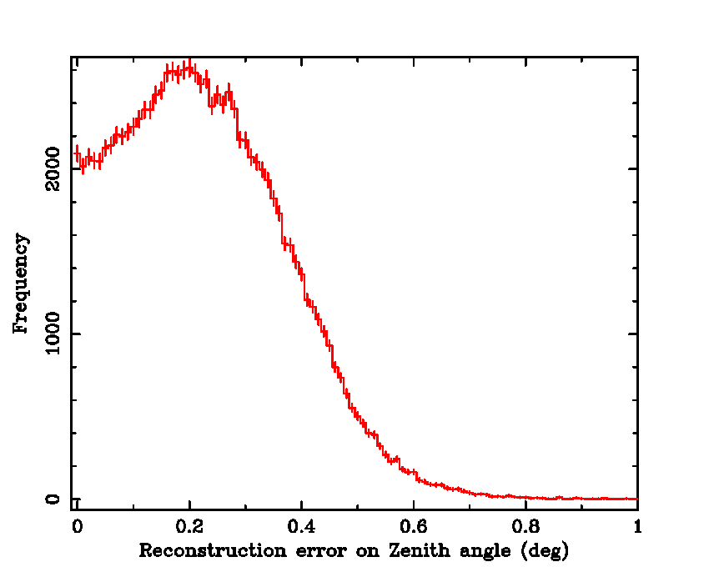
Results: Reconstruction error on the zenith angle
Zen_sim = Simulated zenith angle
a,b = coordinate of the ring center in pixel
Pix = 0.17º pixel size
Fitting with a Gaussian gives the maximum at 0.18º and the sigma 0.18º
T. Mineo – CCF/CTA Meeting, Barcelona, 26-28 October 2015

Slide 6
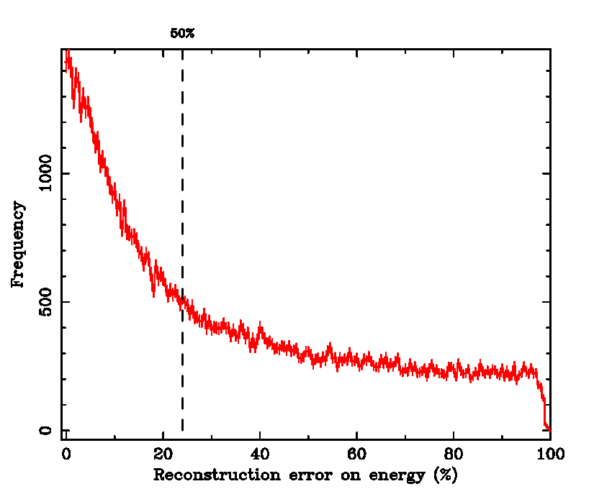
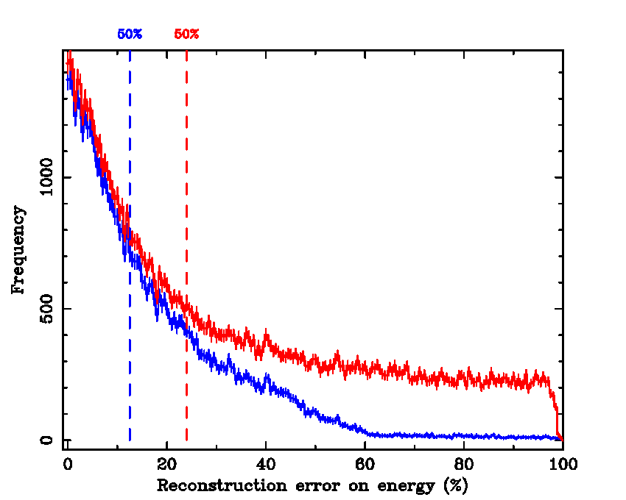
Results: Reconstruction error on the energy
where
Ene_sim = Simulated energy
Ene_rec = Reconstructed energy
n = 1.00019 refractive index
ϑ = Cherenkov angle (ring radius)
For 50% of the events the error on the energy is lower than ~22%
E<20 GeV
For 50% of the events the error on the energy is lower than ~12% and for 80% of the events is lower that ~20%
T. Mineo – CCF/CTA Meeting, Barcelona, 26-28 October 2015

Slide 7
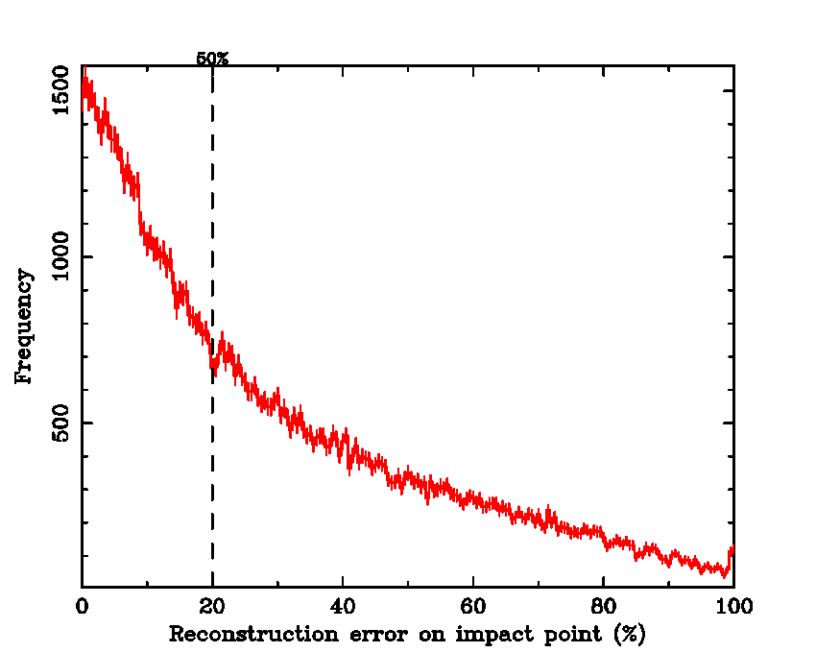
Results: Reconstruction error on the impact distance
Cor_sim = Simulated impact distance
Cor_rec = Reconstructed impact distance
For 50% of the events the error on the impact distance is lower than ~20%
T. Mineo – CCF/CTA Meeting, Barcelona, 26-28 October 2015

Slide 8
Next Steps
The aim of the following iteration is to reduce the reconstruction errors, compute the telescope efficiency and eventually increase the number of selected events (selection on ξ)
This analysis will includes:
an adequate cleaning of the image (see Cettina talk)
fit the ring using as seed the parameters (radius, center coordinate) derived in this first iteration
fit the distribution along the ring with a proper function that includes the shadow from the secondary mirror.
T. Mineo – CCF/CTA Meeting, Barcelona, 26-28 October 2015

