Slide 1
Muon calibration: a brief introduction.
Maria Concetta Maccarone
INAF IASF/Palermo
Italy
M.C. Maccarone, Central Calibration Facilities / CTA Calibration Meeting, Barcelona, 26-28 October 2015

Slide 2
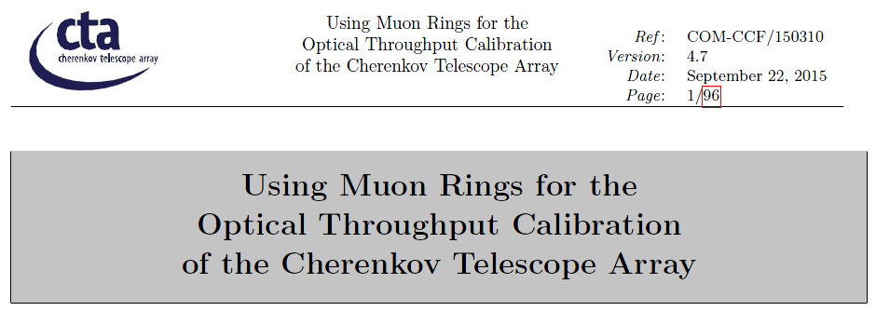
The ‘Muons for CTA’ feasibility study
Muon ring: a method to calibrate the total optical throughput of practically all previous IACTs.
The question:
Can muons be successfully used as calibrators for the various CTA telescopes?
The answer:
Yes, better if certain requirements are met.
Details are the body of the ‘Using Muon Rings for the Optical Throughput Calibration of the Cherenkov Telescope Array’, also known as ‘Muons for CTA’ document, COM-CCF/150310, result of the effort of the entire CCF-Muon group involving all the CTA telescopes teams.
The ‘Muons for CTA’ document is a feasibility study of the muon ring strategy for all the CTA telescopes. The study, started two years ago, is at a well advanced stage (ver.4.7) although not yet completed.
M.C. Maccarone, Central Calibration Facilities / CTA Calibration Meeting, Barcelona, 26-28 October 2015
2

Slide 3
The ‘Muons for CTA’ feasibility study
In the feasibility study, we
investigate for which telescopes the method will work, and derive estimates of the statistical and systematic precision of the method,
establish telescope requirements for a successful muon calibration, and derive expected event rates;
propose a strategy to implement the muon calibration in the CTA data pipeline.
assessing the viability to use muon images for the
calibration of the optical throughput,
monitoring of the optical PSF,
monitoring the flat-fielding of the camera, and
monitoring the uniformity of the mirror reflectivity
for all the different CTA telescopes.
The final outcome is that the muon ring analysis can be considered as the principal calibration method using CTA data.
Moreover, to ensure the required precision, new level-B requirements for all telescopes have been suggested.
M.C. Maccarone, Central Calibration Facilities / CTA Calibration Meeting, Barcelona, 26-28 October 2015
3

Slide 4
Muon ring analysis as calibration method
What we need? Trigger efficiency
Can all telescopes trigger on (mono)-muons?
LST:
Not foreseen, since no previously requested; stereo muons will be used (however monitoring the stereo bias with time)
Could also run the LST without requiring the LST-stereo trigger, worsen a bit the trigger threshold, but can still fulfill the required performance.
Can run dedicated muon runs.
All Other Telescopes:
Yes
…but need to flag muons efficiently at level of the camera server even if they don’t come along with a stereo trigger → new requirement (next slides)
M.C. Maccarone, Central Calibration Facilities / CTA Calibration Meeting, Barcelona, 26-28 October 2015
4

Slide 5
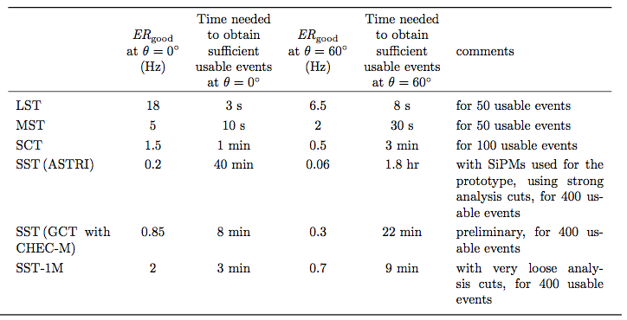
Muon ring analysis as calibration method
What we need? Trigger efficiency, Statistics
The estimated muon image rates have been obtained assuming a dedicated mono trigger. A stereo trigger would reduce the rates according to the distance between telescopes.
(mono)
Target: extract sufficient usable muon rings from the regular data taken in less than one night (new requirements, next slide).
M.C. Maccarone, Central Calibration Facilities / CTA Calibration Meeting, Barcelona, 26-28 October 2015
5
Notes:
Expected rate of ‘good’ muon images:
Requiring a statistical precision of better than 1% for the derived muon efficiency, we estimate a minimum number of about 50 usable muon images for the larger telescopes, and 400 images for the SSTs.

Slide 6
Muon ring analysis as calibration method
What we need? Trigger efficiency, Statistics
It’s necessary to flag muons efficiently at level of the camera server, from un-calibrated images, so ensuring that all ‘usable’ estimated muon rings are written on disc even if they don’t come along with a stereo trigger and at an acceptable residual (mono) cosmic rate.
New requirement proposed for muon trigger
B-M/SST-1300 The camera must be able to trigger on, and flag from pre-calibration data, fully contained muon rings impacting the mirror with an energy >20 GeV with an efficiency greater than 90%, even if visible in only one telescope camera.
The requirement, currently under investigation by all camera teams, should not cause a problem to the currently designed telescopes and cameras.
Presentations and discussion this afternoon and tomorrow morning
M.C. Maccarone, Central Calibration Facilities / CTA Calibration Meeting, Barcelona, 26-28 October 2015
6

Slide 7
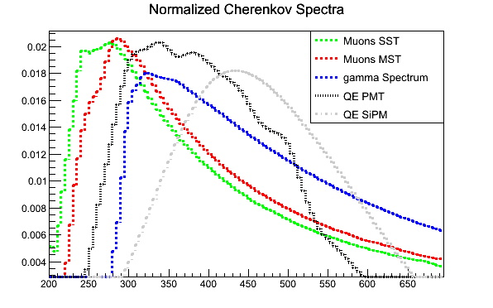
Muon ring analysis as calibration method
What we need? Spectral acceptance
PMT-based cameras need to ensure that the camera becomes sufficiently opaque to light below 290 nm wavelength. This is the range where Cherenkov light from air showers is completely absorbed, but the one from muons still gets through to the camera.
Cameras equipped with SiPMs will observe very similar muon and gamma-ray spectra, while
Cameras equipped with PMTs will have efficiency for muon light at a wavelength range where gamma-ray showers do not emit light.
A 10-30% systematic effect of the muon calibration may be expected unless the degradation of the spectral acceptance in the middle UV is monitored, or this part is cut out in its way through the optical chain.
Normalized Cherenkov spectra of muons arriving from 270 m distance (green line), representative for the case of a SST, from 540 m distance (red line), representative for the case of an MST, and the Cherenkov spectrum from a gamma-ray shower emitted at 8 km above ground (blue line).
M.C. Maccarone, Central Calibration Facilities / CTA Calibration Meeting, Barcelona, 26-28 October 2015
7

Slide 8
Muon ring analysis as calibration method
What we need? Spectral acceptance
To reduce the systematic effect due to the spectral acceptance …
New requirement proposed
B-xST-1500 The optical elements of the telescope (mirrors and camera) must be chosen such that the part of the Cherenkov light spectrum from local muons, which stems from wavelengths below 290 nm, must contribute by less than 5% to the observed muon image size, where “size” is understood as the sum of all photo-electrons contained in the ring image.
This requirement should not cause a problem to the currently designed telescopes and cameras.
Probably the LST has found a technical solution: Acrylite / ShinkoLite protecting PMMA window in front of the camera cuts exactly below 290 nm.
M.C. Maccarone, Central Calibration Facilities / CTA Calibration Meeting, Barcelona, 26-28 October 2015
8

Slide 9
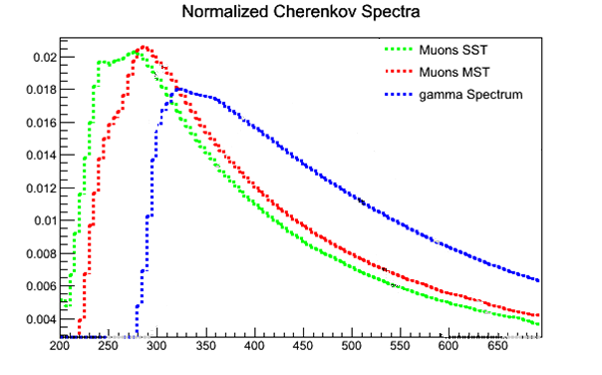
Muon ring analysis as calibration method
What we need? Chromaticity monitoring
Given the different spectra of Cherenkov light from muons and gammas, un-recognized chromatic changes in the telescope elements may lead to un-recognized changes in the conversion from muon to gamma efficiency: the muon efficiency degrades, but differently to the corresponding gamma efficiency, and corrections only based on the muon efficiency may over-estimate the telescope’ optical throughput for Cherenkov photons from gamma showers.
The incorrect estimates can reach values of the order of 13%, depending on:
material of the protecting window
photo multiplier quantum efficiency
focused mirror reflectivity
…
and the muon calibration without wavelength-dependent direct measurements could result (depending on the degradation time) in about 6% systematic error for the LSTs/MSTs, and 4% for SSTs.
With an additional assessment of the wavelength dependency of the degradation,
the precision can be improved to 3%.
M.C. Maccarone, Central Calibration Facilities / CTA Calibration Meeting, Barcelona, 26-28 October 2015
9

Slide 10
Muon ring analysis as calibration method
What we need? Chromaticity monitoring
How to define the precision with which the chromaticity of the degradation of optical elements needs to be (externally) controlled? The easiest way is with respect to a reference wavelength, e.g. 400 nm above/below which about half of the Cherenkov light falls.
New requirements proposed
B-xST-1600 The degradation of the optical throughput of the telescope must always be controlled such that the degradation at a wavelength measured 10 nm around 350 nm is known to better than 10% with respect to the degradation measured 10nm around 450 nm.
This requirement should not cause a problem to the designed telescopes and cameras.
The requirement can be fulfilled using e.g. the “illuminator”.
Presentation and discussion this morning and tomorrow morning
M.C. Maccarone, Central Calibration Facilities / CTA Calibration Meeting, Barcelona, 26-28 October 2015
10

Slide 11
Muon ring analysis as calibration method
What we need? Precision
The feasibility of the method is related to
the determination as precisely as possible of several parameters that play their essential role in the reconstruction procedure;
among them:
Some of these parameters are related to the telescopes characteristics; their knowledge contributes to answer the question:
Cherenkov angle
Impact parameter
Muon size, total number of observed photoelectrons
Local atmospheric transmission
Spectral correction from Cherenkov light from muons to gamma-ray showers
…
What is the precision of the method for each telescope?
This is the main content of the next presentations
The total systematic uncertainties achieved in the feasibility study are currently about 4%.
M.C. Maccarone, Central Calibration Facilities / CTA Calibration Meeting, Barcelona, 26-28 October 2015
11

Slide 12
Muons and CTA
Main CCF-Muons interrelations within CTA groups
OBS
DATA
ICDs
Prod-3 MC simul.
DATA
TEL/Camera Servers
ACTL and SWAT
OBS
TELs
ACTL
Muons
MC
Presentations and discussion this afternoon and tomorrow morning
M.C. Maccarone, Central Calibration Facilities / CTA Calibration Meeting, Barcelona, 26-28 October 2015
12

Slide 13
‘’The importance of being a muon’’
Backup Slides
M.C. Maccarone, Central Calibration Facilities / CTA Calibration Meeting, Barcelona, 26-28 October 2015
13

Slide 14
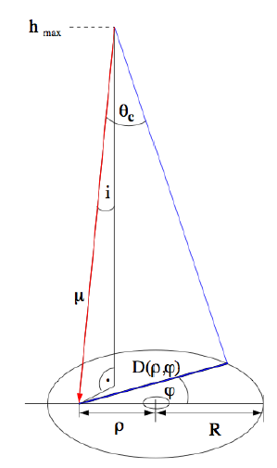
Muon ring analysis as calibration method
What we need? Precision
Cherenkov angle, θ_{c}
Impact distance, ρ
14
M.C. Maccarone, Central Calibration Facilities / CTA Calibration Meeting, Barcelona, 26-28 October 2015
14

Slide 15
‘’The importance of being a muon’’
Moreover, to ensure the required precision, new level-B requirements for all telescopes have been suggested. A set of ICD has been already defined, needed for the definition of DATA pipelines. Work is in progress for some improved camera triggers. Under development are the algorithms to flag events as possible muons at level of camera server.
“The analysis of muon ring images can be a powerful tool to calibrate the response of a single telescope and a precision below 5% seems attainable for those telescopes providing sufficient mirror area and easily triggered images.”
“The technique can be applied even in the relative calibration among telescopes, whenever they are not so far each another so that the same muon event be detected in two telescopes, at least.”
M.C. Maccarone, Central Calibration Facilities / CTA Calibration Meeting, Barcelona, 26-28 October 2015
15

Slide 16
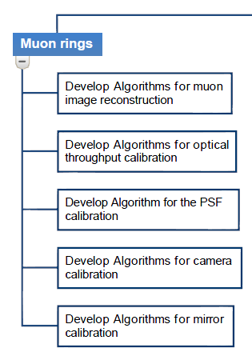
CCF – Methods for Array Calibration:
Muon ring analysis
Pre-production phase
To conclude the pre-construction phase:
Estimates of precision to reconstruct any muon ring parameter
Definition of algorithms for muon ring pre-selection, enrichment in the camera server
Completion of the ICD-DATA documents
Improvements of dedicated muon triggers for some specific cameras
Ref. COM-TDR/140721, v. 5.1, 13 May 2015

Slide 17
‘’The importance of being a muon’’ (ring image)
‘’The importance of Being Muon’’ (ring image)
Preliminary results on the muons as ‘calibrators’
We have assessed the viability to use muon images for the calibration of the optical throughput, monitoring of the optical PSF, the flat-fielding of the camera, and uniformity of the mirror reflectivity for the different telescopes currently designed for the CTA. If certain design requirements are met, like separate mono triggers, possibly adjusted to the expected shapes of muon images, and design of the telescope and camera components which ensure that the transmitted part of the muon spectrum below 290 nm becomes negligible,
such a calibration scheme seems viable for all telescopes, using regular data taken in less than one night.
All implementations of an SST are able to provide sufficient high-quality muon images per night and seem to be free of, or show only negligible, trigger biases. If the mirrors degradation is maintained within current requirements, muon images are adequately selected (ASTRI and GCT-M option) and a low trigger threshold is adopted (SST-1M), at least for observations of extra-galactic sources.
M.C. Maccarone, CTA Consortium Meeting, Turku, Finland, May 2015

Slide 18
‘’The importance of being a muon’’ (ring image)
‘’The importance of Being Muon’’ (ring image)
Preliminary results of the feasibility study
Calibration of optical throughput:
for each telescope it can be calculated with better than 2% systematic uncertainty for any achromatic degradation of the optical throughput and at least on a night-per-night basis. An automatic monitoring of the muon efficiency should be implemented both for the on-site, as for the off-site analysis.
Corrections to the muon calibration:
The muon calibration without wavelength-dependent direct measurements will result in about 6% systematic precision for the L/MSTs (4% for the SSTs), after a long period of degradation of the optical elements. With an additional assessment of the wavelength dependency of the degradation, the precision can be improved to 2-3% again.
M.C. Maccarone, Central Calibration Facilities / CTA Calibration Meeting, Barcelona, 26-28 October 2015
18

