Slide 1
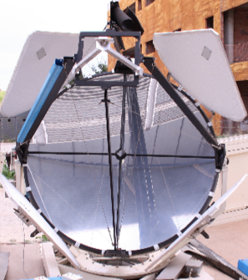

Status of the IFAE/UAB Raman LIDAR
Markus Gaug
Universitat Autònoma de Barcelona
markus.gaug@uab.cat
+ Oscar Abril (IFAE)
+ Oscar Blanch (IFAE)
+ Oriol Calpe (UAB)
+ Michele Doro (INFN Padova)
+ Lluís Font (UAB)
+ Daniel Guberman (IFAE)
+ Manel Martínez (IFAE)

Slide 2
Situation in 2015
  Funding for LIDAR has failed unexpectedly this year (as most Spanish funding proposals in 2015)
  Workshop at IFAE has become heavily involved in bogies for LST, LIDAR has dropped to lowest priority

Slide 3
Achievements in 2015
(practically w/o funds...)
Hardware:
  Polychromator has started production and assembling (but workshop not yet fully dedicated).
  Installed new dichroic guiding mirrors,
  Received permission to operate LIDAR (from 1-3 am)
  Aligned the LIDAR in zenith position (fine-alignment still ongoing)
  Unfortunately, laser needs some additional maintenance
Software:
  Library to read Licel files ready
  Internal communication translated from Labview to C (in process)
Documentation:
  Finished one bachelor thesis on pre-alignment (Eudald Font)
  Another bachelor thesis on alignment and near-range solutions is on-going (Oriol Calpe)
  Constantly update a LIDAR TDR
  ICDs created (except for the one with ACTL)
New ideas:
  Near-range solution

Slide 4
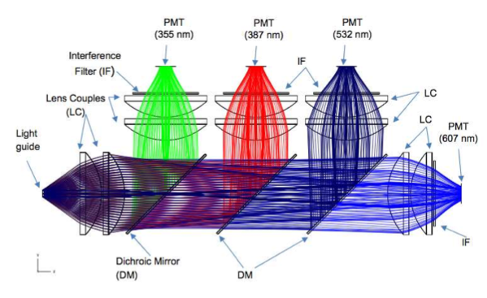
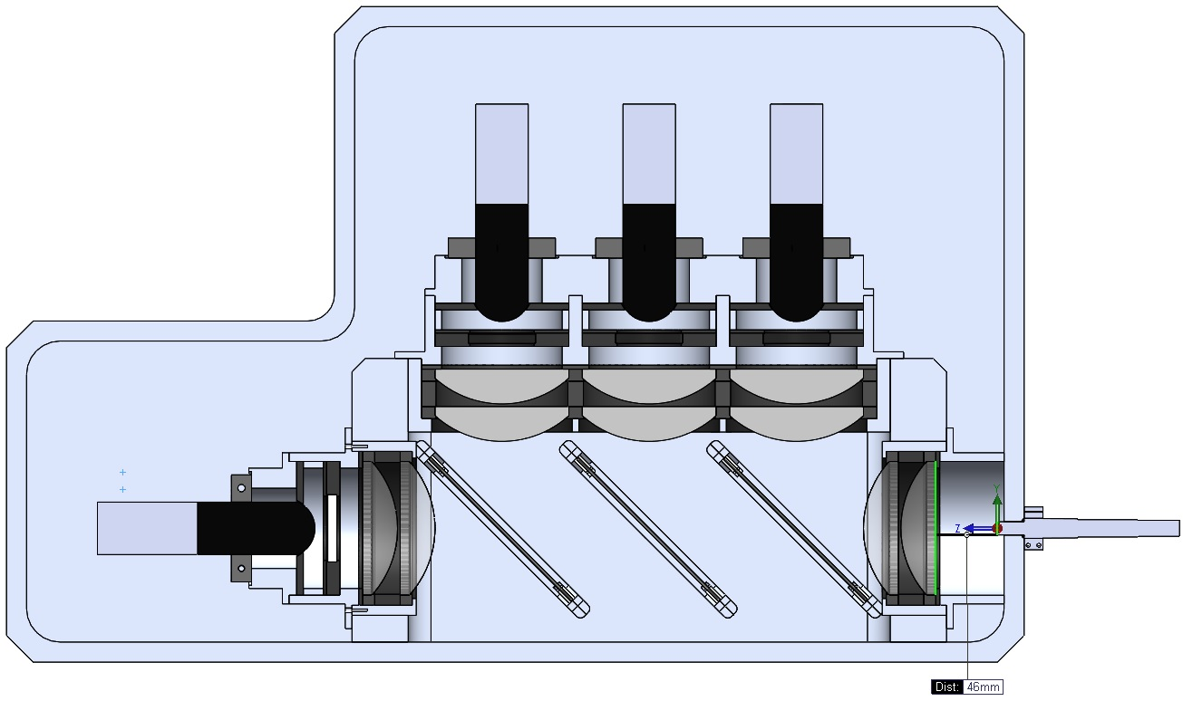
Polychromator

Slide 5
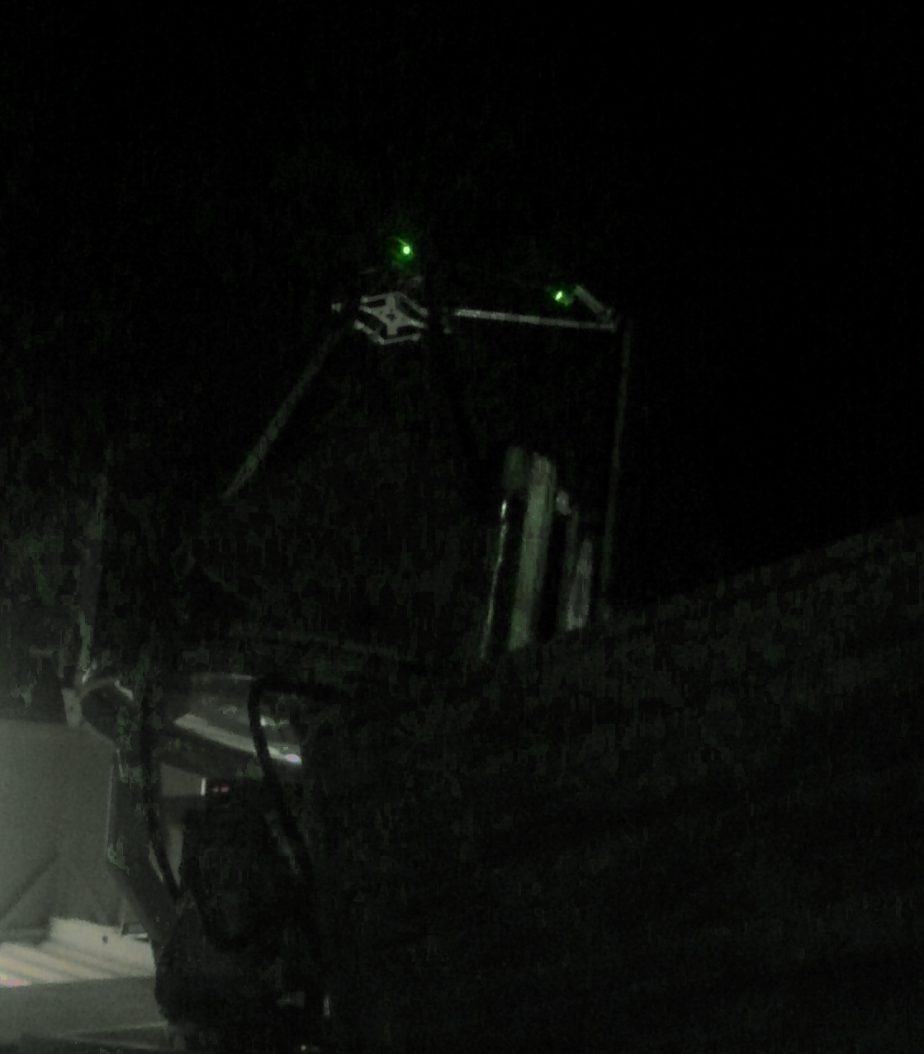
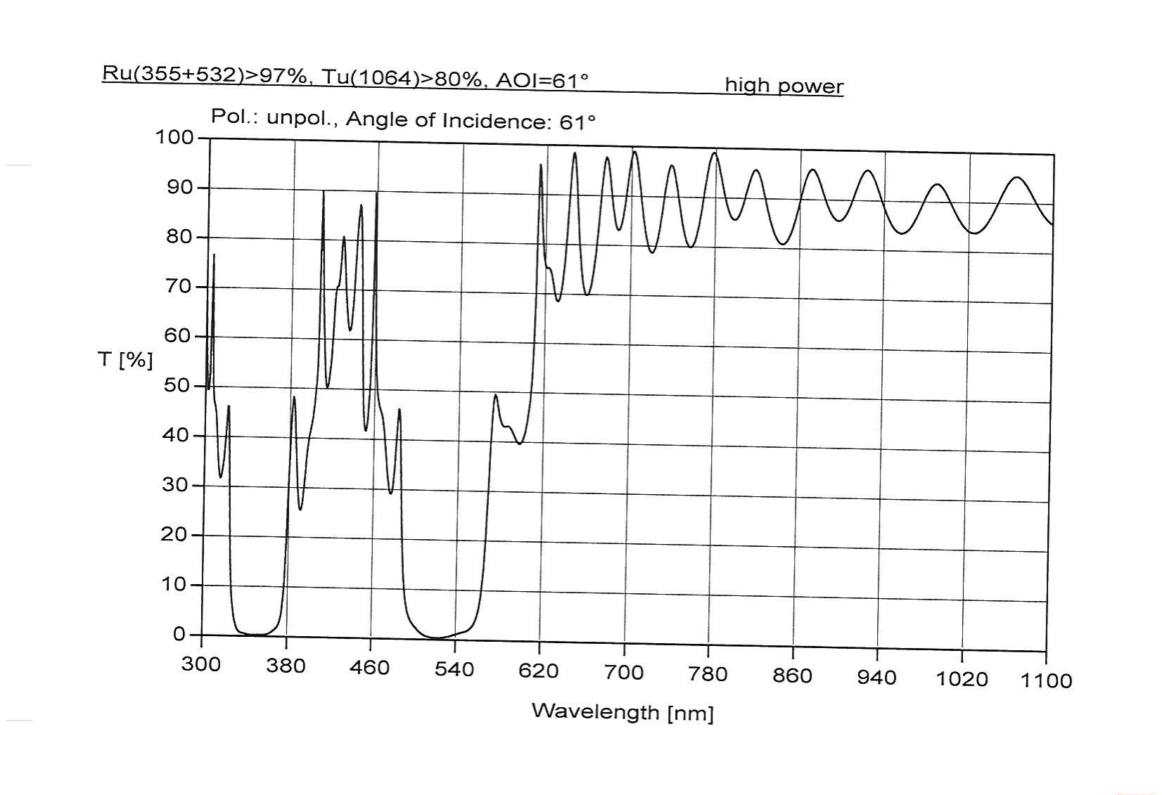
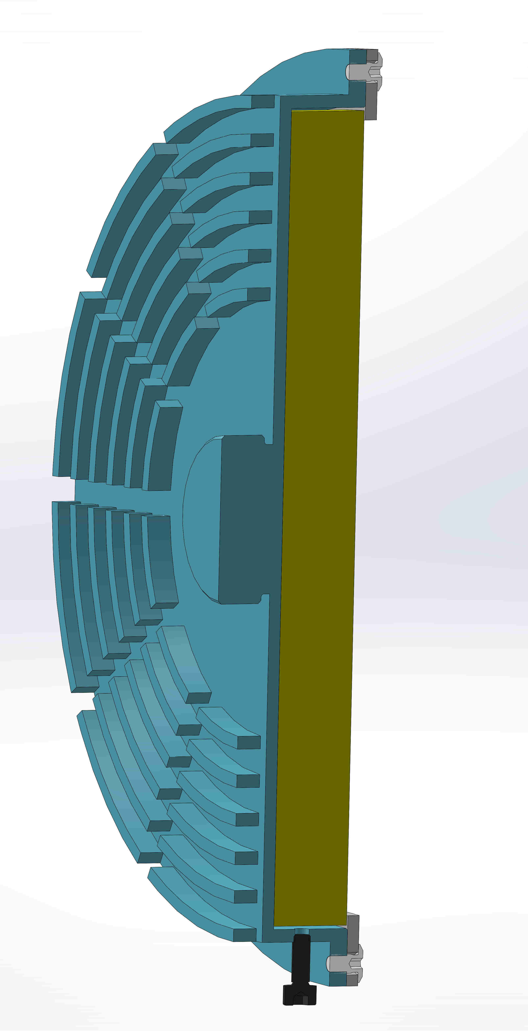
New dichroic guiding mirrors
Tailored by “OptoPrim”, Italy.
Reflect >97% at 355 and 532 nm, but <10% at 1064
(at correct incidence angle of 61 deg,)

Slide 6
LIDAR alignment
The position where we started
aligning

Slide 7
LIDAR alignment
The position where we stopped
gross alignment and started fine-
tuning.

Slide 8
LIDAR alignment

Slide 9
LIDAR alignment
23/07: “calima”

Slide 10
LIDAR Alignment prel. results

Slide 11
LIDAR Alignment prel. results

Slide 12
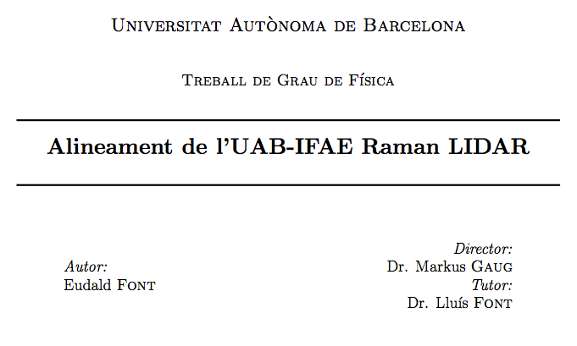
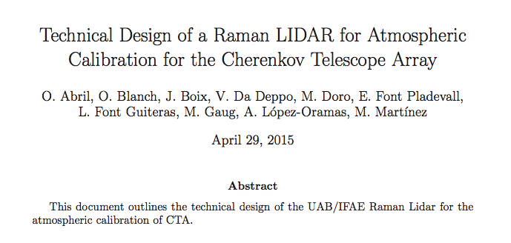
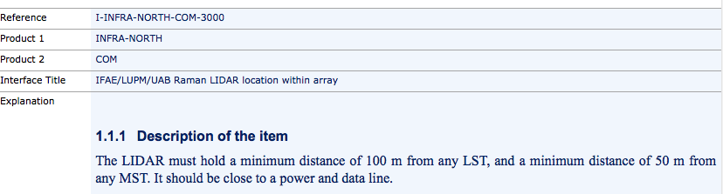
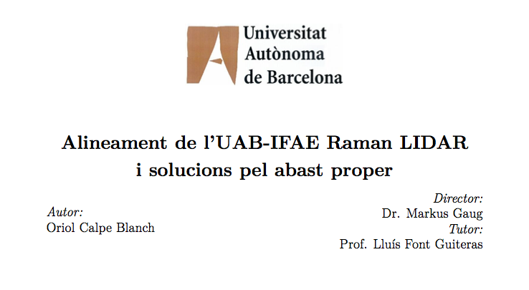
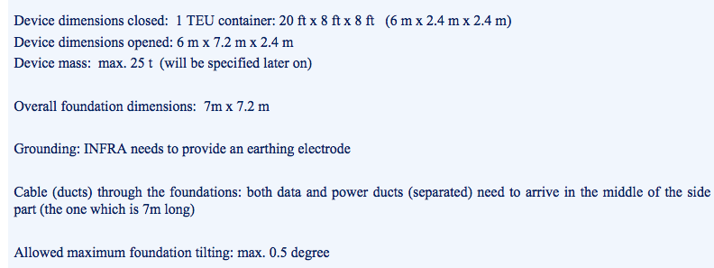
Documentation

Slide 13
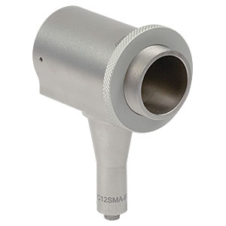
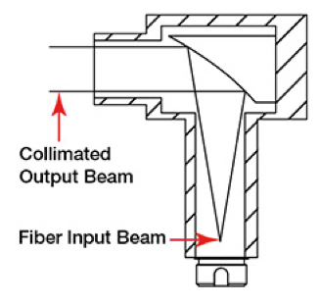
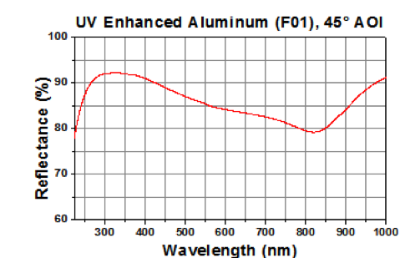
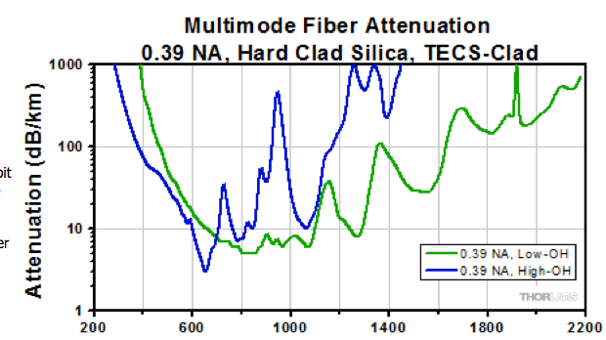
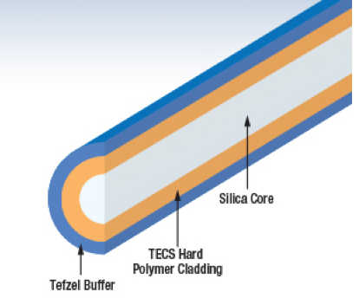
Near-range solution(s)
FC/PC-Connectorized UV-Enhanced Aluminum Reflective Collimators (RC12SMA-F01 by Thorlabs)
Colimador reflector
250 – 450 nm
12 mm dia. beam
Conector SMA
0.39 NA TECS-Clad Multimode Optical Fiber
1,5 mm diàmetre (!!)
SMA Conectors SMA entrance and exit
Negligible attenuation at 355 and 532 nm
Total cost up to here: 1400 eur.
Additional (simple) 2-line polychromator unit

Slide 14
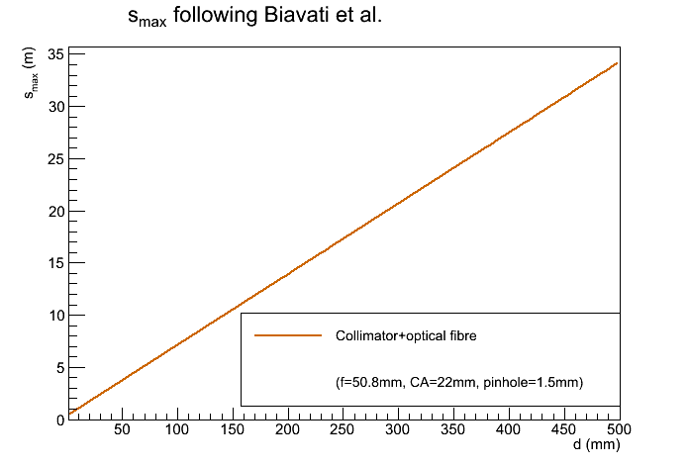
Near range solution(s)

Slide 15
Outlook
Have applied for new funds from 2016-2018
Once polychromator is assembled, LIDAR can start long-term tests (e.g. in La Palma)
After long-term test and evaluation, move to unified design with LUPM for final LIDAR for CTA-N.
Final LIDAR planned to be ready in 2019.

