Slide 1
Central Calibration Facilities / CTA Calibration meeting
Universitat Autònoma de Barcelona ( Facultat de Ciències i Biociències, Sala d'Actes )
All-Sky-Camera
D. Mandat, M. Pech
Institute of Physics of the Academy of Sciences of the Czech Republic & Palacky University Olomouc, Faculty of Science

Slide 2
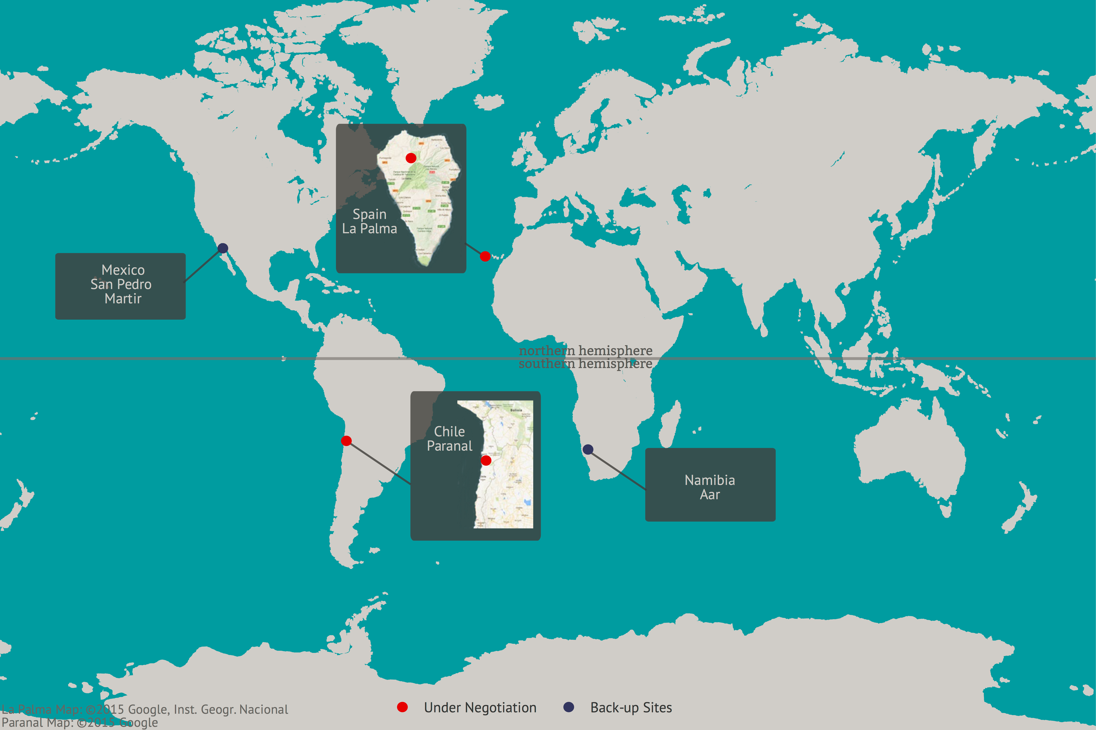
ASC 08/2015 data updated
No new data

Slide 3
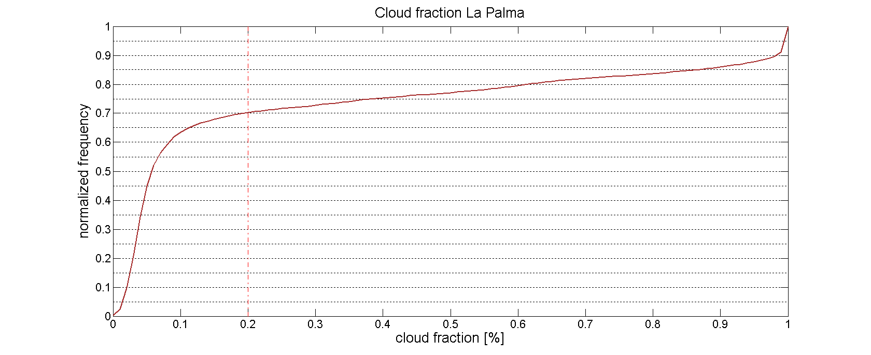
LA PALMA
Magic All Sky Camera

Slide 4
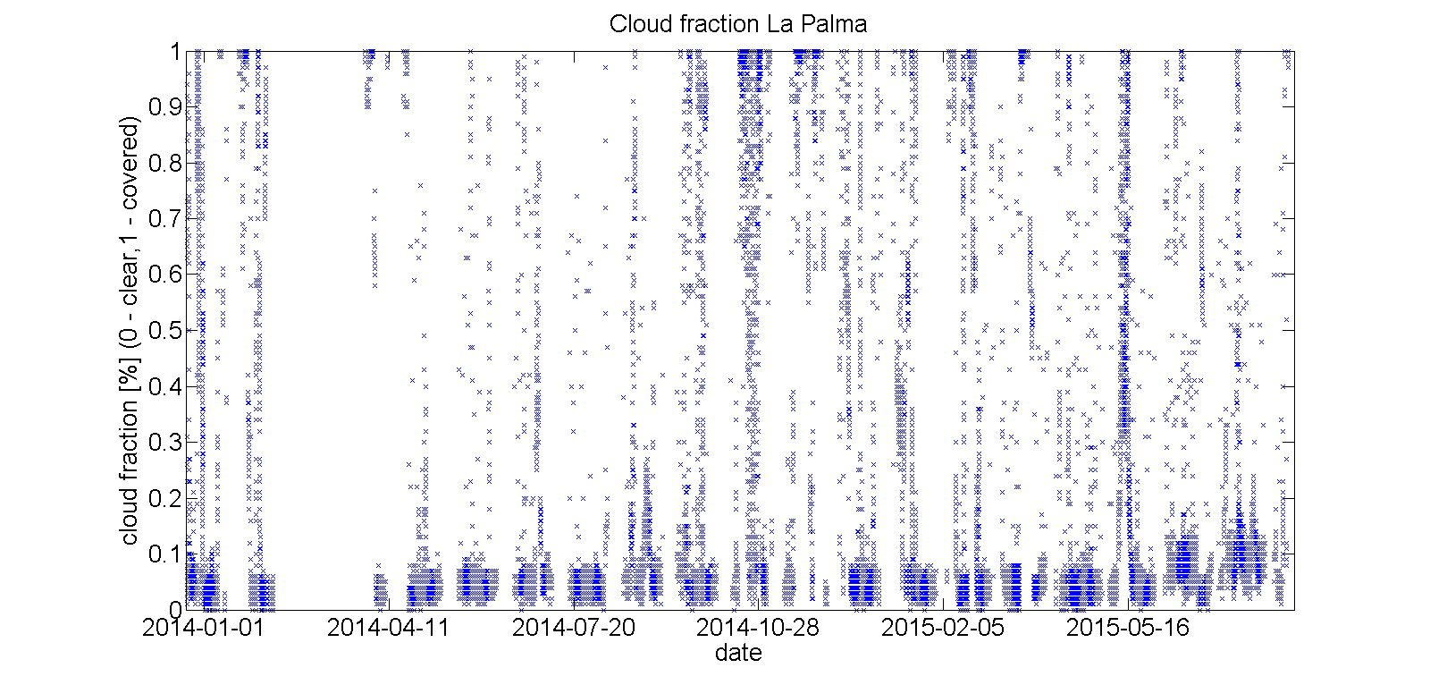
LA PALMA
Seasonal variations

Slide 5
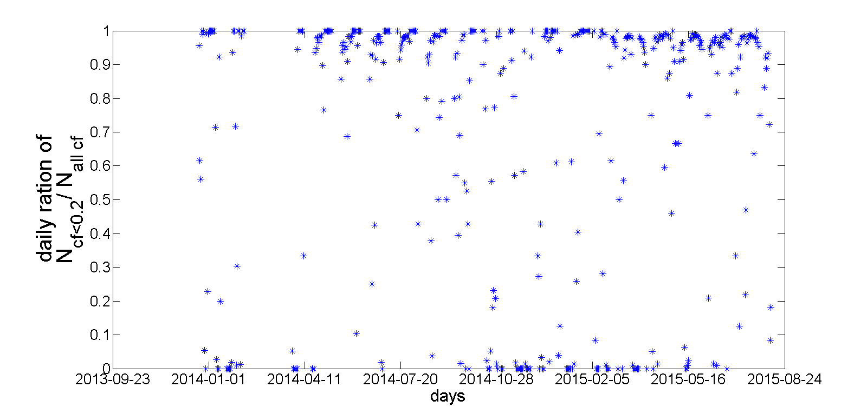
LA PALMA
Ratio of clear sky images and total number of images per night
1 – night-long clear sky
0 – night-long covered sky

Slide 6
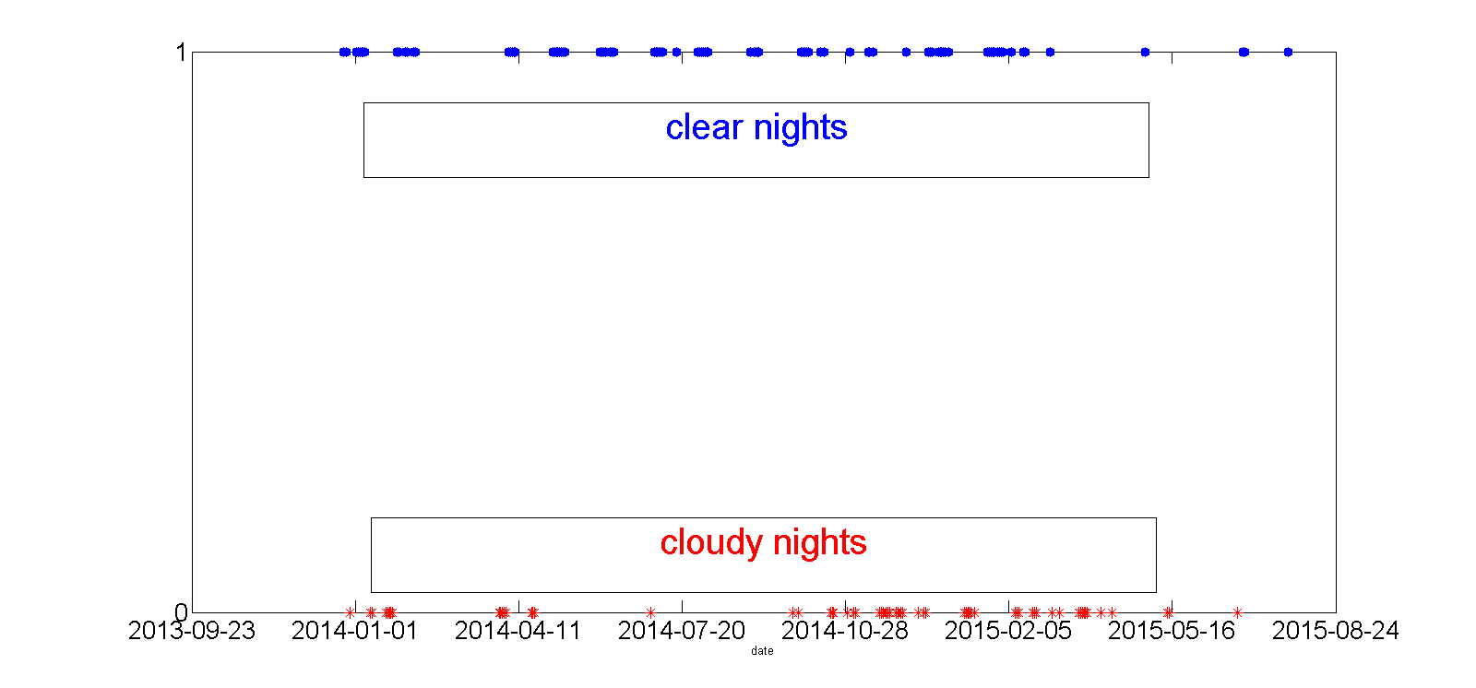
 | no. nights
Total | 439
Fully clear | 91
Fully covered | 64
LA PALMA
Clear nights vs. Cloudy nights

Slide 7
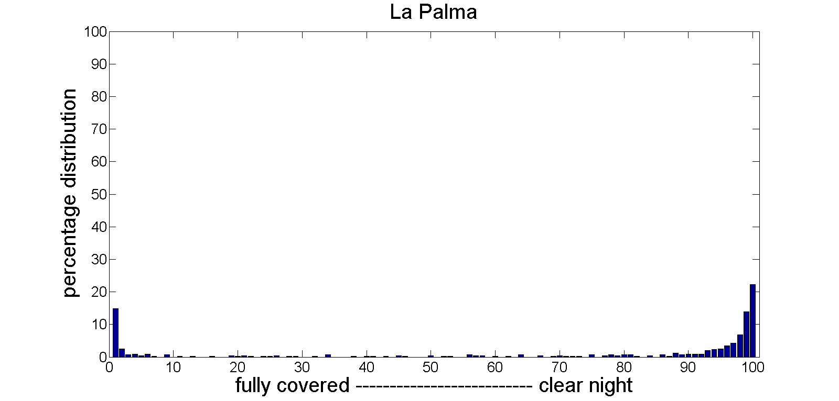
LA PALMA
Clear nights vs. Cloudy nights histogram

Slide 8
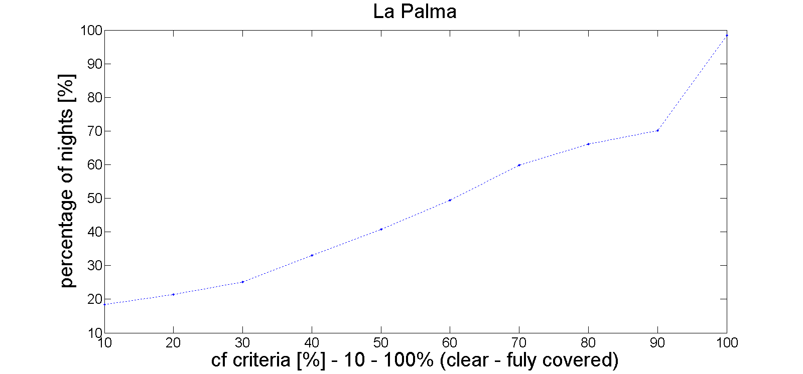
LA PALMA
cf criteria vs night-long clear sky

Slide 9
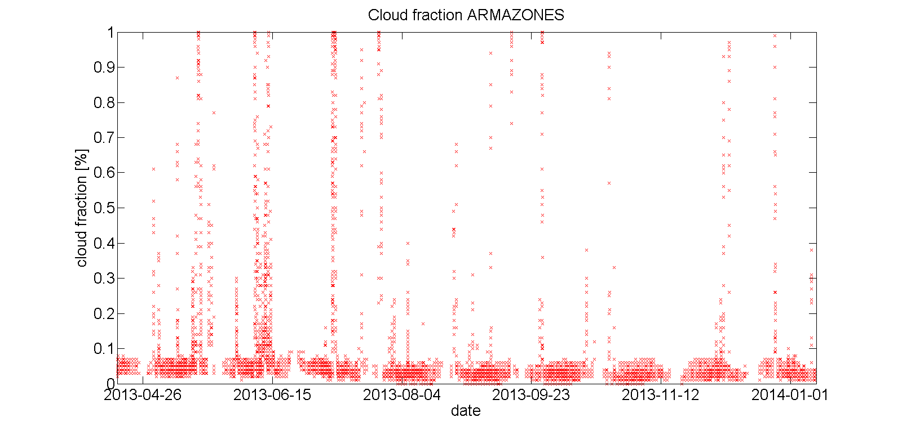
Armazones
Seasonal variations

Slide 10
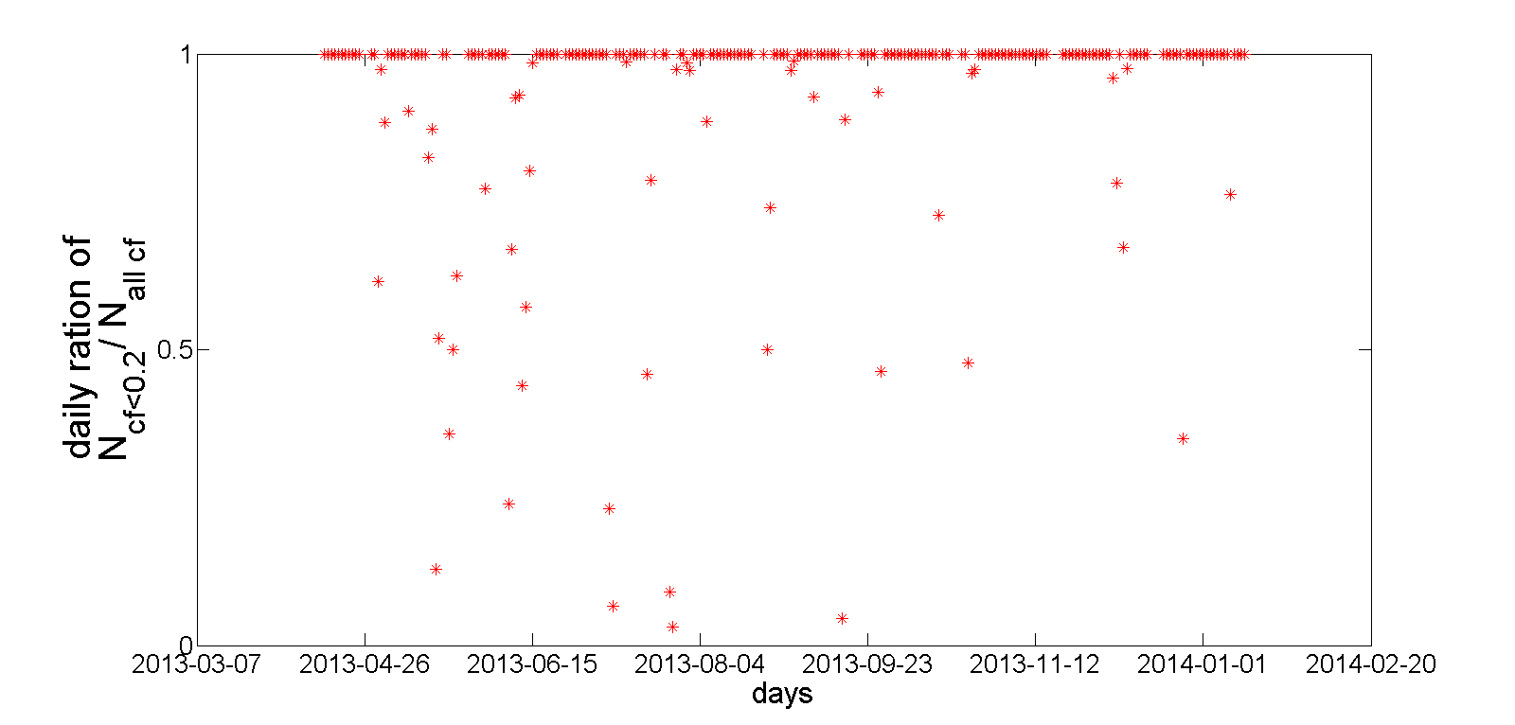
Armazones
Ratio of clear sky images and total number of images per night
1 – night-long clear sky
0 – night-long covered sky

Slide 11
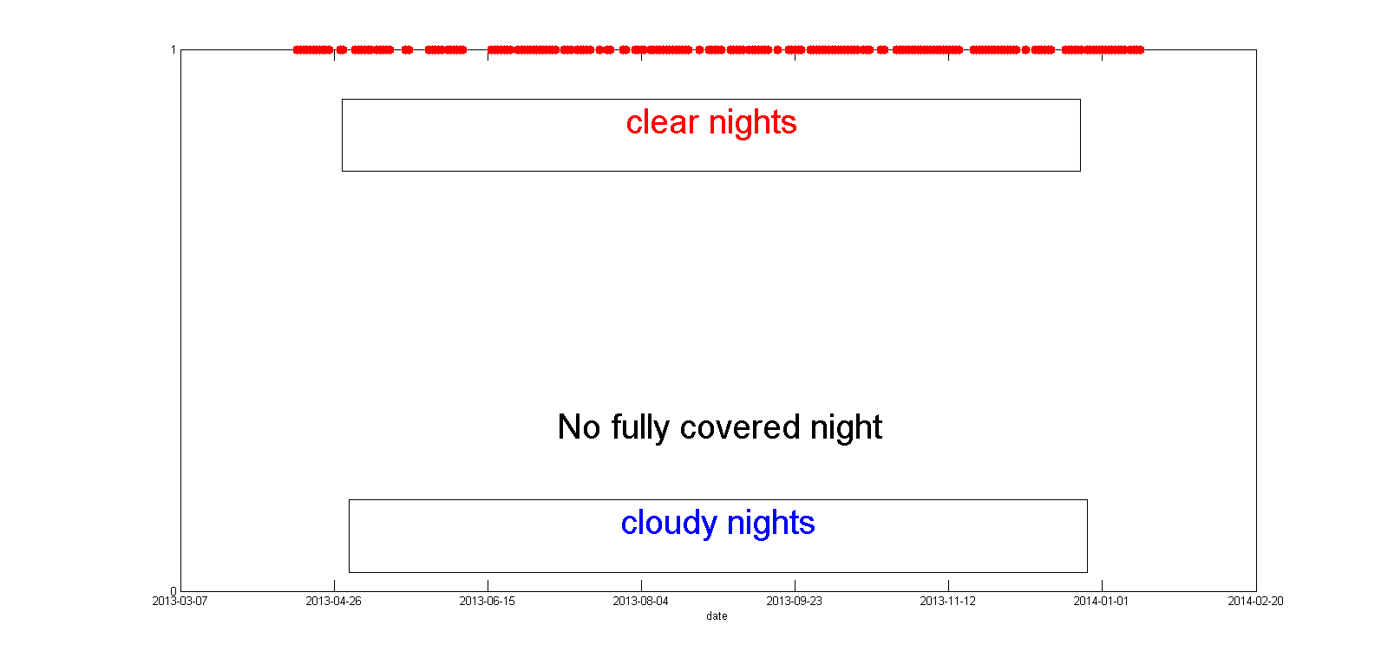
 | no. nights
Total | 248
Fully clear | 198
Fully covered | 0
Armazones
Clear nights vs. Cloudy nights

Slide 12
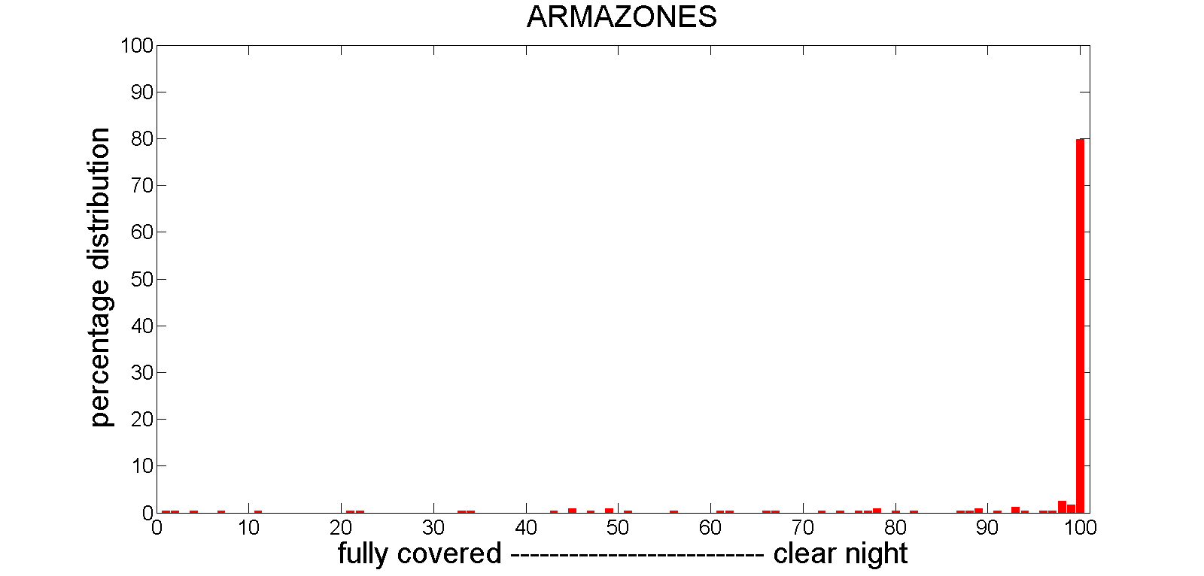
Armazones
Clear nights vs. Cloudy nights histogram

Slide 13
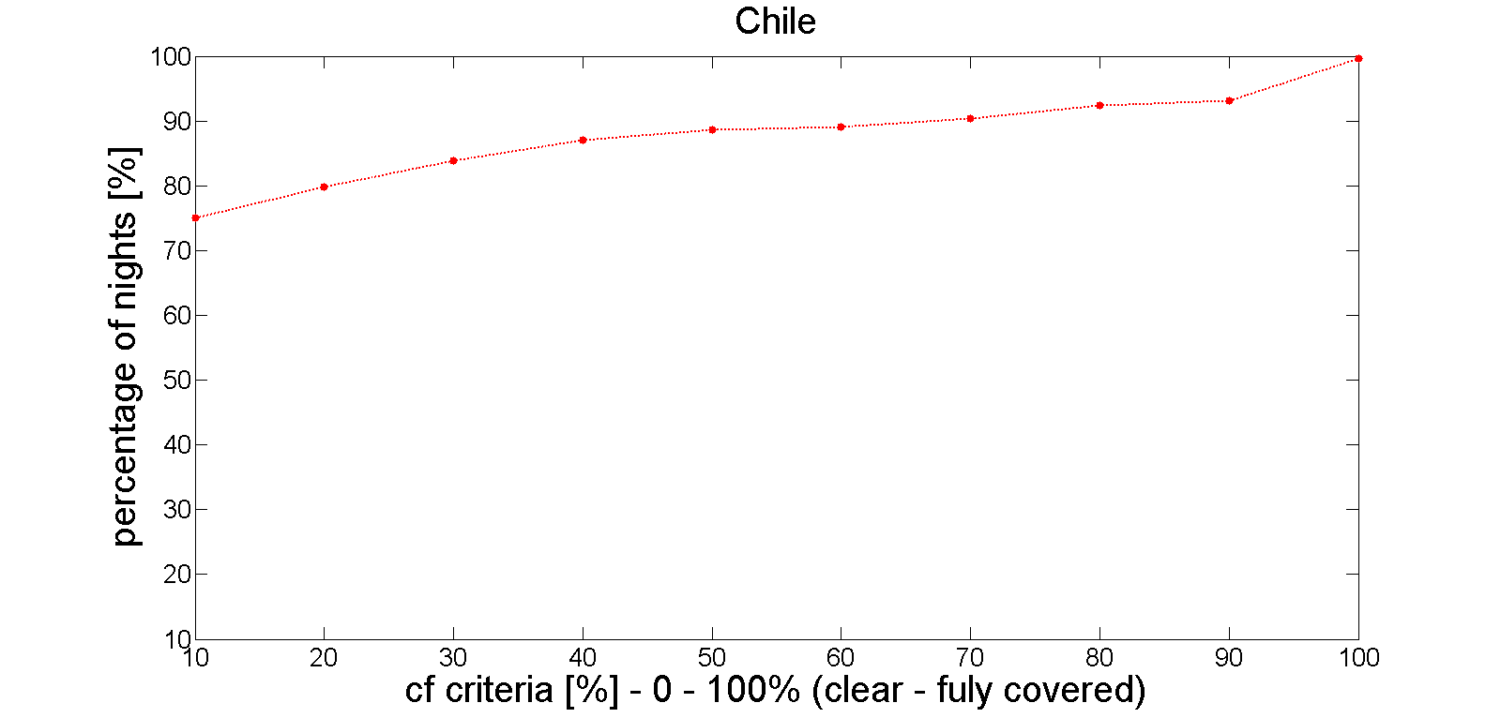
Armazones
cf criteria vs night-long clear sky

Slide 14
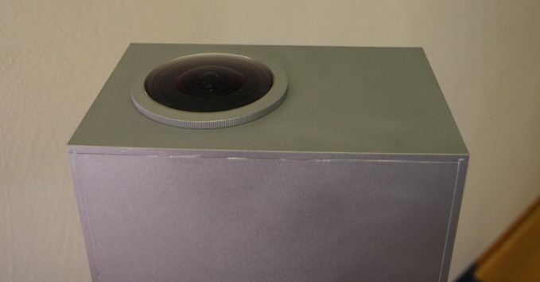
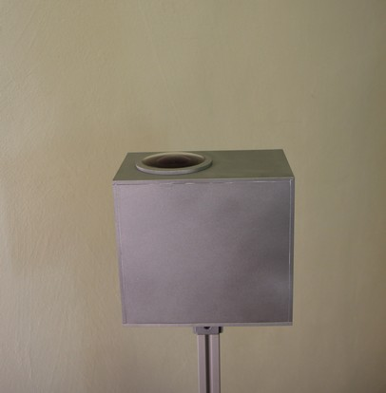
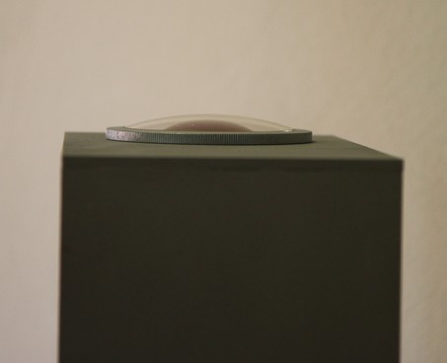
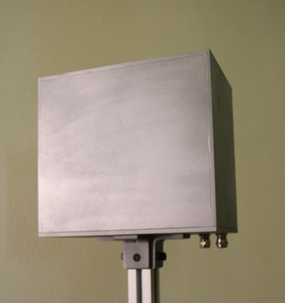
New Camera installation La Palma & Armazones 2K

Slide 15
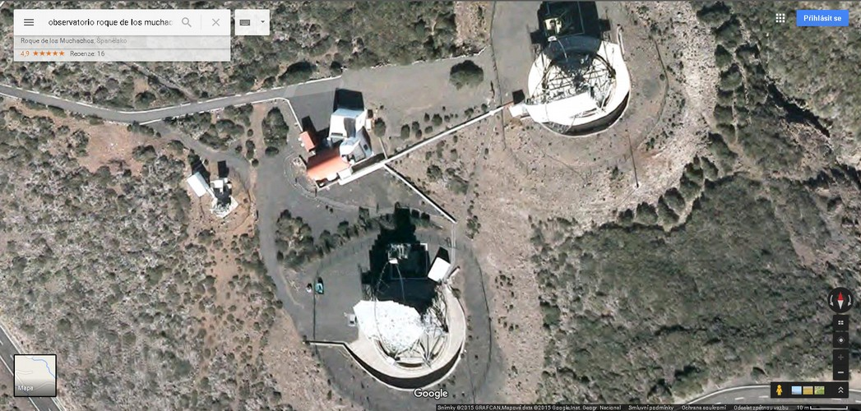
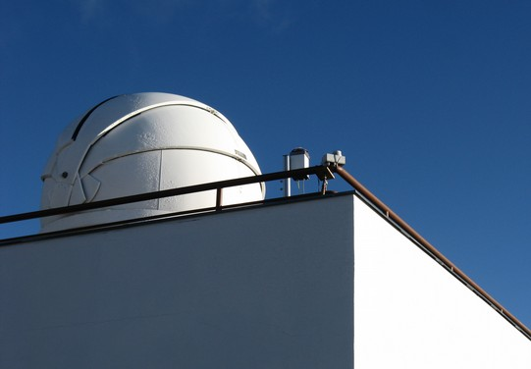
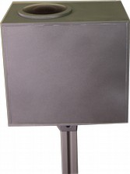
New Camera installation La Palma
13 – 16. 10. 2015

Slide 16
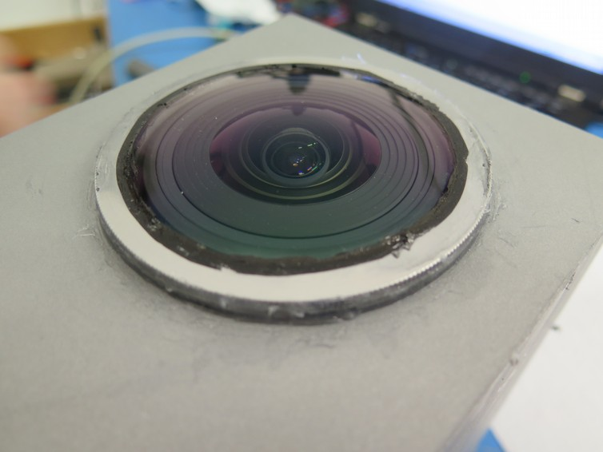
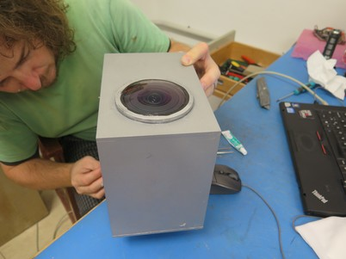
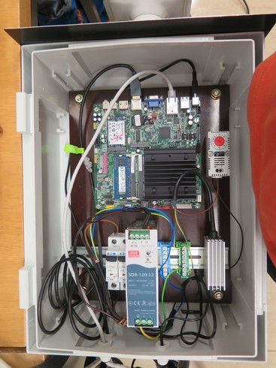

Slide 17
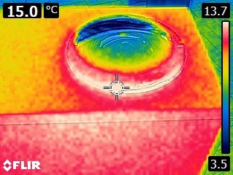
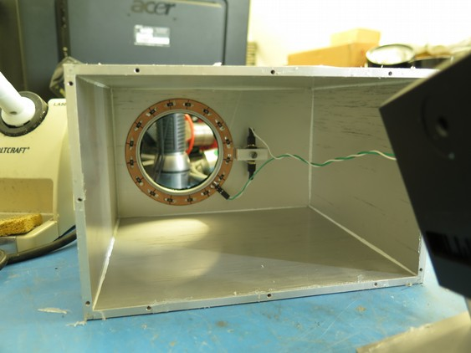
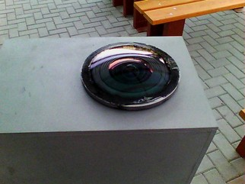

Slide 18
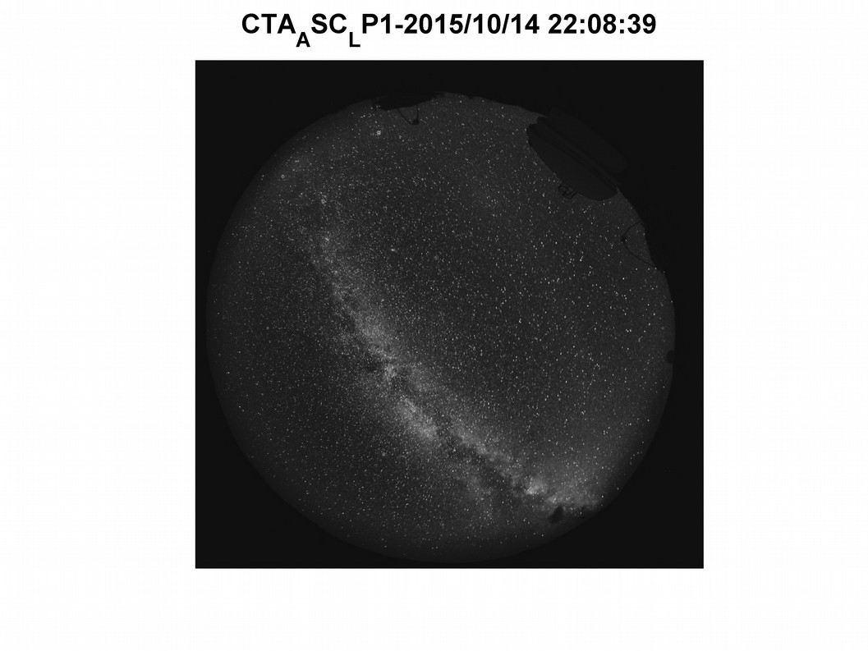
FIRST light

Slide 19
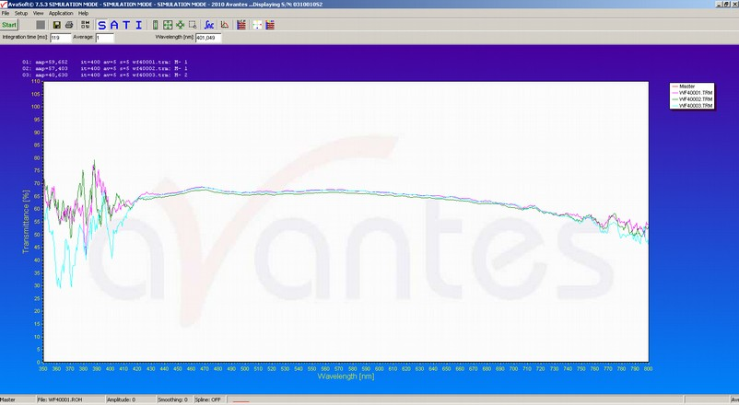

Slide 20
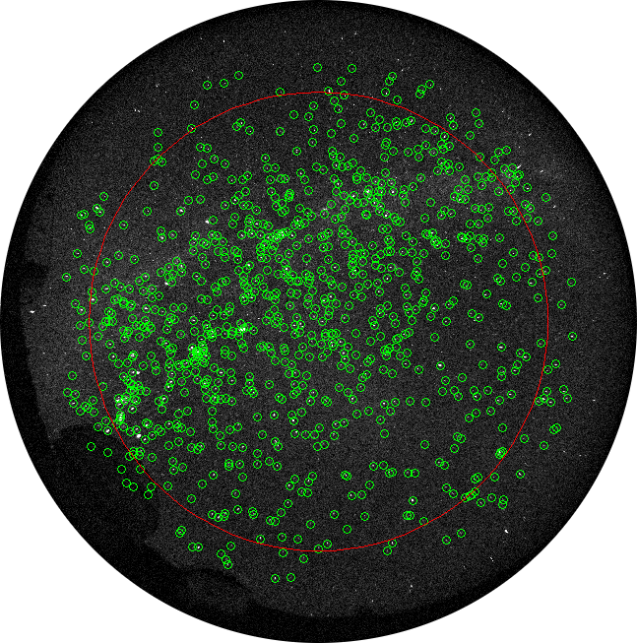
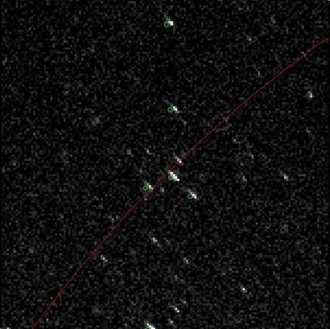
944 stars in B filter

Slide 21
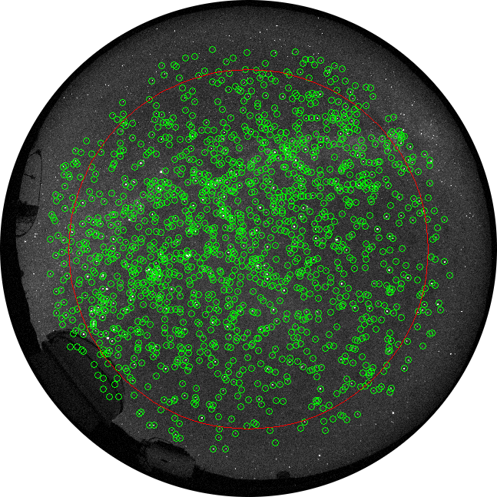
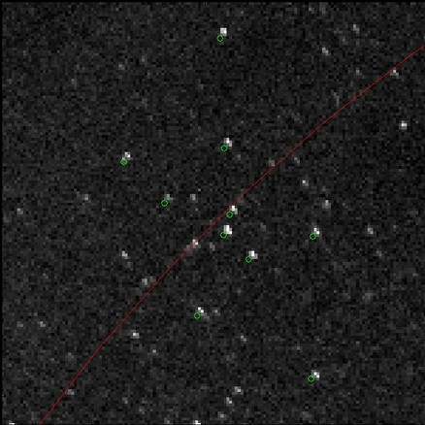
1493 stars in V filter

Slide 22
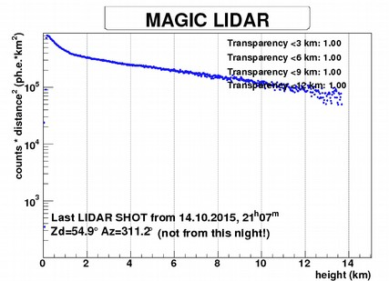
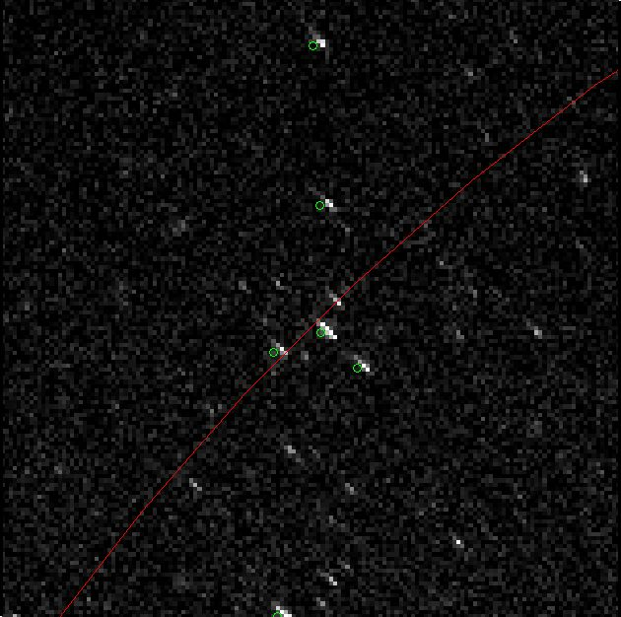
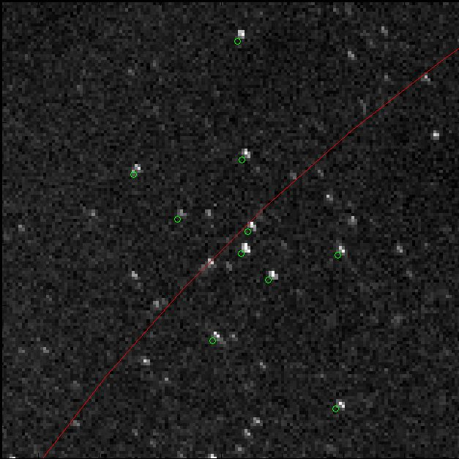
photometry
B filter
V filter

Slide 24
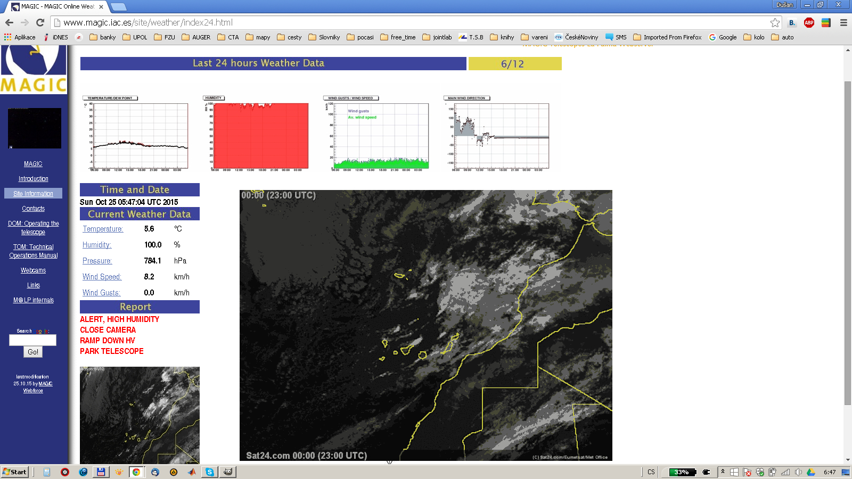

Slide 25
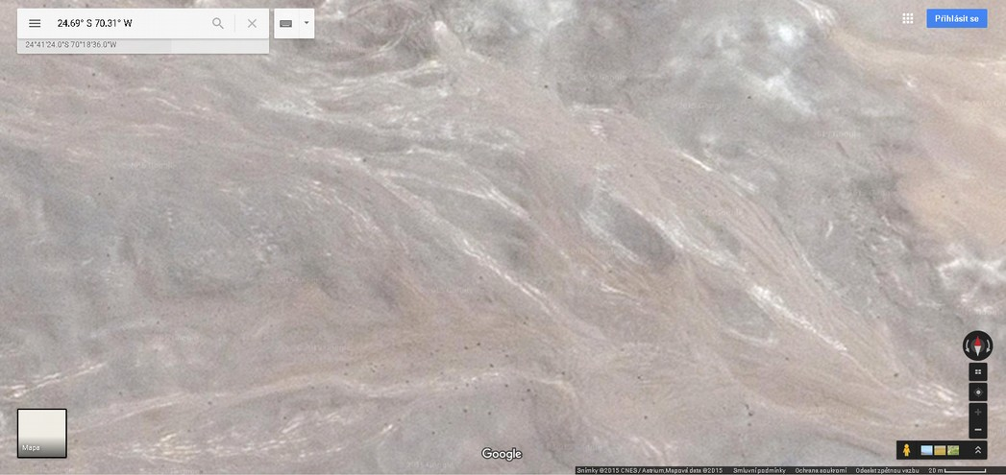
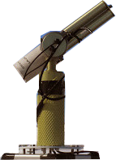
New Camera installation Armazones 2K
19 – 23. 11. 2015
2m

Slide 26
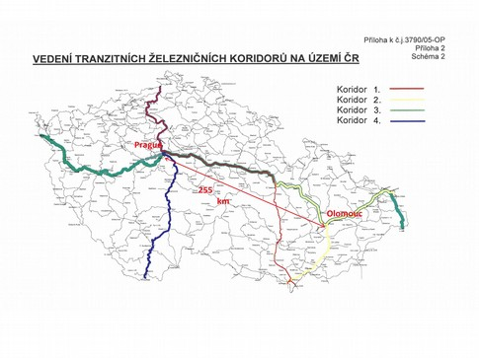
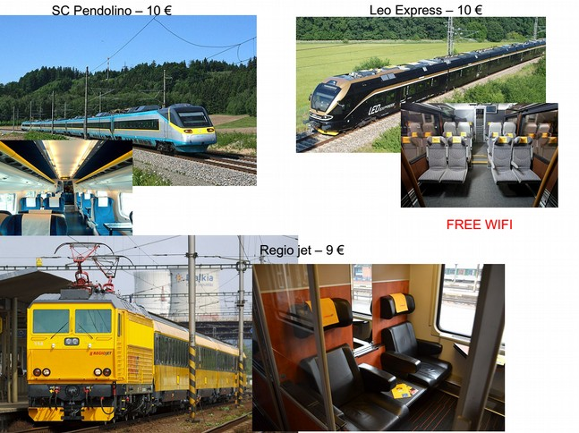
AtmoHEAD 2016: Atmospheric Monitoring for High Energy AstroParticle Detectors
May – June 2016 Olomouc
Abstracts Jan – May 2016

Slide 27
backup

Slide 28
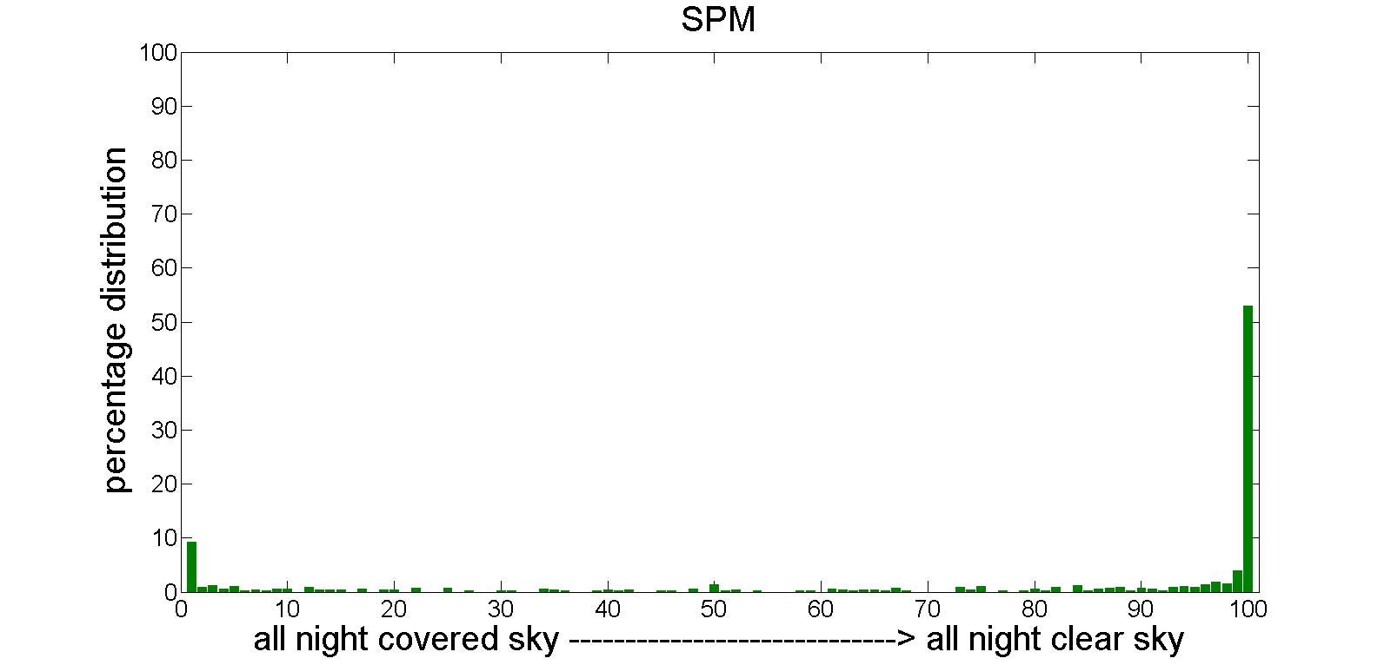

Slide 29
