Slide 1
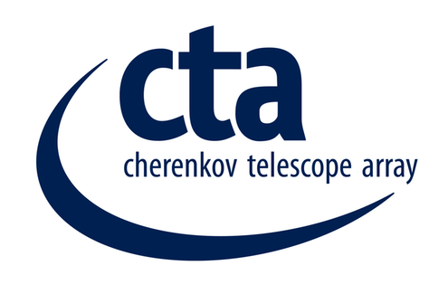
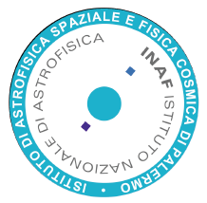
CCF Array Calibration – Instrumentation
Schedule and interfaces
Maria Concetta Maccarone
INAF IASF/Palermo
Italy
M.C. Maccarone, Central Calibration Facilities / CTA Calibration Meeting, Barcelona, 26-28 October 2015

Slide 2
CCF - Array Calibration
Major interfaces within CTA
Instrument or Method | ACTL | DATA | INFRA | MC | xST
Illuminator | yes | indirect | yes | yes | yes
Octocopter | yes | indirect | yes | ? | yes
Muon rings | yes (1) | yes | --- | yes | yes (1)
Cosmic rays air shower | --- | yes | --- | yes | ---
Cherenkov Transparency Coeff, CTC | indirect | yes | --- | yes | yes (2)
Cosmic rays electrons spectrum | --- | --- | --- | yes | ---
Cross-calib CTA-N vs CTA-S | yes (3) | --- | --- | --- | yes
Cross-calib satellites in operation | yes | --- | --- | --- | yes
Cross-calib archive data | yes | --- | --- | --- | yes
(1) specific muon runs and triggers could be required for some telescopes
(2) different camera calibration algorithms are required
(3) an adequate selection of suitable sources observable at the same time, under different zenith (and azimuth) angles, is required
M.C. Maccarone, Central Calibration Facilities / CTA Calibration Meeting, Barcelona, 26-28 October 2015

Slide 3
CCF - Array Calibration - Instrumentation
To Be Discussed Today:
To Be Discussed Today:
Instrument or Method | ACTL | DATA | INFRA | MC | xST
Illuminator | yes | indirect | yes | yes | yes
Octocopter | yes | indirect | yes | ? | yes
… tomorrow
For each instrument I/F (ACTL, DATA, INFRA) and relative code:
status,
assistance by,
schedule,
and explanatory notes/comments, in breif
M.C. Maccarone, Central Calibration Facilities / CTA Calibration Meeting, Barcelona, 26-28 October 2015

Slide 4
CCF - Array Calib. – Instrumentation I/F
Illuminator (from COM-TDR/140721,v.5.1, 13 May 2015):
Interface with INFRA: The Illuminator can be moved on board a pick-up and then placed in a proper location. The main requirements w.r.t. INFRA are then a pick-up (with driver!) and practicable road. A storage room should be considered where to deposit the Illuminator when not used, as well as some its spare parts. The Illuminator is basically a stand-alone system equipped with battery; power facilities could be then required in the observatory to periodically recharge the battery pack.
Interface with ACTL: Telescope(s) to be calibrated must know the location of the Illuminator, so that it(they) can be properly pointed toward it, and the start-end time of this calibration phase.
Interface with DATA: No data are acquired by the Illuminator. Only the input light parameters defined for the Illuminator must be known to be used during the off-line calibration pipeline. Such data are in any case stored in the local computer of the system.
Moreover:
Interface with MC: … see presentation this morning
M.C. Maccarone, Central Calibration Facilities / CTA Calibration Meeting, Barcelona, 26-28 October 2015

Slide 5
CCF - Array Calib. – Instrumentation I/F
UAV Octocopter (from COM-TDR/140721,v.5.1, 13 May 2015):
Interface with INFRA: The Octocopter has a small interface with INFRA, mainly for the place where the control computer is housed, and for storage room for the spare parts.
Interface with ACTL: No interface with ACTL is required since the data are directly triggered and taken by the telescopes.
Interface with DATA: A small interface DATA is necessary, to define how the data taken from the octocopter flashes are correctly tagged. Furthermore, CCF will provide the algorithm to extract common array calibration correction factors for each telescope from these data.
Moreover:
Interface with MC: ???
M.C. Maccarone, Central Calibration Facilities / CTA Calibration Meeting, Barcelona, 26-28 October 2015

Slide 6
CCF - Array Calibration - Instrumentation
To Be Discussed Today:
To Be Discussed Today:
Instrument or Method | ACTL | DATA | INFRA | MC | xST
Illuminator | yes | indirect | yes | yes | yes
Octocopter | yes | indirect | yes | ? | yes
… tomorrow
For each instrument I/F (ACTL, DATA, INFRA) and relative code:
status,
assistance by,
schedule,
and explanatory notes/comments, in breif
M.C. Maccarone, Central Calibration Facilities / CTA Calibration Meeting, Barcelona, 26-28 October 2015

