Slide 1
Two slides about the muon method for CTA
Markus Gaug
markus.gaug@uab.cat

Slide 2
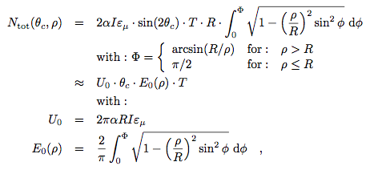
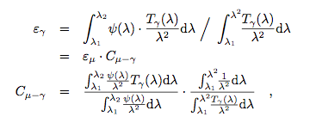
Need to determine as precisely as possible the following numbers:
Muon size (p.e.)
(<1% possible for
unbiased extractors)
local atm. transm. (<< 1% possible)
Cherenkov angle (<1% possible)
Impact distance
(<0.2m possible, <1% for E₀)
Spectral correction (from Cherenkov light from muons to gamma-ray
showers) 2-3% possible with current designs
2

Slide 3
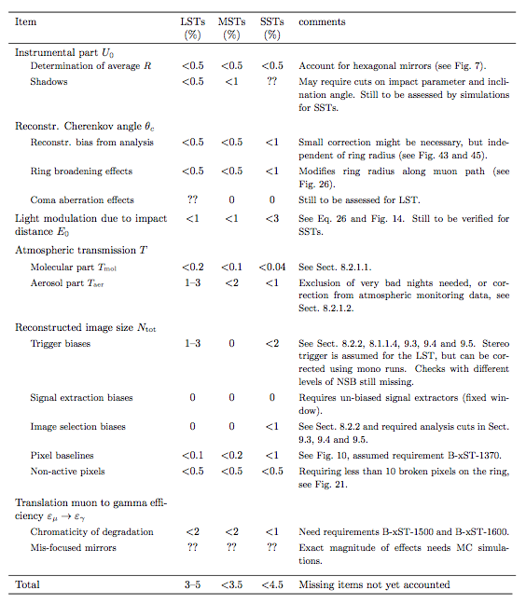
Syst. uncertainties

