Slide 1
Integrated layouts meeting
Introduction

Slide 2
outline
Integrated CTA layout
Roads (and civil)
Power network
Data network
Layouts
Morning
Conclusions
Other aspects
Afternoon
Input to building design
Power
ACTL
Power control and monitoring
integrated to ACTL (?)
COM

Slide 3
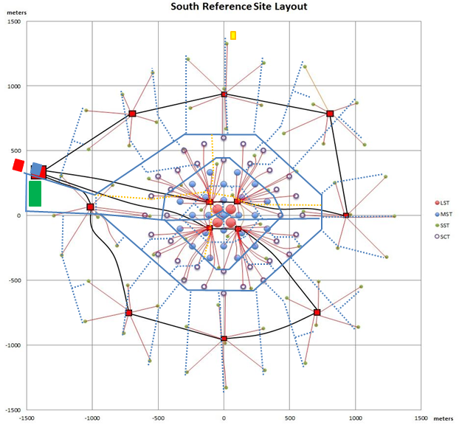
CONCLUSIONS
Considerations
Order: do not lay the cables until after all the heavy traffic is finished
Minimise road crossings from the inner ring: find compromise from the power optimum distribution
Engineer cable-road crossings so they’re reliable: reinforced concrete
Bigger transformer buildings so there’s room for splicing
2ry roads on the upper bit built during the first phase as well
Plans for the SCT
Dedicated splicing room in the transformer/switches “buildings” in the outer ring as well
Fibres for the power control and monitoring and dedicated computers (electrical control system)

