Slide 1

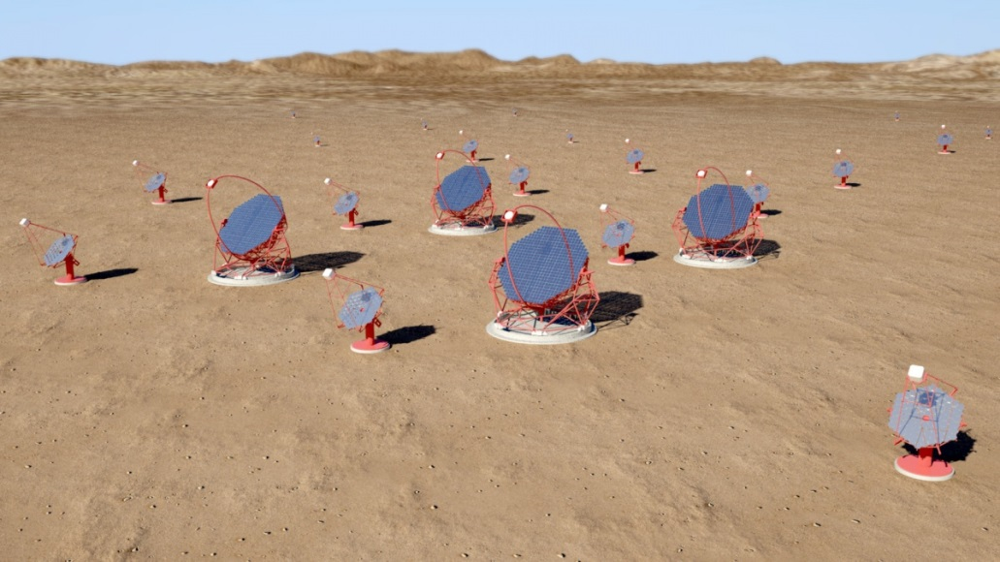
Network-Topology.
Network Topology – Onsite ICT Infrastructure
Rico Lindemann
Onsite ICT Infrastructure
11.02.2014

Slide 2
Array Network
Which data connections we will have?
  2 to 4 x Data (10 Gbit/s)
  1 x Drive system (1 Gbit/s ?)
  1 x Trigger (1 Gbit/s)
  1 x AUX Devices / Network (10 Gbit/s)
  1 x Management network (1 Gbit/s)
  1 x Slow control (1 Gbit/s)
  3 to 5 x reserve (10 Gbit/s)

Slide 3
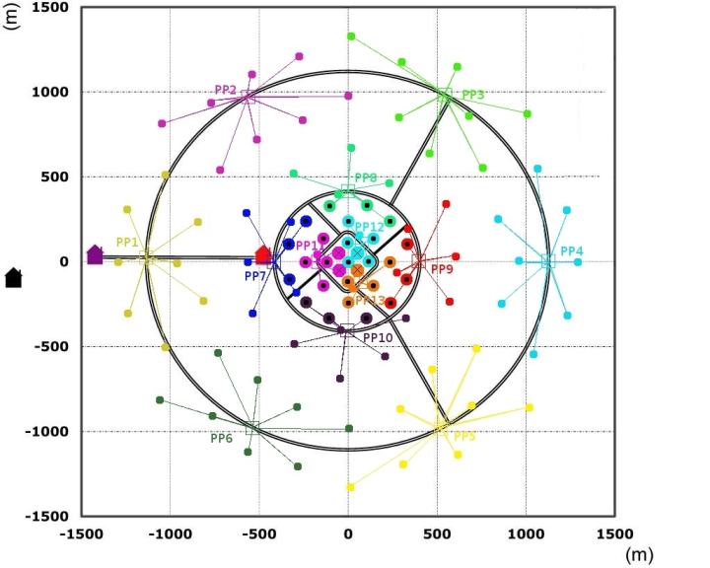
Array Network „Old one“

Slide 4
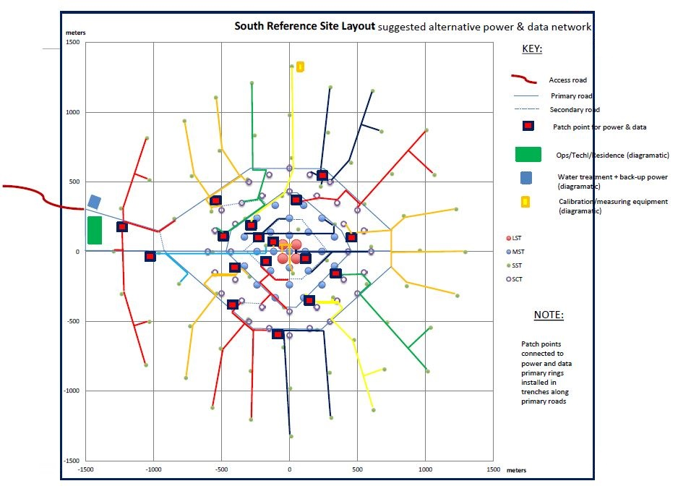
Array Network „New one“

Slide 5
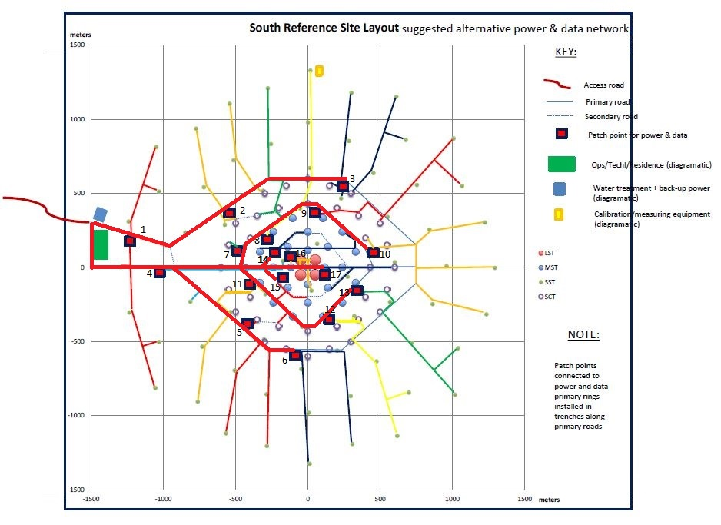
Array Network „New one“

Slide 6
Array Network comparison
„Old“ Layout:
  13 Patch Points
  Cable length (without SCT)
    24 fiber cable about 26 km
    216 fiber cable about 18.5 km
  → average lenght data center to telescope ~1,9 km
„New“ Layout:
  17 Patch Points
  Cable lenght (without SCT)
    24 fiber cable about 47 km
    216 fiber cable about 28 km
  → average lenght data center to telescope ~ 3 km
  → latency little bit higher

Slide 7
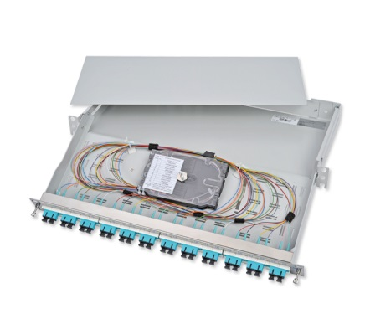
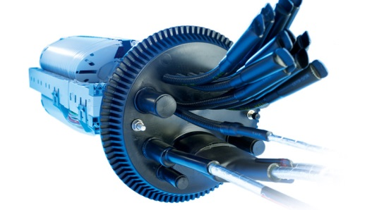
Array Network Cable ways
Cable way and interfaces (datacenter to telescope)
  In the datacenter is located a patch panel for each telescope
    100 x 12 Port SC (with light protective caps), e.g.:
  8 patch panels form a group and are connected with one 216 fiber cable
  This 216 fiber cable goes though the tranches to one of the power transformers and ends to a splice sleeve / wall rack
  Each power transformer is connected to 8 telescopes via 24 fiber cables
  In the telescope we will have a 12 Port SC or LC patch panel
  For network (not data taking network!) and auxiliary devices there will be a 24 port Switch in each telescope

Slide 8
Array Network cables
Cable choice
  Outdoor cable single mode cables (non metallic, dry interstices, water resistant, rodent protection, high crush resistance)
  Robust, non metallic, with stranded loose tubes in one layer
  The 24 fiber cable (12 connections) A-DQ(ZN)B2Y 2x12E 9/125
    Sheath diameter 12mm
    128 kg / km
  The 216 fiber cable (96 connections + 12 connections redundant because of possible bad splices) A-DQ(ZN)B2Y 9x24E 9/125
    Sheath diameter 17mm
    250 kg / km
  Diameter maybe a little higher because of termite protection (additional layer)

Slide 9
Summary
From network point of view, the new layout is not a problem
No improvement of performance
But higher costs (Estimation: about 100k€)
Aim of this meeting: Find a final solution and set a milestone for array layout

Slide 10
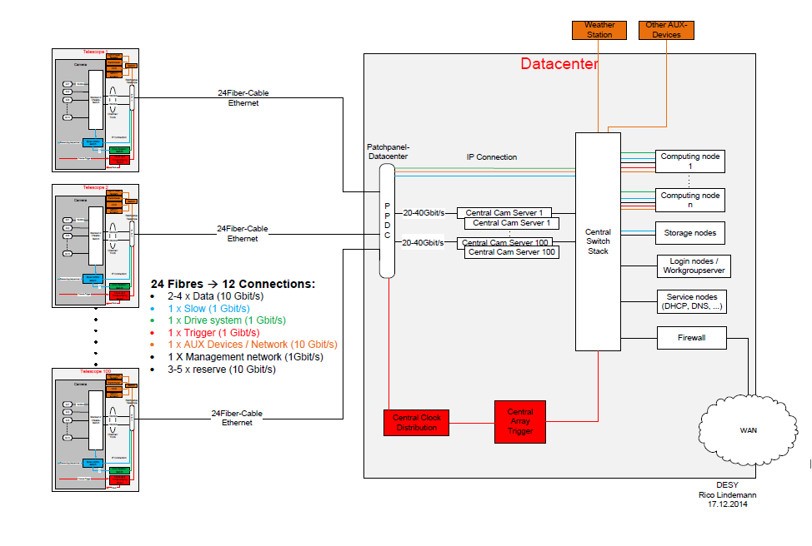
Questions?

