Slide 1
CTA Infrastructure – February 11, 2015

Slide 2
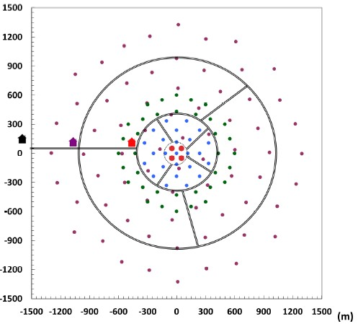
Primary roads

Slide 3
Secondary roads

Slide 4
Power & Data networks

Slide 5
Overlay of roads and power/data network

Slide 6
Key issues
Different road and data/power layouts makes maintenance difficult impacting reliability
Cost per km of road + trench > cost of power & data cables (per km)
giving:
Scope to improve compatibility of road layout and data/power networks

Slide 7
CTAO requirements
Allow for phased construction over 4 year period
A significant period of time when construction and operations are underway at the same time
Flexibility in layout for as long as possible
Flexibility in being able to accommodate telescope deliveries to site
General construction stages to allow central areas to precede outer areas
Last SSTs may be some time
Operational efficiency and reliability
Efficient maintenance programme

Slide 8
Concept for revised layout (1)
Let road network drive overall site layout road €/km> power & data €/km)
Roads to be generally straight not curved
Road direction determined by telescope locations
Primary roads run between telescopes passing as close as possible to them
Secondary roads run direct to outer telescopes and join to inner ones not adjacent to primary roads
Provision of a direct road to the central area
During construction have 2 roads to central area

Slide 9
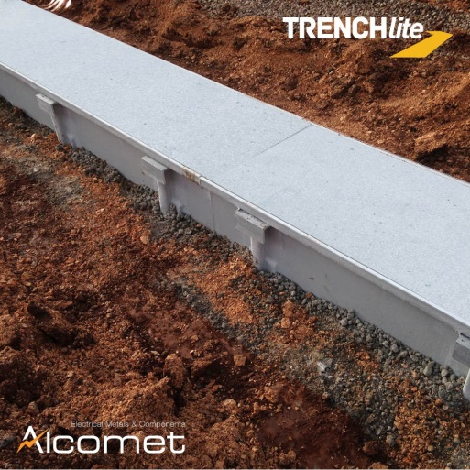
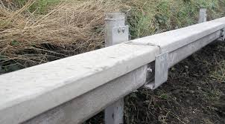
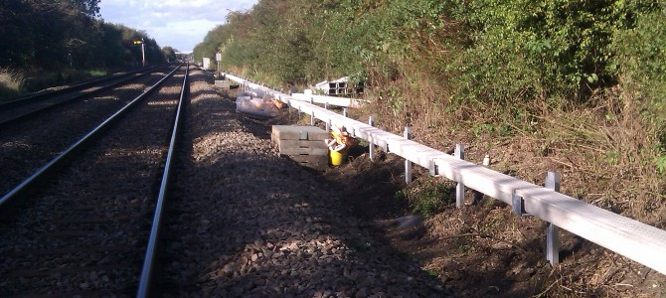
Concept for revised layout (2)
Seek greater compatibility between road, power and data network layouts
Power & data to patch points (PP) in trenches below ground
Power & data from PPs to telescopes above ground
Reduce numbers of roads crossings (reduces cost & improves reliability)

Slide 10
Construction considerations
3 stages to complete the array:
      Initial construction
      Concurrent construction & operation
      Full operations
Programme construction to provide flexibility in deployment of telescopes
Segregate construction and operational activities to improve safety
Designate roads for construction -> improved safety

Slide 11
- suggested alternative road layout
KEY:
Perimeter fence
Access road
Power, data (& if reqd. drainage & lighting) networks follow roads
Primary road
Secondary road
Construction road
Ops/Techl/Residence (diagramatic)
Water treatment + back-up power (diagramatic)
Calibration/measuring equipment (diagramatic)
Site security
NOTE:
Road alignment to suit interface with apron around each telescope i.e. roads to comprise a series of straights between each telescope
05/11/14 – primary road through centre of array revised. Minor revisions to secondary roads.
LBA
07/11/2014

Slide 12
- suggested alternative road layout
KEY:
Perimeter fence
Access road
Power, data (& if reqd. drainage & lighting) networks follow roads
Primary road
Secondary road
Construction road
Ops/Techl/Residence (diagramatic)
Water treatment + back-up power (diagramatic)
Calibration/measuring equipment (diagramatic)
Site security
NOTE:
Road alignment to suit interface with apron around each telescope i.e. roads to comprise a series of straights between each telescope
05/11/14 – primary road through centre of array revised. Minor revisions to secondary roads.
LBA
07/11/2014

Slide 13
- suggested alternative road layout
KEY:
Perimeter fence
Access road
Power, data (& if reqd. drainage & lighting) networks follow roads
Primary road
Secondary road
Construction road
Ops/Techl/Residence (diagramatic)
Water treatment + back-up power (diagramatic)
Calibration/measuring equipment (diagramatic)
Site security
NOTE:
Road alignment to suit interface with apron around each telescope i.e. roads to comprise a series of straights between each telescope
05/11/14 – primary road through centre of array revised. Minor revisions to secondary roads.
LBA
07/11/2014

Slide 14
- suggested alternative road layout
KEY:
Perimeter fence
Access road
Power, data (& if reqd. drainage & lighting) networks follow roads
Primary road
Secondary road
Construction road
Ops/Techl/Residence (diagramatic)
Water treatment + back-up power (diagramatic)
Calibration/measuring equipment (diagramatic)
Site security
NOTE:
Road alignment to suit interface with apron around each telescope i.e. roads to comprise a series of straights between each telescope
05/11/14 – primary road through centre of array revised. Minor revisions to secondary roads.
LBA
07/11/2014

Slide 15
- suggested alternative road layout
KEY:
Perimeter fence
Access road
Power, data (& if reqd. drainage & lighting) networks follow roads
Primary road
Secondary road
Construction road
Ops/Techl/Residence (diagramatic)
Water treatment + back-up power (diagramatic)
Calibration/measuring equipment (diagramatic)
Site security
NOTE:
Road alignment to suit interface with apron around each telescope i.e. roads to comprise a series of straights between each telescope
05/11/14 – primary road through centre of array revised. Minor revisions to secondary roads.
LBA
07/11/2014

Slide 16
- suggested alternative road layout
KEY:
Perimeter fence
Access road
Power, data (& if reqd. drainage & lighting) networks follow roads
Primary road
Secondary road
Construction road
Ops/Techl/Residence (diagramatic)
Water treatment + back-up power (diagramatic)
Calibration/measuring equipment (diagramatic)
Site security
NOTE:
Road alignment to suit interface with apron around each telescope i.e. roads to comprise a series of straights between each telescope
05/11/14 – primary road through centre of array revised. Minor revisions to secondary roads.
LBA
07/11/2014

Slide 17
- suggested alternative road layout
KEY:
Perimeter fence
Access road
Power, data (& if reqd. drainage & lighting) networks follow roads
Primary road
Secondary road
Construction road
Ops/Techl/Residence (diagramatic)
Water treatment + back-up power (diagramatic)
Calibration/measuring equipment (diagramatic)
Site security
NOTE:
Road alignment to suit interface with apron around each telescope i.e. roads to comprise a series of straights between each telescope
05/11/14 – primary road through centre of array revised. Minor revisions to secondary roads.
LBA
07/11/2014

Slide 18
- suggested alternative road layout
KEY:
Perimeter fence
Access road
Power, data (& if reqd. drainage & lighting) networks follow roads
Primary road
Secondary road
Construction road
Ops/Techl/Residence (diagramatic)
Water treatment + back-up power (diagramatic)
Calibration/measuring equipment (diagramatic)
Site security
NOTE:
Road alignment to suit interface with apron around each telescope i.e. roads to comprise a series of straights between each telescope
05/11/14 – primary road through centre of array revised. Minor revisions to secondary roads.
LBA
07/11/2014

Slide 19
- suggested alternative road layout
KEY:
Perimeter fence
Access road
Power, data (& if reqd. drainage & lighting) networks follow roads
Primary road
Secondary road
Construction road
Ops/Techl/Residence (diagramatic)
Water treatment + back-up power (diagramatic)
Calibration/measuring equipment (diagramatic)
Site security
NOTE:
Road alignment to suit interface with apron around each telescope i.e. roads to comprise a series of straights between each telescope
05/11/14 – primary road through centre of array revised. Minor revisions to secondary roads.
LBA
07/11/2014

Slide 20
- suggested alternative power & data network
KEY:
Access road
Primary road
Secondary road
Patch point for power & data
Ops/Techl/Residence (diagramatic)
Water treatment + back-up power (diagramatic)
Calibration/measuring equipment (diagramatic)
NOTE:
Patch points connected to power and data primary rings installed in trenches along primary roads
LBA
07/11/2014

Slide 21
Proposed alternative power/data layout
LBA - 07/11/2014

Slide 22
Conclusions/questions
Layout to be for full 135 telescopes as in this presentation (some to date have shown 99)
Need to provide flexibility in deployment of telescopes
To what degree should road, data and power layouts correspond
Importance of
  scale (3km diameter site)
  construction schedule vs telescope delivery timescale
  allow for concurrent construction & operations

