Slide 1
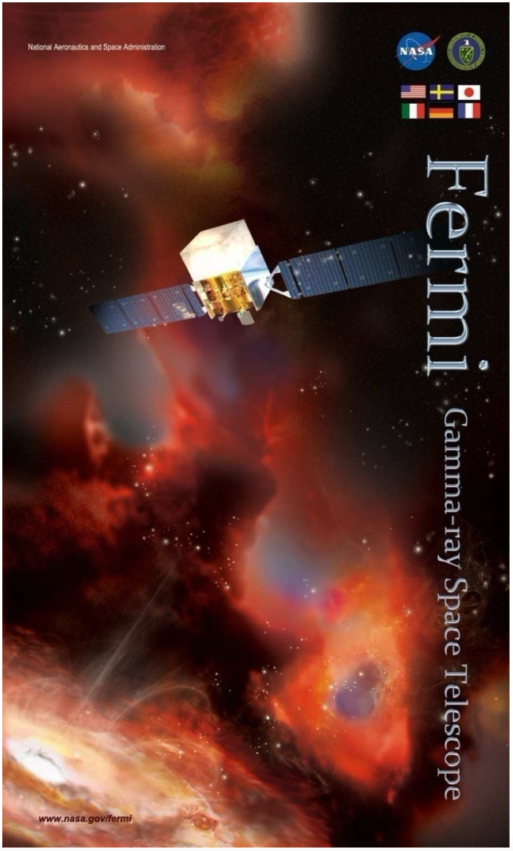
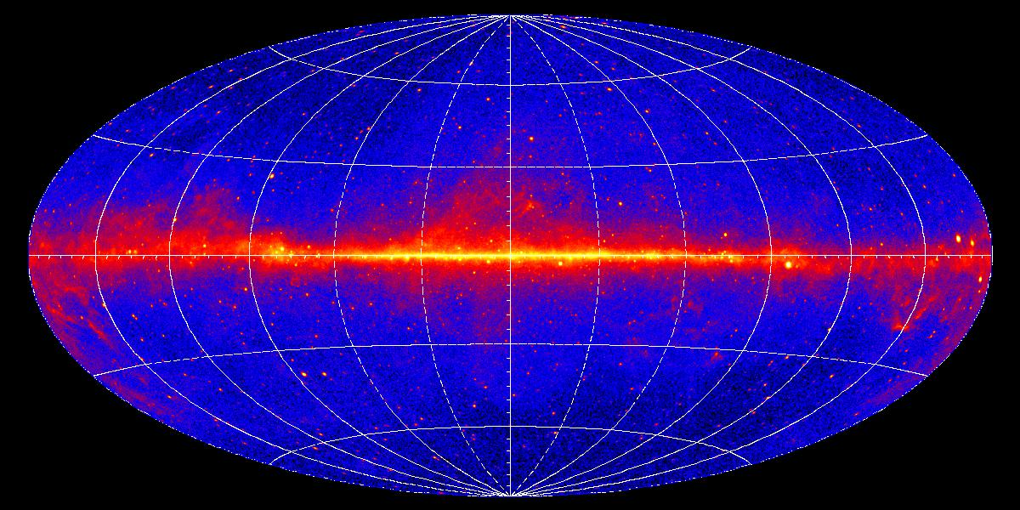
Bridging the GeV and TeV skies with Fermi-LAT
Marianne Lemoine-Goumard
(LP2i Bordeaux, CNRS)
On behalf of the Fermi-LAT Collaboration
Inauguration LST Sub-Array
La Palma, October 16th 2026

Slide 2
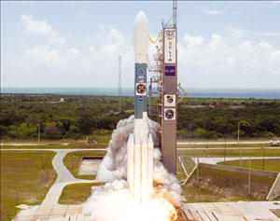
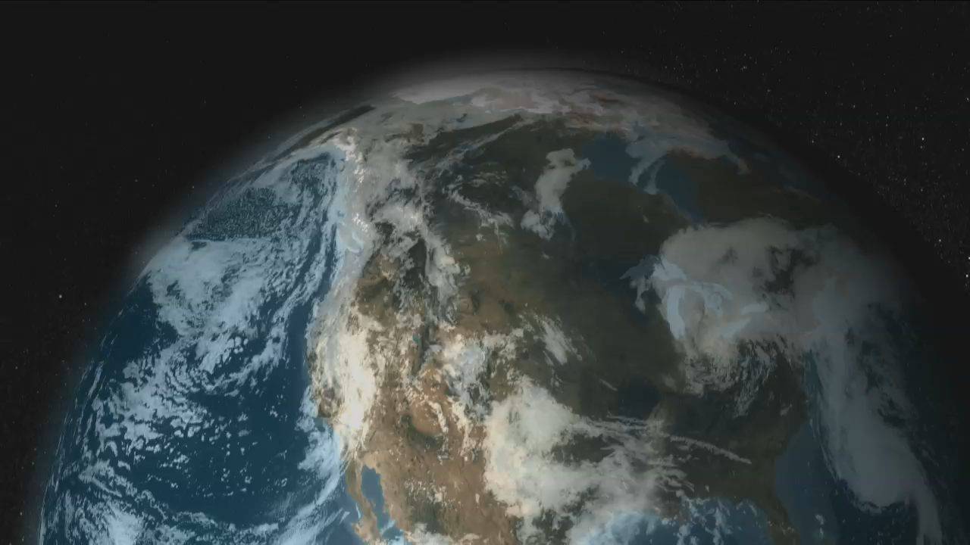
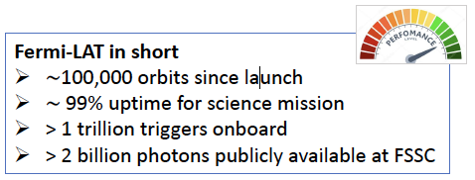
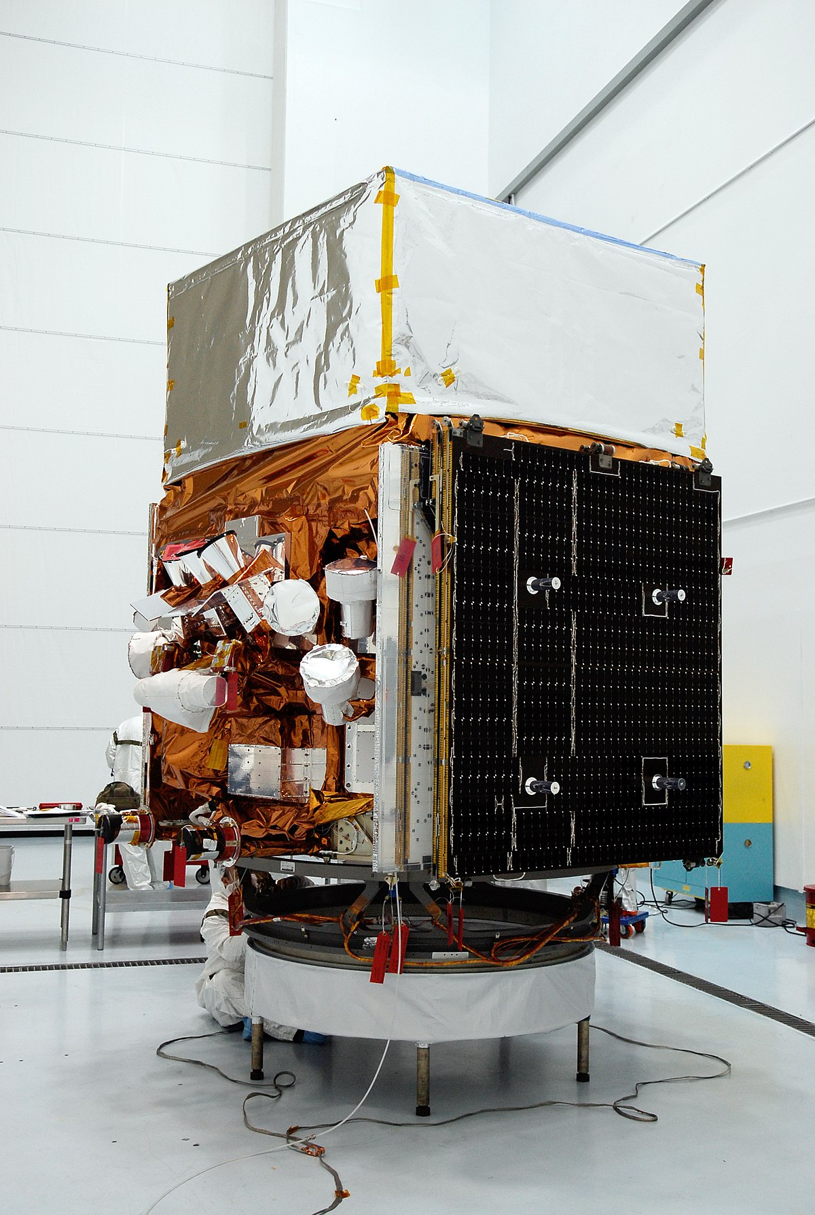
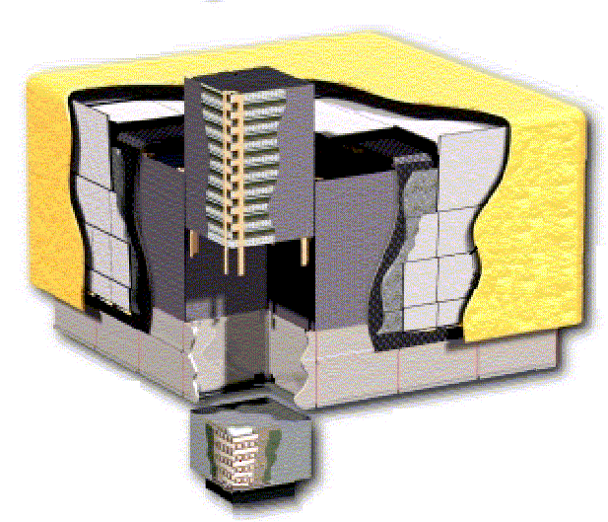
The NASA Fermi satellite
Lauched on June 11 2008 from Cap Canaveral.
$800M mission led by NASA/DOE
Two instruments aboard:
  Gamma-ray Burst Monitor (GBM; 8 keV – 40 MeV)
  Large Area Telescope (LAT; 20 MeV – >1 TeV)
Sky Survey:
2.5 sr field-of-view
whole sky every 3 hours
Public Data Release:
All γ-ray data made public within 24 hours (usually less)

Slide 3
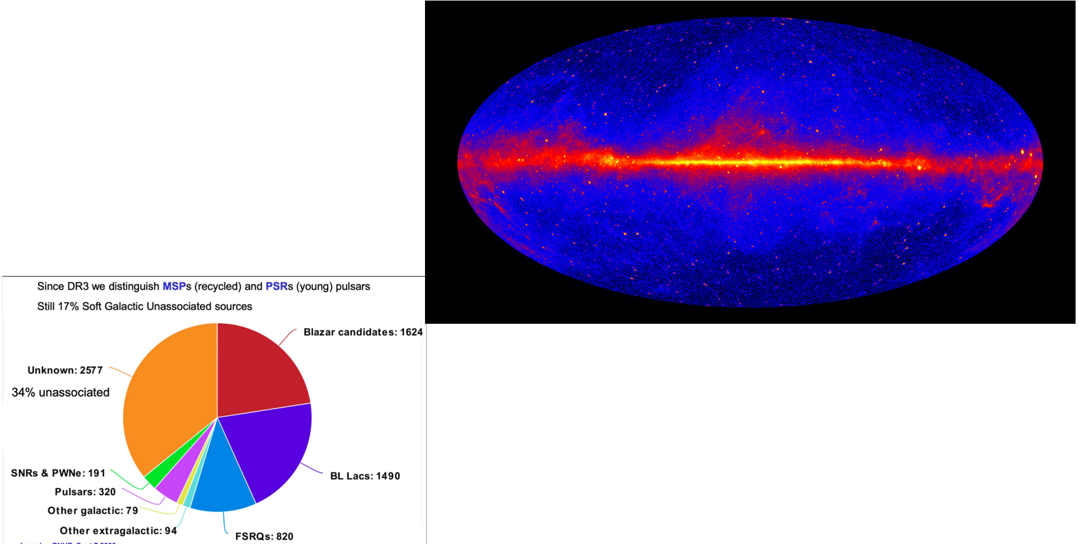
Fermi-LAT catalogs: unveiling the sky at GeV energies
[Ballet et al. (2023), arXiv: 2307.12546; LAT Collab. ApJS 260, 53 (2022)
All of the data available at the FSSC: https://fermi.gsfc.nasa.gov/ssc/data/access/lat/14yr_catalog/

Slide 4
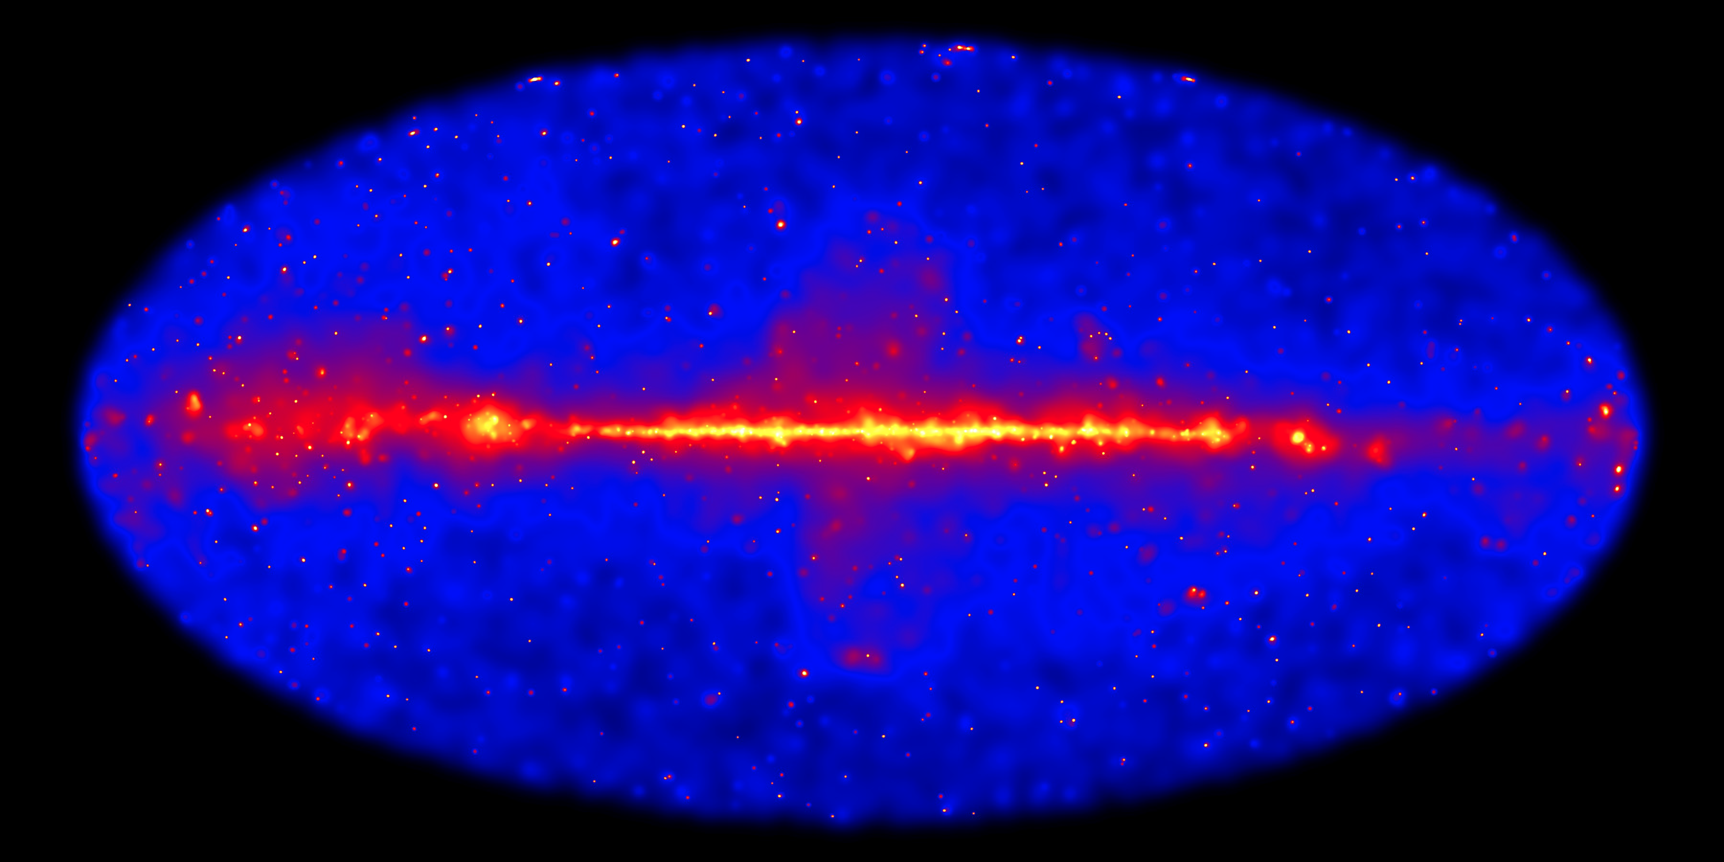
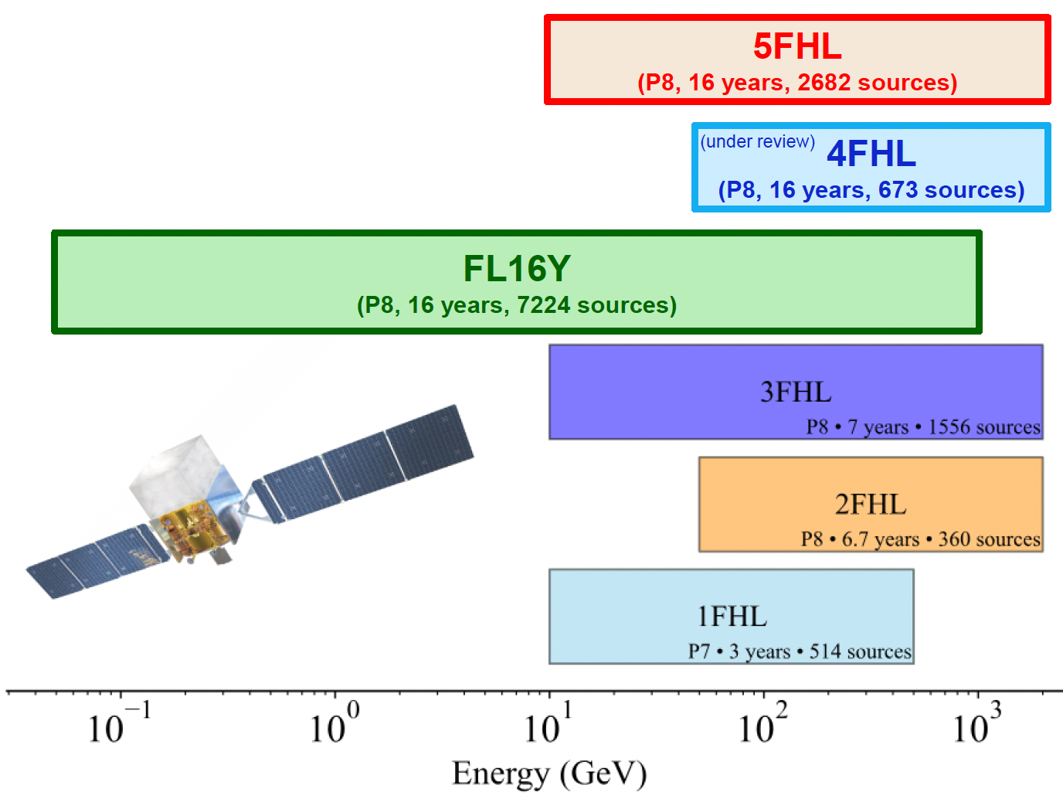
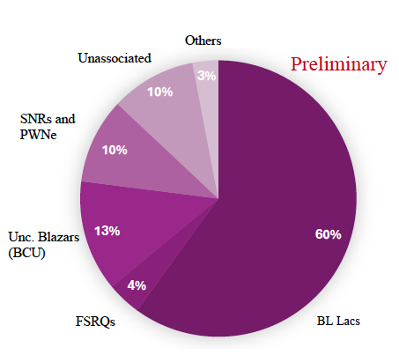
FHL catalogs: bridging the gap with TeV instruments
4FHL catalog (arXiv:2609.31457):
Over 700 sources (TS ≥ 25 and Npred ≥ 3)
• 78% Blazars, 12% Galactic Sources, 10% Unassociated
• 346 detected in 2FHL
• 566 detected in 4FGL-DR4
~ 100 Sources > 500 GeV (TS ≥ 25 and Npred ≥ 3)
45% Galactic / 42% Blazars / 13% Unassociated
The sky above 50 GeV

Slide 5

The 3rd Fermi LAT pulsar catalog
Smith et al. ApJ 2023
Increased the number of observed gamma-ray pulsars from 11 to 340
~10% of all observed pulsars at other wavelengths have been detected in gamma-rays
  First gamma-ray pulsar discovered in another galaxy!
  Over 100 millisecond pulsars-> pulse with extreme regularity
Fermi is also serving as Gamma-Ray Pulsar Timing Array to measure the stochastic Gravitational Wave Background
Credit: NASA’s Goddard Space Flight Center

Slide 6
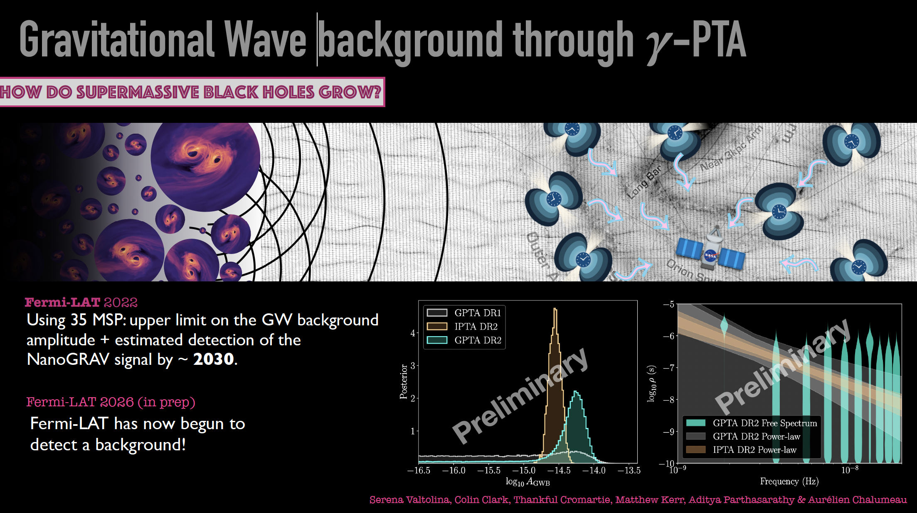

Slide 7
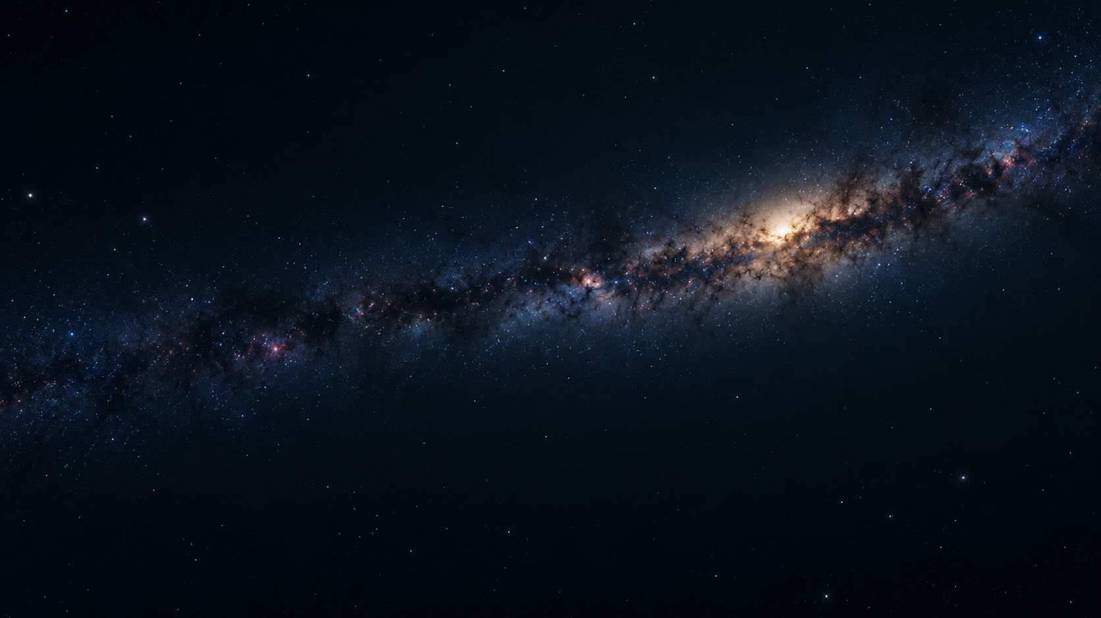
What does the variable sky reveal ?

Slide 8
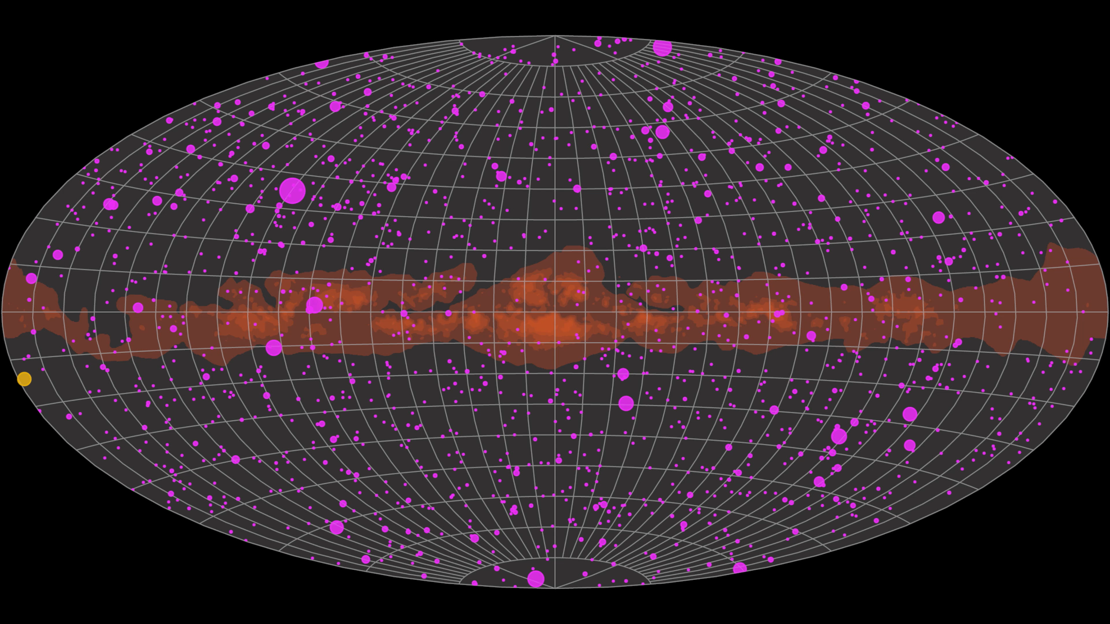
The dynamic gamma-ray sky
Fermi-LAT observations have revealed how dynamic the gamma-ray sky is
The continuous monitoring of the entire sky has shown pulsing, flaring and outbursts from sources in the solar system, to the local galaxy all the way to most distant regions of the universe
Sources found to be variable on time scales ranging from milliseconds to years
Credit: NASA’s Marshall Space Flight Center/Daniel Kocevski

Slide 9
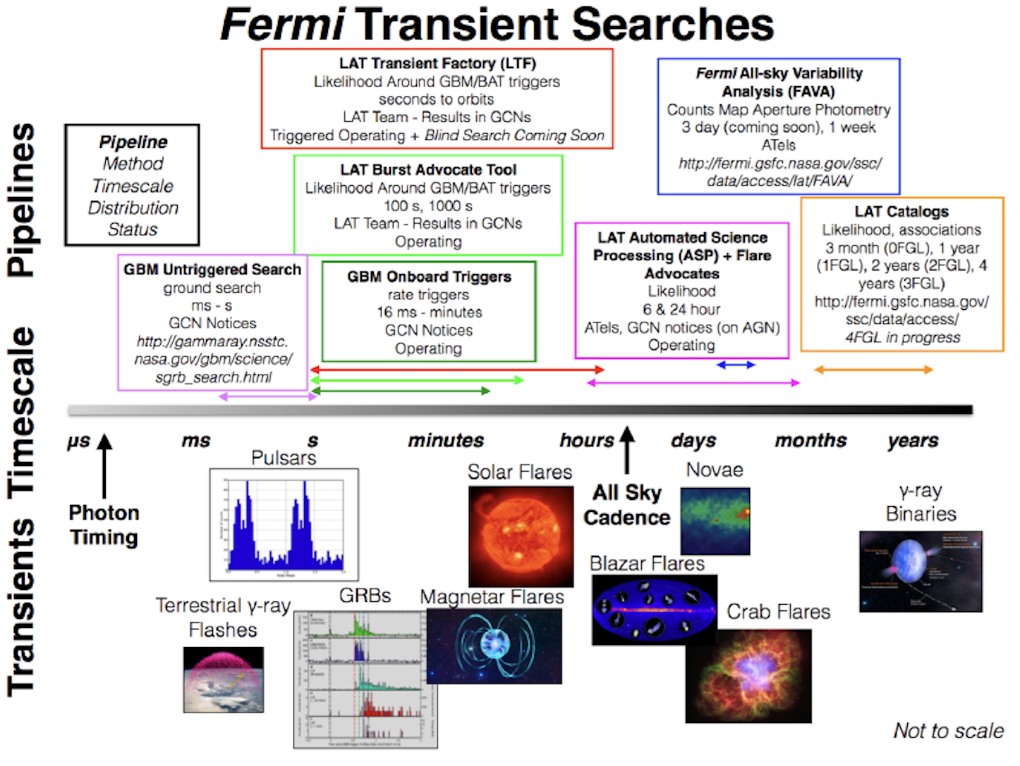
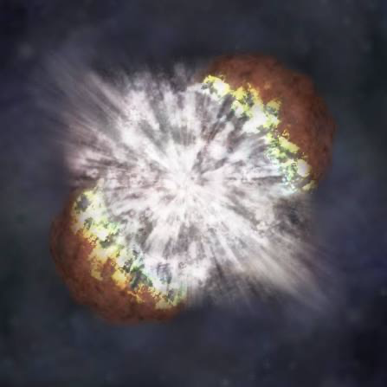
Supernovae

Slide 10
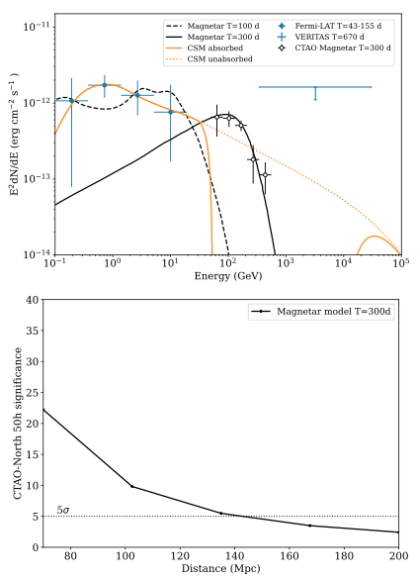
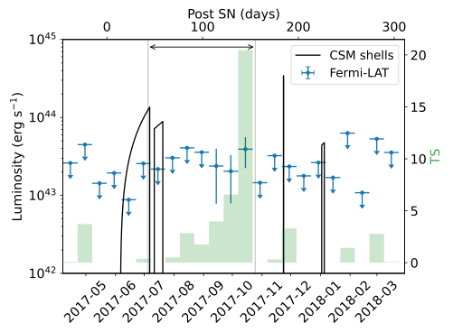
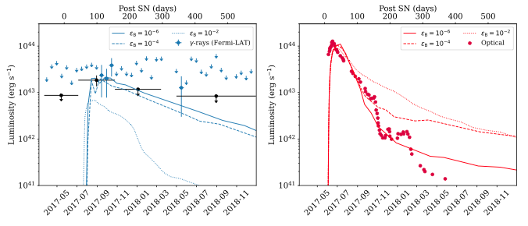
Superluminous supernova detected with Fermi
Acero et al., A&A, 709, A229 (2026)
Reason why SLSNe are SL still debated :
CSM interaction
Accretion onto the newly formed NS or BH
Magnetar wind nebula from a ms pulsar
Ackermann, 2015 : 147 Type IIn SN interacting with dense CSM : no detection
Renault-Tinacci, 2018 : 45 SLSNe studied : no detection
Prokhorov 2021 : Hint of variability on SN candidates AT2019bvr and AT2018iwp
SLSN 2017egm 135 Mpc : claim for a detection
(Li et al., arXiv :2407.05968)
Detection confirmed at more than 5σ
Favour the magnetar model
=> Good prospects for CTAO for magnetar model
CSM
Gamma
Optical
Magnetar

Slide 11
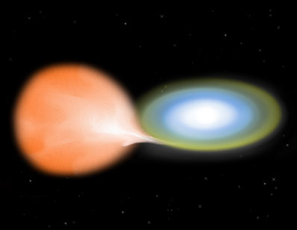
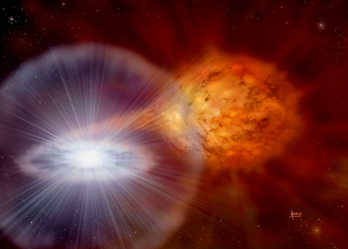
White Dwarfs in Close Binary Systems
Compact cataclysmic variable:
WD + Main Sequence
Roche lobe overflow
Symbiotic system:
Massive WD + Red Giant
accretion from red giant wind
Classical novae
Symbiotic-Recurrent novae
Hydrogen burning in degenerate conditions on top of the white dwarf
Credit: David Hardy
separations, a ~ 10¹¹cm ~ R
P_{orb}~ hr-day
P_{rec} >~ 10⁴ yr
• rate ~ 30 – 50 / yr in Galaxy
a ~ 100’s R
P_{orb}~ years
P_{rec} < 100 yrs
~10 known symbiotic/recurrents
Adapted from M. Hernanz, X-ray Universe 2011 talk

Slide 12
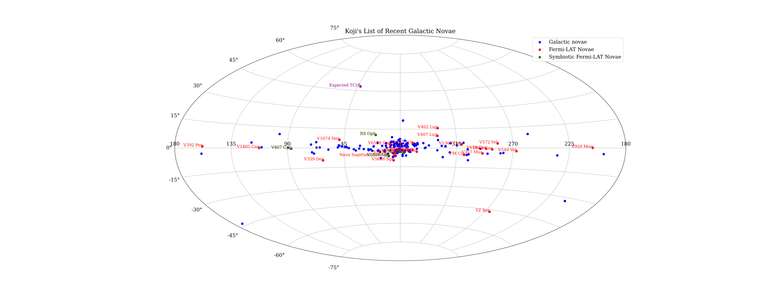
Gamma-ray novae
194 galactic novæ since the beginning of Fermi in 2008
31 announced as detected by Fermi

Slide 13
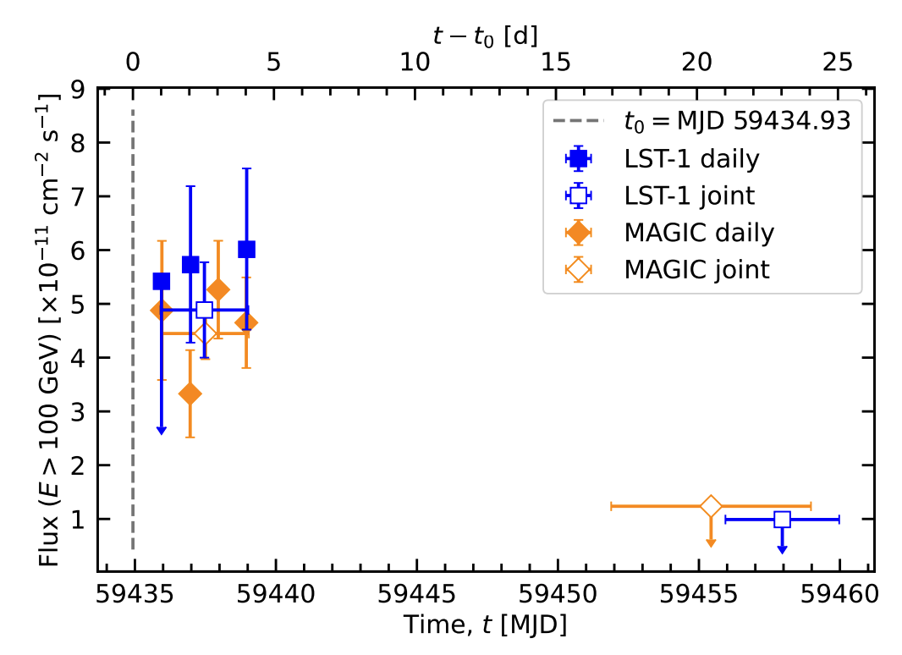
Hadronic Emission from RS Oph, T CrB
  Original predictions from 2006 outburst: Tatischeff & Hernanz (2008 ApJL)
  RS Oph 2021 outburst: Tatischeff & Hernanz arXiv:2302.01276
  RS Oph opened a new class of VHE source: novae
Abe et al. (LST Coll.), A&A, 695, A152 (2025)
HESS Coll. et al., Science, 376, 6588 (2022)
  RS Oph detected up to 40 days !
  Expected Fermi-LAT lightcurve for T CrB :
Real time laboratory to study diffusive shock acceleration
Naively scale by distance (d ~ 0.9 kpc):
T CrB peak >100 MeV flux ~ (1-2) x 10^-5 ph/cm2/s (~1-2x Vela flux), lasting ~100 days !

Slide 14
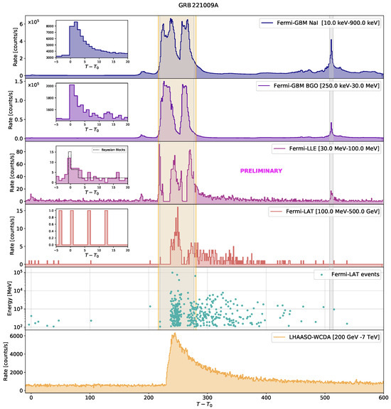
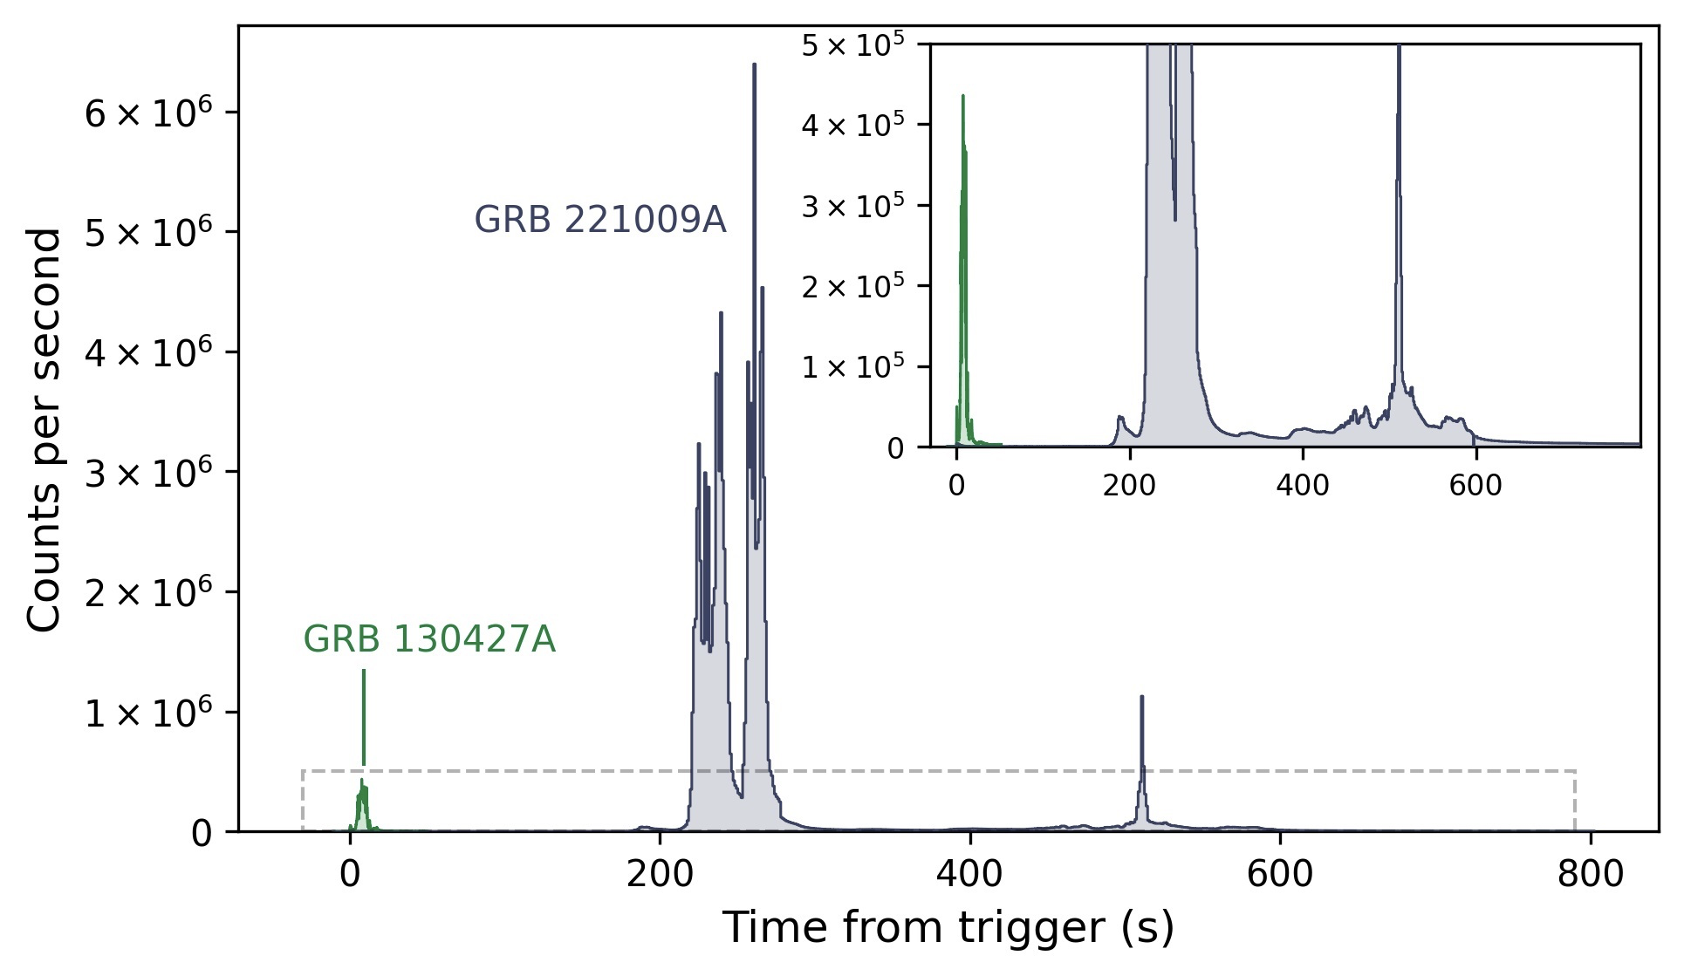
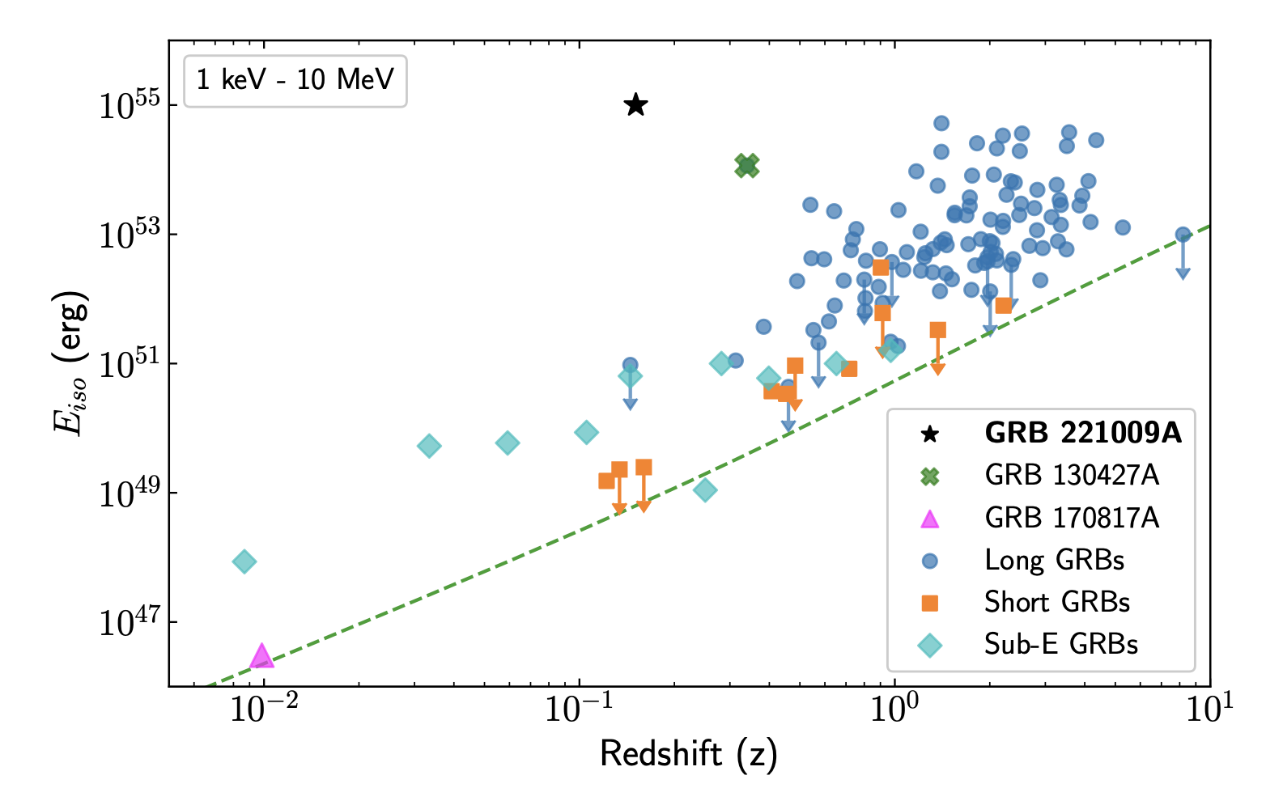
GRB221009A – “The B.O.A.T.”
M. Axelsson et al 2025 ApJS 277 24
Detected on October 9, 2022: highest flux burst ever observed by the GBM.
Unusable data for standard analysis pipelines recovered !
Record-breaking HE duration: GRB was visible for about 2 days by the LAT
High-energy events observed by the LAT are incompatible with synchrotron
origin, and more likely related to an extra component identified as synchrotron self-Compton (SSC).

Slide 15
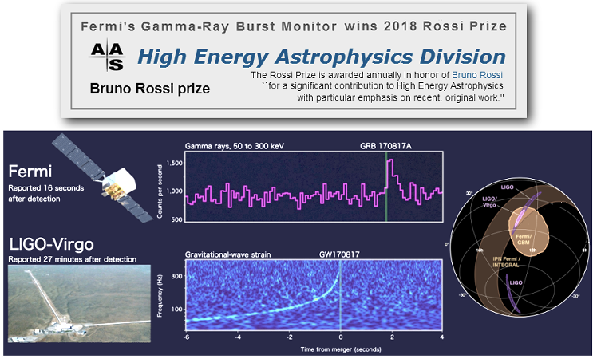
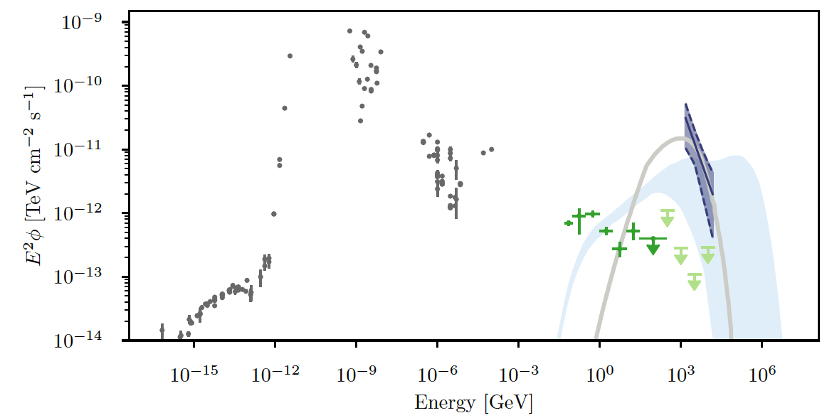
Multi-Messenger astronomy: neutrino and GW
ToO capabilities restored
Automatic Fermi-LAT process for following up of all GW alerts
• Good and timely high-energy coverage guaranteed by the LAT:
-> 75% of the GW events have >90% coverage in <1.5 hours)
• Results released in a public webpage: http://fermigrb.stanford.edu/GWTable/
Association of neutrino with gamma-ray flare from the blazar TXS 0506+056 sparked interest
Neutrino detection from the Seyfert/starburst galaxy NGC 1068: faint and non-variable gamma-ray emission
So far, no other counterparts have been unambiguously identified.
NGC 1068

Slide 16
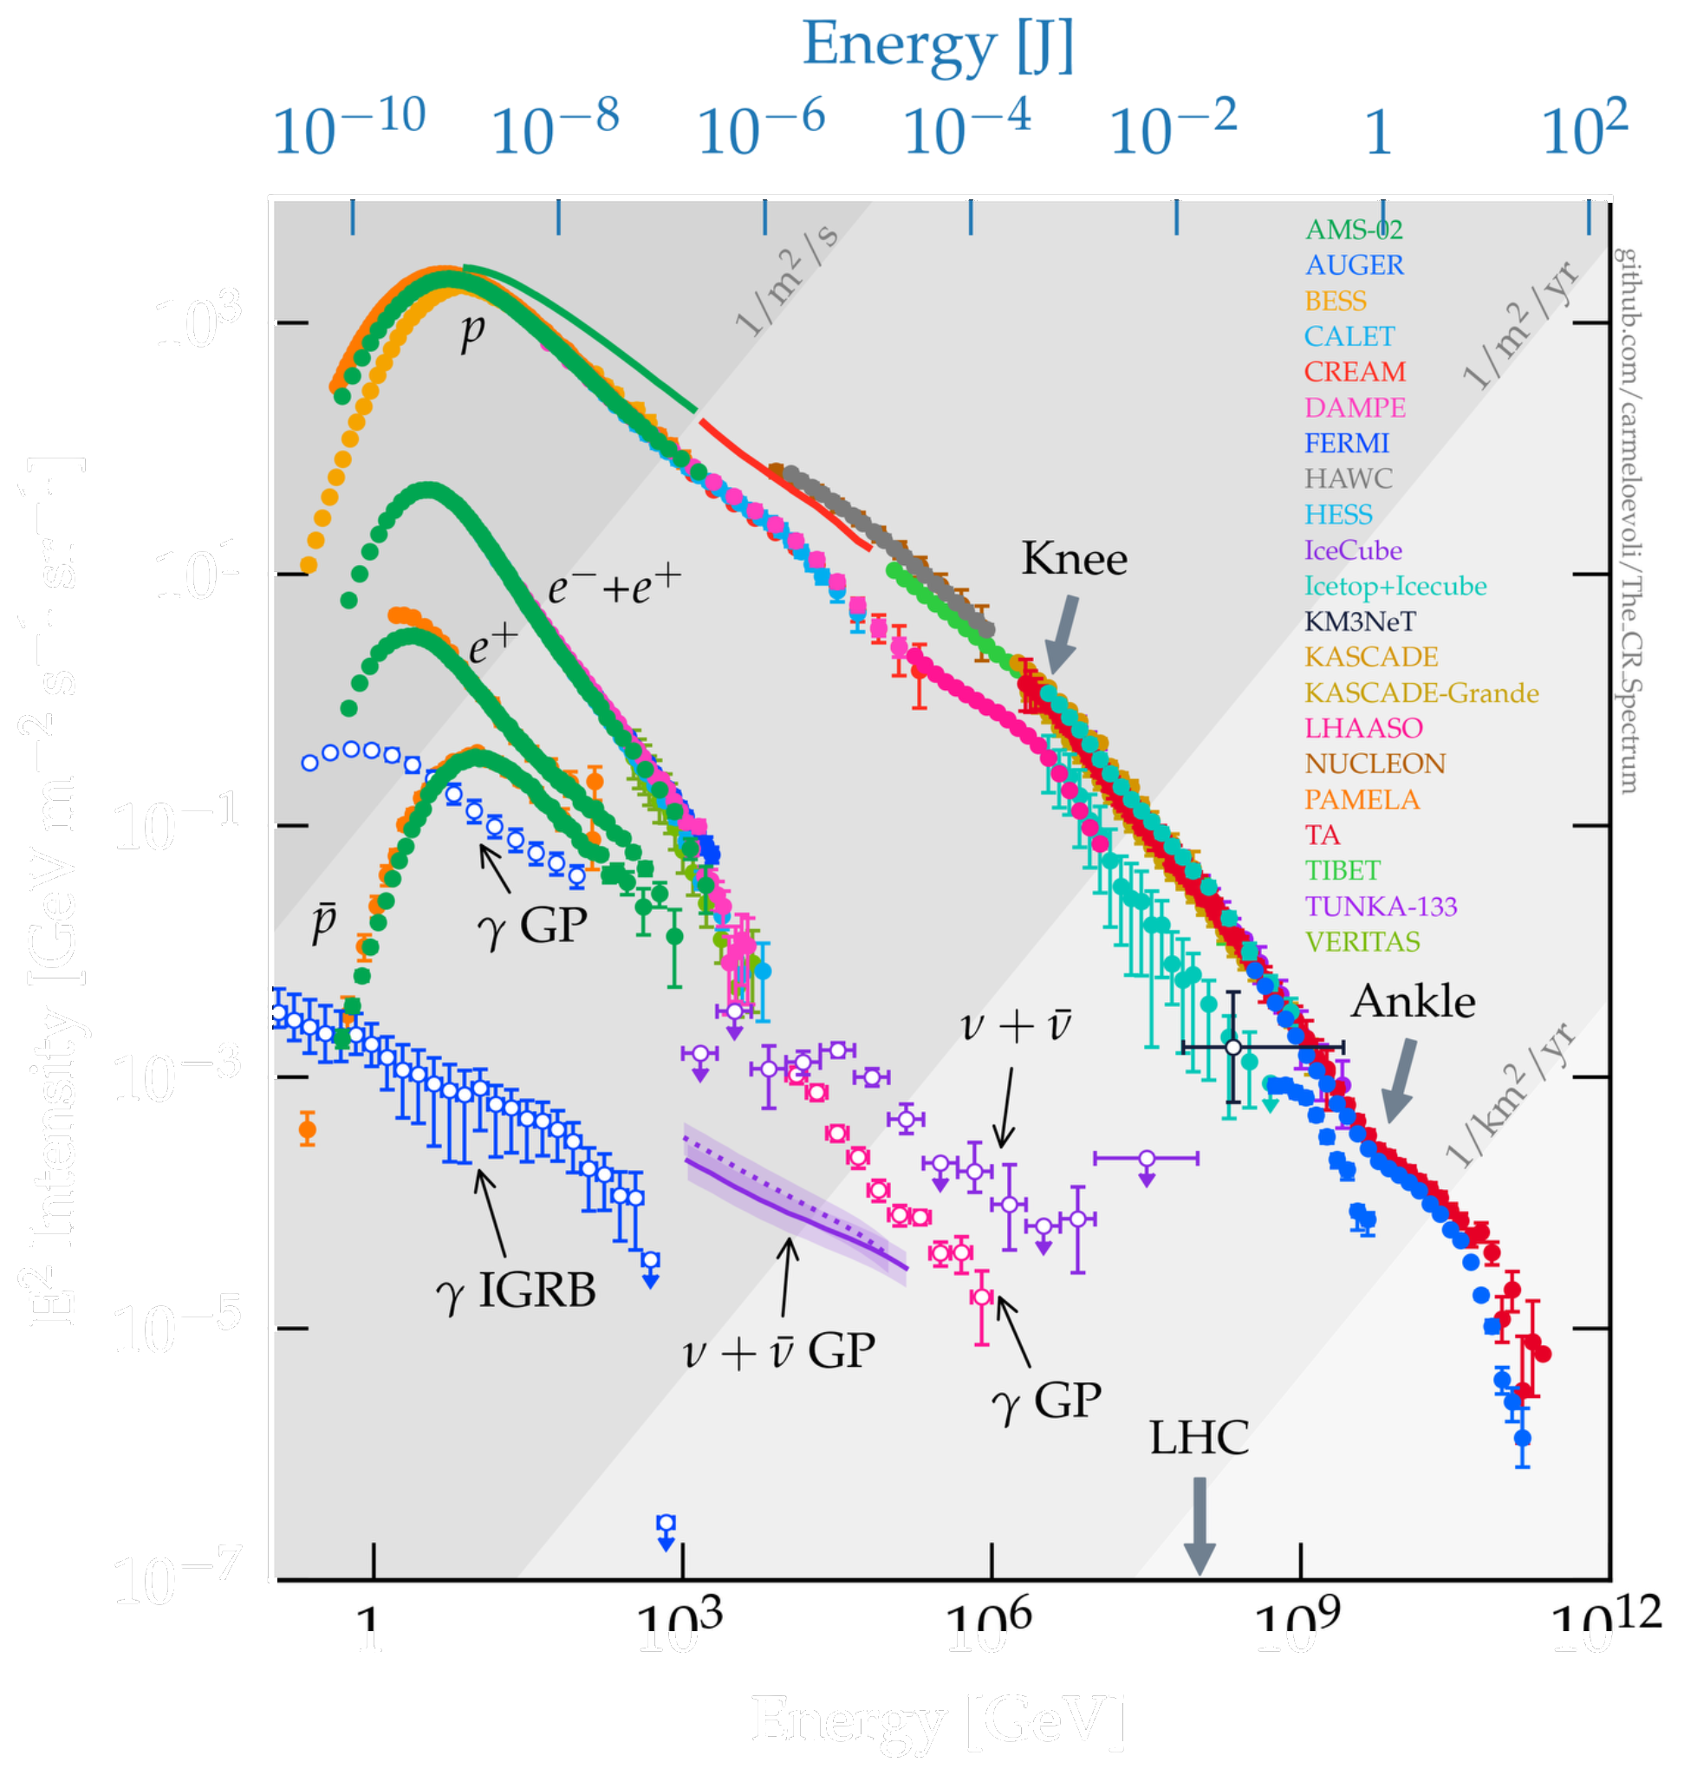
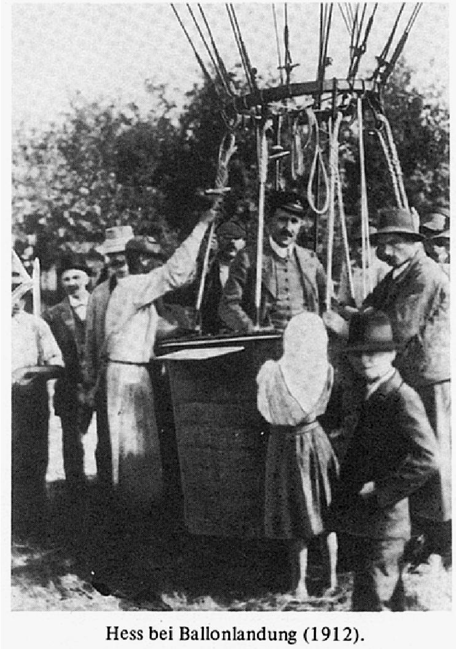
Where are the galactic PeVatrons ?

Slide 17
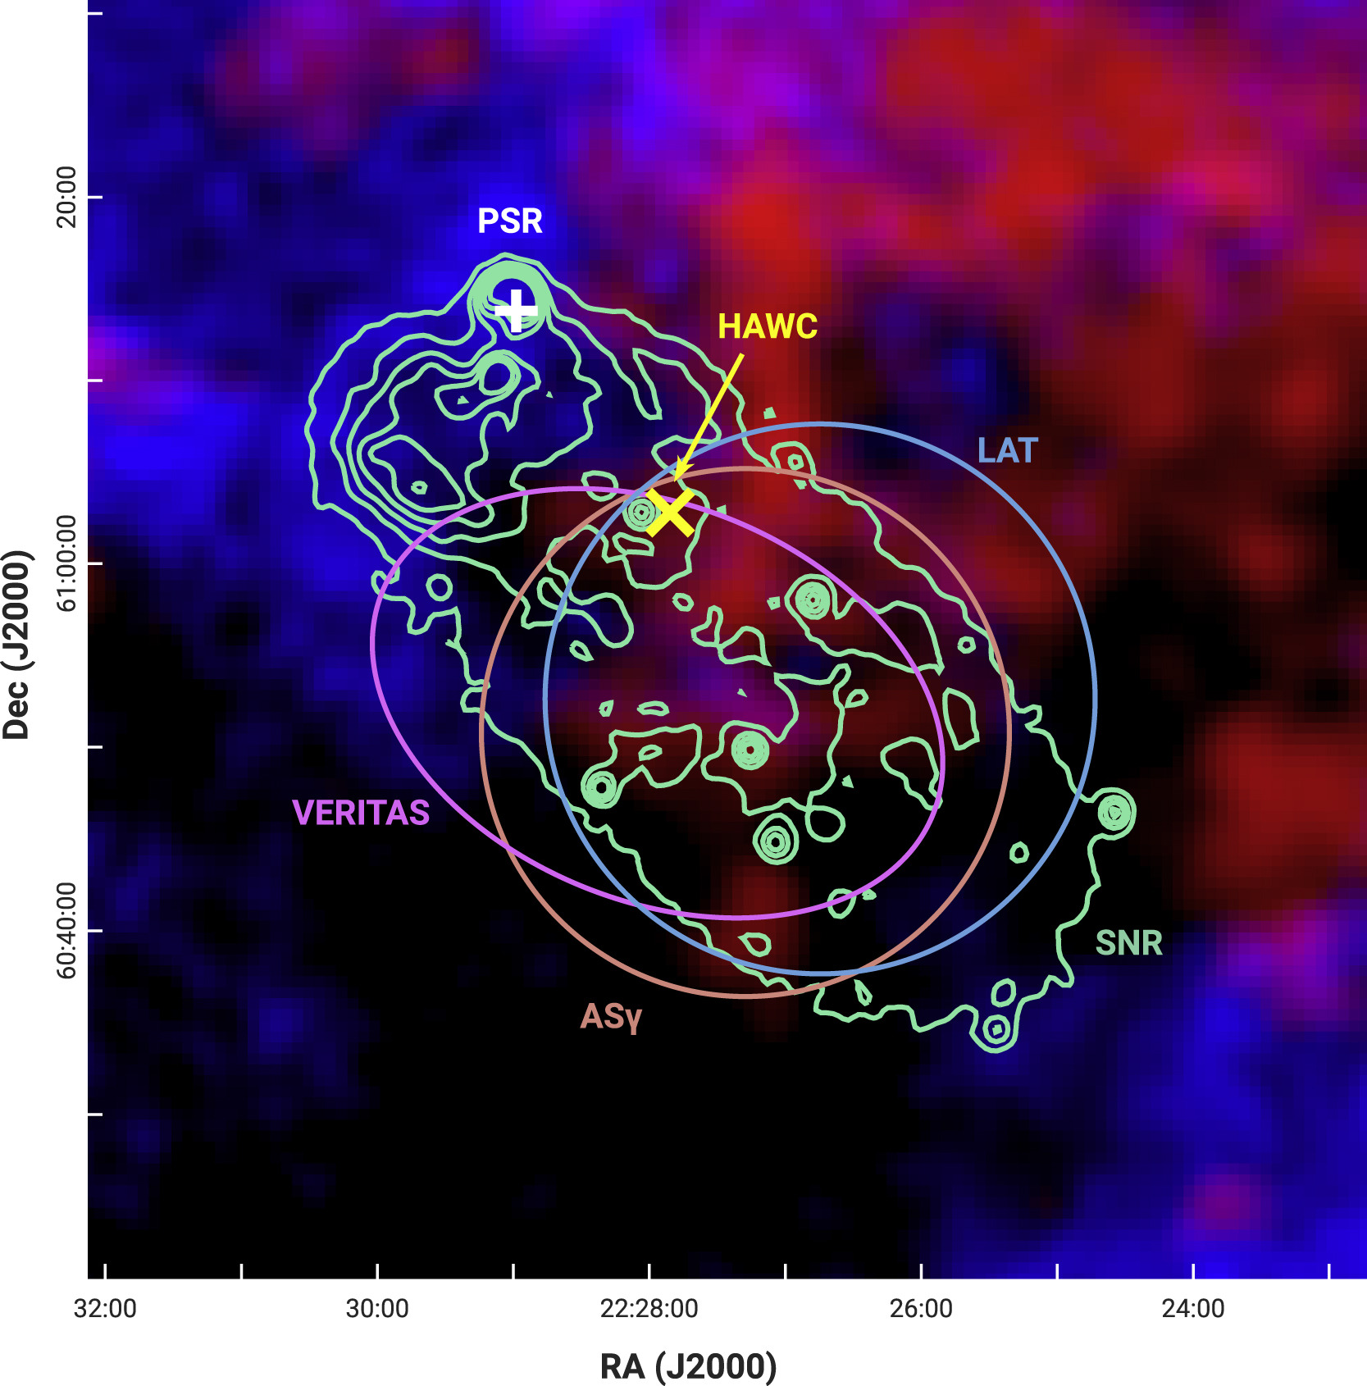
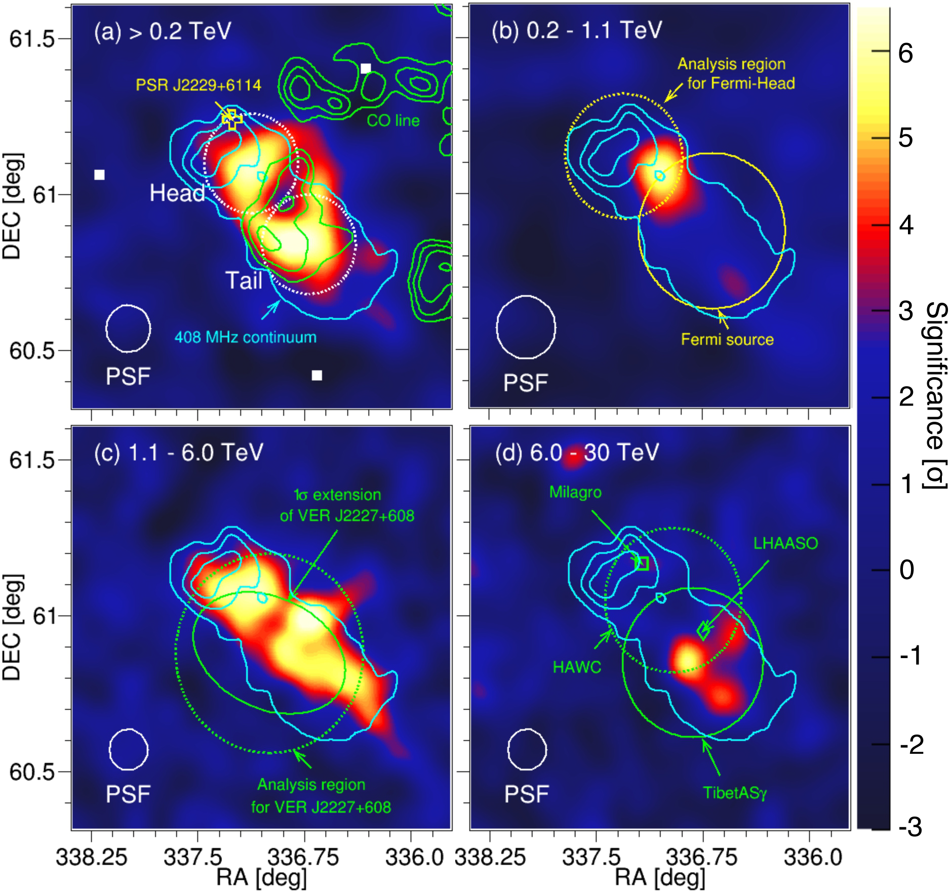
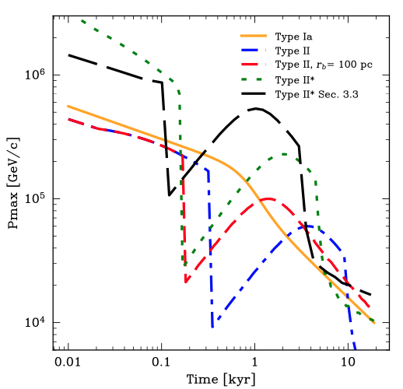
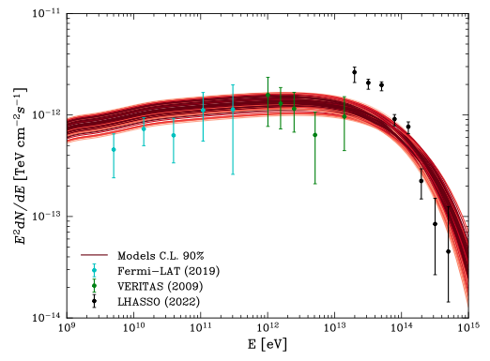
G106.3+2.7: a Galactic PeVatron candidate?
OBSERVATIONAL EVIDENCE
PHYSICAL INTERPRETATION
• Composite SNR: bright head (Boomerang PWN + pulsar), tail interacting with molecular clouds
• Fermi-LAT: pulsar + hard-spectrum tail
• MAGIC / VERITAS: head and tail; LHAASO: up to 600 TeV
• Energy-dependent morphology: >6 TeV emission displaced from pulsar
• SNR shock acceleration with dense clumps can explain TeV emission
• Broadband emission challenges standard SNR models: high explosion energy and acceleration efficiency
• Possible hybrid: SNR at GeV–TeV, PWN above 100 TeV
Kothes et al. (2001)
Cristofari et al. (2026)
Fang et al. (2022)
Cao et al. (2024)
Require high resolution : CTAO !
Ge et al. (2021)
Abe et al. (2023)
Cristofari et al. (2026)

Slide 18
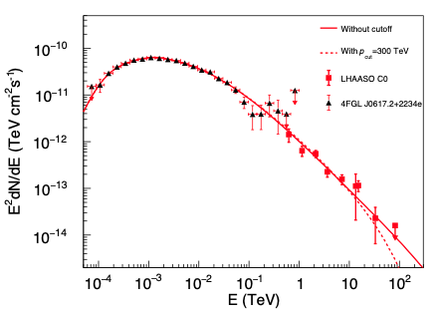
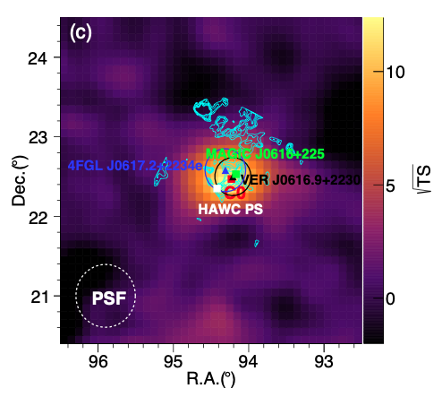
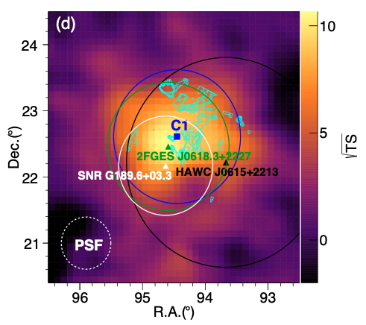
IC 443: evidence for sub-PeV acceleration
Cao et al., Phys. Rev. Lett. 136, 161002 (2026)
LHAASO resolves a compact source consistent with the Fermi-LAT source and an extended component.
• Compact-source spectrum: index ≈ 3, extending beyond 30 TeV without an apparent cutoff
• Hadronic interpretation: accelerated protons reach at least ~300 TeV (95% CL)
In agreement with HAWC limit of 65 TeV
Alfaro et al., ApJ 992 22, (2025)
The spectrum strengthen the case for an SNR sub-PeVatron but morphology is not clear: VERY complex region !
Cao et al., Phys. Rev. Lett. 136, 161002 (2026)

Slide 19
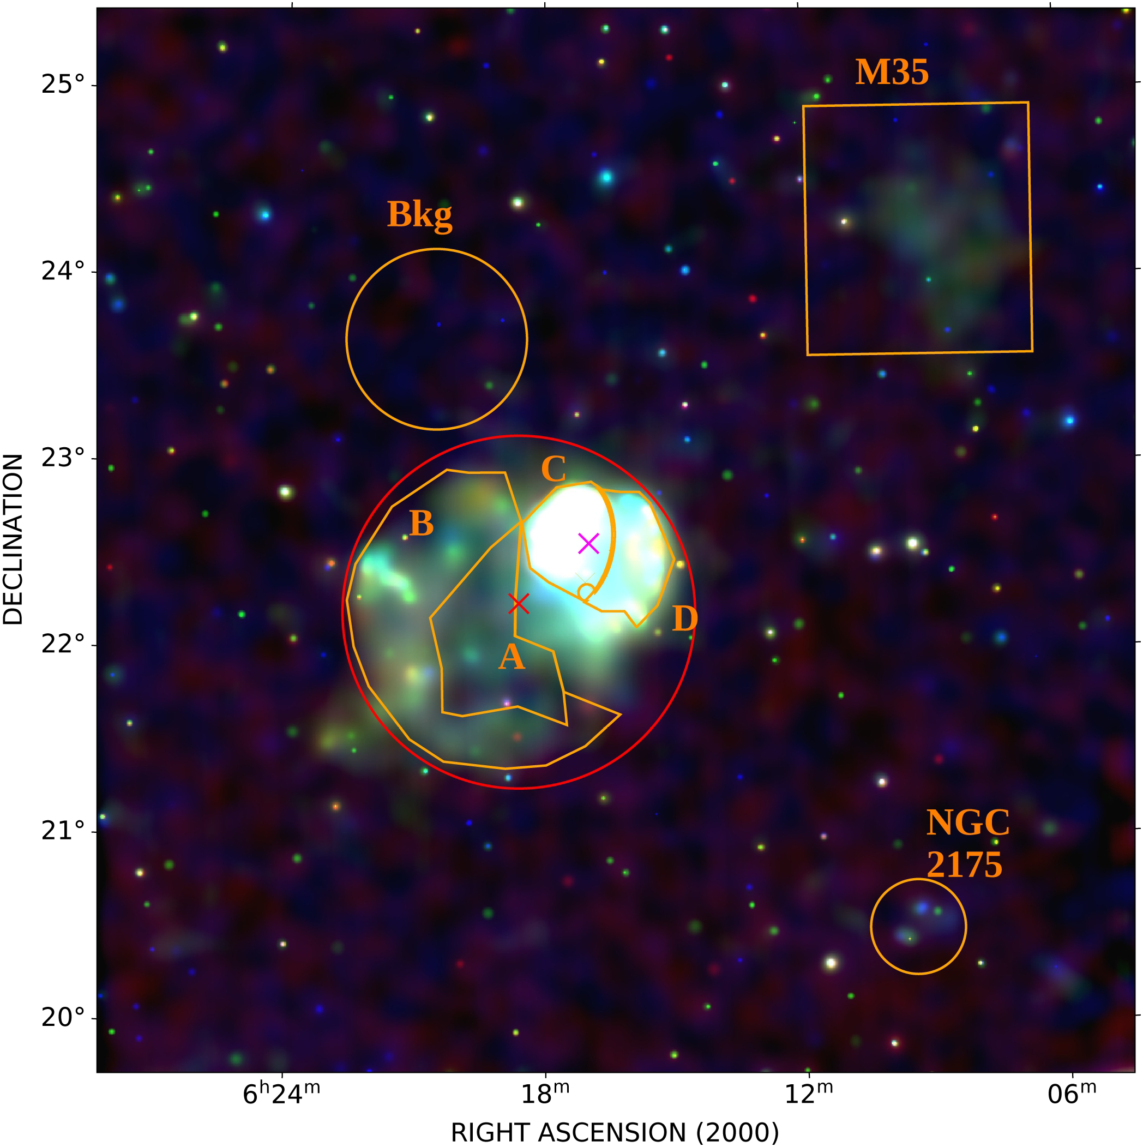
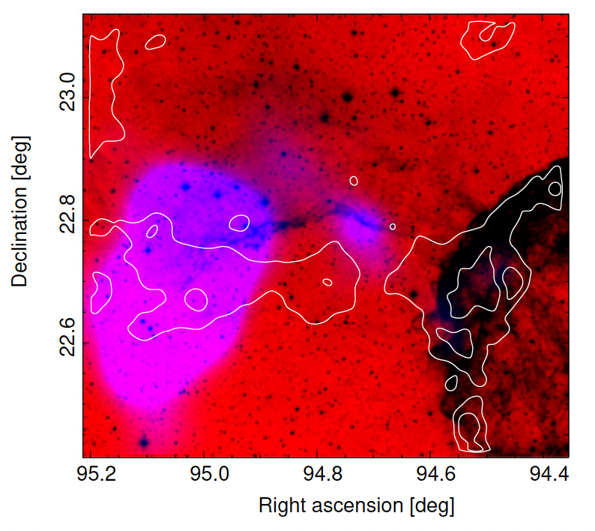
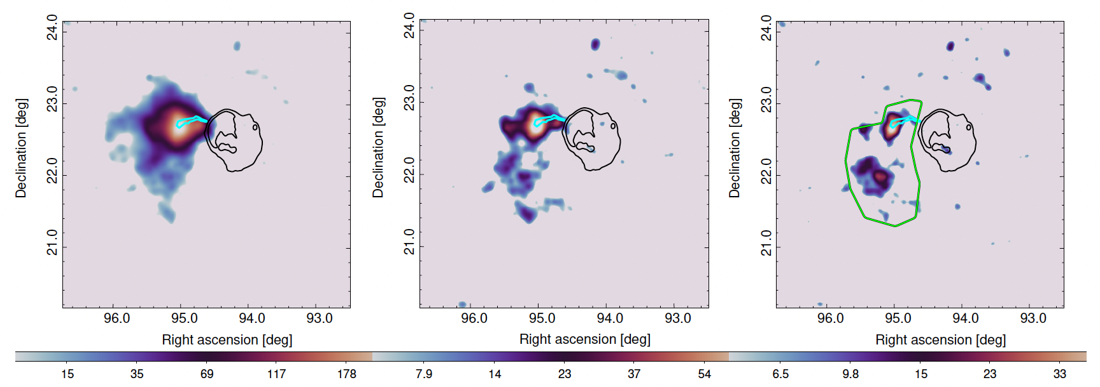
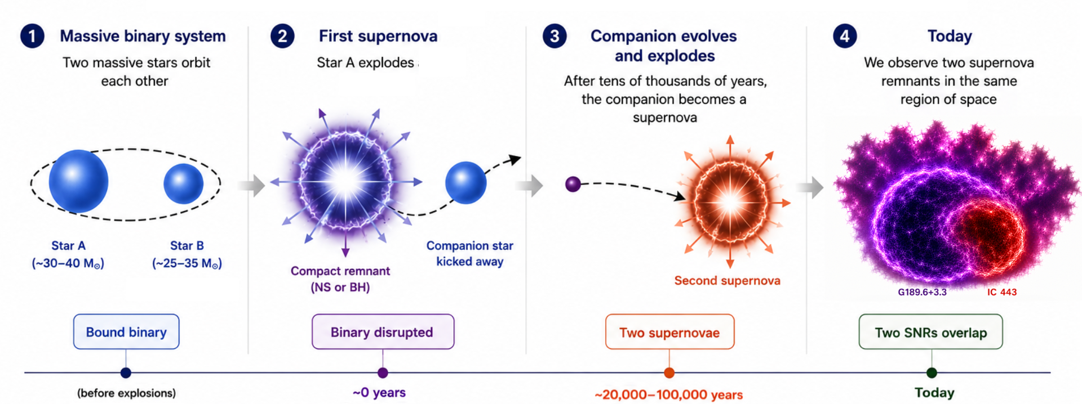
IC 443 / G189.6+3.3: a possible binary origin
Michailidis, MLG et al., Nature Com., 17, 6190 (2026)
G189.6+3.3 identified as an SNR using ROSAT data
But lack of radio counterpart => SNR candidate
Fermi detection of an extended source FGES J0619.6+2229 : CRs escaping IC 443 ?
New observations by eROSITA confirm SNR nature
New Fermi analysis using 16 years of data:
  Interaction with the S249 HII cloud in the Northern
  Same distance as IC 443
  Separation and ages of the SNRs consistent with simulation of binary systems
Asaoka & Aschenbach (1994)
Camilloni & Becker, A&A, 680, A83 (2023)
Camilloni & Becker, A&A, 680, A83 (2023)
DSS2 / Fermi-LAT / WISE overlay
Fermi-LAT TS maps: E > 1, 5, 10 GeV
Binary-origin scenario (schematic): Michailidis et al. (2026)

Slide 20
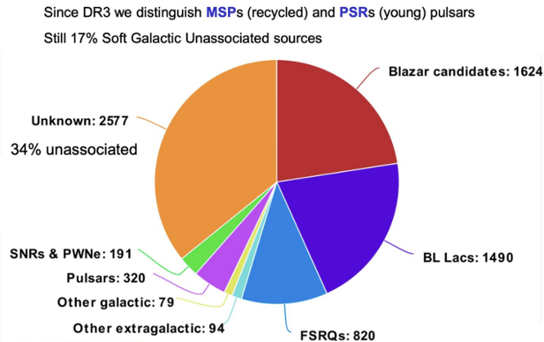
What is hiding in the unidentified γ-ray sky?

Slide 21
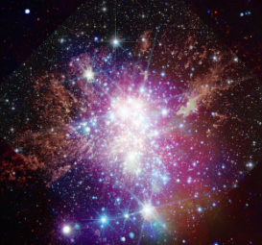
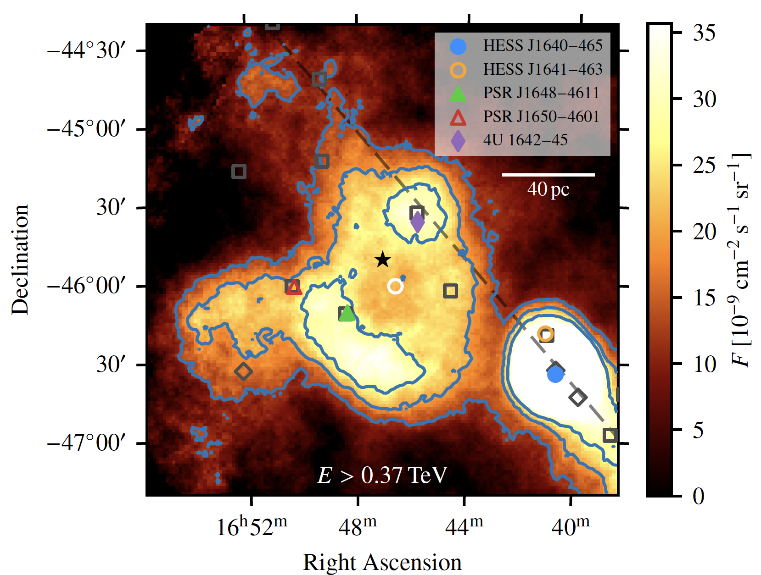
Westerlund 1 at TeV
Most massive known young stellar cluster in Milky Way
▪ Half-mass radius: ~ 1 pc
▪ Total mass: ~10⁵ solar masses
▪ Age: 3.5 – 5 Myr
▪ Distance: ~4 kpc
Harbours X-ray magnetar => at least 1 SN in cluster
HESS dataset : 164h from 2004-2017 on HESS J1646-458
=> Shell like structure detected at TeV
No energy-dependent morphology : hadronic ?
No clear correlation with CO or HI : leptonic ?
▪ Only Wd 1 can explain bulk of emission
Acceleration at cluster wind termination shock
Favoured by the TeV shell-like morphology
(Härer et al. 2023)
JWST+HST+Chandra
Aharonian et al., A&A, 666 (2022) A124

Slide 22
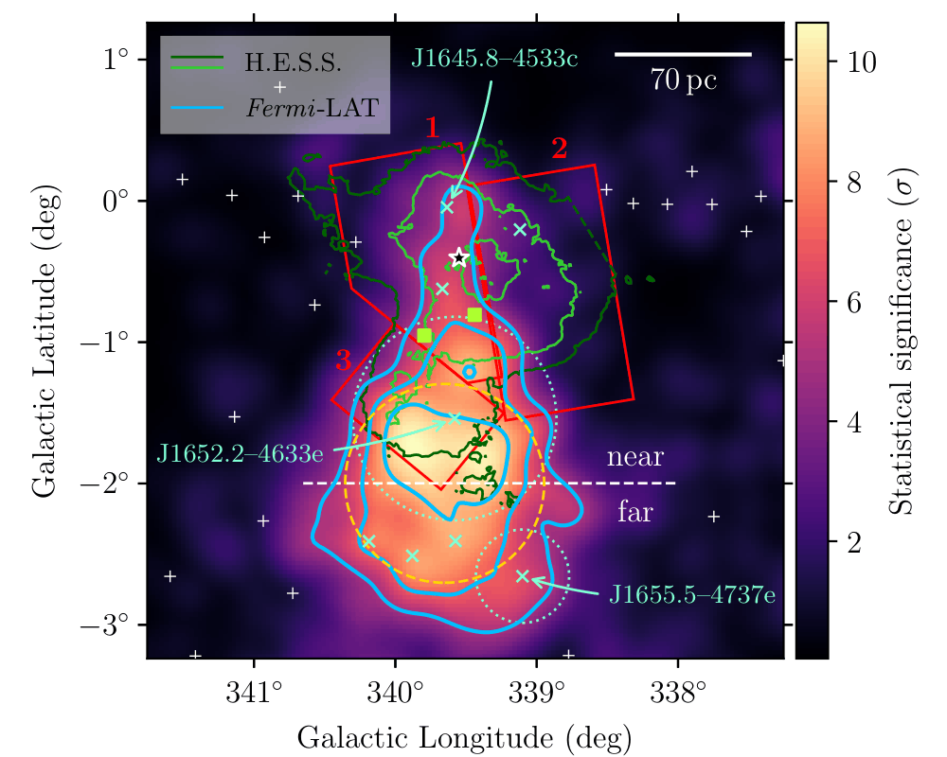
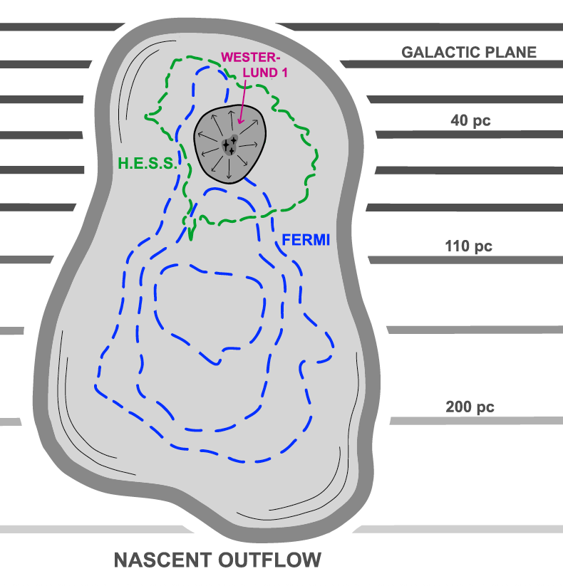
Westerlund 1 above 3 GeV
Lemoine-Goumard et al., Nature Com., 16, 10820 (2025)
Analysis above 3 GeV : 16 years of data
Replace 8 UnIds from Fermi with a Gaussian + HESS template divided
Very extended emission detected with Fermi :
Offset from TeV towards edge of Galactic disk
Spans 150pc diameter
Particles accelerated at cluster wind termination shock
High-energy electrons radiate near shock → TeV ring
Low-energy electrons entrained toward low-density region
A gamma-ray source can be offset from its accelerator !
Total energy density of electrons in outflow 1-10 eV/cm³
Common feature of young massive star clusters ?

Slide 23
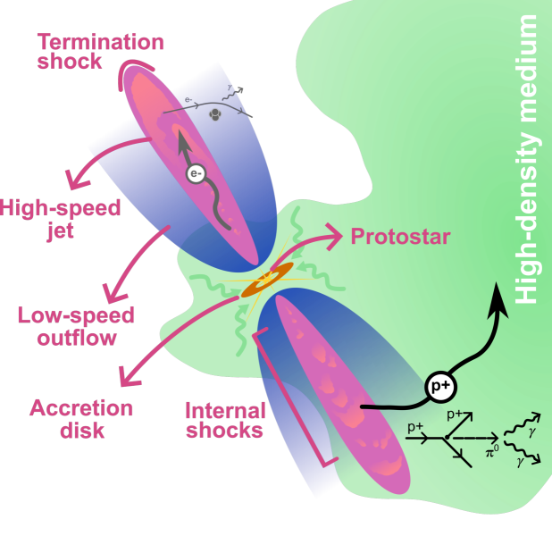
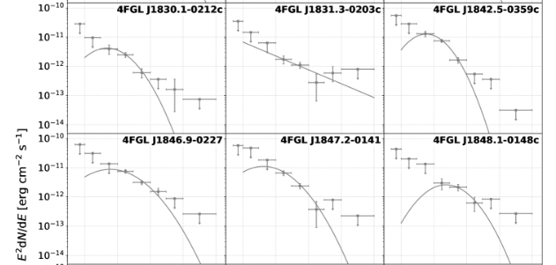
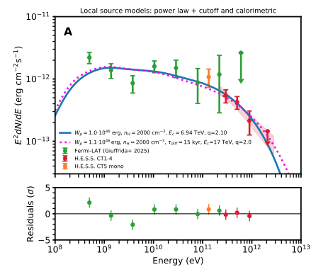
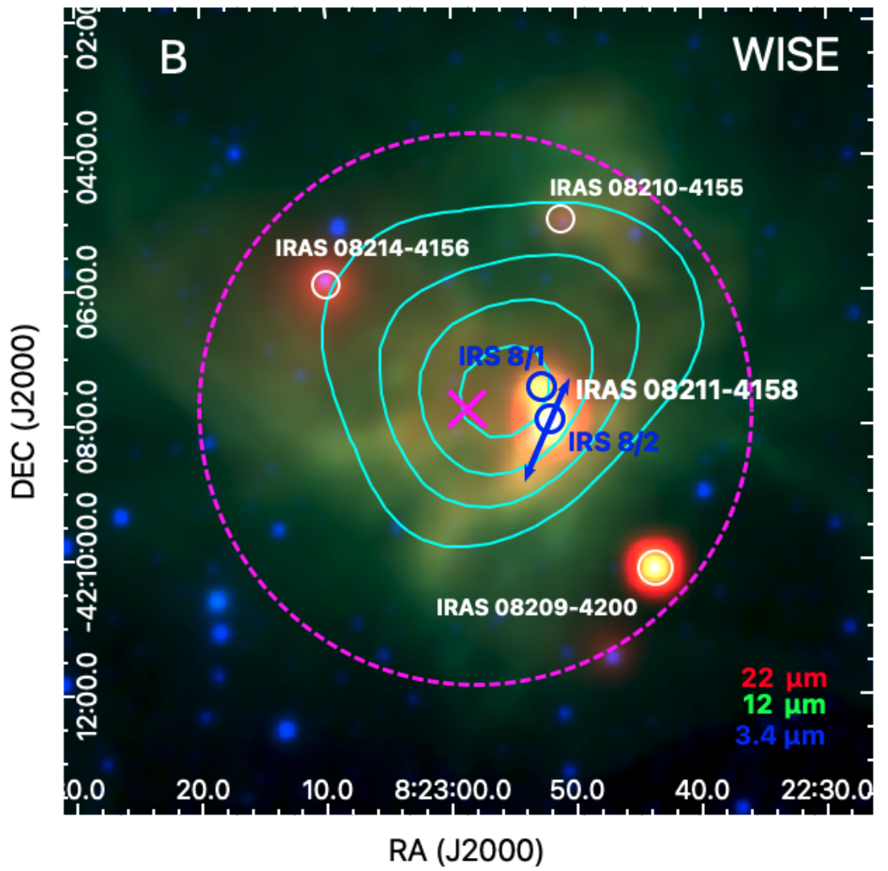
Protostellar jets as a population of hadronic gamma-ray sources ?
Mendez-Gallego et al., Nature Astronomy,arXiv:2606.19445
Protostellar jets likely accelerate protons
=> gamma rays through pion decay in interactions with surrounding gas.
33 candidate gamma-ray protostars identified through Fermi-LAT data
  And there could be a TeV population of these objects
    H.E.S.S. detection of 4FGL J0822.8-4207
H.E.S.S.
PRELIMINARY
H.E.S.S.
PRELIMINARY
Fermi

Slide 24


Thanks!

Slide 25

FERMI-LAT + CTAO LSTs
Exploring the gamma-ray universe together
ALL-SKY TO DEEP SKY
Fermi-LAT monitors the GeV sky; LSTs probe selected targets at high sensitivity
TRANSIENTS & MULTI-MESSENGERS
GRBs, AGN flares and alerts: long-term context meets rapid, sensitive follow-up.
THE NEXT DISCOVERIES
Pulsars, extreme accelerators and unexpected phenomena across the GeV–TeV sky.
18 years of discoveries. The next chapter starts here.

Slide 27

The Fermi LAT science

Slide 28


‘GeV excess’ in the Galactic center
Several groups reported an excess of GeV photons from the GC region
(e.g., Goodenough & Hooper 09, 11; Daylan+14, Abazajian+14, Calore+14; Gordon & Macías 14, Ajello+16)
General agreement on the excess peaking at a few GeV above the standard diffuse emission models.
Interpretation difficult due to complicated foreground/background modeling.
DM annihilation (still) a plausible and exciting possibility
  Spatially consistent with gNFW
  Approx. half the thermal cross section
  Around 50 GeV DM particle mass (bb)
Total flux
Residuals (x3)
[Daylan+14]
[Calore+14]

Slide 29


GC excess circa 2024
Excess persists. Different explanations possible: pulsars, CR outbursts, DM.
Pulsar interpretation is strenghtening:
  Photon counts suggest a point source origin (Bartels+15, Lee+15; Buschmann+20; Malyshev+24; but see also Leane&Slatyer 20).
  GCE seems to trace stellar densities (Bartels+18; Macias+18)
Similar excesses at other longitudes along the Galactic Plane (Ackermann+17)
→ not expected from DM; diffuse emission residuals can mimic a DM signal.
[di Mauro+21]

Slide 30


Interpretation (II): Unresolved sources?
  O(1000) Millisecond pulsars (MSPs) within ~1kpc of the GC [Abazajian+14]
  Young MSPs [O’Leary+15]
  MSPs from globular clusters’ disruption [Brandt+15]
  Non-poissonian photon statistics template analysis [Lee+15]
  Wavelet decomposition of the gamma-ray sky [Bartels+15]
[ Bartels+15 ]
[ Brandt+15 ]

Slide 31


The Fermi bubbles
Giant gamma-ray emitting lobes extending above and below the center of our galaxy
The origin of the bubbles is still unknown
Some possible explanations could be:
  Remnants of a massive burst of star formation
  Leftovers from an eruption by the supermassive black hole at our galaxy's center

