Slide 1
Low-Level Analysis
CTAO Summer School 2026
2026-06-{15,18}
Maximilian Linhoff, DPPS Lead Developer
maximilian.linhoff@cta-observatory.org

Slide 2
This presentation contains videos not exported to the PDF

Slide 3
Introduction
From Raw Data to Images
Image Parametrization
Reconstruction
Instrument Response Functions

Slide 4
Introduction

Slide 5
Scope of this Lecture
This lecture will give an overview of the data processing from DL0 to DL3
DL0:
  First level of data written to disk and long-term preserved in CTAO
  Main data: events that contain pixel-wise time series for each telescope
  Additionally: “monitoring” data, includes pointing, atmosphere, configuration, logs, ...
DL3:
  Lowest data level given out to the users of the observatory on a regular basis
  Reconstructed gamma-ray candidate events (Time, Direction, Energy)
  Mathematical description of the measurement process (Instrument Response Function)
  Data quality information
The task is to “invert” everything that happened
to the gamma rays in the atmosphere and our detectors.

Slide 6
Scope of this Lecture
Many steps already happen before DL0:
  The Camera and/or telescope DAQ server apply pre-processing and first calibration steps to the the raw camera signals.
  Some examples of this lower-level processing are also presented.
  The data is sent in a common data format (R1) for all telescopes to the central DAQ system
  (ACADA Array Data Handler)
  Pixels that likely contain no Cherenkov signal are discarded (Data Volume Reduction, DVR)
This lecture will explain concepts, designs, algorithms etc. It’s not a hands-on tutorial in any particular software
All example data you see here are CTAO simulations or LST observed data processed with ctapipe
https://gitlab.cta-observatory.org/mlinhoff/ctao-school

Slide 7
Some Terminology
Introduction
Array | All telescopes and auxiliary devices (array common elements) of one CTAO Site
Subarray | A group of telescopes observing together
Observation Block | The smallest unit of scheduling. A subarrays observes one target with one configuration, usually for 10 to 30 min.
Subarray Event | All data belonging to one subarray-level trigger, i. e. one air shower or calibration event. Consists of one or more Telescope Events.
Telescope Event | The data of a single telescope for one event, part of a subarray event.

Slide 8
Data Levels up to DL2
Introduction

Slide 9
From Raw Data to Images

Slide 10
What does the Raw Data look like?
From Raw Data to Images
PMT or SiPM signals are readout at high frequencies:
LST: 1 GSample/s = 1 measurement per nanosecond
A local trigger looks for “interesting” data
Telescope triggers are sent to the array trigger, which decides if data should be stored or not
In case of a trigger, the cameras digitize the pixel data in a window around the trigger time.
The LSTs only digitize signals when at least one other LST has triggered (Hardware Stereo Trigger)
Other telescope types readout for each local trigger but only send the data to ACADA if other telescopes also triggered (Software Array Trigger, SWAT).
Some cameras apply two different amplification gains to the analog signal to increase dynamic range (e. g. LST & NectarCam)

Slide 11
What does the Raw Data look like?
From Raw Data to Images
DL0TelescopeTrigger(
tel_id=1
trigger_id=1
trigger_type=3
trigger_time_s=1738704882
trigger_time_qns=7648132
readout_requested=False
data_available=True
hardware_stereo_trigger_mask=1)
Data structure sent by the telescopes to the Software Array Trigger.

Slide 12
What does the Raw Data look like?
From Raw Data to Images
DL0SubarrayEvent(
event_id=1
trigger_type=1
sb_id=2000000066
obs_id=2000000200
event_time_s=1738704882
event_time_qns=8420956
trigger_ids=array([2], dtype=uint64)
tel_ids=array([1], dtype=uint16))
Data Structure recorded by the Software Array Trigger for successfully triggered subarray events.

Slide 13
What does the Raw Data look like?
From Raw Data to Images
DL0TelescopeEvent(
event_id=1
tel_id=1
event_type=32
event_time_s=1738704882
event_time_qns=8420956
pixel_status=array([5, 5, ..., 5, 5], shape=(1834,), dtype=uint8)
first_cell_id=array([2260, 0, ..., 0, 0], shape=(2096,), dtype=uint16)
num_channels=1
num_samples=36
num_pixels_survived=1834
calibration_monitoring_id=0
waveform=array([ 0, 0, ..., 0, 480], shape=(66024,), dtype=uint16)
pedestal_intensity=array([], dtype=float64)
num_modules=262,
)

Slide 14
Raw Data Calibration
From Raw Data to Images
The cameras are delivering pixel data in ADC counts
Camera servers perform a first low-level calibration to amplitudes in photoelectrons
Cameras are calibrated using different kinds of calibration events
From these, the calibration coefficients needed for the different calibration steps are computed
During observations, sky pedestal and flatfield events are taken at regular intervals, “interleaved” with the physics trigger events
This allows computing new calibration coefficients relative to the initial calibration
Dark Pedestal | Randomly triggered event without HV switched on, closed shutter
Single-PE | Randomly triggered event with HV switched on, closed shutter
Sky Pedestal | Randomly triggered event with HV switched on, open shutter
Flatfield | Calibration-box laser in the dish illuminates the camera with a light pulse

Slide 15
Example for Low-Level Calibration: LST

Slide 16
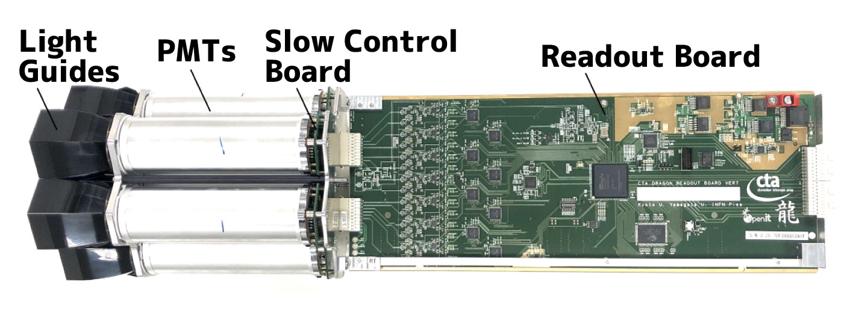
LST DRS4 Calibrations
From Raw Data to Images
The LST camera uses DRS4 chips as an analog buffer before digitizing the pixel data
This chip adds several “artifacts” to the data, which need to be corrected
Needs several tables of calibration coefficients
Computed from dark pedestal events
Are updated regularly and immediately after hardware changes
doi:10.1016/j.nima.2025.170229

Slide 17
LST DRS4 Calibrations
From Raw Data to Images
Readout Window
0
1
2
3
4
5
6
7
…
first_cell_id=7, sample=0
A DRS4 chip as 8 channels of 1024 capacitor cells
The input data is sampled with a rate of 1 GHz
LST cascades 4 channels to have a larger time buffer
1 pixel/gain combination uses 4096 cells ⇒ 4 μs of buffer time
A window of 40 samples is read out around the trigger time
Position of the window on the buffer is recorded as first_cell_id

Slide 18
LST DRS4 Calibrations
From Raw Data to Images
Five different effects need to be calibrated:
Cells affected by strong noise
  The first three and the last sample in the readout window show increased electronic noise
  No efficient way to correct ⇒ just discard these samples
Baseline Correction
  each cell as an individual value for “no signal”
  2 · 1855 · 4096 calibration coefficients
Spike Subtraction
  For certain predictable combinations of first_cell_id and sample,
  the amplitude is increased for 3 consecutive cells.
  Mean height per channel of these spikes needs to be subtracted. 2 · 1855 · 3 coefficients.

Slide 19

LST DRS4 Calibrations
From Raw Data to Images
Five different effects need to be calibrated:
DT-Correction
  The amplitude also depends on the time since last read out, described using a power law:
  $$f\left(Δt\right)=\left\{\begin{aligned}a⋅{\left(\frac{Δt}{t_{0}}\right)}^{b}−a, Δt<t_{0} \\ 0, Δt≥t_{0}\end{aligned}\right.$$
  There are two generations of DRS4 chips in the LST cameras, the same coefficients can be used for all chips of the same generation.
Time Correction
  The readout time of each cell is not perfectly uniform -> time shift
  This time shift is not corrected at the waveform level but later in the analysis

Slide 20
LST DRS4 Calibrations
From Raw Data to Images

Slide 21

Calibration to Photoelectrons
From Raw Data to Images
Computed from flatfield and pedestal events
Method for PMT cameras like LST & NectarCam:
$N_{p.e.}=\frac{{\left(\overline{Q }−\overline{P}\right)}^{2}}{σ_{Q}^{2}−σ_{P}^{2}}⋅F^{2}⇒C=\frac{\overline{N_{p.e.}}}{\overline{Q} −\overline{P}}$
Calibration factors also need be corrected for an additional noise term dependent on signal strength ($F$)
Needs flat field events with different amplitudes → Filter Wheel Scans
Then simply applied as
$S_{i}=\left(R_{i}−P_{i}\right)⋅C_{i}$
Relative time shifts between pixels are also computed from flatfield events
“Camera Calibration of the CTA-LST Prototype” doi:10.22323/1.395.0720

Slide 22
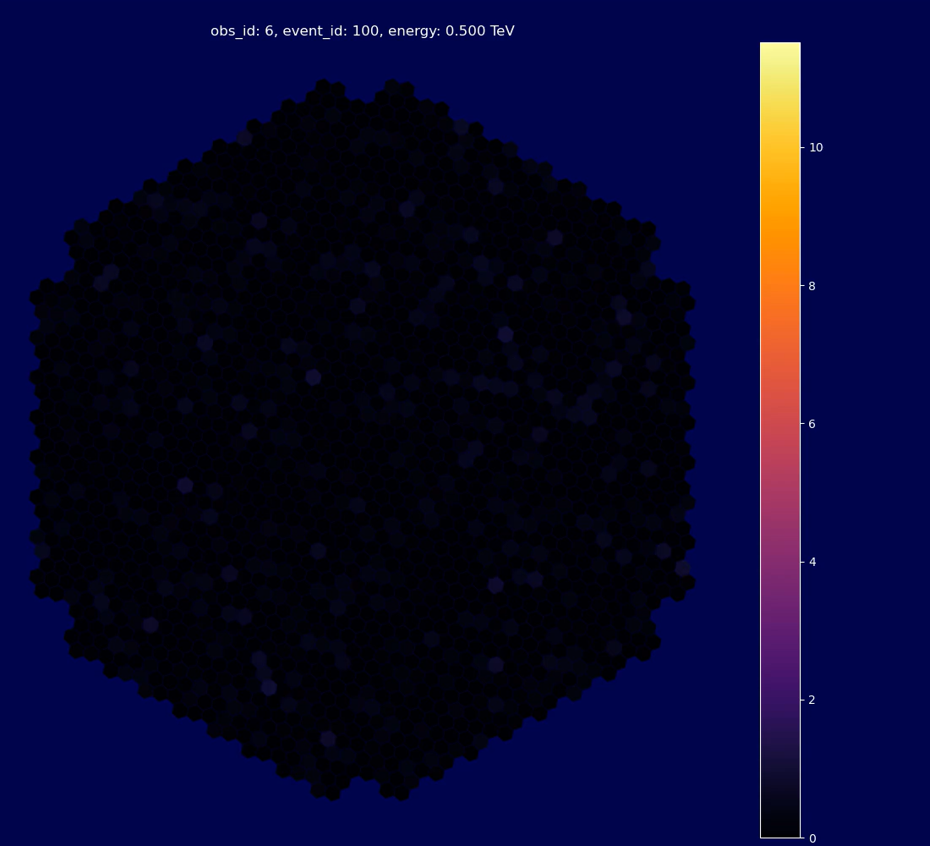

Gammas
From Raw Data to Images
Protons

Slide 23
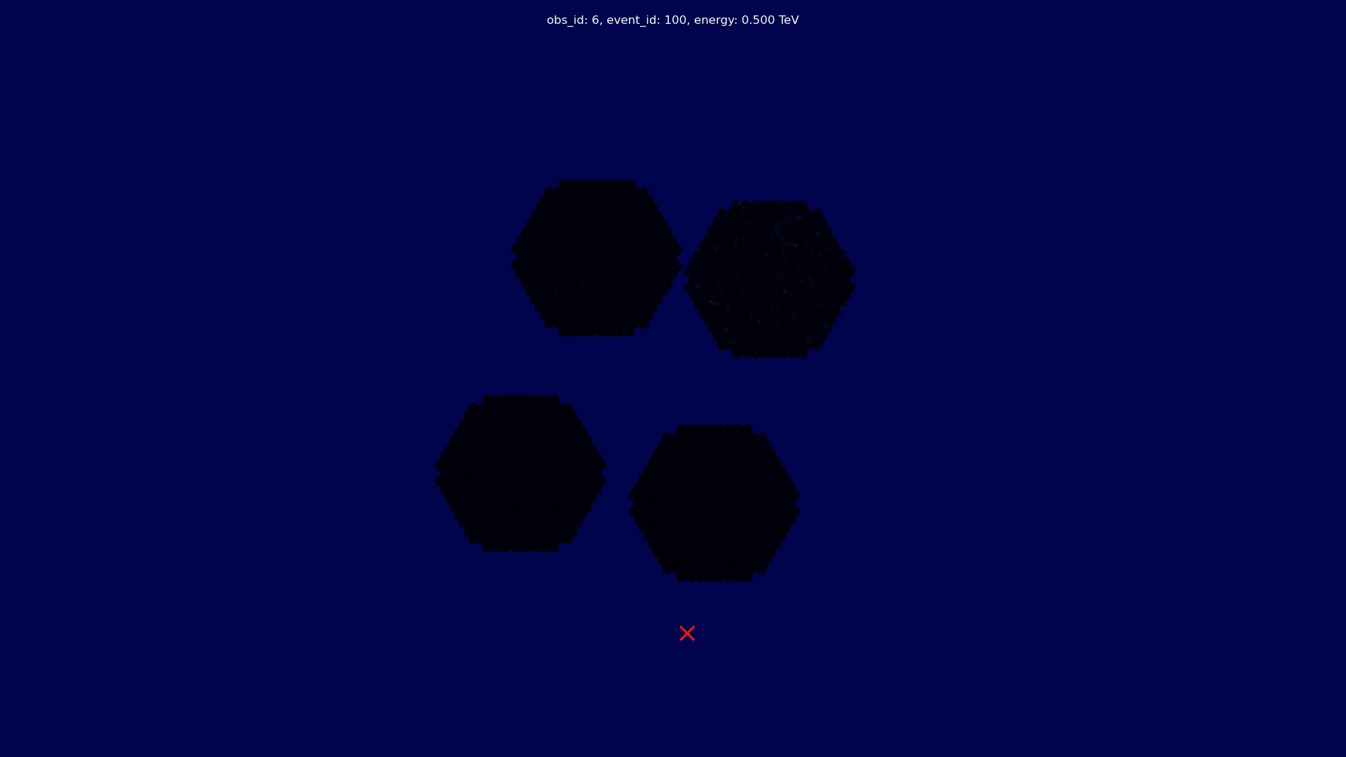
From Raw Data to Images

Slide 24

From Raw Data to Images
Image Extraction
Second large data reduction, reduce waveform to just two values for each pixel:
  Number of photoelectrons
  Average arrival time (peak time)
Several algorithms available in ctapipe
Most work by finding a peak, integrating around it and computing a weighted average for the peak time
To minimize effect of noise, peak finding can combine waveforms of neighboring pixels or the whole camera
The peak time is corrected to mitigate timing differences between the pixels,
computed from flat field events

Slide 25
Image Extraction
From Raw Data to Images

Slide 26
Image Extraction
From Raw Data to Images

Slide 27
Image Cleaning
From Raw Data to Images
Most pixels in any given event only contain noise
⇒ Identify pixels likely containing Cherenkov light
Many different algorithms
Can use intensity, peak time and noise level estimated from pedestal events
Simple Example: tailcuts clean:
  Identify pixels above first threshold
  Remove pixels with less than 2 neighbors
  Add neighboring pixels above a second, lower threshold

Slide 28
Image Parametrization

Slide 29
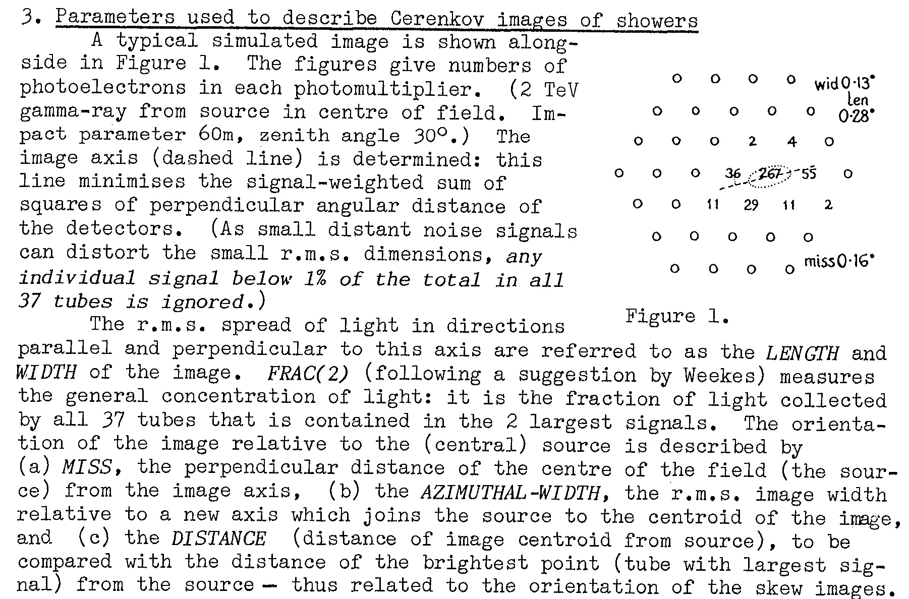
Image Parameters
Image Parametrization
Next step of the data reduction
From two values per pixel to tens of parameters per telescope event
Goal: keep as much information from images in high-level parameters
Will be used in reconstruction of energy, direction and primary particle type
Initial set of parameters proposed by Hillas in 1985
Extended over time
A. M. Hillas, “Cerenkov Light Images of EAS Produced By Primary Gamma Rays and By Nuclei”,
19th International Cosmic Ray Conference, 1985

Slide 30
Side note: camera coordinate frames
Image Parametrization
LST
MST
NectarCam

Slide 31
Hillas Parameters Today
Image Parametrization
The computation lined out by Hillas is equivalent to a well-known statistical method:
Principal Component Analysis
  Compute weighted mean vector
  ⇒ center of gravity
  Compute covariance matrix
  Diagonalize covariance matrix by solving eigenvalue problem:
    Eigenvalues give length and width;
    Eigenvectors give orientation of major axis (psi)
The total number of photoelectrons is called
size or intensity
Additionally, also compute higher level moments skewness and kurtosis along the shower axis
Uncertainties can also be computed

Slide 32
Timing Parameters
Image Parametrization
After computing the Hillas Parameters, we can perform a fit of the peak times along the shower axis
Slope is highly correlated with impact distance
Sign of the slope is very useful for monoscopic direction reconstruction
Good agreement with linear fit only for electromagnetic cascades, hadrons much more erratic

Slide 33
Morphology & Concentration
Image Parametrization
For gamma-ray showers, we expect only a single blob of light
Hadronic cascades have higher probability of sub-showers and muon rings
Compute the number of “islands”, groups of connected pixels after cleaning
Algorithm: breadth-first search of neighboring pixels
Number of pixels after cleaning, number of all, small, and large islands
Concentration features: ratios of intensity
  inside of the Hillas ellipse
  the brightest pixel
  the three pixels closest to the cog
  to the total intensity

Slide 34
Leakage
Image Parametrization
Ratios of photoelectrons or pixels after cleaning in the outer edge of the camera
To describe how well an event is contained in the telescope’s FoV
Mainly important for energy estimation
and discarding non-contained events

Slide 35
Descriptive Statistics
Image Parametrization
We also collect descriptive statistics of pixel values, intensity and peak times:
  Min
  Max
  Mean
  Std
  Skewness
  Kurtosis

Slide 36
Image Parametrization

Slide 37
Image Parametrization

Slide 38
Image Parametrization

Slide 39
Image Parametrization

Slide 40
Mean Scaled Parameters
Image Parametrization
This is a higher-level analysis step “from the old days, before machine learning”
Still helpful to gain insights into parametrization
Idea: scale image parameter by the mean of this image parameter for gamma rays (depending on image intensity, impact distance, zenith angle)
Can also be averaged over telescopes
⇒ one number per subarray event
Values around 1 are “gamma like”
Values aways from 1 are “hadron like”
Well suited for manual cut analysis or machine learning models that cannot deal with many features
Less useful in e. g. tree-based learners

Slide 41
Reconstruction

Slide 42

Reconstruction Tasks
Reconstruction
Three main tasks for each air shower event:
Primary energy
Direction on the sky
Particle type
Additionally, these quantities might be useful to reconstruct:
“Impact” point on the ground
Atmospheric depth of the shower maximum $X_{\text{max}}$
Together with the direction, these are also referred to as “shower geometry”
Hofmann, W., Jung, I., Konopelko, A., Krawczynski, H., Lampeitl, H., & Pühlhofer, G. (1999). Comparison of techniques to reconstruct VHE gamma-ray showers from multiple stereoscopic Cherenkov images. Astroparticle Physics, 12(3), 135-143.
doi:10.1016/S0927-6505(99)00084-5

Slide 43
Hillas Reconstructor
Reconstruction
Only method we’ll discuss today that does not need simulated training data
Purely geometrical
Reconstructs 3D shower axis:
  Direction in horizontal coordinates: altitude, azimuth
  Impact point on the ground: x, y
Least squares intersections of planes spanned by each telescope
Requires at least 2 telescopes

Slide 44
Energy Reconstruction
Reconstruction
There is no way to “calibrate” IACT energy reconstruction purely by measurements:
  No tens of GeV to hundreds of TeV photon test beams
  Atmosphere part of the detector
⇒ Energy reconstruction is always based on simulated “training” data
Classical approach is training a machine learning model per telescope type and averaging the predictions over the telescope events
Tree based ensemble methods have proven robust and performant
  Random Forests
  Boosted Decision Trees

Slide 45
Excursion:
Basics of Machine Learning
Reconstruction

Slide 46

What is Machine Learning?
Machine Learning
We usually employ supervised machine learning, where a model is trained on a labelled dataset and can then be applied to new data
We will use $X$ and $Y$ to denote the generic random variables
A particular sample of these random variables will be $x_{i}$ or $y_{i}$
We can stack several samples in rows and combine multiple variables as columns of a matrix $X$,
e.g. if you measure $p=2$ observables (height and weight) of $N=200$ people, you get a matrix $X$ of shape $(200, 2)$
A more formal definition of supervised machine learning:
“Given an $N×p$ Matrix $X∈ℝ^{N×p}$ and some associated output vector $Y∈ℝ^{N}$,
find a function $f\left(X\right)=\hat{Y}$, that takes a vector $x∈ℝ^{p}$ and returns a prediction $\hat{Y}$,
where some ‘loss function’ $L\left(Y, f\left(X\right)\right)$ is minimized for all $X$”
Based on: “The Elements of Statistical Learning”, Hastie, Tibshirani and Friedman (2009). Free PDF online.

Slide 47

Regression vs. Classification
Machine Learning
We distinguish two main cases:
  Predicting a discrete output $Y∈\{g_{1}, g_{2}…,g_{k}\}$, called classification with the special case of $k=2$ called binary classification
  Predicting a continuous output $Y∈ℝ$, called regression
For our tasks, in general,
  Energy reconstruction is 1-dimensional regression
  Particle type is a classification, most often just a binary classification for signal vs. background
  Geometry reconstruction is at minimum a two-dimensional regression,
  more variables might be desirable ( $X_{\text{max}}$, Impact point).
Many different algorithms are available for both types of machine learning; some algorithm can do either

Slide 48

Decision Trees
Machine Learning
Algorithm:
  Split the data space recursively by splitting in one feature at a time:
  $R_{1}\left(j,s\right)=\left\{X | X_{j}≤s\right\}$
  $R_{2}\left(j,s\right)= \left\{X | X_{j}>s\right\}$
  One split is called a node
  Repeat until no more splits can be made, either because the leaf is pure or a maximum depth has been reached
  For classification: predict the most common value in a leaf, for regression: predict the mean
Training:
  Finding the globally optimal splits is computationally infeasible (N-P-hard)
  Instead, we recursively split, making the best split possible according to loss function for the current node (greedy approach) and never question again splits we already made
  In each node, we need to find the best split among all possible splits in all possible attributes
  Typical loss functions are based on entropy (classification)
  or mean squared error (regression)

Slide 49
Decision Trees
Machine Learning

Slide 50

Random Forests & Boosted Trees
Machine Learning
A single tree is not very robust, due to the greedy algorithm, small fluctuations in the training sample result in large changes in the model
Prone to overfitting if not constrained by setting a maximum depth, the model learns the statistical fluctuations of the training data instead of the underlying distributions
Two approaches use ensembles of decision trees to improve over the single model
Random Forests train $N$ Decision Trees, randomizing the training in two ways to create slightly different models:
  Each tree is trained on a dataset created by sampling with replacement from the original training data (bootstrapping)
  In each node, only a random subset of all attributes is searched for the best split
The prediction is then the average of all individual trees
Boosting uses small trees (low maximum depth) that iteratively improve over the previous generation
Both Random Forests and Boosted Decision Trees have proven suitable, robust methods for IACT event reconstruction

Slide 51
Energy Reconstruction
Reconstruction
There is no way to “calibrate” IACT energy reconstruction purely by measurements:
  No tens of GeV to hundreds of TeV photon test beams
  Atmosphere part of the detector
⇒ Energy reconstruction is always based on simulated “training” data
Classical approach is training a machine learning model per telescope type and averaging the predictions over the telescope events
Tree based ensemble methods have proven robust and performant
  Random Forests
  Boosted Decision Trees

Slide 52
Energy Reconstruction
Reconstruction

Slide 53
Particle Type Classification
Reconstruction
As a gamma-ray observatory, for almost all science cases we can simplify to binary classification:
Signal, gamma rays ⇔ background, everything else
Training needs labelled datasets for signal and background
Signal is almost always taken from simulated gamma-ray events
Background can either be simulations as well or taken from observations of “dark spots”
Hadronic air showers:
  are much more expensive to simulate
  interaction models have known issues in describing air showers (muon puzzle)
Using real observations for background training comes with its own caveats:
  Model might learn to differentiate simulations from observations
  Needs available observations matching conditions of observations to be analyzed
MAGIC usually uses observed background, LST-1 uses simulated protons

Slide 54
Particle Type Classification
Reconstruction

Slide 55
Side note on comparing energies
Reconstruction
The energy regressor is only trained on gamma rays → predicts “gamma-like” energy
Hadronic showers create less Cherenkov light at the same true total energy
Never compare events at the same true energy
Use observables like Hillas intensity or an estimated gamma-ray energy

Slide 56
Reconstruction
Monoscopic Reconstruction: The Disp-Method
Assume the source lies on the shower axis estimated by the Hillas parametrization
Simplifies general 2D regression to
  |disp|: 1D regression
  sgn(disp): Binary classification
⇒ train one machine learning model for each task using the image features as input
Lessard, R. W., Buckley, J. H., Connaughton, V., & Le Bohec, S. (2001). A new analysis method for reconstructing the arrival direction of TeV gamma rays using a single imaging atmospheric Cherenkov telescope. Astroparticle Physics, 15(1), 1-18.
doi:10.1016/S0927-6505(00)00133-X

Slide 57
Reconstruction
The Disp-Method: Head-Tail Disambiguation
Showers are not perfectly symmetric along the main shower axis
Allows models to learn and predict sign(disp)
Usually, Random Forest Classifiers or Boosted Decision Trees

Slide 58
Stereo-Disp
Reconstruction
We can also combine the individual disp predictions to form a stereo prediction
Has shown slightly better performance than the 3D reconstruction in EventDisplay, especially at low multiplicities and high energies
Usually does not use sgn(disp) prediction
⇒ Search for best-fit among all solutions.

Slide 59
Advanced Reconstruction Methods

Slide 60
Can we take shortcuts here?
Reconstruction

Slide 61
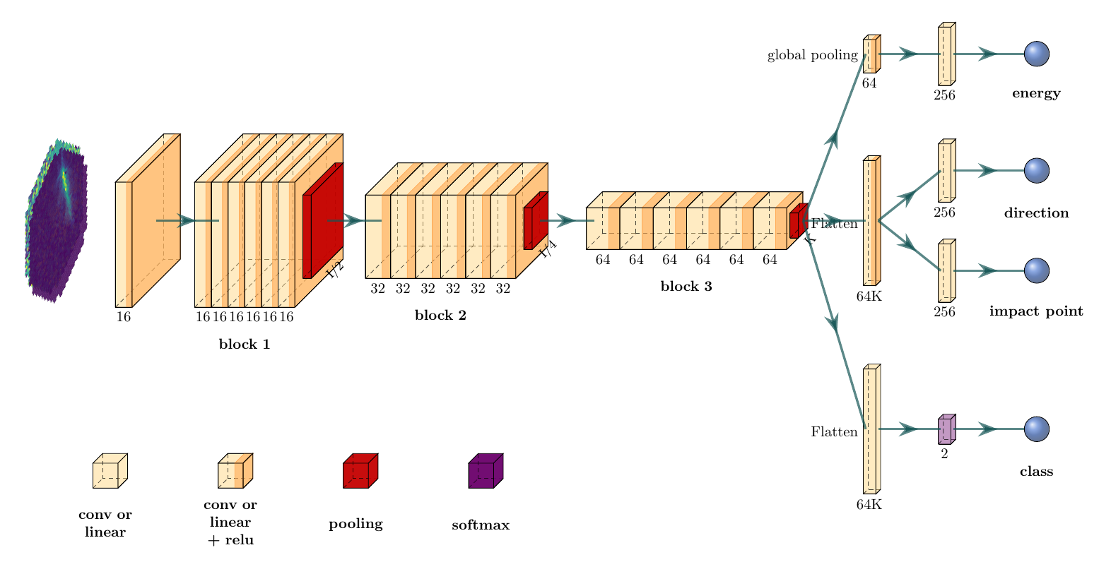


Modern Machine Learning Approaches
Reconstruction
Several groups are working on using Deep Learning using Convolutional Neural Networks
for IACT event reconstruction:
  https://gammalearn.pages.in2p3.fr/pages/ (based on pytorch)
  https://github.com/ctlearn-project/ctlearn (based on tensorflow)
Predicting reconstructed properties directly from DL1 images or even DL0 waveforms
Shown to outperform Image Parameters + Random Forests under controlled conditions (simulations, good quality data)
Seem to struggle more with data/monte carlo mismatches, changing conditions, in general less robust

Slide 62

Likelihood-based Methods: ImPACT + FreePACT
Reconstruction
Based on simulations, it is possible to have a “template” function that predicts the image of a telescope given the true parameters of the air shower (energy, direction, impact, $X_{\text{max}}$) and the telescope properties (pointing, position on the ground).
These templates can be used to perform a likelihood fit on the actual event data
Initial method: ImPACT with look-up tables of the mean image built from specialized simulations interpolated at runtime
FreePACT: a neural network trained to predict the likelihood of pixel values from the true gamma ray properties and the position and direction of the pixel replaces the template library
  Better description of the likelihood (not just mean)
  Can be trained on standard simulations
Schwefer, G., Parsons, R., & Hinton, J. (2024). A hybrid approach to event reconstruction for atmospheric Cherenkov Telescopes combining machine learning and likelihood fitting. Astroparticle Physics, 163, 103008.
doi:10.1016/j.astropartphys.2024.103008

Slide 63
Optimizing Event Selection

Slide 64
From DL2 to DL3 Event Lists
After having performed the event reconstruction, we are left with a list of air shower events with predicted properties, maybe even from multiple algorithms
In the classical analysis scheme, as last step of the event analysis, we need to:
  Decide which set of reconstructed parameters to use for each event
  Apply the gamma/hadron separation to only retain gamma ray candidate events
  Optionally apply additional event selection cuts, e. g. to discard badly reconstructed events
How to optimize these decisions will vary greatly by your science case
In current collaborations, people mostly start analysis at DL2 level and optimize for their analysis
CTAO for most science cases, will hand out DL3 data, where this optimization has already happened.
This is somewhat less flexible and restricts which science cases are possible / optimized for using given analysis configuration

Slide 65
Optimizing event selection
There are many metrics that can be used to optimize event selection, most commonly:
  Point source detection sensitivity for a given observation time (0.5 h, 5 h, 50 h)
  Angular resolution
  Gamma ray efficiency
  Systematic uncertainties
But: no clear high-level metrics for many science cases (extended sources, dark matter line searches, …)
Optimizing event selection for point source sensitivity will not yield the best results for almost any other science case, it’s a very specific metric
This is something you should keep in mind when using the current, public CTAO IRFs.
If your target of interest is not a strong point source, the current public CTAO IRFs
are only a rough approximation of what CTAO could achieve

Slide 66
Instrument Response Functions

Slide 67
IRF Formalism
Instrument Response Functions
What we discussed up to now is a very indirect form of measurement suffering from three main effects:
Limited Acceptance
  Not all gamma rays that reach the atmosphere create enough Cherenkov photons to trigger at least two telescopes
  Not all images survive the image cleaning and can be parametrized
  At least two telescopes are needed for stereo reconstruction in most cases
  Gamma/Hadron separation is not perfect, leading to rejecting gamma rays as false negatives
Limited Resolution
  All reconstruction methods have finite, non-negligible errors that can only be described on a statistical basis

Slide 68
IRF Formalism
Instrument Response Functions
What we discussed up to now is a very indirect form of measurement suffering from three main effects:
Residual Background
  The Gamma/Hadron separation cannot remove all background events, especially at low energies
  Cosmic ray electrons are basically indistinguishable from gamma rays on an event-by-event basis and are a dominant background in the central energy range for CTAO

Slide 69

IRF Formalism
Instrument Response Functions
We model the whole measurement process stochastically:
Instrument Response Function
Residual Background
$$g\left(\hat{E},\hat{α},\hat{δ},\hat{t}\right)=\int{R\left(\hat{E},\hat{α},\hat{δ},\hat{t} | E,α,δ,t\right)⋅f\left(E,α,δ,t\right) dE dΩ}+b\left(\hat{E},\hat{α},\hat{δ},\hat{t}\right)$$
Observed Signal Distribution
True gamma-ray signal
The goal of any gamma-ray high-level analysis is to solve the Inverse Problem of
deducing $f$ from known $g, R,b$
Computing $R$ requires datasets with known ground-truth (labelled datasets)
In high energy astroparticle physics, simulations are the only way to obtain such datasets
The measurement equation is an inhomogeneous Fredholm integral equation of the second kind,
by definition an ill-posed problem. More on this in the statistics lecture!

Slide 70

IRF Factorization
Instrument Response Functions
Thanks to very precise clocks and the time scales involved in the science cases of interest,
it is almost always possible to treat
$t=\hat{t}$
This still leaves us with a six-dimensional IRF that changes on minute time-scales
⇒ computationally infeasible
Solution: Make strong assumptions on the statistical independence of the variables
⇒ factorization into independent, lower-dimensional IRF Components
This assumption is wrong, energy and direction reconstruction are strongly correlated
⇒ Systematic errors
Instrument Response Function
Energy Dispersion
$R\left(\hat{E},\hat{α},\hat{δ} | E,α,δ,t\right)=A_{\text{eff}}\left(E,α,δ,t\right)⋅M\left(\hat{E} | E,α,δ,t\right)⋅\text{PSF}\left(\hat{α},\hat{δ} | E,α,δ,t\right)$
Effective Area
Point Spread Function

Slide 71

Discretization
Instrument Response Functions
Until now, we have shown the IRF formalism using continuous variables and probability densities
However, almost all existing approaches to solving the inverse problem work by discretization
This let’s us describe the measurement process using linear algebra:
$g=R⋅f+b$
$g=A_{\text{eff}}⋅M⋅\text{PSF}⋅f+b$
But requires defining bins and ranges for each variable
Optimal binning depends on the dataset, need strike balance between
  too fine ⇒ large uncertainties in each bin
  too coarse ⇒ low resolution, cannot detect small features in spectrum or morphology
When starting the analysis at DL2, IRFs can directly be computed in the chosen binning for the analysis, common approach in older analyses
For DL3-based analyses, IRFs are usually computed in very fine bins but need to be re-evaluated for the chosen analysis binning in the science analysis tools (Gammapy).

Slide 72
Computation of the IRF
Instrument Response Functions
In general, IRF components are computed from simulated events that have gone through the full low-level analysis chain
Specific parametrizations of these components and how to store them in FITS files are defined in the Data Formats for Gamma-Ray Astronomy (GADF)
Most components use tabulated values in parameter grids (energy, position in the field of view) of the discretized IRF components
Most IRF components in GADF are limited to being radially symmetric in the field of view ⇒ another wrong assumption that we likely need to lift for CTAO
IRFs for specific observation conditions can be interpolated from a grid of IRFs computed from simulations
The background rate is usually inferred from observations, not simulations
  Simulating hadronic primaries is much more computationally expensive
  Too dependent on instrument effects and observation conditions
  Larger uncertainties in hadronic interaction models

Slide 73
Effective Area
Instrument Response Functions
Effective area combines the detection efficiency with the sensitive area of the detector
Converts event rates to flux per time and area
Corrects for the non-detection of events
Can be interpreted as the area of a perfect, direct detector
GADF supports effective area as tabulated values in bins of true energy and FoV offset ⇒ radial symmetry

Slide 74
Effective Area
Instrument Response Functions

Slide 75

Energy Dispersion
Instrument Response Functions
Energy dispersion is the probability density of observing an event of true energy $E$ at a reconstructed energy $\hat{E}$
To reduce sparseness of the resulting matrix, GADF defines the energy dispersion in relative terms using:
$μ=\frac{\hat{E}}{E}$
Again, the energy dispersion is stored as tabulated values of this PDF in bins of true energy and the field of view offset ⇒ radial symmetry

Slide 76

Point Spread Function
Instrument Response Functions
The PSF is the probability density of observing an event with true coordinates $α, δ$ at reconstructed coordinates $\hat{α},\hat{δ}$
GADF allows several descriptions
  Tabulated values
  Gaussian mixture model with three distributions
  King distribution
All three are expressed in the distance from the point source $r$
⇒ radial symmetry around the point source
Only supported in bins of true energy and FoV offset
⇒ radial symmetry in the FoV

Slide 77
Point-Like IRFs
Instrument Response Functions
For the use case of spectral analysis of a point source, the IRF can be simplified further
We select events only in a circular region around the assumed source position
The radius of this region can be energy dependent and should scale with the PSF
The PSF is not needed anymore, the effective area is reduced by discarding the non-selected events
This also reduces the systematic error due to the factorization, as we compute the energy dispersion only on the well-reconstructed events inside the source region
The computed IRF is fixed to the radius of the signal region (“θ²-cut”)
Only computation of spectra possible, no sky maps or spectral cubes
Instrument Response Function
Energy Dispersion
$$R\left(\hat{E} | E,α,δ,t\right)=A_{\text{eff}}\left(E,α,δ,t\right)⋅M\left(\hat{E} | E,α,δ,t\right)$$
Effective Area

Slide 78
Background Rate
Instrument Response Functions
The background rate can in principle be computed from electron and hadronic simulations, but:
  Very hard to obtain realistic simulations
  Much more uncertainty in hadronic interaction models
  Extremely cost intensive
Instead, the background model will be computed from observations
  Excluding known gamma ray sources
  Combining many observations
Also not without challenges
  Needs enough suitable observations
  Especially hard for early science
  Probably still needs to be re-fitted to the current observation conditions
Berge, David, S. Funk, and J. Hinton. "Background modelling in very-high-energy γ-ray astronomy." Astronomy & Astrophysics 466.3 (2007), doi:10.1051/0004-6361:20066674

Slide 79

Time Dependence
Instrument Response Functions
Even after factorization, the IRF components are still time dependent, mainly due to the atmosphere
Even for a perfectly stable atmosphere, the atmospheric depth will vary over time when tracking a source over several minutes
This effect is much stronger when observing closer to the horizon, goes with $≈\cos^{−1}⁡(θ)$ for $θ<60°$
Current instrument limit observation blocks to 10 to 30 minutes, using the same IRF for the whole observation, potentially excluding time ranges that deviate.
For CTAO, we plan to split an observation block into multiple Stable Observation Intervals (SOIs), where each SOI uses one IRF tailored to the conditions of the SOI.
Instrument Response Function
Energy Dispersion
$R_{i}\left(\hat{E},\hat{α},\hat{δ} | E,α,δ\right)=A_{\text{eff}\text{,}i}\left(E,α,δ\right)⋅M_{i}\left(\hat{E} | E,α,δ\right)⋅{\text{PSF}}_{i}\left(\hat{α},\hat{δ} | E,α,δ\right)$
Effective Area
Point Spread Function

Slide 80
Performance Benchmarks

Slide 81
Flux Sensitivity
Gives the lowest flux of a gamma-ray point source still “detectable” for a given observation time
Detectable in CTAO is defined as:
  Significance of at least 5σ according to the
  Li & Ma likelihood ratio test¹
  At least 10 signal excess events over the background rate
  At least 5 % more excess than the background rate
  Usually for 50h of observation time
Some caveats:
  Can only be defined vs. reconstructed energy
  Same binning required to be comparable
  ¹ Li, T. P., & Ma, Y. Q. Analysis methods for results in gamma-ray astronomy. ApJ, vol. 272, 1983. doi:10.1086/161295

Slide 82
Angular Resolution

Slide 83
Energy Bias & Resolution

Slide 84
Event Types
Different science cases need different optimizations of the event selections
  Pulsar analysis is mostly not concerned with background events due to timing information
  ⇒ can live with higher background contamination
  Galactic plan has high source density ⇒ requires well reconstructed events to avoid source confusion
But: DL3 IRFs are only valid for one set of event selection cuts
How to give scientists the ability to chose?
⇒ Categorize events into “event types” and compute individual IRFs
Scientists can choose appropriate types for their analysis, combine event types in joint likelihood analysis (See science tools lectures)
Used extensively by Fermi LAT, in development for IACT / CTAO analysis, stay tuned
Also reduces the systematic error introduced from the independence assumptions
Bernete, Juan et al. for the CTAO Consortium, “Performance update of an event-type based analysis for the Cherenkov Telescope Array”, ICRC 2023, doi:10.22323/1.444.0738

Slide 85
Software

Slide 86


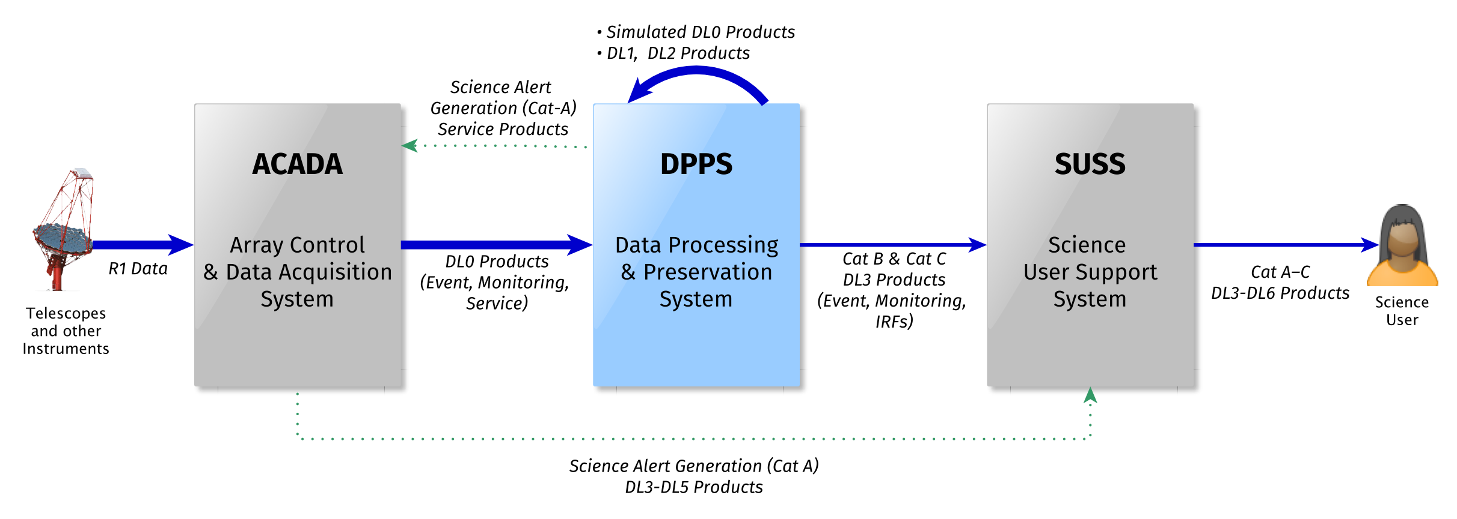
DPPS: Data Processing and Preservation System
Introduction

Slide 87

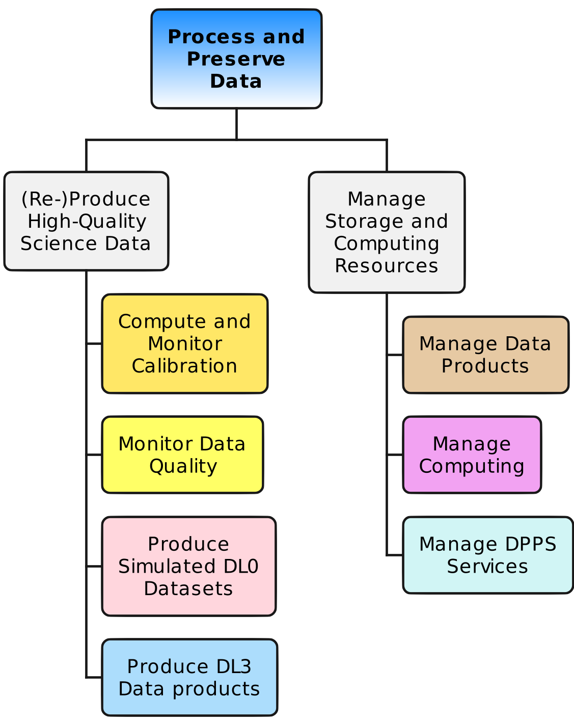
DPPS Subsystems
Introduction
Management
Subsystems
Pipeline
Subsystems
Ops
Operations Management System
CalibPipe
Calibration
Production Pipeline
SimPipe
Simulation
Production Pipeline
Deployment & monitoring
BDMS
Bulk Data
Management System
DataPipe
Data Processing
Pipeline
Data
ingest,
retrieve
Metadata
queries
WMS
Workload
Management System
QualPipe
Data Quality
Pipeline
Software &
workflows that
execute on

Slide 88

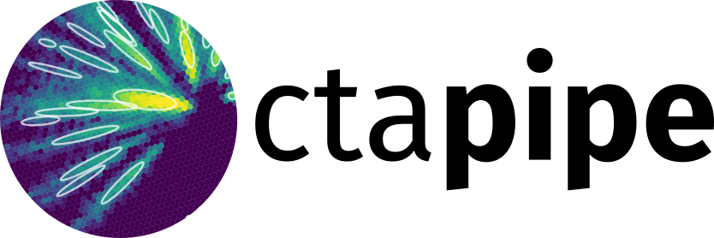

Main Software Components
WMS is based on DIRAC
BDMS is based on Rucio
CalibPipe, DataPipe, QualPipe are all built on-top of ctapipe
SimPipe uses CORSIKA 7, sim_telarray and ctapipe

Slide 89
https://ctapipe.readthedocs.io/en/latest/

Slide 90
Conclusions
The low-level analysis of IACT data is complex and must deal with very high data volumes
⇒ we cannot expect astronomers to learn all of this and download terabytes of data
⇒ by default, we give out only high-level, reduced, reconstructed data with IRFs (DL3)
One of the main challenges is the high number of configuration options, lack of good intermediate metrics and slow feedback loops:
  What is the effect of changing {image extractor, cleaning levels, low-level cuts} on the science analysis of your source?
  How does it affect systematic uncertainties?
You need a working, robust analysis chain first before trying new, experimental things
Physical interpretation is key: how do you adjust your simulations when your DNN does not work on actual observations?
Calibration vs. Simulation is always a trade-off: they meet in the middle
Parametrizing the IRFs and making sure the DL3 data we hand out are useful to many scientists are the current main conceptual challenges, contribute!

Slide 91
Questions?

