Slide 1
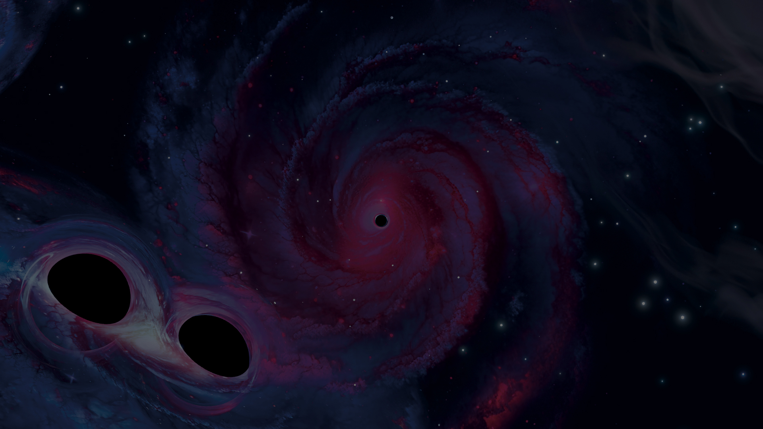














Flexible modelling of gravitational-wave signals using Gaussian processes
Lachlan Passenger lachlan.passenger1@monash.edu
Nov 04 CTAO-OzGrav Meeting

Slide 2
Overview
Gravitational wave signals – modelled and “unmodelled”
Deviations from general relativity
Gaussian processes
- Application to single-event searched for general-relativity violations
- Extension to a population-level analysis

Slide 3

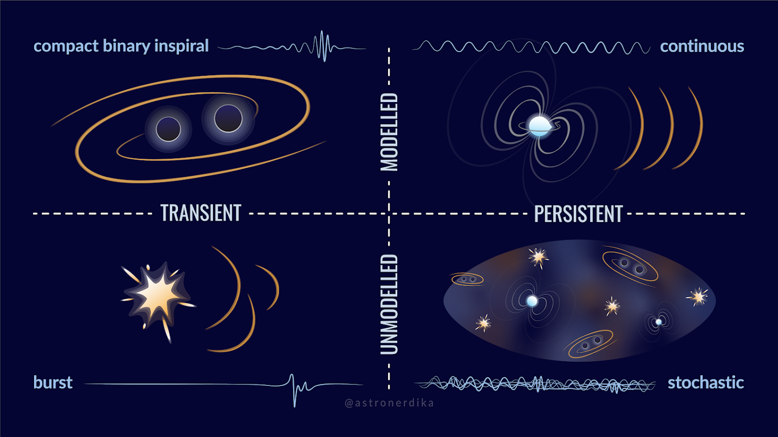
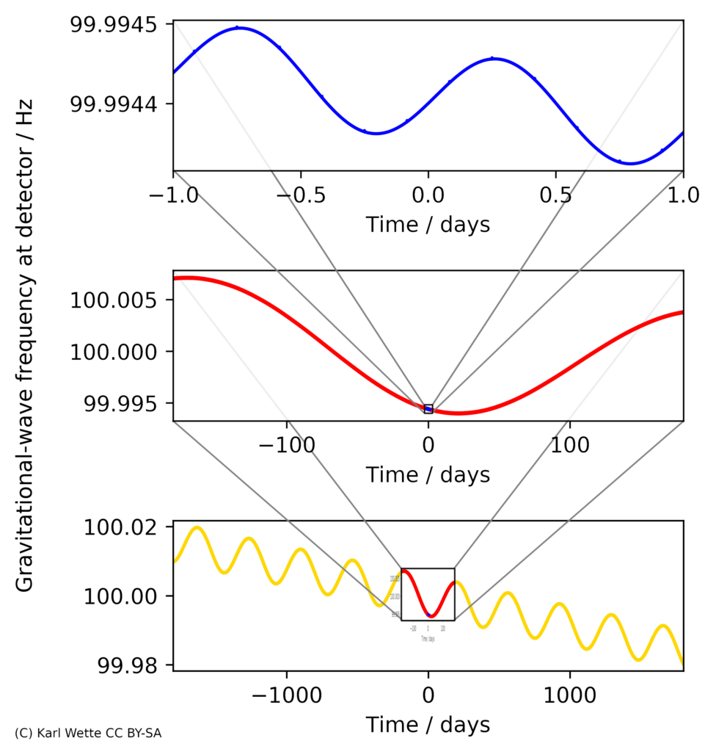
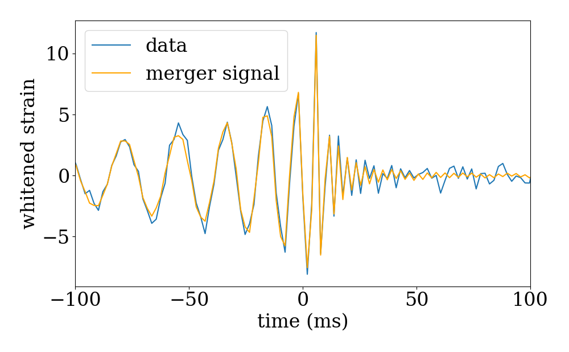
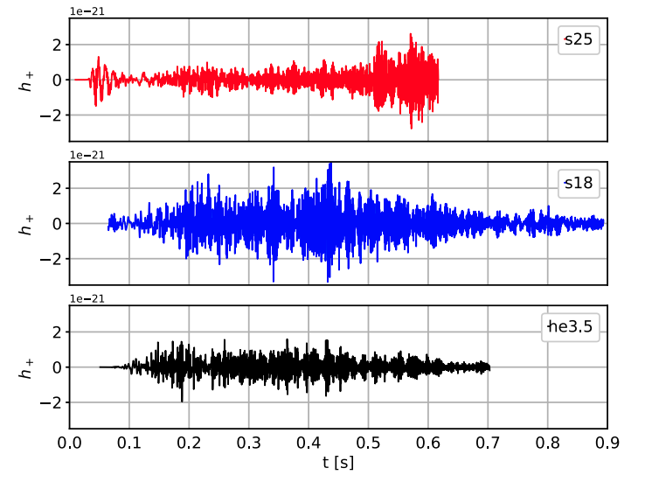
The gravitational-wave zoo – “modelled”
Binary mergers
Burst-like signals
(e.g. supernovae)
Continuous waves (e.g. rotating neutron stars)
Wette (2023)
Abbott et al. (2016)
Iess et al. (2020)

Slide 4

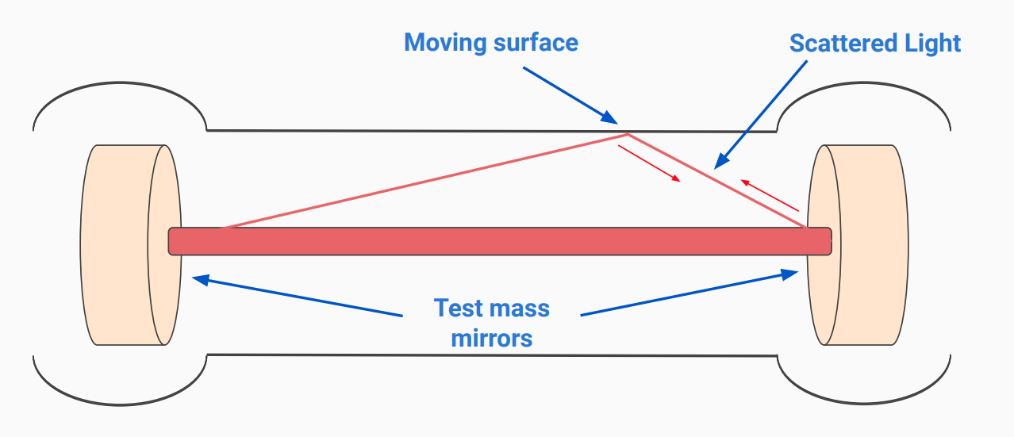
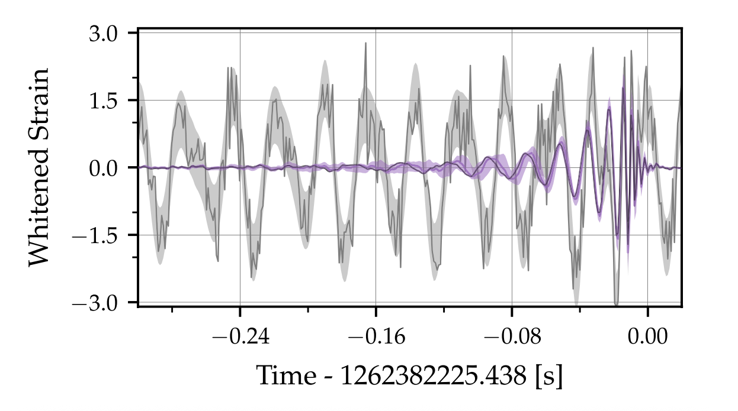
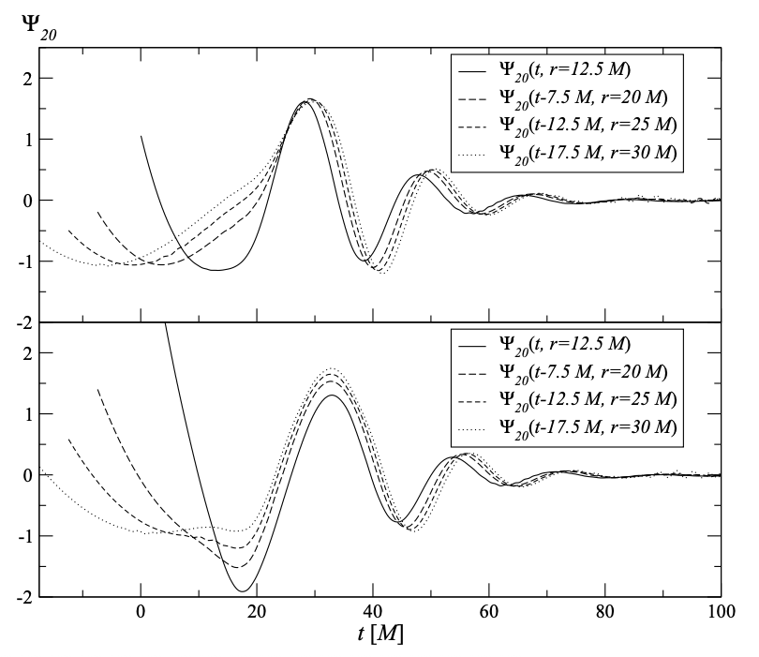
The gravitational-wave zoo – “unmodelled”
Burst-like signals (e.g. SNe, head on collisions)
Deviations from general relativity?
Instrumental glitches
Iess et al. (2020)
Sperhake et al. (2018)
Soni (2021) and Ashton (2023)

Slide 5

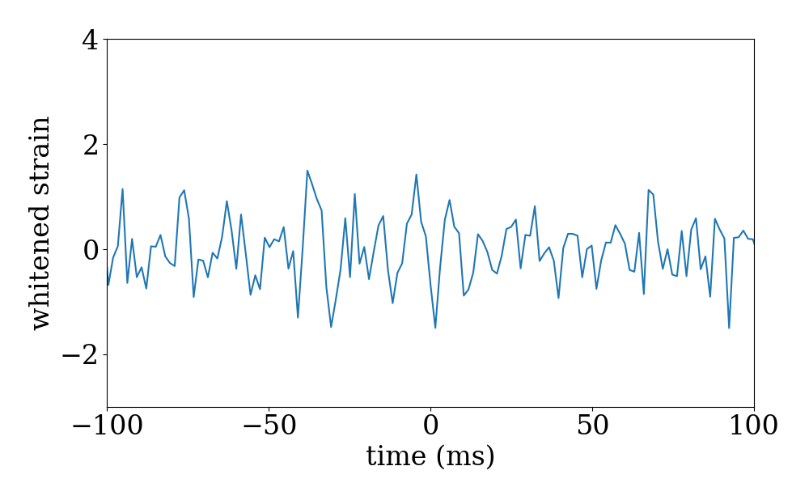
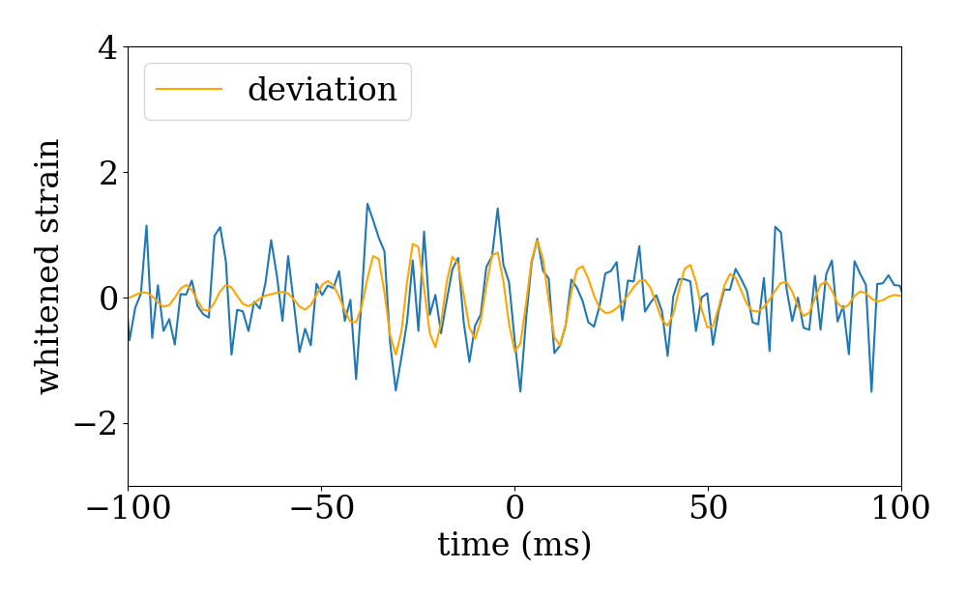
Deviations from General Relativity
Binary merger signal
Residual data

Slide 6
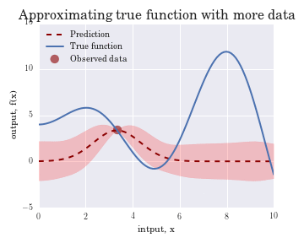
Gaussian Processes
Model the covariance structure of a signal, instead of the functional form
Choose kernel functions which describe the overall structure, based on prior assumptions
Condition these kernel functions on the data to fit signals
Man (2023)

Slide 7
The structure of a GR deviation
We choose kernel functions that encode our prior beliefs about what the structure of a deviation from GR is
Strongest at merger = Gaussian-envelope kernel
Periodic = Cosine kernel
Asymmetric = Squared-exponential kernel

Slide 8
Deviations from General relativity
Binary merger signal
Deviation from GR?

Slide 9
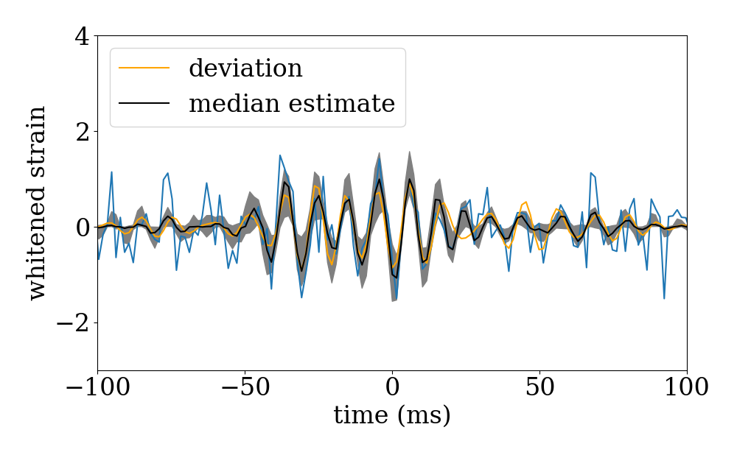
Deviations from General relativity
Binary merger signal
Deviation from GR!

Slide 10
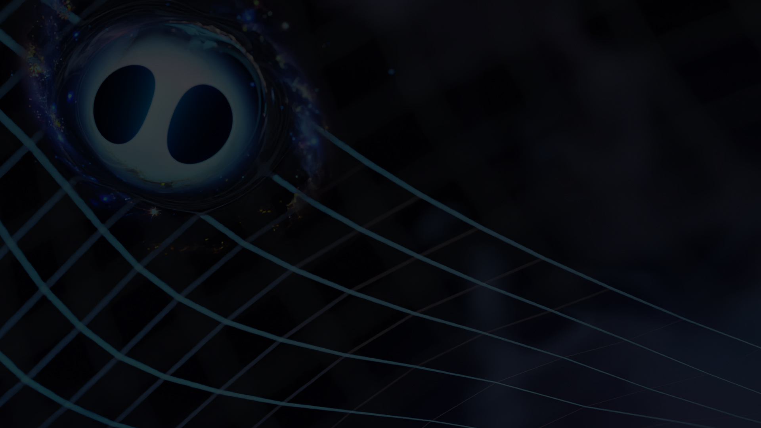
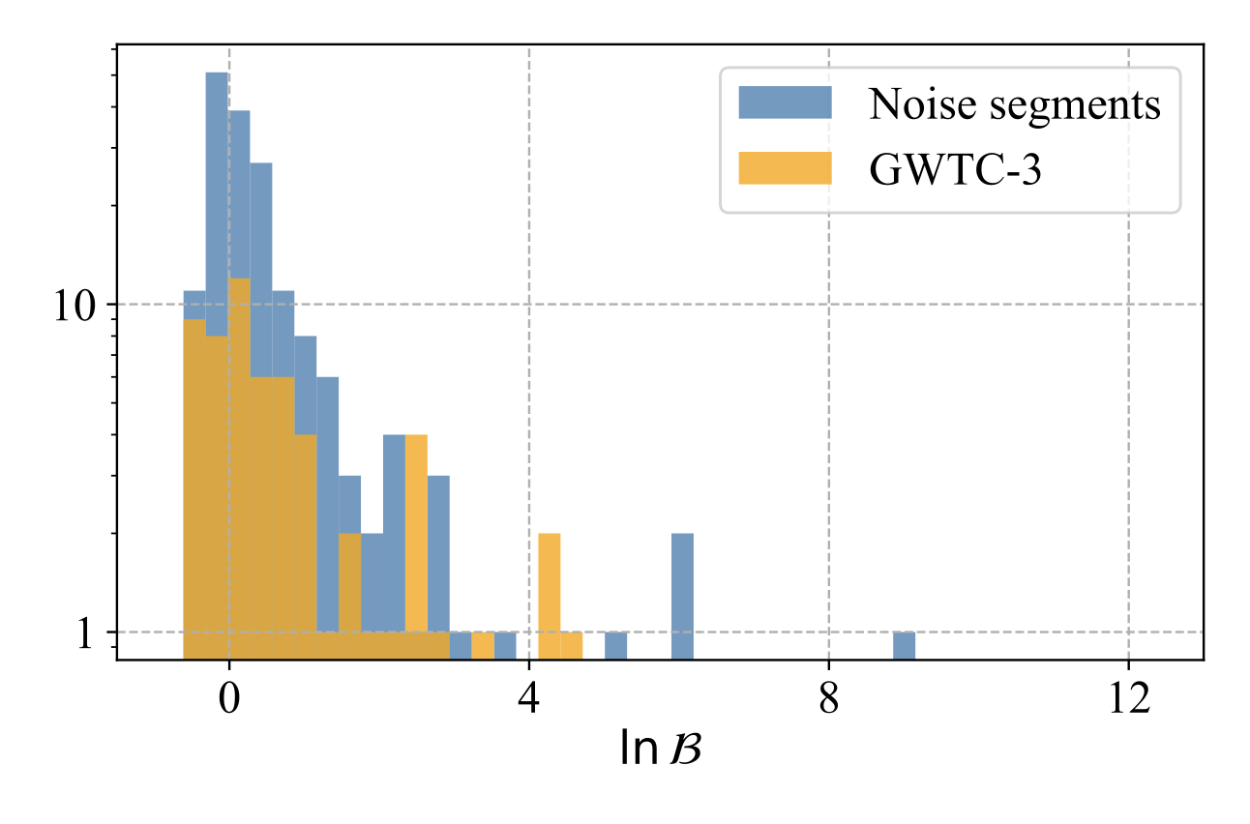
What did we find?
No statistically significant deviations (so far!)
Passenger and Cheung et al., (2025)

Slide 11

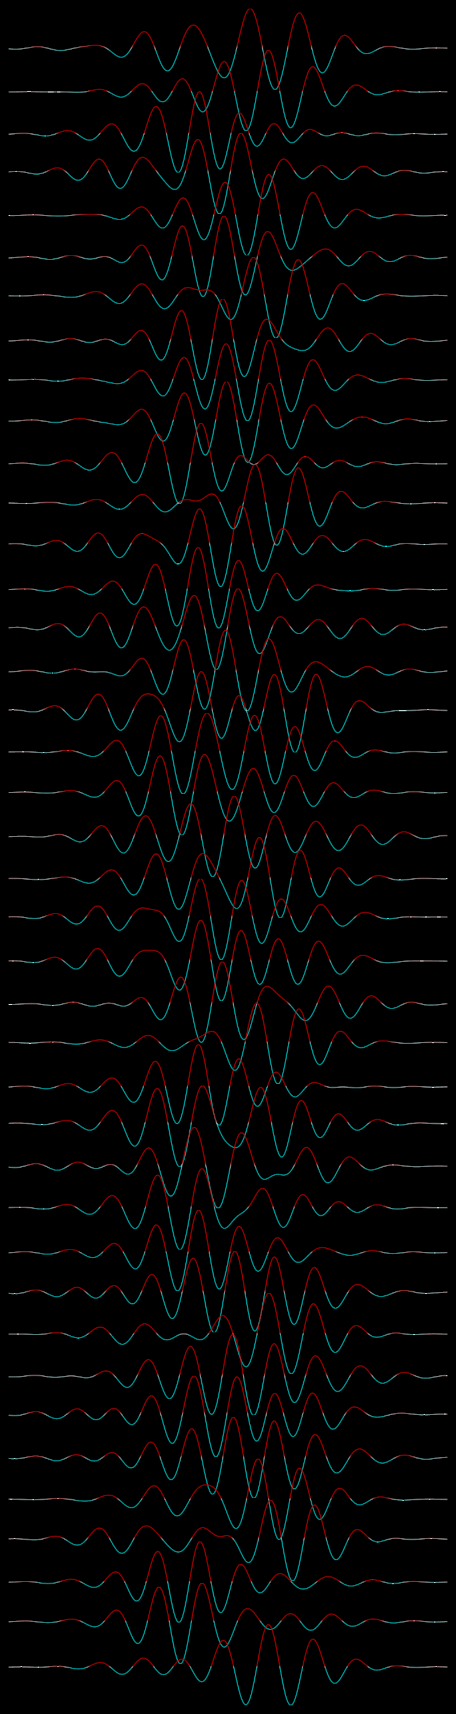
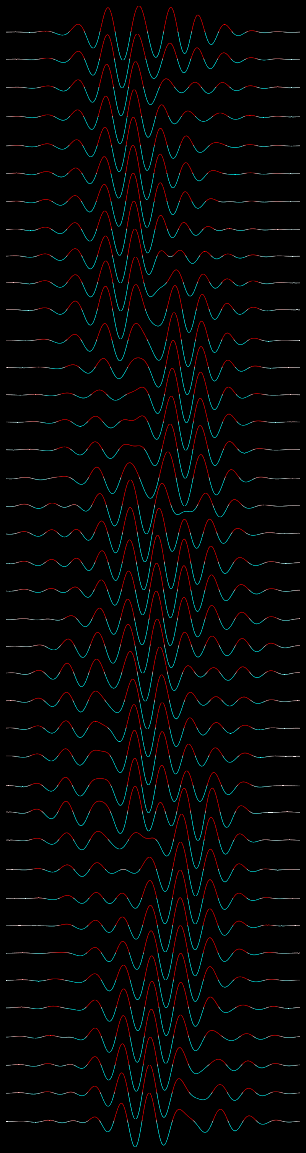
Population-level deviations
Q: How can we stack deviations from multiple events coherently?
A: Leverage information contained in the covariance structure across events!
Ordered by event #
Ordered by total mass

Slide 12
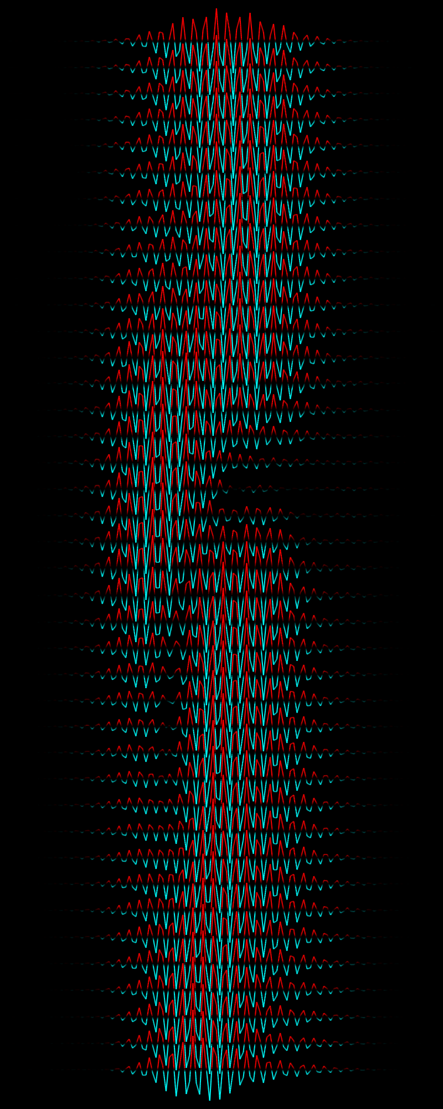
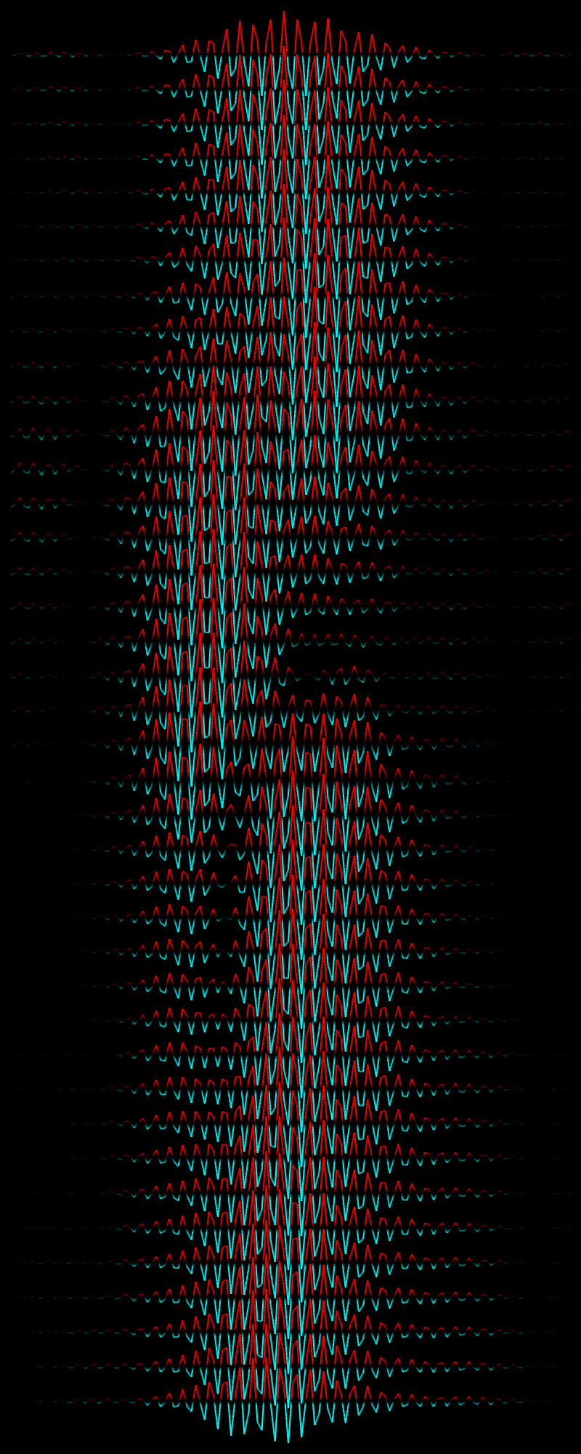
Demonstration
Assume the deviation smoothly varies in event total mass (like a GP!)
Preliminary results suggest this is more effective than combining the individual probabilities for each event
Ordered by total mass
Passenger and Guttman et al. (in prep)

Slide 13
Summary
There is large uncertainty in the functional form of deviations from general relativity
Gaussian processes can fit signals in which the functional form is unknown, but the structure is
We applied a Gaussian process framework to search for deviations from GR We are extending this framework to perform a population-level test, with promising preliminary results

Slide 14
Ordered by total mass
Man (2023)

