Slide 1
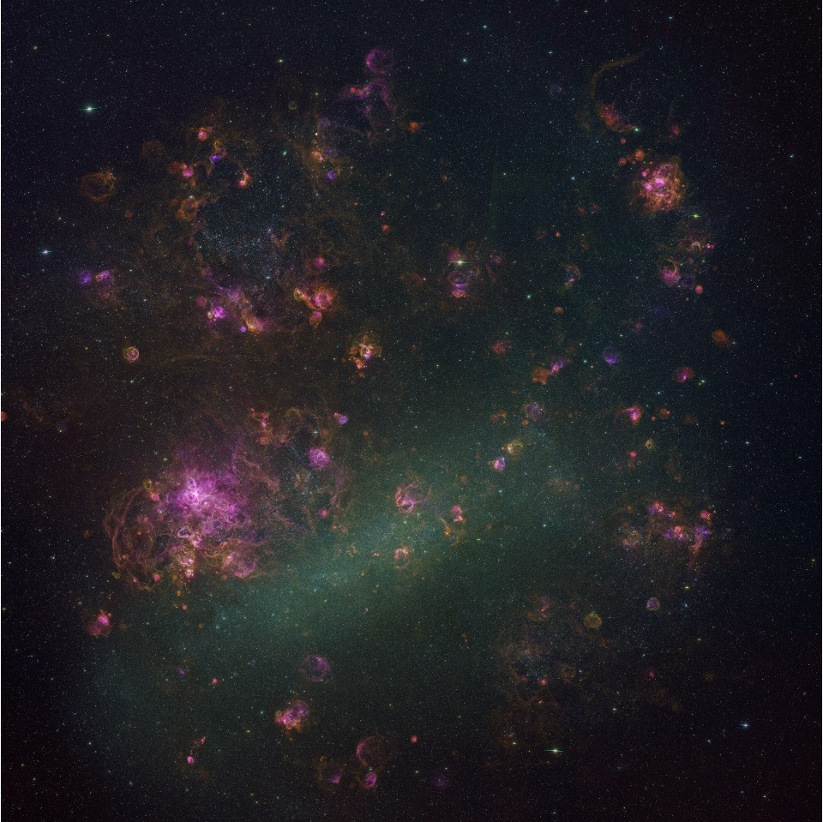

SNRs in the LMC: a multi-frequency population study
Zachary Smeaton, Miroslav Filipović and Evan Crawford
Image: Optical RGB of entire Large Magellanic Cloud

Slide 2
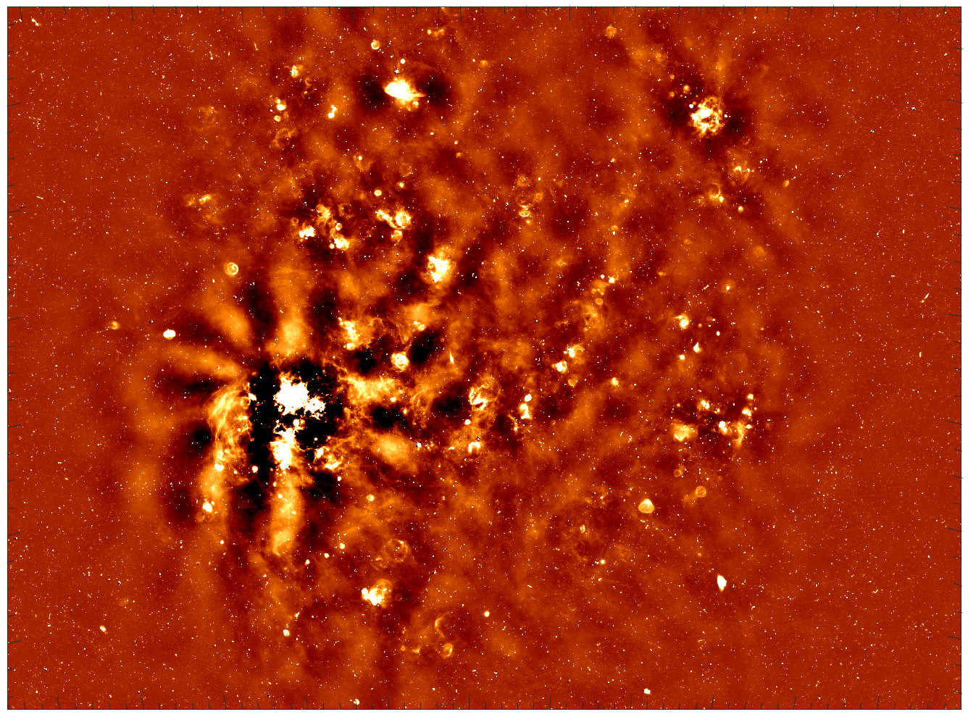
SNRs in the LMC
Large Magellanic Cloud
Nearby face-on, spiral galaxy
Known distance (50 kpc)
Numerous multi-frequency surveys
Well-studied SNR population
CTA key science project
Image: MeerKAT radio image of Large Magellanic Cloud

Slide 3
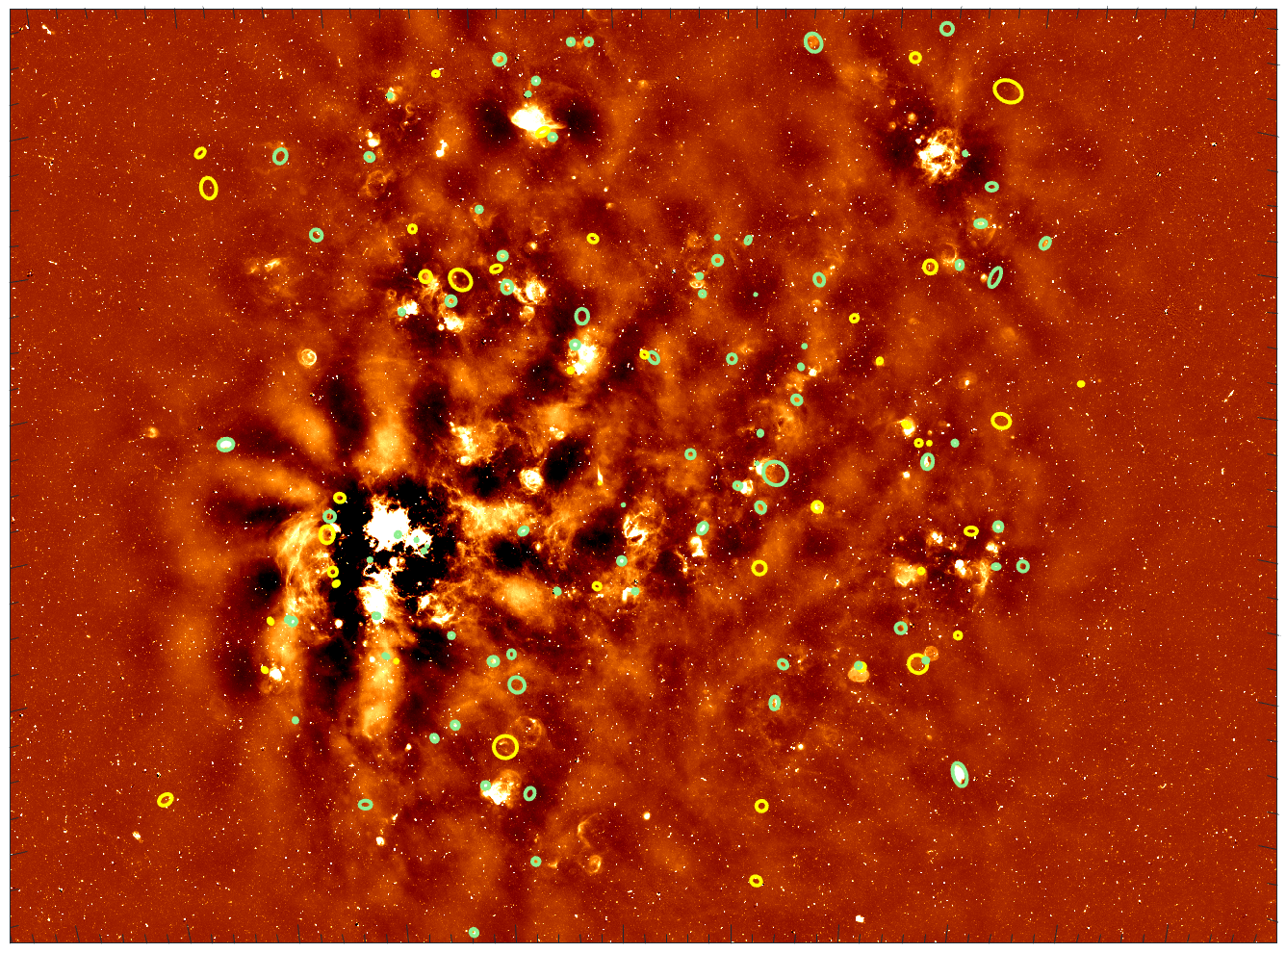
SNRs in the LMC
Large Magellanic Cloud
Population:
86 SNRs
Previously 80
New radio detections confirmed 6 candidates as SNRs
45 candidates
Previously 43
6 promoted to SNR
8 newly discovered
Image: MeerKAT radio image of Large Magellanic Cloud with SNRs (green) and candidates (yellow) shown

Slide 4
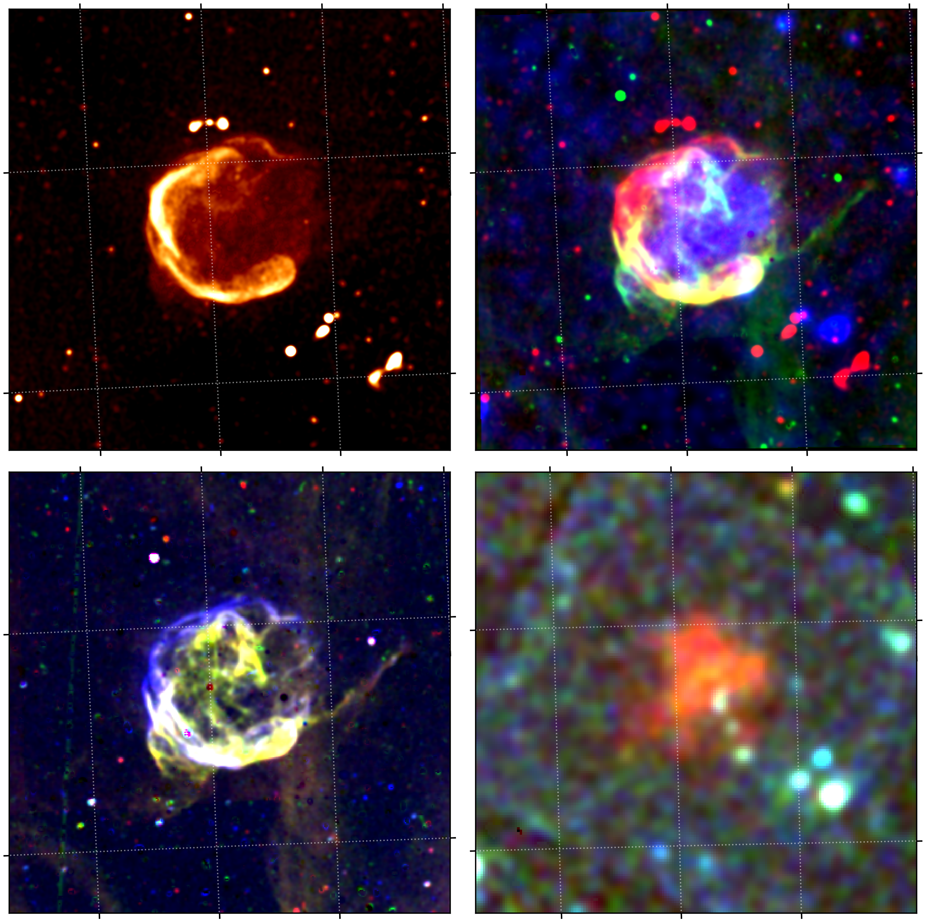
Multi-frequency approach
Radio: MeerKAT 1.3 GHz
R: 1.3 GHz radio
G: H⍺ optical
B: soft X-ray
Radio:
MeerKAT: 1.3 GHz
EMU: 888 MHz
Optical:
MCELS: H⍺, [SII], and [OIII] filters
DeMCELS: H⍺ and [SII] filters
X-ray (soft, medium, and hard):
XMM-Newton
eROSITA
R: H⍺
G: [SII]
B: [OIII]
R: Soft (0.2 - 1.0 keV)
G: Medium (1.0 - 2.0 keV)
B: Hard (2.0 – 4.5 keV)
Image: SNR 0527-6549 (DEM L204) multi-panel image. Top left to bottom right: MeerKAT 1.3 GHz, multi-frequency RGB, optical RGB, X-ray RGB

Slide 5
Catalogue properties
Measured for all:
Position
Size (Diameters, PA, ovality)
Radio properties:
Flux density (MeerKAT 1.3 GHz, EMU 888 MHz, MWA 118 – 200 MHz)
Spectral index and surface brightness: 59 SNRs (69%)
Literature values:
SN Type: 27 TN (31%), 31 CC (36%), 26 Unknown (30%)
Age: known for 56 (65%)

Slide 6
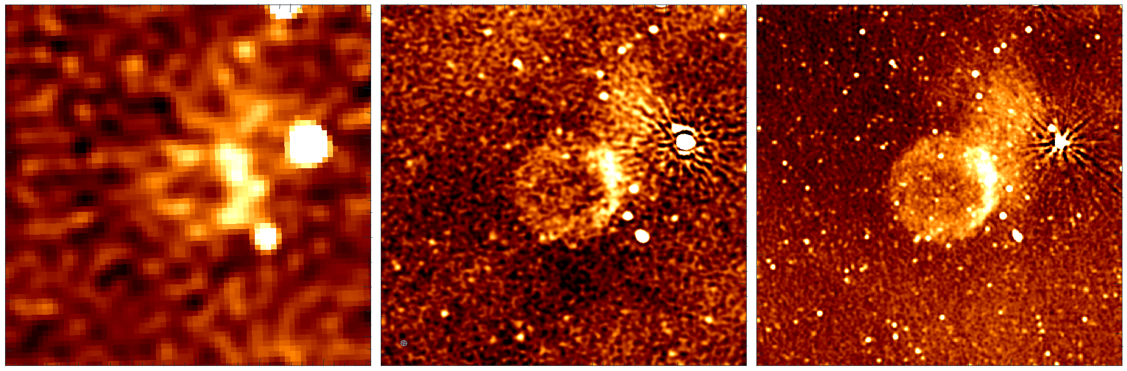
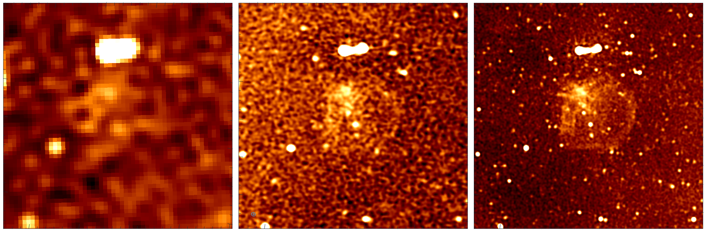
New radio data
0456-6950
- whole shell structure now visible
ATCA 1.4 GHz
B.S. 30 arcsec
EMU 888 MHz
B.S. 15 arcsec
MeerKAT 1.3 GHz
B.S. 8 arcsec
0447-6918
First real radio detection
Not 3 sigma for entire shell

Slide 7
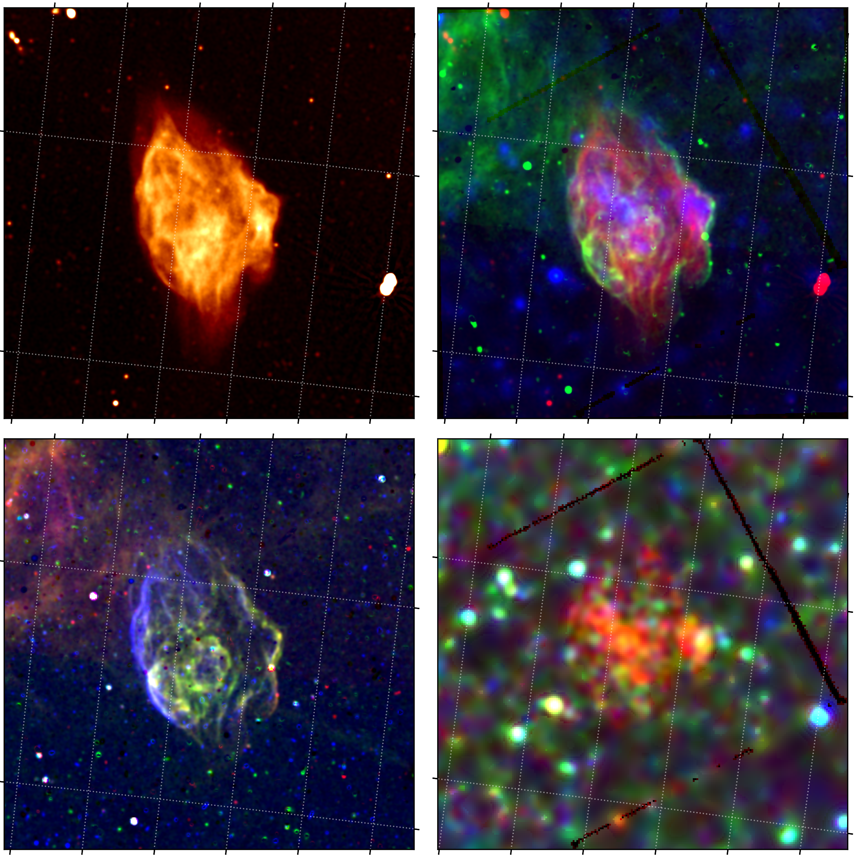
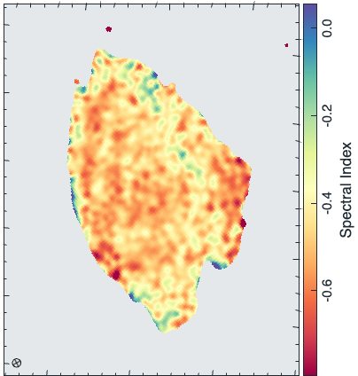
0450-7050
Dedicated case study
One of the largest in the LMC (150 x 80 pc)

Slide 8
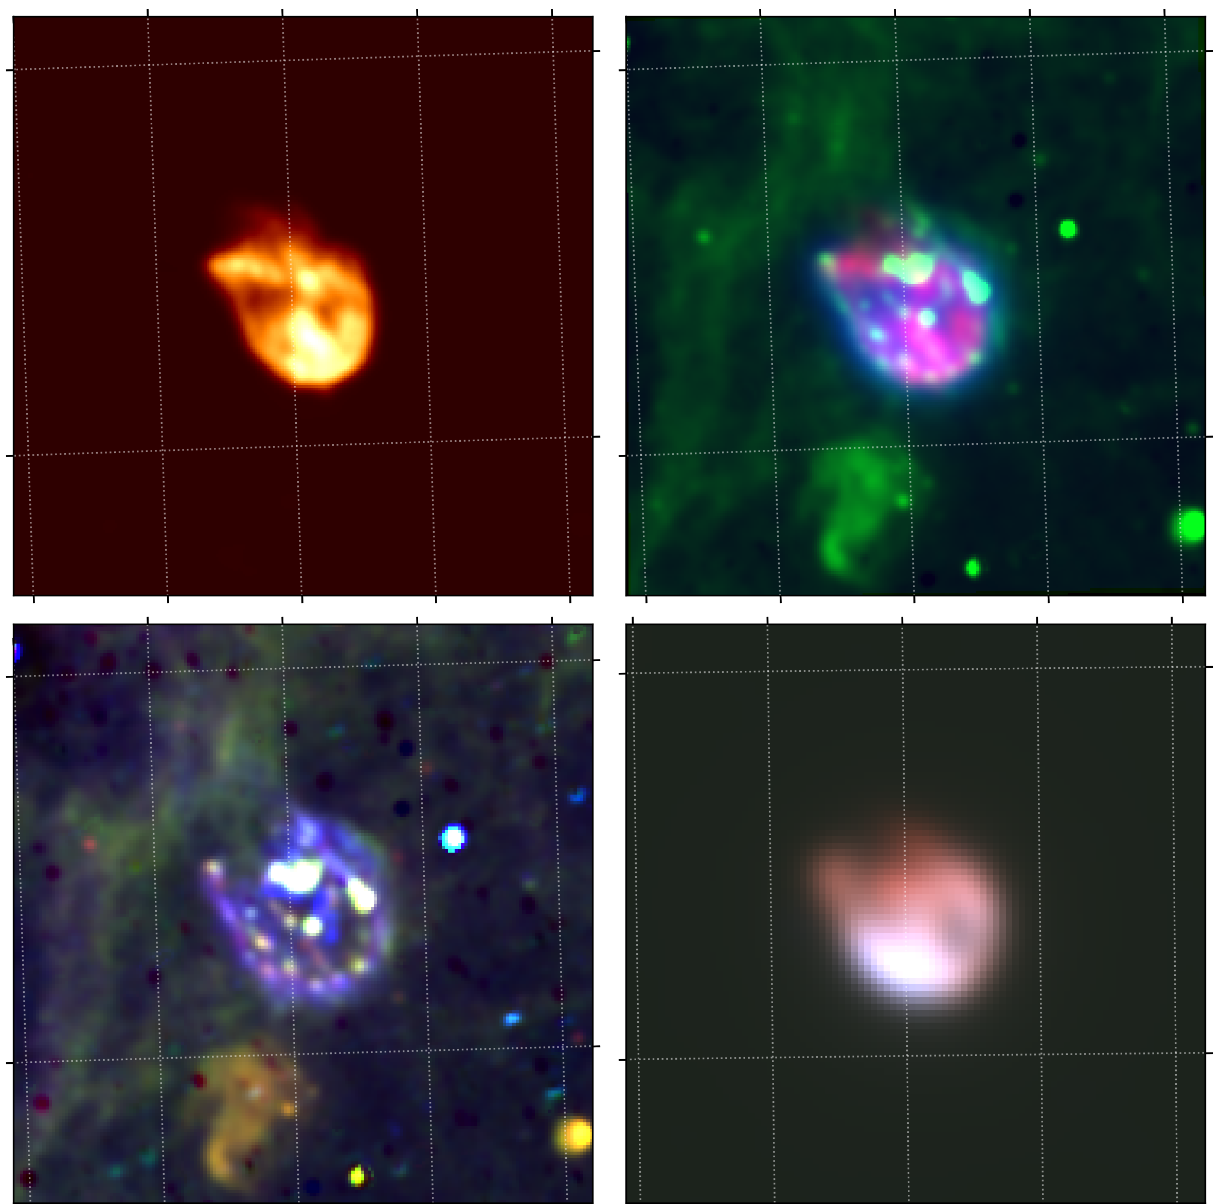
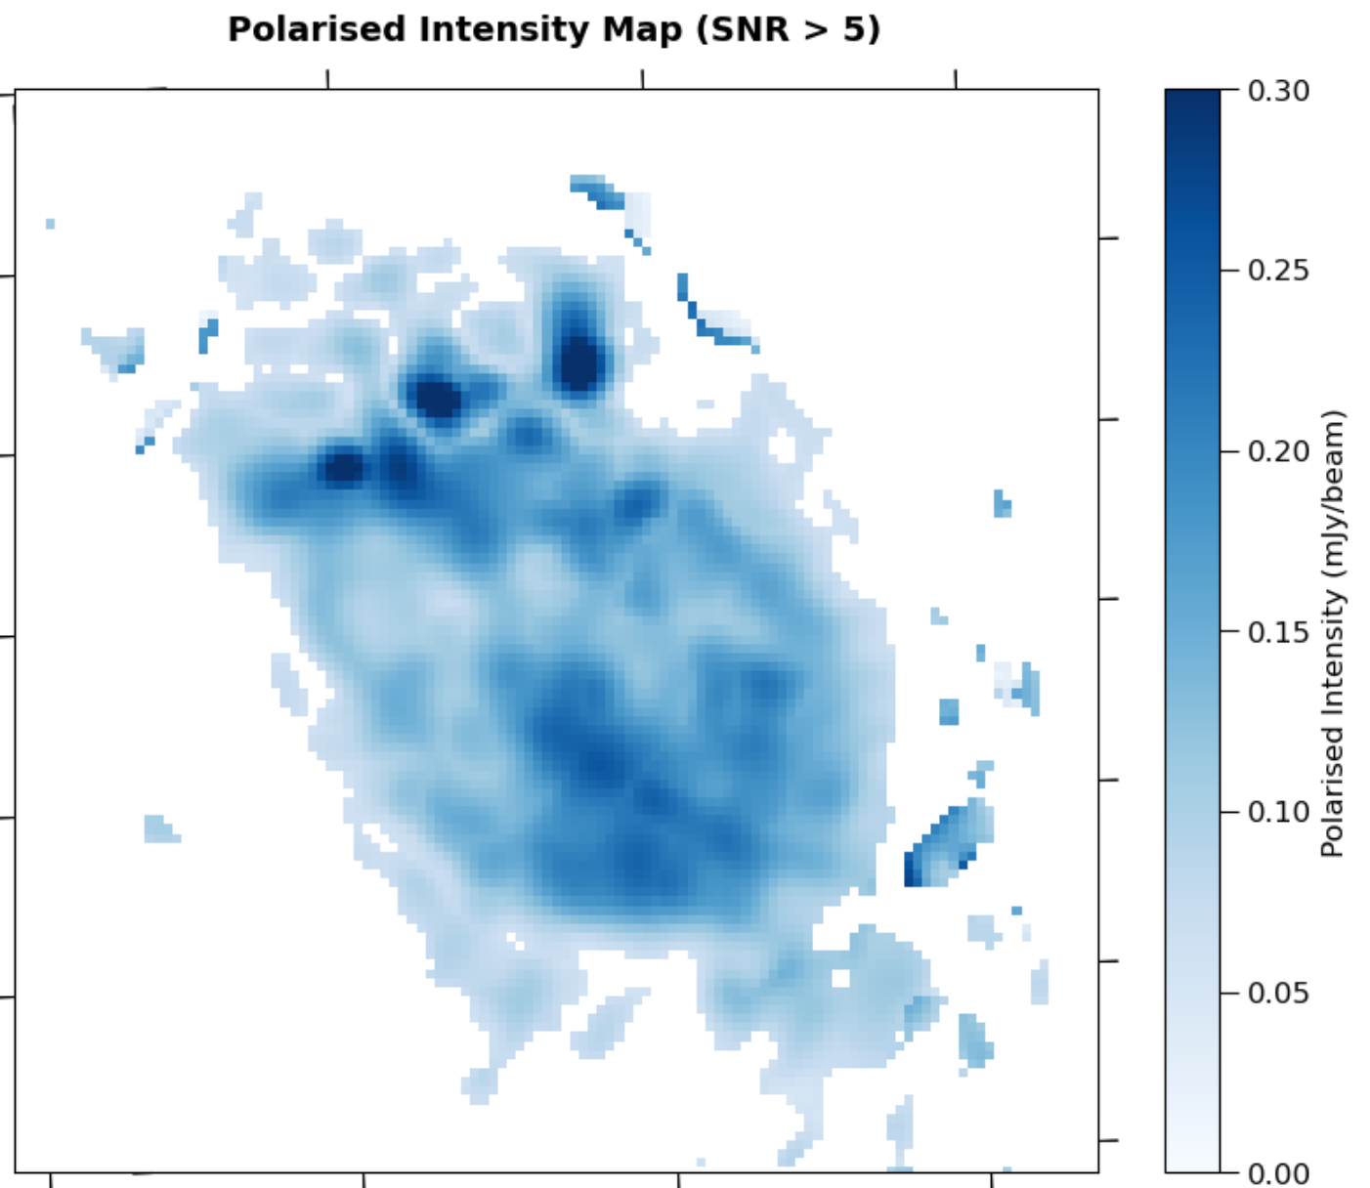
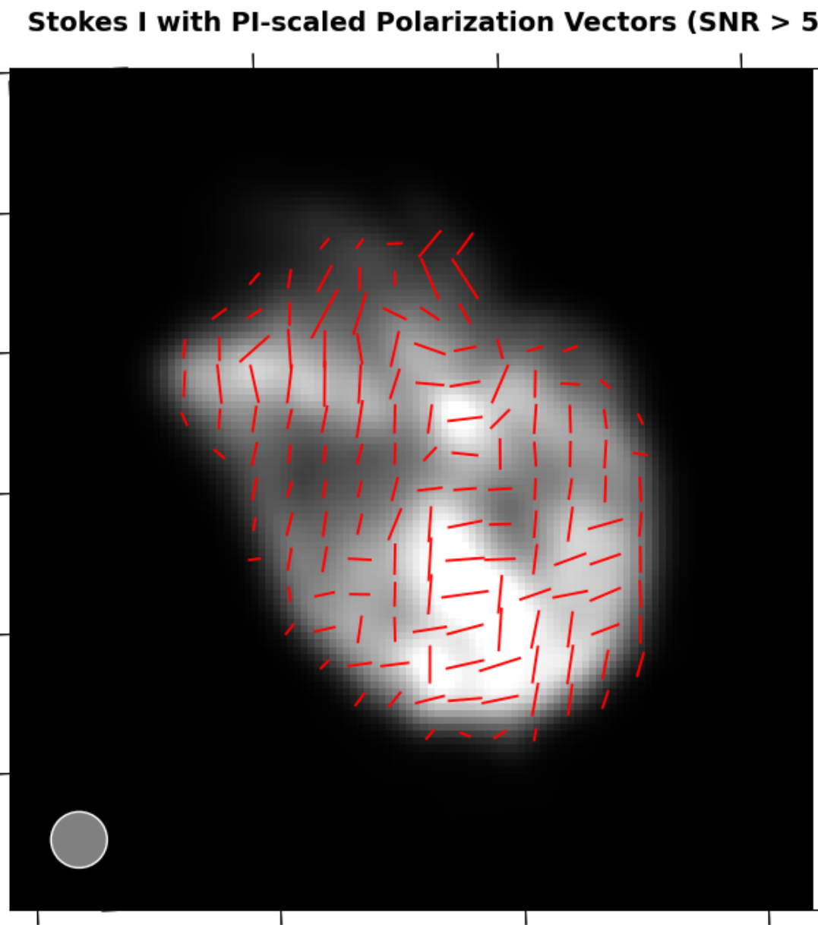
N132D
Paper in preparation
One of the brightest SNRs in the LMC
One of the few known gamma-ray emitting LMC SNRs

Slide 9
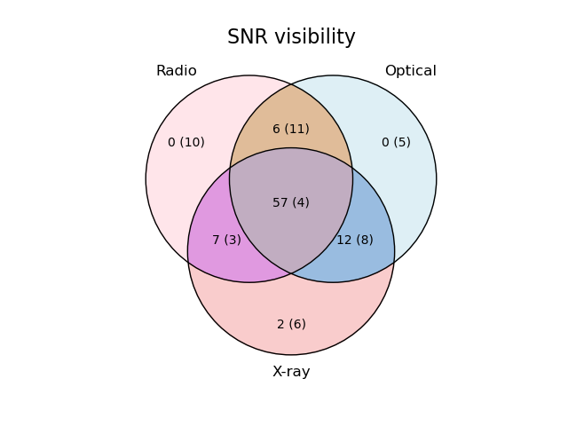
Some statistics
Visibility
Most SNRs (66%) detected at all 3 frequencies

Slide 10
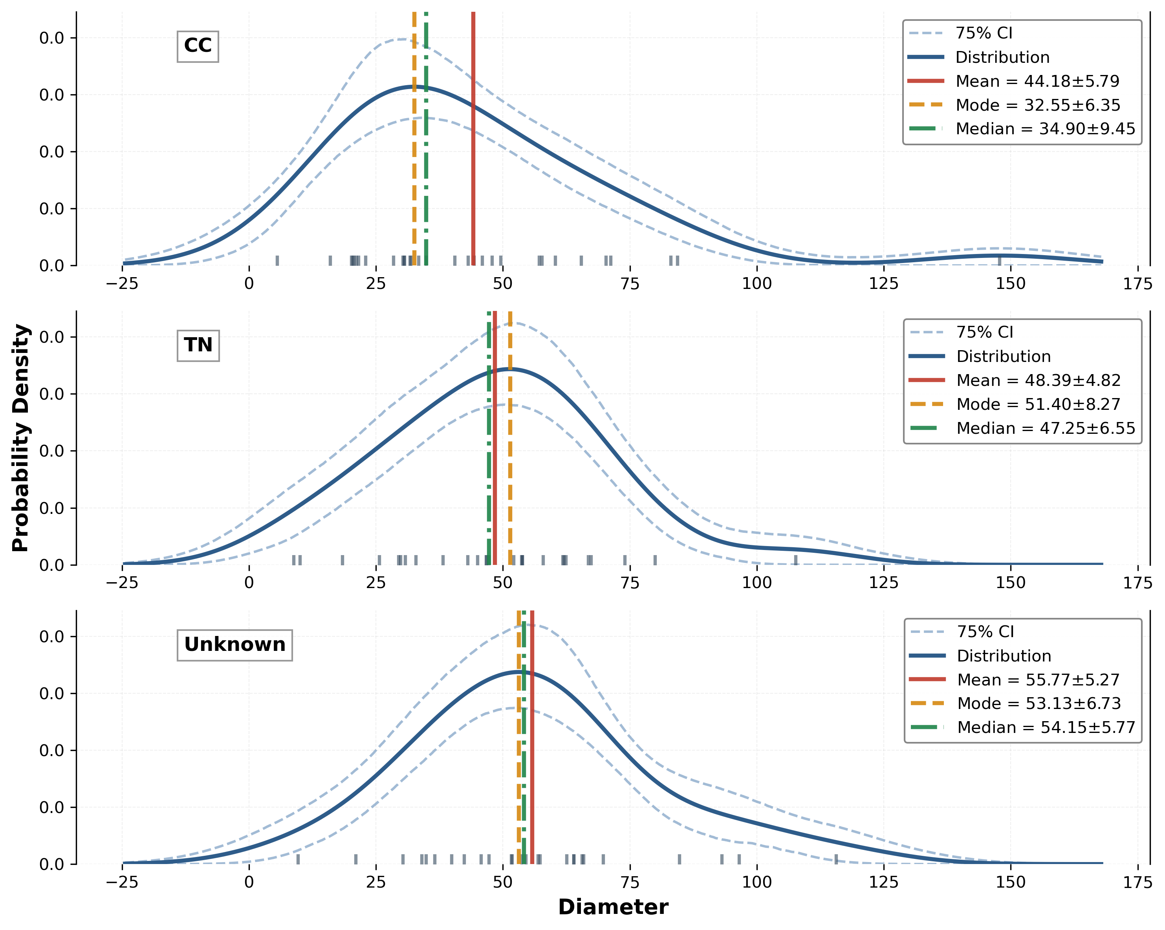
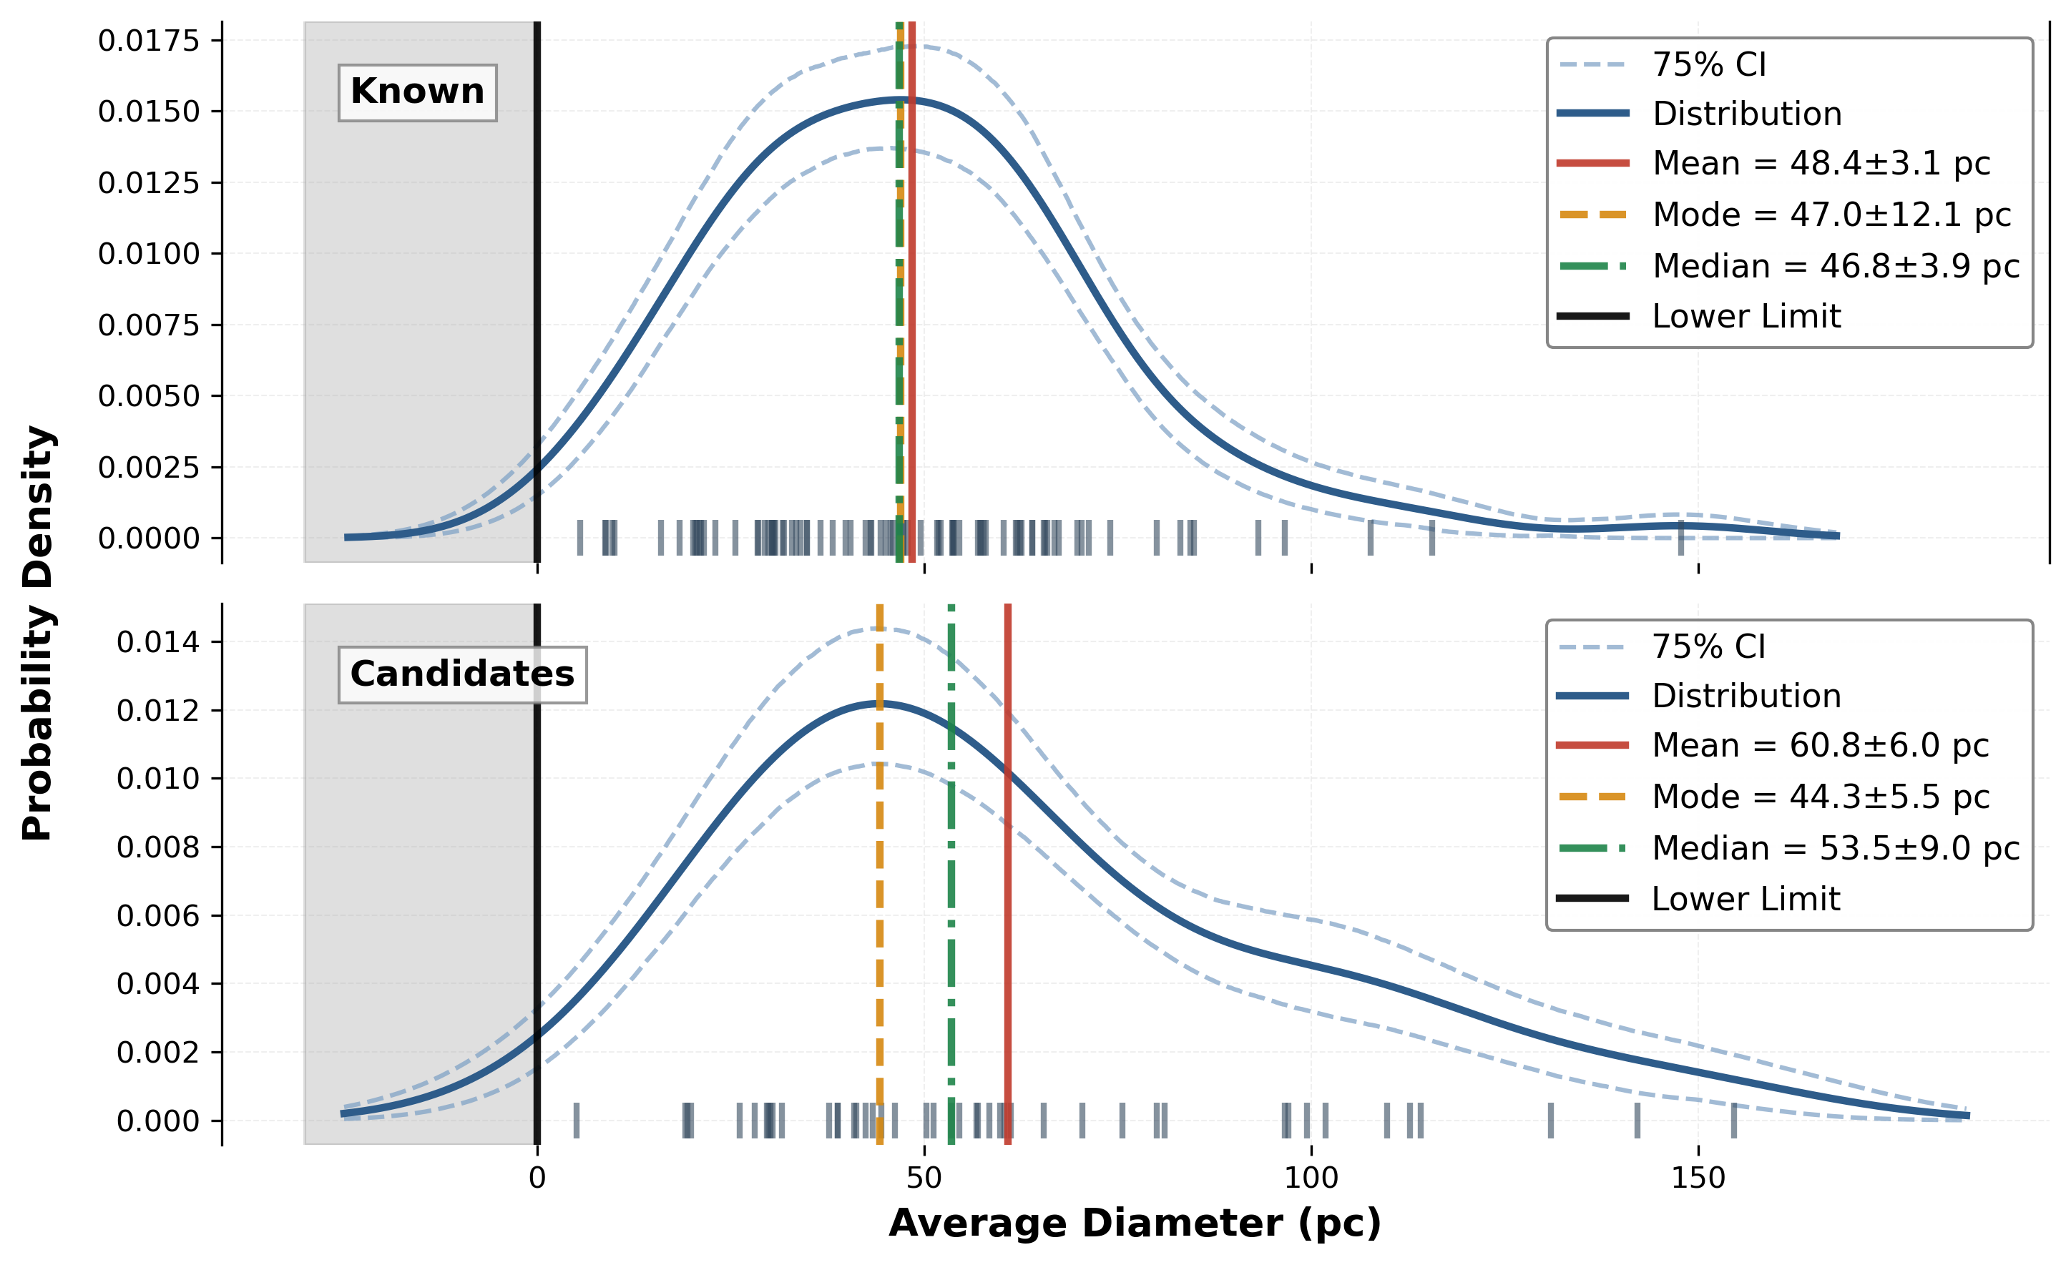

Distributions: Diameter
Average: 48.4 $±$ 3.1 pc
Candidates larger
Galactic: 30.5 $±$ 1.7 pc
(Ranasinghe & Leahy, 2023, ApJS, 265, 2)

Slide 11
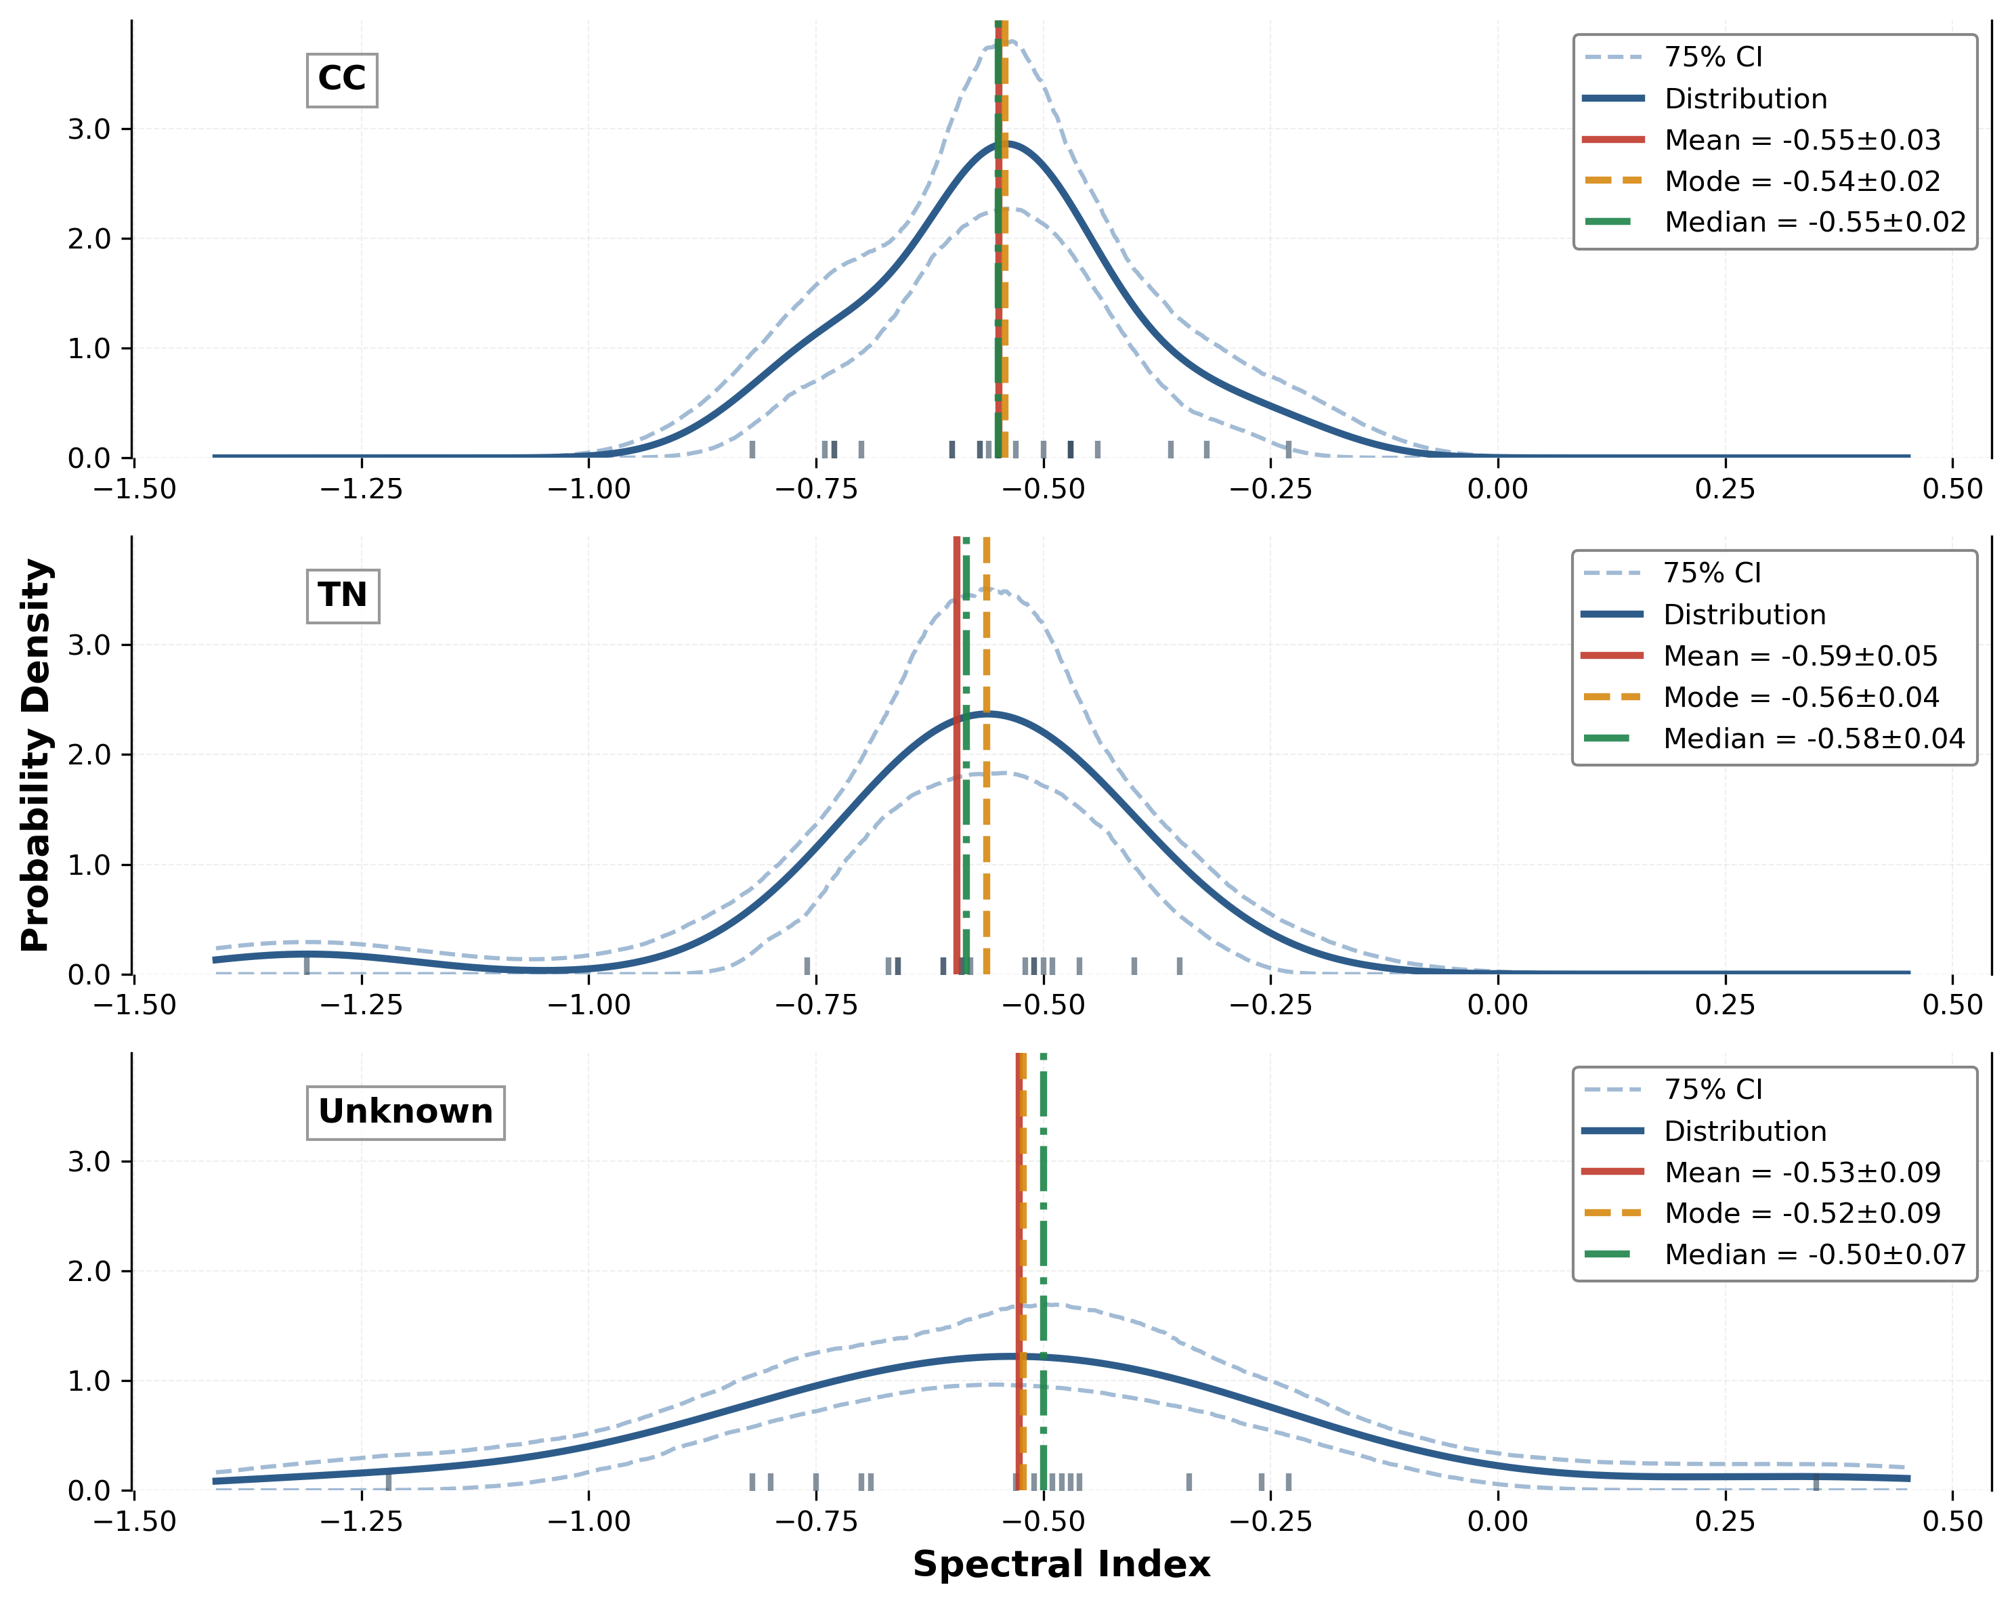
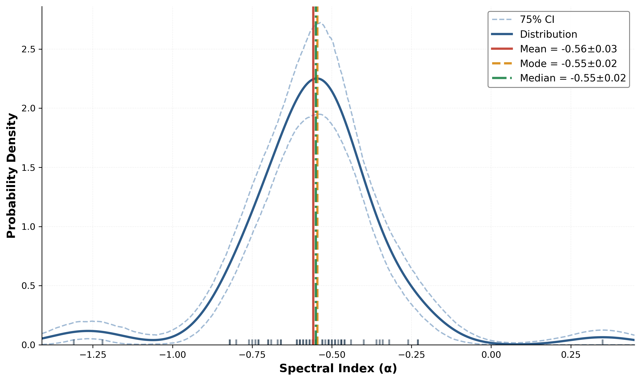
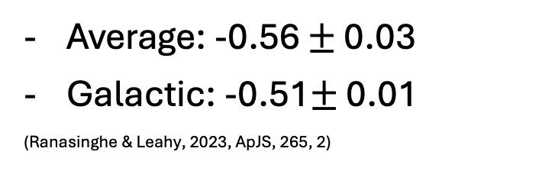
Distributions: Spectral Index
Average: -0.56 $±$ 0.03
Galactic: -0.51$±$ 0.01
(Ranasinghe & Leahy, 2023, ApJS, 265, 2)

Slide 12
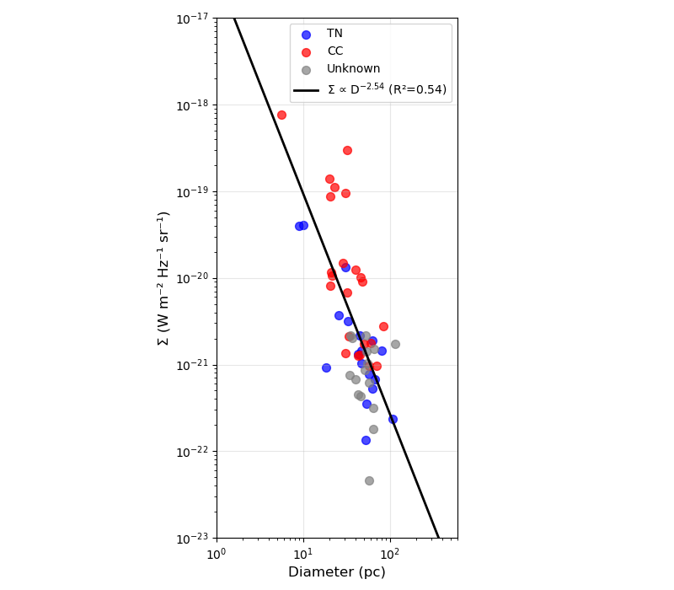
Sigma-D relation
∑_{v} (D) ∝ D^{−β}
β = 2.54
Preliminary, done with linear regression
To do: orthogonal fitting
For context LMC values:
- β = 3.92 (orthogonal)
Bozzetto et al. 2017, ApJS, 230, 1

Slide 13
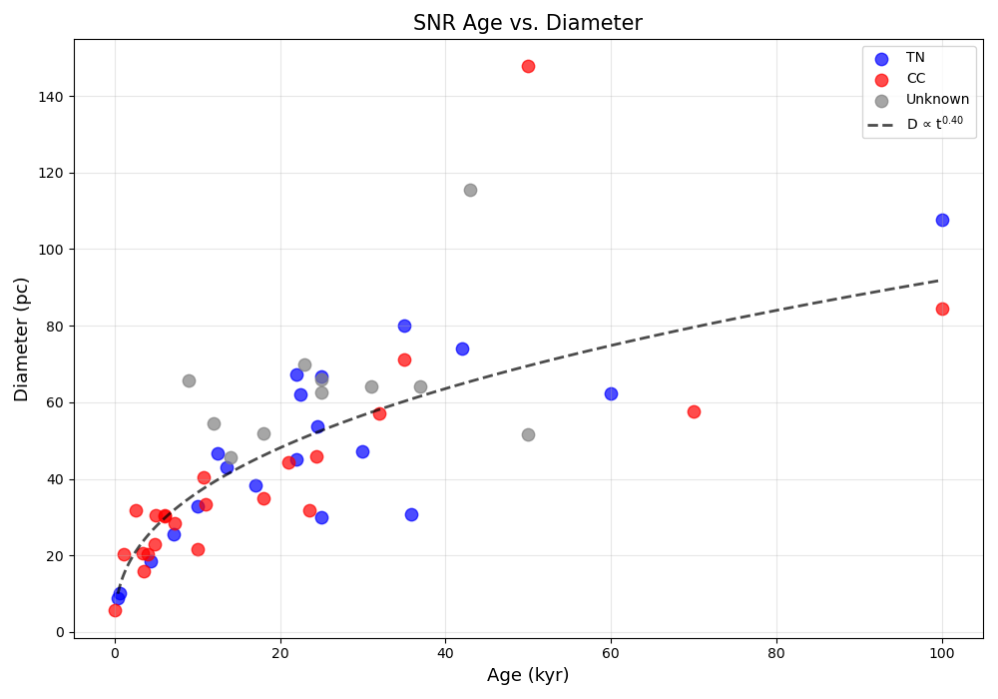
Age vs Diameter
Spectral index KDEs

Slide 14
Relation to CTA
LMC is a key CTA science project
SNRs are good gamma-ray targets
Recent Fermi-LAT paper showed gamma-ray emission from 16 LMC SNRs above 4 GeV
Majority were young, CC, with environmental interactions
Better constraints on the LMC SNR population can be used to advise these observations
Tramacere et al. 2025, A&A, 697

Slide 15
Future work
Publish final catalogue
Online database for LMC SNRs
Multi-wavelength view and summary of properties
Updated as new data becomes available
Potential future projects
Systematic study with polarization
Dedicated X-ray vs radio morphology systematic study
Environmental interaction signatures, radio vs IR, combined with age helps to constrain properties

