Slide 1
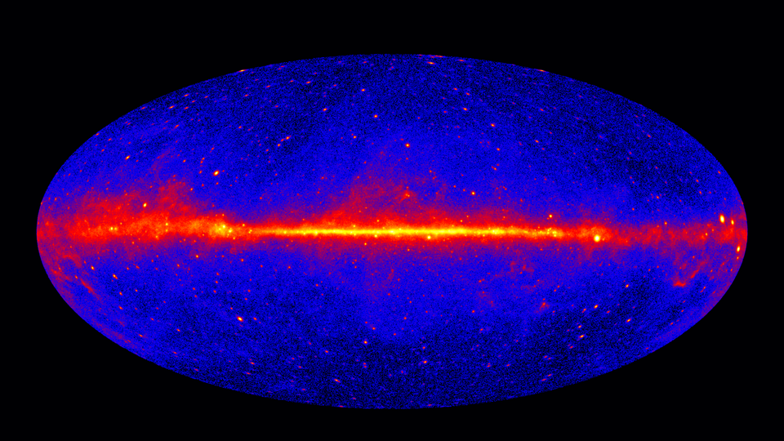

Modelling the unknown with CTAO:
Investigating indirect WIMP dark matter search systematics
Liam Pinchbeck, Csaba Balazs, Eric Thrane

Slide 2


Pinchbeck et al. 2024, arXiv:2401.13876

Slide 3
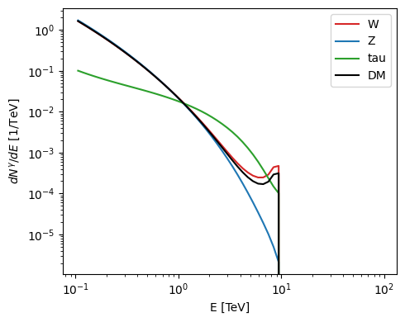
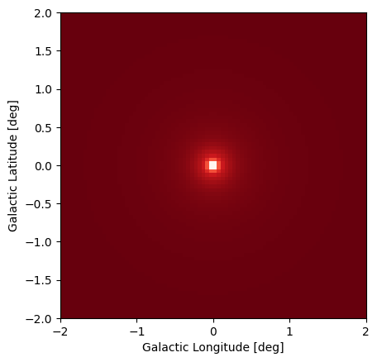
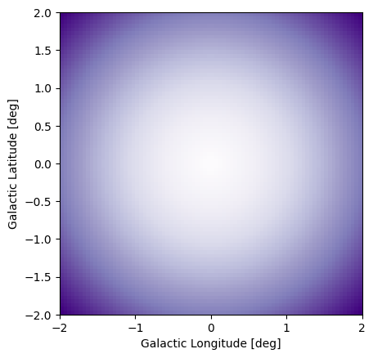
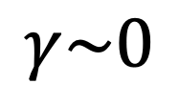
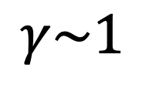
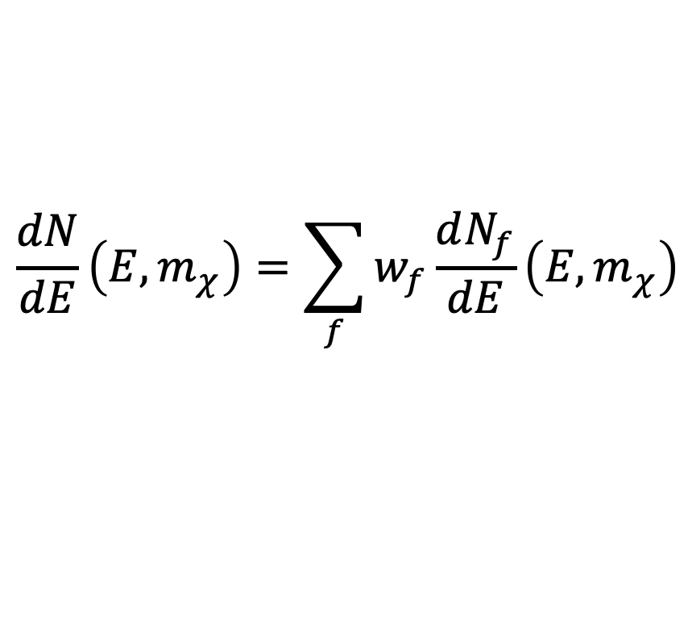
Dark Matter Signal
SPECTRAL DISTRIBUTION
SPATIAL DISTRIBUTION
NFW
Burkert
$$\frac{dN}{dE}\left(E, m_{χ}\right)=\sum_{f}{w_{f}\frac{dN_{f}}{dE}\left(E, m_{χ}\right)}$$
$$γ\sim 1$$
$$γ\sim 0$$

Slide 4
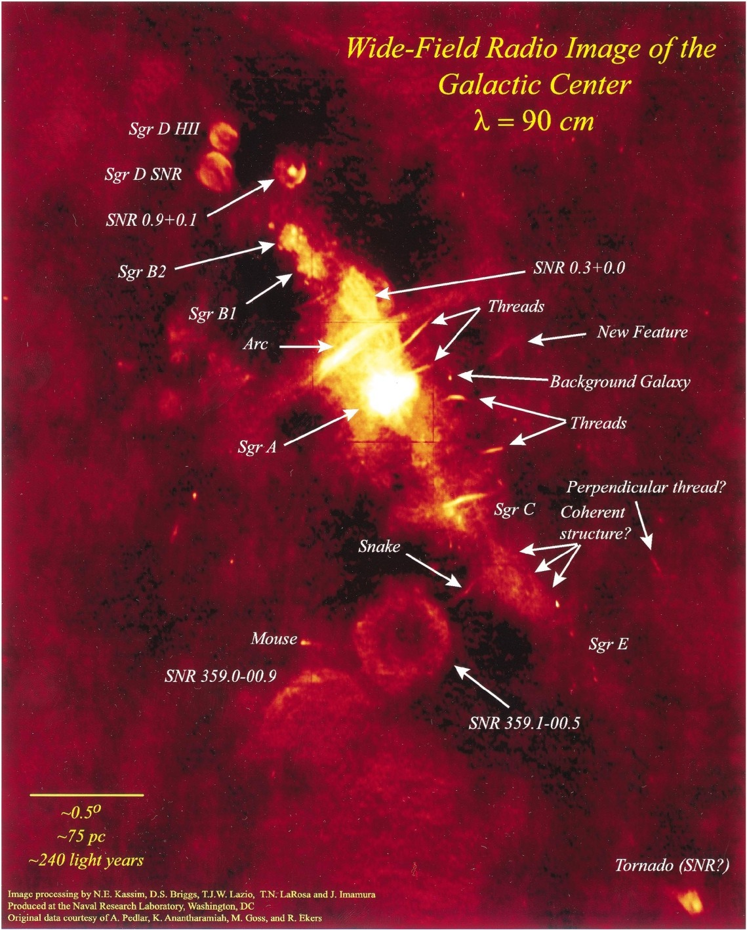
Complicated Backgrounds
[1]
[1] Image Credit: NASA/DOE/Fermi LAT Collaboration
[2] Image Credit:- arXiv:1505.06055
[2]

Slide 5
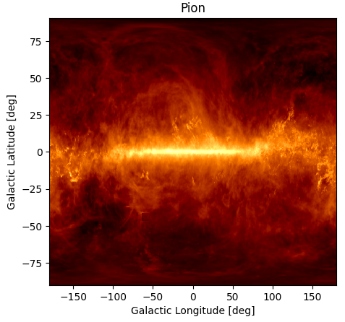
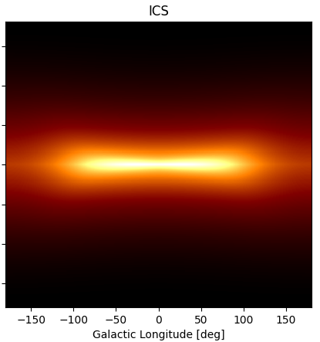
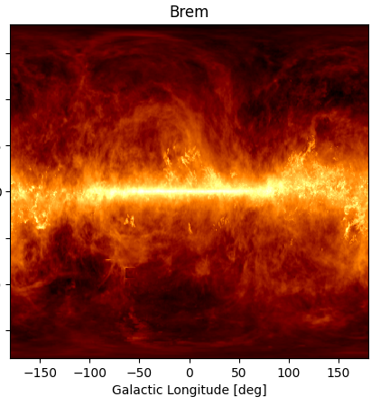
GALPROP Diffuse Emission Maps

Slide 6
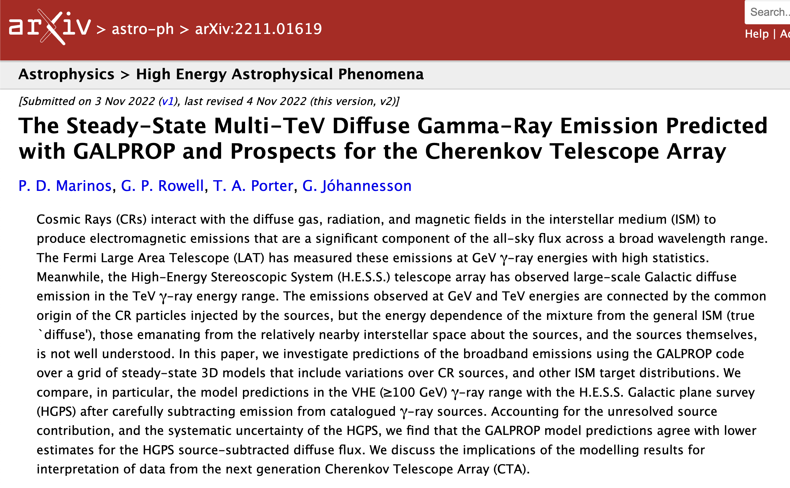
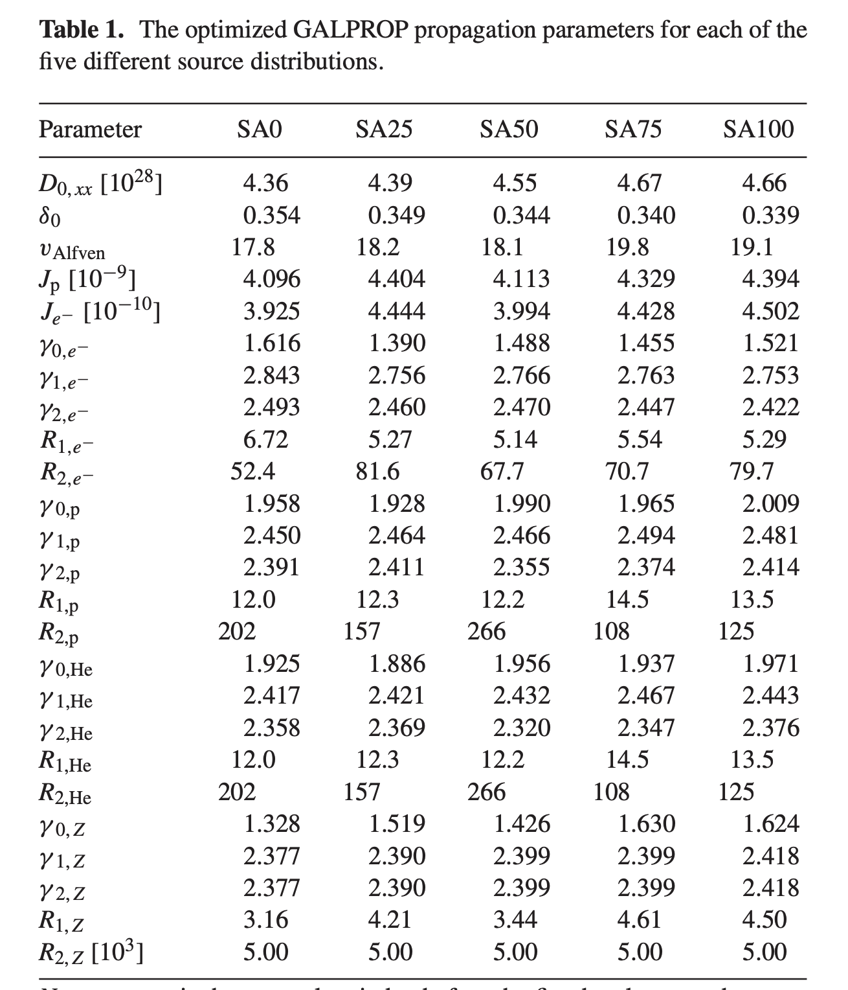
SA0
SA50
SA100
+ 2 ISRF Models Mentioned
+ 2 Magnetic Field Models Mentioned

Slide 7
Event
R12 Model
F98 Model
Pshirkov Model
GASE Model
…
SA0
SA50
SA100
…

Slide 8
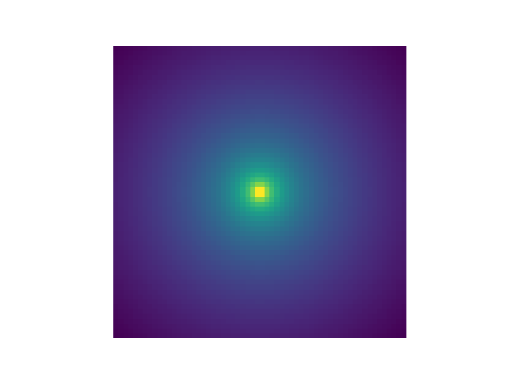
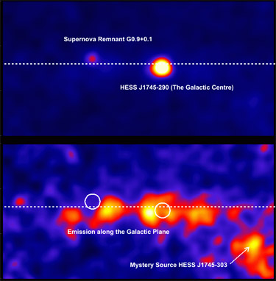
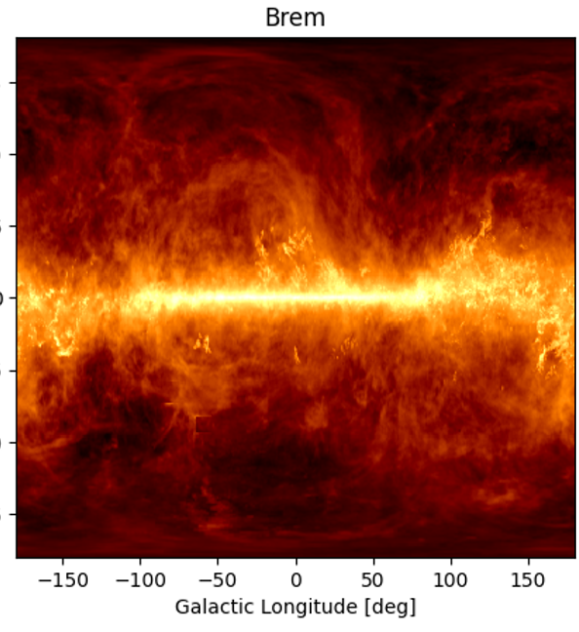
+ MORE!
Dark
Matter
Local
Sources
Diffuse
Sources
- mass
- annihilation ratios
- ”cuspy-ness”
…
- Spectral indices
- Spatial positions
- Spatial Extent
…
Magnetic field model
ISRF model
Source injection model
(Residual CCR Background)
(Isotropic Background)
…
Notes:
- 4:30

Slide 9
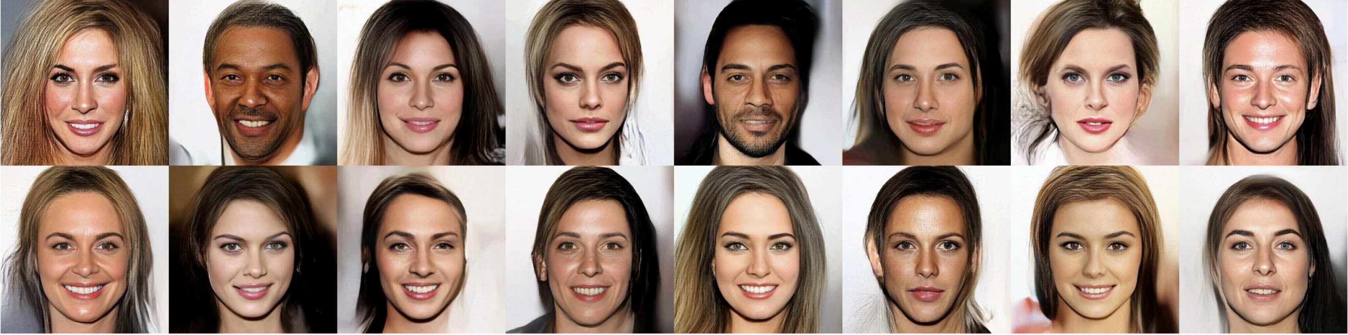
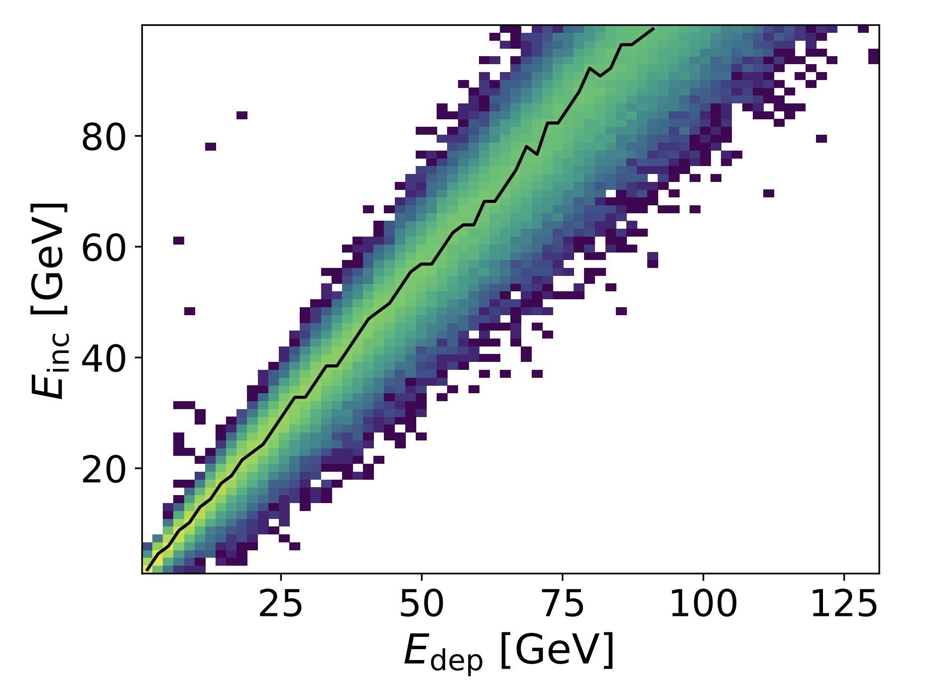
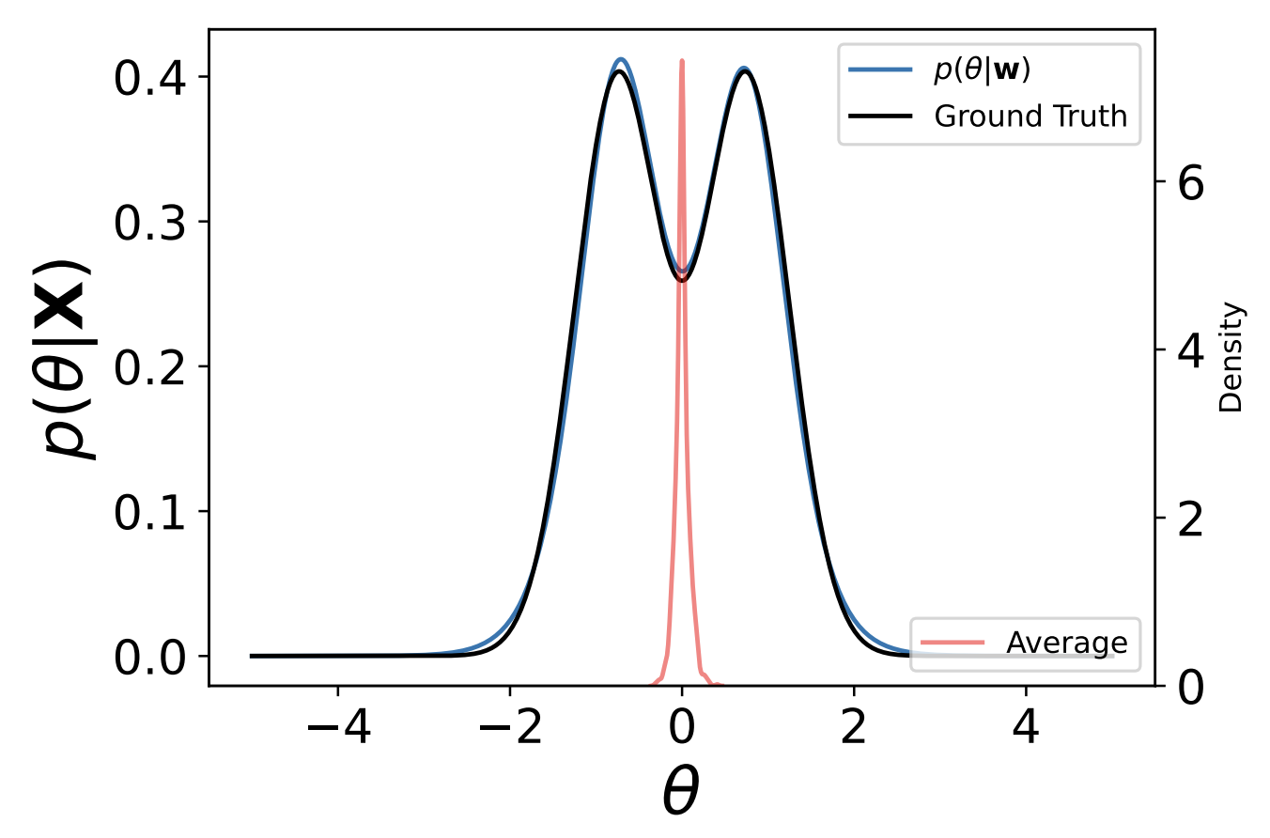
Normalising Flows
Image Generation: https://vds.sogang.ac.kr/wp-content/uploads/2023/01/VDS_2022_%EC%97%AC%EB%A6%84%EC%84%B8%EB%AF%B8%EB%82%98_%EA%B9%80%EC%A4%80%EA%B7%9C.pdf
“Glow: Generative Flow with Invertible 1×1 Convolutions”
arXiv:1807.03039
Modelling:
ATLAS Shower Energy Reconstruction
Gravitational Wave Population Parameter Studies
arXiv: 2404.18992v1
arXiv: 2211.09008
Notes:
9min
What specifically are the benefits?
Take out the ATLAS plot

Slide 10
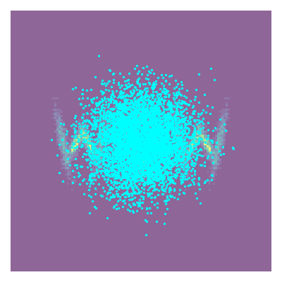
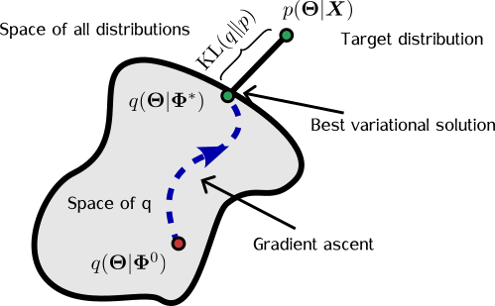
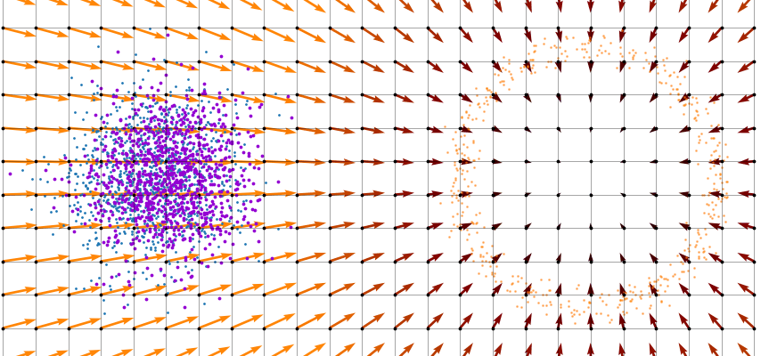
Normalising flows
Normalising Flow demonstration
General flow demonstration
[1] “Bayesian Seismic Tomography using Normalizing Flows” - DOI:10.31223/X53K6G
Notes:
- Motivate this slide better

Slide 11



V2
(current public on GitHub is V1)
A full probabilistic programming language that can implement normalising flows and other methods such as Hamiltonian Monte Carlo
$γ$-ray Astronomy
Notes:
- Get rid of equation – make dot points -- simplify

Slide 12
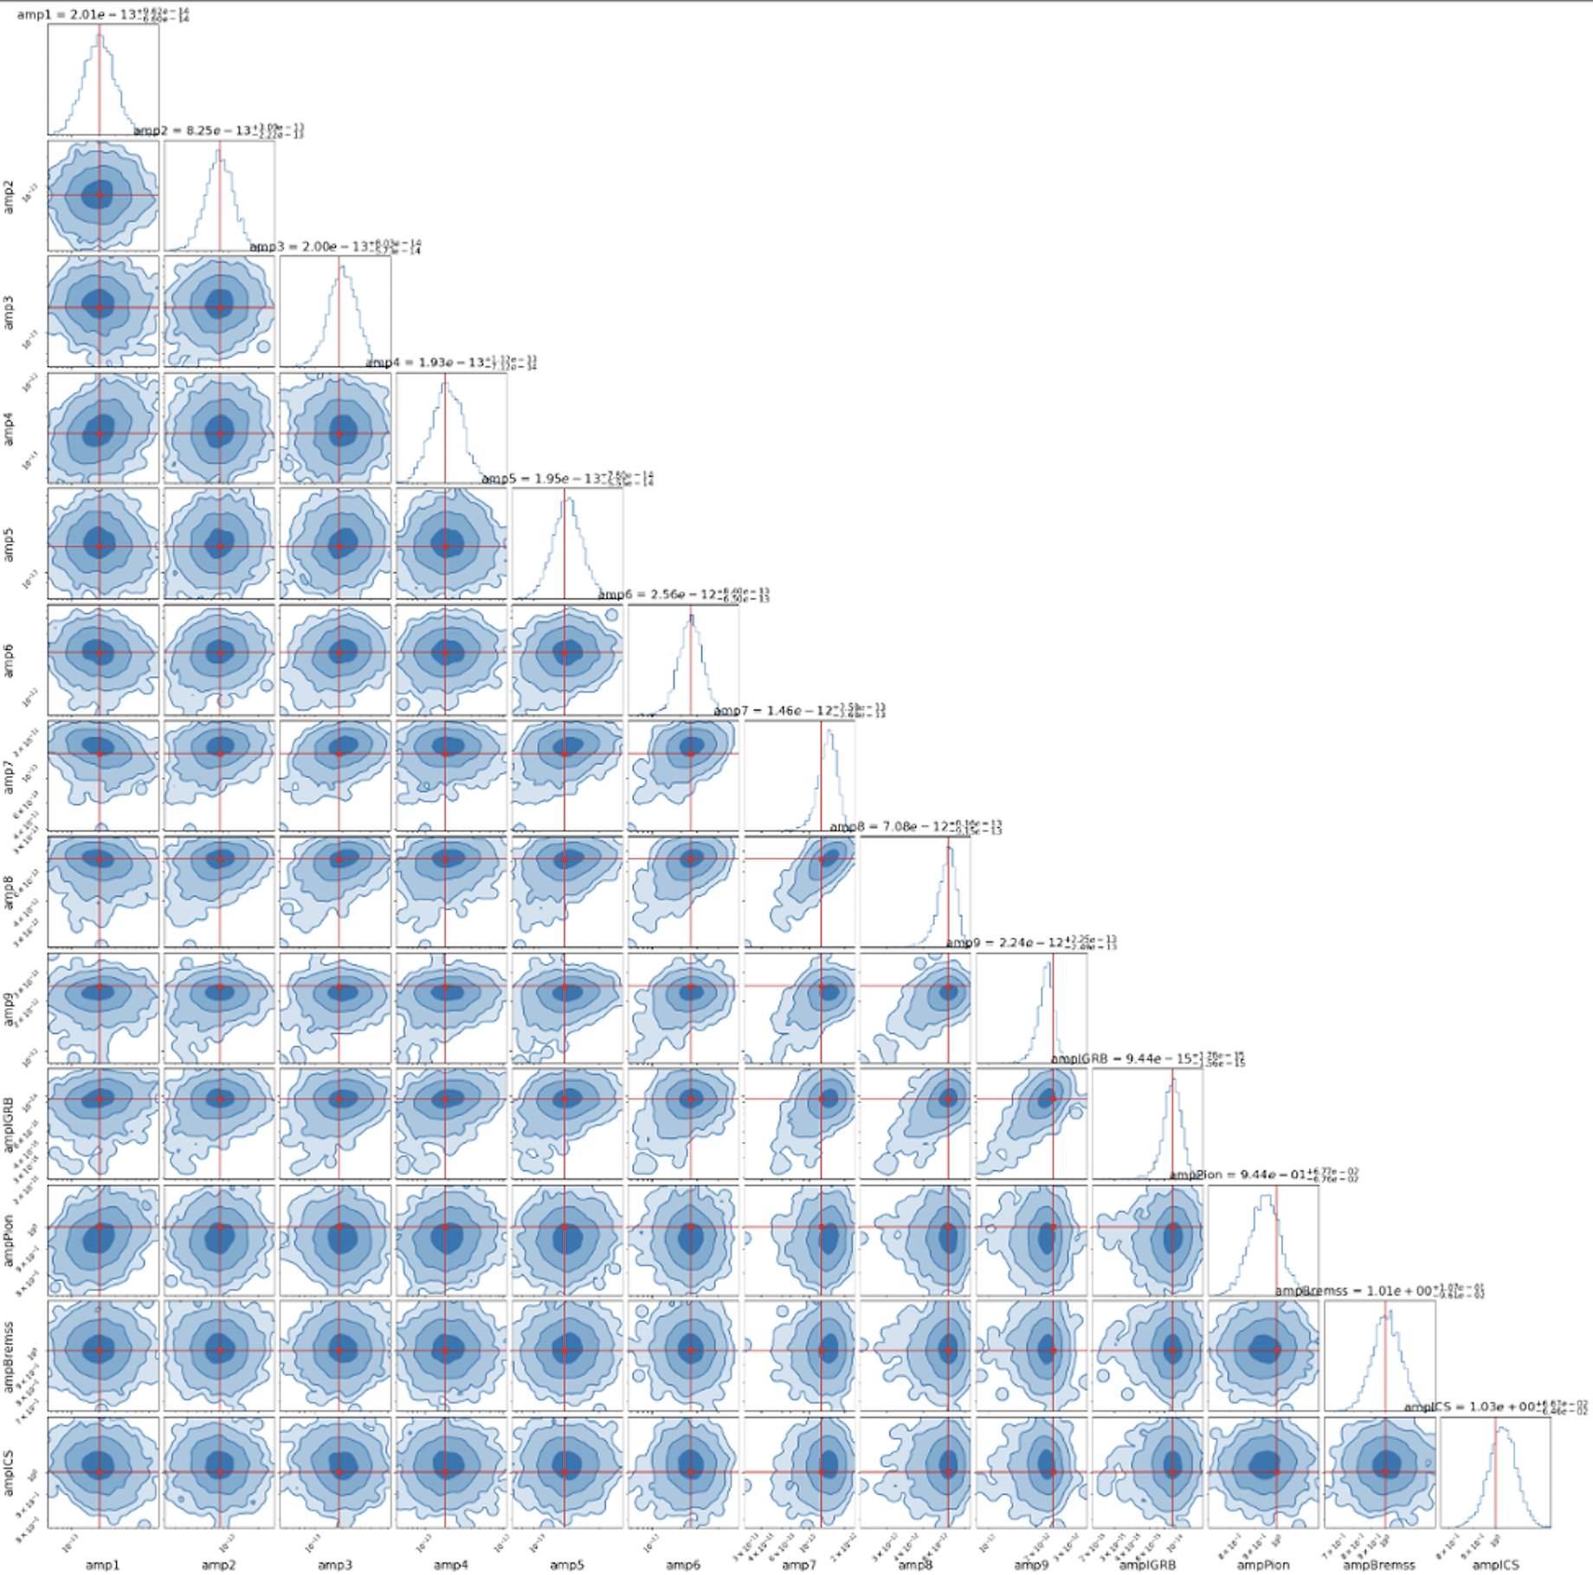
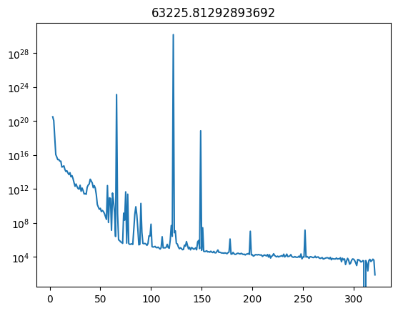
PRELIMINARY
ELBO
Just some of the flux normalisations!
(don’t read)
Iteration
V2
Notes:
Spend more time on the cool things
Make clear not to read it/Dad joke?
Have a clear message

Slide 13
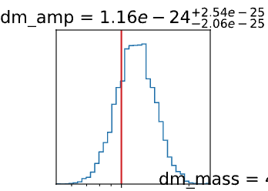
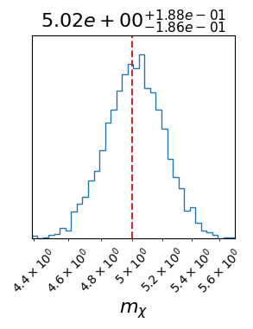
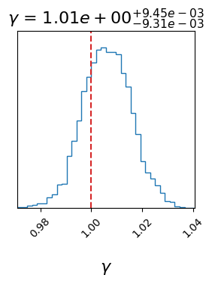
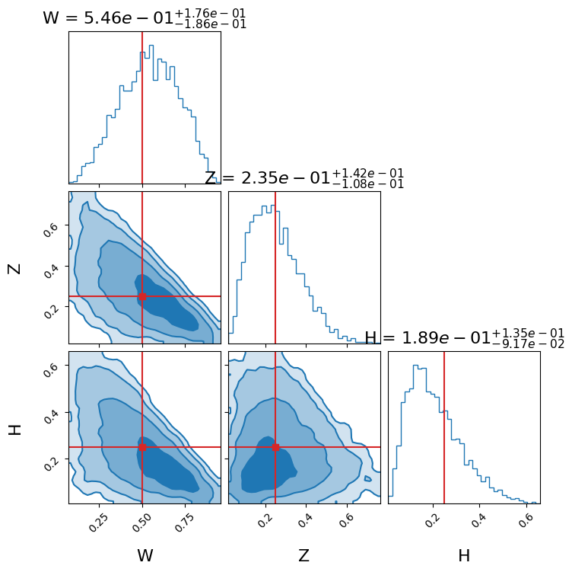



Example Synthetic Dataset Results
$$\left\langle σv\right\rangle ×m_{χ}$$
$$\left\langle σv\right\rangle ×m_{χ}$$
PRELIMINARY
V2
Notes:
Spend more time on the cool things
Make clear not to read it/Dad joke?
Have a clear message

Slide 14
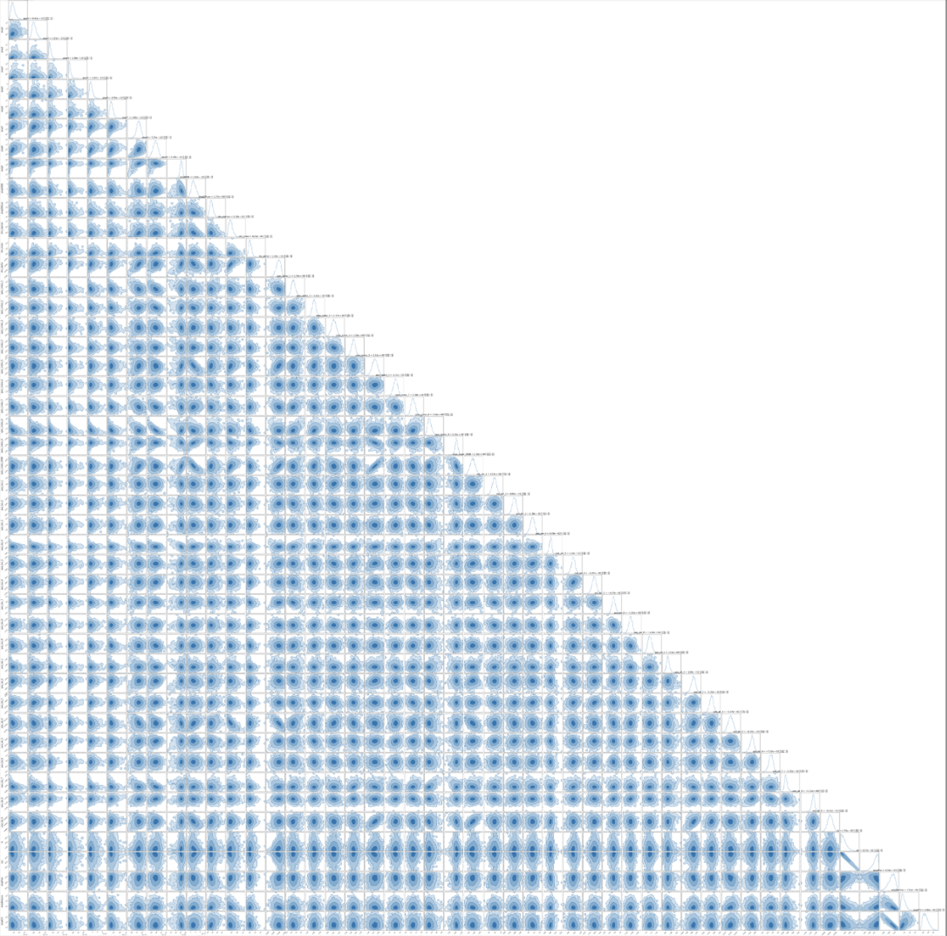

Thank you for listening!
x
Liam.Pinchbeck@monash.edu
And look out for our paper in the next couple of months on arXiv!
GammaBayes GitHub
My website
x
V2
Notes:
QR Code for model independent paper
QR Code for website

Slide 15
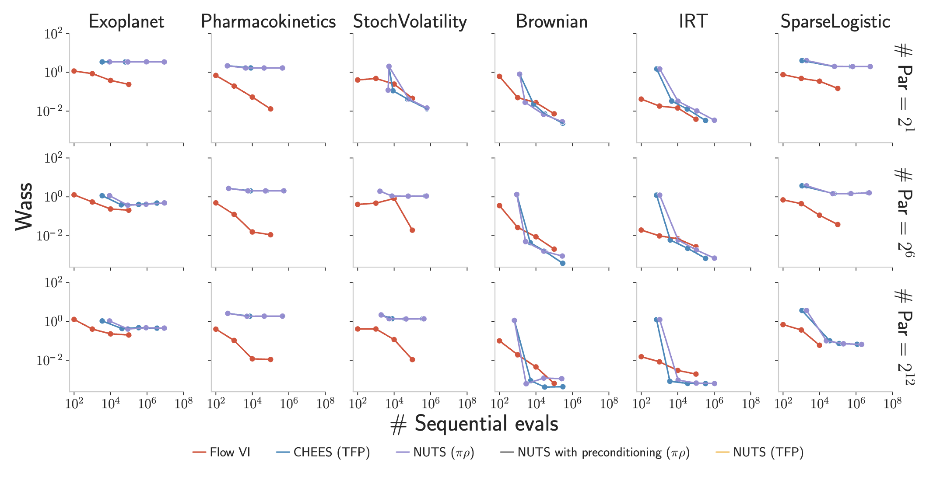
How do flows compare?
“Disentangling impact of capacity, objective, batchsize, estimators, and step-size on flow VI” - arXiv:2412.08824

Slide 16
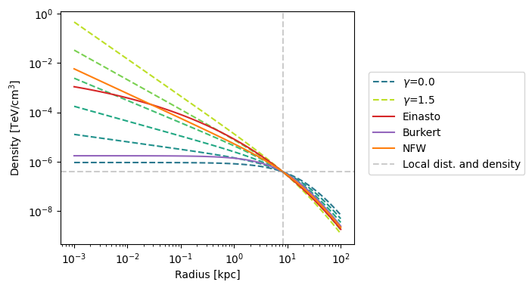

Slide 17
