Slide 1
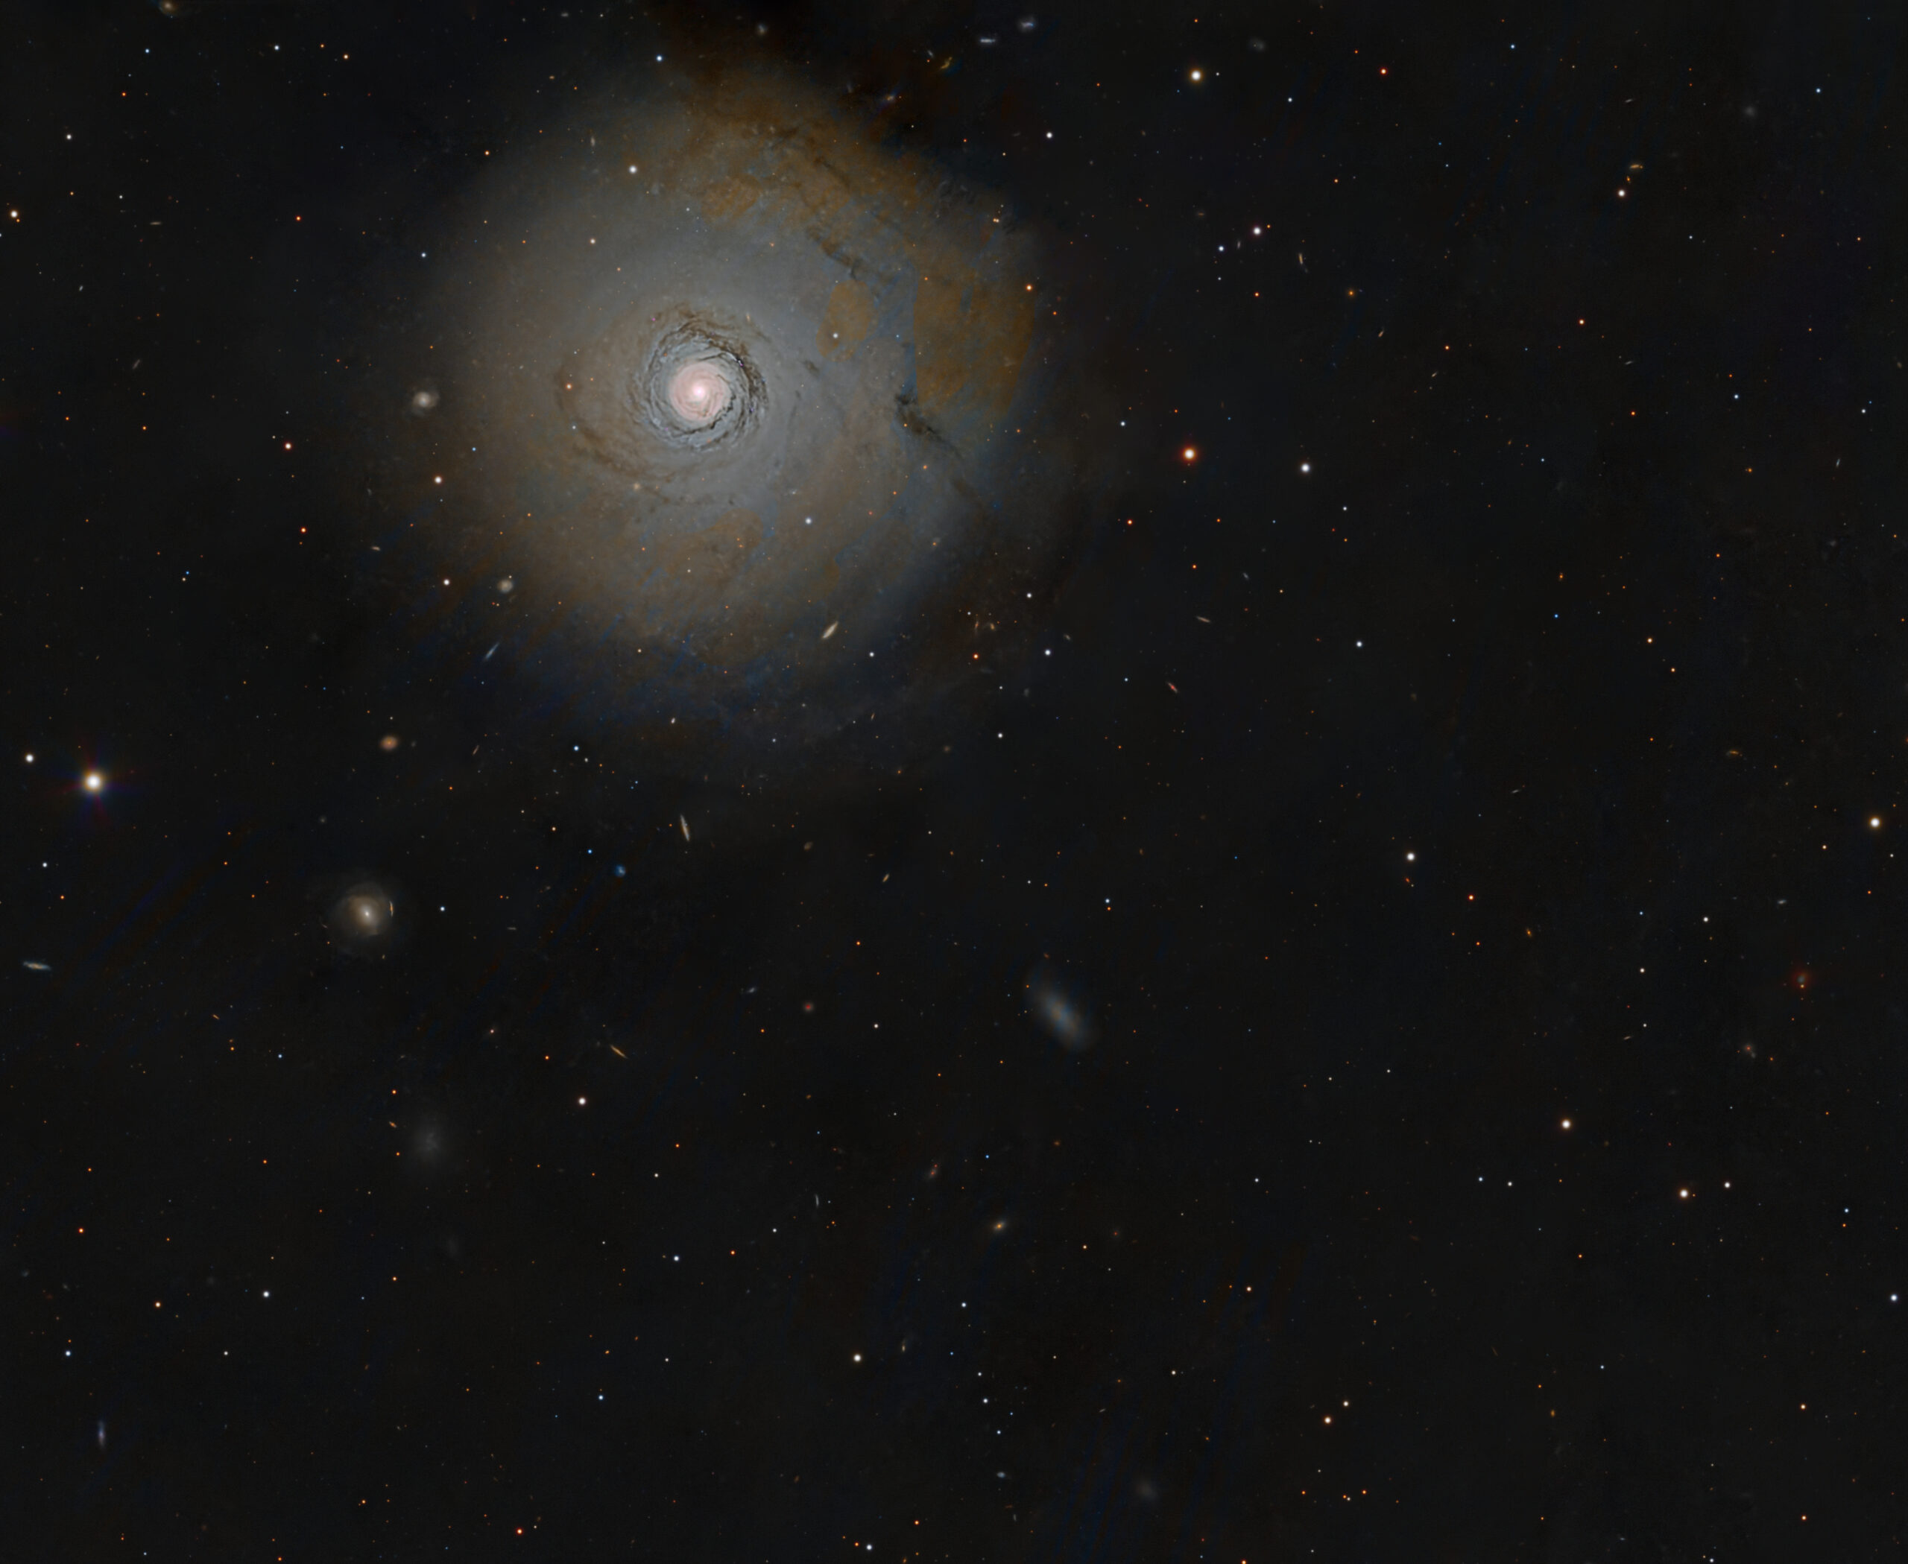
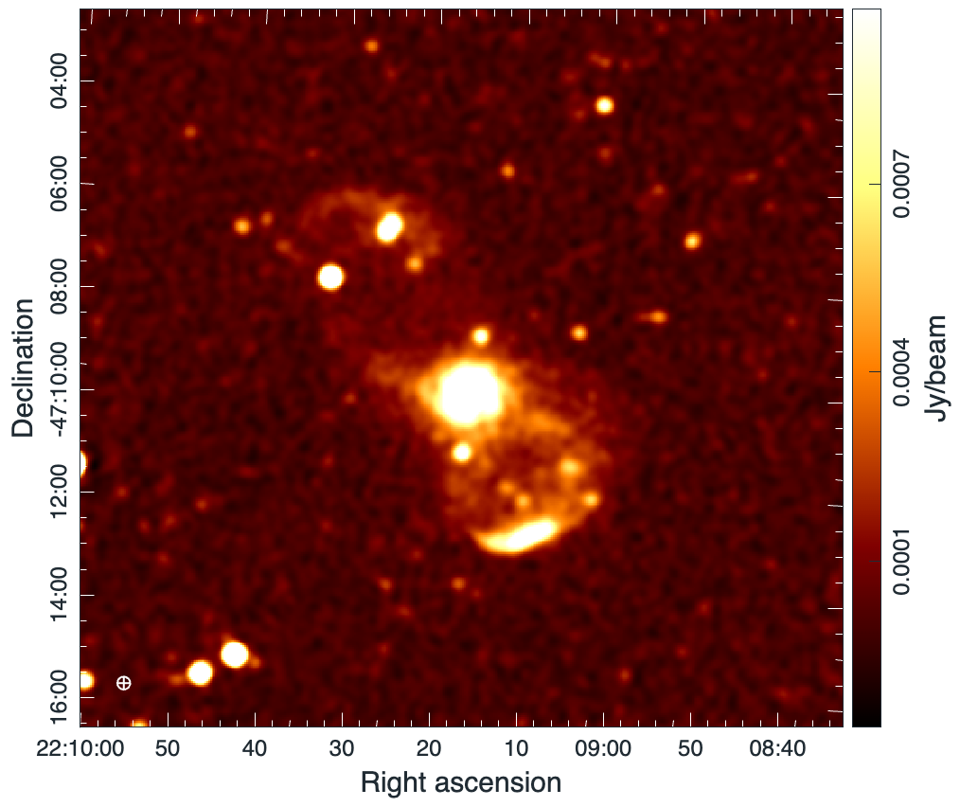

NGC 7213
Mystery of multiple component radio-continuum emission from nearby spiral Seyfert I or LINER type galaxy
`sand-timer’ (NGC 7213)
Prof. Miroslav D. Filipovic

Slide 2
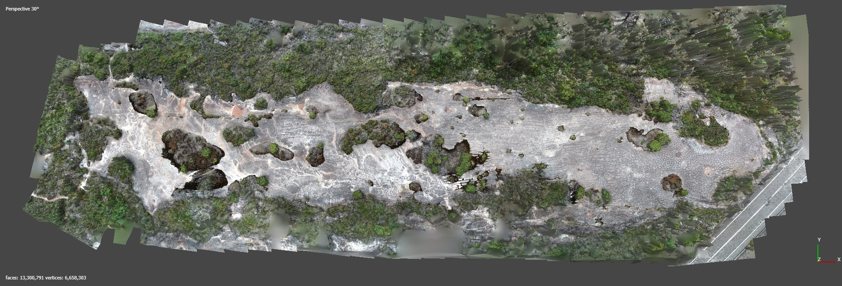
Acknowledgement of Country
Elvina

Slide 3
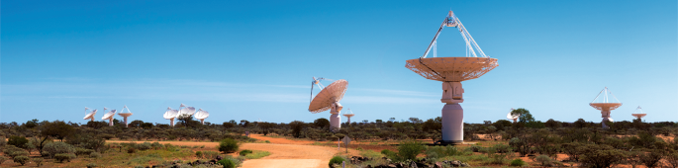
THANKS:
A lot of people … about 250+
SUPER SPECIAL THANKS: ASKAP!

Slide 4
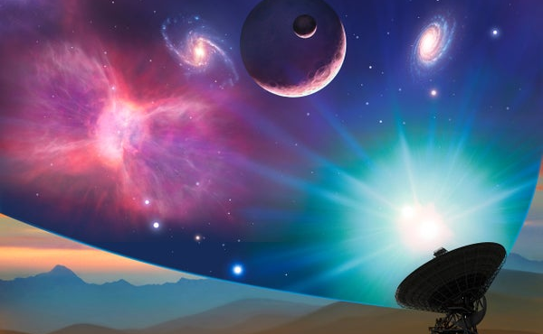
High energy astrobiology

Slide 5
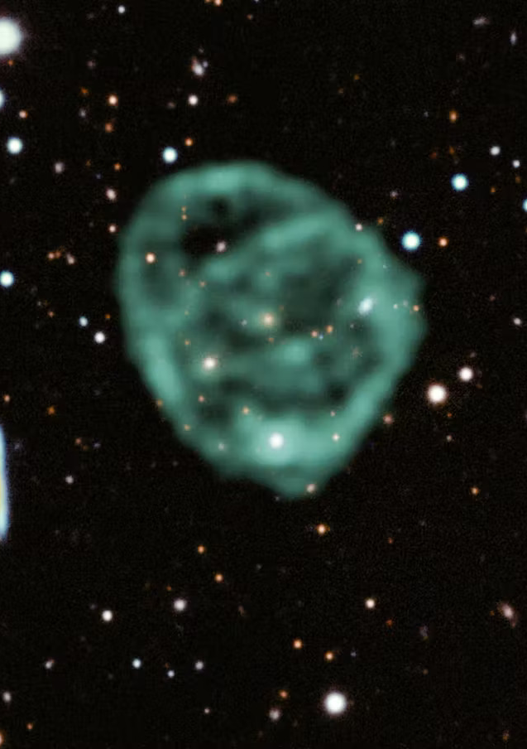
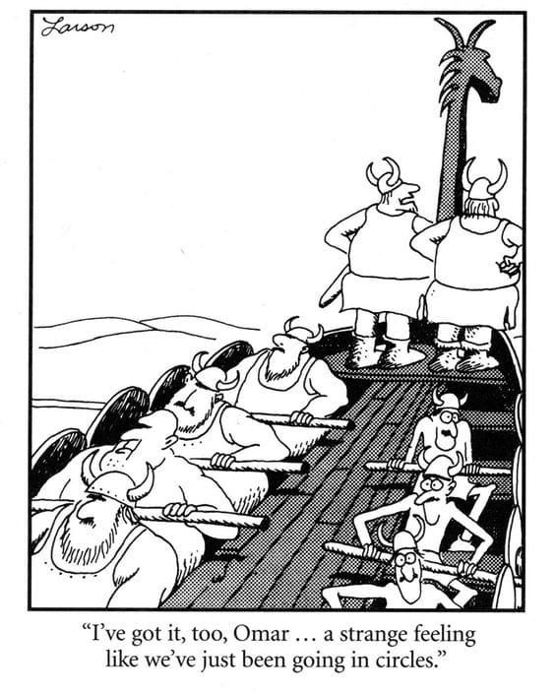




Odd Radio Circles (ORCs)
MeerKAT, Norris+22

Slide 6
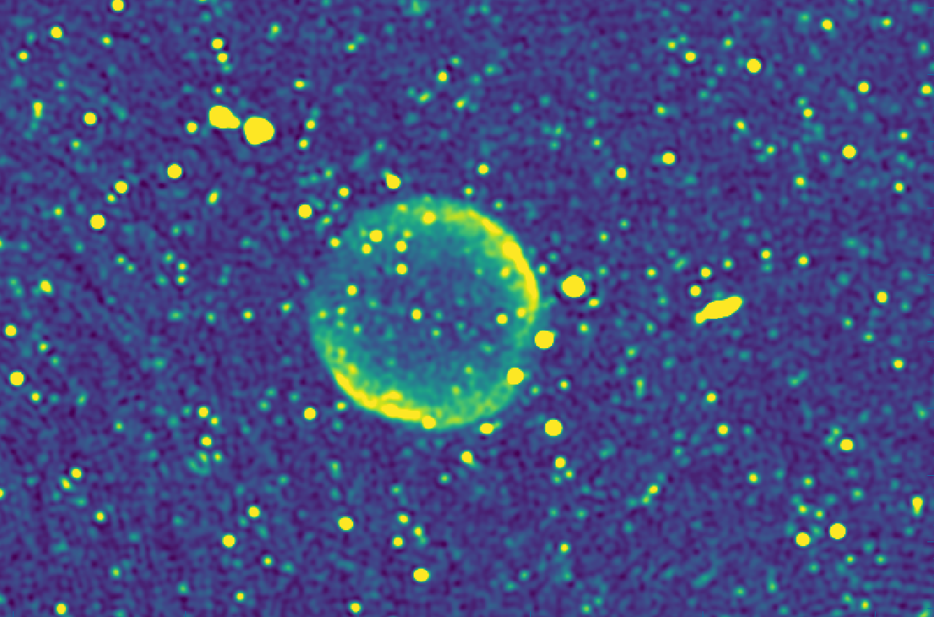

LMC ORC!
First intergalactic SNR
MeerKAT at 1.283 MHz
Sasaki+24

Slide 8
Macgregor+ 2025

Slide 9

Anglerfish
ASKAP
Area of diffuse non-thermal radio emission
Central variable star V687 Car
V687 Car not associated?
Central elliptical galaxy WISEA J094409.17-751012.8
ORC candidate with WISE galaxy as host
Filipović+25

Slide 10
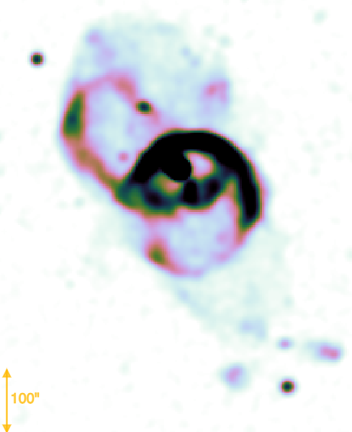
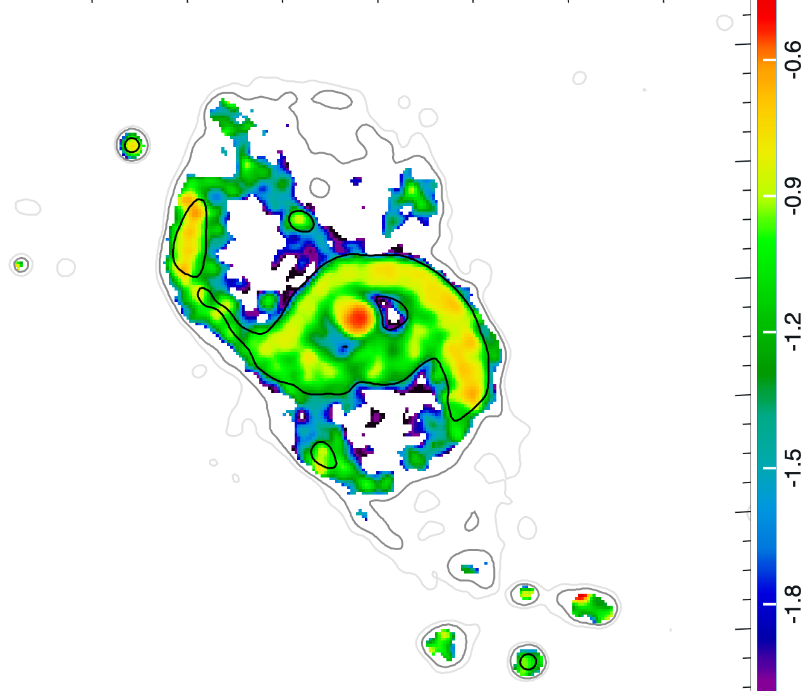

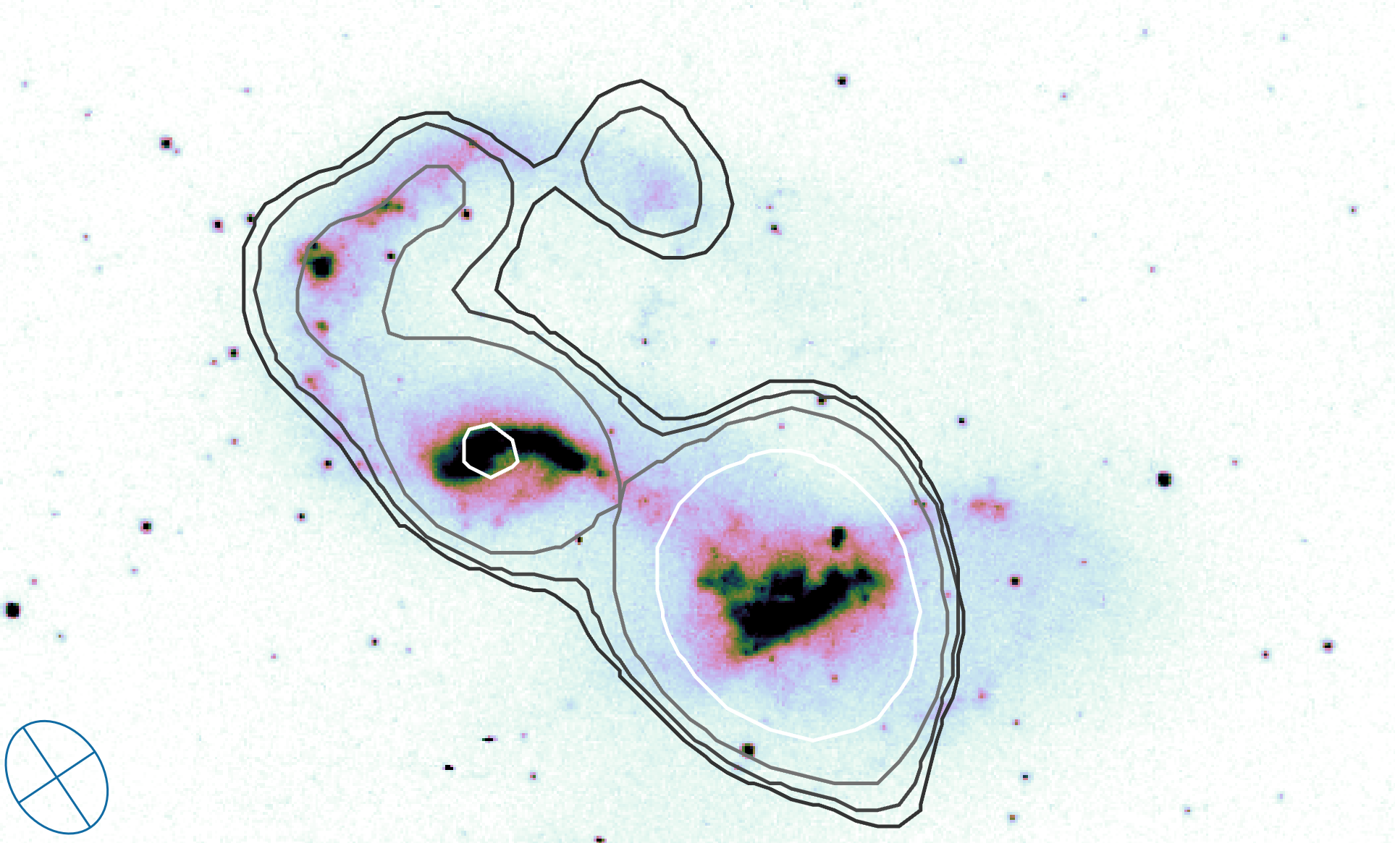
Velović+ 2025
ASKAP
ATCA 5 GHz
HST

Slide 11
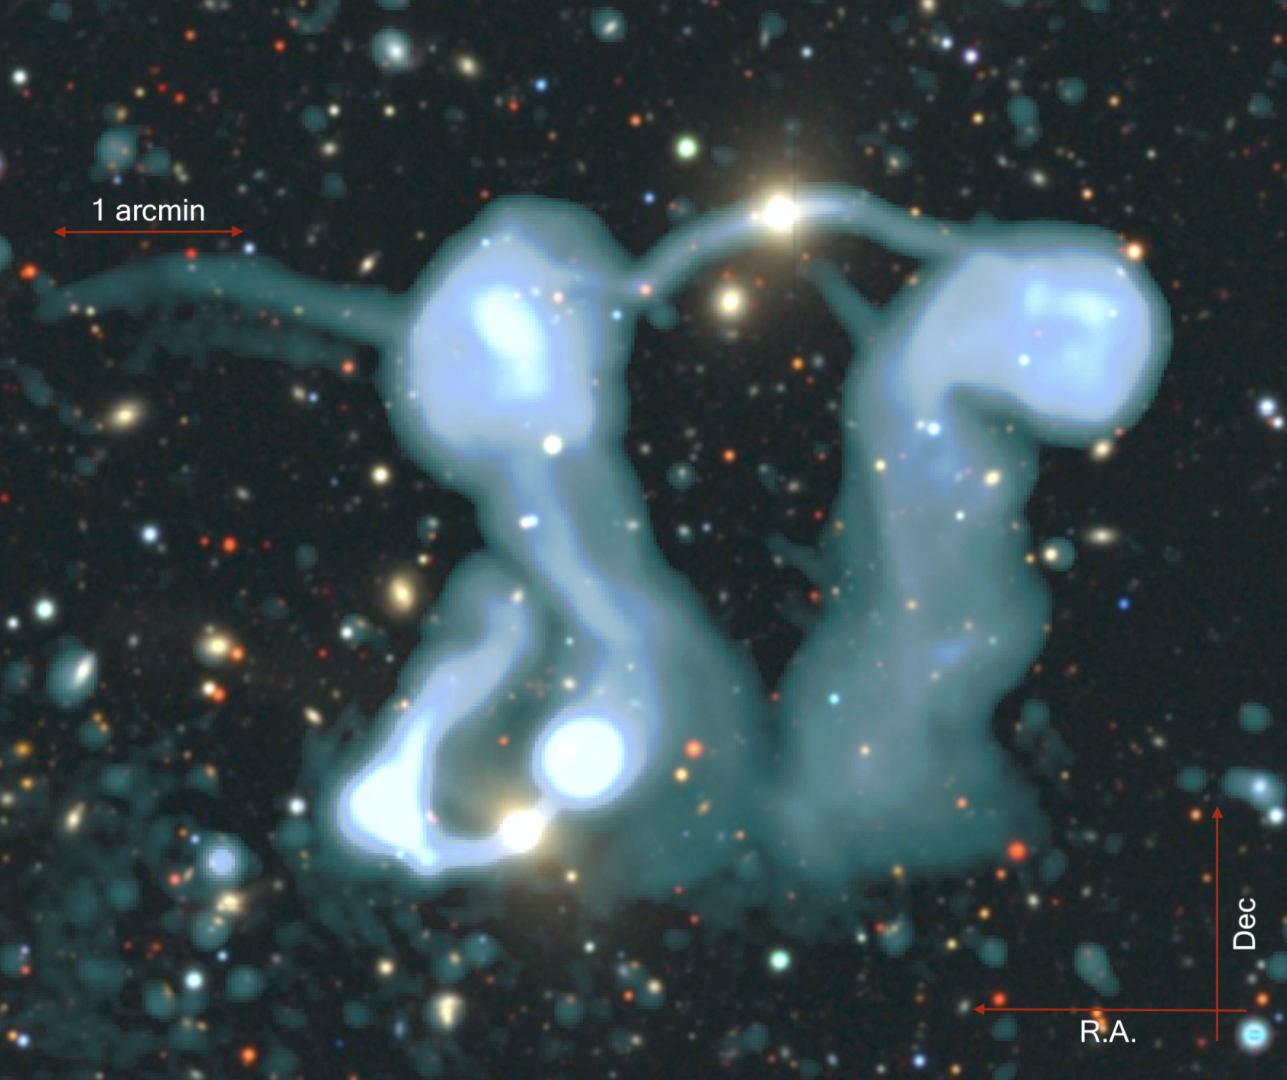

The Dancing Ghosts
Velović et al. 2023
ASKAP/MeerKAT at 1284 MHz
Beam size: 7.5´´ x 7.1´´

Slide 12

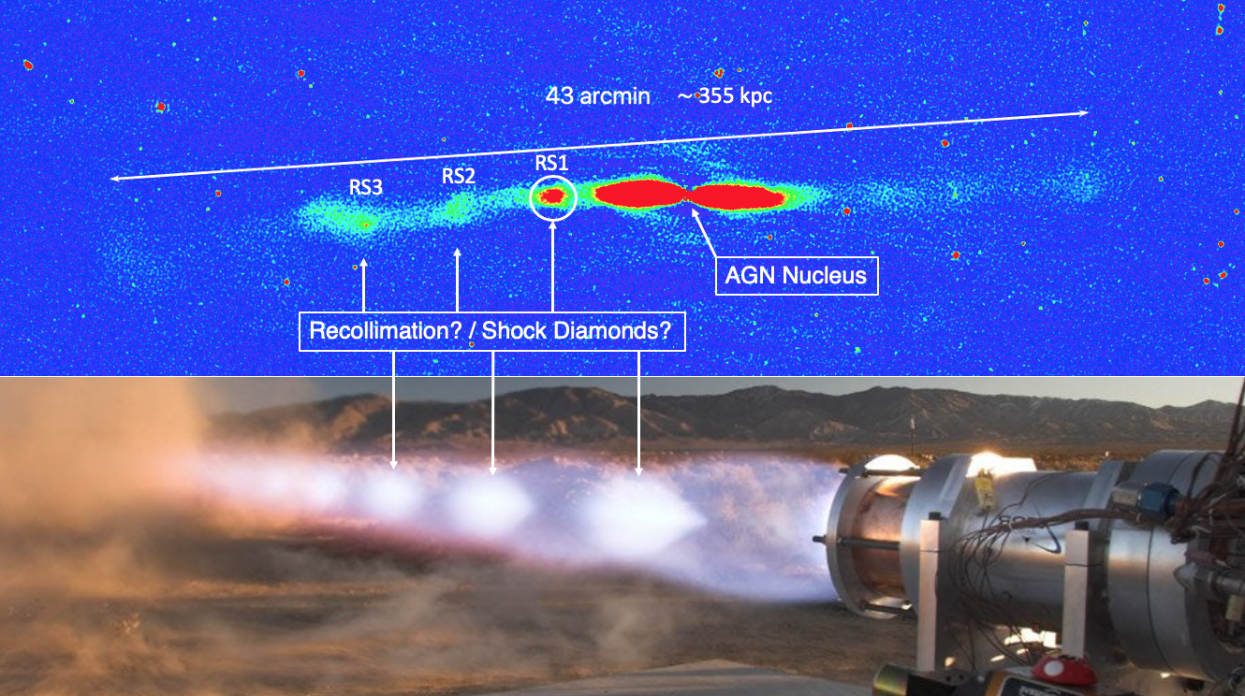
(Re)collimation shocks on large-scales
NGC 2663
D = 28.5 Mpc
N
S
ASKAP
Pressure mismatch between the jet and the ambient medium (rarefied).
Jet narrows and brightens up.
Velović+22
Notes:
pressure mismatch
supersonic exhaust system jet

Slide 13
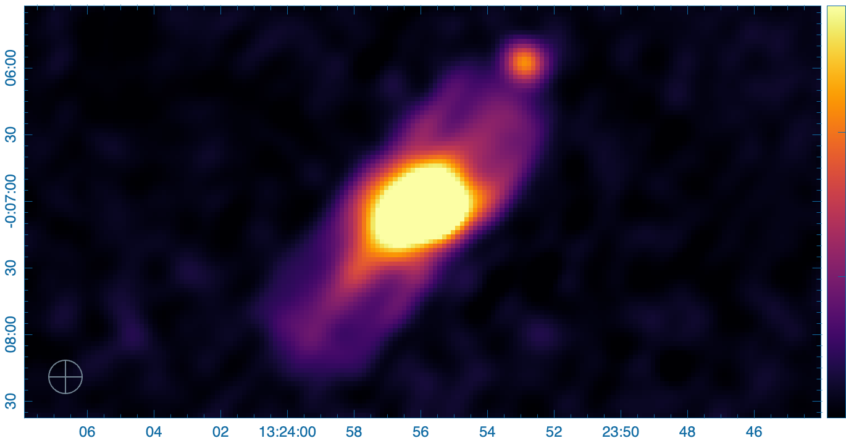
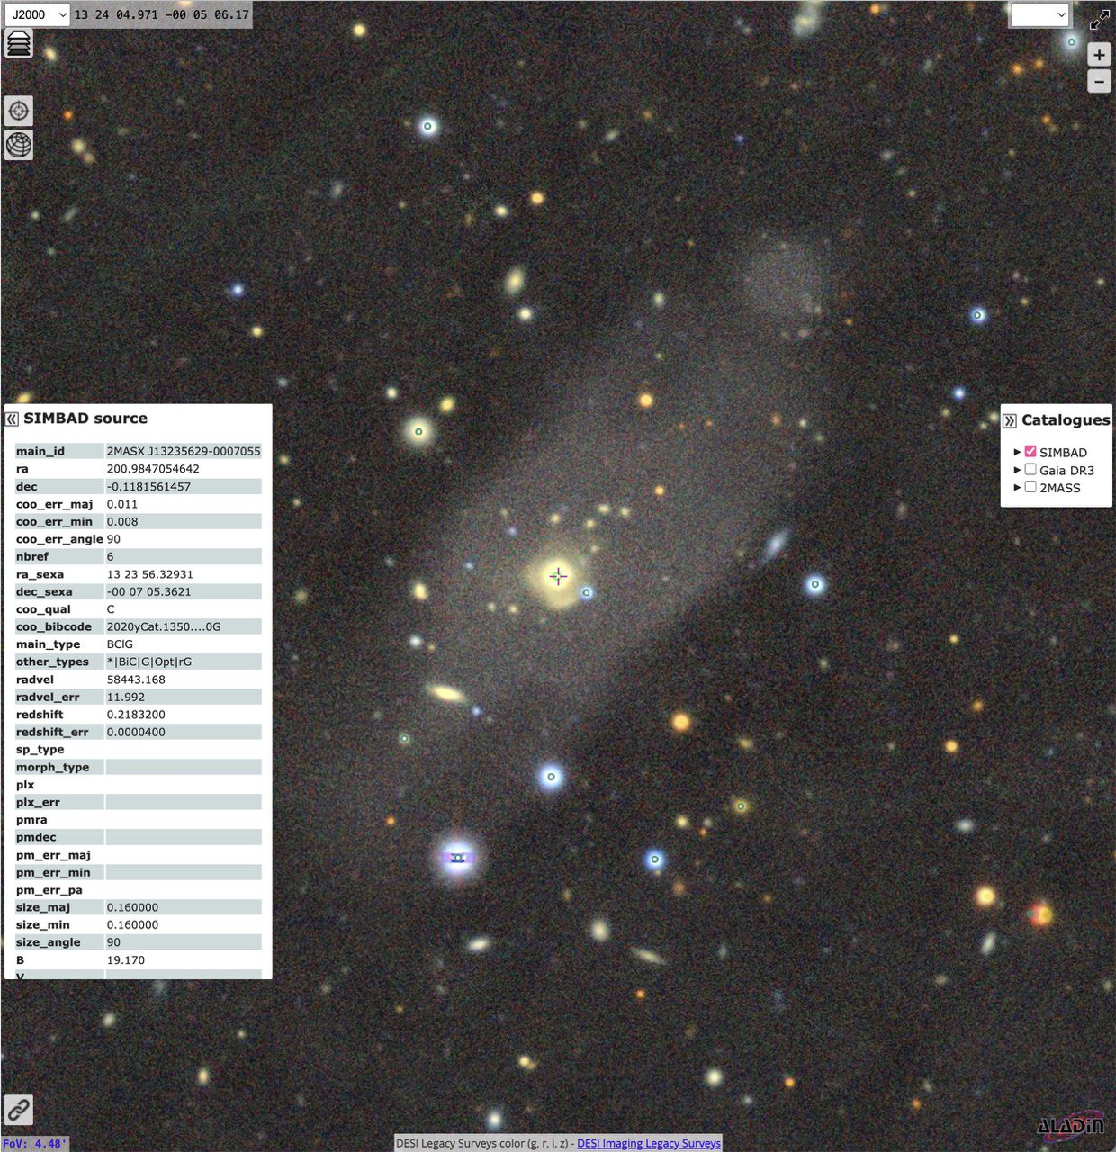
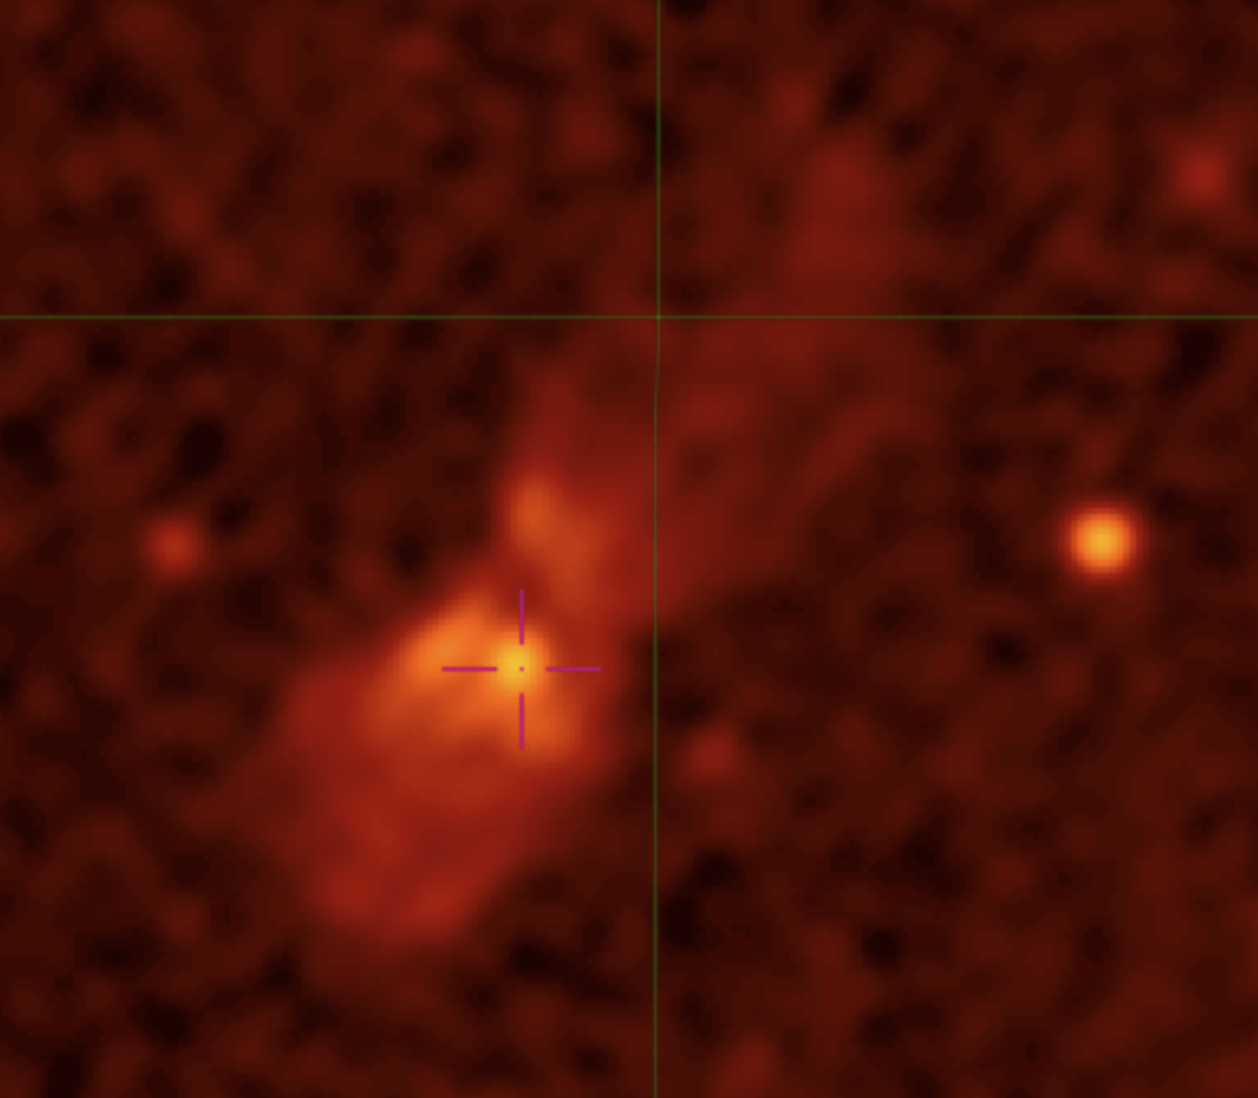
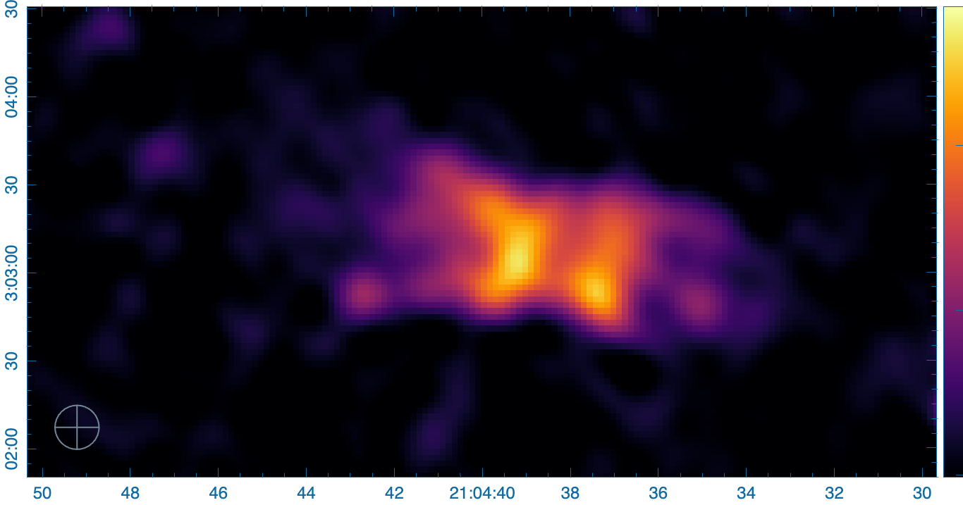

“TRIDENT” AGN
ASKAP
ASKAP
Ahmad+ 25

Slide 14
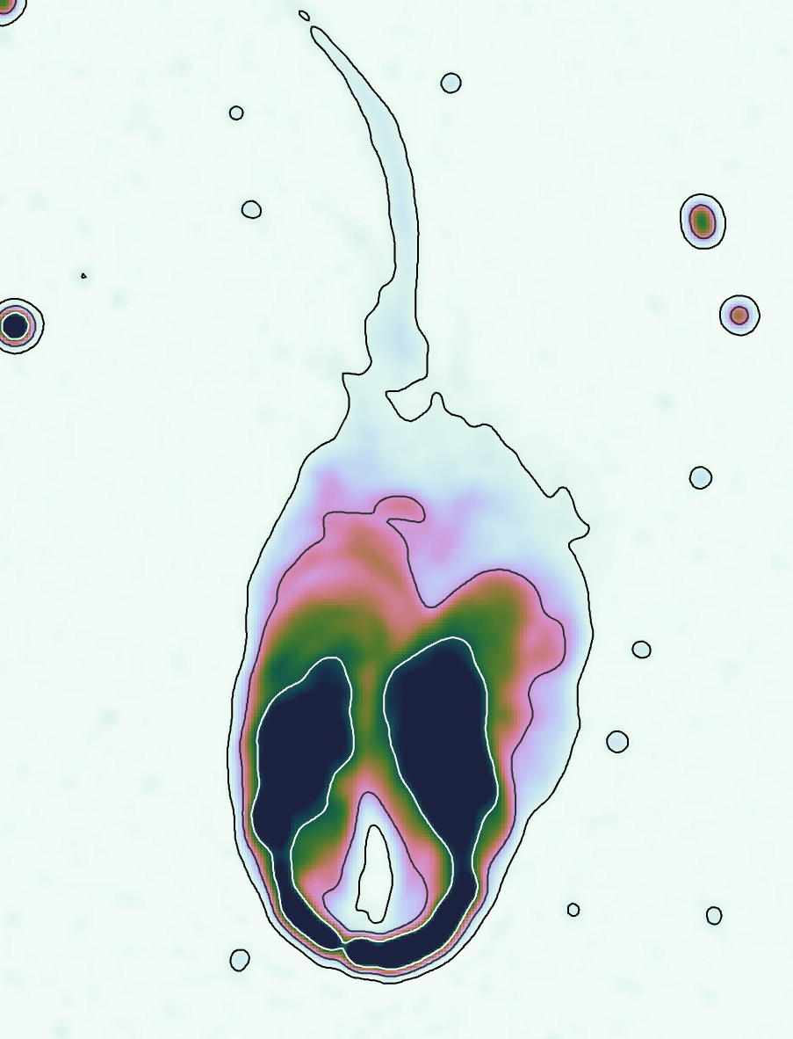
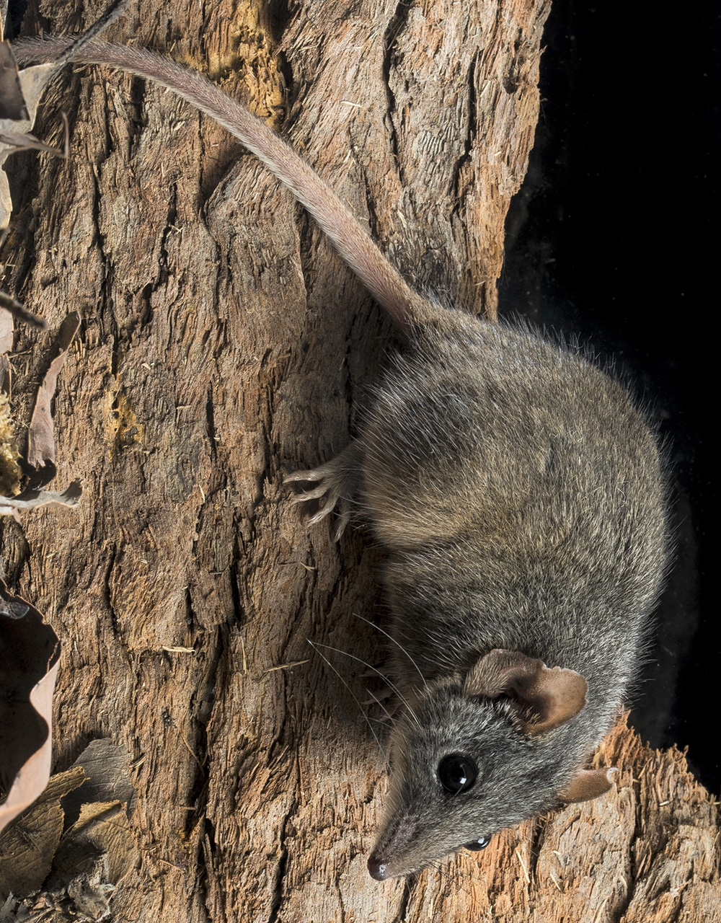

ASKAP
Antechinus (LEDA 309326)
Bent tail radio galaxy
Radio galaxy with powerful jets being pushed back, likely by strong environmental winds
Long tail trailing behind, discovered in new radio data
Distance: 152 Mpc
Size
Main body: 190 kpc
Tail: 180 kpc
Total: 370 kpc
Rajabpour+ 25

Slide 15

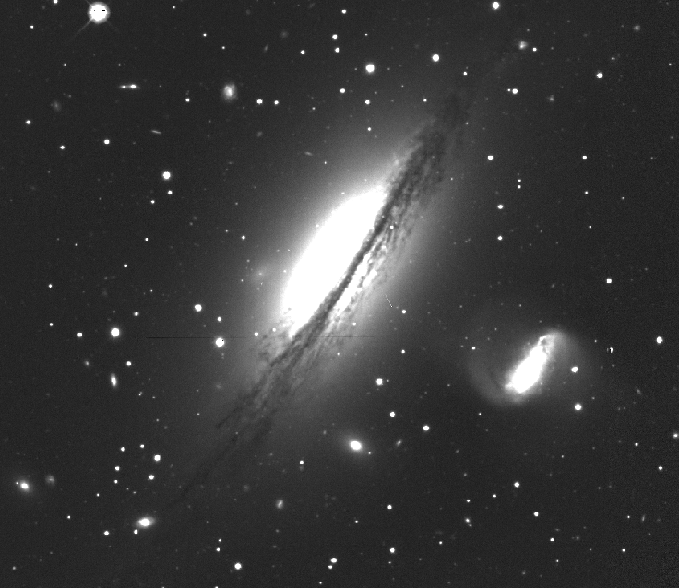
Killer AGN (NGC 5078 and IC 4222)
ASKAP
Smeaton+25
IC 4222: Smaller galaxy being hit by radio jets
Modelling of IC 4222 shows a dramatic event 300 Myr ago, where IC 4222 star formation rate dropped 40%
Galaxy pair NGC 5078 and IC 4222
NGC 5078: Radio AGN with bright jets pointing towards the smaller galaxy IC 4222
Left: Composite optical image from DESI DR10 survey, averaged over the four DESI DR10 optical bands, g, r, i, and z. Right: 944 MHz ASKAP EMU radio-continuum image of NGC 5078 IC 4222 galaxy pair.

Slide 16

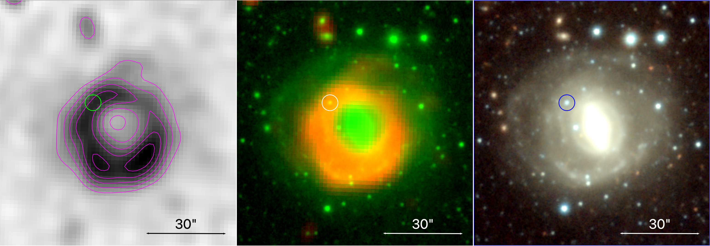
Starburst (?) Radio Ring Galaxies (RaRiGx)
Karakondzula
ASKAP
DES
Lindblad resonance ?
Rajabpour+ 25
Notes:
an orbital resonance in which an object's epicyclic frequency (the rate at which one periapse follows another) is a simple multiple of some forcing frequency

Slide 17
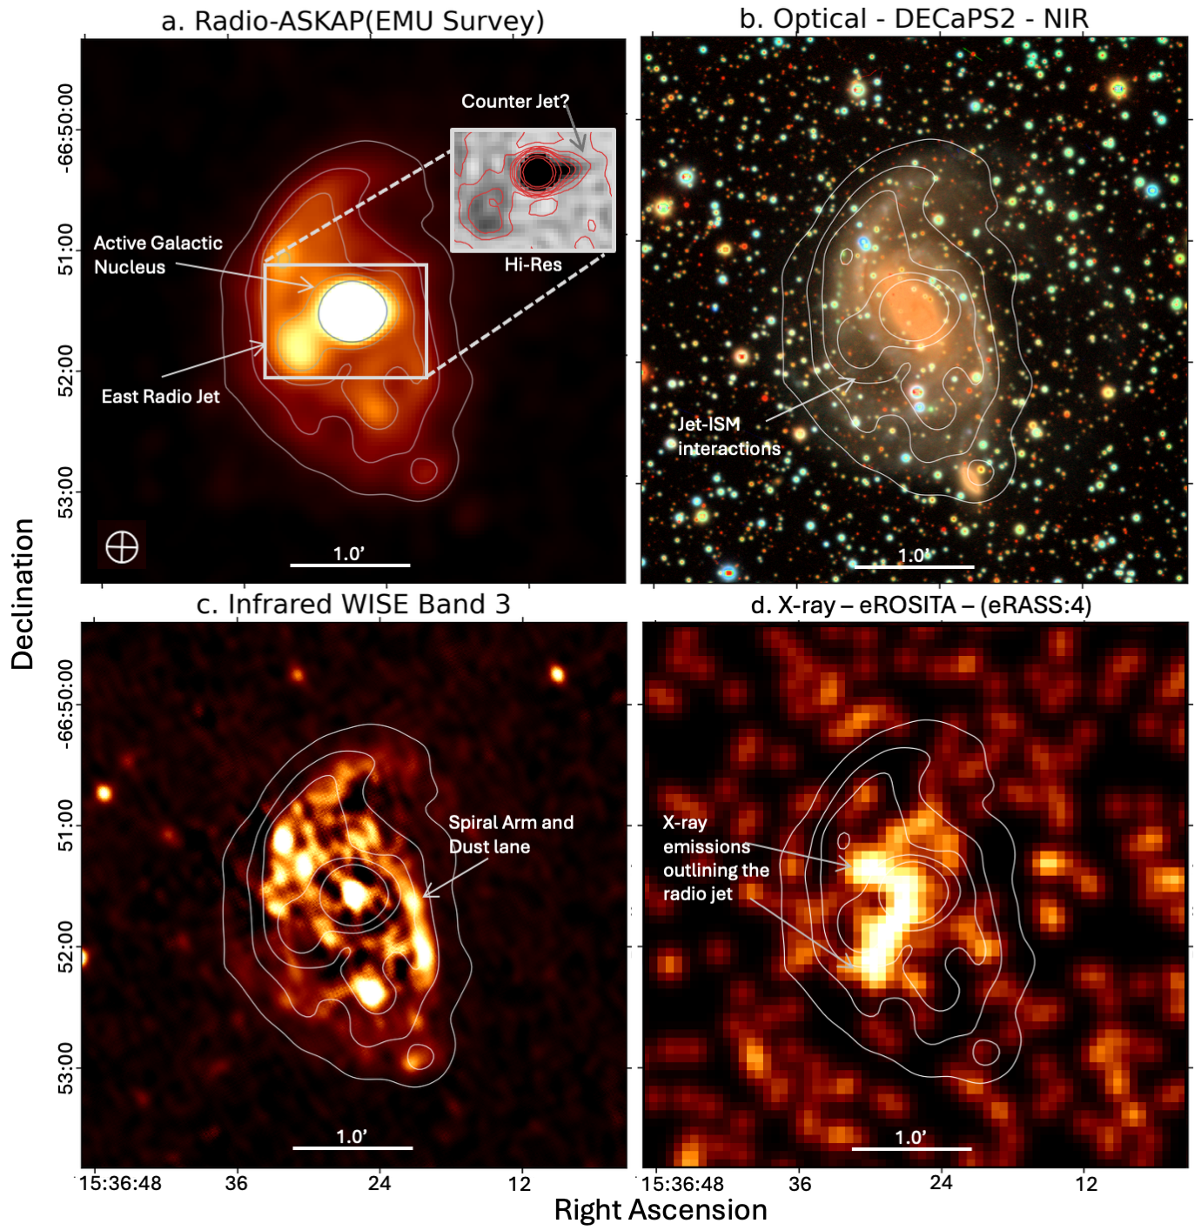

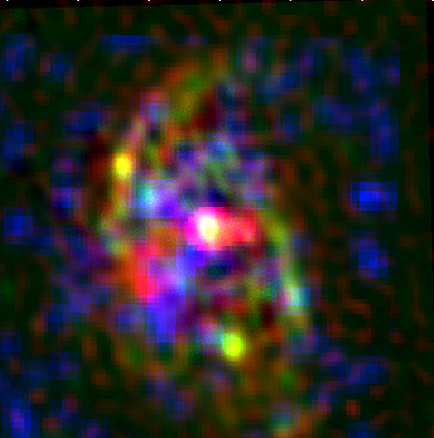
Barred Spiral Galaxy NGC 5938 -- Araish
(means adornment in Urdu)
D_{ist} ~26 Mpc
Zakir+ 2025

Slide 18
NGC 7213 – sand-timer
Nearby face-on spiral at D~25Mpc
A member of the Indo-Pavus group
Seyfert I and/or
Low-Ionisation Narrow Emission-Line Region (LINER)
The most-luminous low-luminosity AGN (LLANG)
Substantial variability at radio & X-ray frequencies
Unlike many spirals, deficient in cold gas and shows suppressed star formation.
The lack of molecular gas near the centre may explain why the AGN dominates while the galaxy is otherwise relatively quiescent (ALMA).

Slide 19
ASKAP and NGC 7213
944 MHz -
Recent ASKAP tile SB76123
Stokes I and V
Resolution 15”x15” at rms~25μJy/beam
Stokes Q and U but at 18”x18”

Slide 20
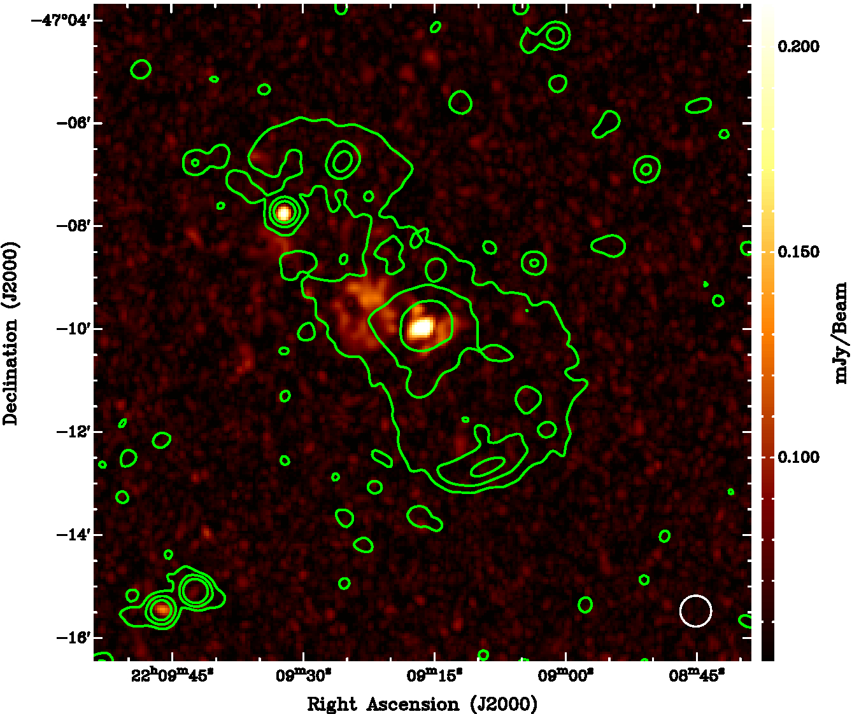
ASKAP and NGC 7213
944 MHz - SEND-TIMER
Recent ASKAP tile SB76123
Stokes I and V
Resolution 15”x15” at rms~25uJy/beam
Stokes Q and U but at 18”x18”

Slide 21
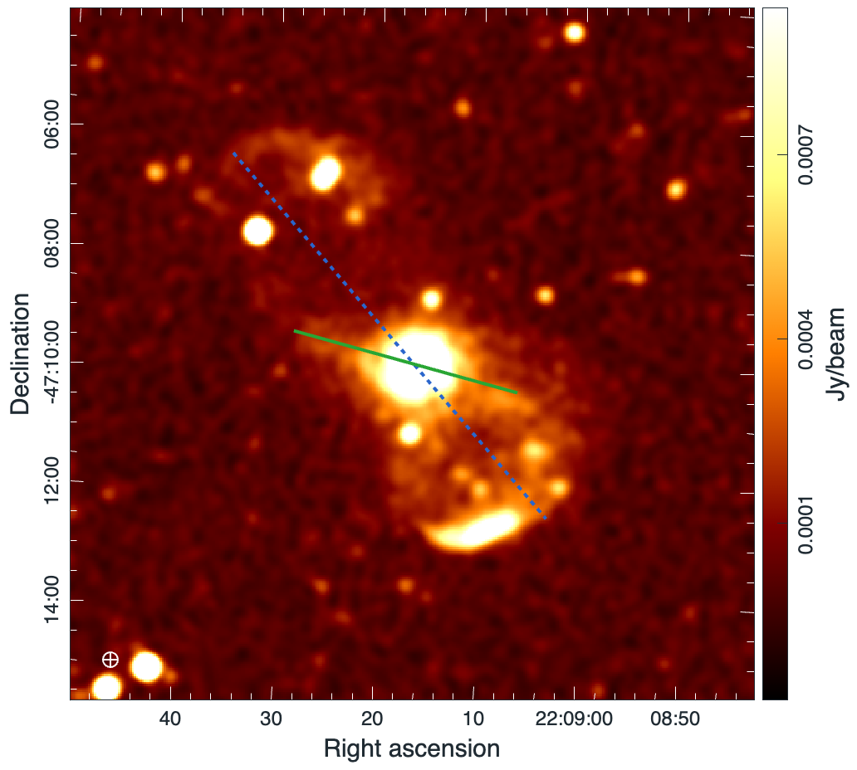
ASKAP and NGC 7213

Slide 22
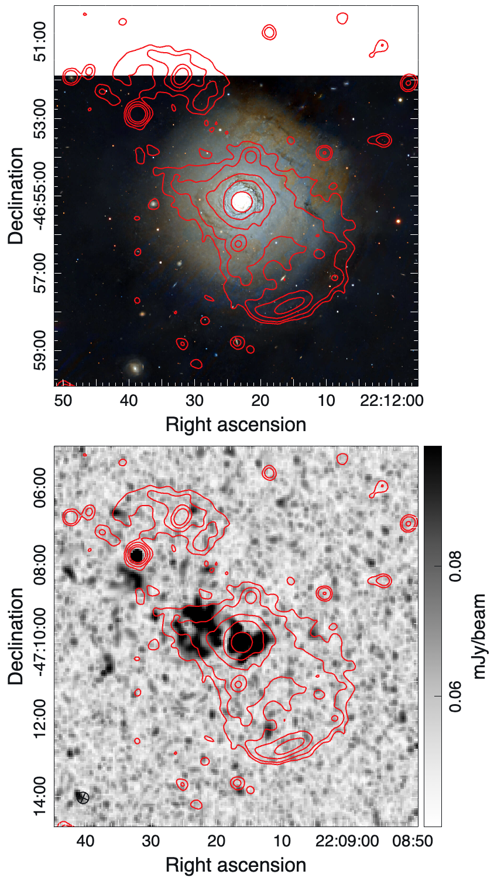
ASKAP and NGC 7213

Slide 23
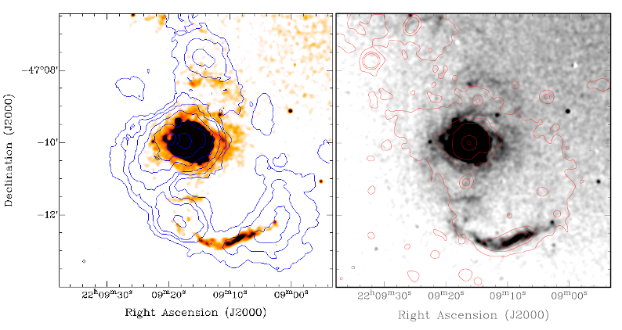
HI/Hα and NGC 7213
Hameed+01

Slide 24
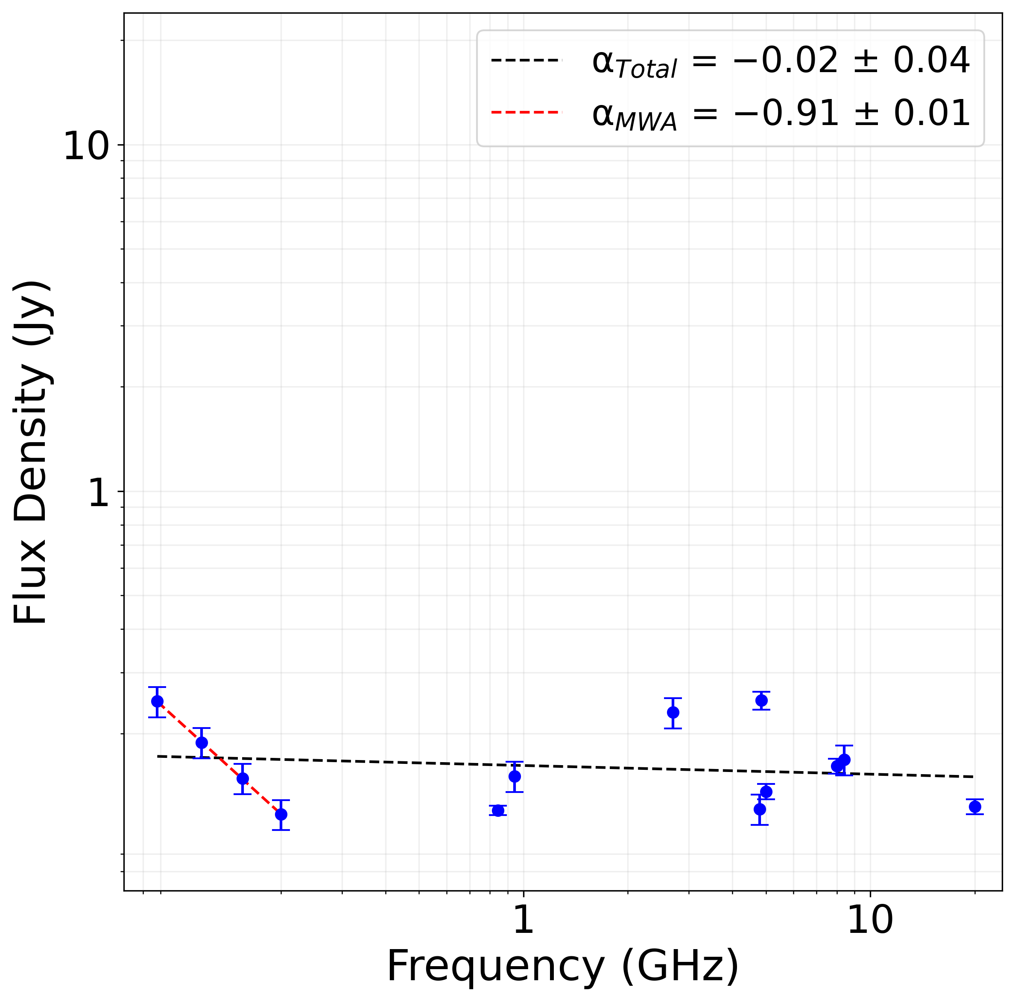
NGC 7213 radio spectral index

Slide 25
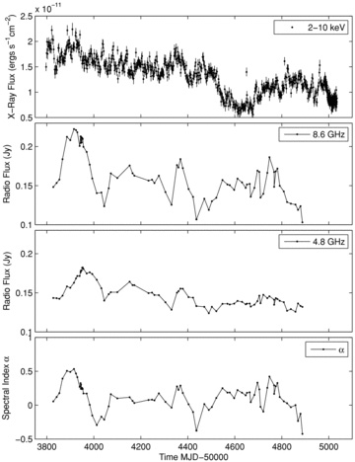

Top panel: X-ray flux versus time (MJD 50000). Top central panel: radio flux S_{8.4 GHz} versus time.
Rossi X-ray Timing Explorer (RXTE) Proportional Counter Array
NGC 7213:
ATCA and variability
Notes:
Figure 1 Top panel: X-ray flux versus time (MJD 50000). Top central panel: radio flux S8.4 GHz versus time. Bottom central panel: radio flux S4.8 GHz versus time. The errors are too small to show on both radio flux figures, but are typically ∼0.4 mJy beam−1. Bottom panel: spectral index (8.4–4.8 GHz) α versus time, where Sv∝ν+α.
Unless provided in the caption above, the following copyright applies to the content of this slide: © 2010 The Authors Monthly Notices of the Royal Astronomical Society © 2010 RAS

Slide 26
Rossi X-ray Timing Explorer (RXTE) Proportional Counter Array
NGC 7213:
ATCA and variability
Recent ATCA-CABB observations (AUG 24 to MAR 25)
SPT: “Dramatic change (72%) in flux over two weeks period”
Notes:
Figure 1 Top panel: X-ray flux versus time (MJD 50000). Top central panel: radio flux S8.4 GHz versus time. Bottom central panel: radio flux S4.8 GHz versus time. The errors are too small to show on both radio flux figures, but are typically ∼0.4 mJy beam−1. Bottom panel: spectral index (8.4–4.8 GHz) α versus time, where Sv∝ν+α.
Unless provided in the caption above, the following copyright applies to the content of this slide: © 2010 The Authors Monthly Notices of the Royal Astronomical Society © 2010 RAS

Slide 27
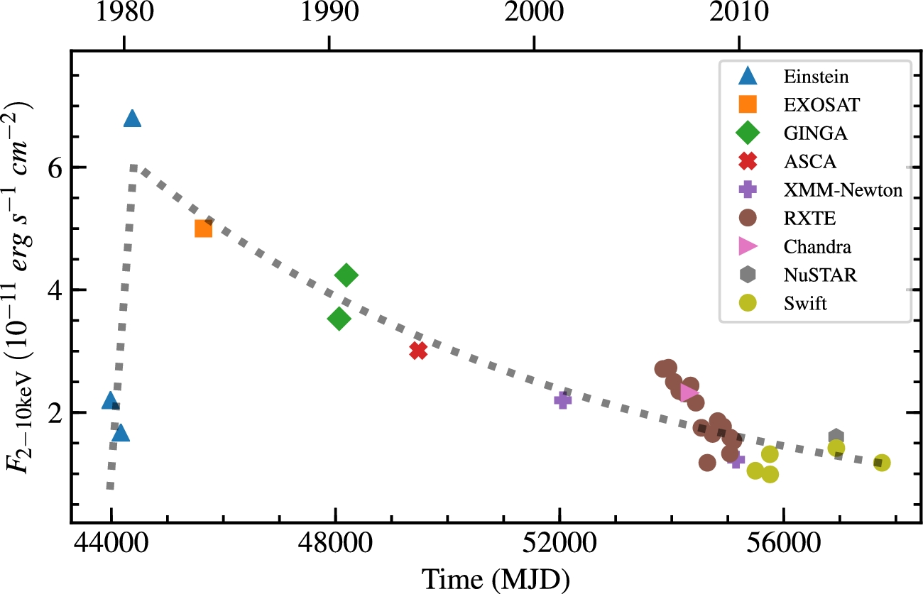
NGC 7213: X-ray variability
Yan & Xie 2017
The long-term X-ray light curve in LLAGN NGC 7213. This source brightens by a factor of ∼4 within ∼ 200 days and then slow declinE.

Slide 28
WHAT we see in send-timer
hyperbubbles
56.7×27.7 kpc
Radio jets
Polarisation
“Dramatic” Variability
"inner jets”?
32.5×20.7 kpc

Slide 29
WHAT is NGC7213
Precessing SMBH with restarting jets
SMBBH with TDE (Changing Look (CL))
Galaxy Hyperbubble as FRII
"inner jets”?
56.7×27.7 kpc

Slide 30
FUTURE
SPT and JWST is happening as we speak…
LBA
MeerKAT
ESO (MUSE) and GEMINI
CTA?
…

Slide 31
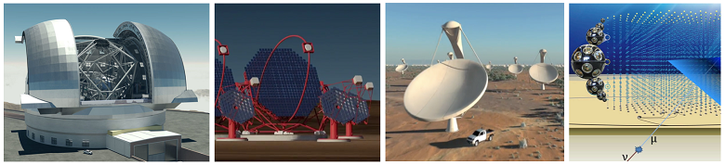
Are these golden days for Astronomy?
EELT CTA SKA KM3NeT

Slide 32
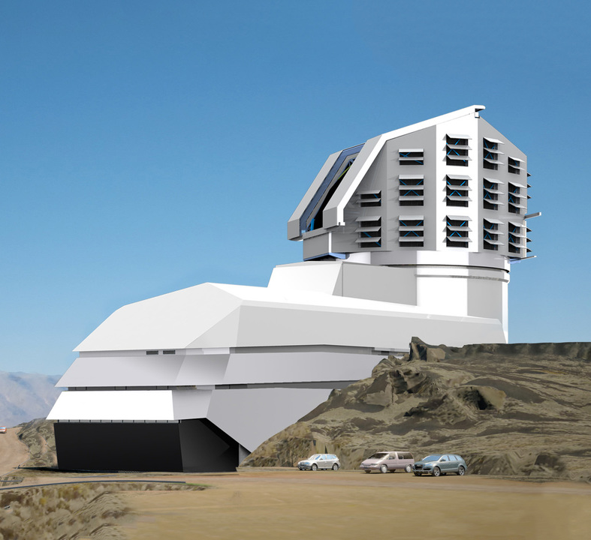
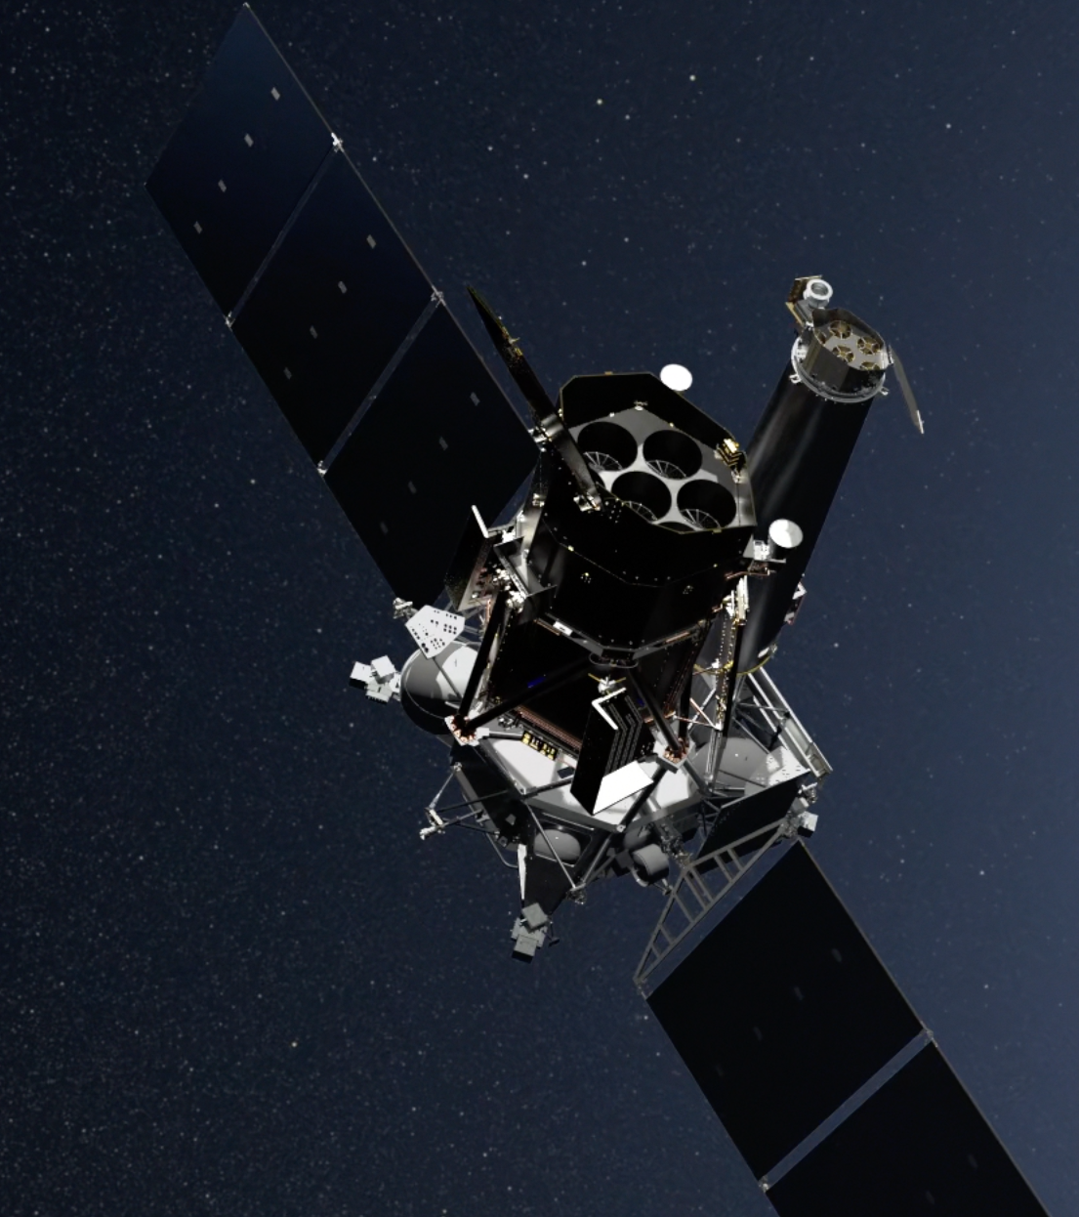
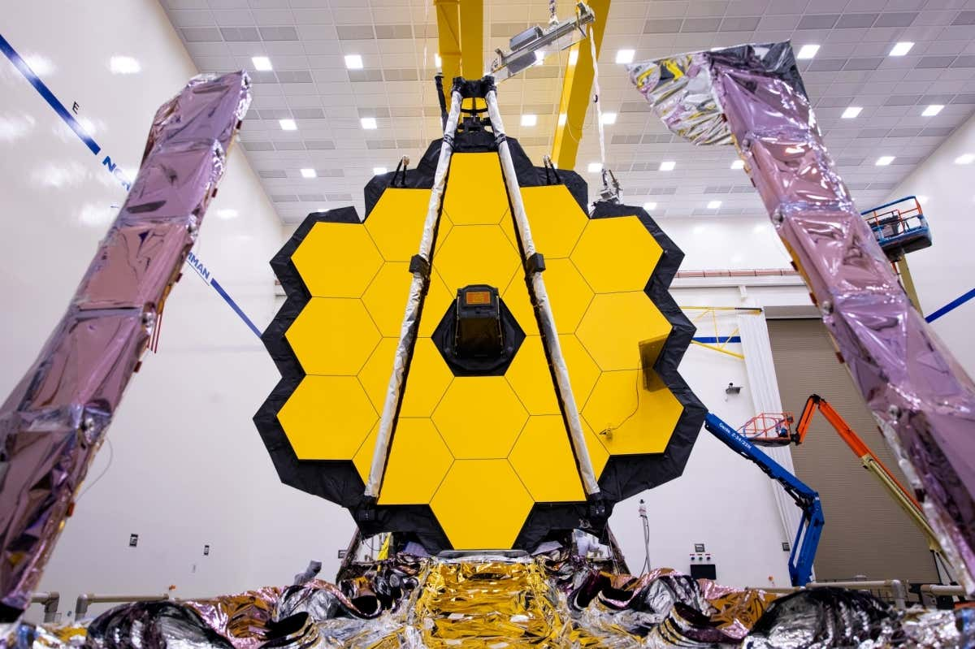
Are these golden days for Astronomy?
LSST eROSITA JWST

Slide 33
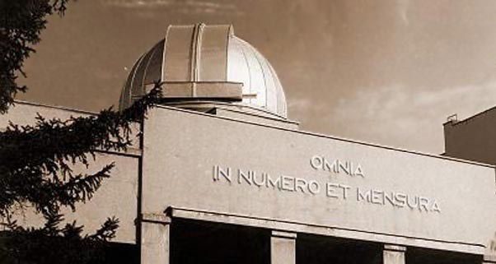
The Rare Earth Equation
Solomon's Book of Wisdom (mid-first century BC) "all things by number and measure"

Slide 34


Slide 35
Are these golden days for Astronomy? I think YES! But, how about 10-50-500-5000yrs from now?

Slide 36




Slide 37
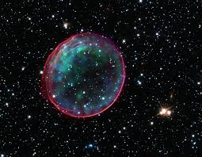
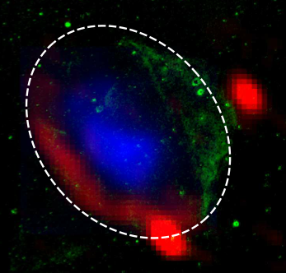
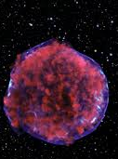
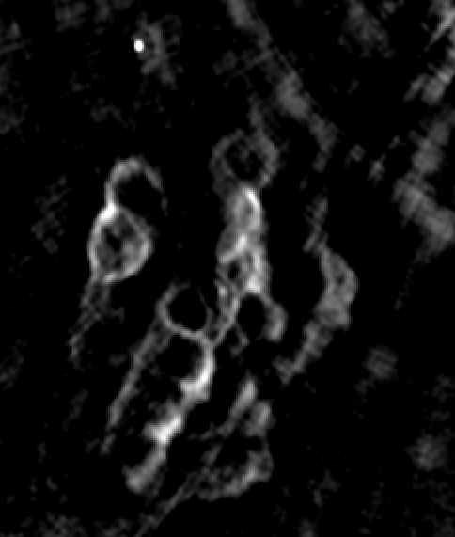
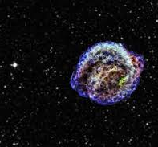
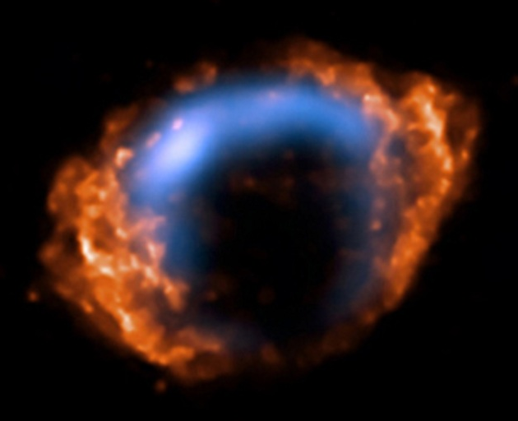
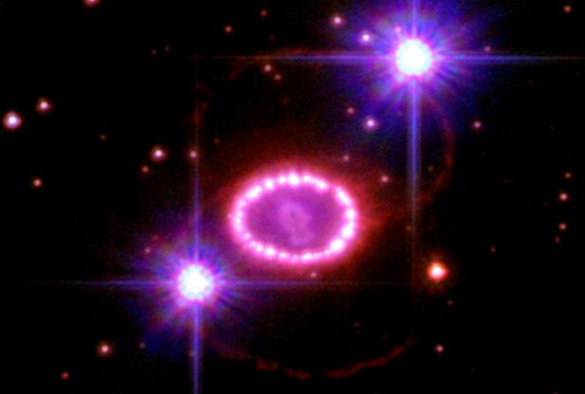
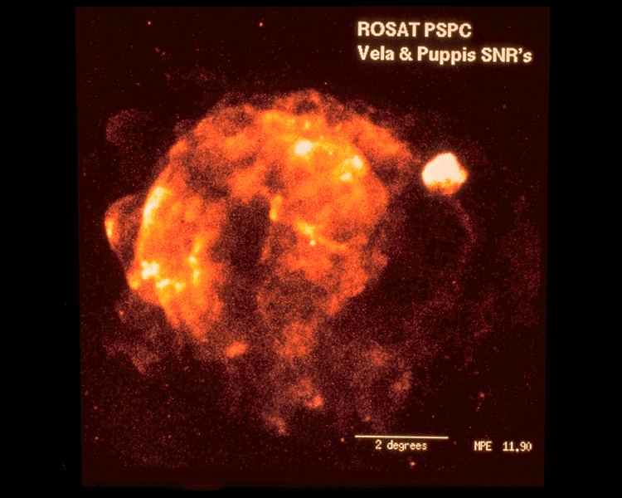
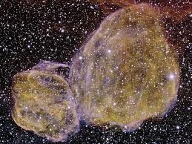
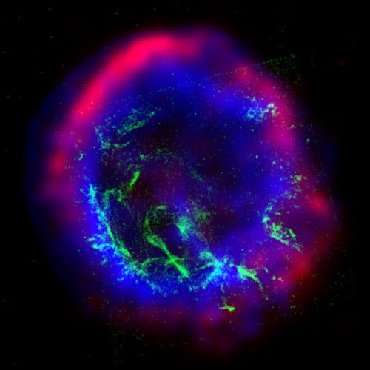
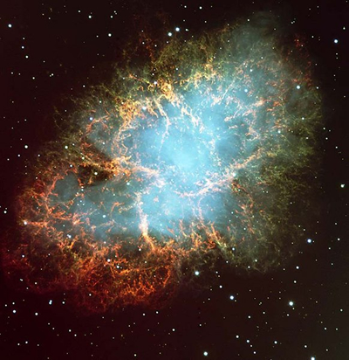
We are all different!
Just accept it!

Slide 38







westernsydney.edu.au/observatory
ObservatoryApp

Slide 39

?

Slide 40

So, could this be Mars sometime soon?
Springtime on Mars
2021
Notes:
The video lasts 1 min 20 secs

