Slide 1
CTA Update
13 November 2024
James Murray AAL Director of Programs
CTAO-South Rendering. Credit: CTAO.

Slide 2
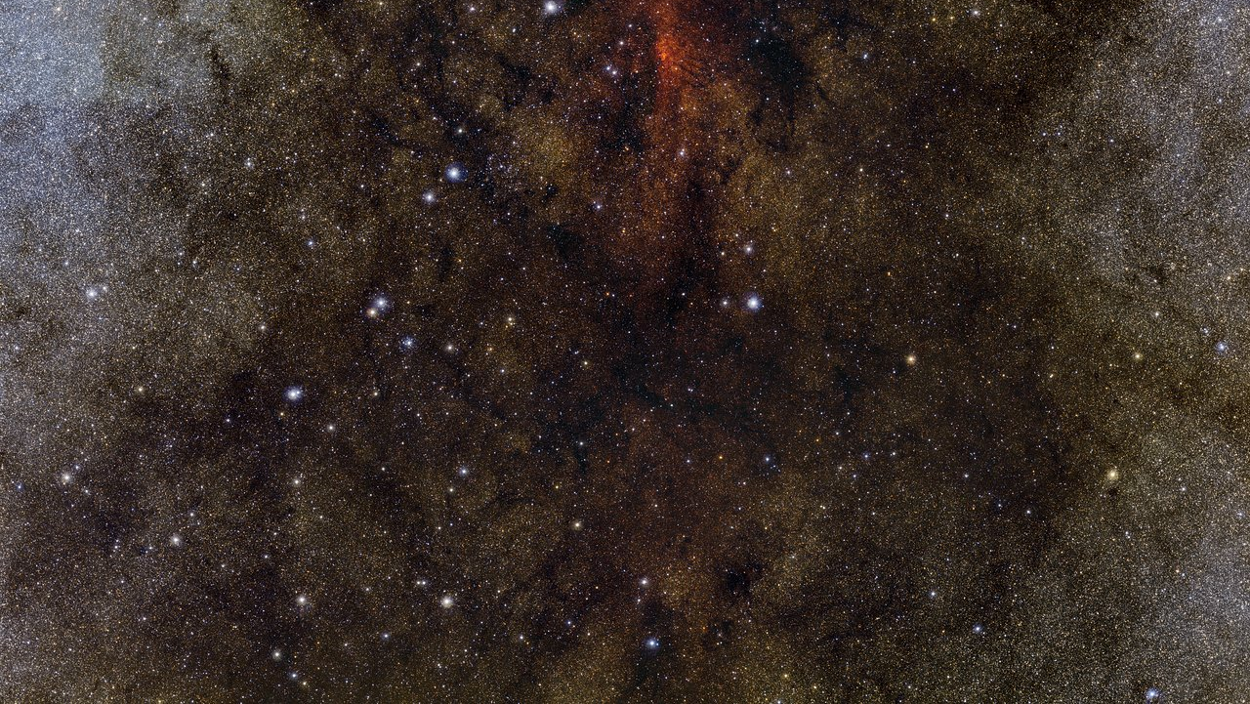
Who we are Astronomy Australia Ltd (AAL)
AAL is a not-for-profit organisation, whose members are Australian universities and research organisations with a significant astronomical research capability.
AAL works with national observatories, infrastructure providers, astronomers at universities, and the Australian Government to advance the infrastructure goals in the Australian Astronomy Decadal Plan.
OUR VISION
Australian astronomy is world leading and publicly valued.
Credit: ESO and Digitized Sky Survey 2. Acknowledgment: Davide De Martin and S. Guisard (www.eso.org/~sguisard).

Slide 3
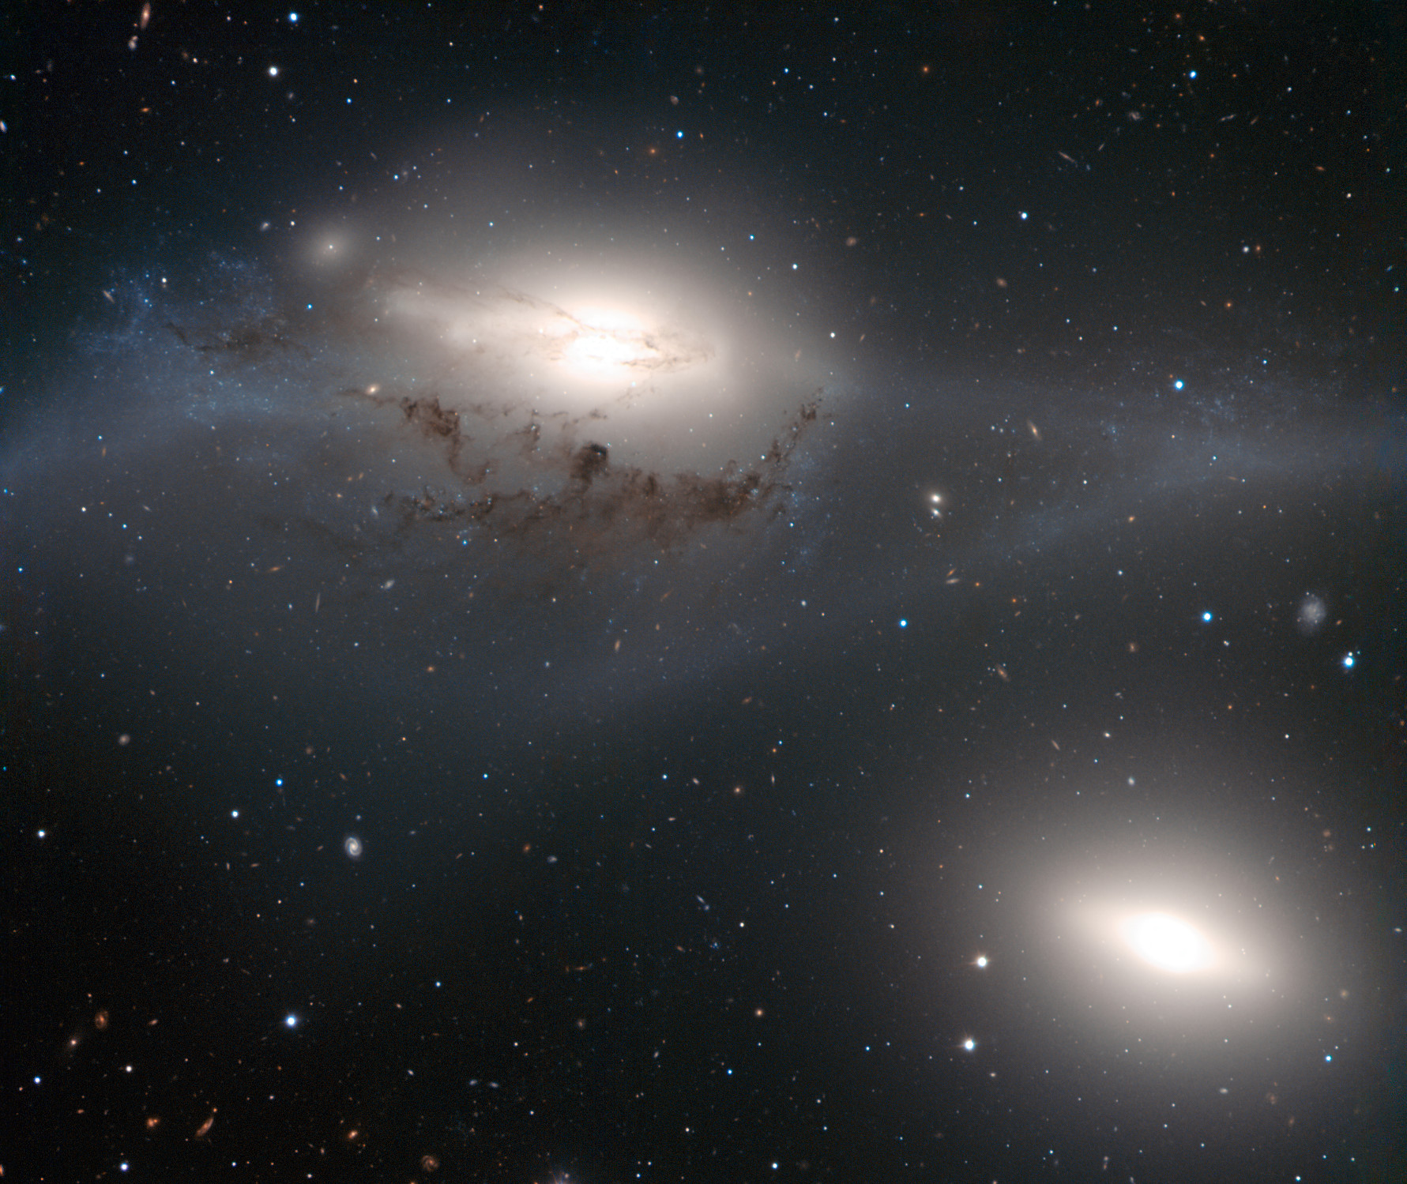
Who we are Astronomy Australia Ltd (AAL)
AAL is a not-for-profit organisation, whose members are Australian universities and research organisations with a significant astronomical research capability.
AAL works with national observatories, infrastructure providers, astronomers at universities, and the Australian Government to advance the infrastructure goals in the Australian Astronomy Decadal Plan.
OUR MISSION
AAL will facilitate access for Australian-based astronomers to the best research infrastructure, encourage the sharing of astronomical technical capabilities to maximise their value to the nation, and inspire Australians with these astronomical achievements.
NGC 4438 and NGC 4435. Credit: ESO.

Slide 4
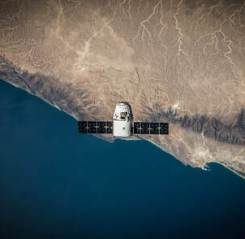
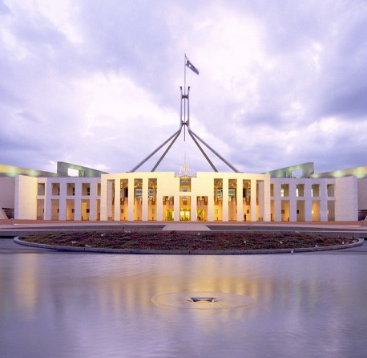
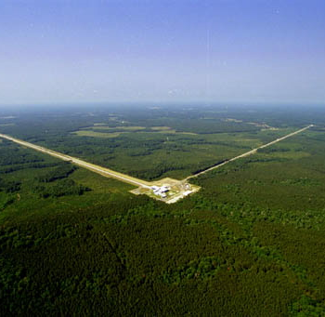
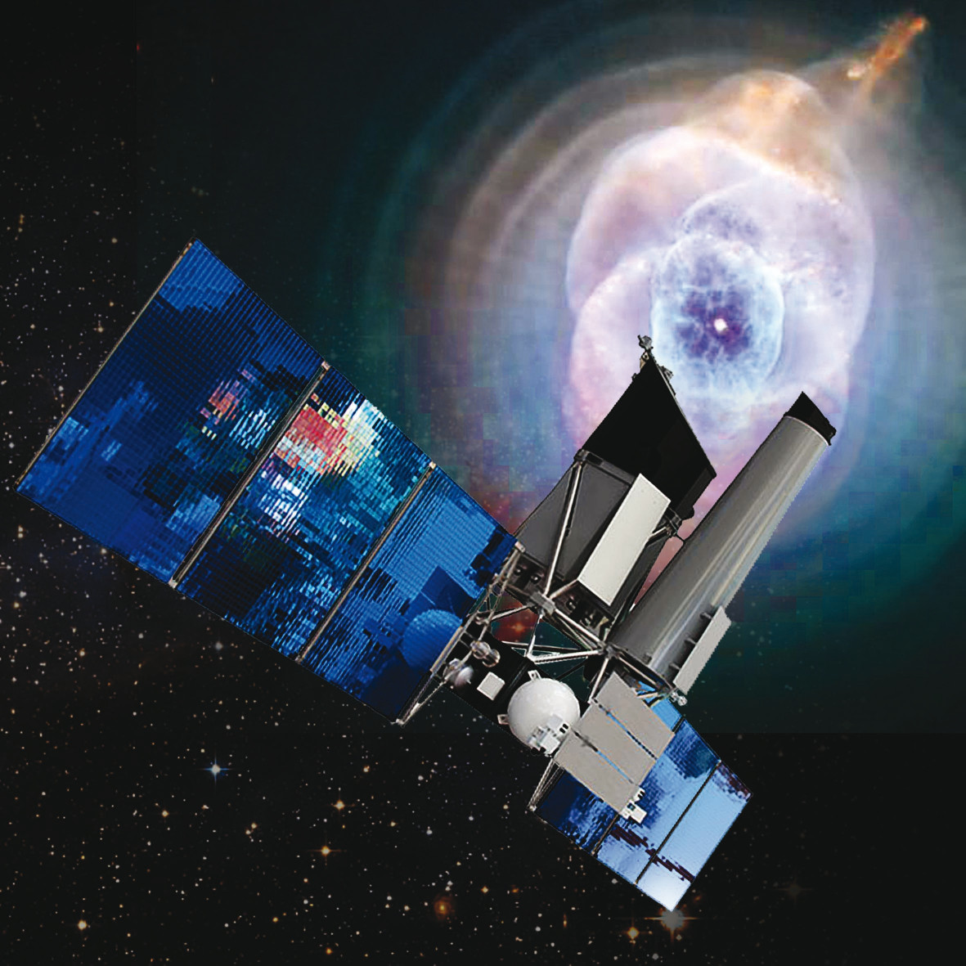
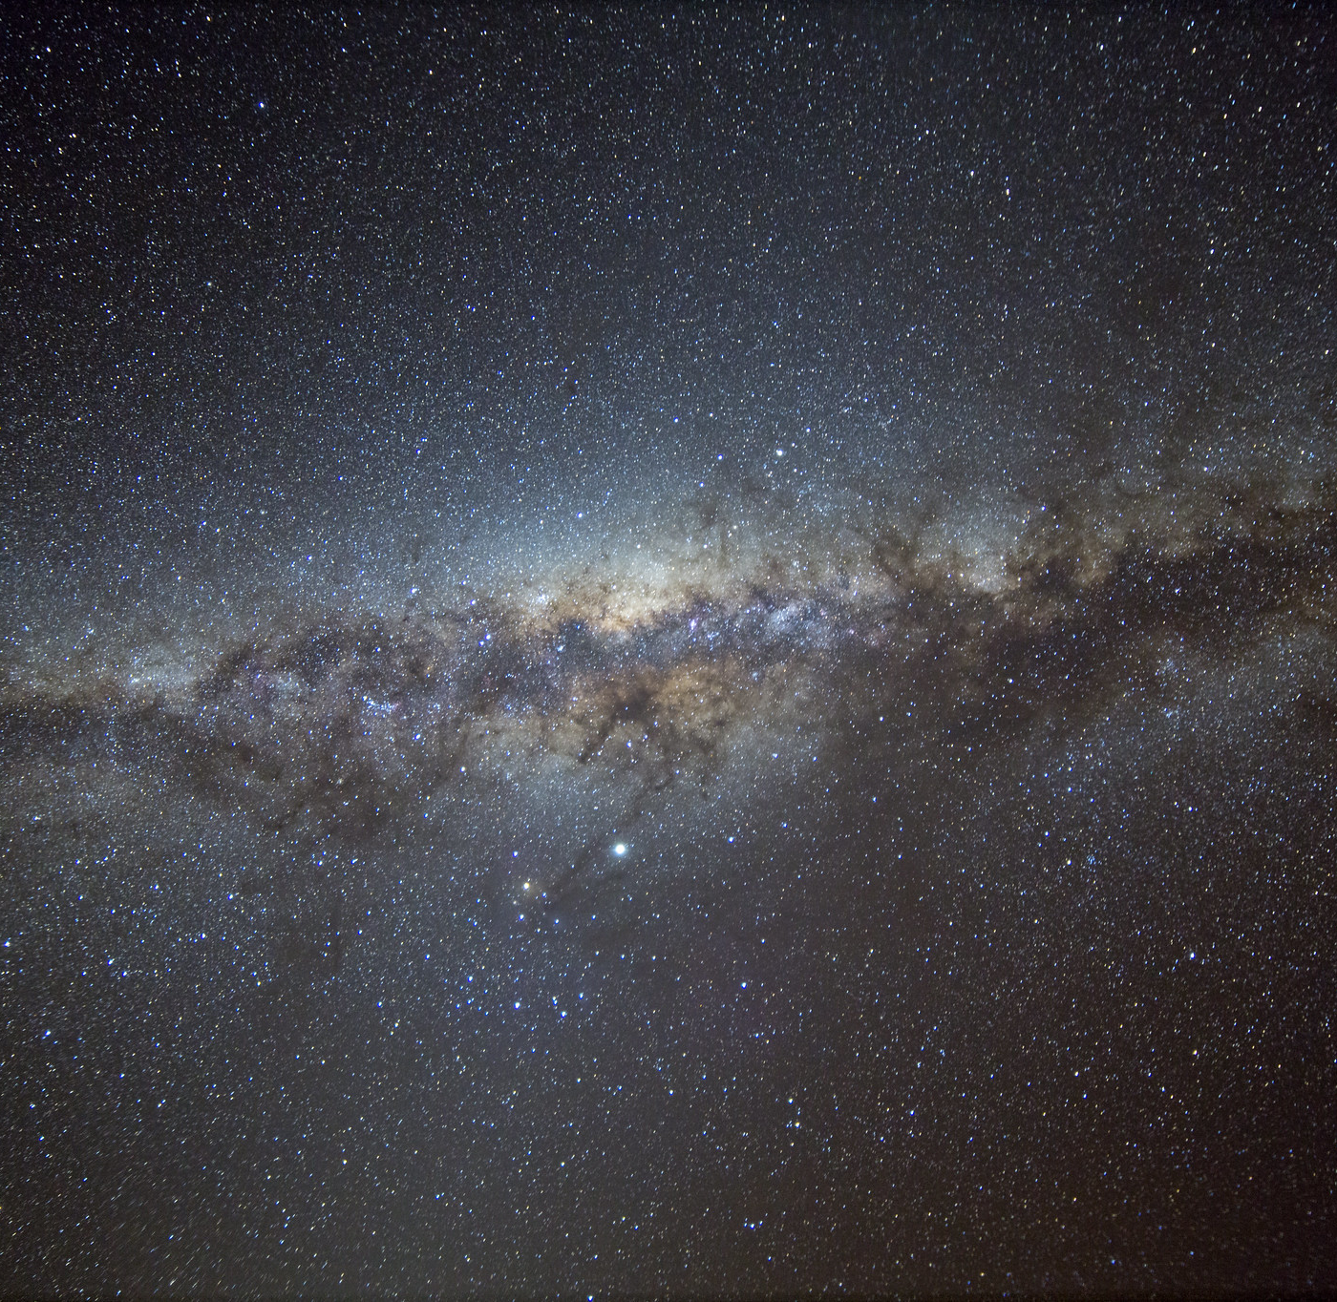
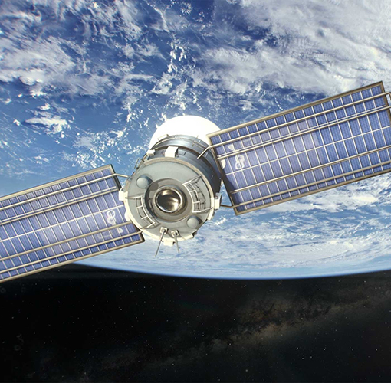
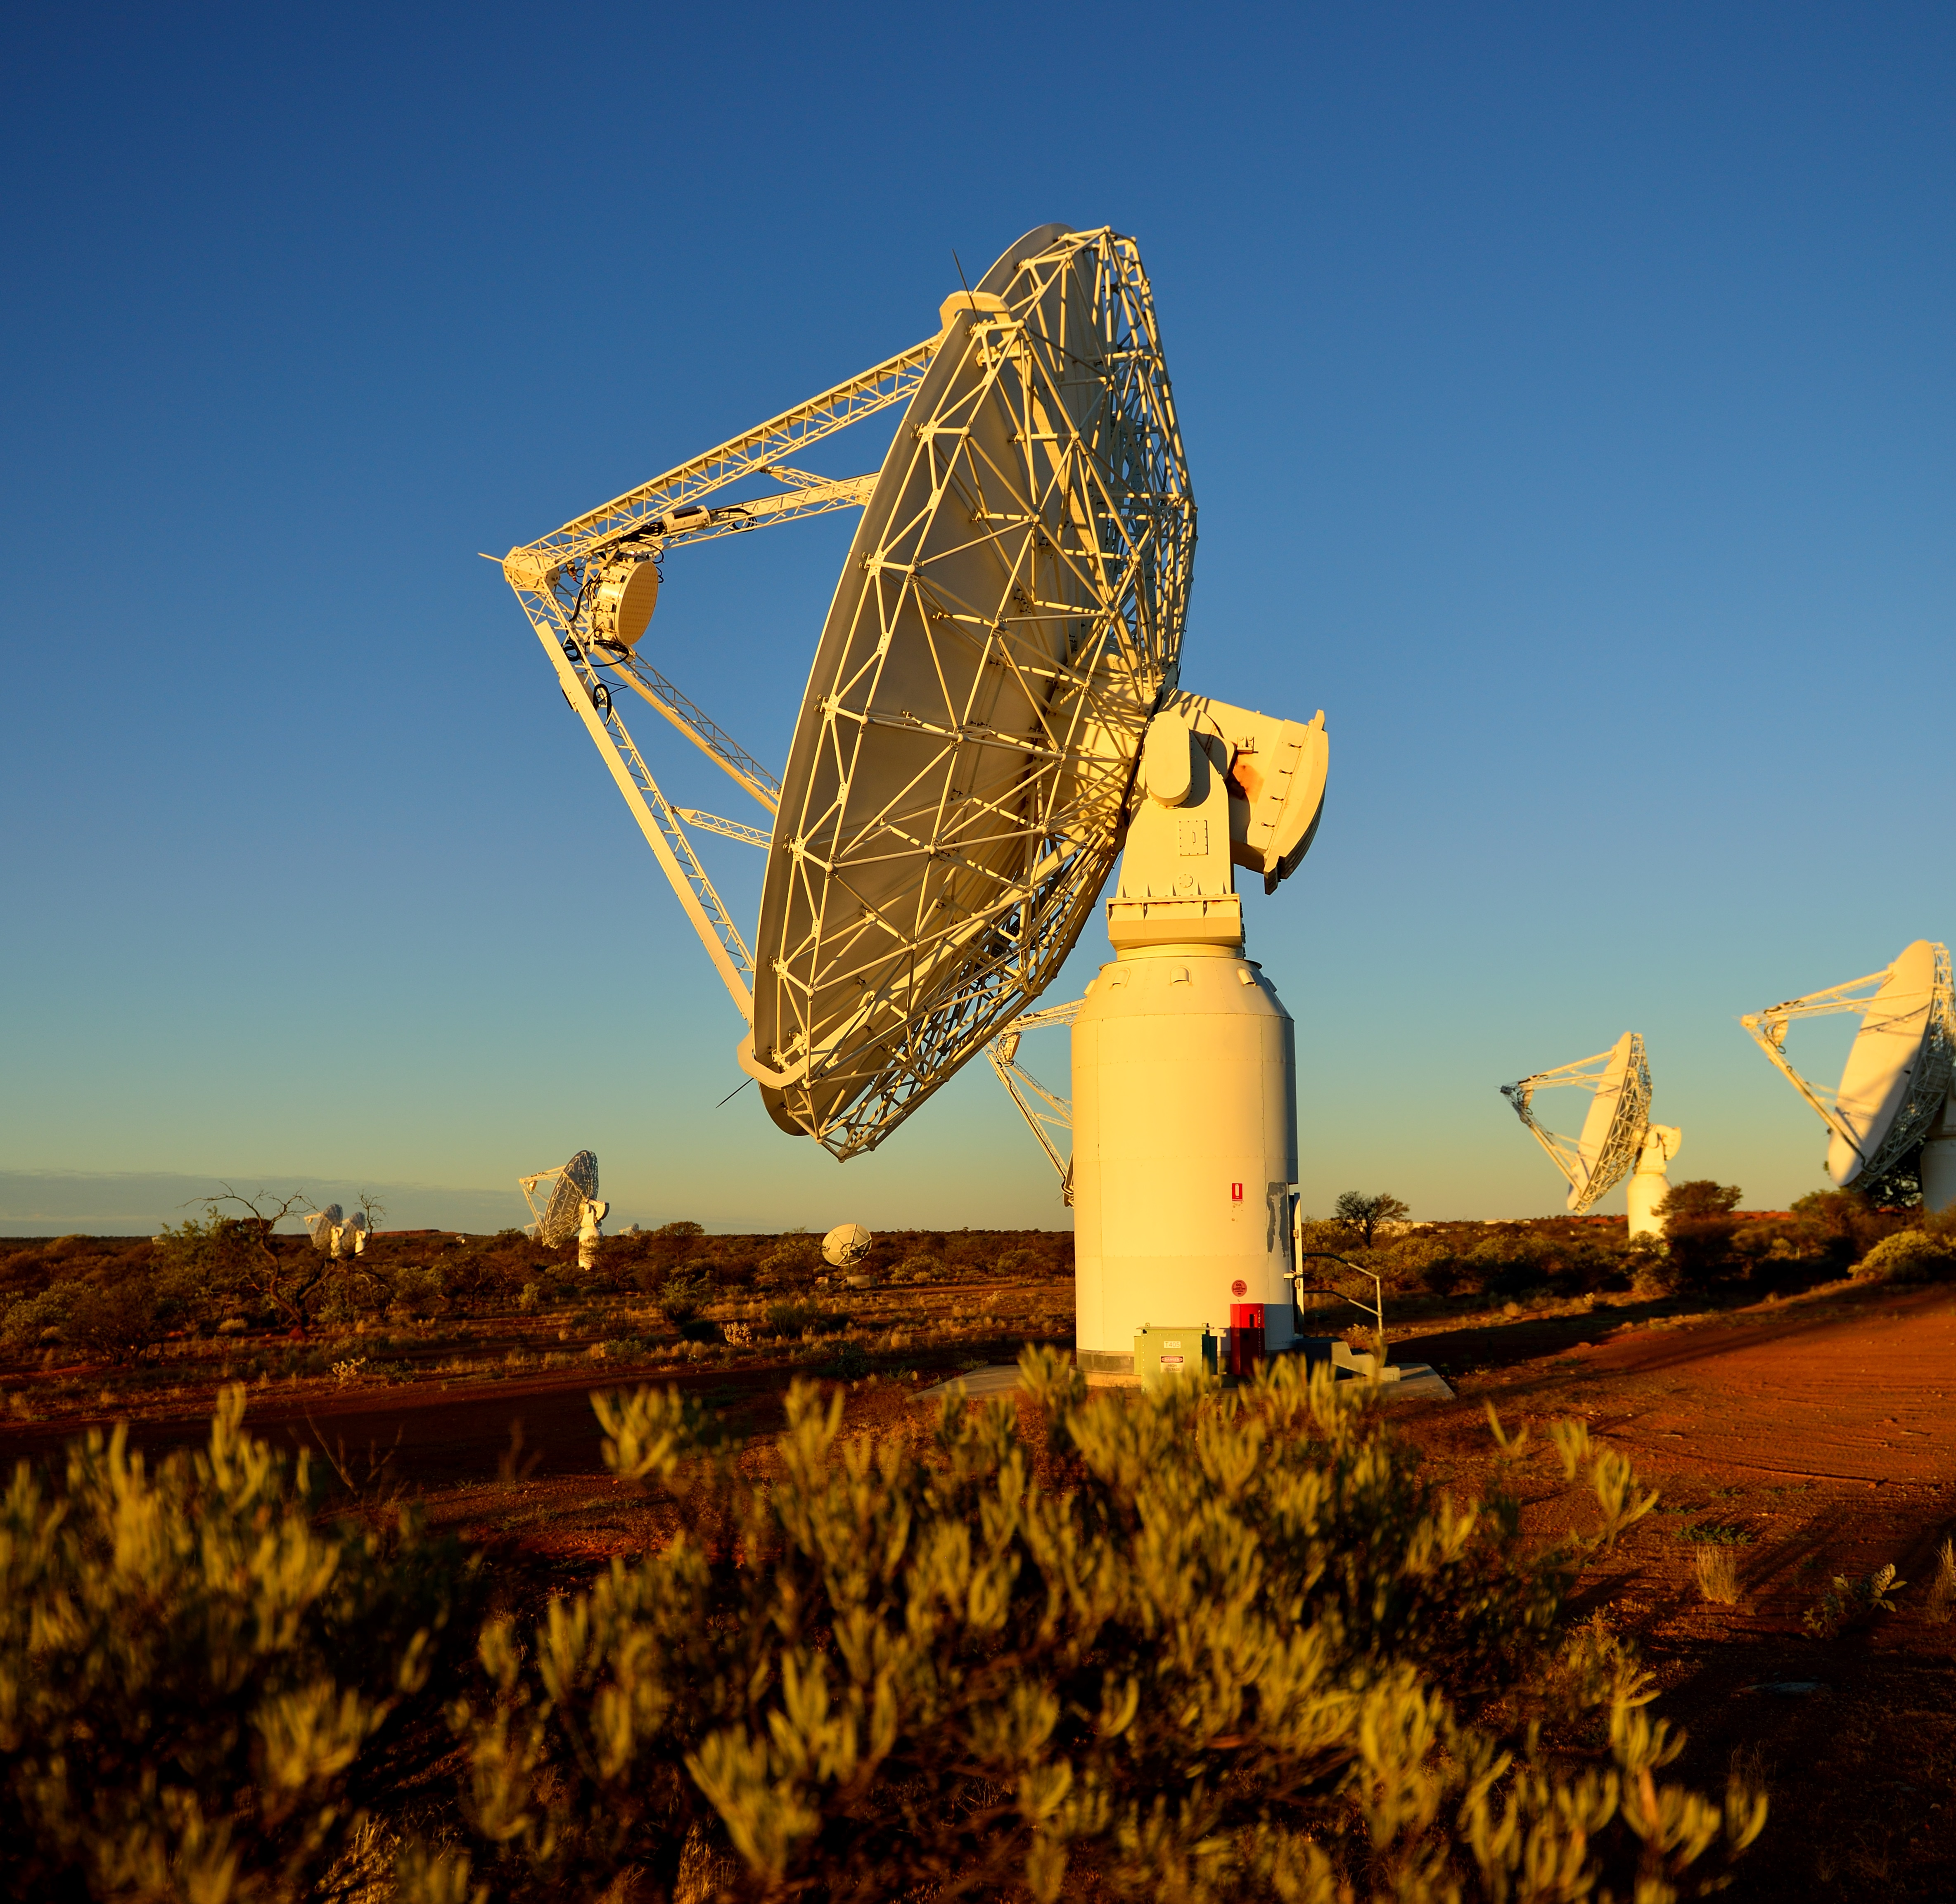
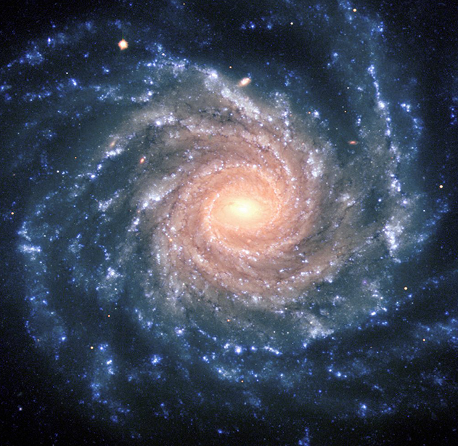
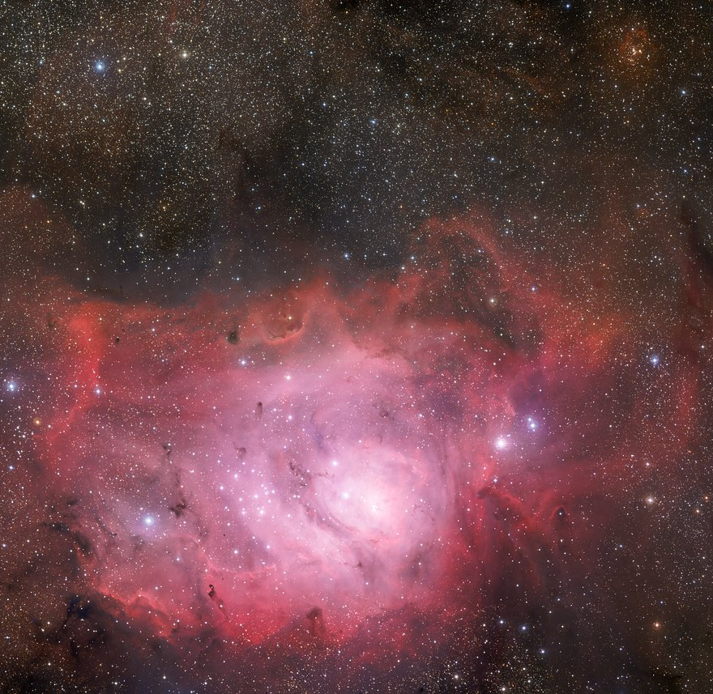
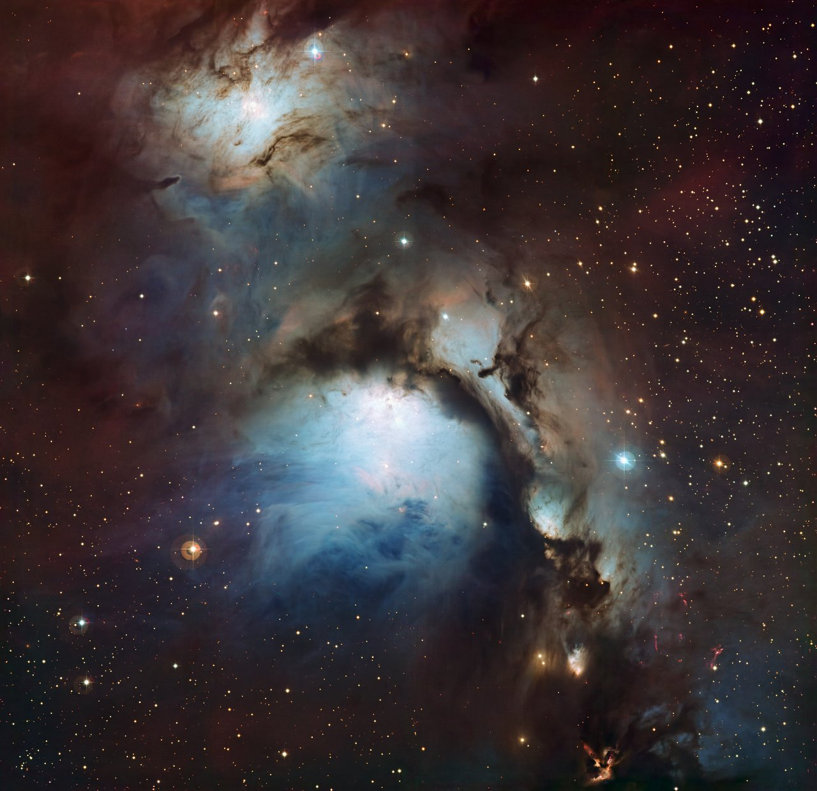
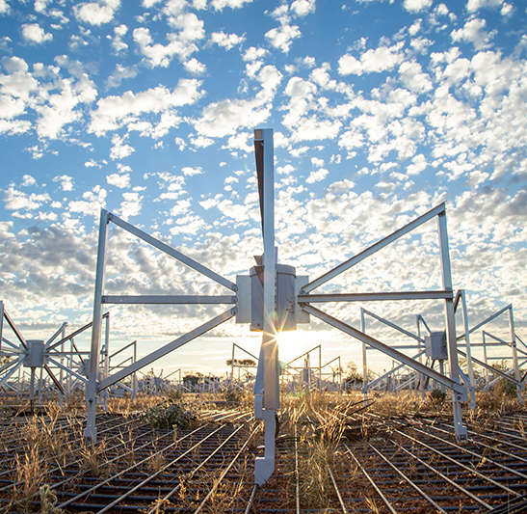
AAL 2023/24 Staff resource allocations – 7.4 FTE
ESO 0.5
Industry Engagement
0.5
DE/DISR 0.6
AAT 1.0
Data & Computing 0.4
Astralis 0.3
GW Detector 0.1
GMT 0.2
eROSITA 0.1
CTA 0.1
Rubin Observatory 0.1
General Comms 0.8
Space 0.1
ASKAP & MWA 0.1
Finance/accounting 0.8
Contracts/reporting 0.6
Staff support/guidance 0.5
Governance/admin 0.6

Slide 5
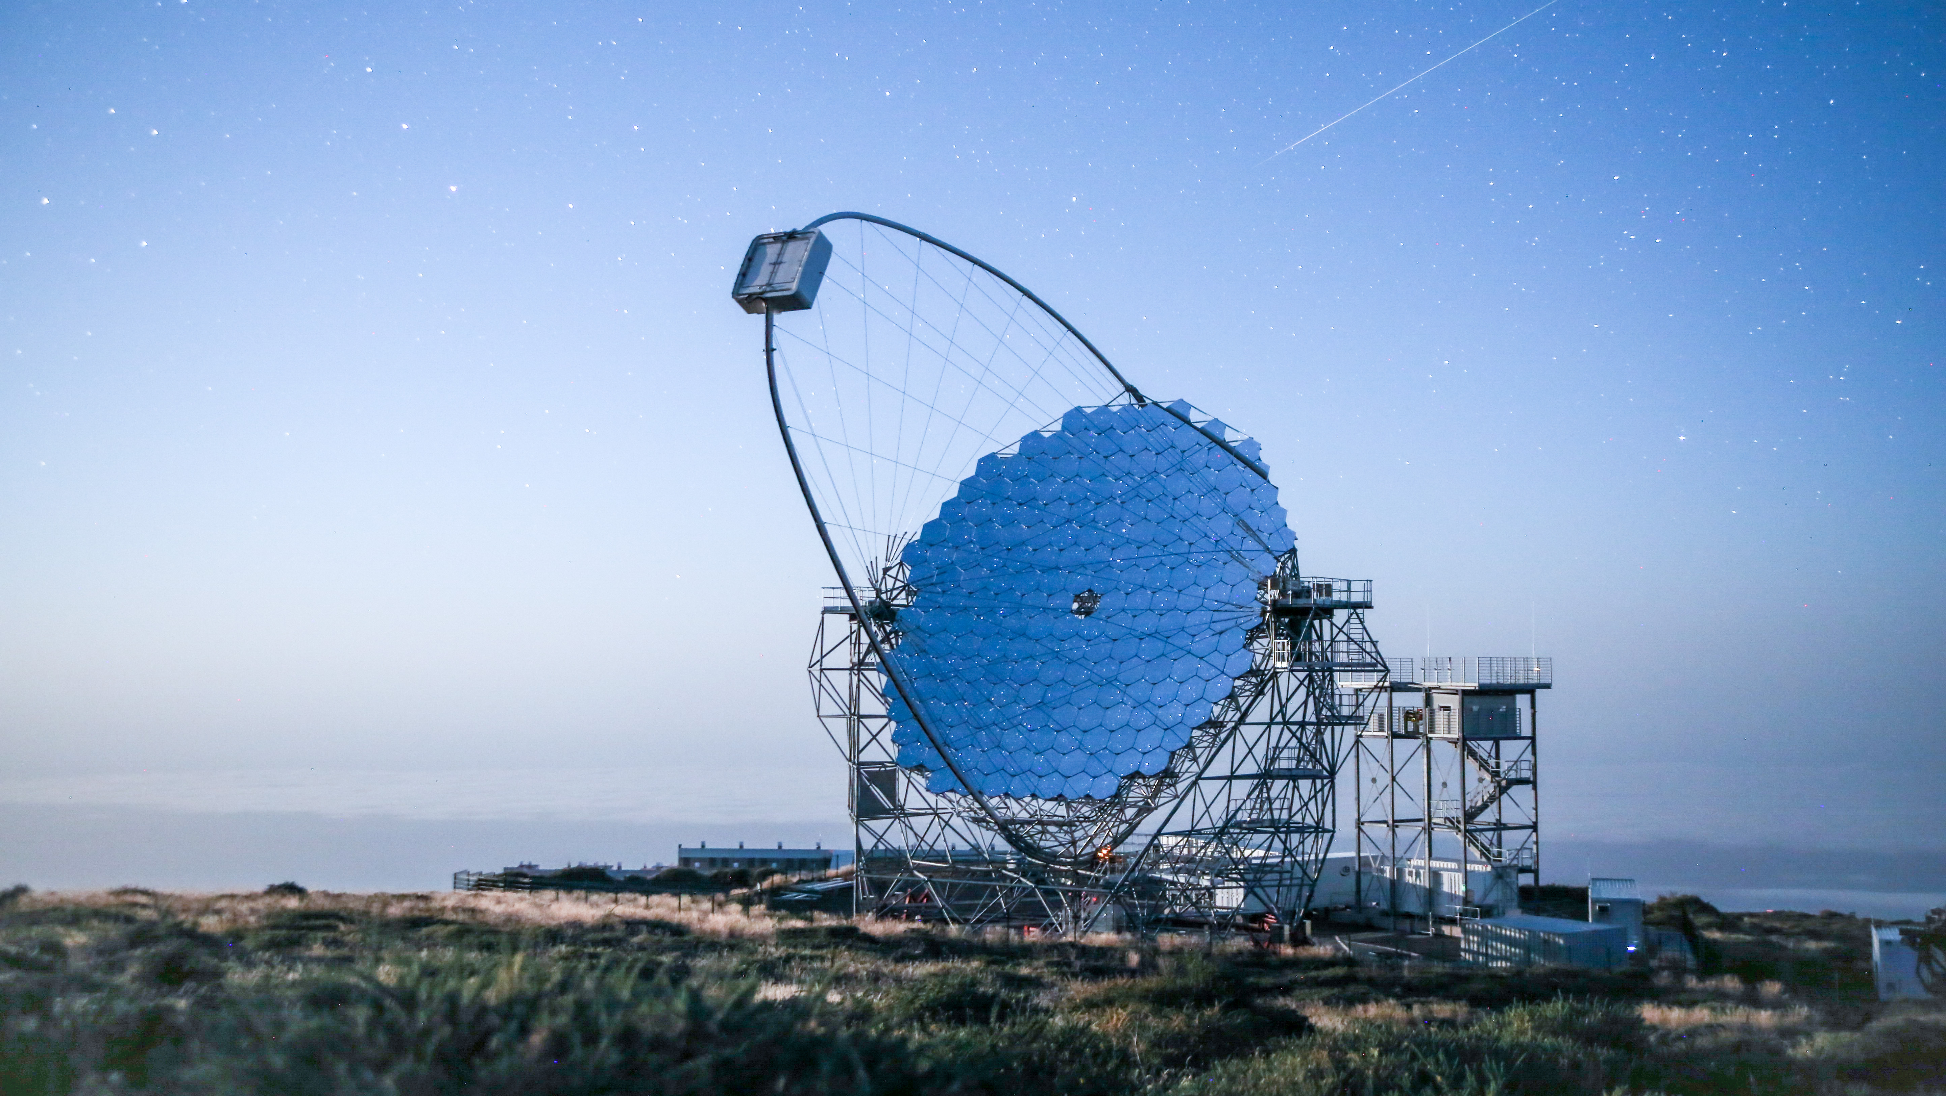
AAL is supporting Australia’s involvement in the CTA
AAL is supporting Australia’s continued contribution to the CTA, incl. CTAO membership, attendance at meetings, workshops and travel assistance.
Representatives from the CTA-Australia consortium, AAL Board and staff have worked to maintain this relationship.
Cherenkov Telescope Array's Large-Sized Telescope prototype (LST-1). Credit: Tomohiro Inada.
Notes:
This is the what has AAL done for me lately slide - CTA

Slide 6
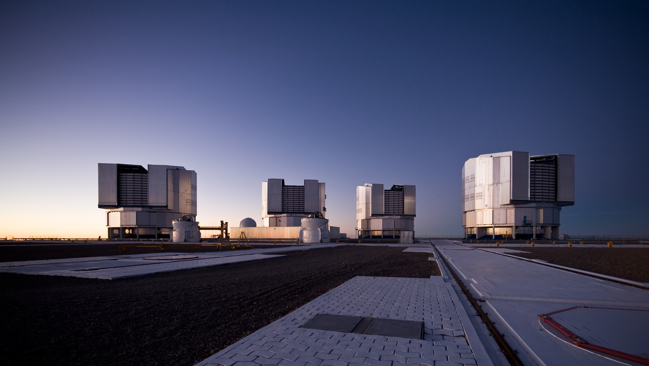
AAL provides ongoing support to the Strategic Partnership
The Federal Government previously provided funding for Australia’s 10-year strategic partnership with ESO.
Since then, AAL has received almost no funding to support the partnership.
AAL continues to manage the ESO relationship for DISR (no financial support to cover staff hours).
Paranal platform after sunset. Credit: ESO/H.H.Heyer.
Notes:
This is the what has AAL done for me lately slide - ESO

Slide 7
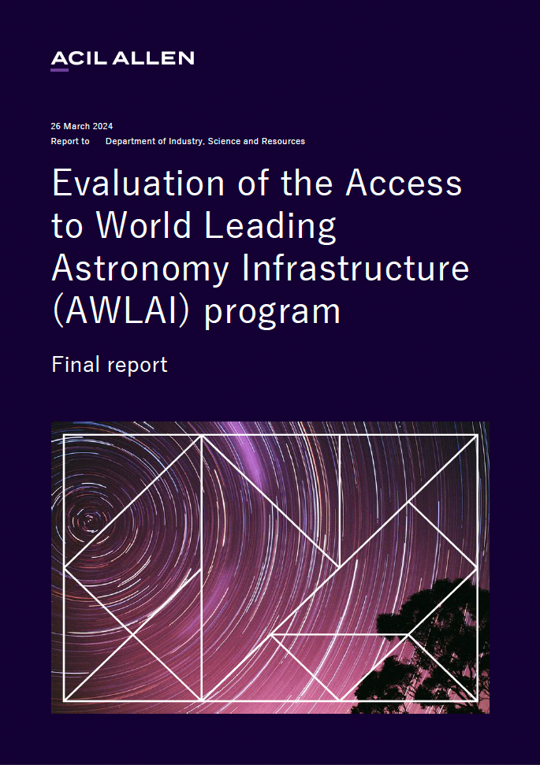
ACIL Allen report
In 2023, the Department of Industry, Science and Resources (DISR) commissioned ACIL Allen to evaluate AWLAI. From the report:
“Australia’s ROI in ESO is neutral… $1 generating approx. $0.97…. however, this likely underestimates the full benefit of Australia’s involvement in the Strategic Partnership (ESO-SP), including broader socio-economic impacts, knowledge advances and innovations arising from astronomy research.”
“The ESO-SP has enabled access to and award of commercial tenders (valued at $9.3M), industry collaborations, and the commercialisation of astronomy technical expertise. This is despite the restrictions on industry opportunities available through the ESO-SP.”
Notes:
This is a neutral review. It is a mid-term review. There are expectations that there are many things that haven’t been considered in this assessment.

Slide 8
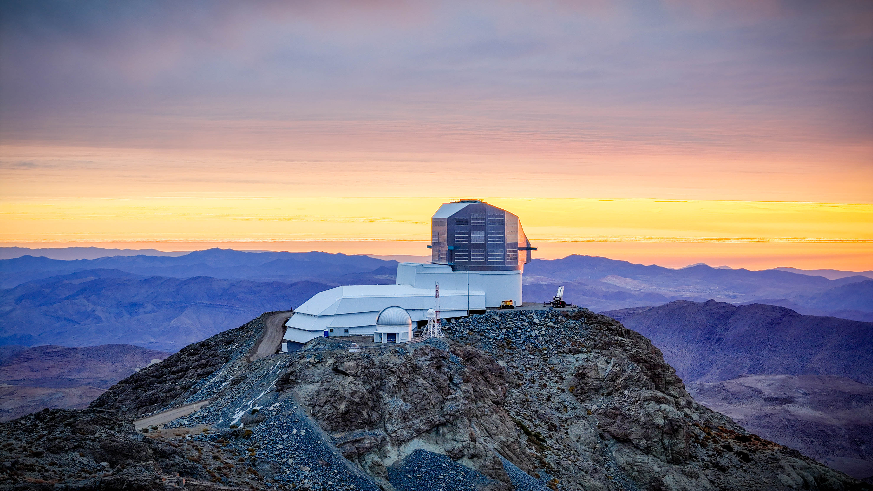
AAL has worked to get access to LSST data
AAL spent more than a year developing the recently formalised data rights agreement with LSST – 47 PIs / 188 JAs.
AAL has also supported international travel to conferences and may fund membership to the LSST Discovery Alliance.
AAL continues to manage the LSST relationship (no financial support to cover staff hours).
Rubin Observatory at sunset in May 2024. Credit: Rubin Obs/NSF/AURA.
Notes:
This is the what has AAL done for me lately slide – LSST.
We now have 47 PIs and 188 Junior Associates.

Slide 9
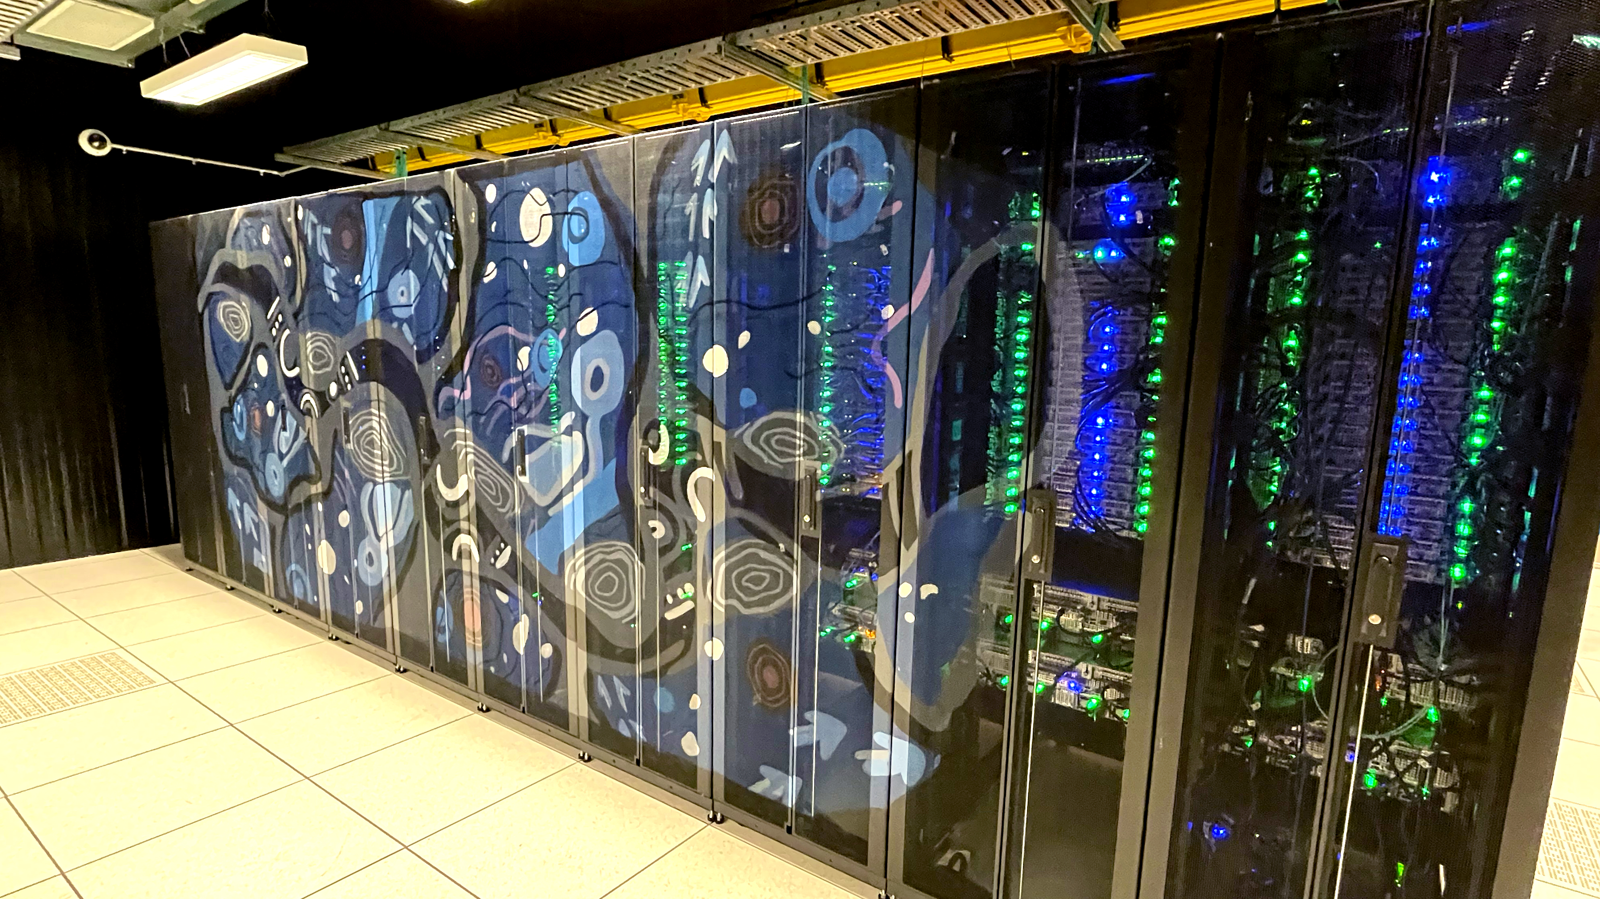
Upcoming Strategic Investment in National Research Infrastructure
NCRIS will invest $830 mill in the coming year to advance research infrastructure in 3 areas:
National Digital Research Infrastructure
Research Translation
Collections
Rubin Observatory at sunset in May 2024. Credit: Rubin Obs/NSF/AURA.
Notes:
This is the what has AAL done for me lately slide – LSST.
We now have 47 PIs and 188 Junior Associates.

Slide 10
Vision
User-centric design must lie at the heart of Australia’s NDRI system.
Australian researchers, from all disciplines, should have access to cutting-edge, sovereign NDRI capabilities to continue delivering world-class research and innovation.
Outcome 1
UNDERPINNED BY TRAINING FRAMEWORKS FOR RESEARCHERS AND NRI WORKFORCE
Opportunity:
Supporting Australia’s NDRI workforce will enhance the quality of the nation’s research.
Challenge:
Without a highly skilled NDRI workforce, Australia will not reach its full potential.
Approach:
Governments should work with NDRI providers to address staff shortages and expand workforce training opportunities.
Outcome 5
CYBERSECURE, PARTICULALRLY FOR NATIONAL-SCALE DATA AND COMPUTING
Opportunity:
Enforcing Australia’s NDRI cybersecurity protects nationally valuable and sensitive digital resources.
Challenge:
Cybersecurity threats are growing as research data sensitivities increase.
Approach:
NDRI providers should support assessment and mitigation of cybersecurity risks, underpinned by system-wide trust and identity solutions.
Outcome 6
MAXIMISED BY OPENLY AVAILABLE RESEARCH SOFTWARE TOOLS
Opportunity:
Supporting research software tools as critical NDRI capabilities ensures efficient and effective research conduct.
Challenge:
Software is critically important, yet its place in NDRI is not well defined.
Approach:
Research software tools should be recognised with equal importance to NDRI computing, data and networking capabilities.
Outcome 2
RESPONSIVE TO TECHNOLOGICAL AND SOCIETAL SHIFTS
Opportunity:
NDRI technological advancements support Australian researchers to perform unprecedented research.
Challenge:
Rapid advances and societal shifts can lead to obsolete and ineffective digital resources.
Approach:
Coordinated, expert-informed strategic planning should underscore Australia’s future NDRI system.
Outcome 3
CONSISTENT IN ITS STANDARDS FOR DATA COLLECTION, CURATION AND ACCESS
Opportunity:
Ensuring Australia’s growing volume of research data is as FAIR as possible will offer benefits to researchers.
Challenge:
Increasing volumes of research data are being generated that are not FAIR/CARE compliant.
Approach:
A sector-wide data management framework that supports FAIR/CARE compliance nationally.
Outcome 4
INTEGRATED ACROSS LEVELS OF COMPUTING AND DATA INFRASTRUCTURE
Opportunity:
A seamlessly integrated NDRI ecosystem will support Australia’s researchers.
Challenge:
Researchers have rapidly expanding NDRI demands but may lack expertise to use data efficiently and effectively.
Approach:
Pursue integrated access to different tiers of compute and shared data.
Implementation
An independent NDRI Working Group will develop an NDRI Investment Plan to implement the NDRI Strategy. The NDRI Investment Plan will be underpinned by stakeholder engagement and guided by the NRI Advisory Group. The Investment Plan will be funded, implemented, and monitored through NCRIS.

Slide 11
National Digital Research Infrastructure (NDRI)
The National Digital Research Infrastructure Strategy has been released and NCRIS is now funding an implementation plan
AAL will seek funding for:
ADACS
High Performance Data Centres
Other (your ideas here)
Rubin Observatory at sunset in May 2024. Credit: Rubin Obs/NSF/AURA.
Notes:
This is the what has AAL done for me lately slide – LSST.
We now have 47 PIs and 188 Junior Associates.

