Slide 1
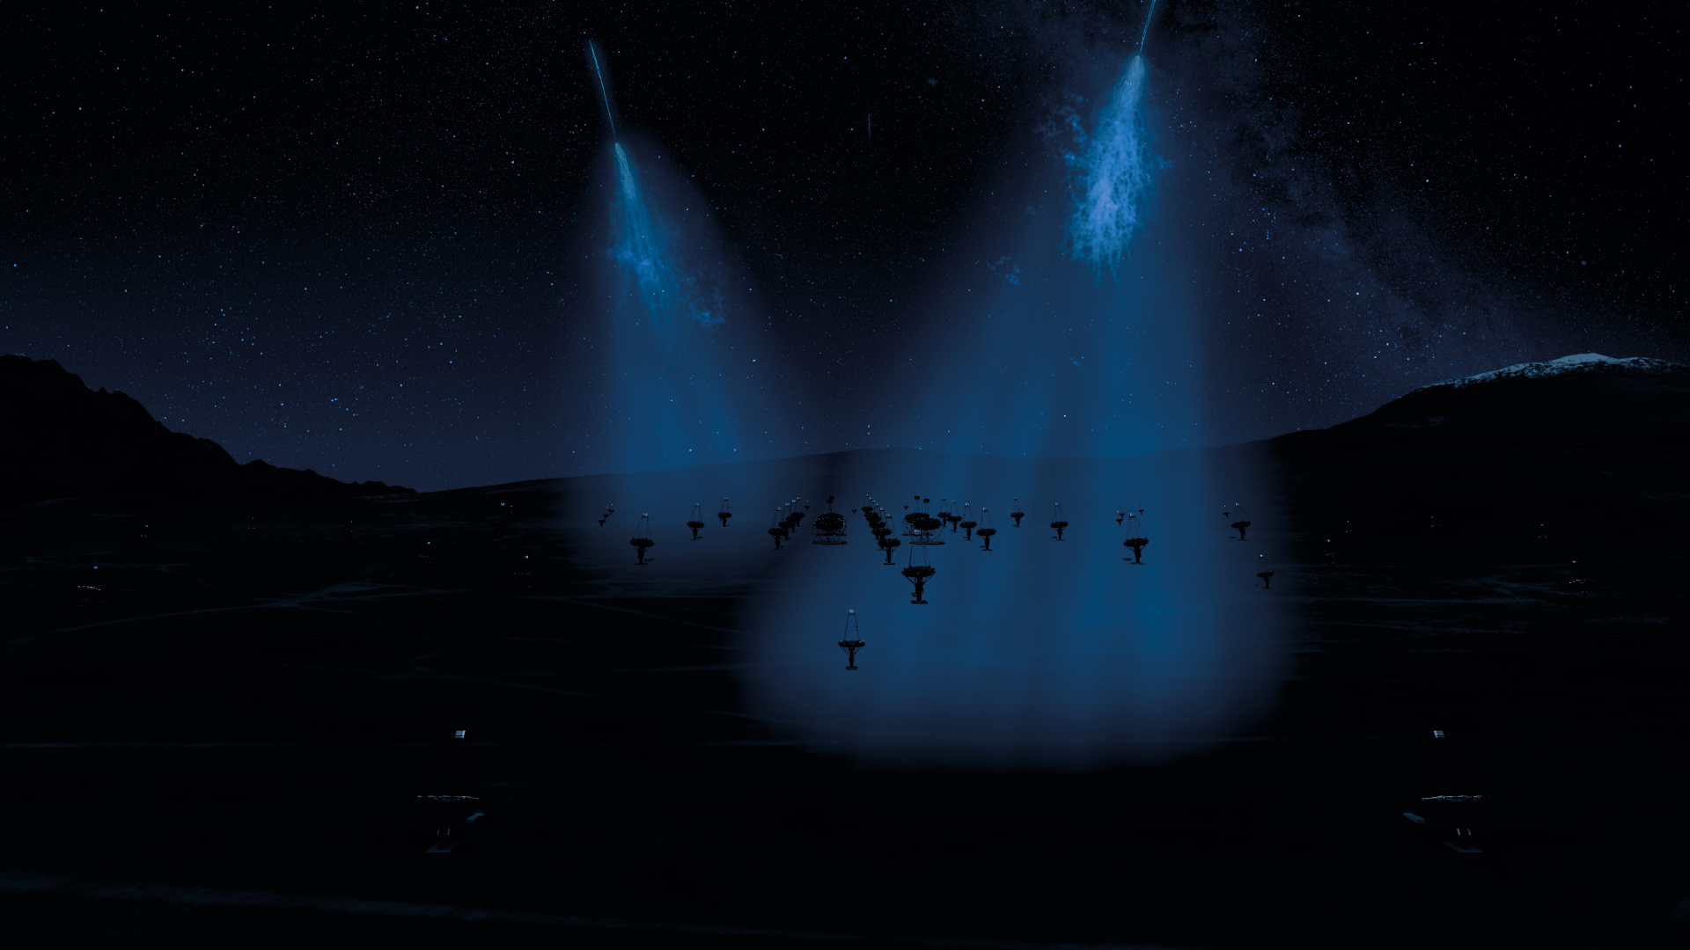


A phenomenological approach to indirect dark matter searches with CTAO
Liam Pinchbeck
CTAO Australia Meeting, Nov 2024
Notes:
- Paper title
- GC

Slide 2
A phenomenological approach to indirect dark matter searches with CTAO
Dark matter (phenomenological) model
Background Distributions
Instrument Response Functions
Mixture Modelling
Detection-like Demonstration
Sensitivity Projections
Liam Pinchbeck
CTAO Australia Meeting, Nov 2024
Notes:
- Paper title
- GC

Slide 3
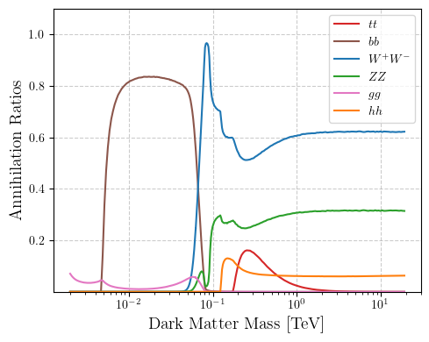
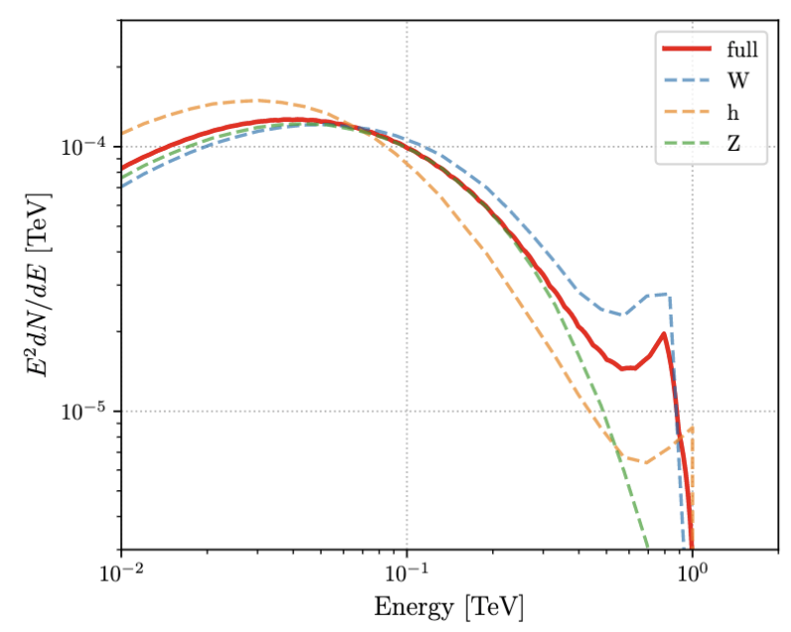
Dark Matter Annihilation Ratios and Spectra
Di Mauro+ 2023, arXiv:2305.11937
Cirelli+ 2010, arXiv:1012.4515

Slide 4
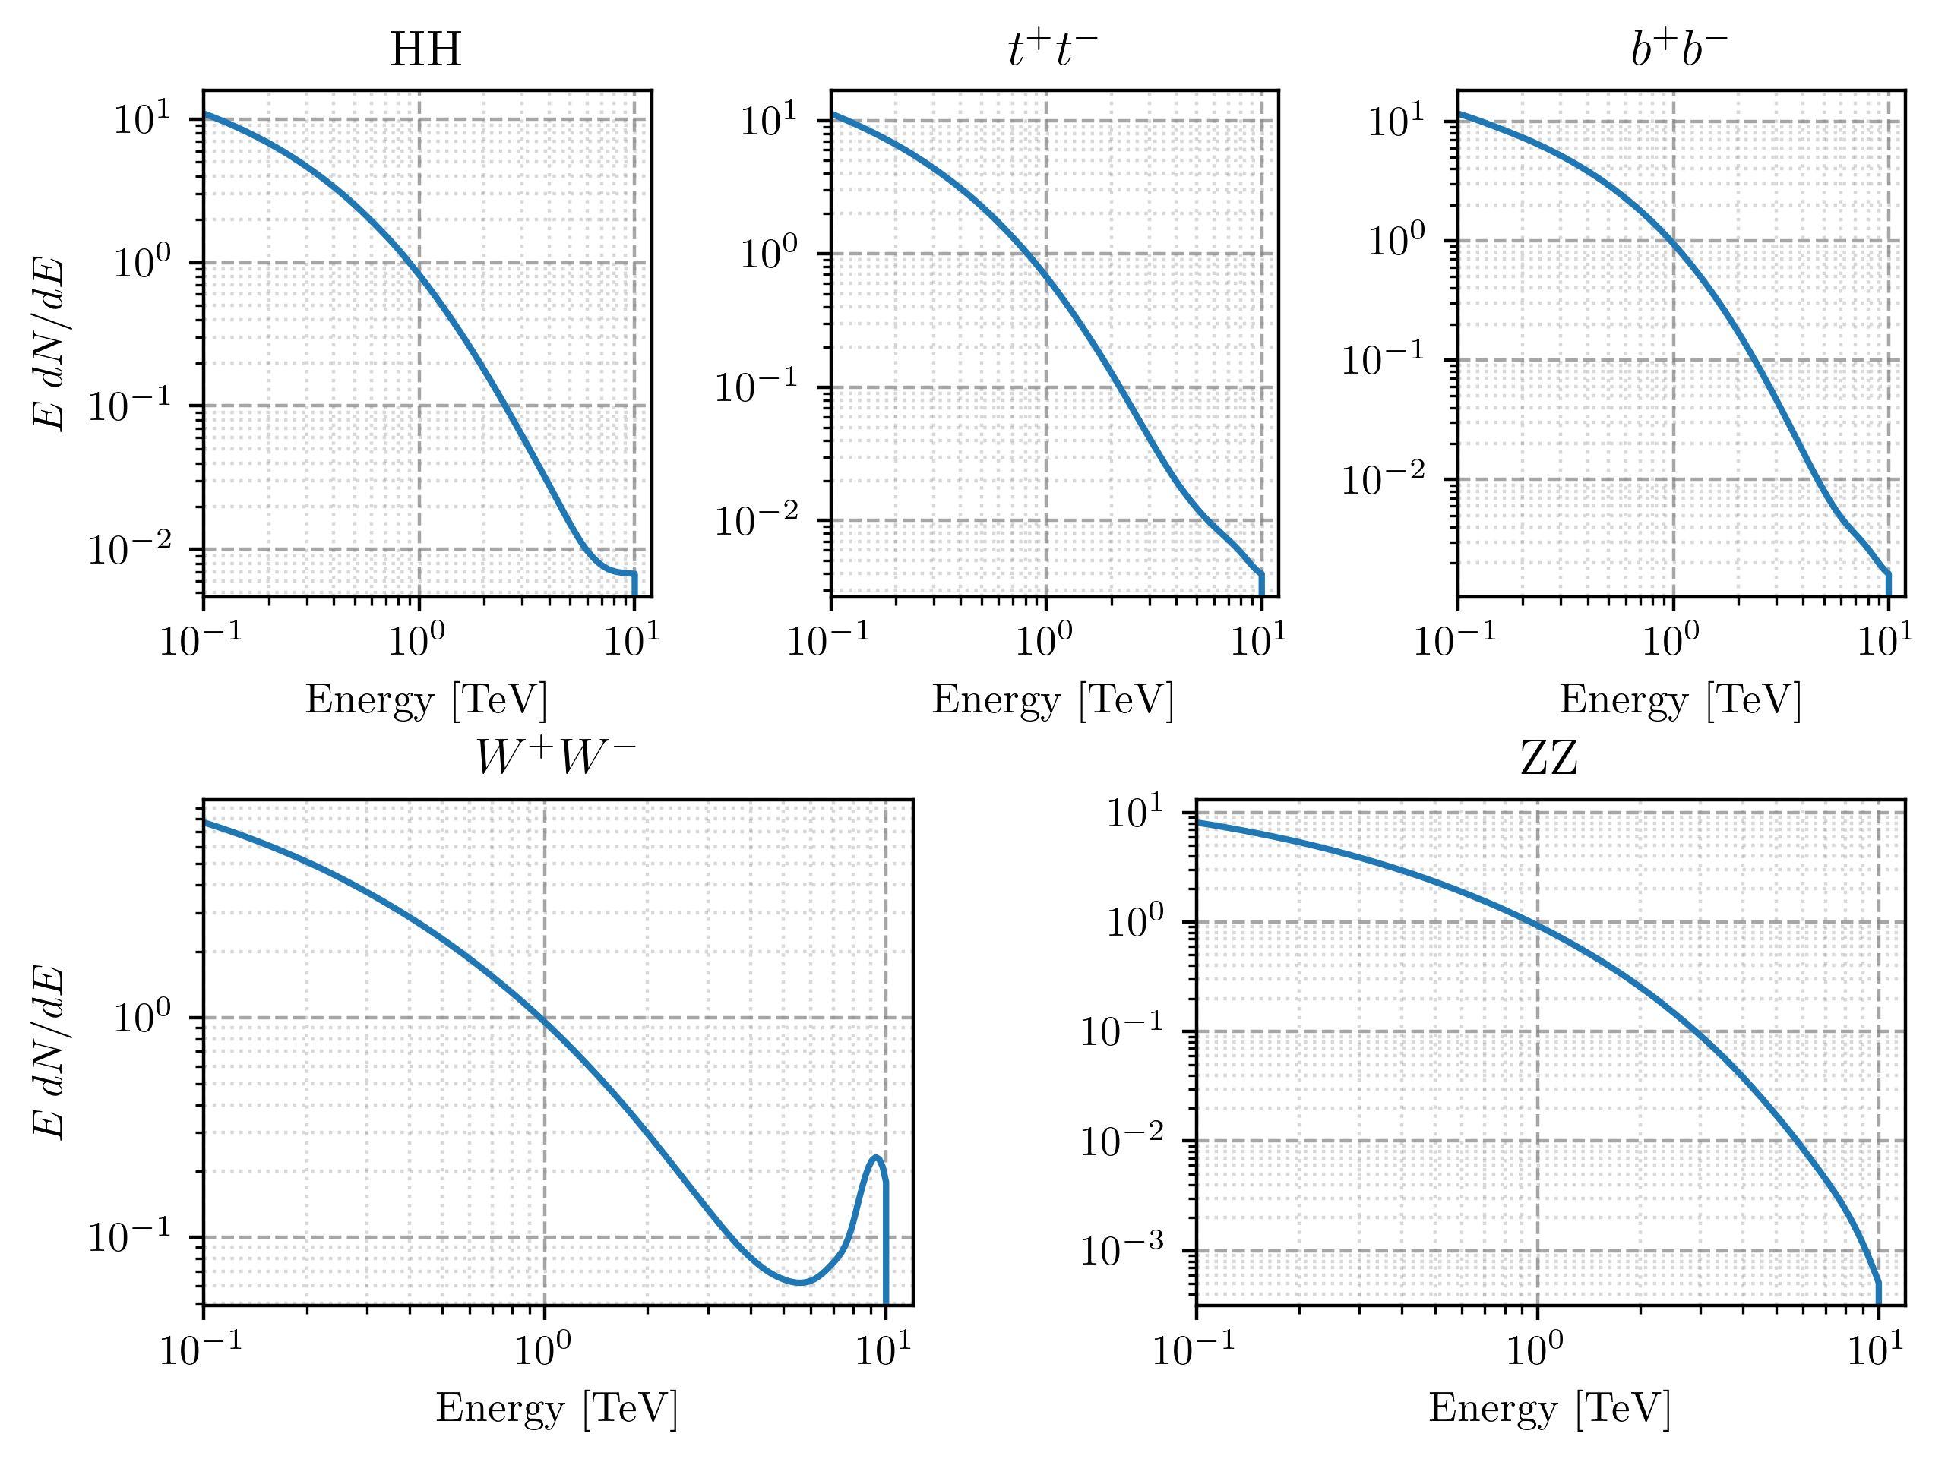

Slide 5
Signal Angular Distribution

Slide 6

GammaBayes
Makes optimal usage of gamma ray data for detecting dark matter
We can very naturally include systematics uncertainties in all the models considered
We can very easily incorporate new dark matter or background models into the analysis
arXiv:2401.13876
Notes:
- The lightest neutralino bino-wino-Higgsino mixture WIMP with chargino-stop loop correction, arXiv:hep-ph/0702041

Slide 7
Dark Matter Signal Prior
Energy distribution
Sky Map
Notes:
- Red CURVE
- Bayes

Slide 8
Background Model → Background Prior
Notes:
- well-known/main bkg
- match order of labels

Slide 9
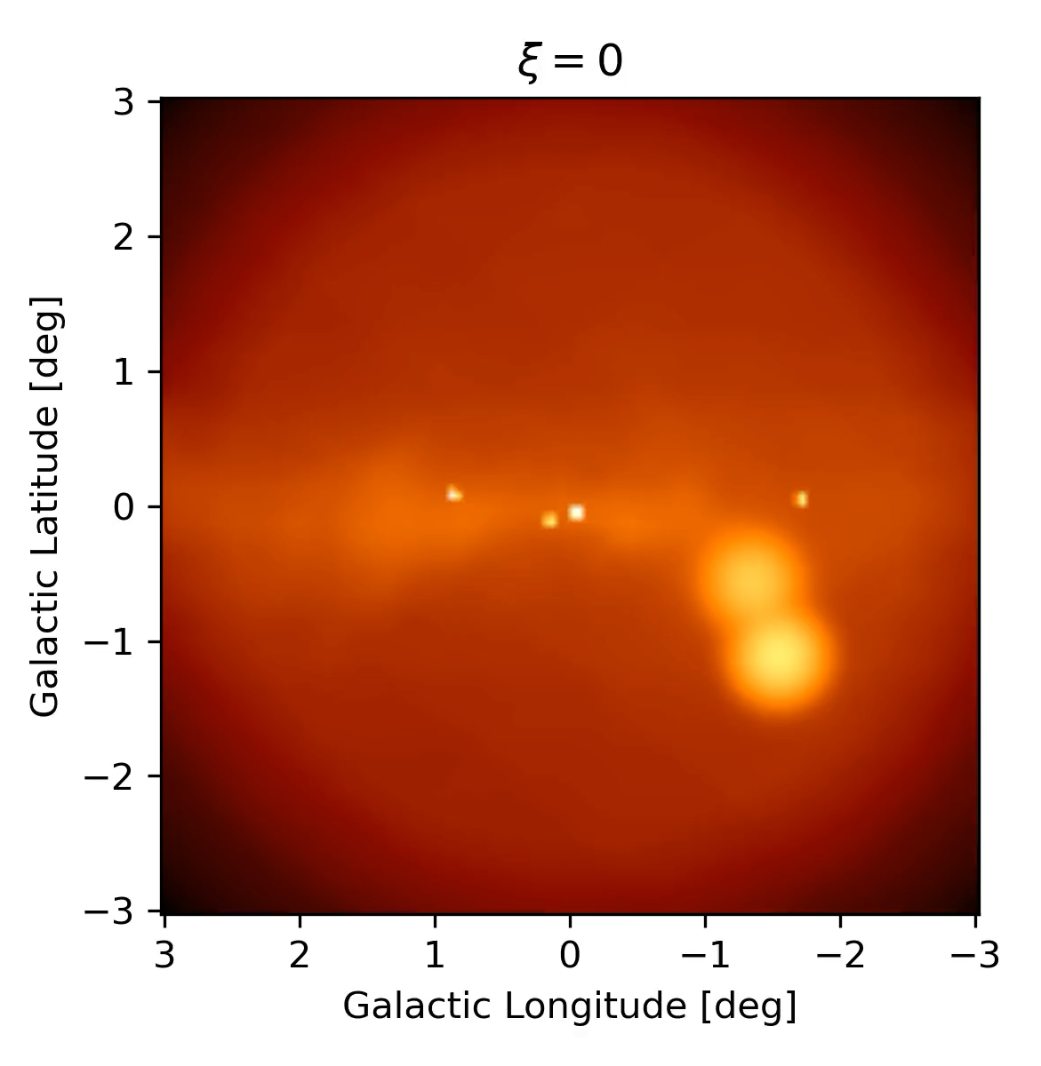
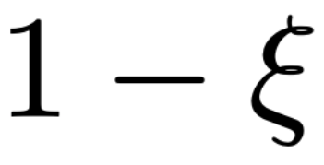
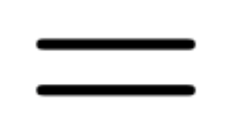
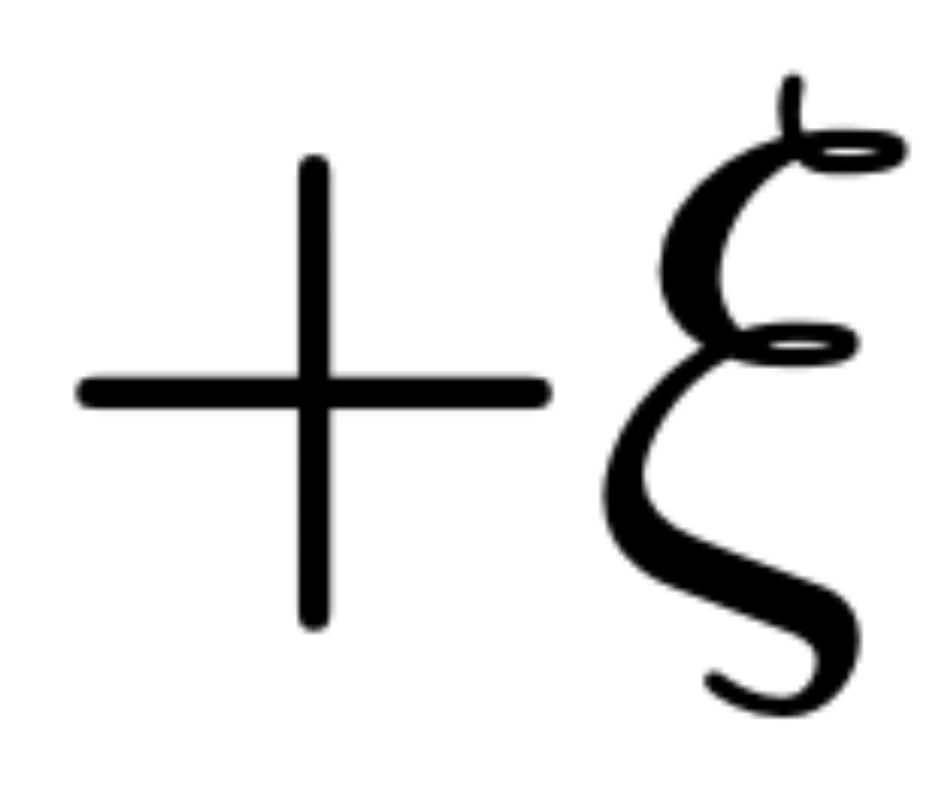
Mixture Model
Notes:
- Labels not important
- Double note signal/background
- KEEP xi=0 and xi=1 explanation

Slide 10










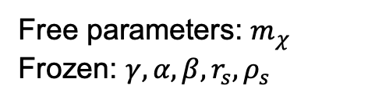


Paper Model
$$SIG$$
$$BKG$$
$$t^{+}t^{−}$$
$$τ^{+}τ^{−}$$
$$Diffuse$$
$$CCR$$
$$Local$$
$$W^{+}W^{−}$$
$$ZZ$$
$$HH$$
$$gg$$
$$b^{+}b$$
Free parameters: $m_{χ}$
Frozen: $γ, α, β, r_{s}, ρ_{s}$
Free parameters: None
Frozen: All

Slide 11













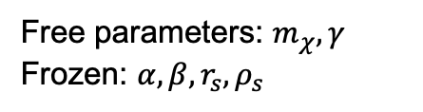


Current working development model
$$SIG$$
$$BKG$$
$$ZZ$$
$$t^{+}t^{−}$$
$$b^{+}b$$
$$Fermi$$
$$Bubbles$$
$$Isotropic$$
$$Bremss$$
$$W^{+}W^{−}$$
$$HH$$
$$gg$$
$$τ^{+}τ^{−}$$
$$ICS$$
$$CCR$$
$$π$$
$$Local$$
Free parameters: $m_{χ}, γ$
Frozen: $α, β, r_{s}, ρ_{s}$
Free parameters: Isotropic BKG spec index, Fermi Bubbles spec index
Frozen: Isotropic cutoff energy, Fermi Bubbles cutoff energy

Slide 12
Demonstration
Simulated data for 10⁸ events, roughly 500 hr of observation time of the Galactic Centre by CTAO
Includes 500000 dark matter signal events from the scalar singlet dark matter annihilation; m_{χ} = 10.0 TeV
Use GammaBayes to infer mixing weights and dark-matter mass m_{χ} through the posterior…
Notes:
- 525 hrs
- TeV

Slide 13
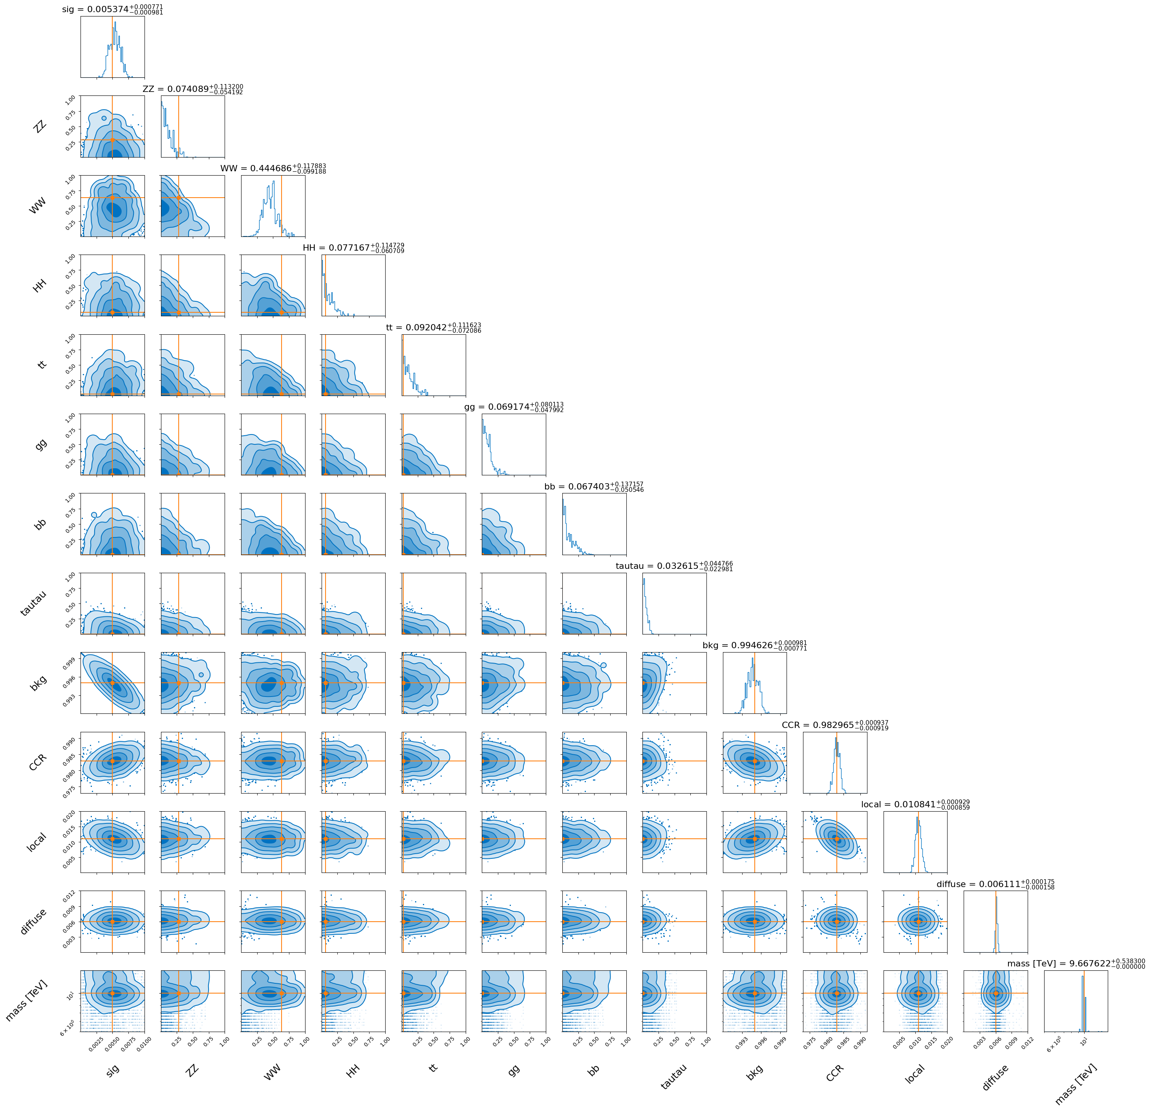

Slide 16
Notes:
Different IRF versions
Simplistic projection
Different dark matter models/approaches
Different background models

Slide 17

Next steps and Questions?
Previous paper arXiv:2401.13876
Including more background systematic uncertainties
Including IRF systematic uncertainties
Validation of framework using public HESS crab nebula data
GammaBayes Code
Email me at Liam.Pinchbeck@monash.edu
Notes:
- Tell them it is flexible and extendable

Slide 18
Reasons for Differences
Different IRF versions
Simplistic projection
Different dark matter models/approaches
Different background models
Previous paper arXiv:2401.13876
Email me at Liam.Pinchbeck@monash.edu
Notes:
- Tell them it is flexible and extendable

Slide 19
GitHub Repo

Slide 20
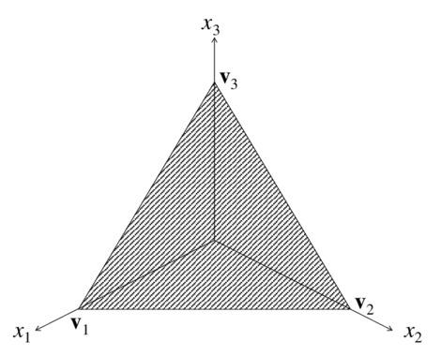
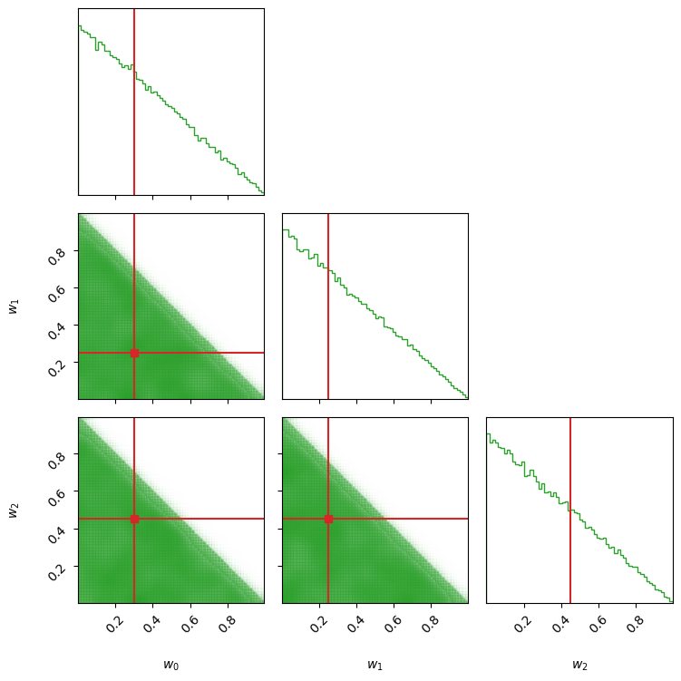
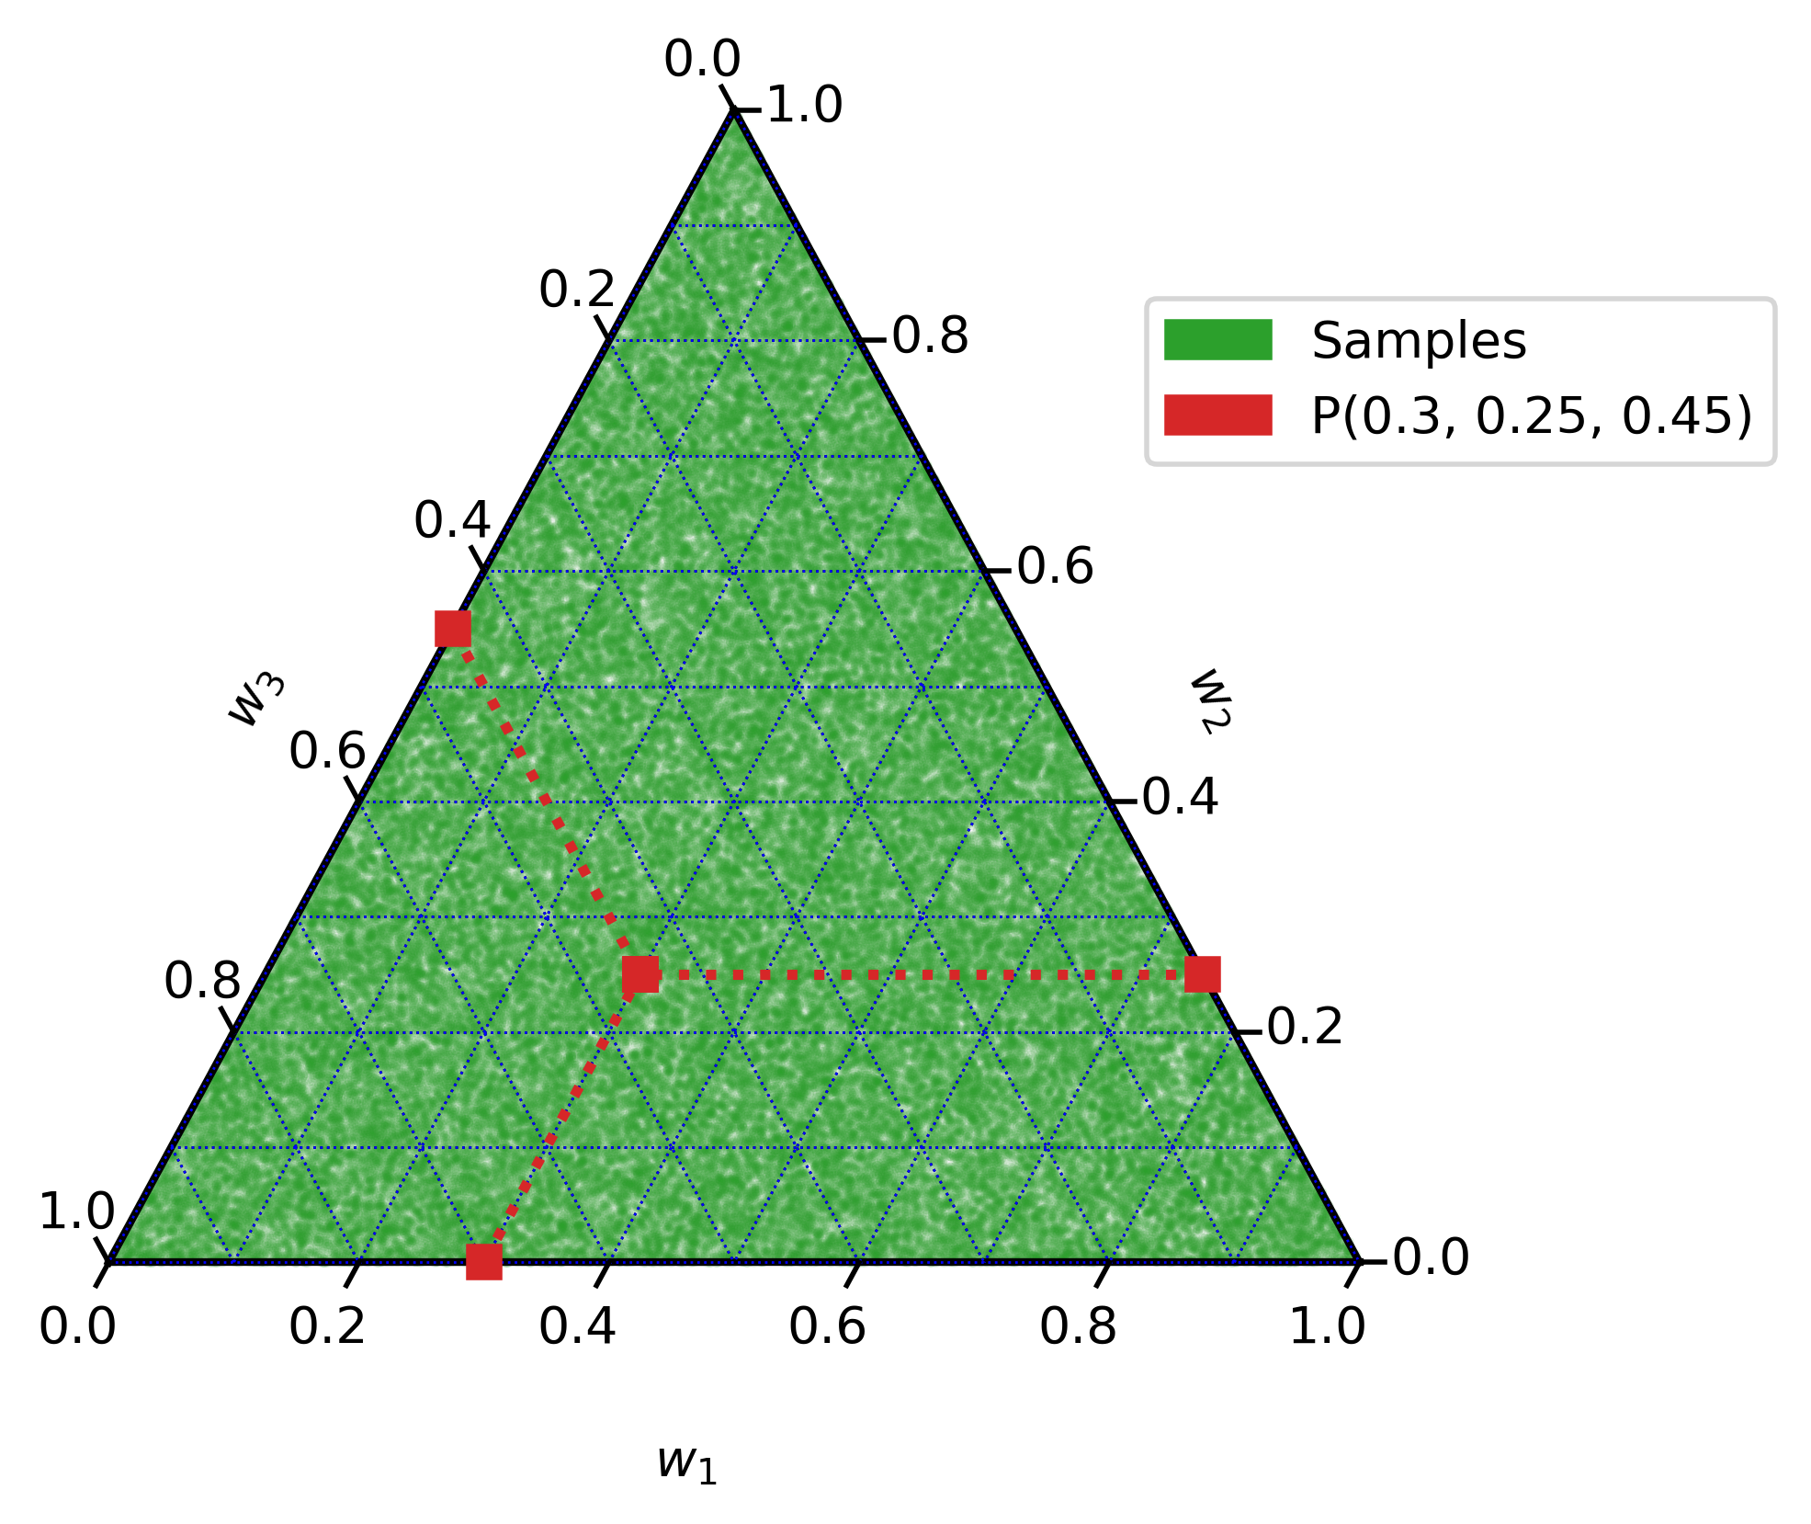
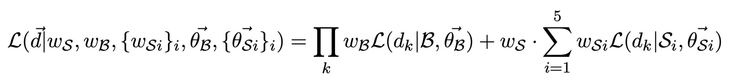

Slide 21
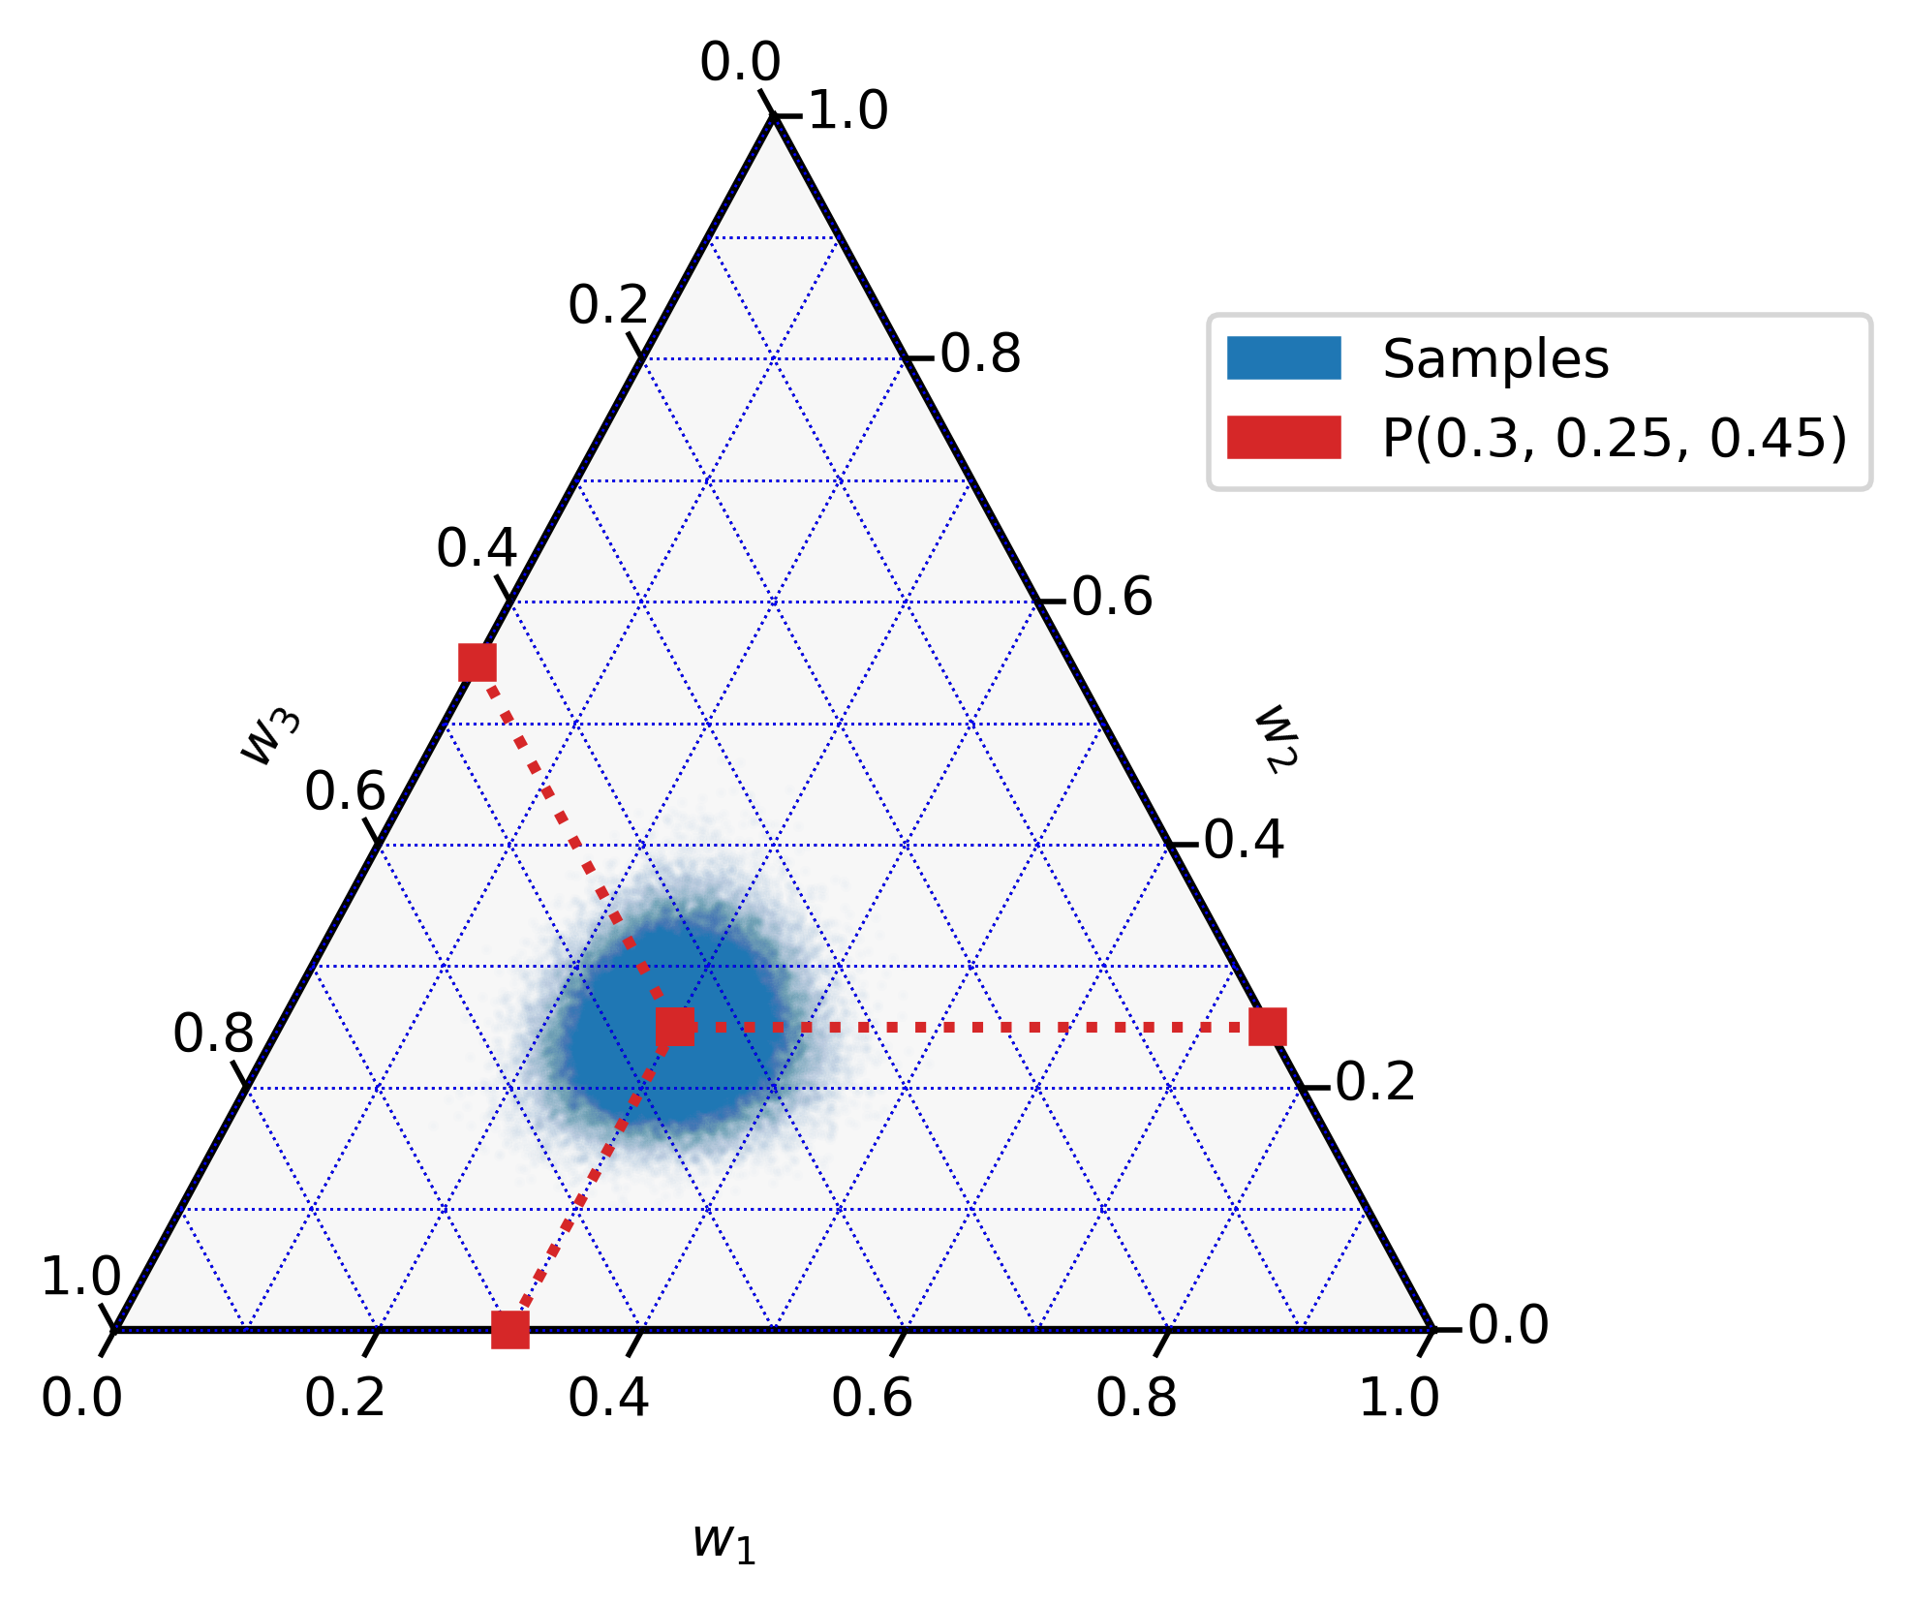
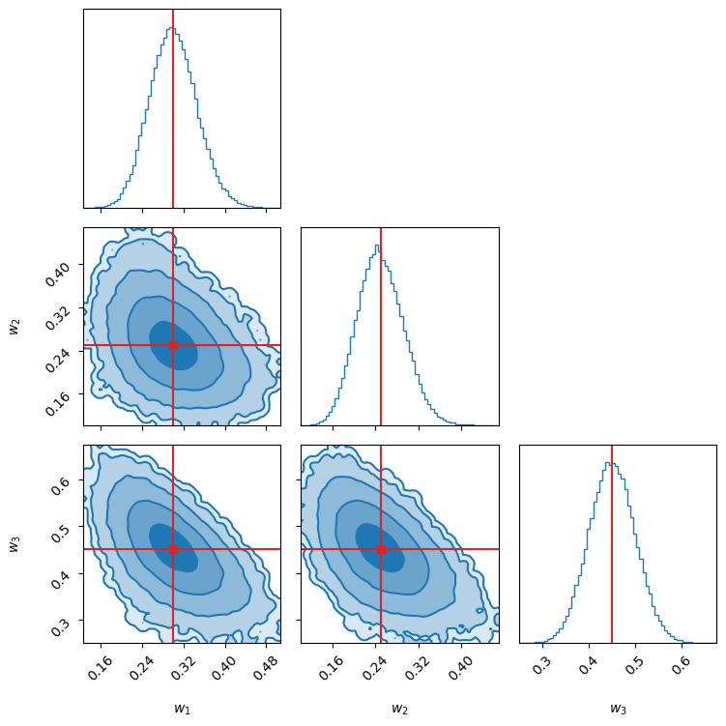

Slide 22
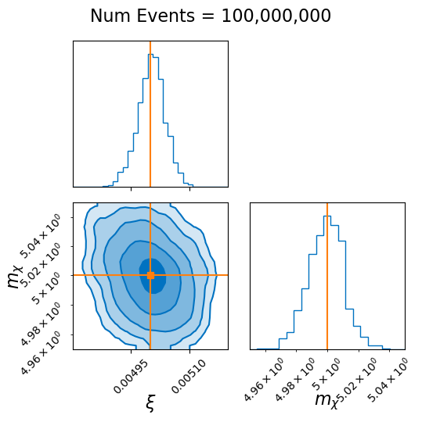
Notes:
On this slide and in the paper, make the horizontal axis labels bigger. Too small.
- useful excluder

Slide 23
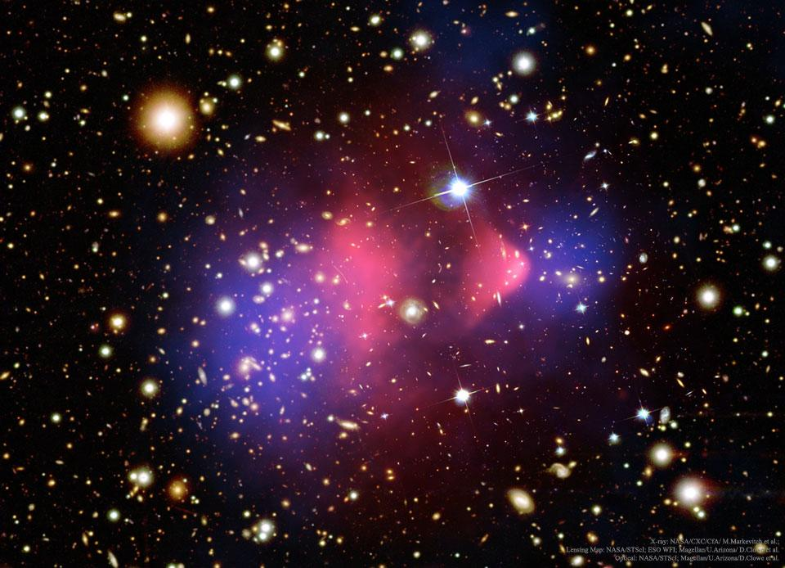
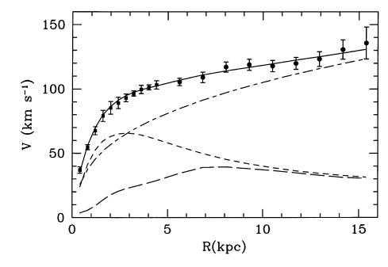
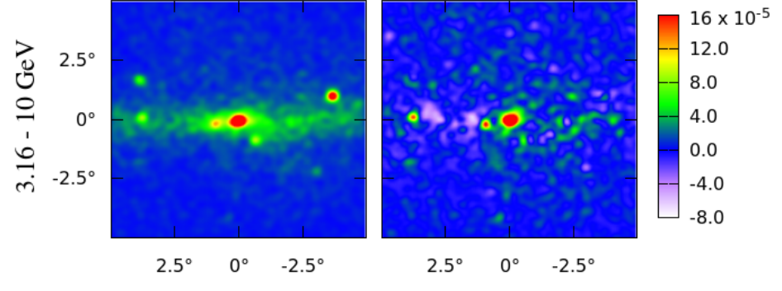
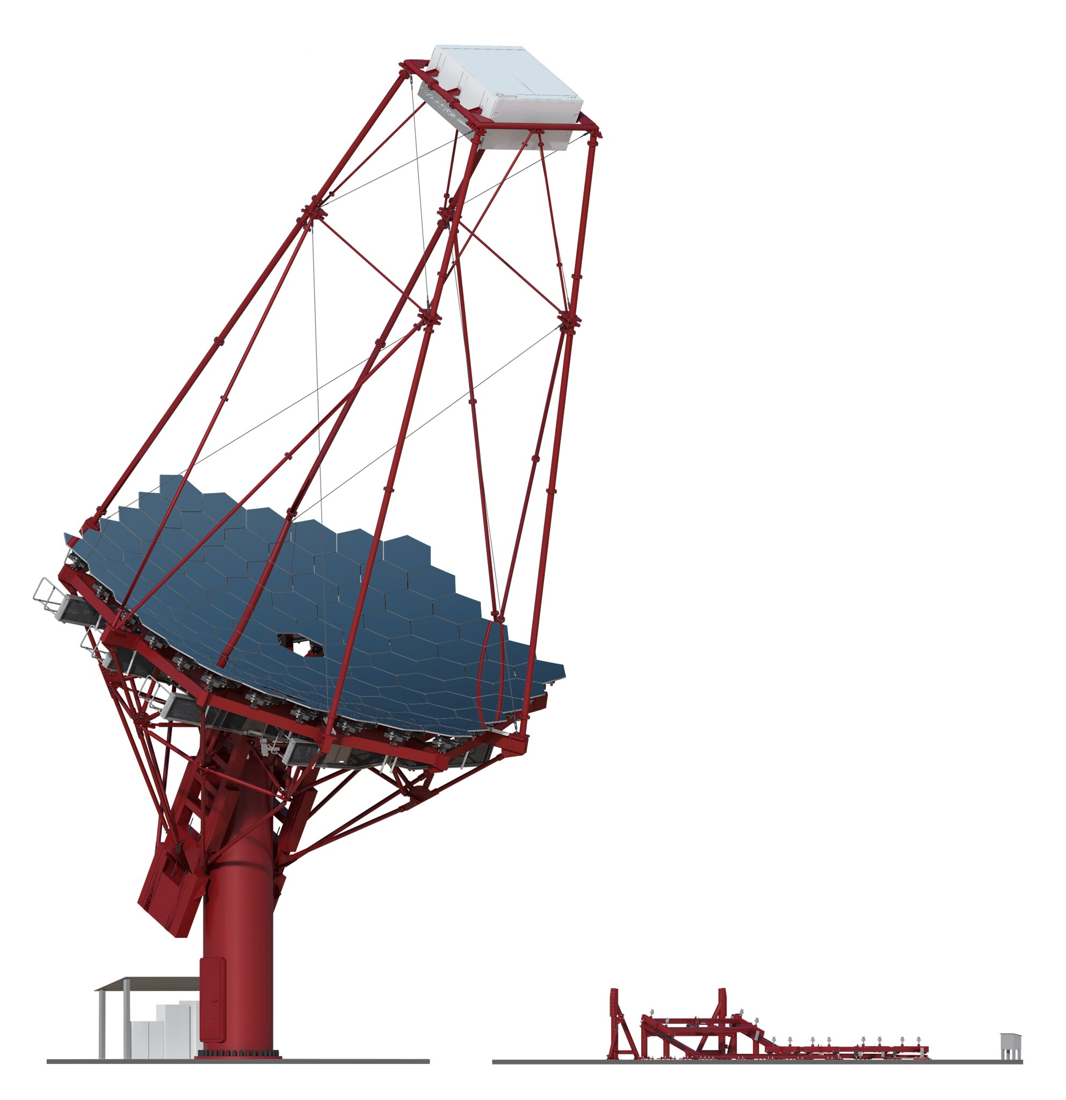

Dark Matter: Found?
Dark Matter: Found?
NASA/CXC/CfA/ M. Markevitch et al.
ESO WFI; Magellan/U.Arizona/ D.Clowe et al.
Magellan/U.Arizona/D.Clowe et al.
Flux $\left(E^{2}\frac{dN}{dE}\right)$ [GeV]
Corbelli, E. & Salucci, P. (Jan. 2000).
Daylan et. al (Mar. 2015), arXiv:1402.6703
Notes:
M33 Galaxy on left
Virial Theorem
“M33, a satellite of the Andromeda galaxy. Most recently, GeV gamma-ray emission from M33 and Arp 229 (Xi et al. 2020b) has also been reported.”

Slide 24
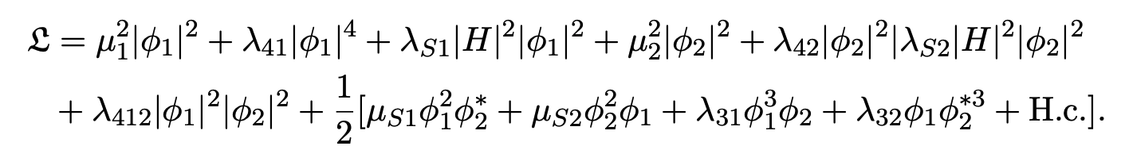
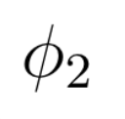
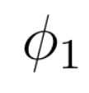
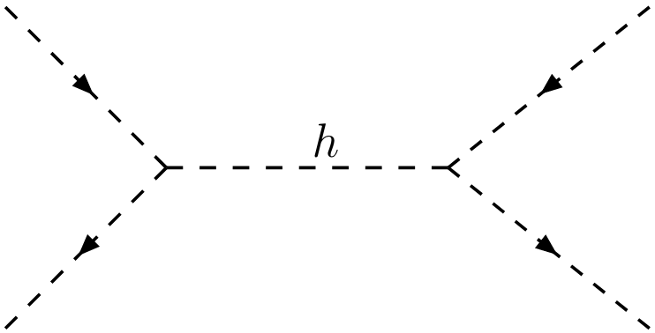
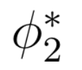
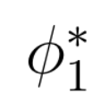




Dark Matter: Take 5!
$$\overline{SM}$$
$$\overline{SM}$$
Corbelli, E. & Salucci, P. (Jan. 2000).
$$SM$$
$$SM$$
Flux $\left(E^{2}\frac{dN}{dE}\right)$ [GeV]
Daylan et. al (Mar. 2015), ArXiv:1402.6703

Slide 25
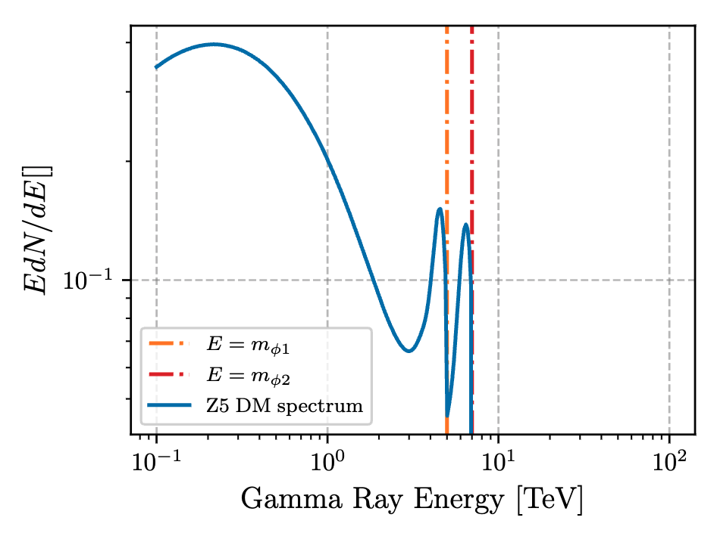

Slide 26
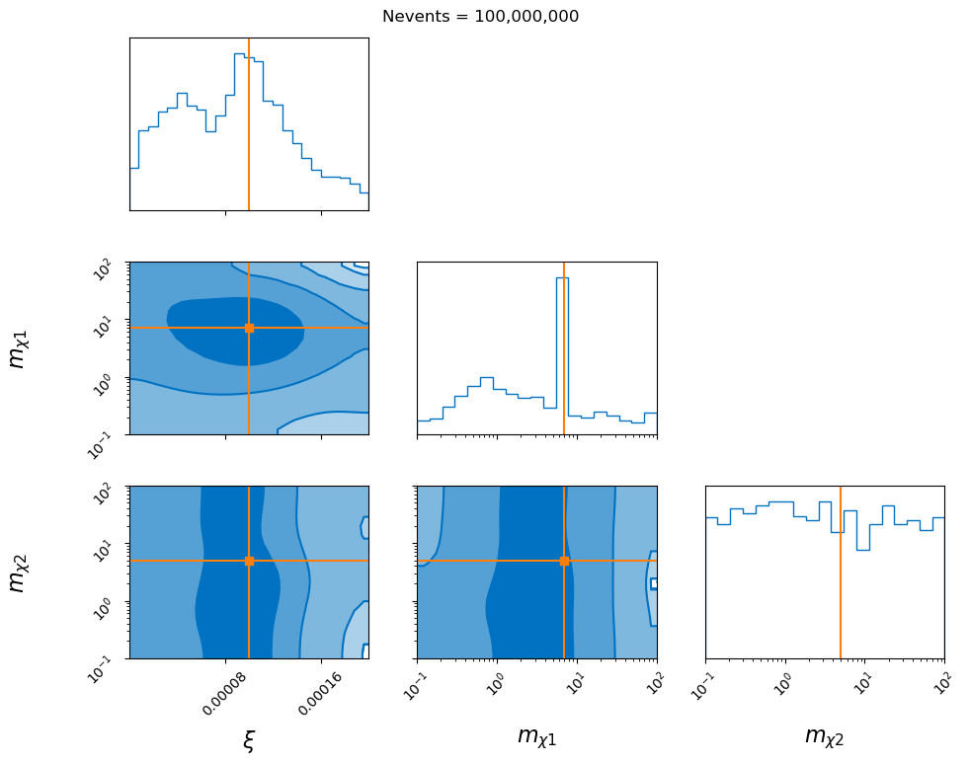

Slide 27
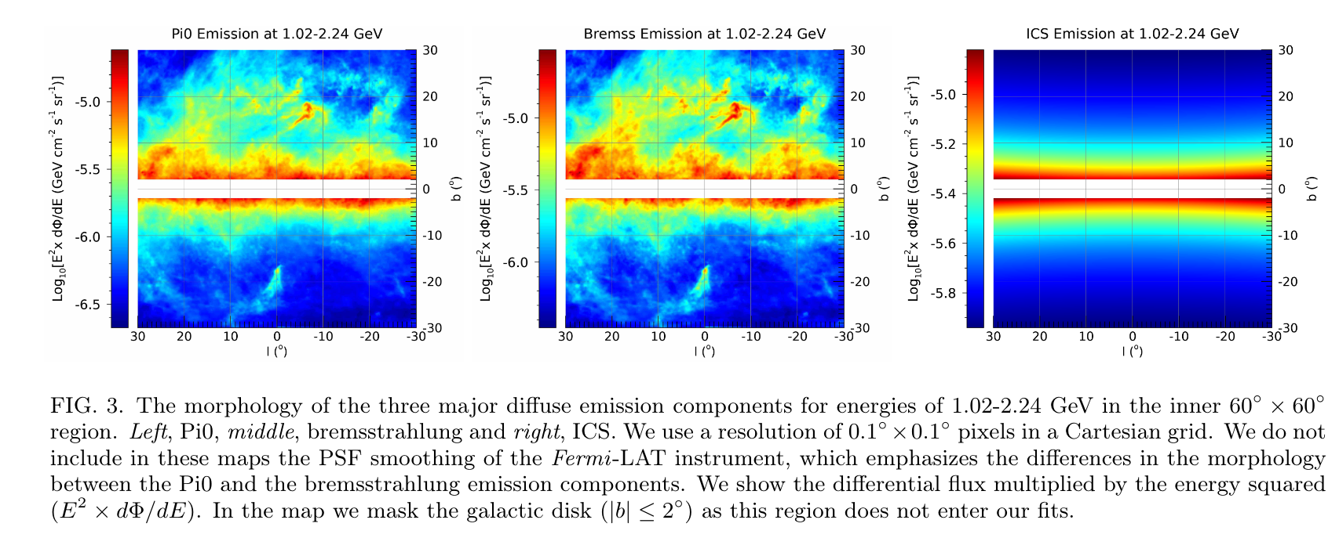
Taken from Cholis+, 2112.09706

Slide 28
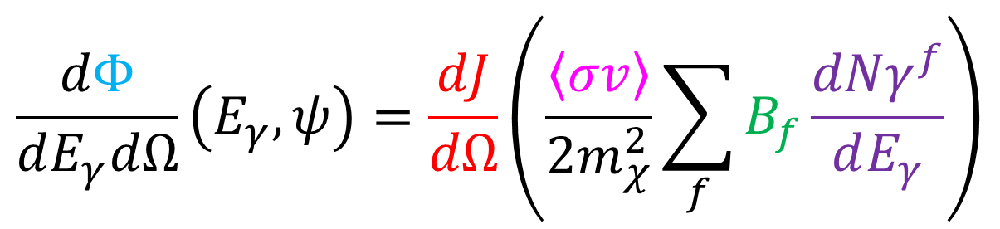
$$\frac{dΦ}{dE_{γ}dΩ}\left(E_{γ},ψ\right)=\frac{dJ}{dΩ}\left(\frac{\left\langle σv\right\rangle }{2m_{χ}^{2}}\sum_{f}{B_{f}\frac{dNγ^{f}}{dE_{γ}}}\right)$$

Slide 29
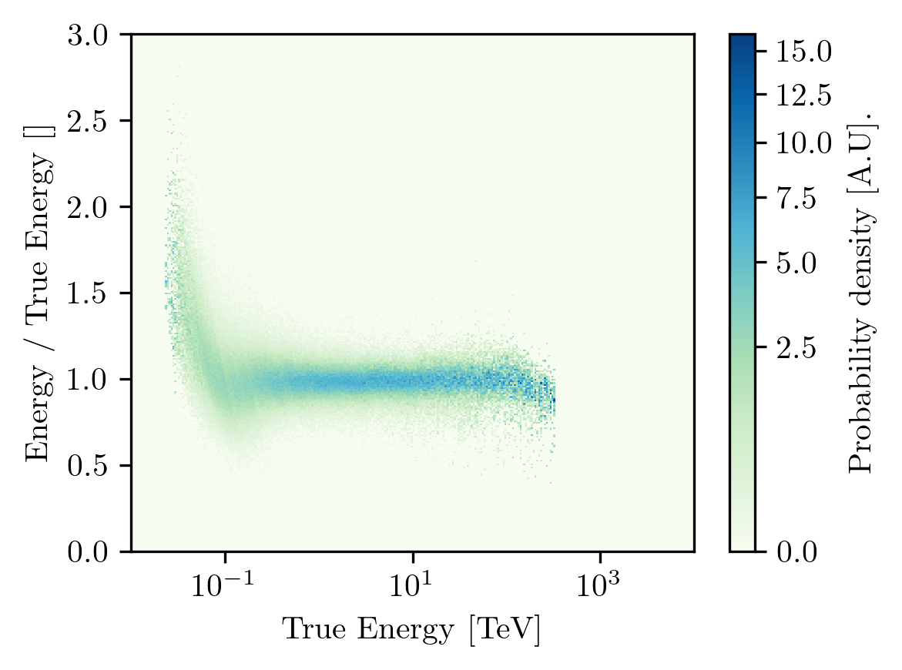
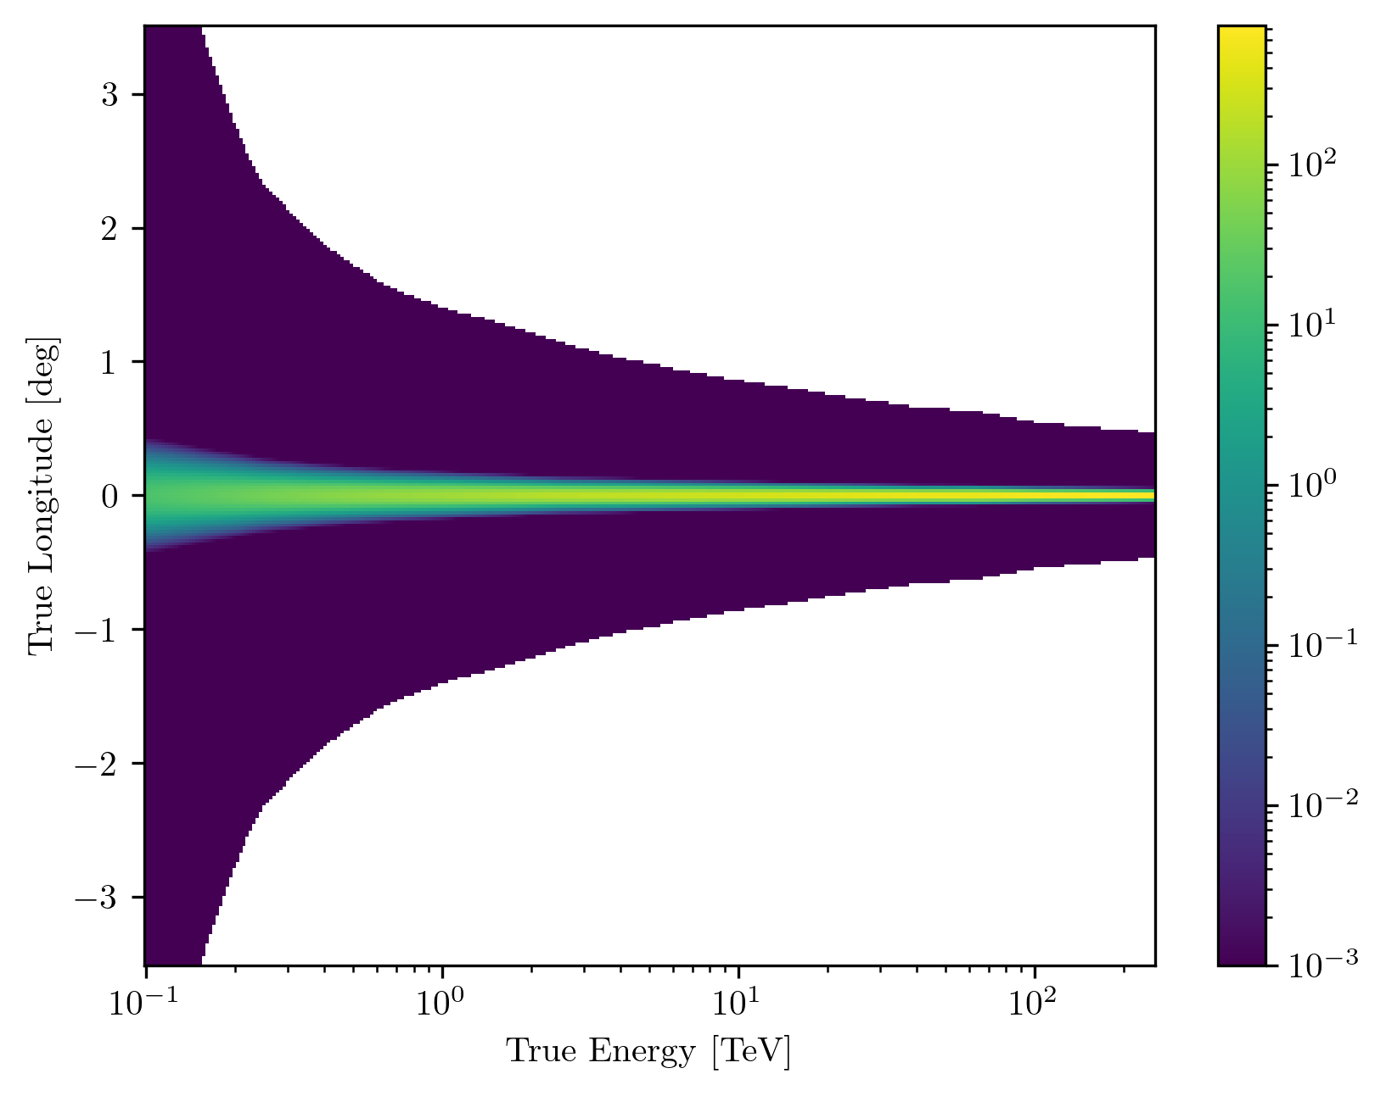
Instrument Response Functions

Slide 30
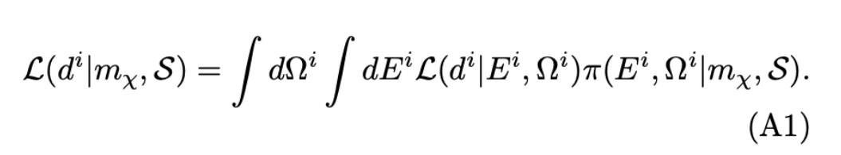
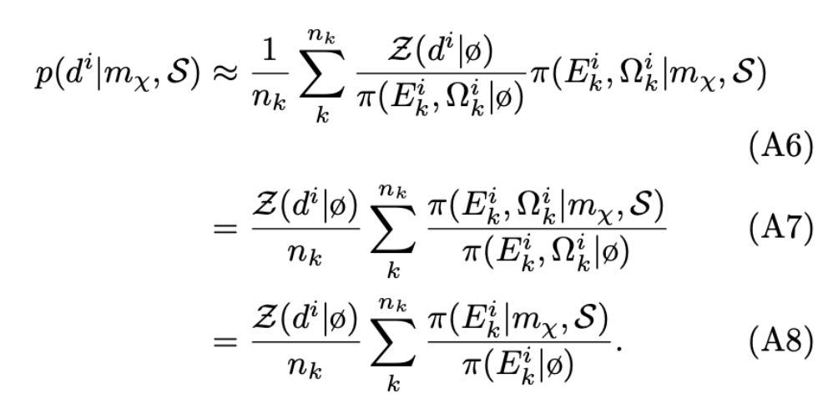
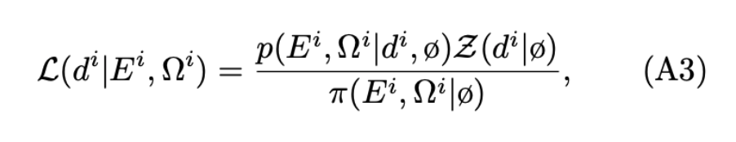
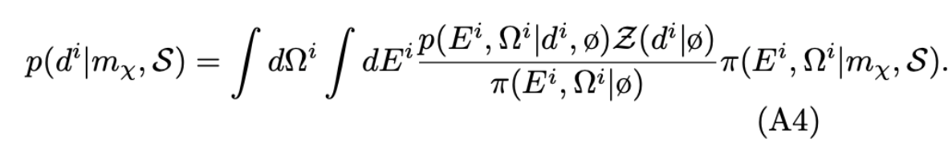
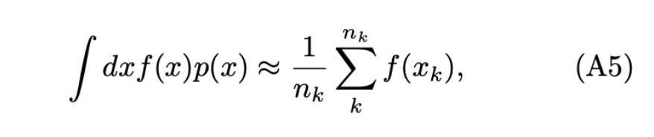

Re-sampling technique

