Slide 1
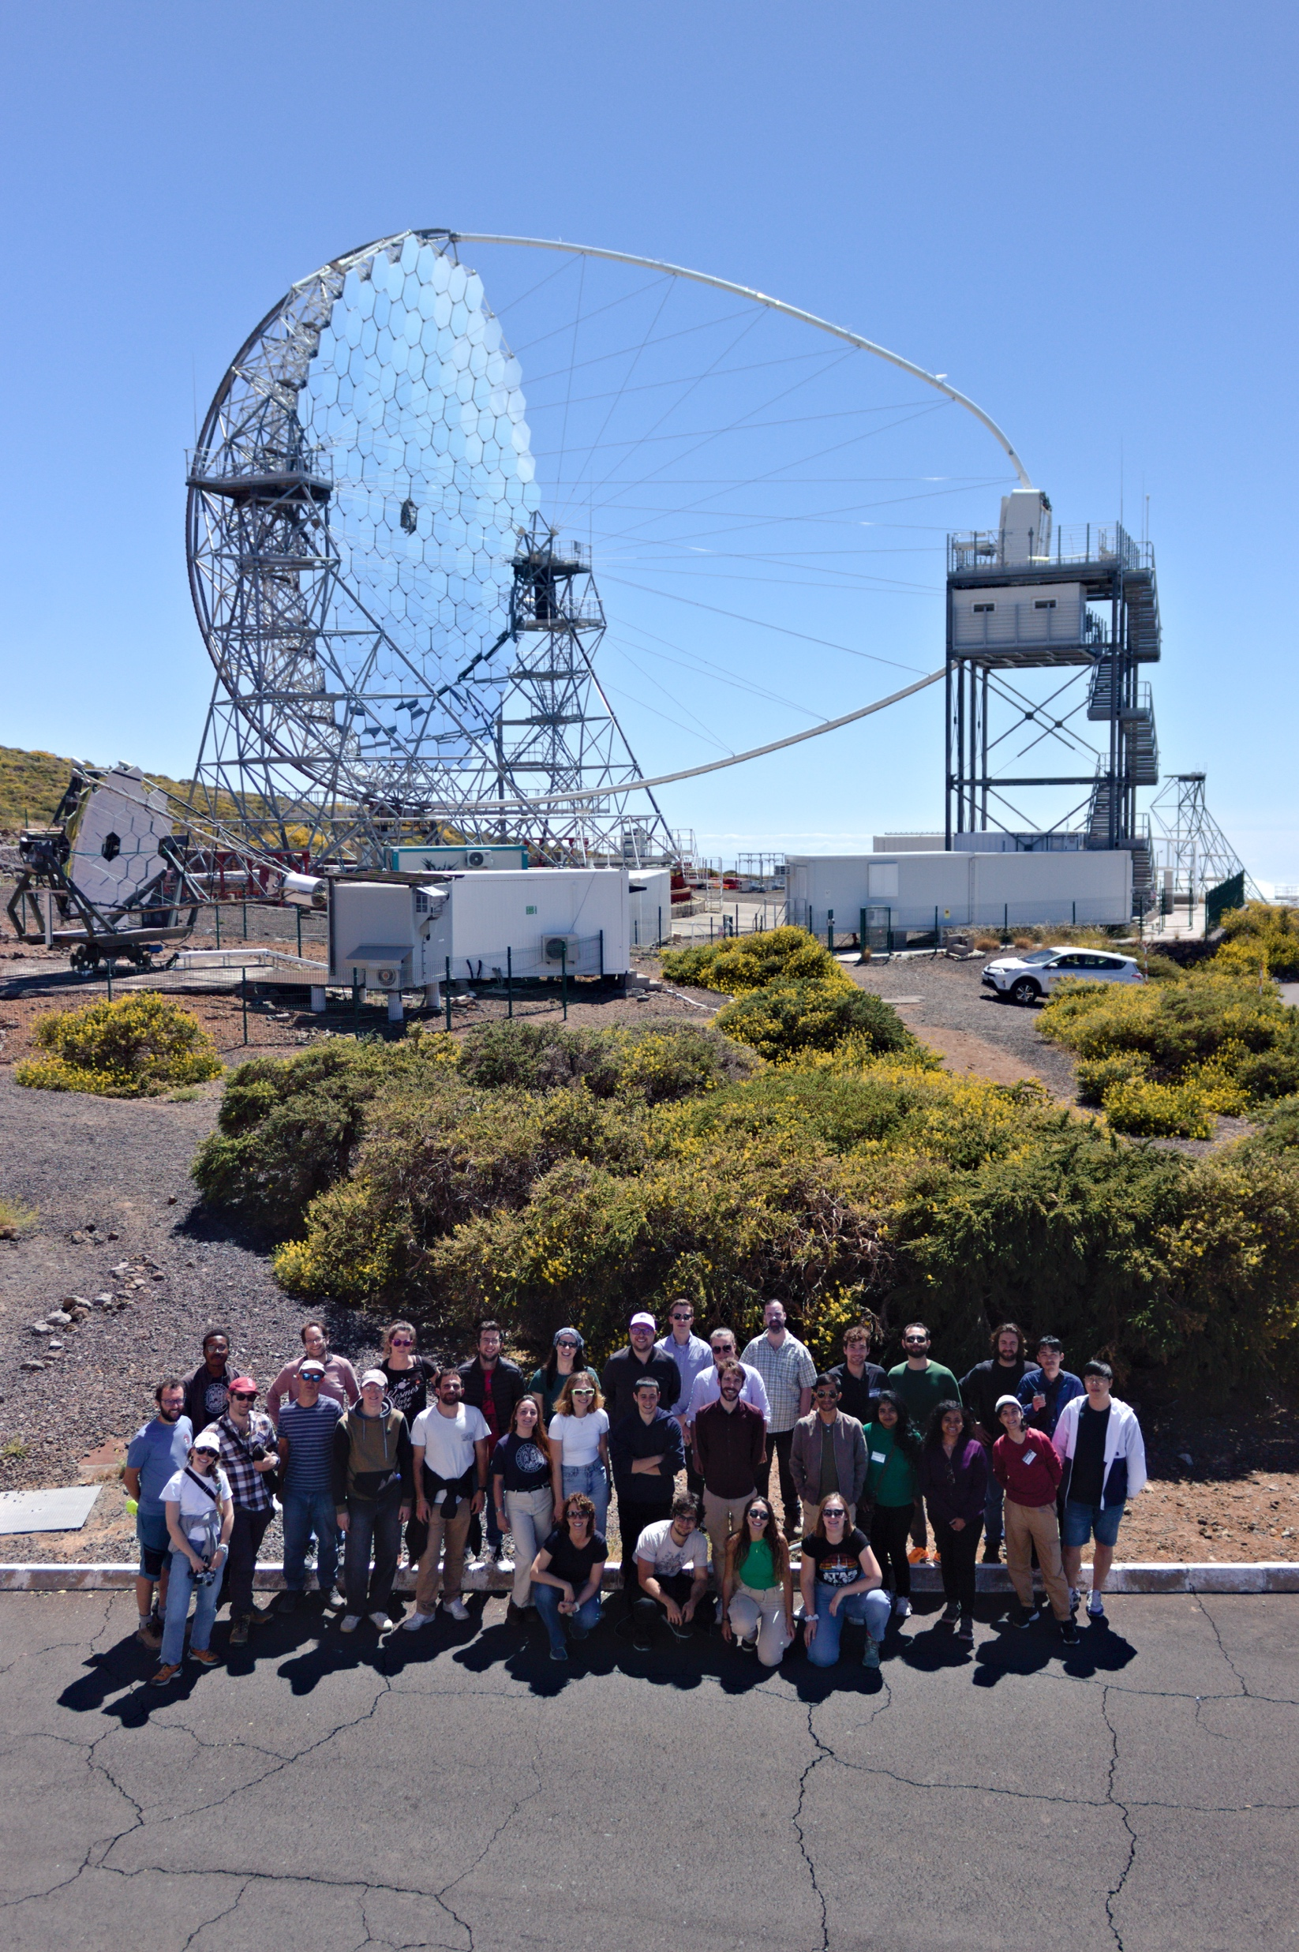
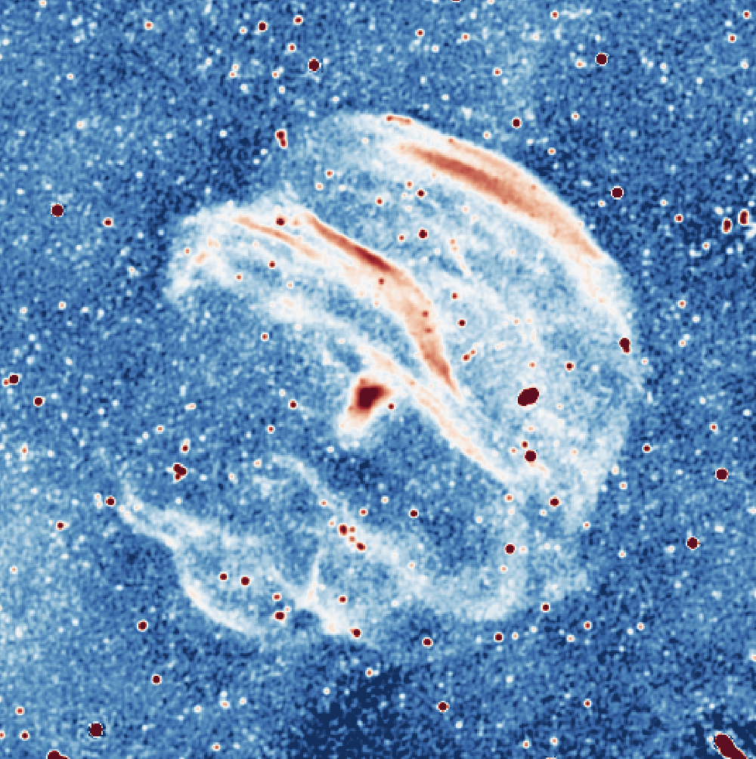
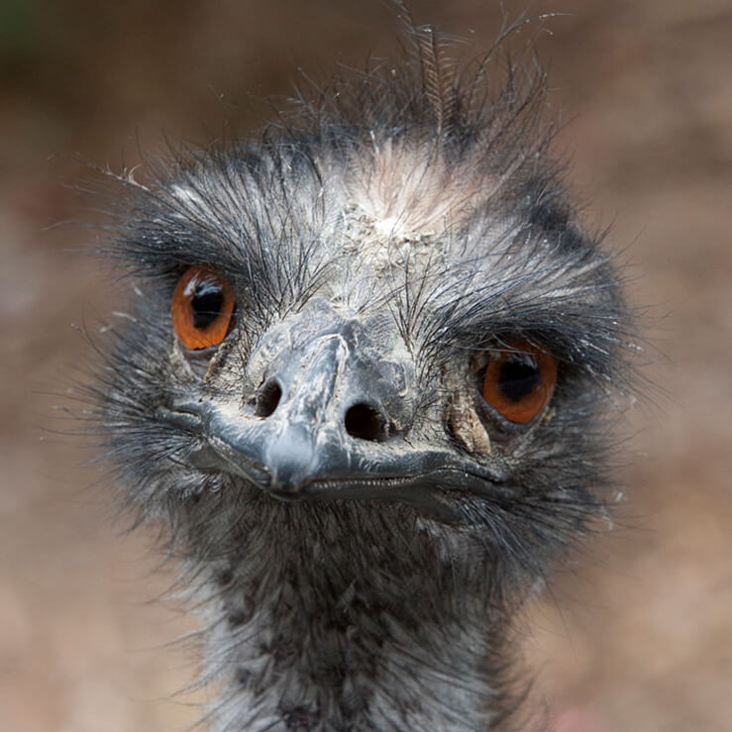
The first CTAO School,
an overview of SNR G289.6+5.8 and other EMU discoveries
Sanja Lazarević
PhD candidate
Western Sydney University
CTAO-Oz 2024

Slide 2
1st CTAO School
Sanja Lazarević CTAO-Oz 2024

Slide 3
1st CTAO School
week 1: Bertinoro (Italy), 16-22 June 2024
Sanja Lazarević CTAO-Oz 2024

Slide 4
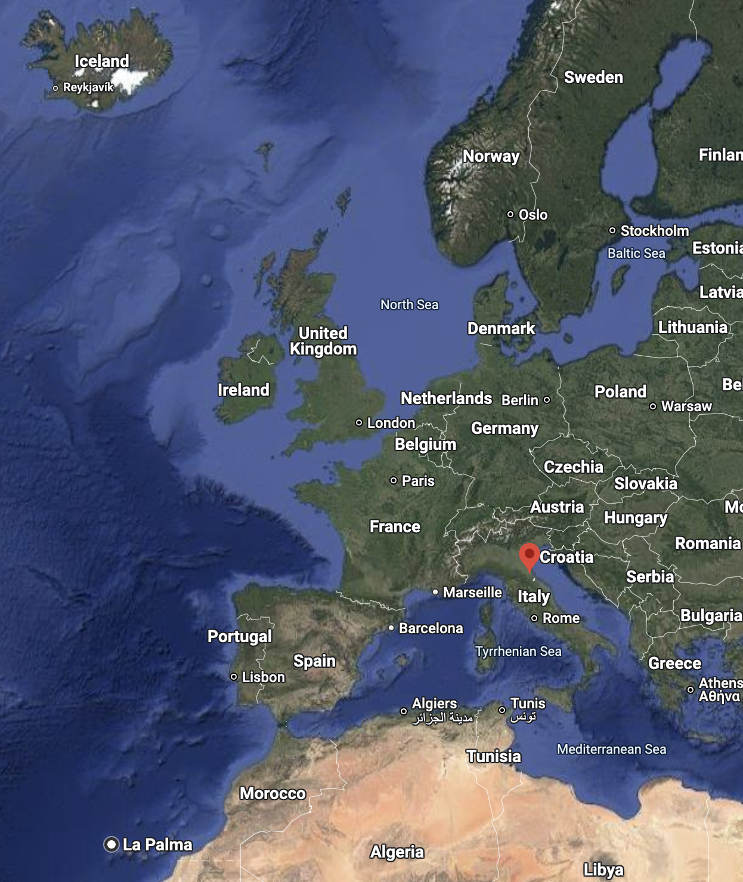
1st CTAO School
Sanja Lazarević CTAO-Oz 2024

Slide 5
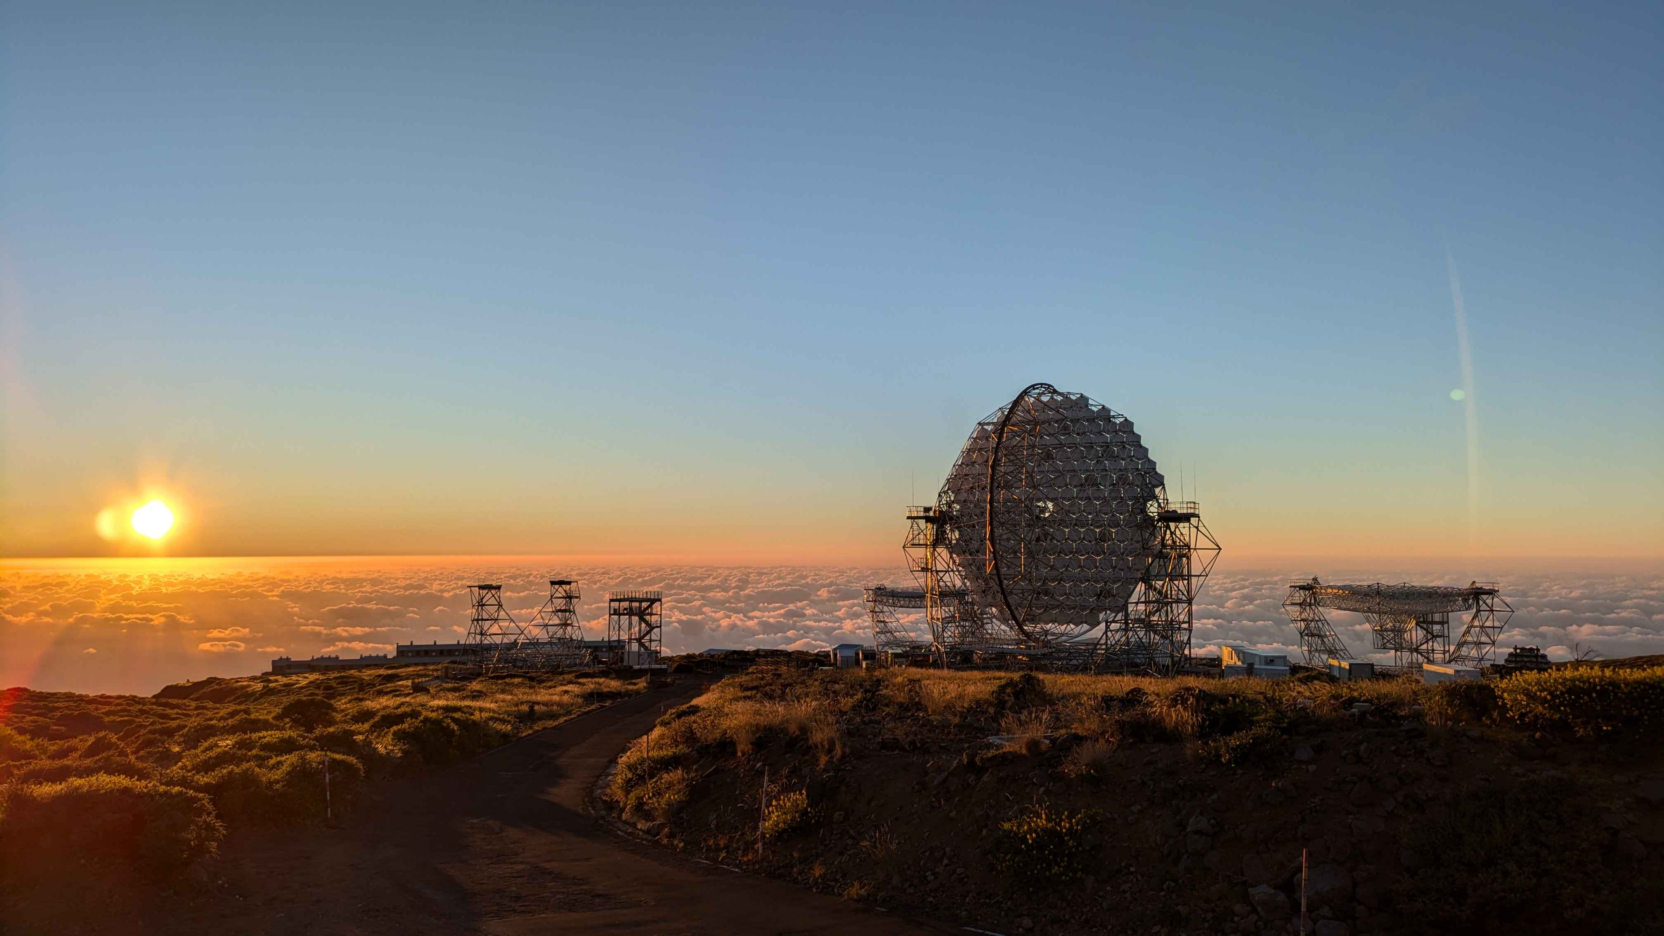
1st CTAO School
week 2: La Palma (Spain), 22-29 June 2024
Sanja Lazarević CTAO-Oz 2024

Slide 6
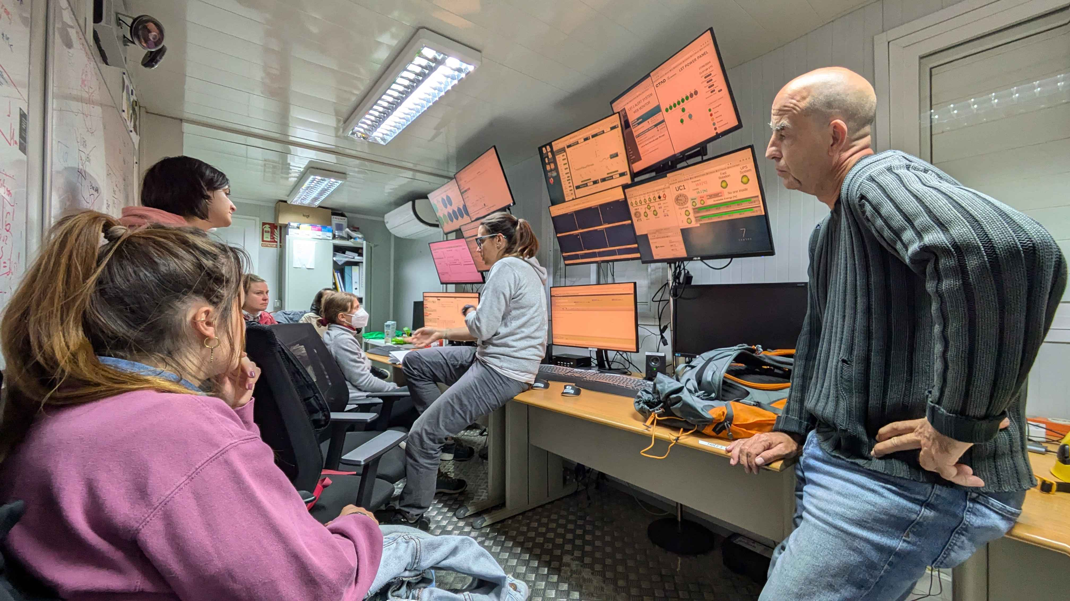
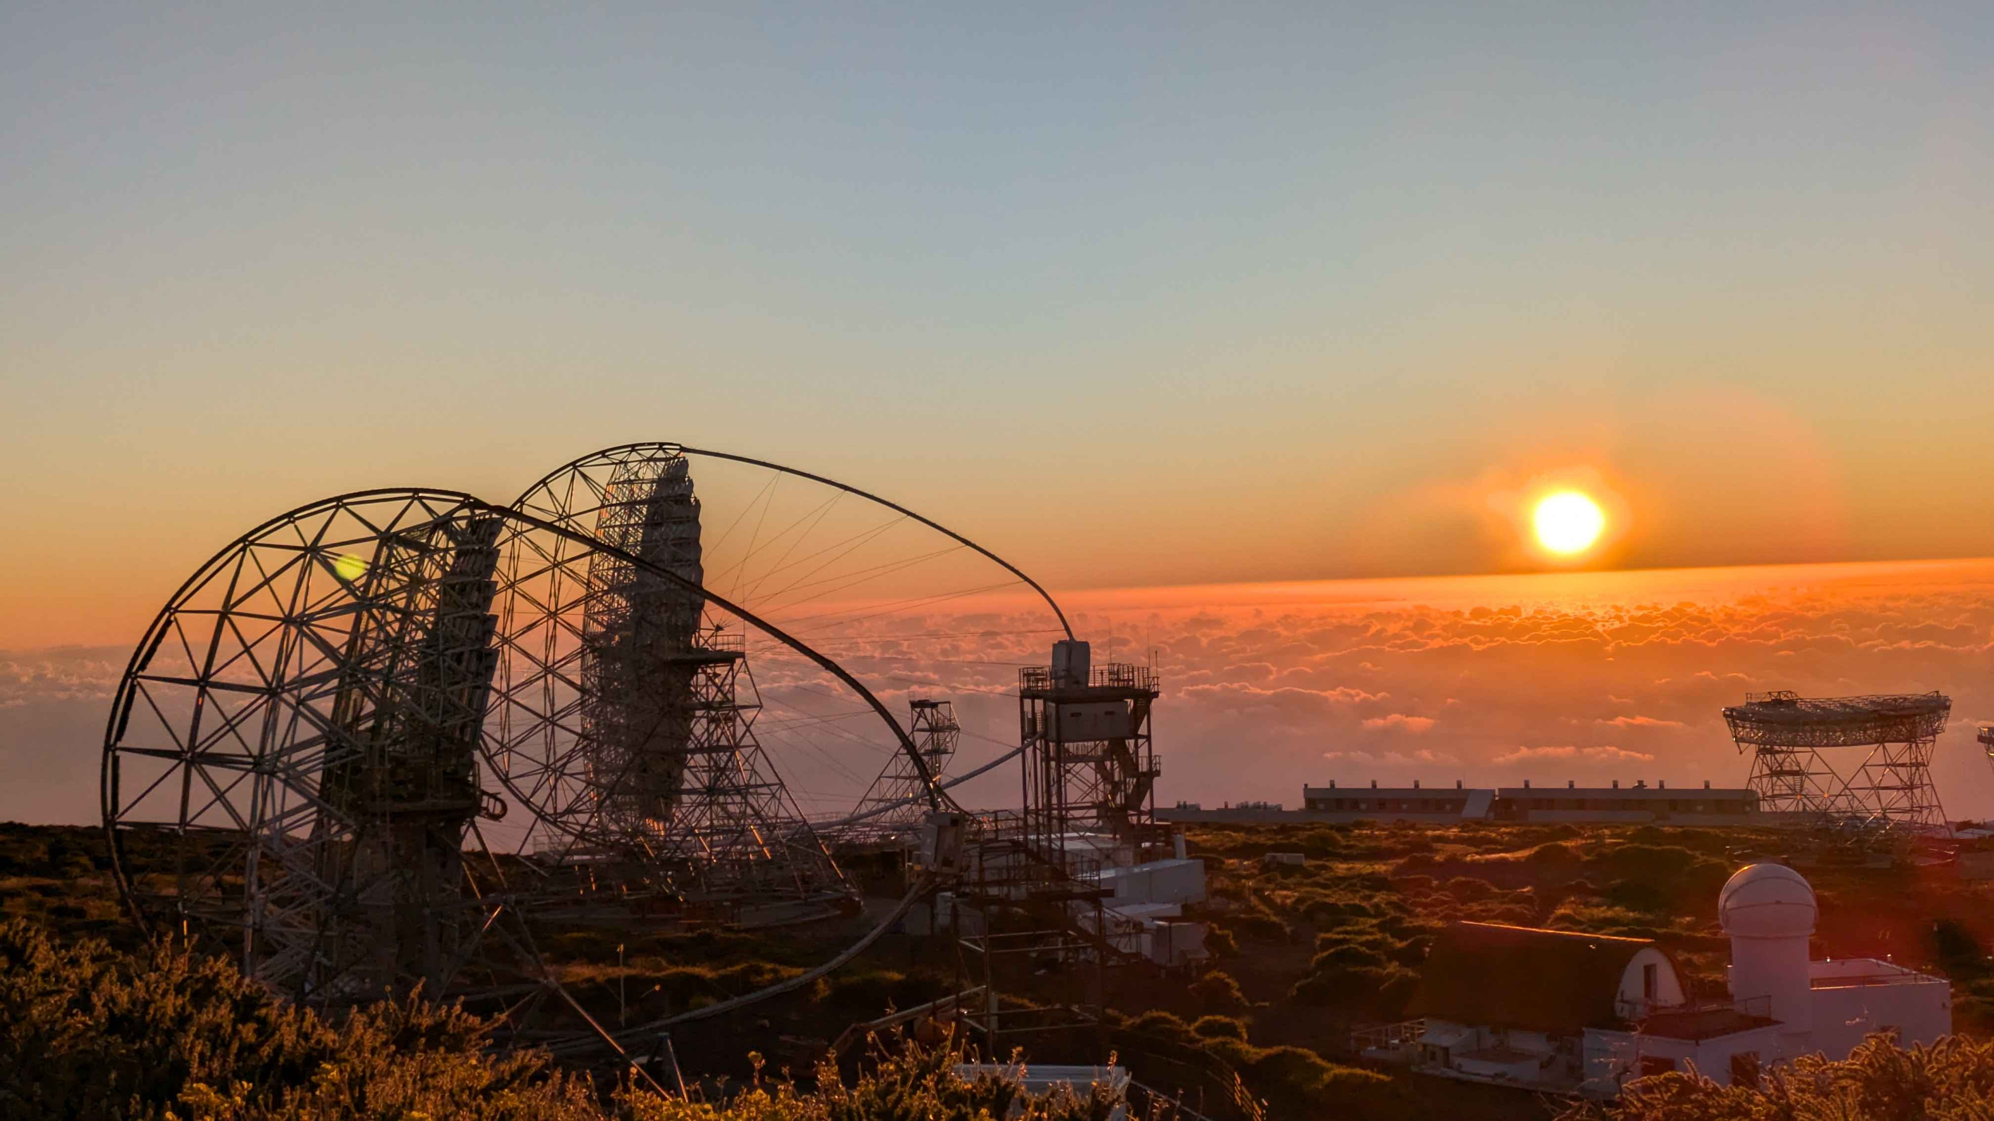
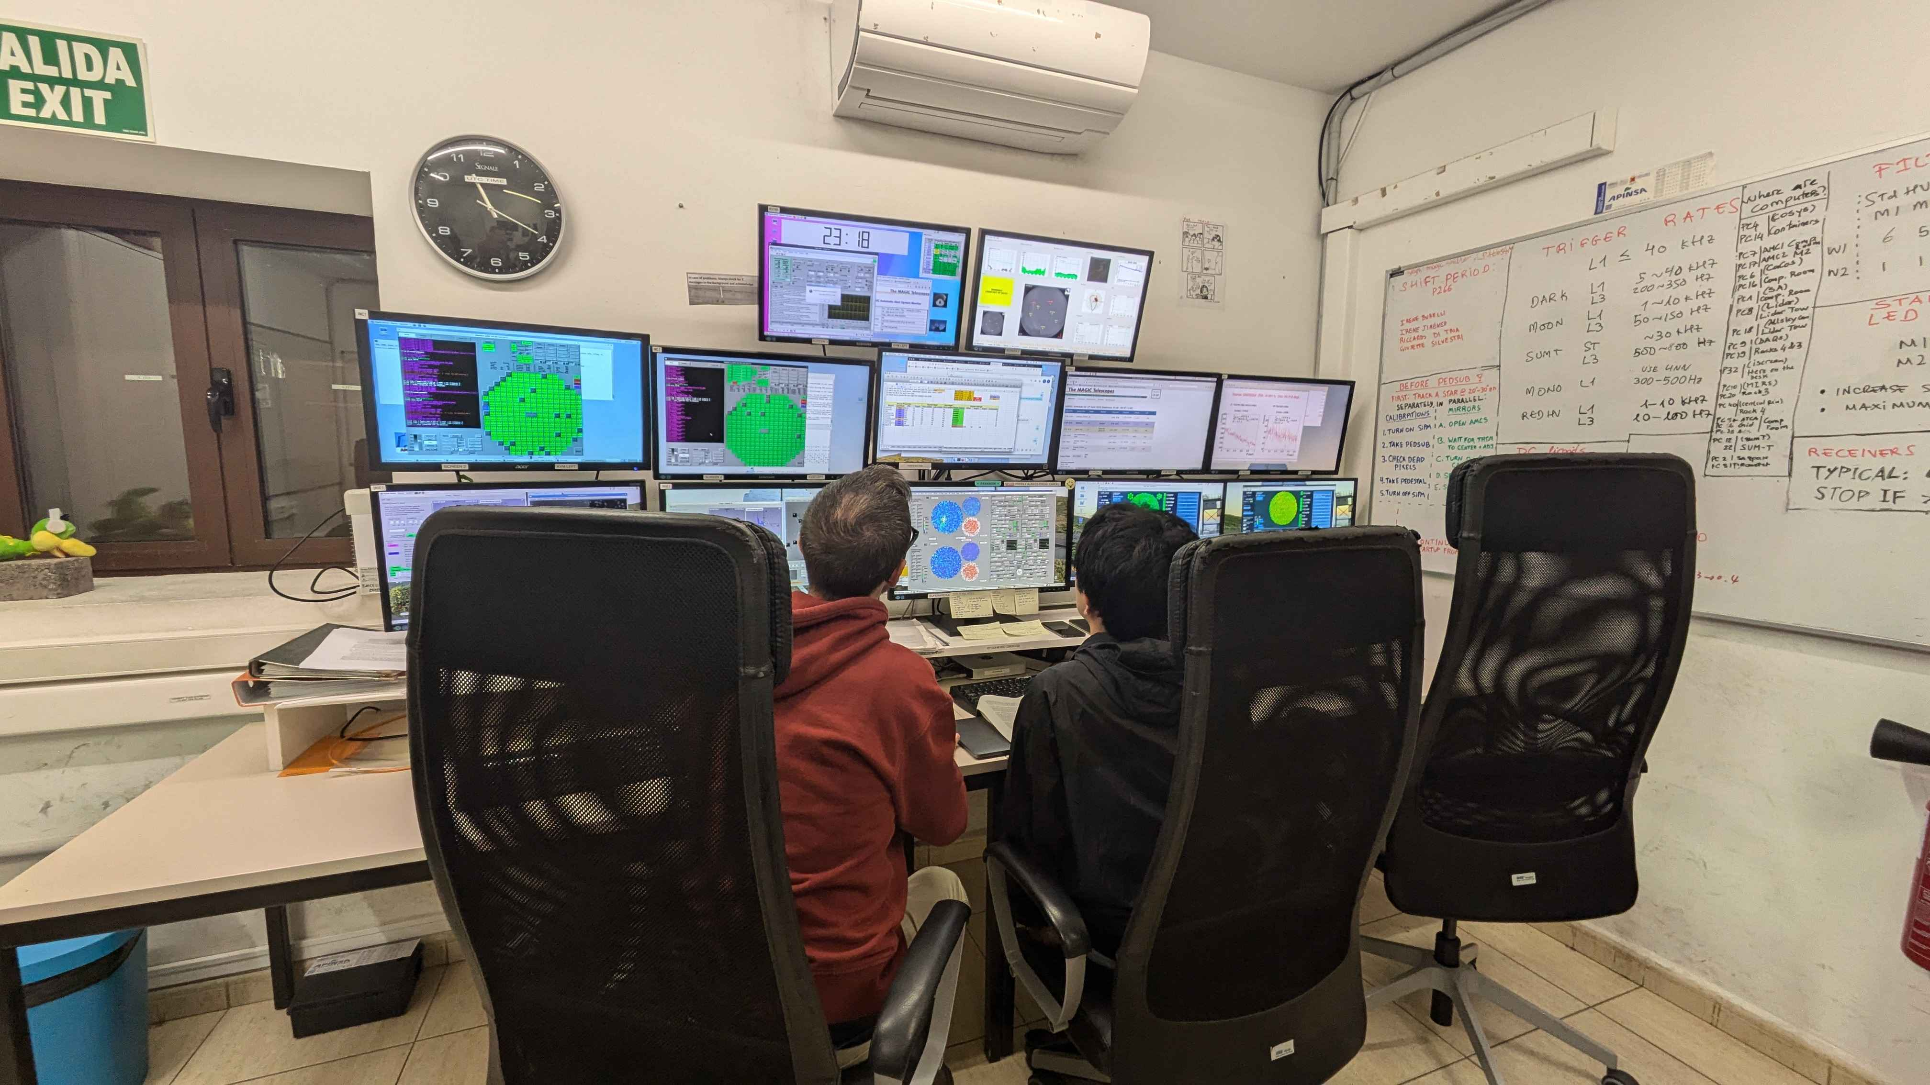
1st CTAO School
Sanja Lazarević CTA-Oz 2024

Slide 7
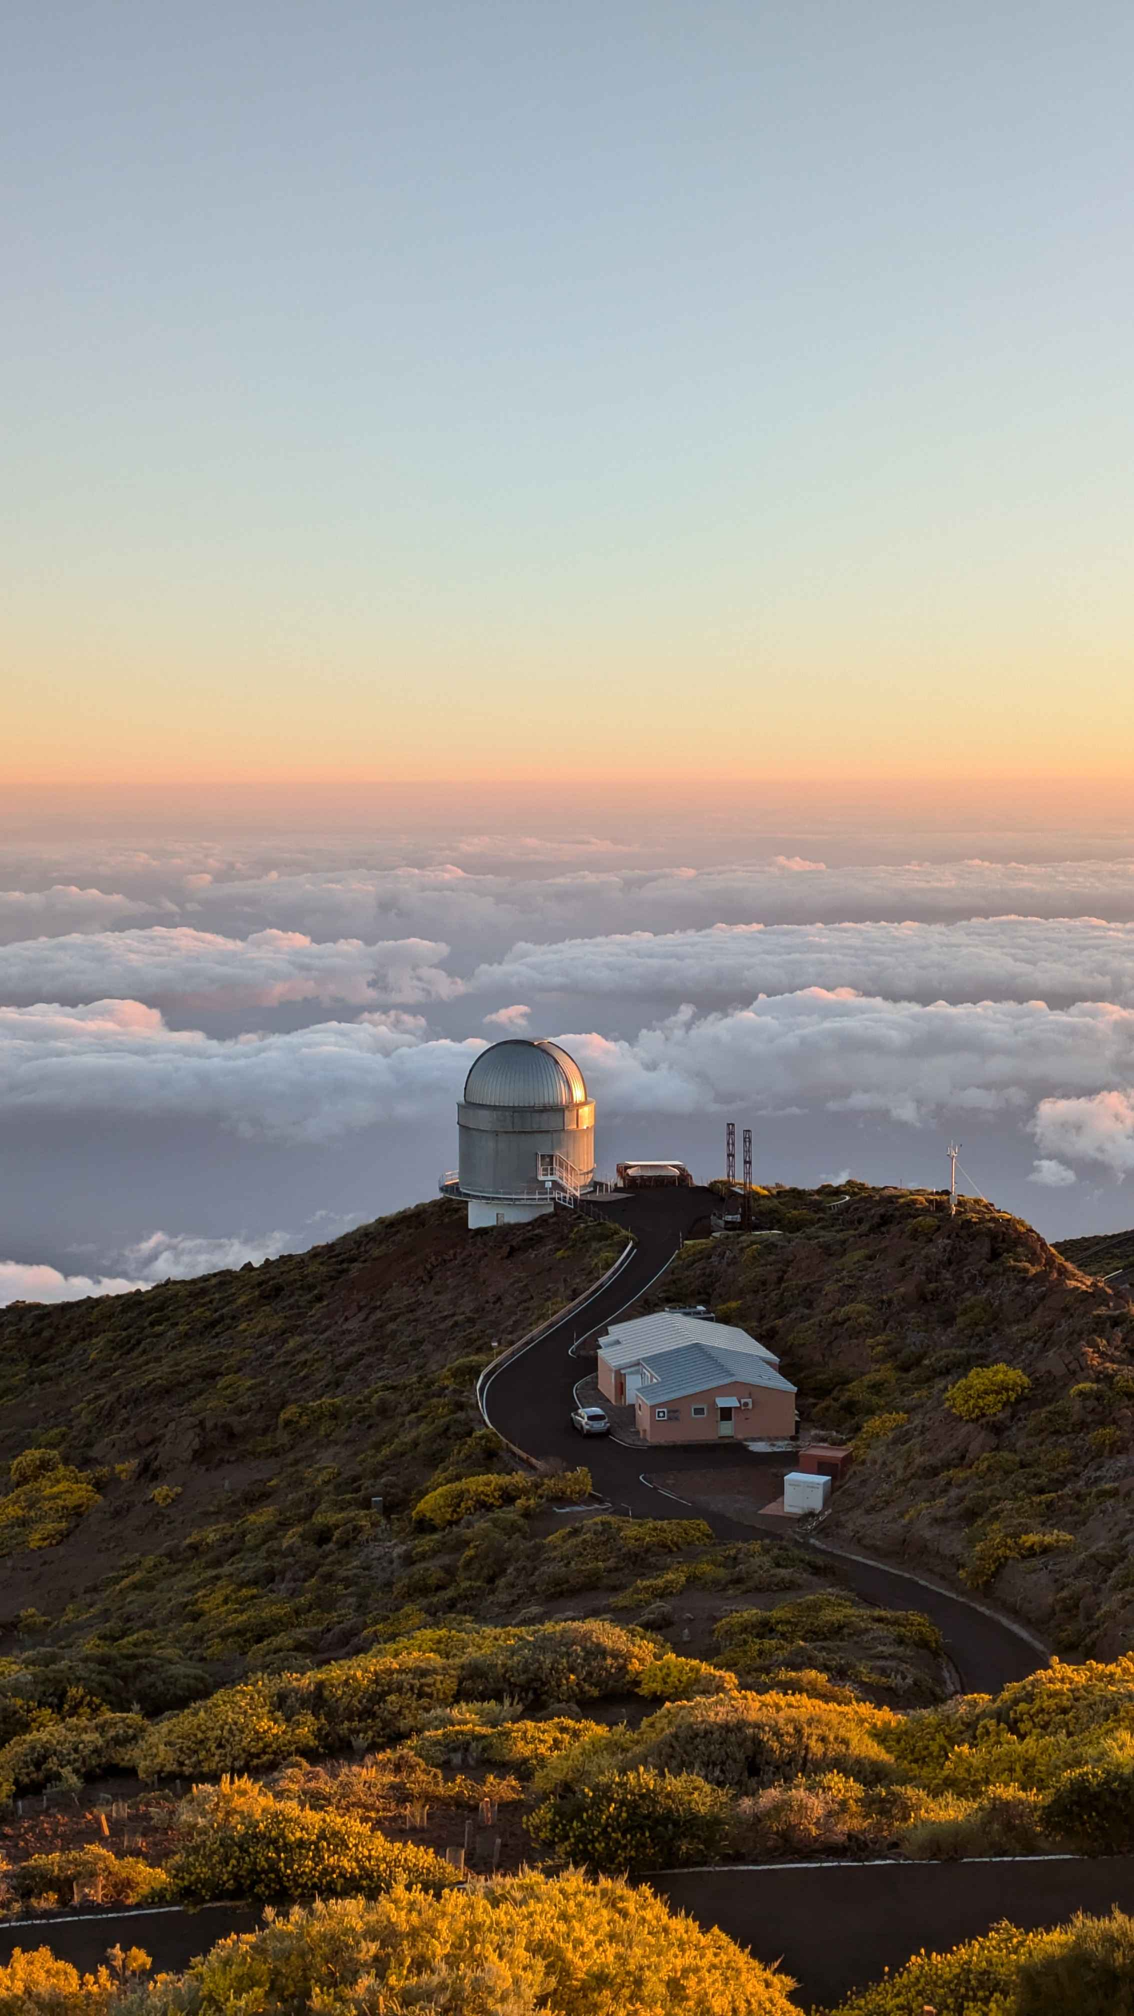
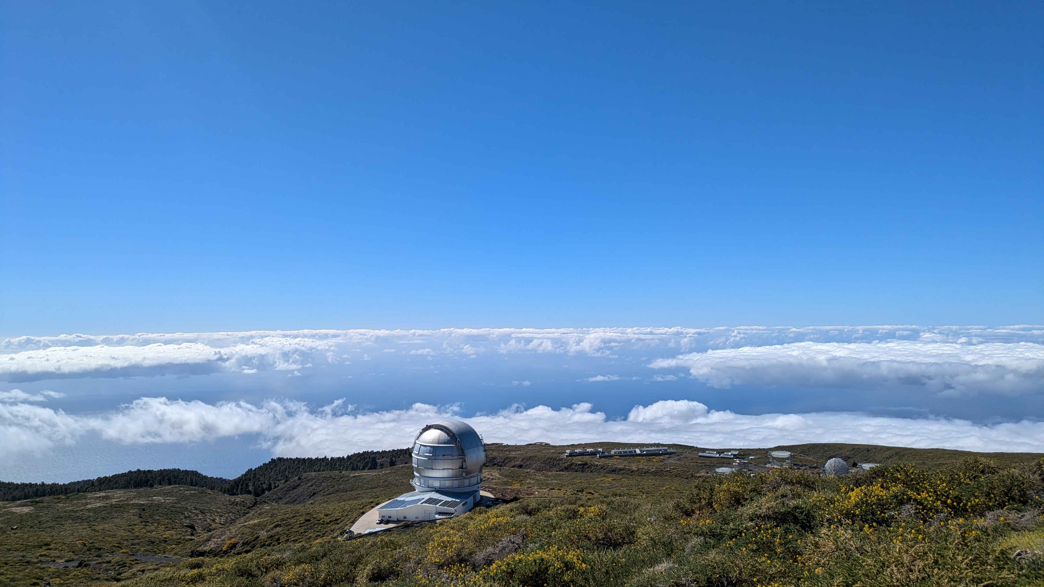
1st CTAO School
Left: Gran Telescopio Canarias (GTC), 10.4m Right: Nordic Optical Telescope (NOT), 2.5m
Sanja Lazarević CTA-Oz 2024

Slide 8
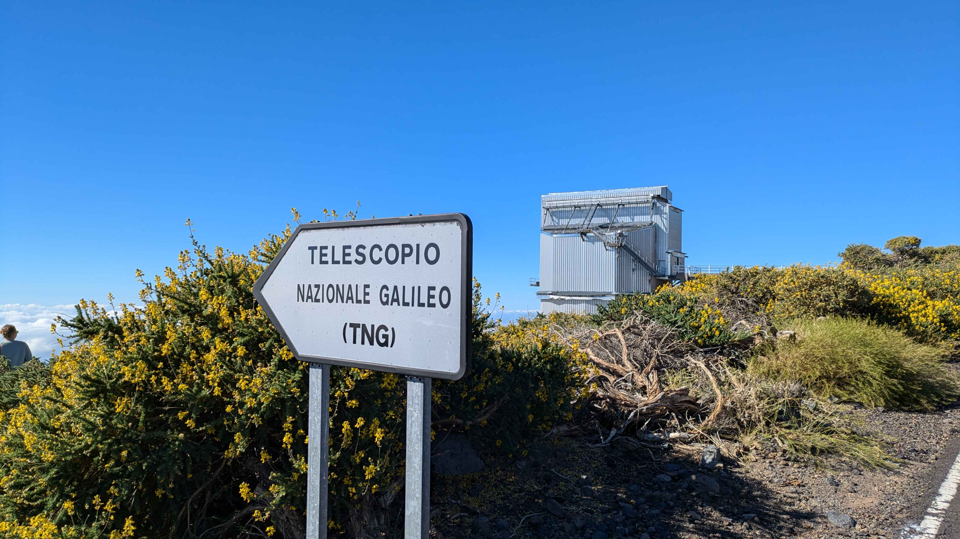
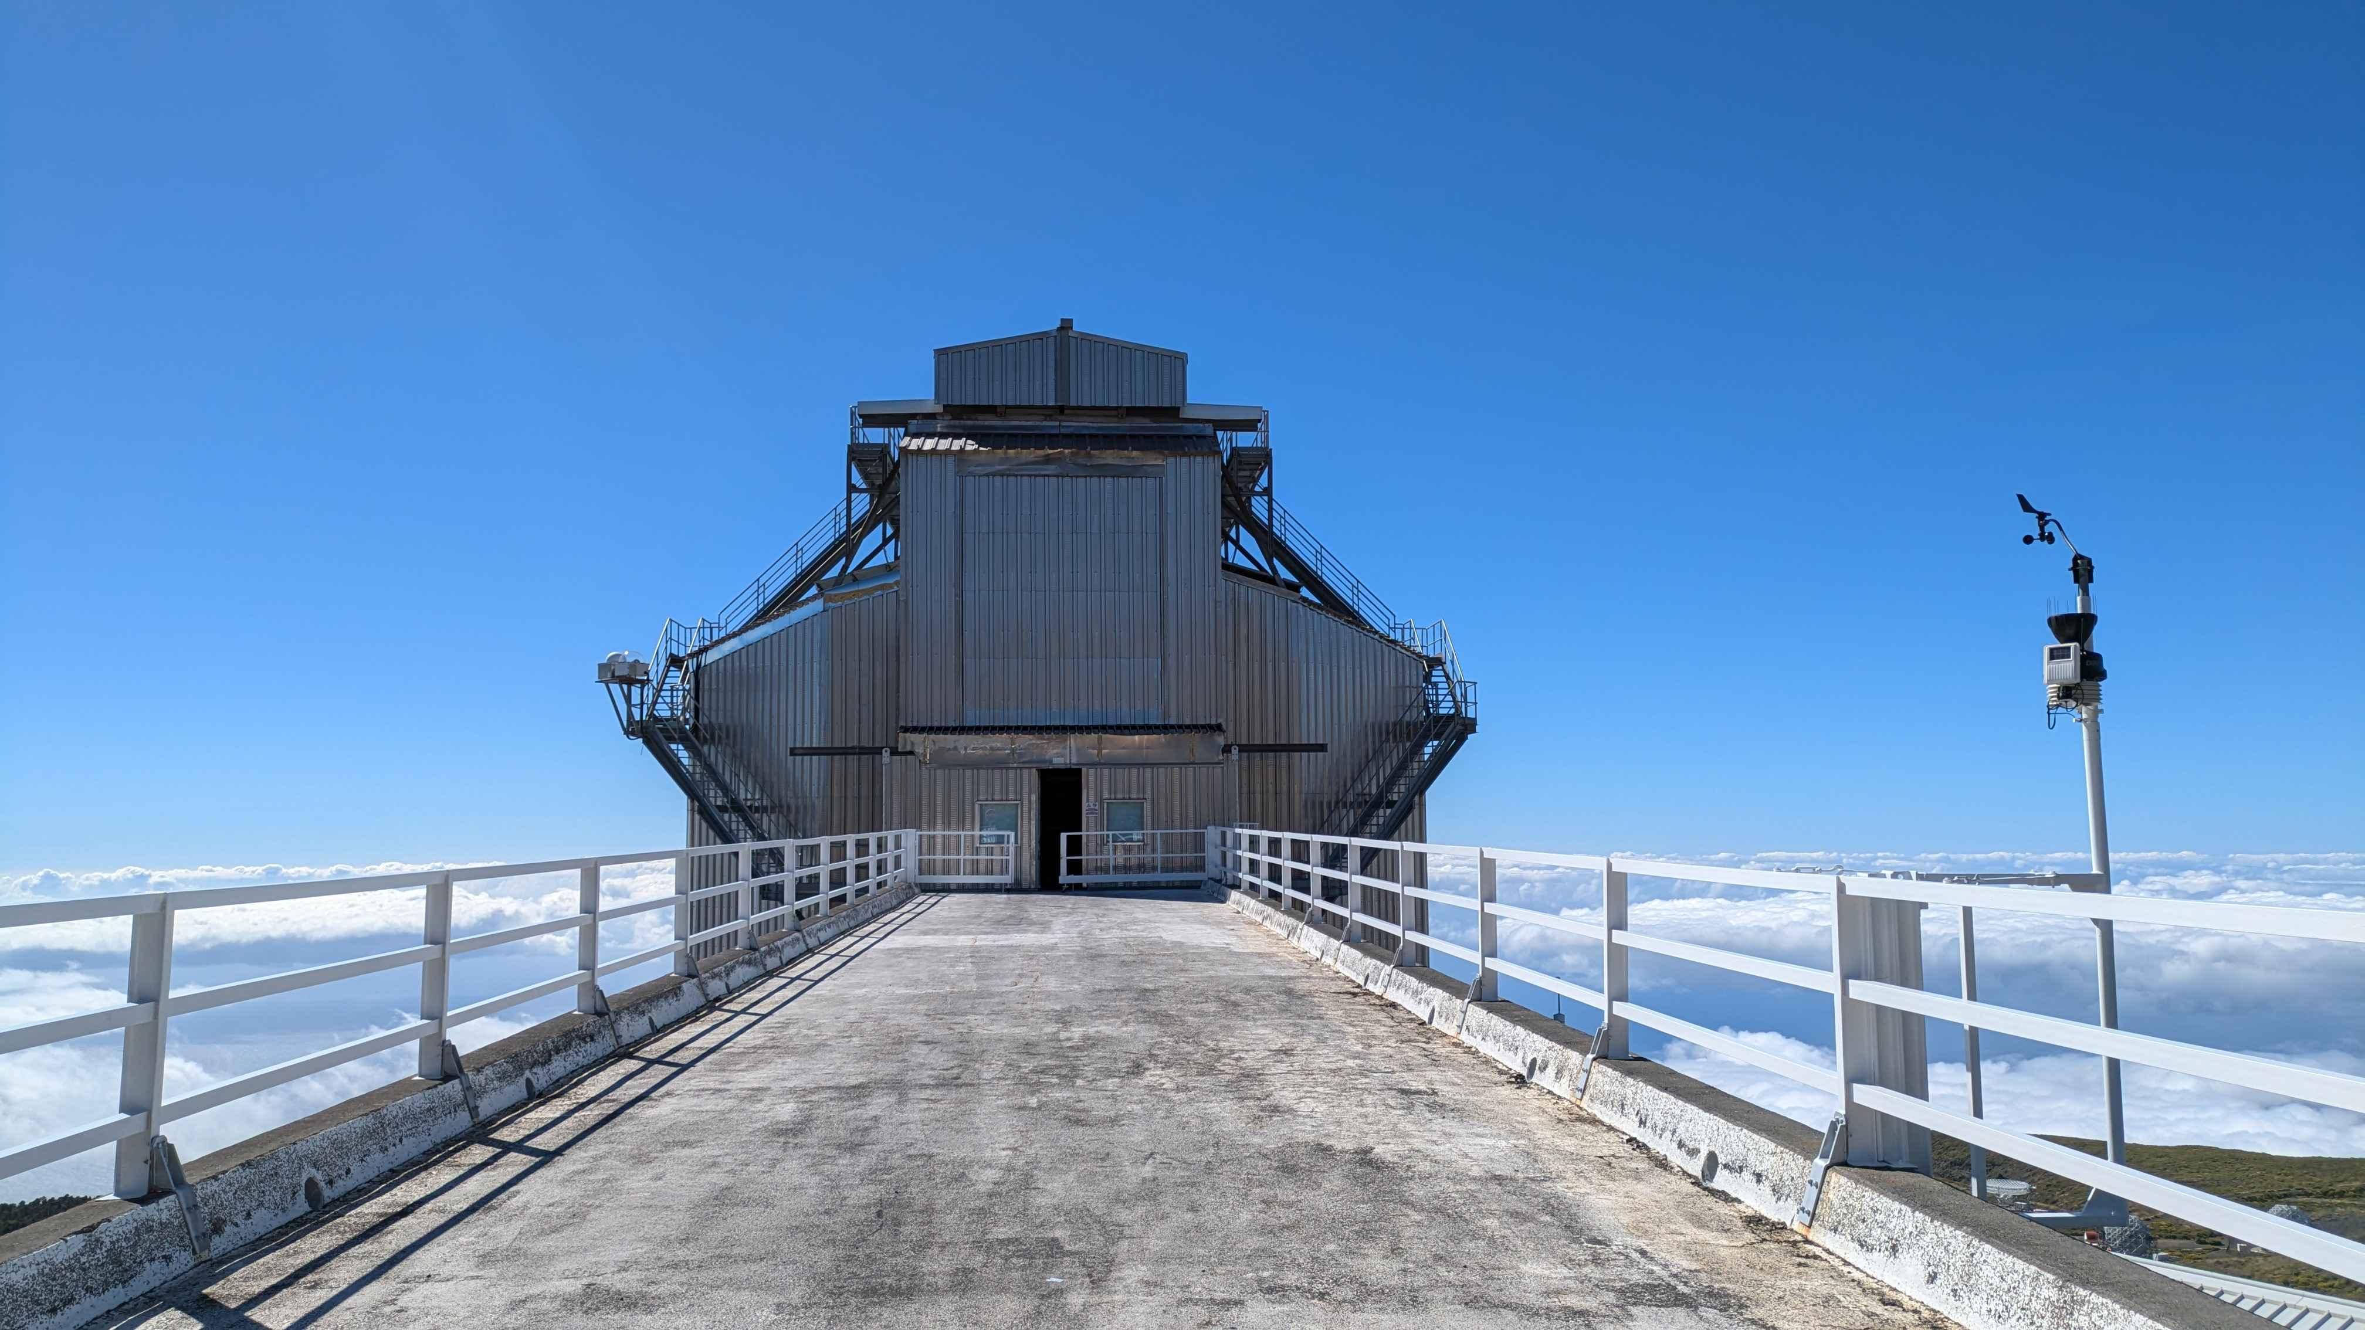
1st CTAO School
Sanja Lazarević CTAO-Oz 2024

Slide 9
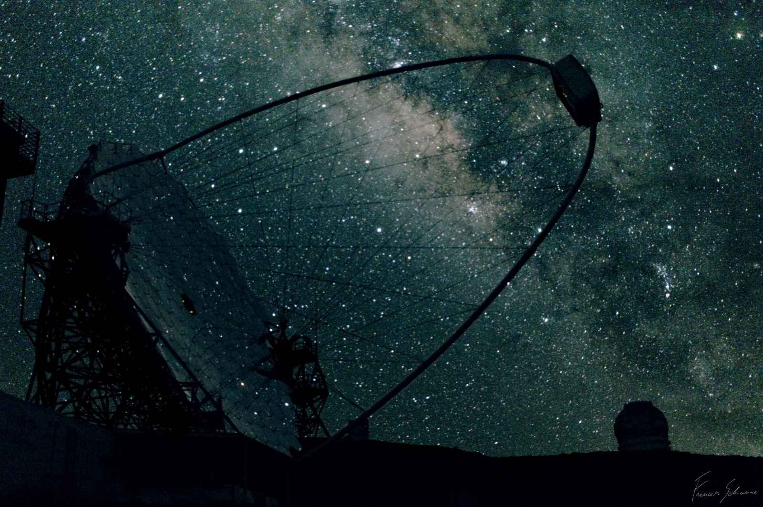
1st CTAO School
Funding
Week 1:
CTAO Plus project
University of Bologna
Week 2:
Spanish Ministry of Science and Innovation
Japanese Institute for Cosmic Rays
Registration Fee
CTAO – Australia (Thank you!)
Sanja Lazarević CTAO-Oz 2024

Slide 10
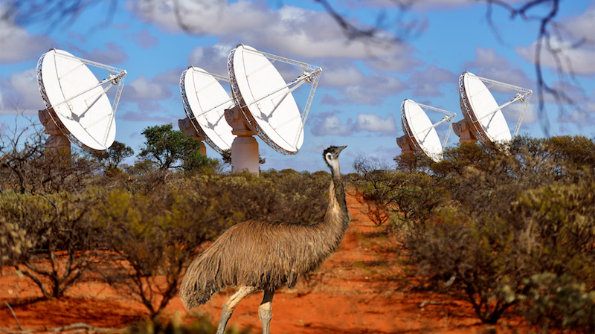
ASKAP EMU Survey
36 stationary antennas
12 m diameter
6 km max baseline
10 h exposure
rms 25 μJy/beam
resolution 15x15 arcsec
Sanja Lazarević CTAO-Oz 2024

Slide 11
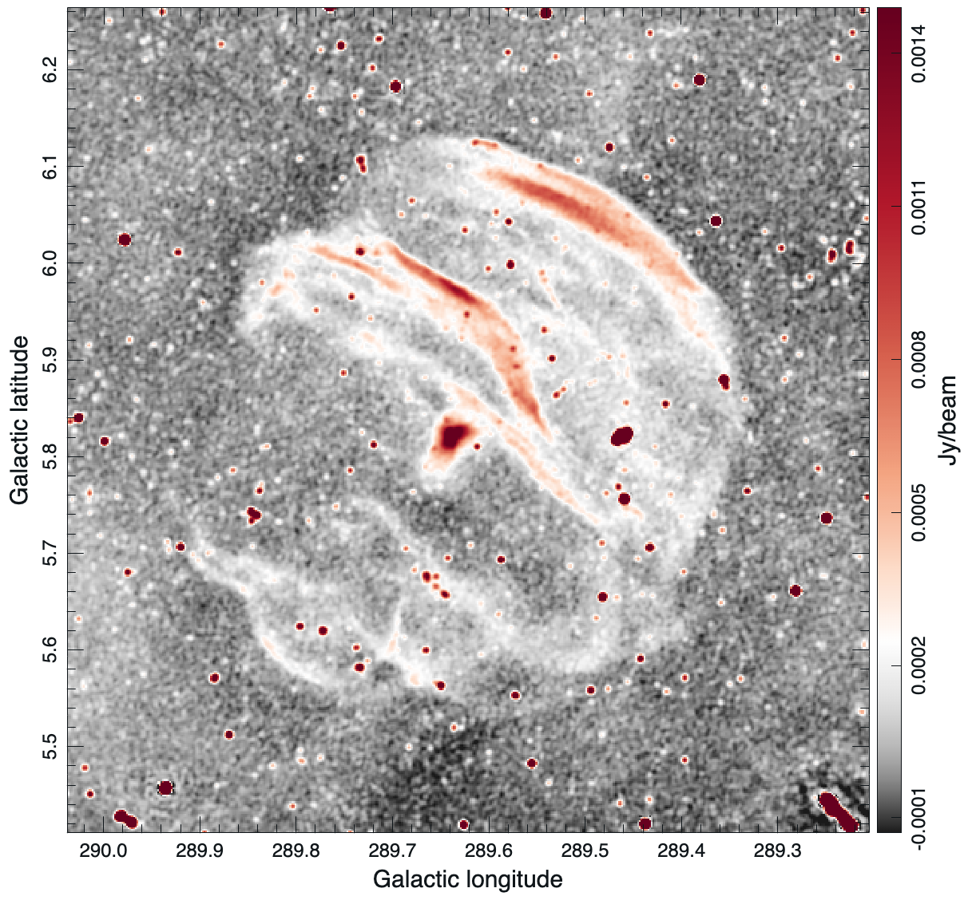
SNR G289.6+5.8
a new high Galactic latitude SNR candidate discovered in the ASKAP EMU survey
SNR identification and verification methods:
Morphology
Diameter: 35 arcmin
Flux density of the central emission:
46 mJy
EMU 944 MHz: - two EMU fields
~ 20h exposure time
Sanja Lazarević CTAO-Oz 2024

Slide 12
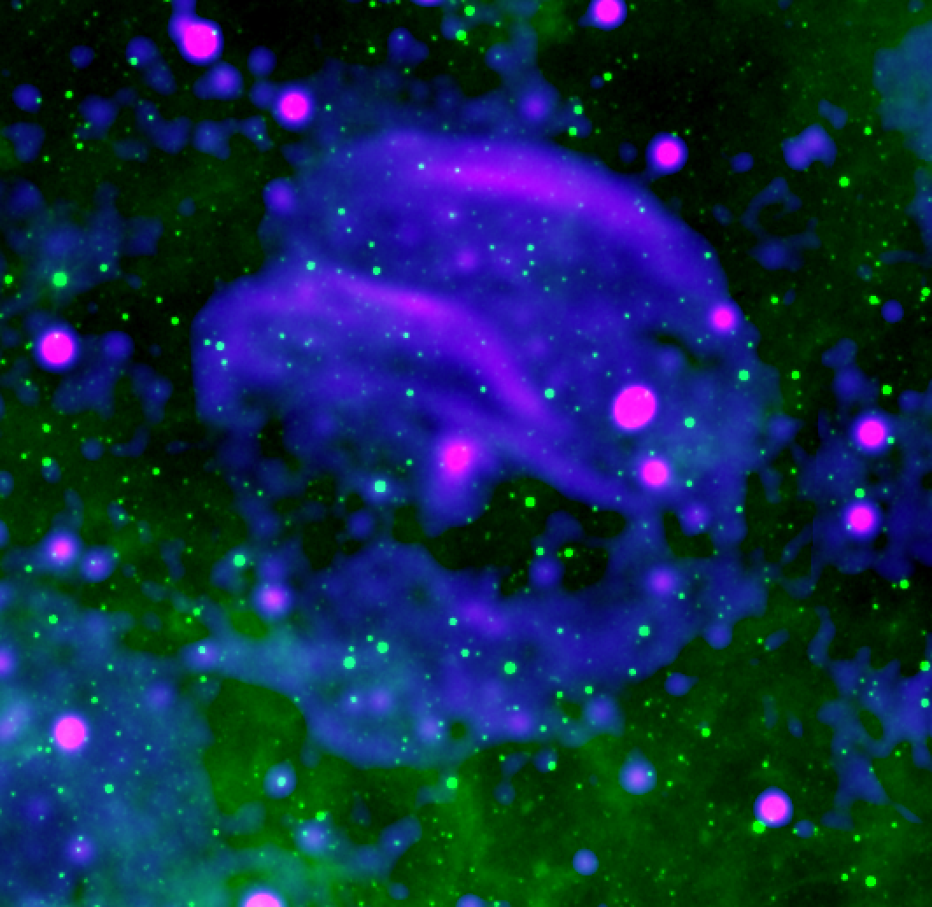
SNR G289.6+5.8
SNR identification and verification methods:
Morphology
Mid-IR counterpart emission
RBG image - EMU 944 MHz (red&blue) - WISE 12 µm (green)
Sanja Lazarević CTAO-Oz 2024

Slide 13
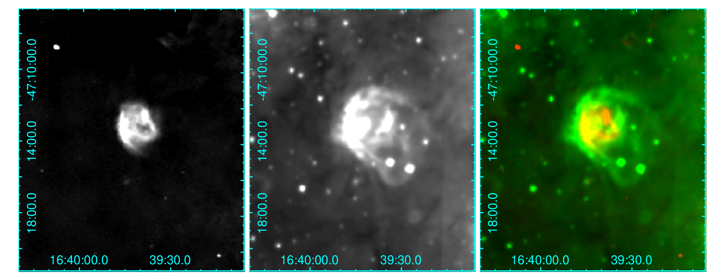
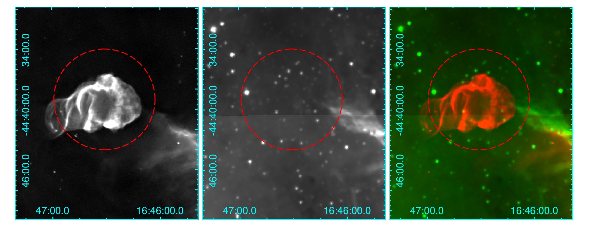
Sanja Lazarević CTAO-Oz 2024

Slide 14
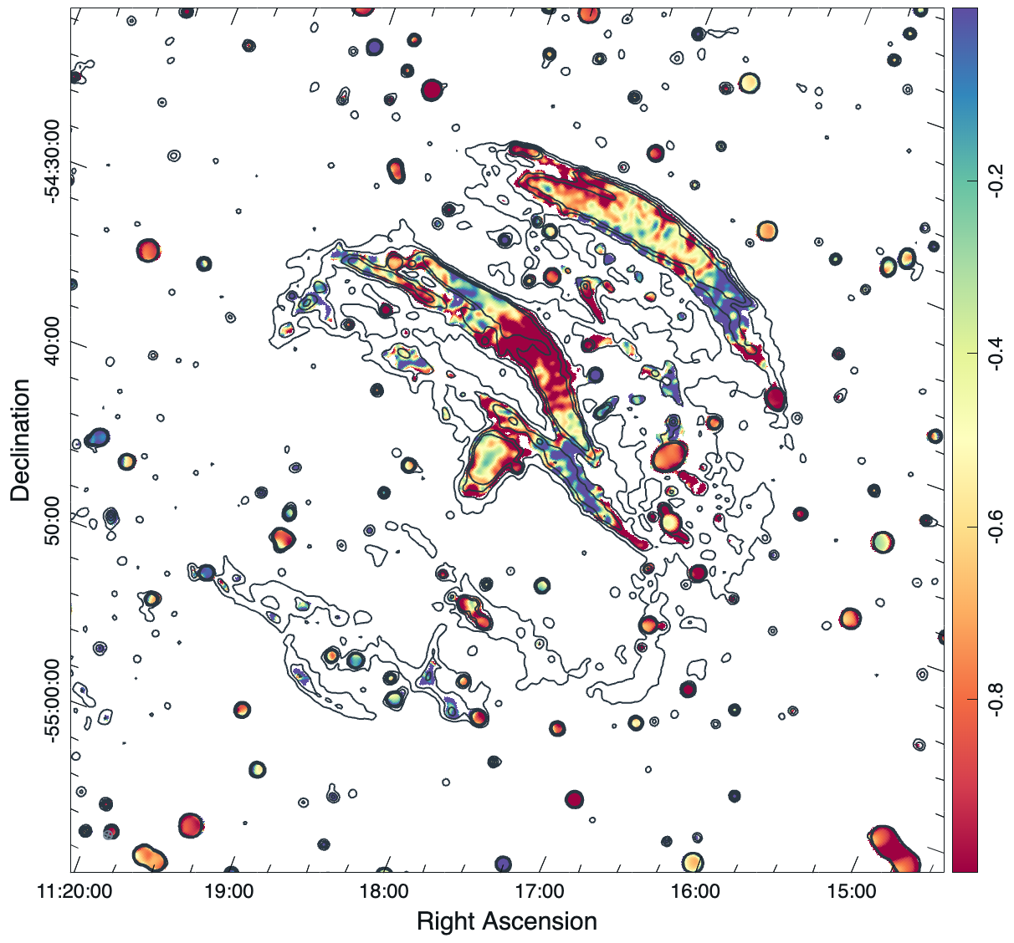
SNR G289.6+5.8
SNR identification and verification methods:
Morphology
Mid-IR counterpart emission
Spectral index
Overall shell spectral index: -0.5
Central emission: -0.3
In-band spectra index map - POSSUM 288 1-MHz channels cube
- 4 images, each image 72 channels
Sanja Lazarević CTAO-Oz 2024

Slide 15
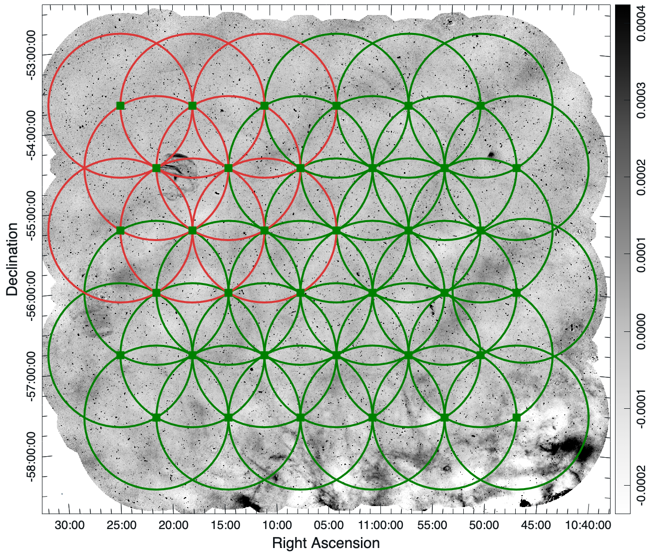
Sanja Lazarević CTAO-Oz 2024

Slide 16
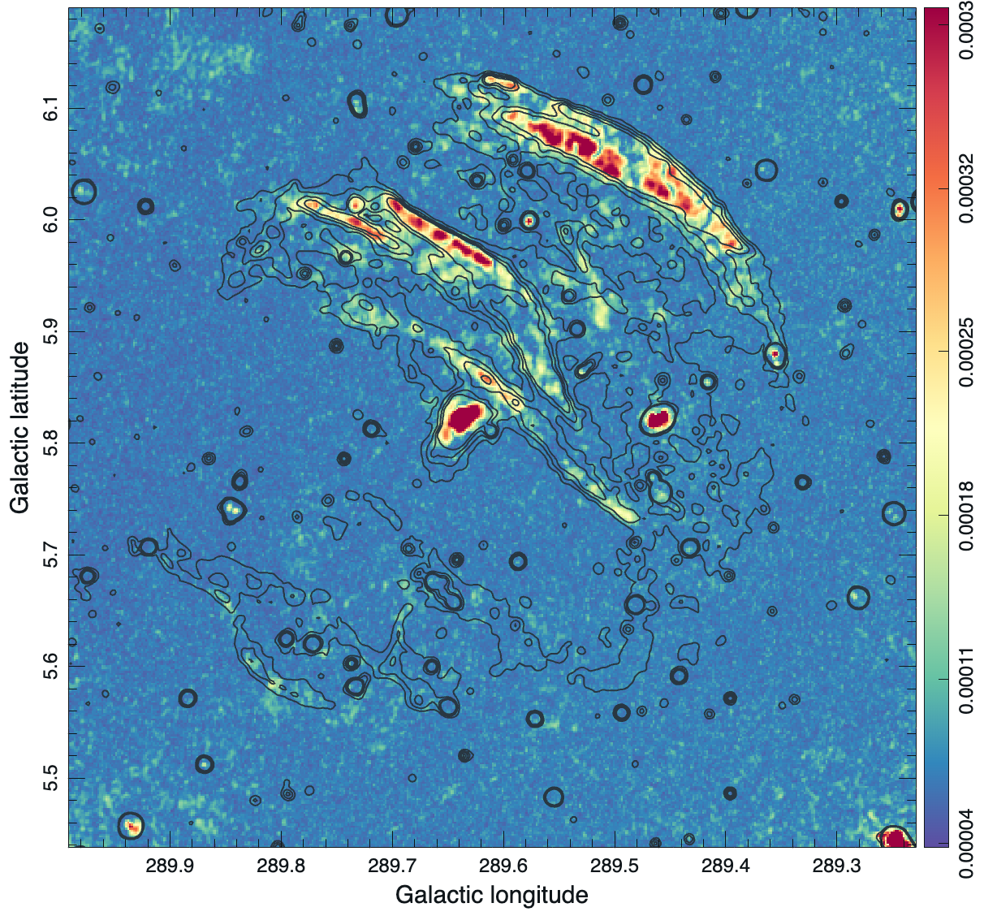
SNR G289.6+5.8
SNR identification and verification methods:
Morphology
Mid-IR counterpart emission
Spectral index
Polarisation
Polarisation Intensity map - POSSUM Q and U cubes
Sanja Lazarević CTAO-Oz 2024

Slide 17
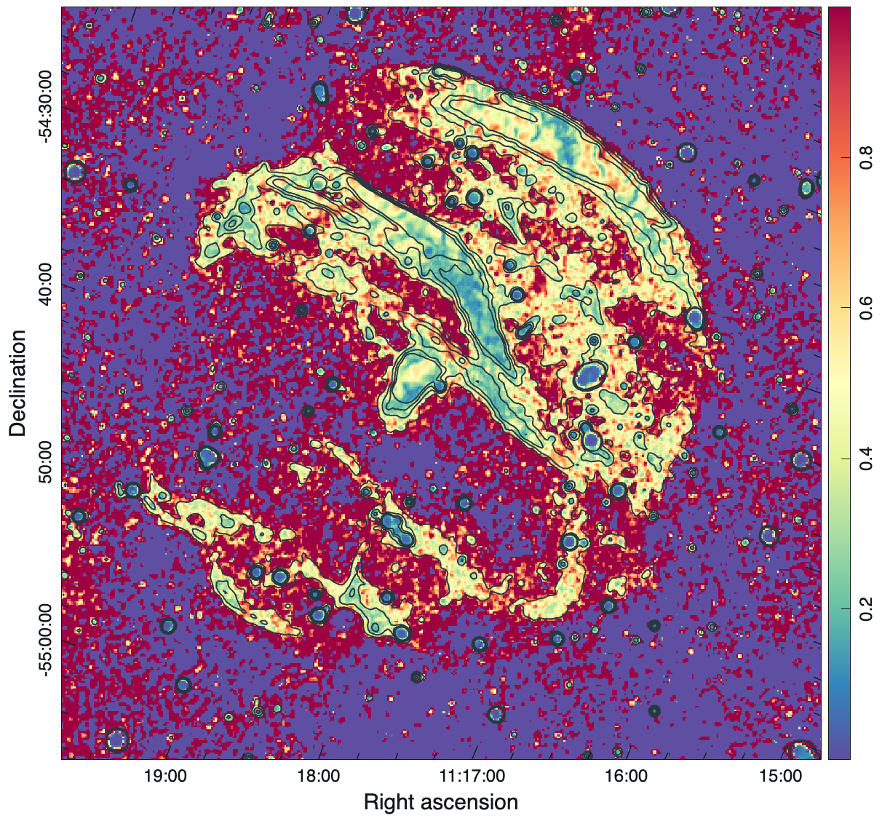
SNR G289.6+5.8
SNR identification and verification methods:
Morphology
Mid-IR counterpart emission
Spectral index
Polarisation
Shell: ~20%
Central emission: ~30%
Fractional Polarisation map - FP = PI / I
Sanja Lazarević CTAO-Oz 2024

Slide 18
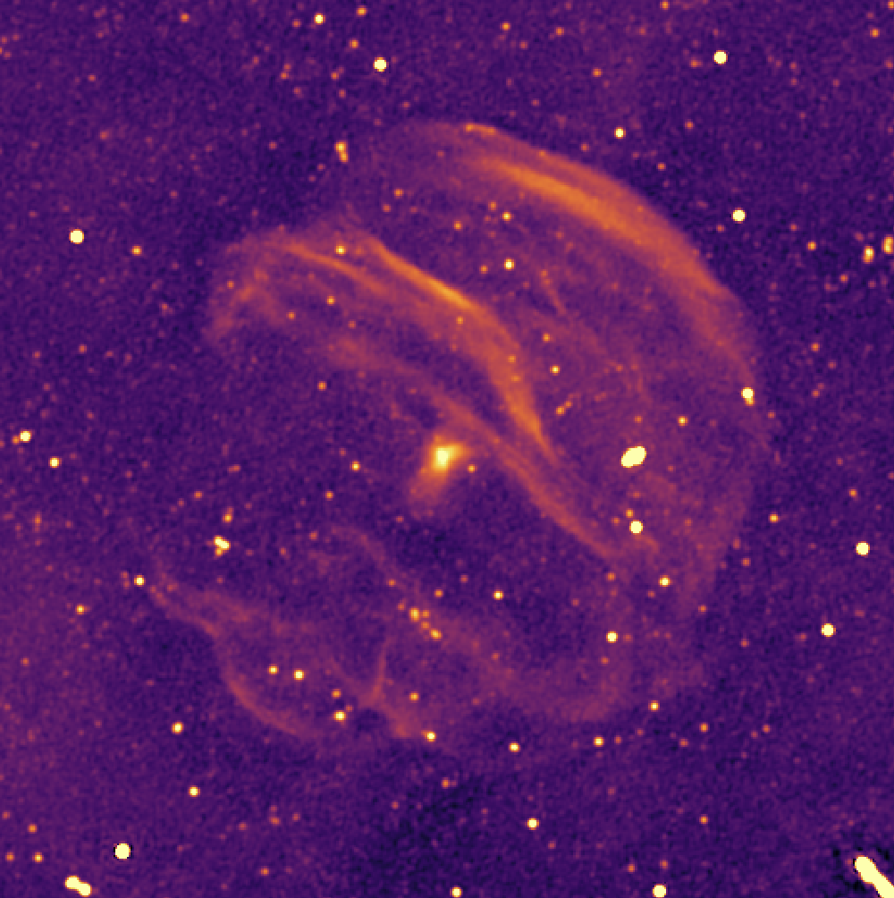
SNR G289.6+5.8
SNR identification and verification methods:
Morphology
Mid-IR counterpart emission
Spectral index
Polarisation
Other possible counterparts
EMU 944 MHz: - high-resolution image, 8’ x 8’
Sanja Lazarević CTAO-Oz 2024

Slide 19
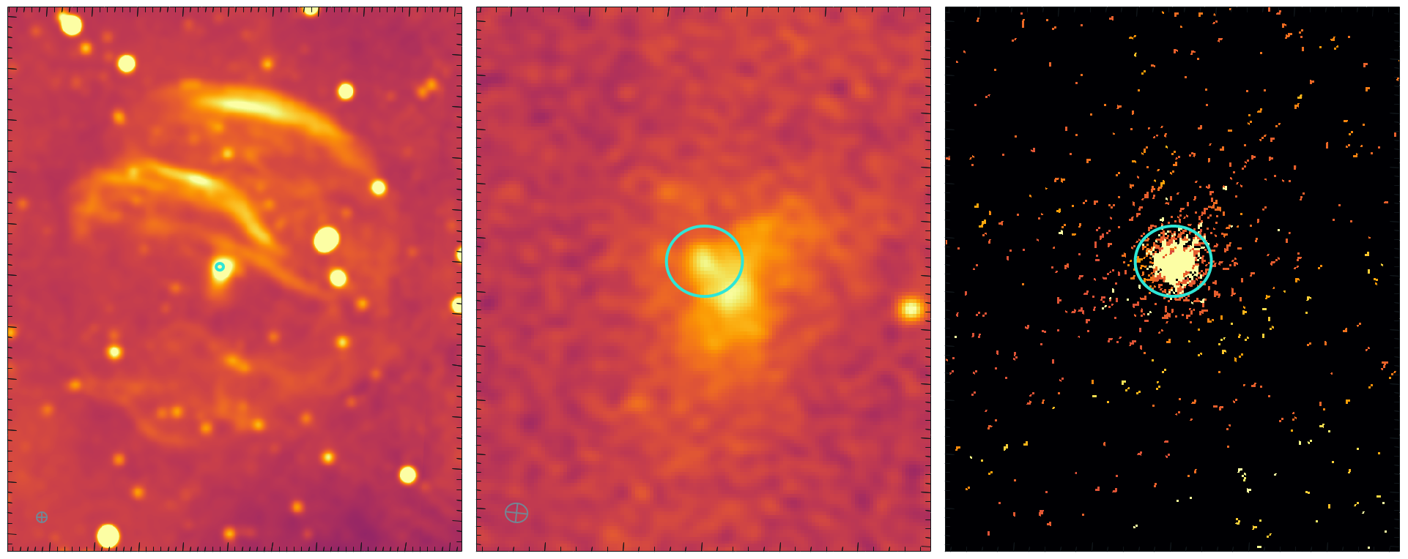
SNR G289.6+5.8
Left: EMU 944 MHz
Middle: EMU, high-resolution, 8’ x 8’, image
Right: SWIFT XRT
Sanja Lazarević CTAO-Oz 2024

Slide 20
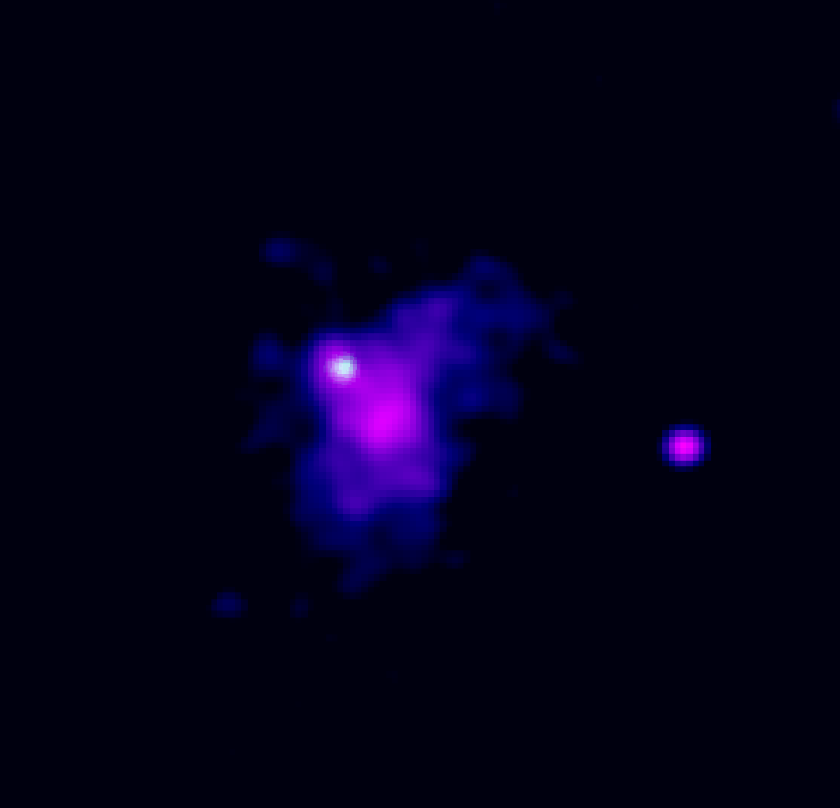
SNR G289.6+5.8
SWIFT - LMXB
Gaia distance: 266 pc
SNR physical size 2.6 pc
RGB image, zoom-in to central emission: - EMU (red&blue) - SWIFT (green)
Sanja Lazarević CTAO-Oz 2024

Slide 21
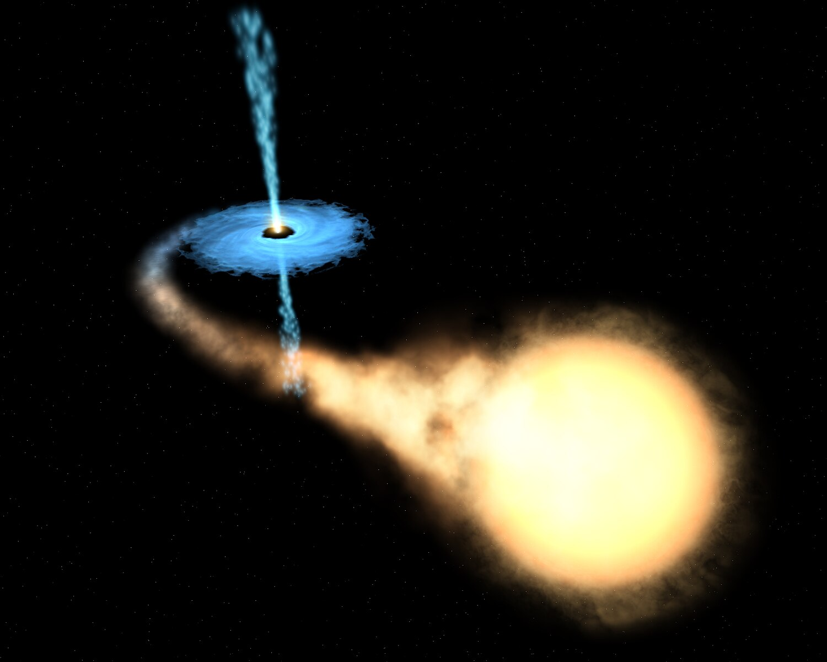
SNR G289.6+5.8
SWIFT - LMXB
Gaia distance: 266 pc
SNR physical size 2.6 pc
Artistic impression of an XRB
- Companion star overflows its Roche lobe
Sanja Lazarević CTAO-Oz 2024

Slide 22
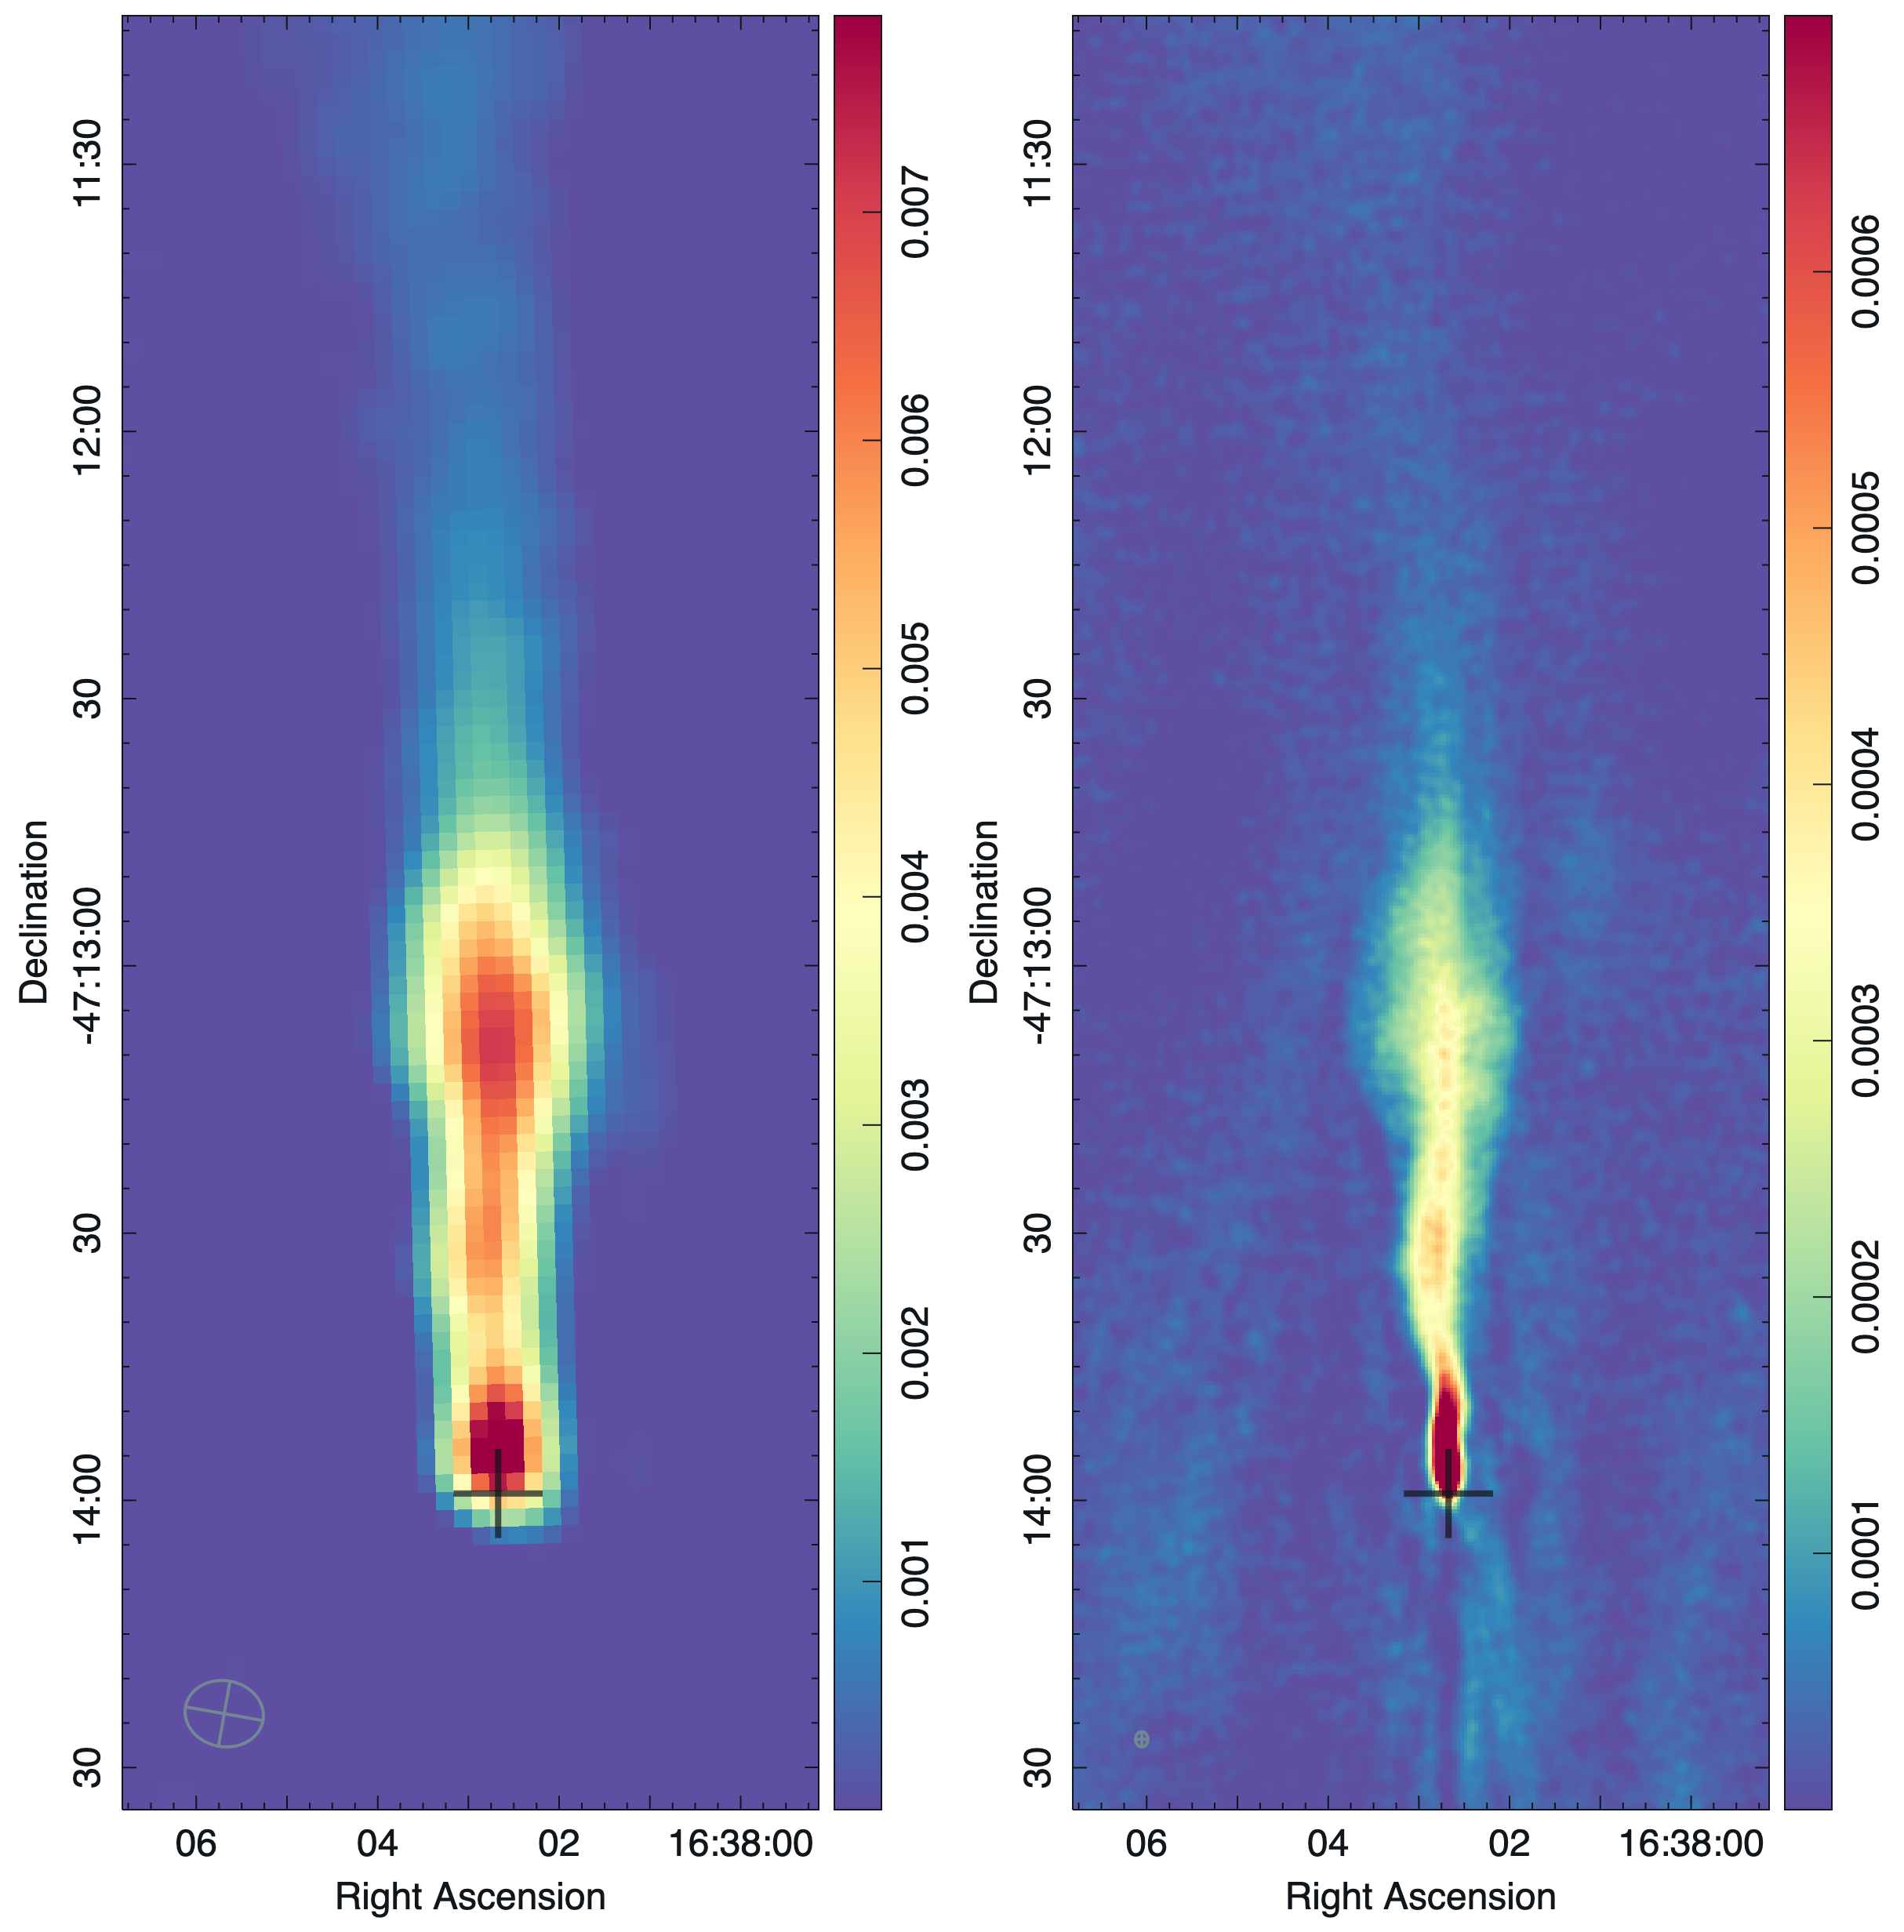
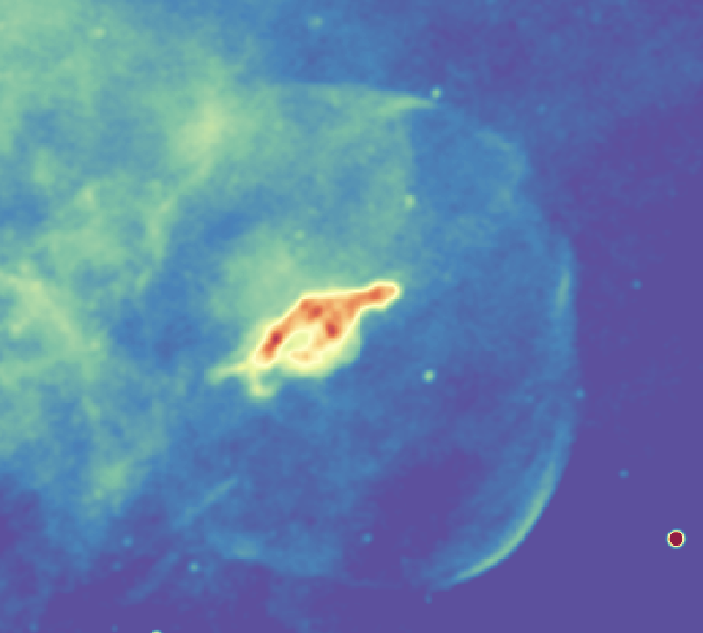
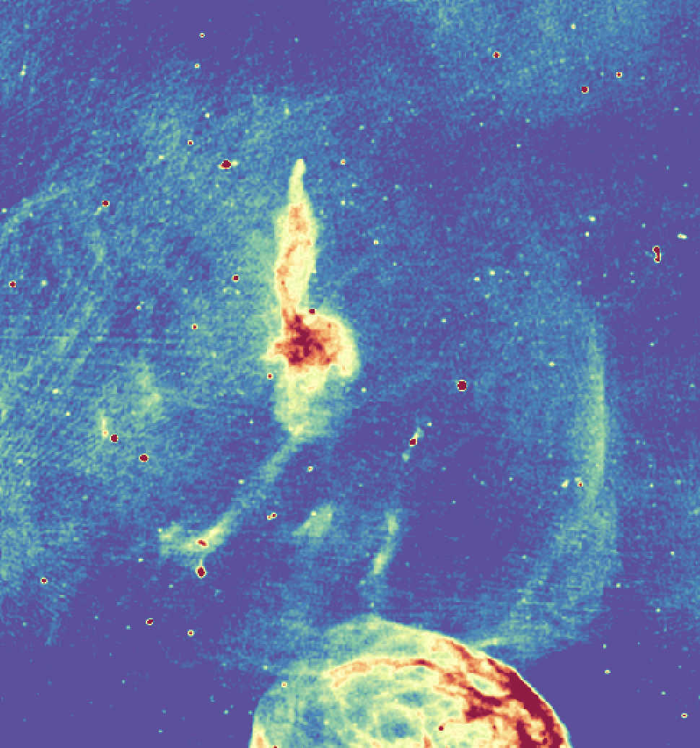
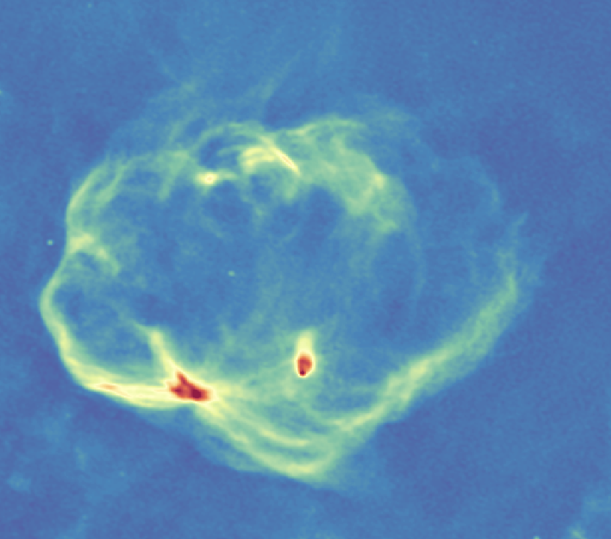
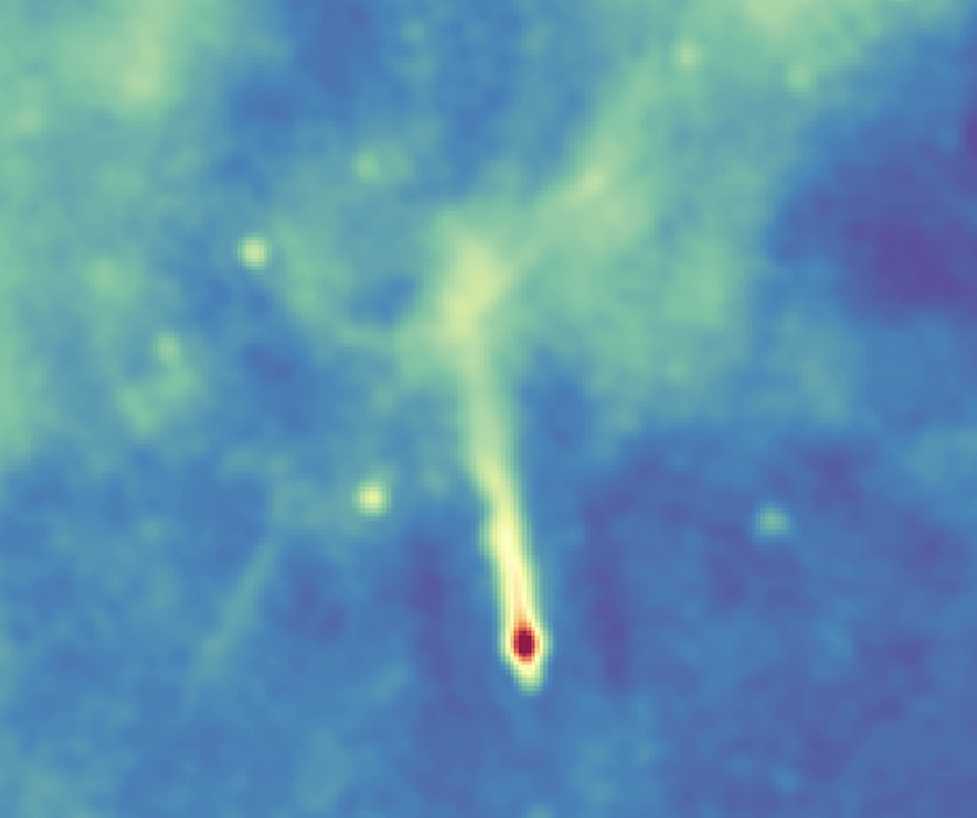
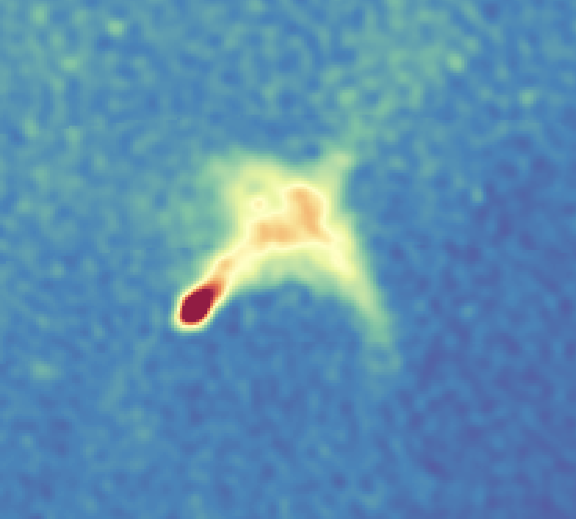
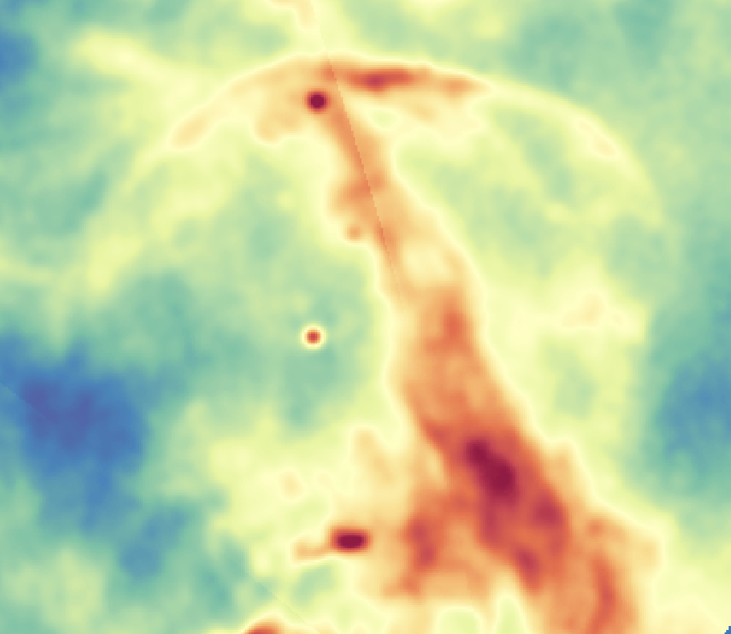
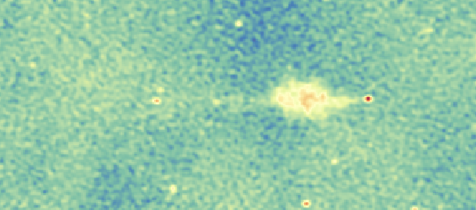
Other EMU discoveries
Potoroo PWN
S. Lazarević et al. 2024
Sanja Lazarević CTAO-Oz 2024

Slide 23
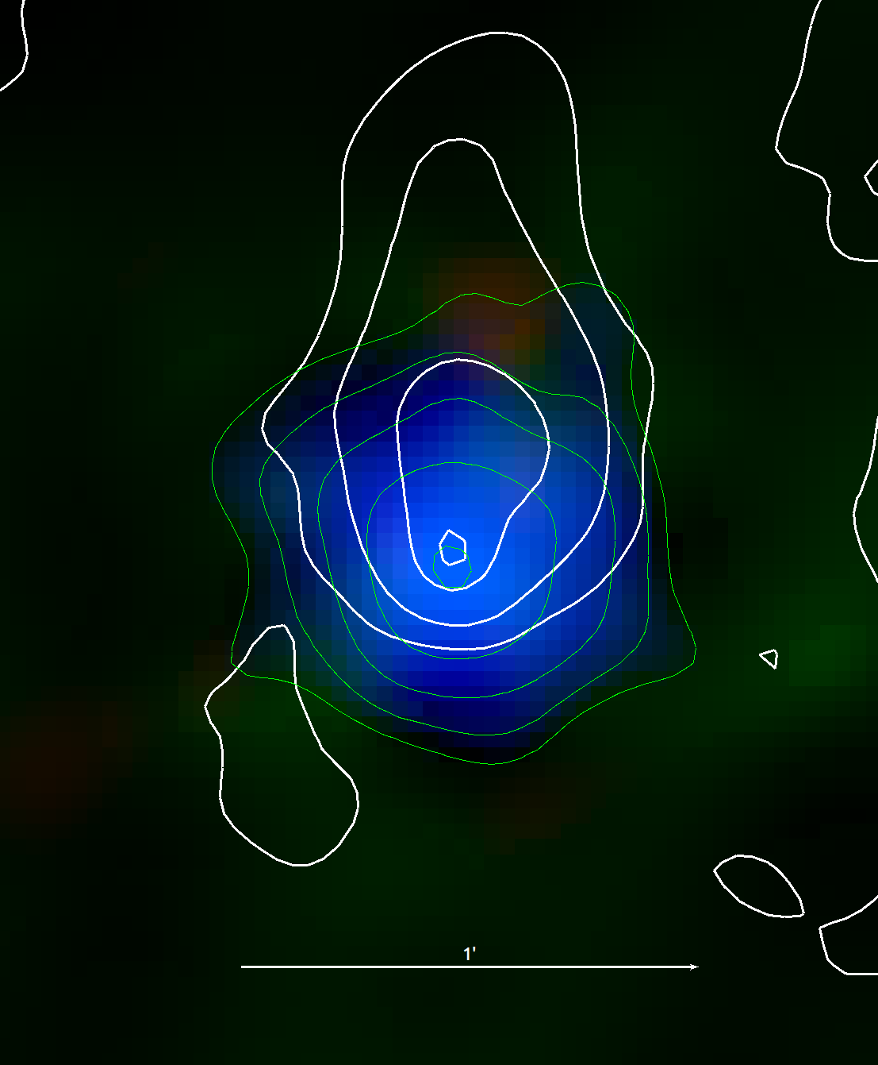
Other EMU discoveries: SNR G336.7+0.5
SNR G336.7+0.5 (Shaver & Gross, 1970)
∑ - D relation distance: 6.6kpc (Pavlovic, M et al., 2014)
Discoveries:
bow-shock PWN
followed up with ATCA
Chandra proposal
pulsar J1631-4721
- high DM, similar to Potoroo
timing paper (Ahmad, A. et al.)
characteristic age: 33.8 kyr
DM distance: 6.8 kpc
left: EMU, 944MHz
right: XMM-Newton with radio contours
Sanja Lazarević CTAO-Oz 2024

Slide 24
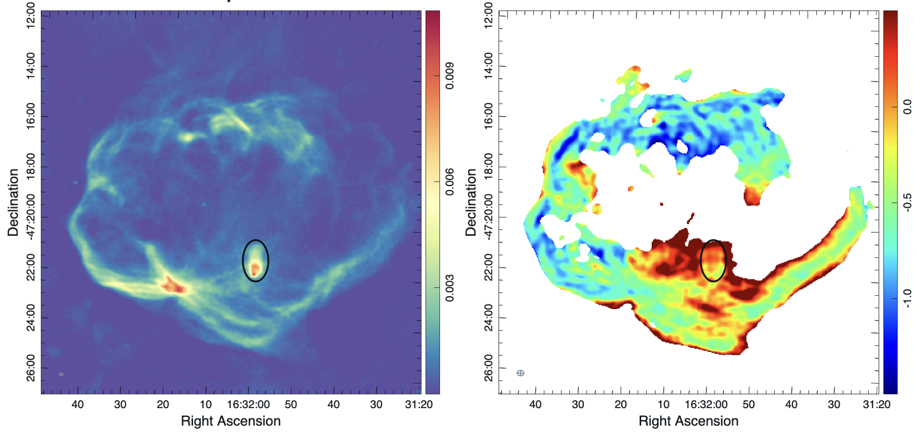
Other EMU discoveries: SNR G336.7+0.5
Sanja Lazarević CTAO-Oz 2024

Slide 25
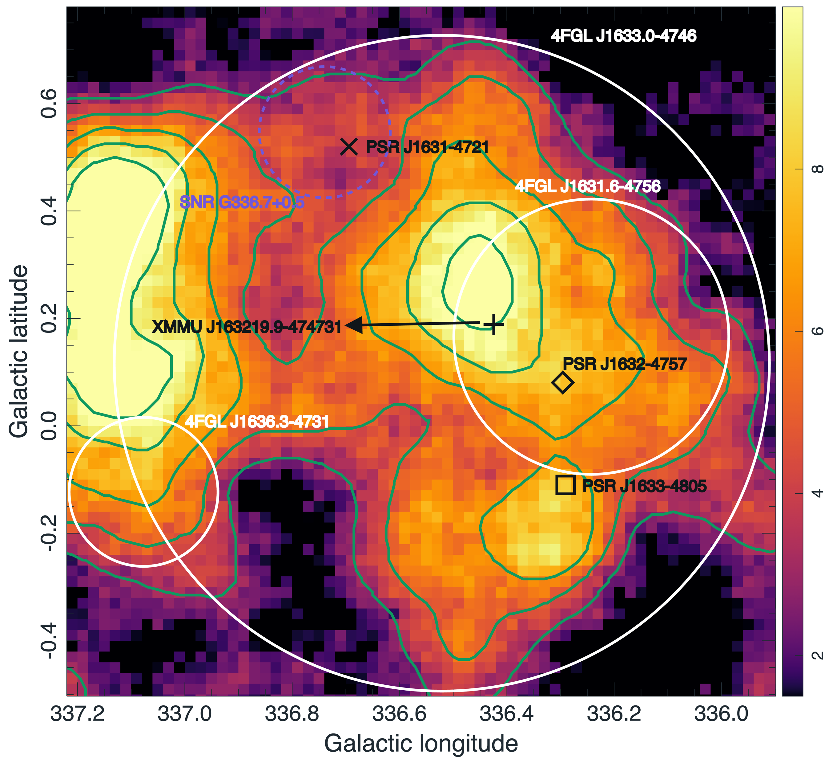
Other EMU discoveries: SNR G336.7+0.5
HGPS significance map:
HESS TeV green contours, 3-10 sigma
2 TeV 𝛾-ray sources: HESS J1634–472 and J1632–478 (Aharonian et al. 2006)
3 GeV 𝛾-ray sources: 4FGL J1633.0–4746, J1631.6–4756, and 4FGL J1636.3–4731 (Ballet et al. 2023)
3 pulsars: J1631–4721, J1632–4757, and J1633–4805 (ATNF catalogue)
SNR G336.7+0.5
Does PRS J1631-4721 contribute significantly to the observed 𝛾-ray emissions in the region, being the most energetic pulsar in the area?
Figure 6, Ahmed, A. et al., submitted
- HESS Galactic Plane Survey significance map
Sanja Lazarević CTAO-Oz 2024

Slide 26
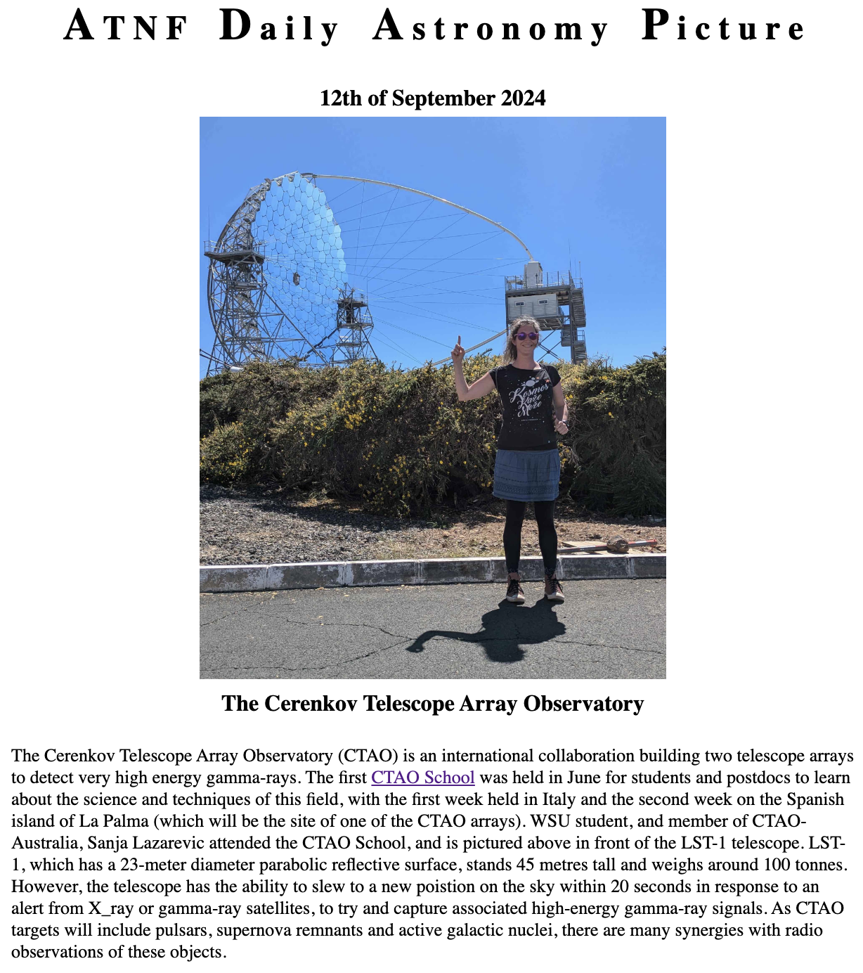
Thank you for your attention!
Sanja Lazarević
S.Lazarevic@westernsydney.edu.au
CTAO-Oz 2024

