Slide 1
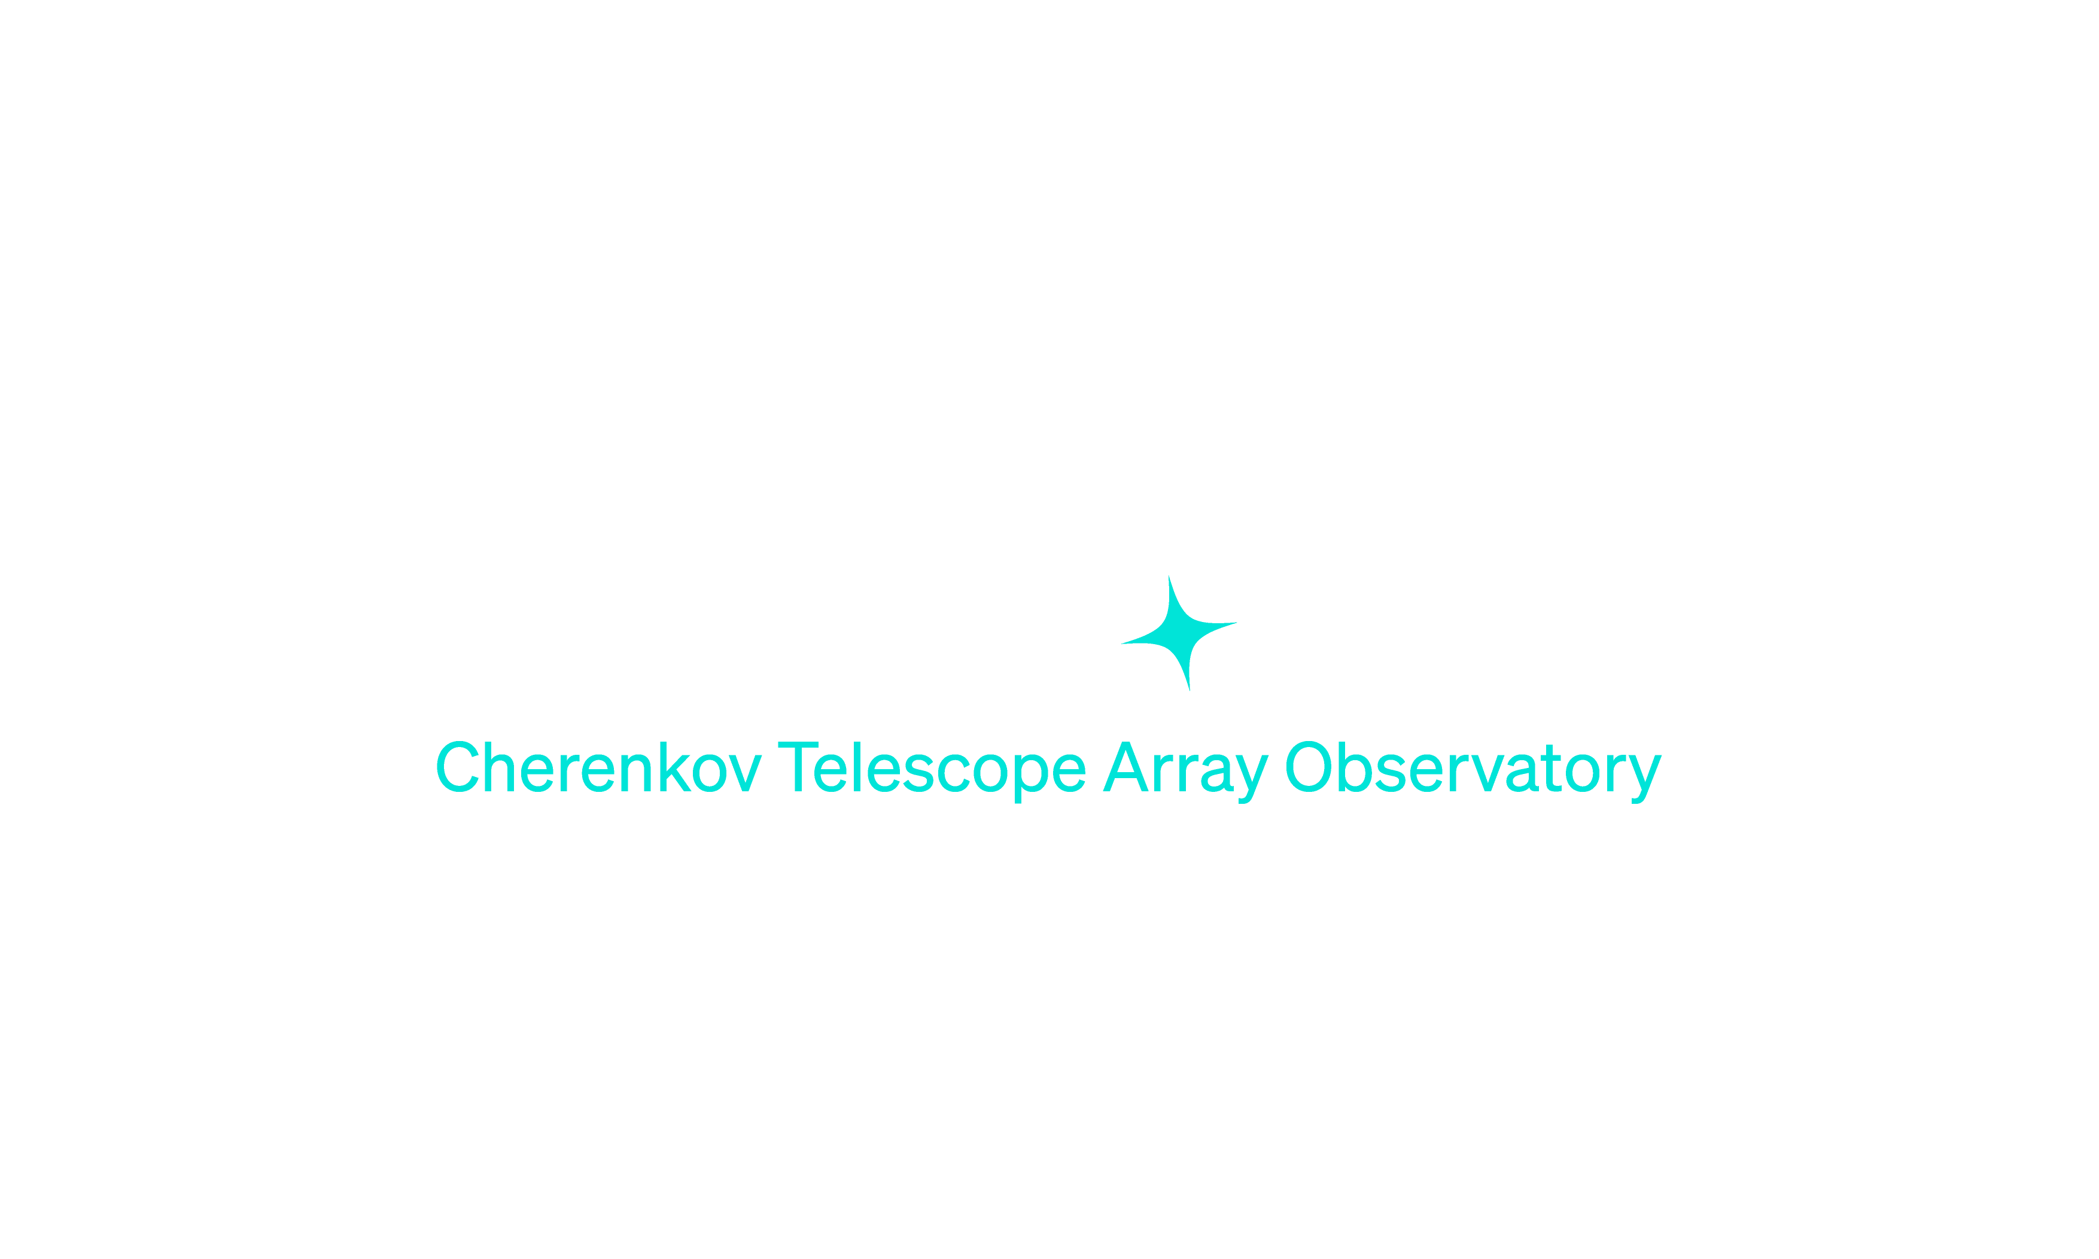

Array Control
CTAO summer school 2024 – La Palma
Dominik Neise, ACADA Lead Developer
dominik.neise@cta-observatory.org

Slide 2
1
2
3
4
5
ACADA in CTAO
What is ACADA
Concepts
Middleware - ACS
LST1 Control

Slide 3
1
ACADA in CTAO

Slide 4
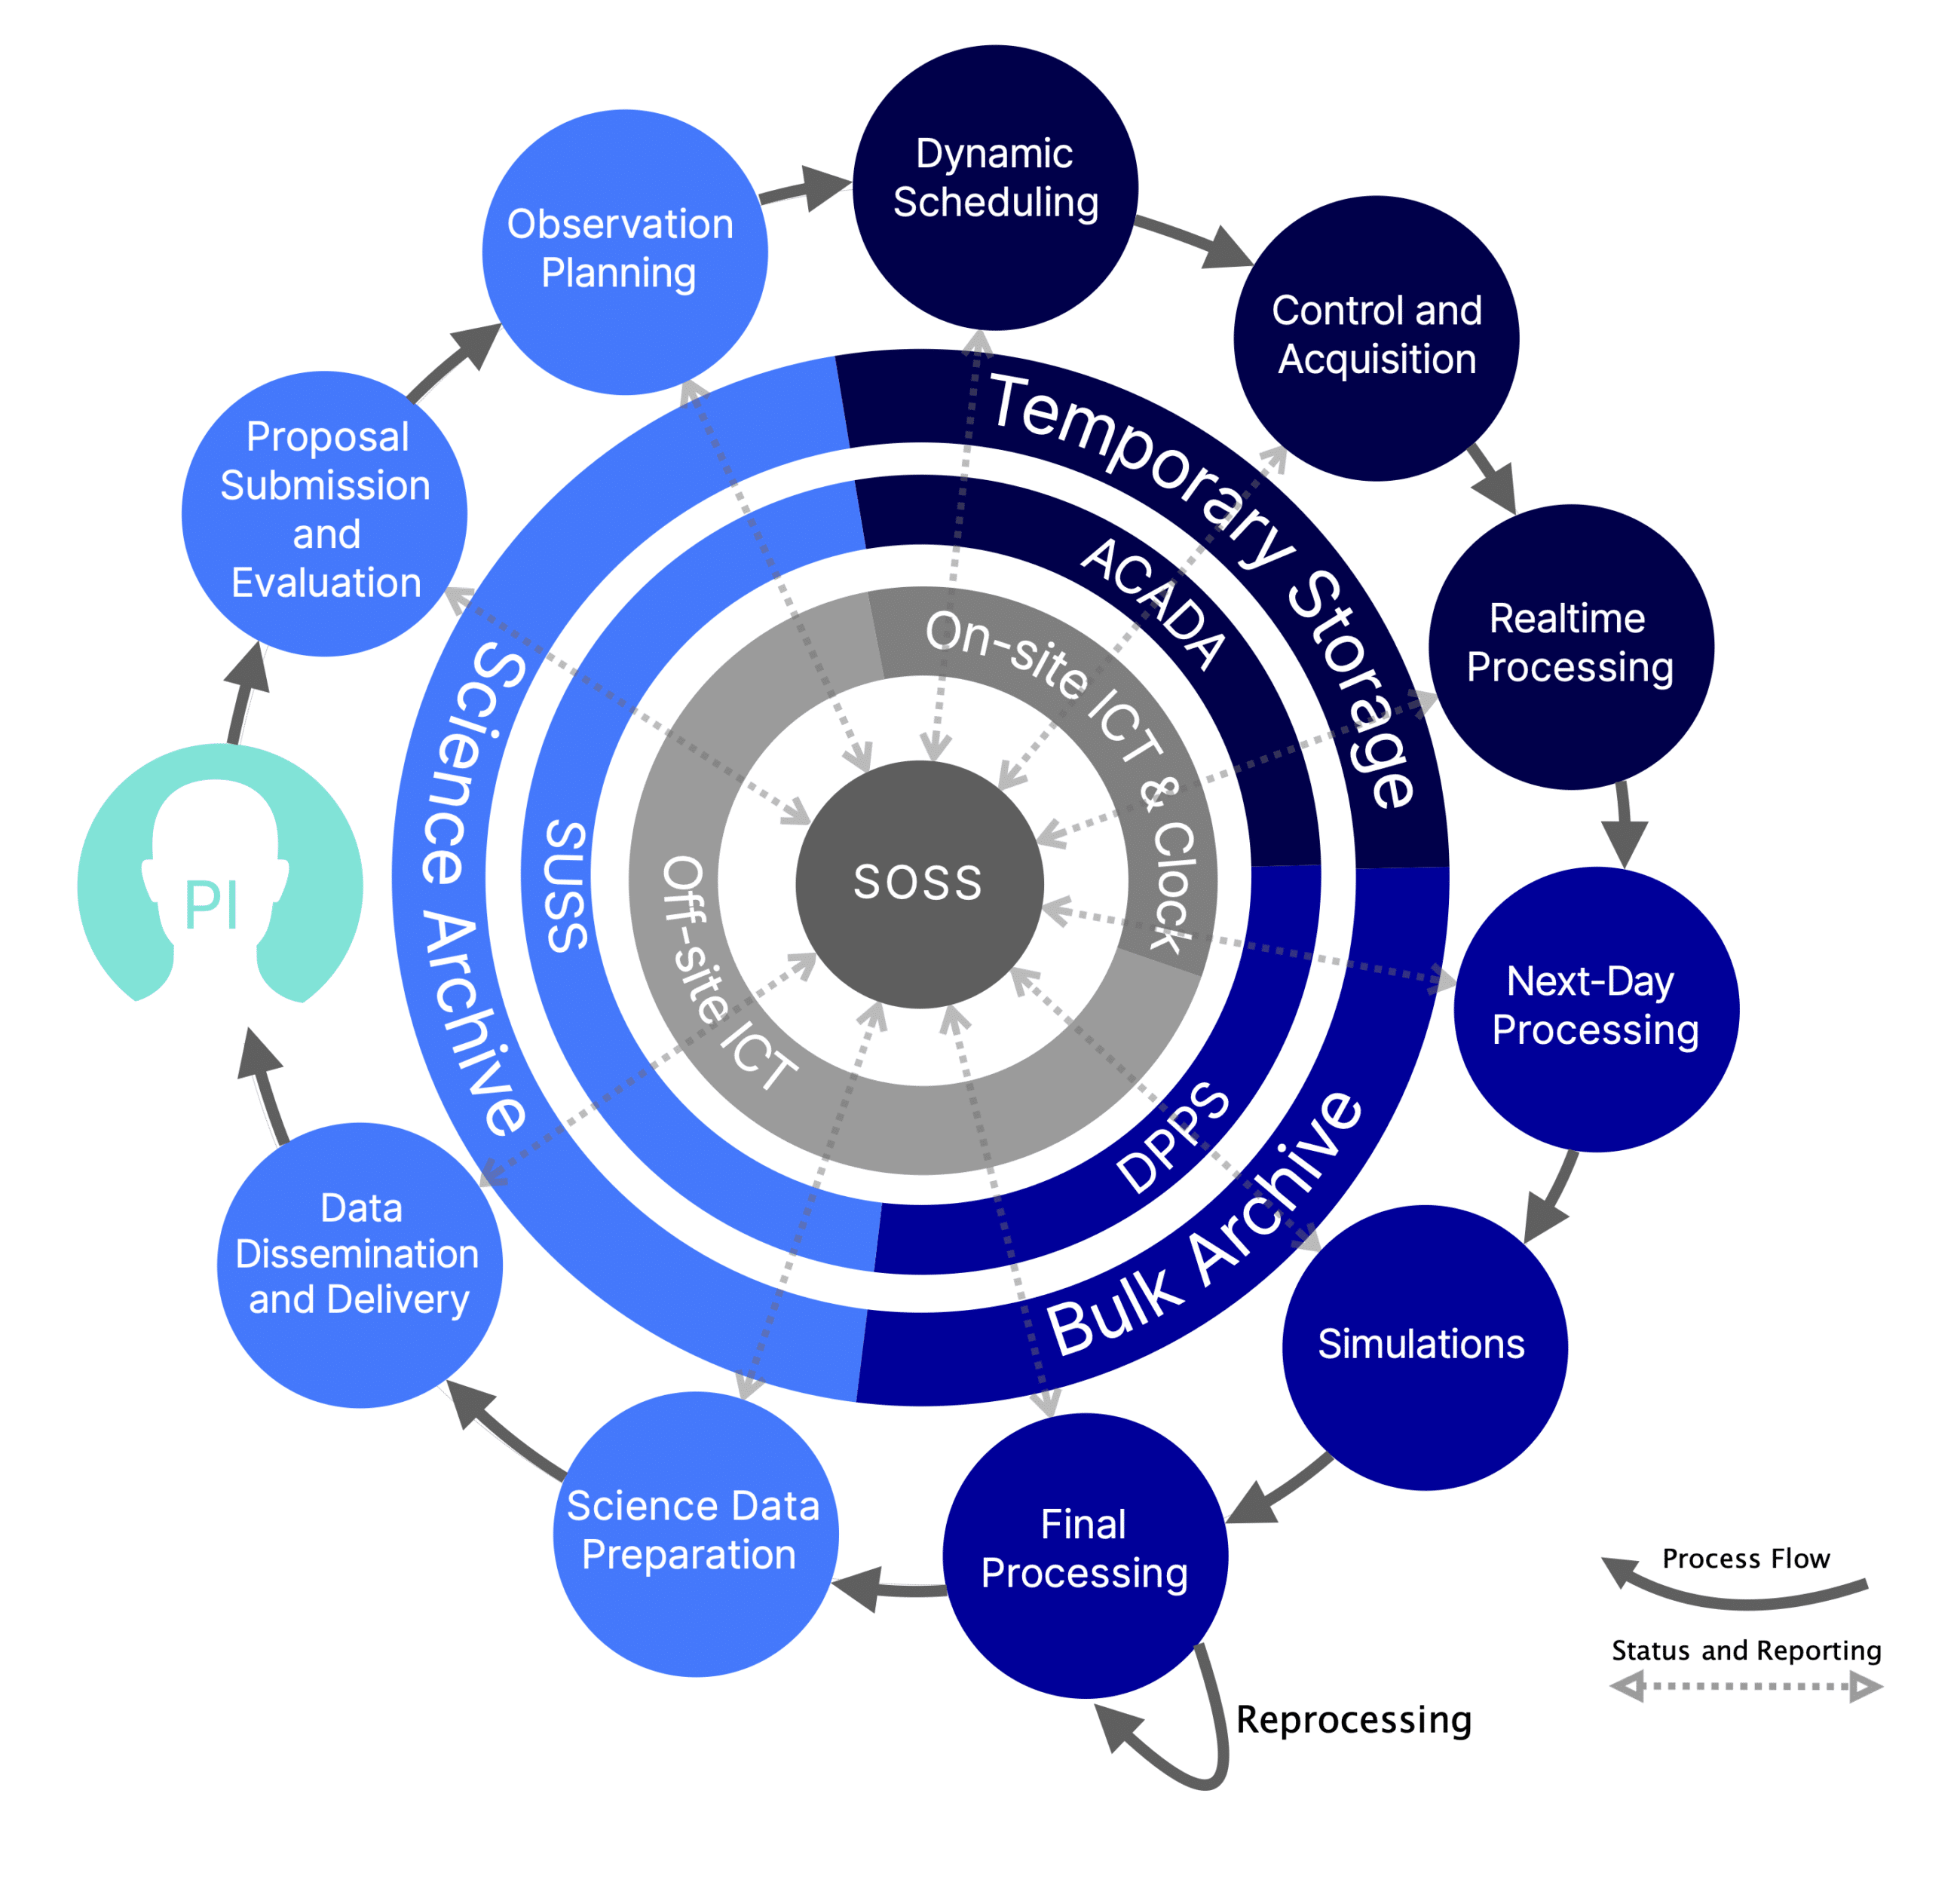
ACADA in CTAO

Slide 5
ACADA in CTAO
ACADA is the Supervisory Control and Data Acquisition (SCADA) system of the scientific instrumentation at each CTAO array site, including Telescopes, Array Calibration, and Environmental Monitoring devices.
  Highly reliable & Fault tolerant

Slide 6
2
Parts of ACADA

Slide 7
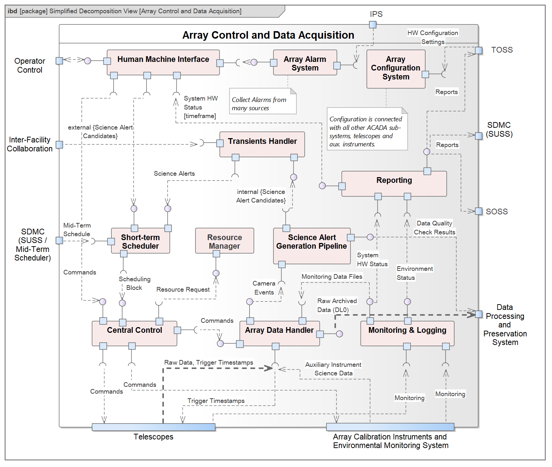

Slide 8


Array Configuration (CDB)
Parts of ACADA
stores and distributes the configurations of
  ACADA system
  Telescopes
  Calibration Systems
  including the software deployment configuration

Slide 9

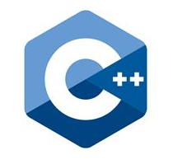
Resource Manager
Parts of ACADA
responsible for supervision of all other systems of ACADA, and any external system under its supervision such as the Telescope Control Systems, as well as for coordinating the allocation of telescopes to sub-arrays.
Incl. Supervision Tree Support Libraries

Slide 10
Central Control
Parts of ACADA
responsible for the execution of the scheduling blocks (SB) provided by the short-term scheduler (STS) by sending corresponding commands to the telescopes and other controllable array elements, while supervising the ongoing operations, and overseeing the Array Data Handler.
Incl. Obs. Script Sequencer

Slide 11

Short Term Scheduler
Parts of ACADA
decides, in real-time, how to group and use the Telescopes of CTAO to perform nightly operations
based on a Mid-Term Schedule
reacts in real time to changing environmental conditions
Reacts to and to science alert observation requests by the Transients Handler.
Includes functionalities for short-term planning, lidar coordination with other scientific installations near the CTA array sites, and the coordination of observations between both CTA array sites and with other scientific installations.

Slide 12

Transients Handler
Parts of ACADA
Manages internal and external transient science alert candidates by filtering, processing, and ranking them, submitting Scheduling Blocks to the Short-Term Scheduler, and requesting immediate reaction if needed.

Slide 13


Science Alert Generation
Parts of ACADA
The analysis pipeline running online that performs a quick look analysis of the acquired data and produces data quality indicators, which are exposed to the support astronomer at the control room and transferred to the DPPS.
generates internal candidate scientific alerts → TH.
science monitoring (sky maps & light curves) for the Support Astronomer.

Slide 14



Array Data Handler
Parts of ACADA
Provides Software Array Trigger (SWAT)
Handles raw data from the array instrumentation
Includes components to handle the Cherenkov cameras data and to reduce the received volume of data
Handles acquired data by Auxiliary Instrumentation onboard telescopes, as well as for the Array Calibration and Environmental Monitoring System devices
Provides local temporary storage of data until the on-site DPPS system receives that data

Slide 15
Monitoring & Logging
Parts of ACADA
Components providing services for monitoring data items from the Telescopes and other devices deployed at the CTA array sites and making those data immediately available for the operator interface and for quick-look quality checks, as well as to store them for later detailed inspection.
Includes the production of the software for the Monitoring System (incl. Repository) Logging System (incl. Repository) and Logs Analyzer

Slide 16
Array Alarm System
Parts of ACADA
gathers, filters, exposes, and persists all the relevant alarms raised
  ACADA processes,
  Telescopes,
  and auxiliary instrumentation under the supervision of the ACADA system.
creates new alarms based on the analysis and correlation of the system software logs and the status of the hardware systems and provides mechanisms for alarm filtering.
→ Operator via HMI

Slide 17

Reporting
Parts of ACADA
Responsible for gathering the relevant data from the other ACADA sub-systems in order to produce status and quality reports of the ACADA operations for the HMI and for other systems outside the ACADA.
Includes the software for the reporting of the HW status, environment status, and the status of the observed data.
Operator logbook.

Slide 18


Human Machine Interface
Parts of ACADA
Comprehensive view of the status of the observations to the Operators and Support Astronomer located in the control room of the CTA installation, providing means to interact with the array elements.
Creation of Scheduling Blocks
Overview of ongoing & planned Observations

Slide 19
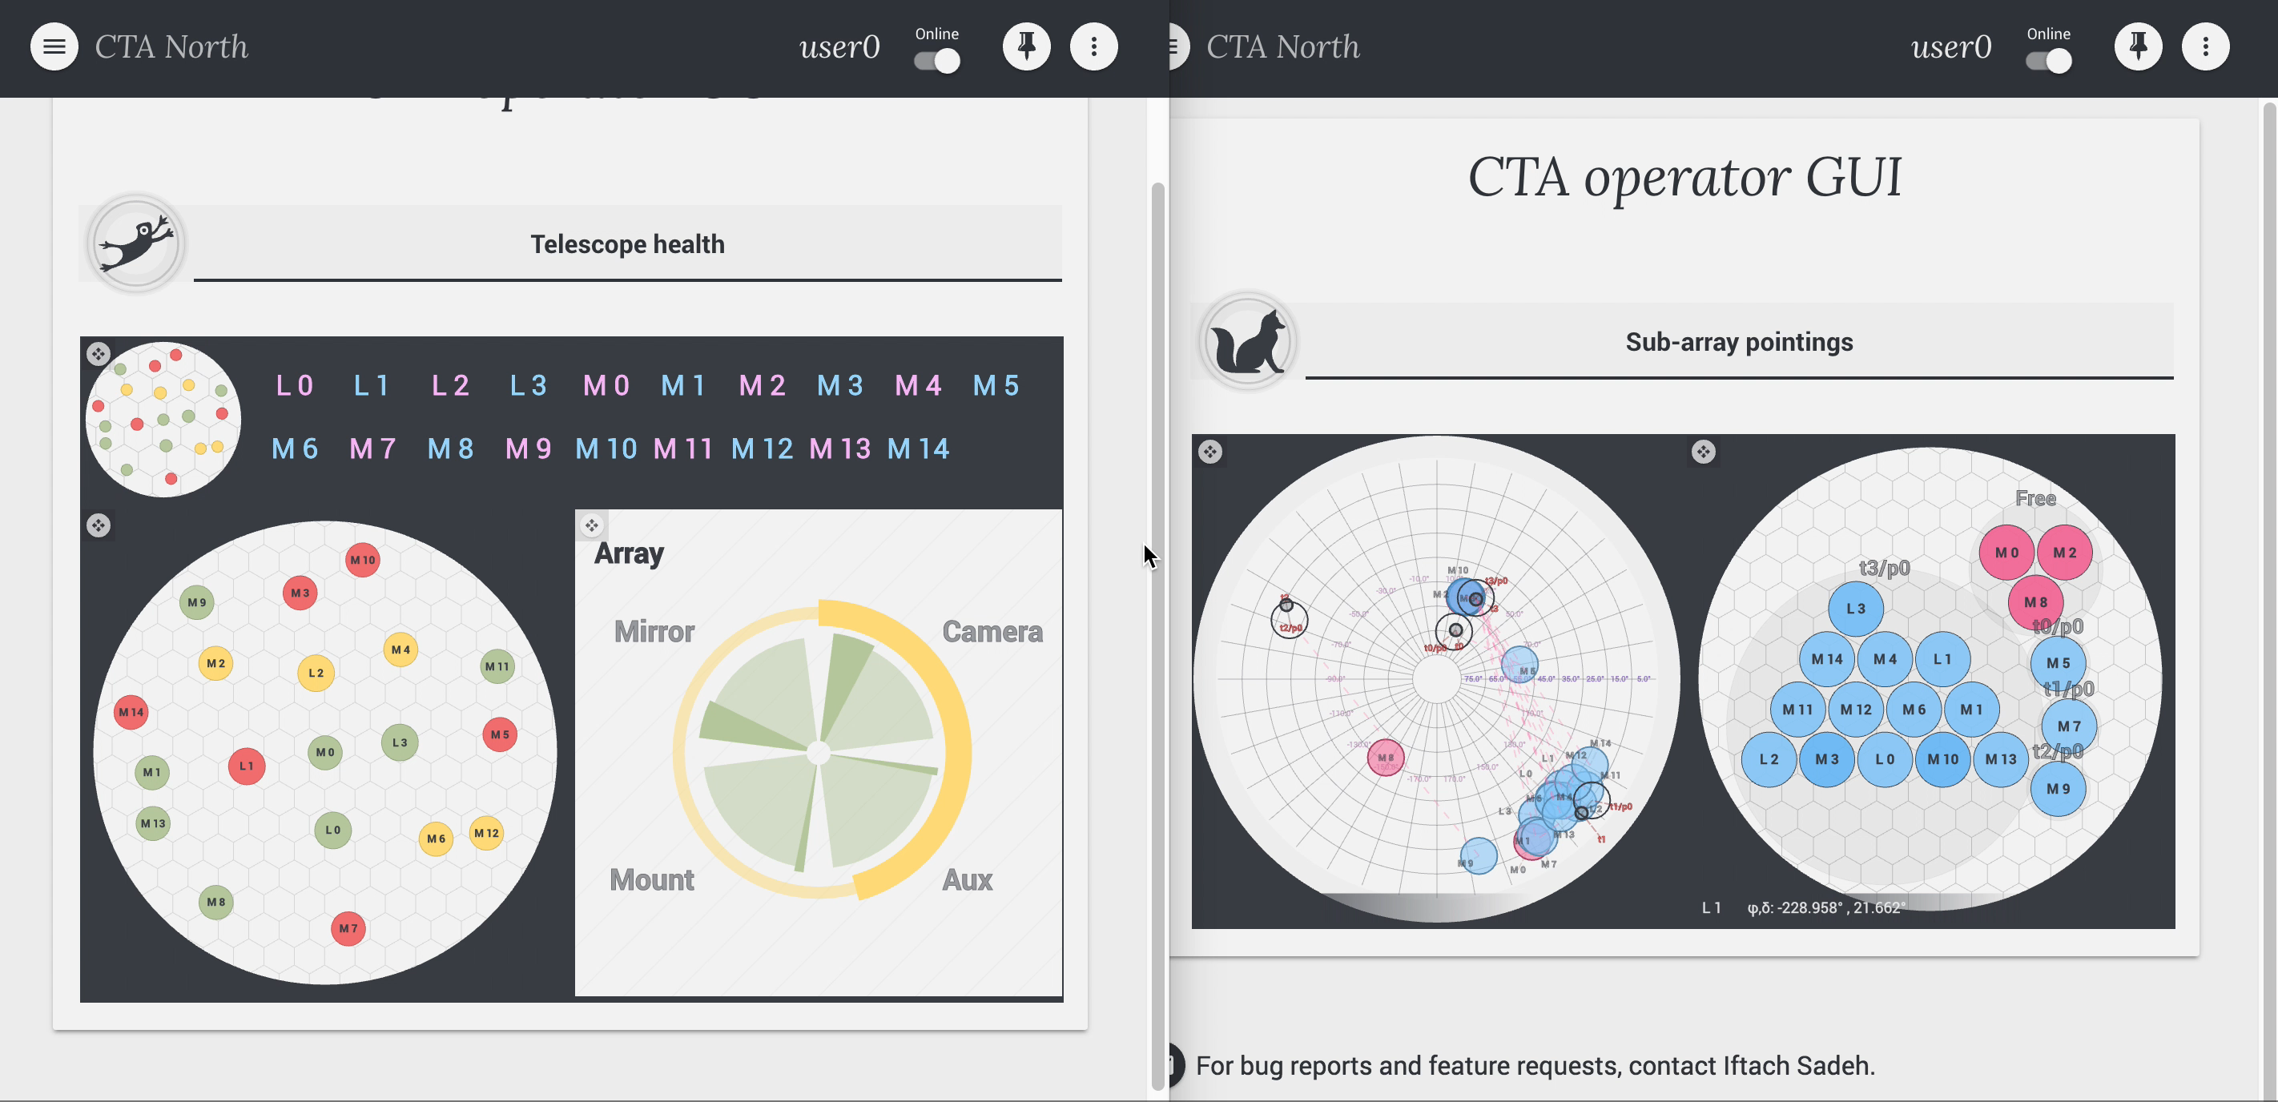
Human Machine Interface
Section of the presentation

Slide 20
3
Concepts

Slide 21
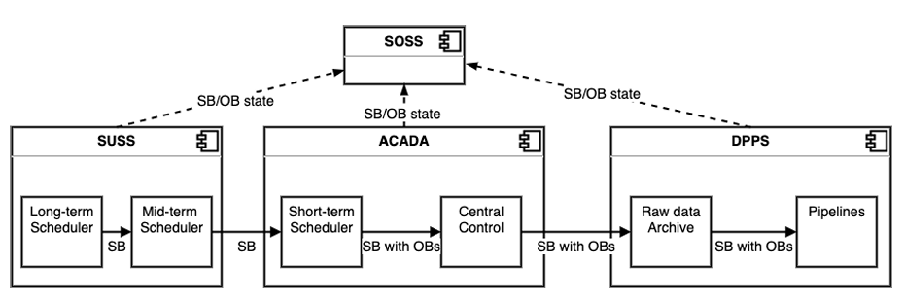
Scheduling Blocks
Concepts

Slide 22
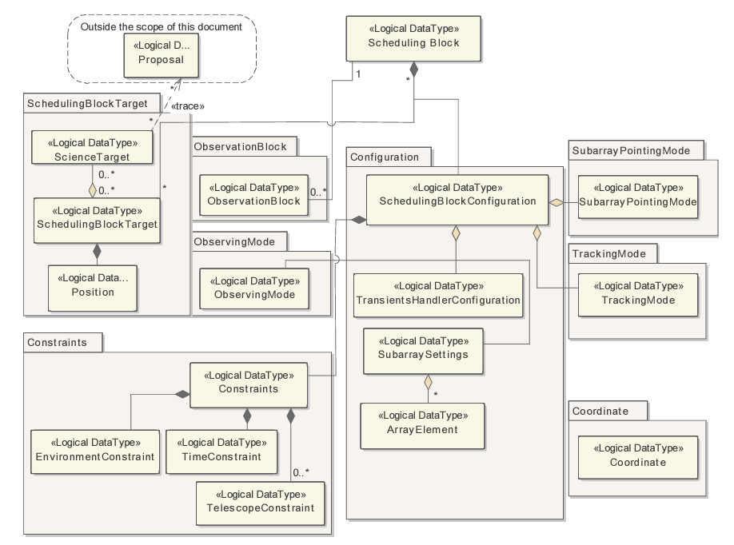
Section of the presentation

Slide 23
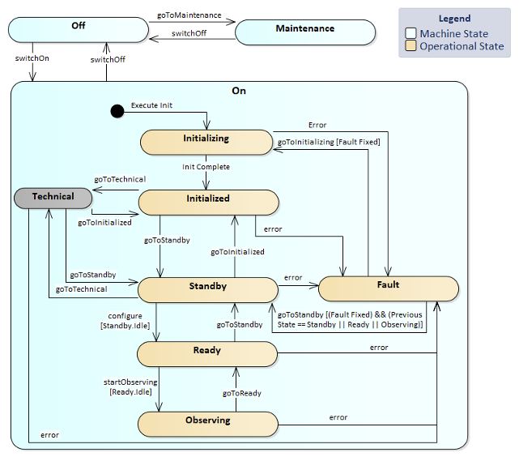
Array Element FSM
Initialized: Safe & Monitored
Standby: still safe, all components activated. Structure: all internal systems on & unparked.
Ready: prepared for a rapid transition to the Observing State. Internal calibration activities may take place.

Slide 24
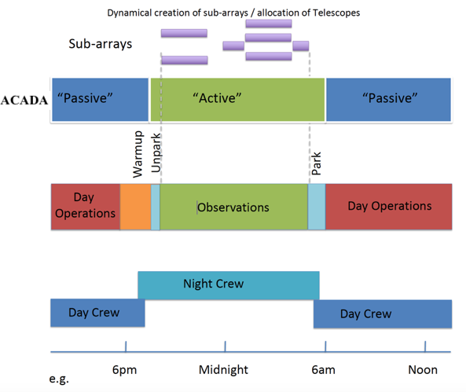
Operation Modes
Concepts

Slide 25
4
Middleware - ACS

Slide 26

ALMA Common Software
Middleware
documented collection of common patterns in and of components, which implement those patterns.
based on a distributed component model
ACS components implemented as CORBA objects in any of the supported programming languages.
provides common CORBA-based services such as logging, error and alarm management, configuration database and lifecycle management.
ALMA ACS Documentation Confluence
ACS git repo

Slide 27
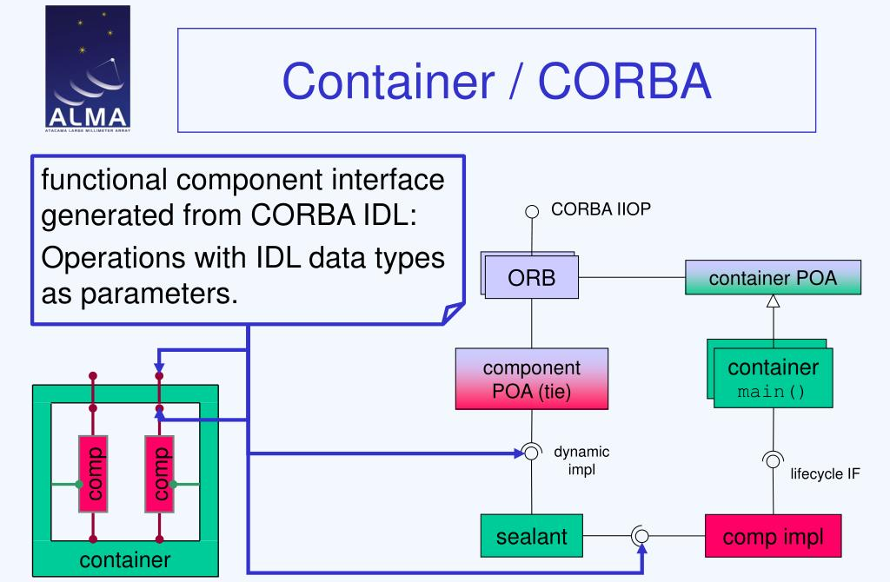
Middleware

Slide 28


OMG IDL
Middleware
IDL is a declarative language for defining the interaces of CORBA objects
IDL is language independent
ILD is used by ORB-specific IDL compilers to generate stubs, seltons and interface code in a given programming language in compliance with the IDL mapping specification for that programming language.

Slide 29
5
LST1 Control

Slide 30
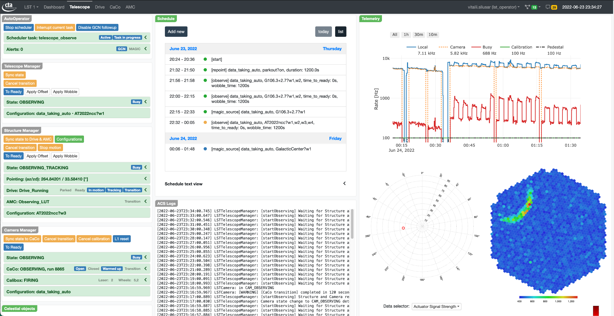
Example for tonight

Slide 31
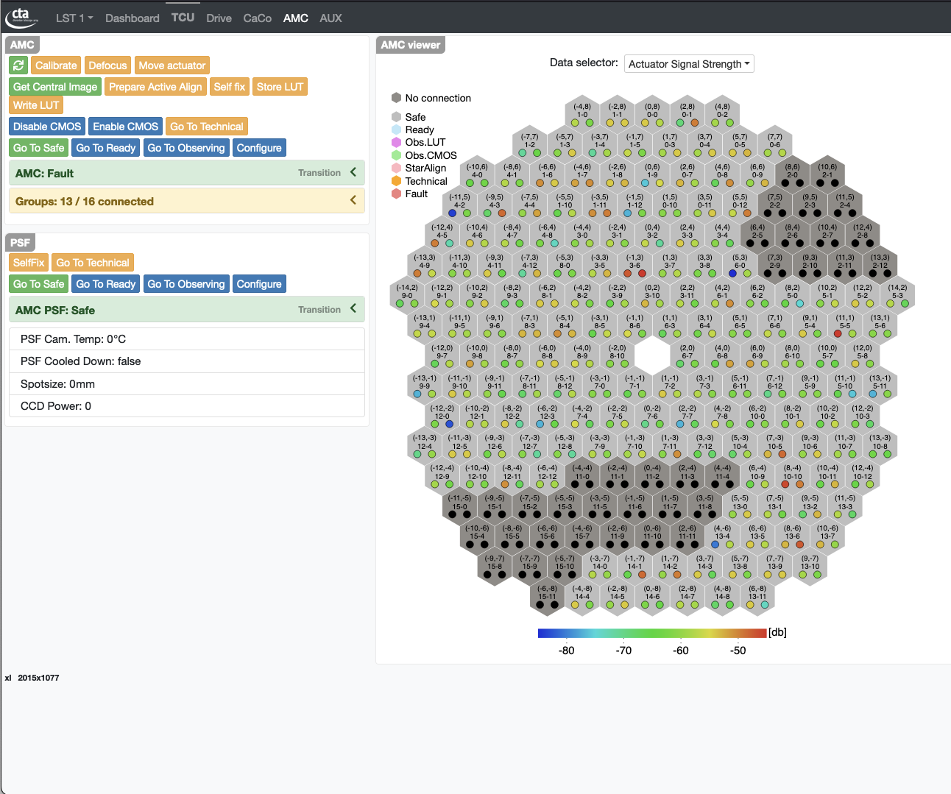
LST1 Active Mirror Control – experts only

Slide 32
6
Quo Vadis ACADA?

Slide 33
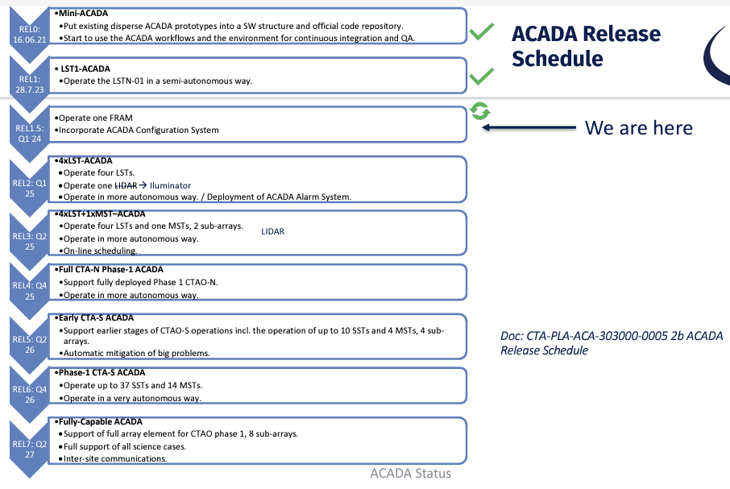

Slide 34
Thank you & Stay Tuned!

