Slide 1

Historical Overview and Basic Details of the Ground-Based VHE γ-Astrophysics by Means of Imaging Air Cherenkov Telescopes
Razmik Mirzoyan
Max-Planck-Institute for Physics, Munich, Germany

Slide 2
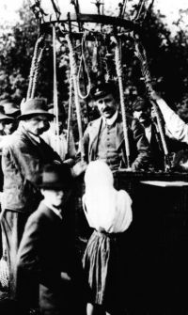
1912: Birthday of cosmic rays
In a series of balloon flights, up to an altitude of 5000 meters a.s.l., Victor Hess discovered "penetrating radiation" coming from outside, from space.

Slide 3
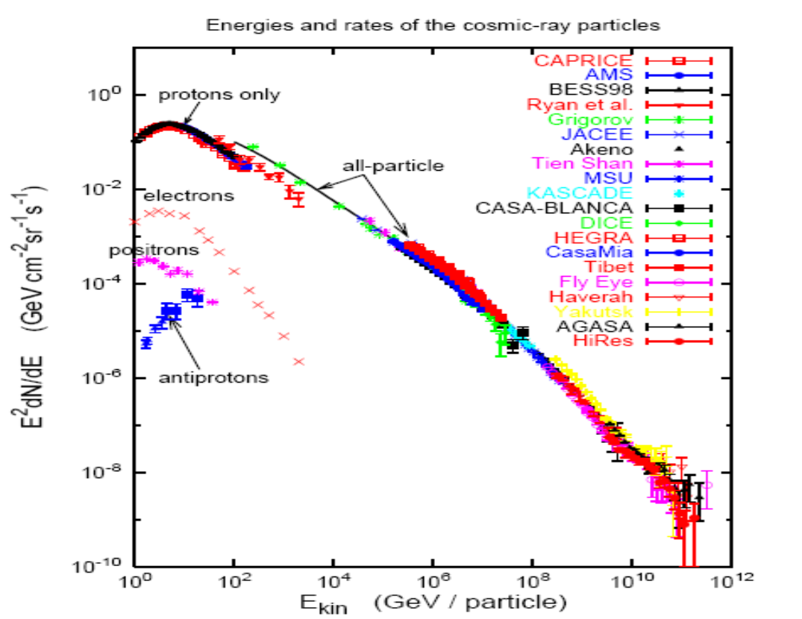
The non-thermal sky: energies and rates of CR

Slide 4
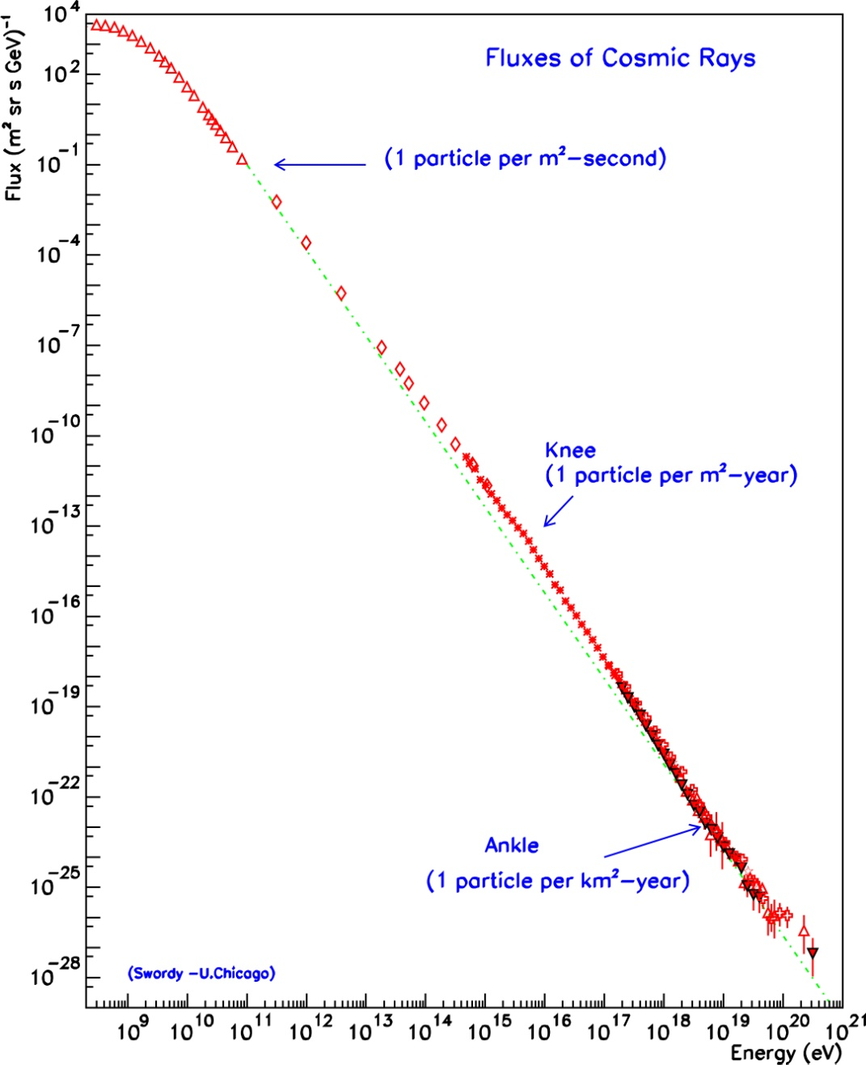
Origin of cosmic rays
Discovered in 1912 but their sources are not yet identified!
Which object(s) in our galaxy can
provide the right amount of CR?
galactic origin
Supernova remnants could
accelerate swept-up particles in
their magnetic shock waves
extragalactic
origin
Signature: Hadronic generated Gamma-rays from SNRs

Slide 5
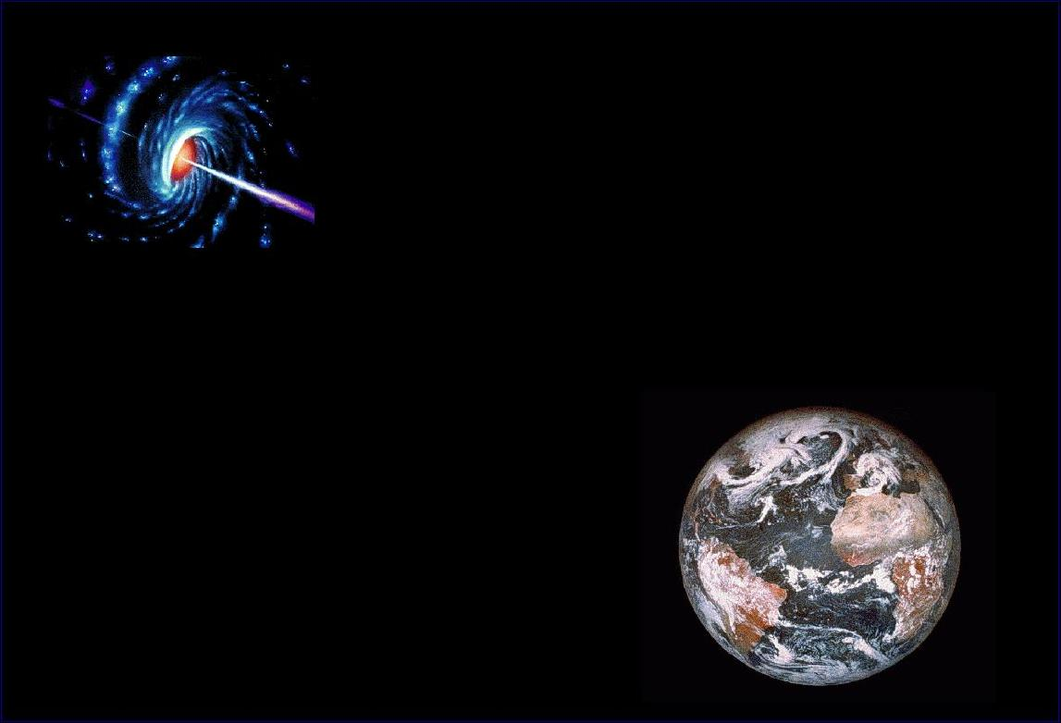
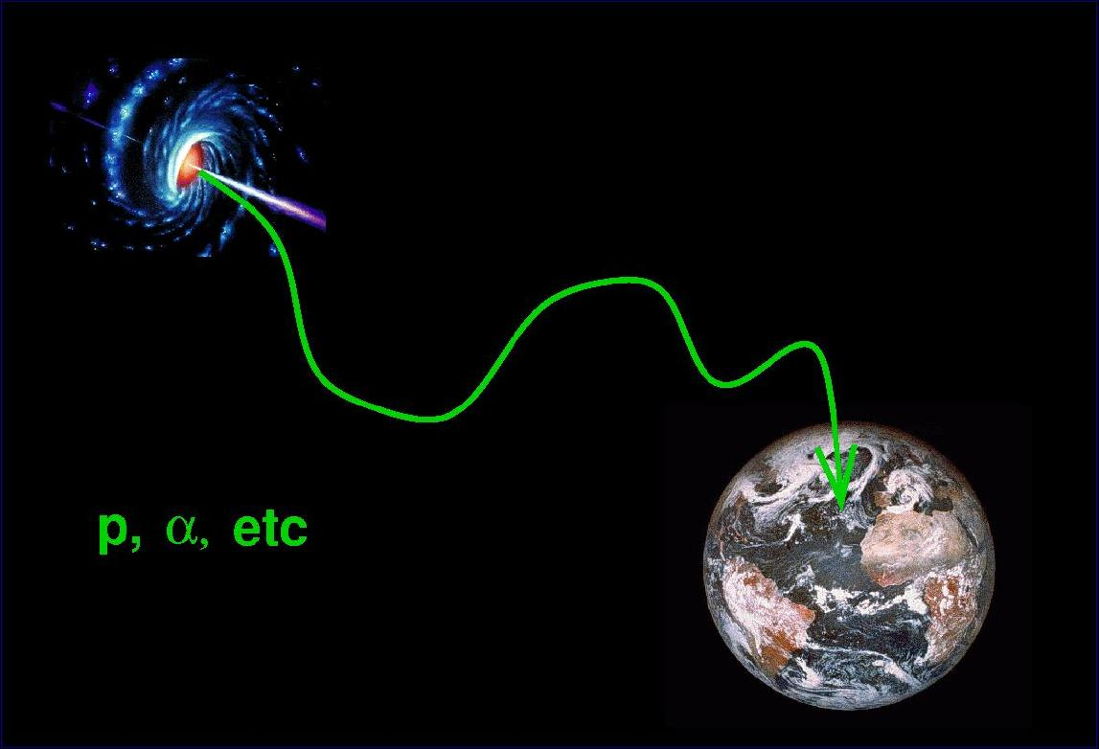

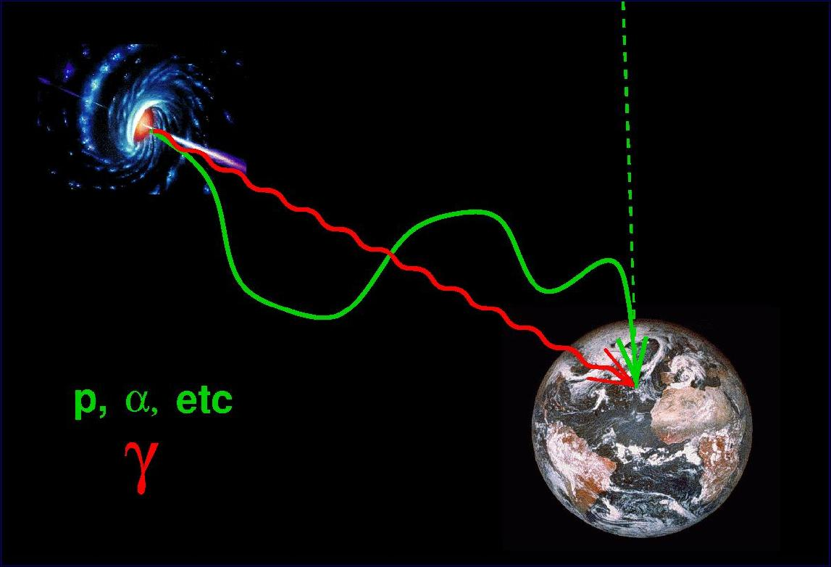
Astronomy with Charged Cosmic Rays ?
Charged CR particles, deflected by magnetic fields, lose their information on the location of the emission site (unless E is very large)
B

Slide 6
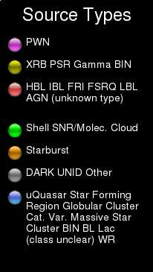
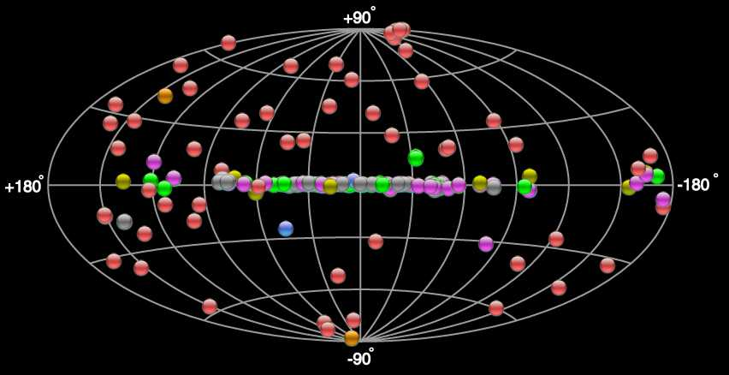
Today‘s VHE γ−ray Sources in the Sky
http://tevcat.uchicago.edu/
≥ 250 Established Sources

Slide 7
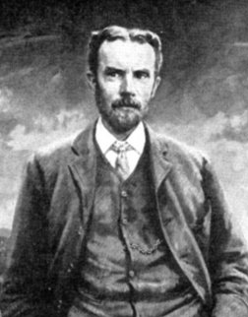
Cherenkov light: the beginnings
In a series of publications Oliver Heaviside has calculated and predicted the main features of a special emission when an e- movs in a transparent medium with a speed higher than that of light.
The work of the genius, who advanced his time by half a century, was not appreciated by contemporary scientists and was forgotten. In 1912 he calculated the geometry and the angle of emission relative to the axis of movement of the charge (1888, 1889, 1892, 1899, 1912a,b)
Please note that during the end of 19th century scientists believed the space was feeled-in with Ether.

Slide 8
Cherenkov light: the beginnings
It took almost 50 years until the effect was experimentally discovered and later on got the name Cherenkov
Also Sommerfeld studied the problem of a charge moving in vacuum with a speed v > c (1904). The relativistic principles prohibit such a motion in vacuum but in a medium with given n then his equations give valid solution („sonic boom“).
First observation of ghostly bluish glow of bottles in the dark cellar, containing radium salts dissolved in distilled water, by Marie Curie in 1910 (E. Curie, 1937). It was thought to be a type of fluorescence.

Slide 9
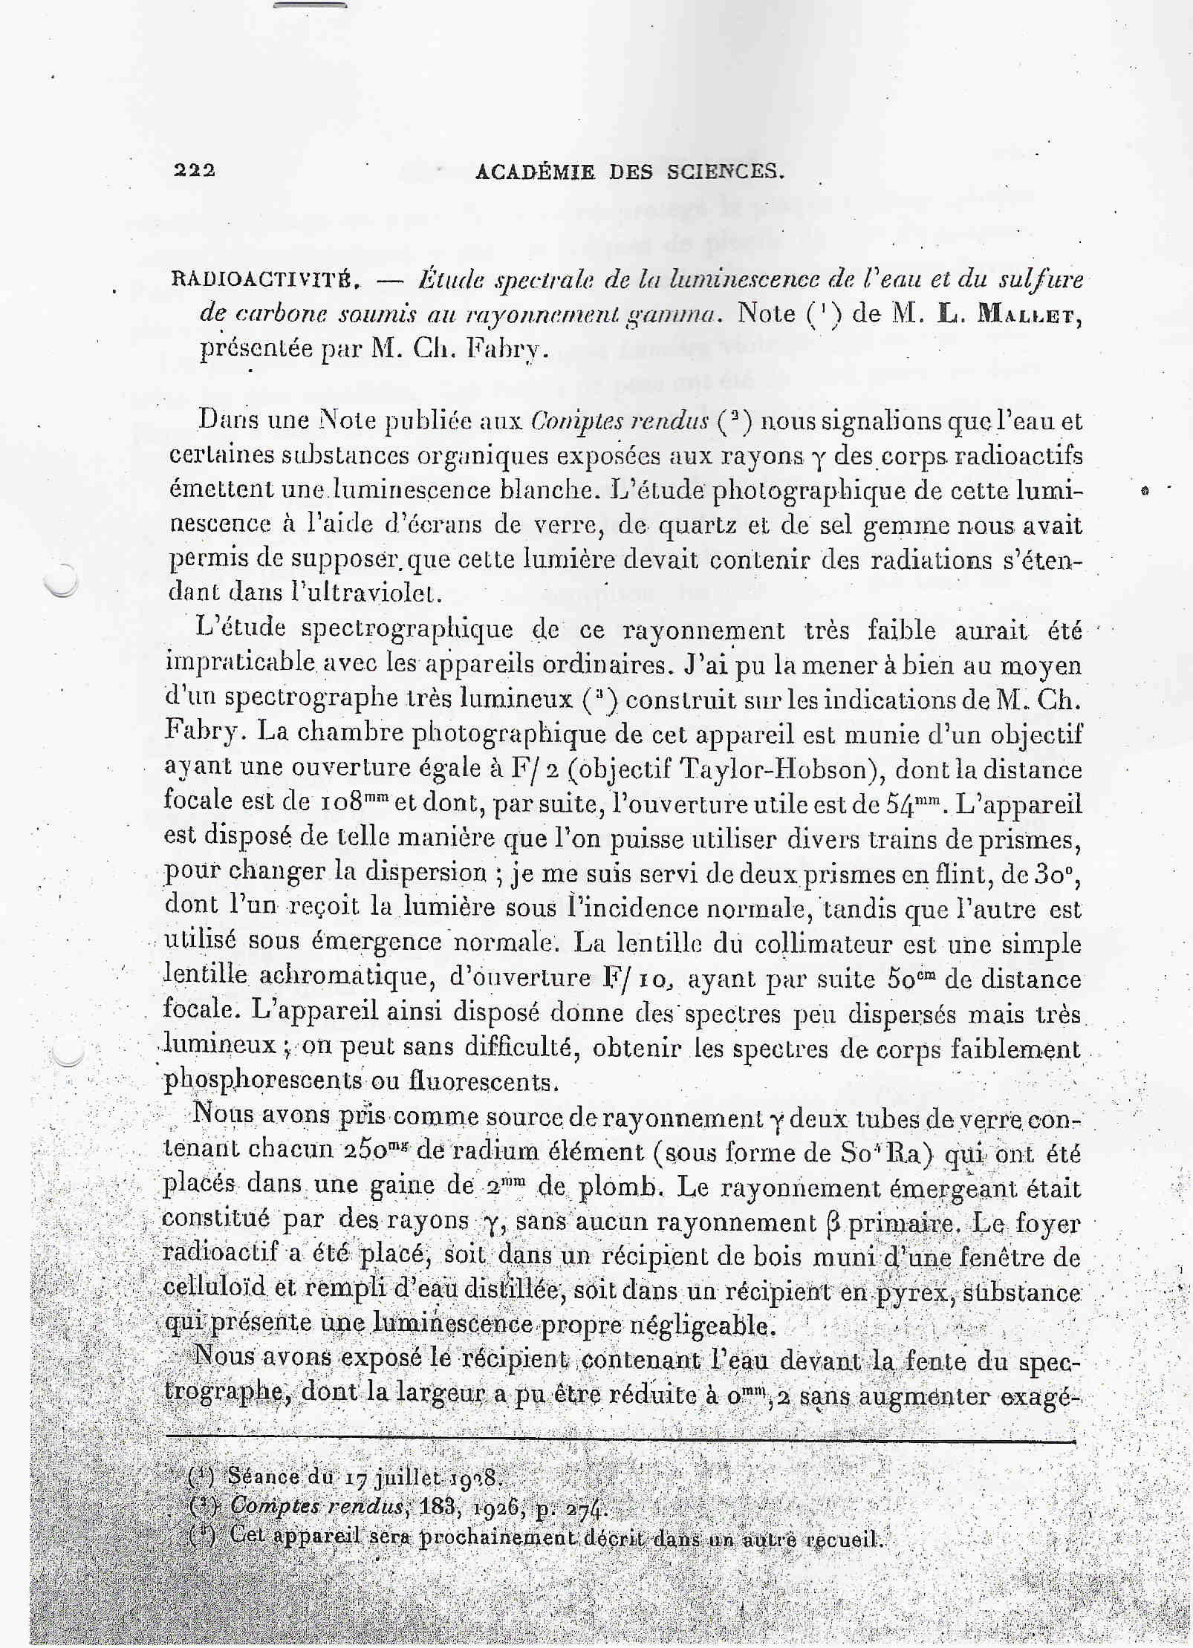
French scientists
M.L. Mallet
published 3 articles on the
bluish glow in transparent liquids (1926-1929).
On the left one can see a scan of one of those papers (1926)
Mallet recongnised the continuous spectrum of emission that was contradicting the fluorescence theory, but failed to offer any deep explanation

Slide 10

Cherenkov light: the beginnings
Pavel Cherenkov: born July 28th 1904 in a poor peasant family in village Novaya Chigla, Voronezh province.
1924-1928 studying in Voronezh sate university.
1930: postgraduate student of Sergej Vavilov at the Institute of Physics of Soviet Academy of Sciences in Sankt-Petersburg (later on FIAN).
Had to find the fluorescence nature of solvents of uranium salts, emitting bluish light
Big was his surprise that also pure solvents and even water were emitting the annoying background light

Slide 11
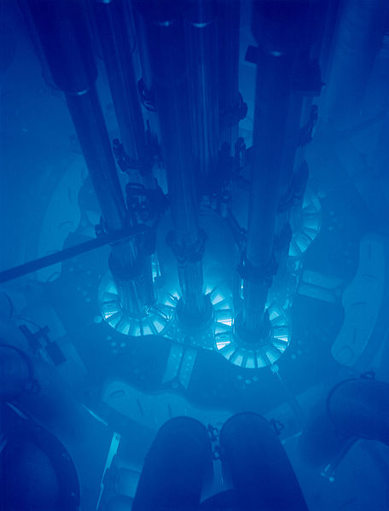
Initially complaning about his boss: he had to spend >1-1,5 hours in a dark, cold cellar, for accomodating his eyes
He noticed that the emission is not chaotic, but is related to the track of moving particle.
1934-1938 conducting a series of brilliant expeirments.
Obtained doctorate in 1940

Slide 12
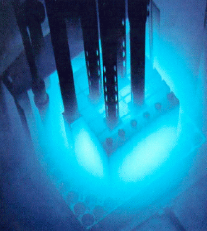
The Suspicious Emission
In 1937 Cherenkov succeeded to measure the anisotropy of the emission and submitted it to the journal „Nature“
„Nature“ declined his paper
Fortunately „The Physical Review“ accepted it
In that paper he has mentioned the possibility to measure fast e-

Slide 13
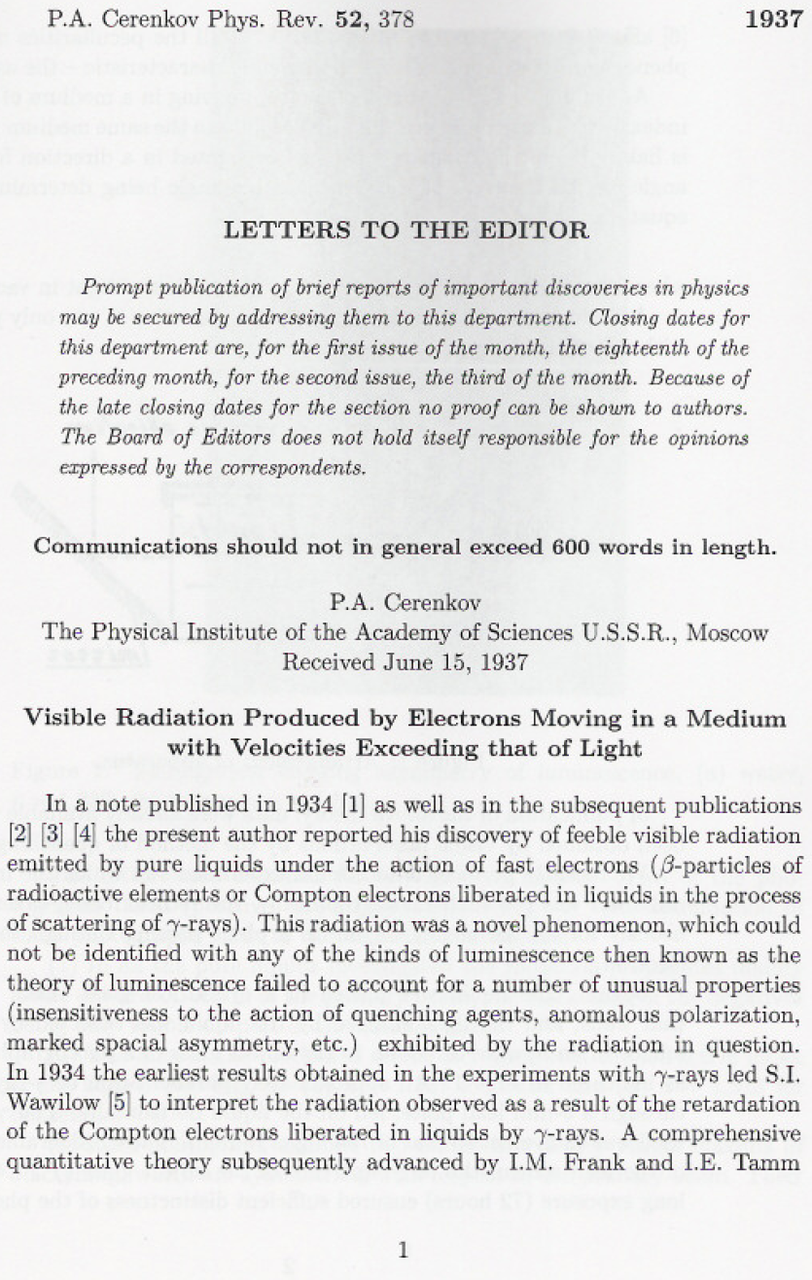
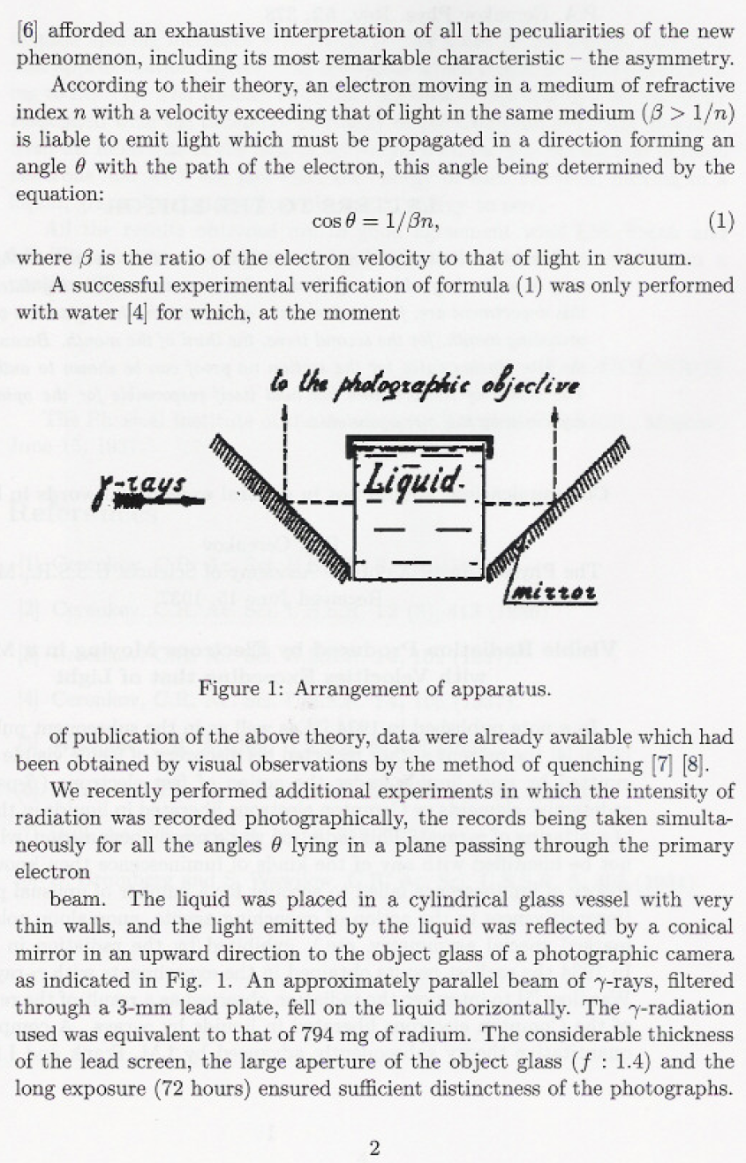

Slide 14
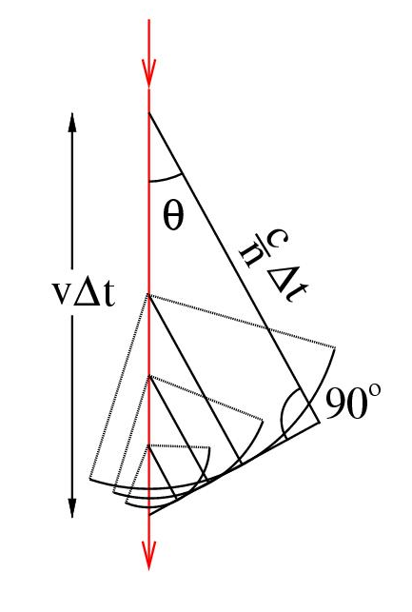

Cherenkov radiation
Analogous to “sonic boom”
cos θ = 1 / (β n)
θ_{max} = cos⁻¹(1/n)

Slide 15
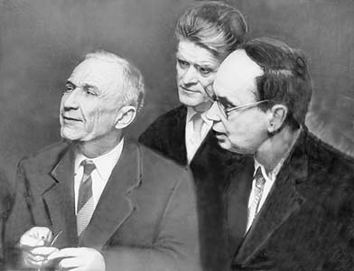
Cherenkov, Tamm and Frank awarded Nobel Prize in 1958
S. I. Vavilov has
passed away in
1951 (after ~10
heart attackes).
Nobel prize is
awarded only to
scientists who are
alive
Tamm
Frank

Slide 16
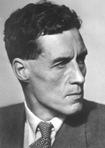
Cherenkov radiation in the atmosphere
In 1948, P.M.S. Blackett suggested that secondary CR’s should produce Cherenkov radiation which would account for a fraction 10⁻⁴ of the total night sky light
Pulses of Cherenkov light from air showers were first recorded by Galbraith and Jelley in 1953

Slide 17
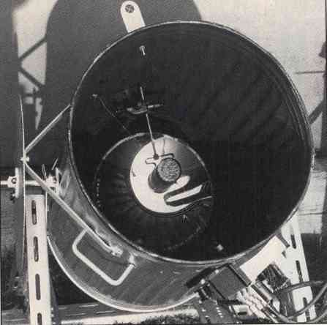
The Experimental Beginning
1953
By using a garbage can,
a 60 cm diameter mirror
in it and a PMT in its focus Galbraith and Jelly had discovered the
Cherenkov light pulses
from the extensive air
showers.

Slide 18
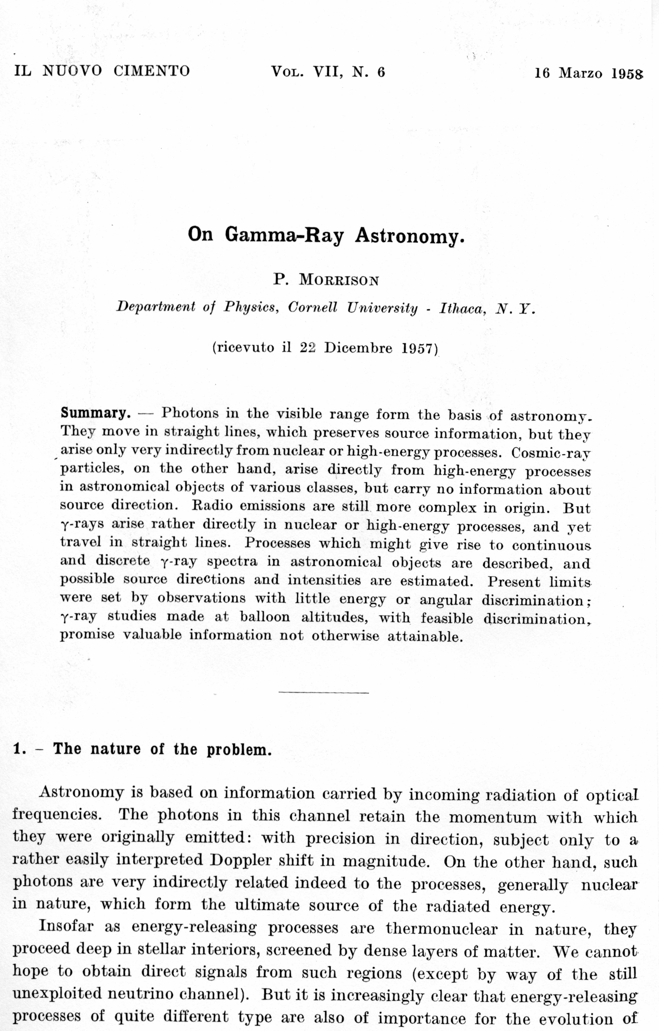
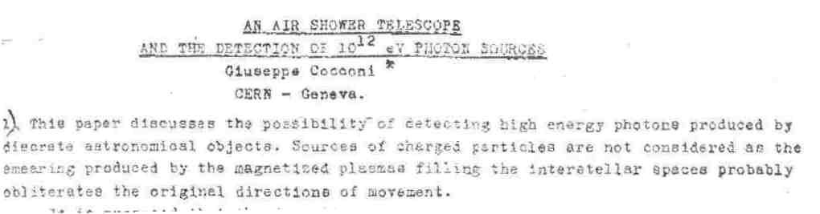
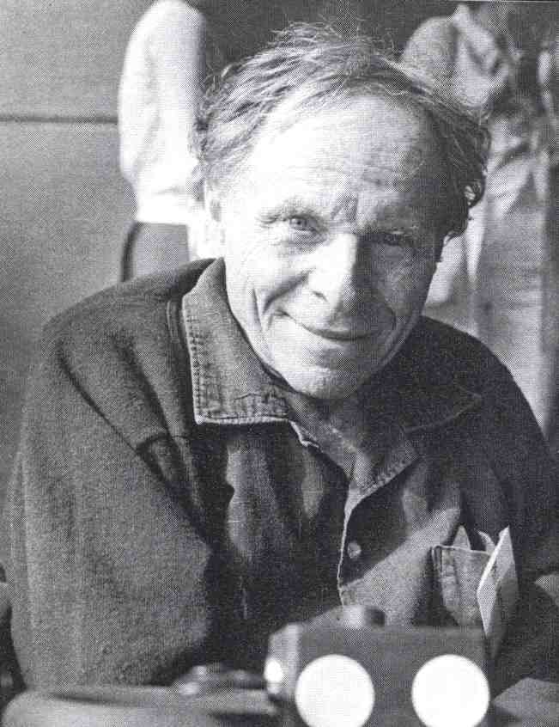
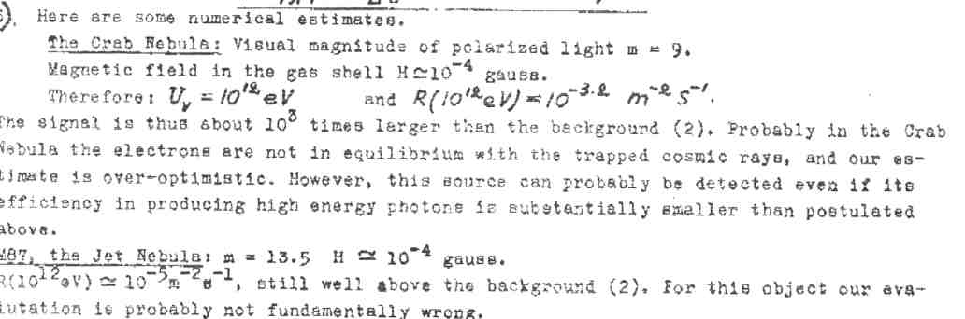
Gamma-ray Astronomy, the beginning
Seminal paper by
Phillip Morrison,
1958
Also proposed at
higher energies
independently by
Giuseppe Cocconi,
1959

Slide 19
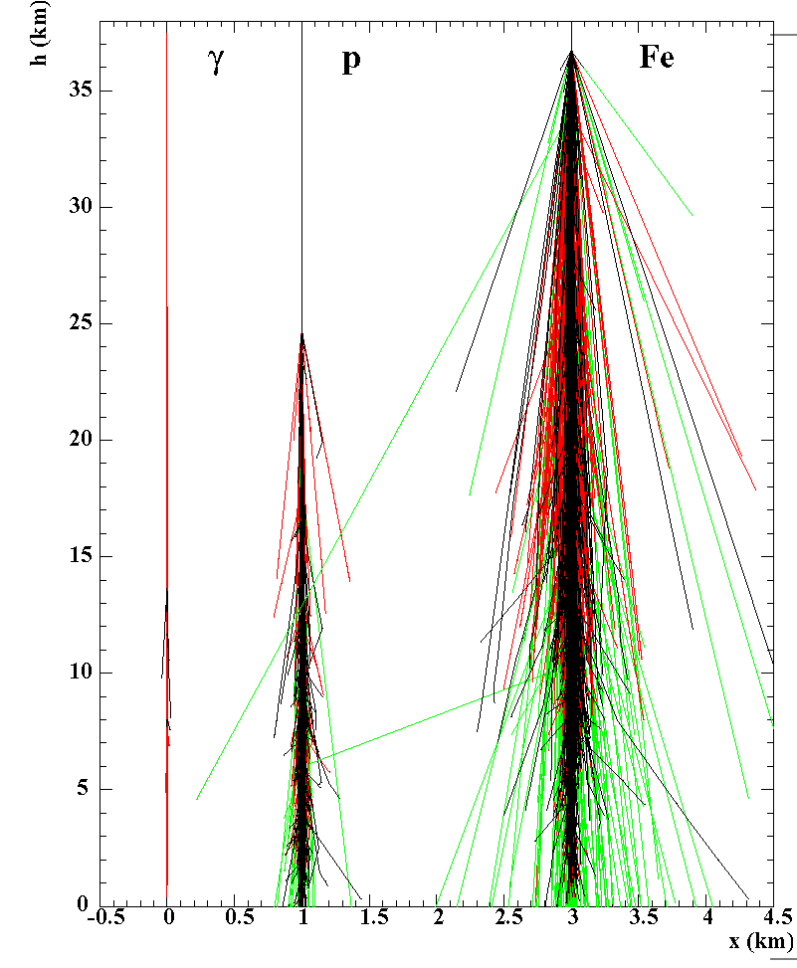
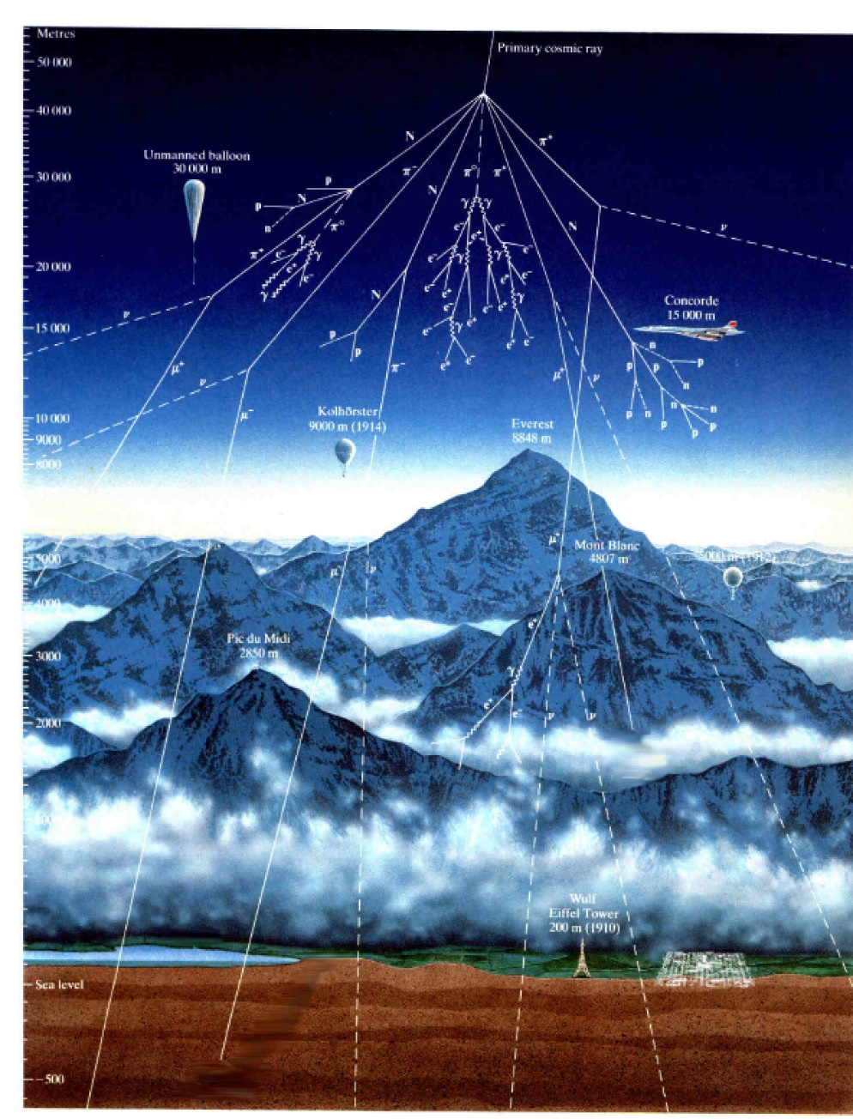
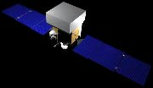
Extensive Air Showers

Slide 20
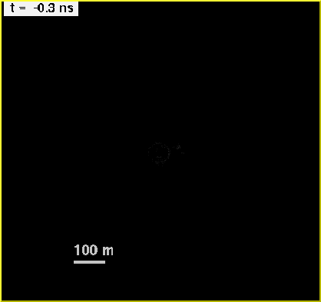

A 100 GeV γ-ray event on the ground

Slide 21
A 200 GeV proton on the ground

Slide 22
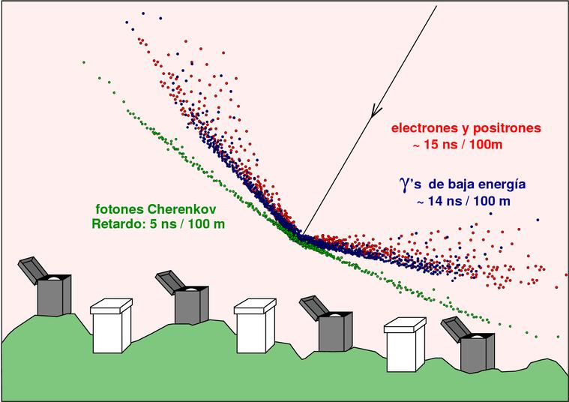
Air Showers measured on the ground
Electrons and positrons
Gamma rays
Cherenkov photons
Particle detectors

Slide 23
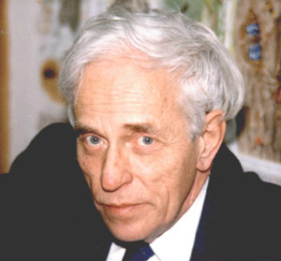
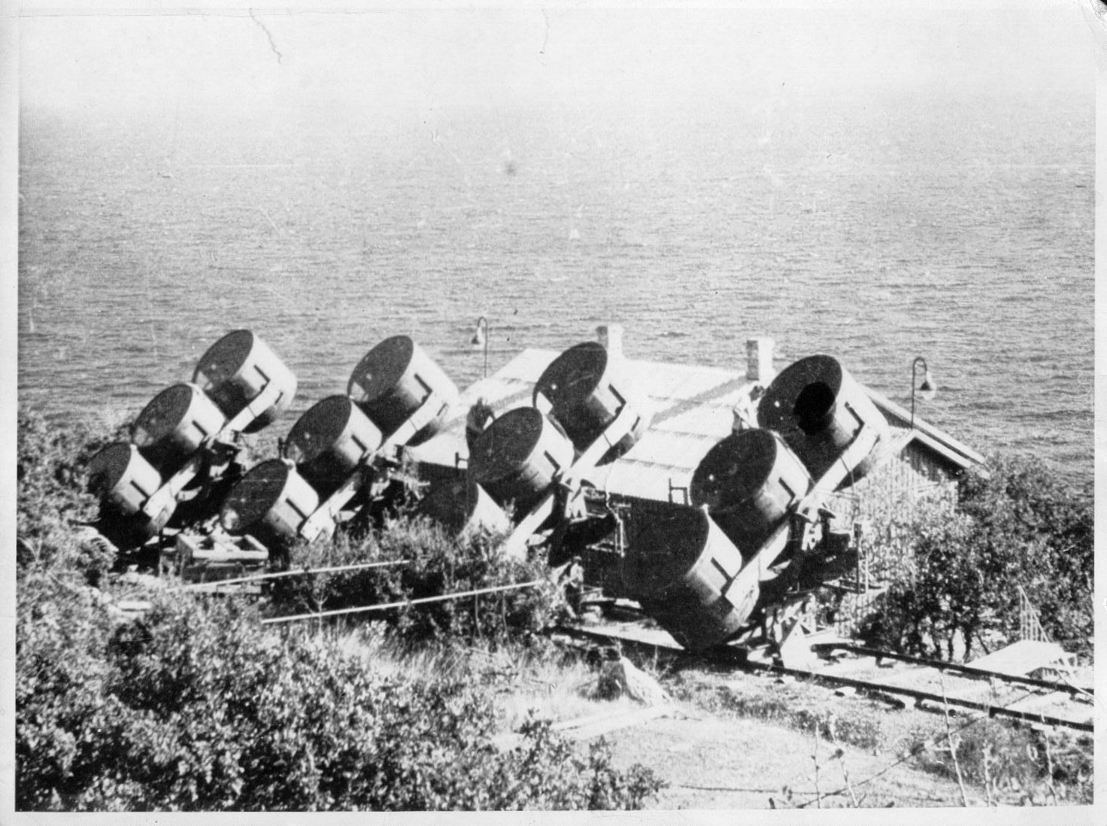
Alexander Chudakov and the Cherenkov Technique for
Gamma Ray Astronomy
1921-2001
Crimea Experiment 1959-1965, Chudakov, et al., (SNR, radio galaxies)

Slide 24
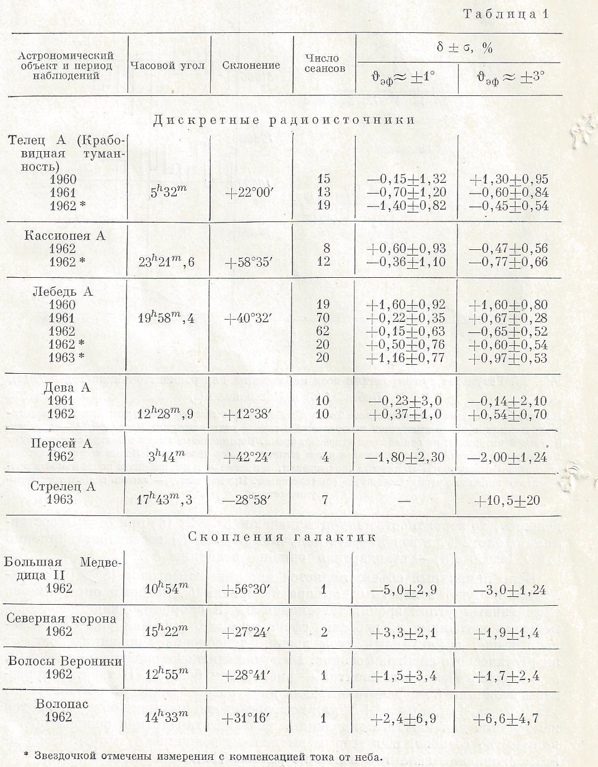
A multitude of sources
have been observed and
serious statistical treatment
of data has followed
Except for some small
fluctuations no significant
flux has been observed
≥ 3.5-5 TeV,
Flux upper limit:
5 x 10-11 ph/cm²s
They turned down the too
optimistic prediction of
Cocconi about 1000:1 S/N
Crab
Cas A
Cyg A
Perseues A
Center of galaxy
Galaxy clusters

Slide 25
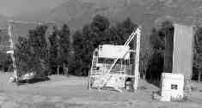
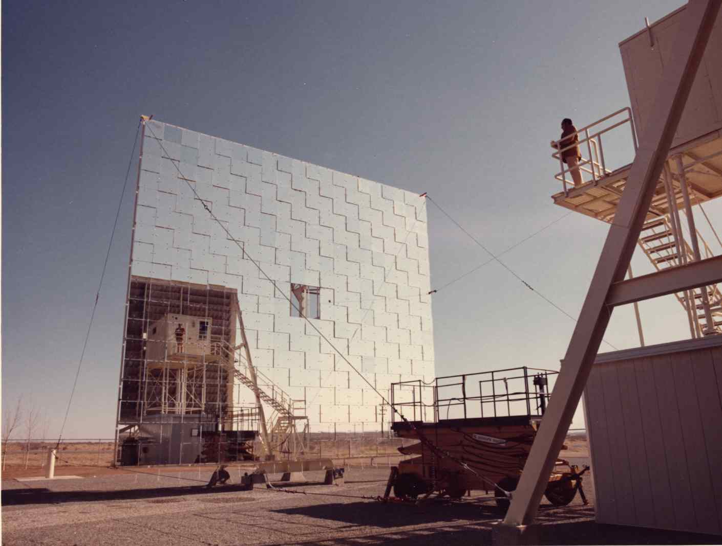
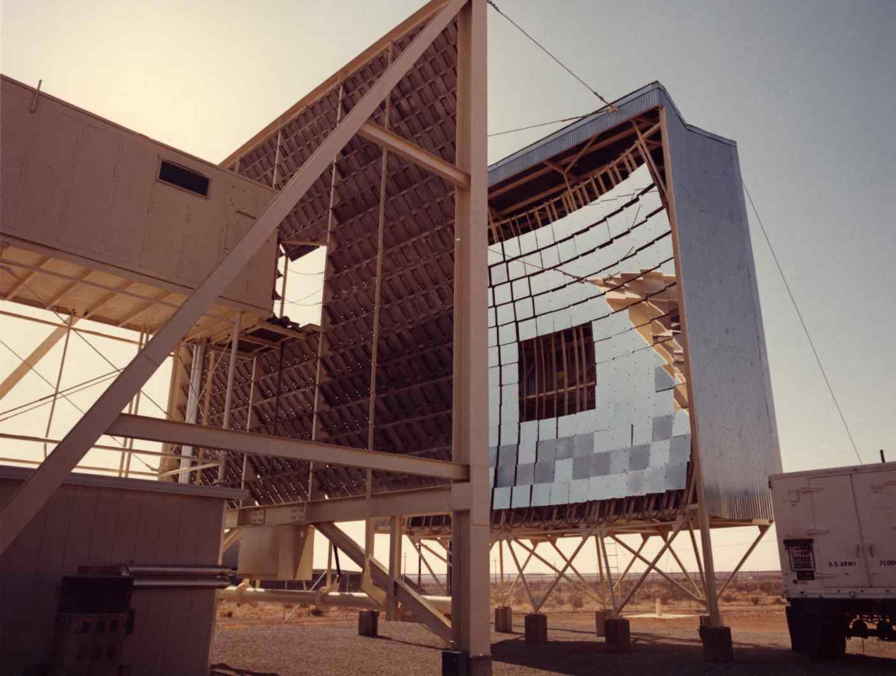
1st Smithsonian venture into VHE gamma-ray used Solar Furnace at Natick, MA ~ 1965-6.
Gamma-ray Astronomy Group led by Giovanni Fazio
Heliostat
Davis-Cotton design

Slide 26
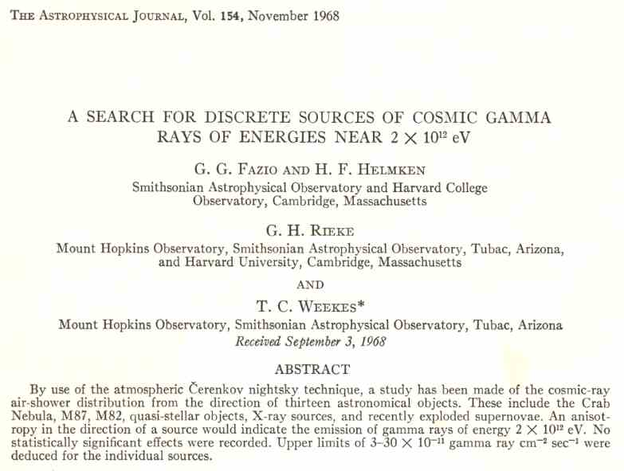
The Pioneer Trevor Weekes; life-long trying hard, until succeeding with Crab Nebula in 1988

Slide 27
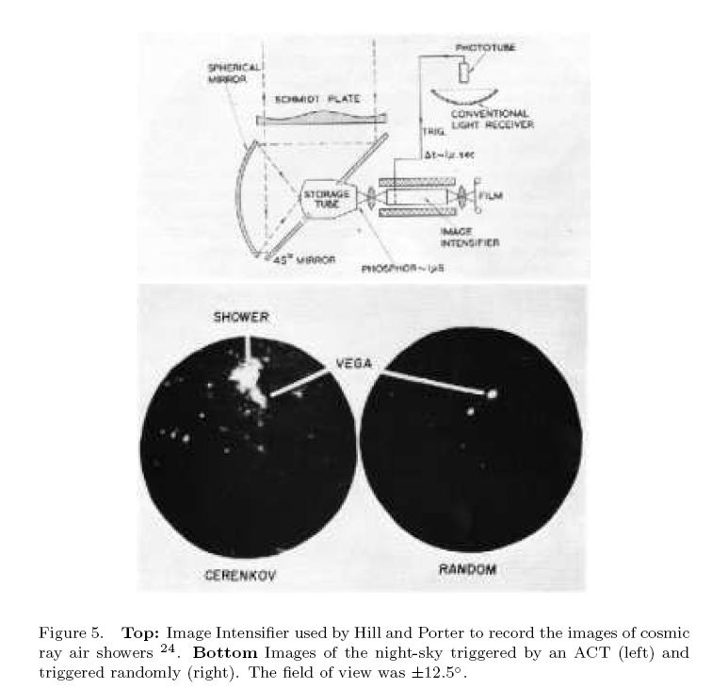
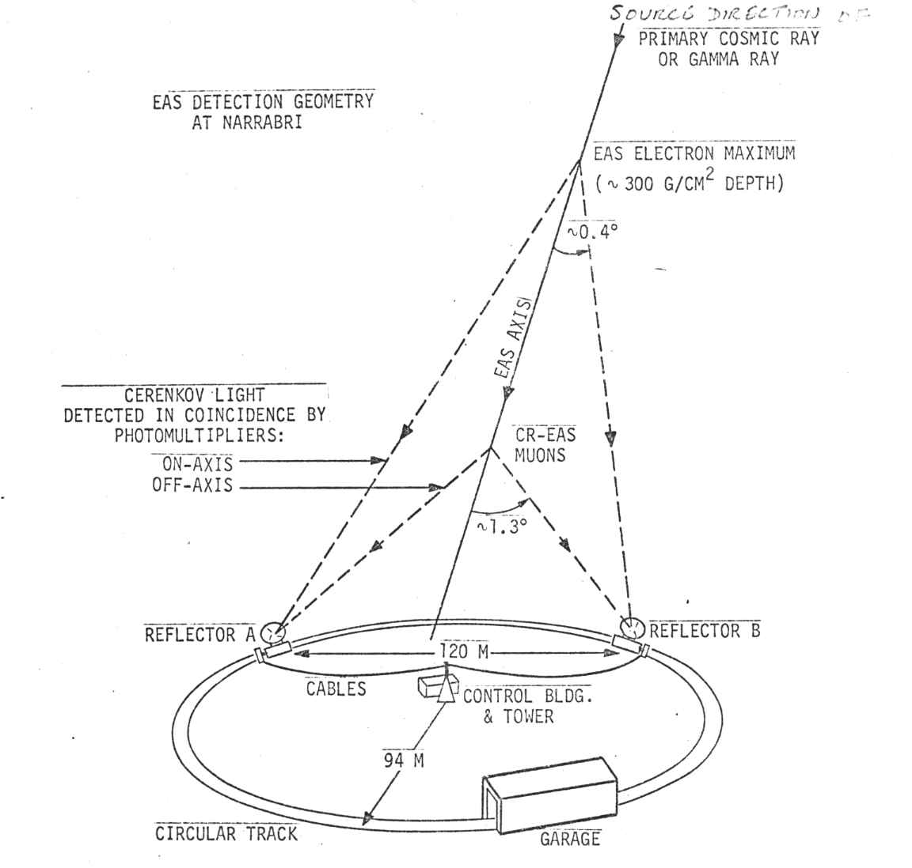
Cherenkov Shower Imaging using Image Intensifiers (1960-65) and Stereo Detectors (1972-76)
Image Intensifier Pictures of Cherenkov light
Image from Cosmic Ray Air Shower.
On short time-scale images are brighter than
bright star (Vega).
Work by David Hill (M.I.T.) and Neil Porter
(U.C.D.) in 1960
Josh Grindlay demonstrates value of
stereo imaging with two-pixel system
(Double Beam Technique) at Mt.
Hopkins and Narrabri (1972-76)

Slide 28
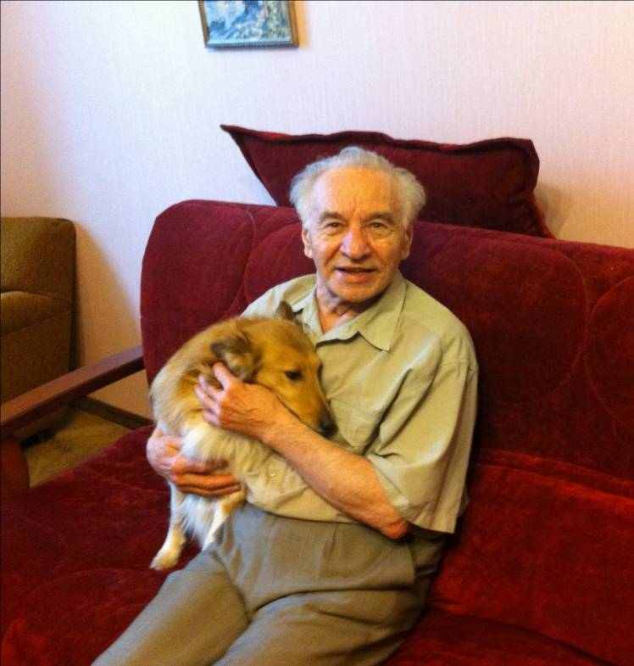
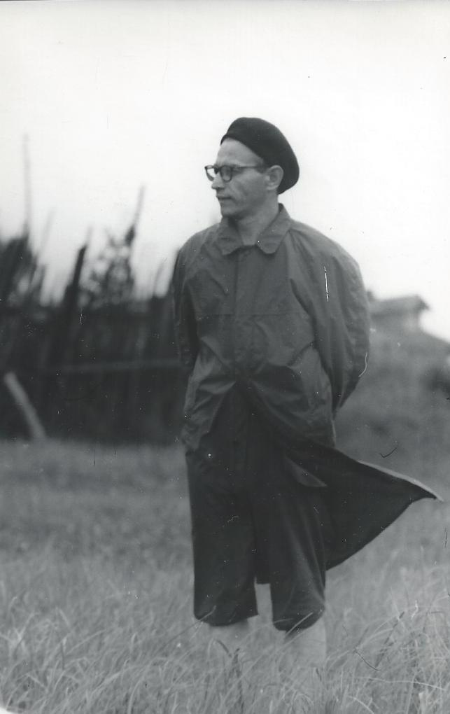
Victor Zatsepin, born in 1928
In 1960‘s Victor Zatsepin well-
-understood all the main features of the air Cherenkov technique.
I learned from him that in 1960‘s he
was long seriously considering a key question about how one could measure multiple images of showers (which kind of cameras can do it?).
He performed simulations of air showers in 1961-64 (were there computers available, really ?)
„URAL“ was the name of the russian computer
that was operated by a specially trained staff.
V. Zatsepin in 1962

Slide 29
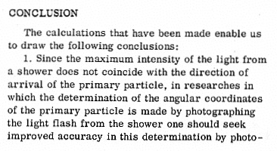
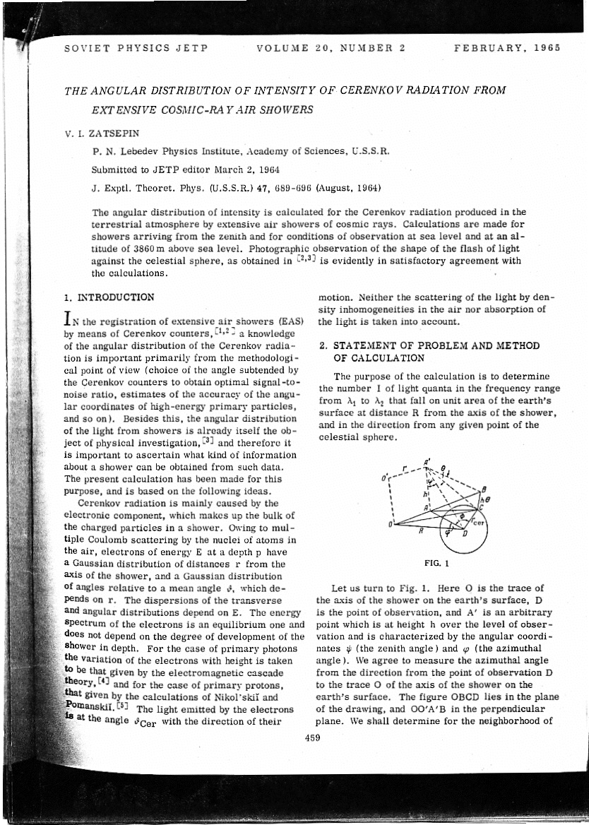
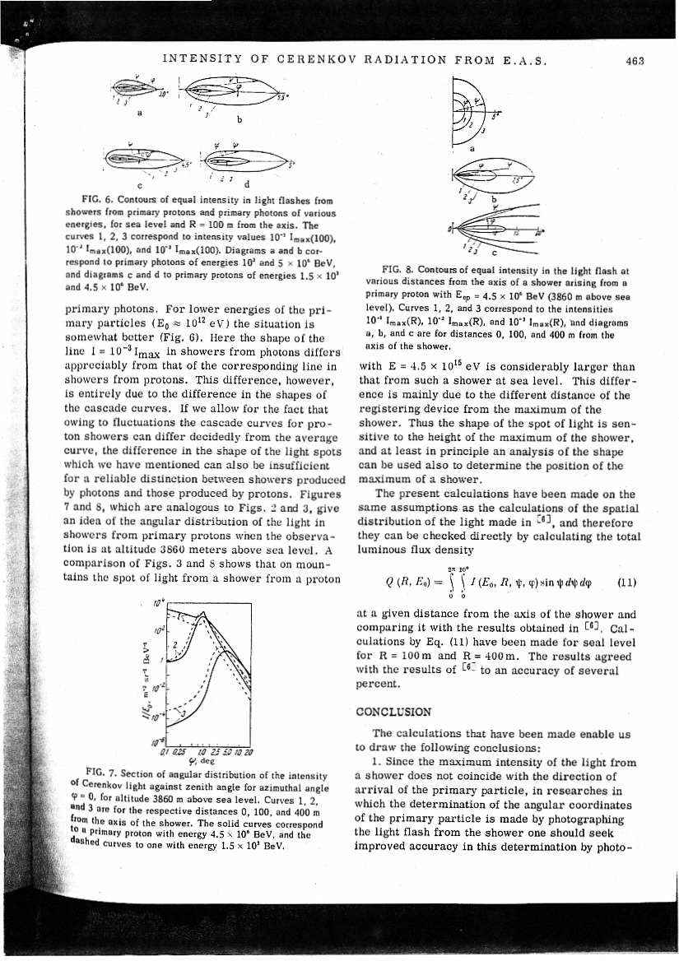
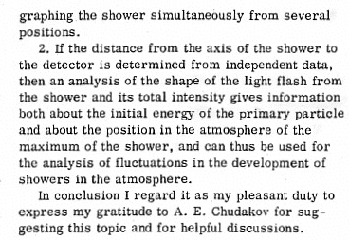
The 1st Statement in the Literature on the Potential of the Stereo Imaging Detector

Slide 30
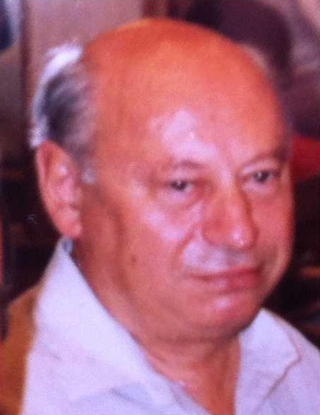
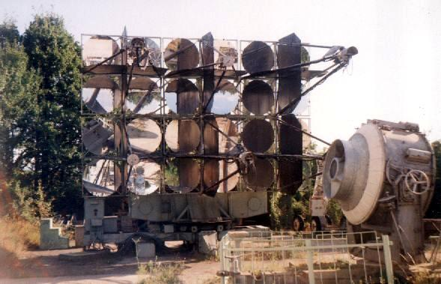
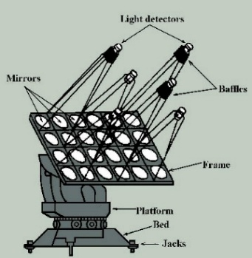
Arnold Stepanian’s pioneering imaging “stereo ”telescopes: GT-48 in Crimea
Construction and start of operation
1985 - 1989
20 m distance between the telescopes

Slide 31
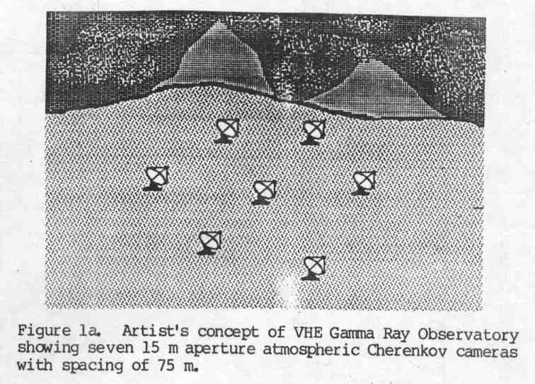
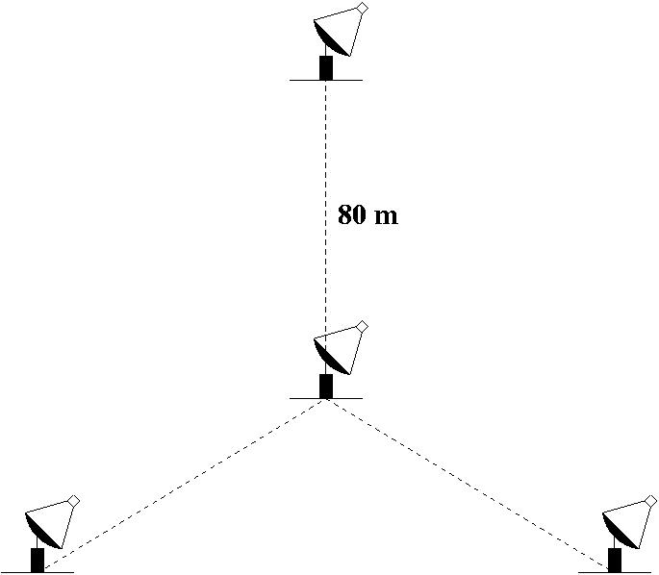
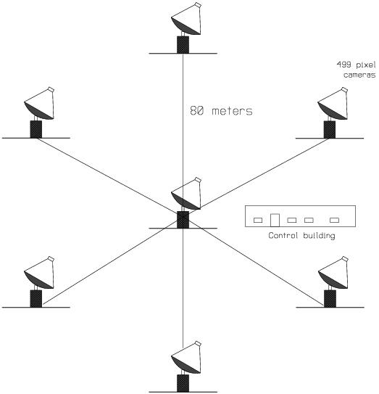
An array of ACIT’s was first proposed in 1984 (prior to the detection of the Crab Nebula).
(NASA Workshop, Space Lab. Science, Baton Rouge, 1984)
This is the configuration that was later adopted for VERITAS.

Slide 32
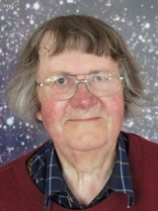
Some key developments
70-80‘s: plenty of „discoveries“ on 3-4 σ level
M. Hillas: „A physicist‘s aparatus gradually learns what is expected of it (blame the apparatus for a dog-like desire to please)“
La Jolla, 1985: Michel Hillas suggested to use the „Hillas“ parameters
1989: Whipple discovers 9σ signal from Crab

Slide 33
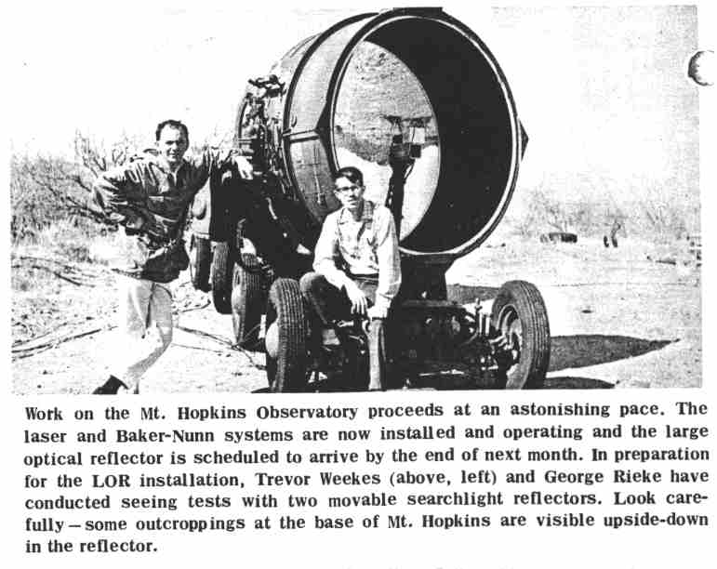
First Gamma-ray Experiment at Whipple Observatory, 1967-68
The pioneer, the #1
in gamma astronomy

Slide 34


The Pioneer Trevor Weekes and his 10m Ø Whipple telescope gave birth to γ-ray astrophysics: 9σ from Crab Nebula in 1988 !
„If a telescope can within
a few s evaporate a solid
piece of steel, it can also
measure gamma rays“
;-)

Slide 35

The 1st telescope (of 5 planned) we´ve built: 1989
Nor Amberd cosmic ray
Station, mount Aragats,
2000 m a.s.l., Armenia

Slide 36



CT1 started to collect data in summer 1992
The 1st signal from Crab Nebula fall 1992
2 x larger reflector, 1997
CT2 – CT6: 5 more telescopes were built until 1997.
The 1st telescope of
HEGRA, the CT1
(installed spring 1992)

Slide 37

The HEGRA detector, including
6 air Cherenkov imaging telescopes
Location: ORM @ La Palma
Operation 1992 - 2002
CT6
CT3
CT1
CT4

Slide 38
Milestones in VHE γ astro-physics
2nd generation imaging telescopes, lead by the pioneering 10m Ø Whipple telescope, made the breakthrough, in the first time allowing to measure reliably γ sources at E ≥ 700 GeV
2nd generation telescope arrays, put in proximity and set into coincidence (later on dubbed as „Stereo“), led by HEGRA, allowed increasing the sensitivity and precision of measurements
3rd generation telescope MAGIC was 1st to lower the operational energy range of an IACT by one order of magnitude, down to 25 GeV (discovery of γ pulses from Crab pulsar at E ≥ 25 GeV, SCIENCE,2008)

Slide 39



VERITAS, H.E.S.S. & MAGIC: still exploring the limits of VHE γ-astro-physics

Slide 40
System of 2 MAGICs: the main parameters
Energy threshold (trigger): ~ 50 GeV
Energy threshold in “Sum-Trigger” modus: 30 - 35 GeV
Energy resolution: 15 % - 23 % for E ≤ 10 TeV
Angular resolution: 0.07° for E ≥ 300 GeV; 0.05° @ 1 TeV
Sensitivity: source with 6/1000 of Crab Nebula 5σ in 50h
Light-weight construction, only ~ 70 T
Fast re-positioning to any coordinates in the sky: 25s/180°
Opto-electric design optimized to provide ~ 2.5ns FWHM pulses
Data digitized by using DRS4 chips operated at 1.67 GigaSample/s
Producing ~ 1 TB data per observation night per telescope

Slide 41





GRB observations
Uniformity
GLAST
Duration of Burst
MAGIC
“long”
GRB trigger from a satellite to MAGIC: 13 sec
Capability: slew to any position in ≤ 50 sec
“short”

Slide 42

Fast Rotation of MAGIC to„catch“ GRB

Slide 43


Cherenkov radiation in the atmosphere; simple model
Air density:
h₀ = 7.1 km
Air density exponentially reduces with increasing height
Refractive index:
with
at sea level
So, for example, at the height of 7.1km the air density is
(1/e) times less, i.e. only ~37 % of its value at sea level

Slide 44


Definition of refractive index: n = c/v (c-speed of light; v-speed of electromagnetic interaction in a given medium)
Definition of β: β = v/c = 1/n = n⁻¹ ;
β² = n⁻² ;
n = 1 + η_{h}
n⁻² = (1 + η)⁻² = 1 - 2η + η² ; η << 1 ; → n⁻² = 1 – 2η
Threshold for Cherenkov emission for e±:
(≈ 21 MeV at
sea level)
Cherenkov angle for β = 1 :

Slide 45
Cherenkov emission threshold in atmosphere
Let us estimate Cherenkov light emission threshold energy for e±, µ± and p for few height levels in the atmosphere
particle type | e± | µ± | p
E_{thr}. @ sea level, GeV | 0.021 | 4.4 | 38.9
@ 2 km a.s.l. | 0.024 | 5.1 | 44.8
@ 10 km a.s.l. | 0.043 | 8.9 | 78.6
@ 15 km a.s.l. | 0.061 | 12.6 | 111.5

Slide 46

Number of emitted Cherenkov photons
An electron traveling at speed β in a medium of refractive index n emits, between wavelengths λ₁ and λ₂, per unit length:
For λ₁ = 300 nm, λ₂ = 600 nm (this is the usual sensitivity range of classical PMTs), in air, β = 1, for exponential atmosphere ρ profile:
dN/dx ~ 45 . e^{-h/h0} photons/m = 45 . t/t₀ photons/m
t-slanth depth at given atmospheric height, t₀ = 1036 g/cm²

Slide 47
Cherenkov emission threshold in water and in glass
Water: n = 1.33;
θ_{max} = 41.2°
for e± E_{thr} = 775 KeV
for µ± E_{thr} = 160 MeV
N_{photons/mm} = 36 for λ in (300 – 600) nm
Plexiglas: n = 1.50;
θ_{max} = 48.2°
for e± E_{thr} = 686 KeV
for µ± E_{thr} = 142 MeV
N_{photons/mm} = 46 for λ in (300 – 600) nm

Slide 48
Number of emitted Cherenkov photons in the atmosphere
A relativistic particle at a given height (slanth depth) a.s.l. will emit in the atmosphere, in the wavelength range of 300-600 nm, the following number of photons per 1m path length:
Slanth depth, g/cm² | 100 | 300 | 800 | 1036
Height a.s.l., km | 16 | 10 | 2.2 | 0
Number of emitted C- photons/m | 4.5 | 13 | 35 | 45

Slide 49

Index of Refraction and Cherenkov Emission
Angle versus Altitude

Slide 50

Lateral distribution of light from a single μ

Slide 51


Lateral distribution of C-light
If e± shower extinguishes before reaching observation level (E< a few TeV) : Plateau up to the hump, then fast drop
Else, C-light density is maximum at shower core and drops exponentially with R
100 GeV
50 GeV
20 GeV
10 GeV
5 GeV
Note above: for a given E₀, a γ-ray produces far less light than a hadron!
D. Sobczynska, CORSIKA simulations

Slide 52

d – diameter of the telescope
2π x (r + d/2) – circumference of ring
ϕ = d/r + d/2 – arc length of μ image

Slide 53

VHE γ-astrophysics with IACTs is possible thanks to exponential atmosphere

Slide 54


Slide 55

Arrival time distribution of Cherenkov photons

Slide 56


The IACT principle

Slide 57



Gamma-Ray Emission Processes
Astrophysical process

Slide 58
IC 310: Unexpected Discovery in the Perseus Cluster of Galaxies
Flux and spectral variability in X-ray
Day-scale variability in VHE, no spectral variability
Hard spectrum in HE and VHE → 2nd hump ≥ 1TeV
Original head-tail classification not supported
VLBI reports parsec-scale blazar-like structures; θ ≤ 38°
MWL campaign in Nov. 2012 to Feb 2013
IC 310: detected ≥ 30GeV by Fermi/LAT (Neronov et al. 2010) &
≥ 260GeV by MAGIC (Aleksic et al. 2010)

Slide 59

Radiogalaxy IC 310
Aleksic et al., submitted
Nov.12, 2012
5 crabs
1 crab
Light curve with 1-minute bins shows extreme variability; unusual for a radio galaxy
Still, spectral shape in the VHE remains constant
No curvature in spectrum from 60 GeV – 10 TeV
Difficult to explain with current (standard) theoretical scenarios !

Slide 60


Slide 61




Exotic Physics: Test of Lorentz Invariance Violation with VHE γ
If Gravity is a Quantum theory,
at a very short distance it may show a very complex
“foamy” structure due to quantum fluctuation.
Use gamma ray beam from AGNs/GRBs
to study the space-time structure
Energy 1000GeV ~ 10⁻¹⁶E_{Pl}
Distance 100~1000Mpc (10¹⁶⁻¹⁷sec)
Visible time delay ~ 1 - 10 sec

Slide 62

Fast time variation of VHE γ from AGN Mrk-501 by MAGIC, PKS 2155 by HESS
Mrk501(z=0.03) MAGIC observation
M_{QG1}> 0.26 x 10¹⁸GeV
PKS2155(z=0.116) HESS observation
M_{QG1}> 0.72 x 10¹⁸GeV
250-600GeV
600-1200GeV
>1200GeV
CTA can provide ~10sec time resolution
for the fast variation

Slide 63


VERITAS discovery of Tycho SNR
Historical SNR first observed in 1572
Type Ia; estimated distance: 3.8 kpc
0.9 % crab units
Berezhko, et al., 2012

Slide 64






Gamma Ray Absorption by EBL
Extragalactic Background Light
blazar
IACT
γ_{VHE}
γ_{EBL}
e⁺
e⁻
MAGIC
SCIENCE
320 (2008)
Notes:
64

Slide 65

Composite figure of Crab Nebula

Slide 66

Crab pulsar
Aliu et al. (MAGIC collab.)
Science 322 (2008) 1221
First detection of emission above 25GeV for a pulsar
Aliu et al. (VERITAS collab.)
Science 334 (2011) 69-72
First detection of emission above 100GeV
Aleksic et al (MAGIC collab.), ApJ, 742 (2011) 43,
First spectrum 25-100GeV
Aleksic et al (MAGIC collab.), A&A, 540 (2012) A69
First spectrum 50-400GeV
Aleksic et al (MAGIC collab.),
A&A, accepted for publication
Discovery of Bridge Emission

Slide 67

Cartoon of a pulsar

Slide 68
MAGIC bridge emission & very narrow pulses
J. Aleksic, et al., arXiv:1402.4219
Fermi bridge emission becomes strong above few GeV
P1: 8σ
P2: 14σ
Bridge: 7σ
Nebula component
bridge
bridge hints on toroidal bending of magnetic lines near LC
This result set a quest for precision Crab pulsar theories
The last word is not yet said: soon new results, new insights…

Slide 69

the Crab pulsar as a very compact
accelerator of TeV γ rays

Slide 70


Discovery of Gravitationally Lensed Blazar S3 0218+357 residing at the red shift 0.944
In 2012 Fermi observed high state, with many overlapping flares
Fermi claimed 11.46 ± 0.16 days delay for the lensed component
On July 13/14 2014 Fermi again observed a high state
Magic started observing 2 days before the predicted delayed signal and kept on-going till 5th of August

Slide 71

Gravitational lense system S3 0218
(also known as B0218+357)

Slide 72
First association of a ~300 TeV neutrino to a γ-ray source
Science 361, July 2018

Slide 73


GRB190114C MWL light curves by MAGIC & 2 dozen space- and ground-based instruments measured on 14.01.2019
MAGIC published 2-papers in Nature, 575 Nov. 2019
Acciari, et al., Nature 2019
For the first time GRB measured @ TeV
Measurements started 57 s after onset
T₉₀~ 360 s, bright, long GRB
• E_{iso}~ 3 x 10⁵³ (1keV - 10 MeV)
• Red shift z = 0.4245
Detected ~ 60σ in afterglow,
the energy range 200 GeV – 2 TeV
TeV flux similar to that in X-rays
Intensity > 130 Crab in the first minute
Purest ever gamma-ray sample
Nature 575, 455-458 (2019) & Nature 575, 459-463 (2019)

Slide 74

Evolution of GRB 190114C could be followed with ultra-short time resolution
MAGIC collaboration, et al., Nature 2019
Nature, 575
November 2019
The incredible intensity @ TeV allowed us to follow the spectral evolution in extremely short time intervals
  42s (1st bin)
  70s (2nd bin)
  180s (3rd bin)
The SSC process with two-bump structure could successfully explain the TeV emission
GRBs even more powerful than assumed before the discovery of the TeV emission

Slide 75

HAWC

Slide 76
HAWC
HAWC is located at an altitude of 4100 meters on the slope
of the Volcanoes Sierra Negra and Pico de Orizaba at the
border between the states of Puebla and Veracruz in Mexico.
Currently all 300 Cherenkov detectors are deployed
and taking data. Each Cherenkov detector consists of
180,000 liters of extra pure water stored inside an enormous
tank (5 meters high and 7.3 meters in diameter) with four
highly sensitive light sensors fixed to the bottom of the tank

Slide 77
Total-cost: 180.-M$

Slide 78


LHAASO in China
Last couple of years LHAASO discovered several tens of PeVatrons

Slide 79


Next generation VHE γ ray Observatory CTA
MAGIC
>1500 scientists
>130 institutions
CTA
HESS Phase II
Astro-physicists from EU
JAPAN, US, India, Brazil, Mexico,..…

Slide 80

LST1 taking data

Slide 81
Reflector frame of LST-4 installed recently

Slide 82
Photo of the LST-construction site in La Palma taken several weeks ago

Slide 83
Slide shown at the recent LST/CTAO Collab. Meeting in Prague; construction of 4 LSTS will be ready in coming 2 years

