Slide 1
Schwarzschild-Couder Telescope: An innovative technology for gamma-ray astrophysics
2nd CTAO Science Symposium
Ruo-Yu Shang (Barnard College, Columbia University) for the SCT group

Slide 2




Outline
Need for new IACT technology
Design of Schwarzschild-Couder Telescope (SCT)
Performance of SCT
Expected improvement to CTA science
Current status and future plans
Instrument Funded by 3 NSF MRI Awards
SCT Telescope MRI (2012-2018)
SCT Camera upgrade MRI (2018-2025)
SCT/MST Optical Alignment MRI (2023-2026)
+ Multiple International Partners

Slide 3
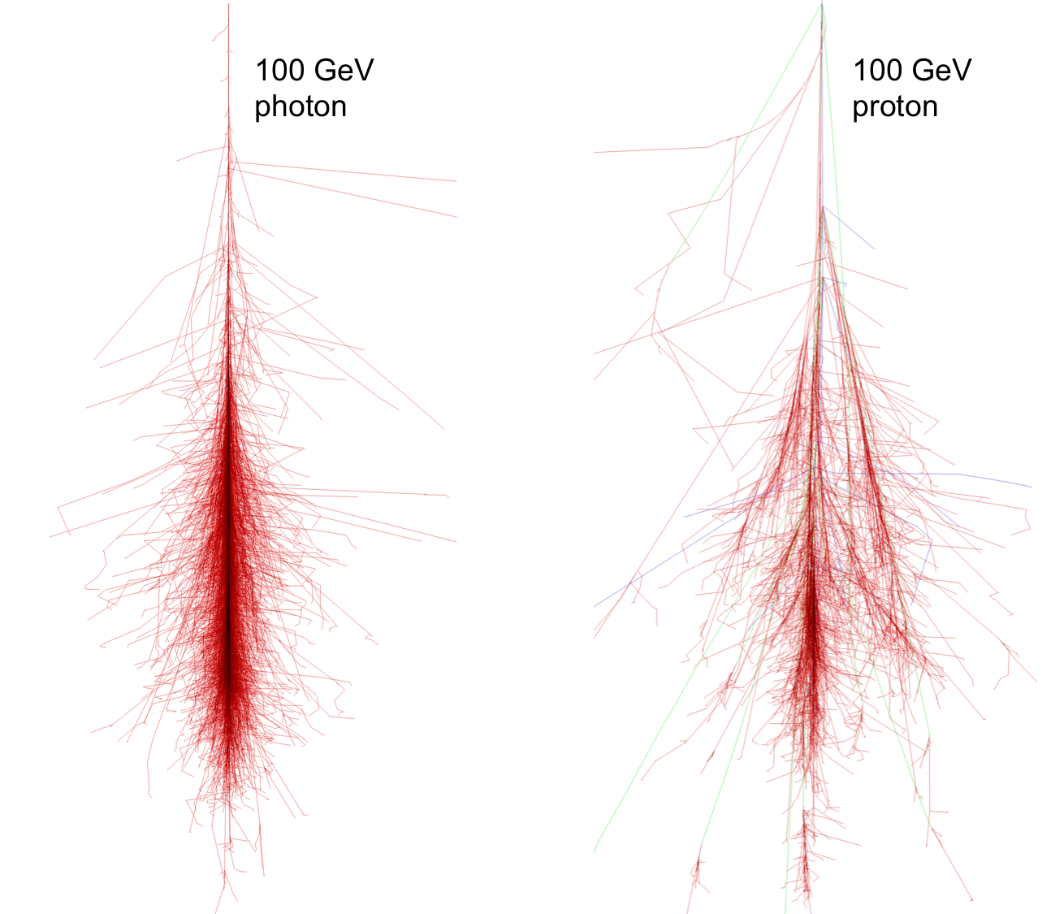
Need for fine angular resolution
At lower energies (< 1 TeV), the telescope operates in a background dominated regime
  Gamma-ray showers: clean and narrow
  Hadronic showers: fat and messy.
The angular resolution has a major impact on gamma-ray sensitivity.
Transverse angular size of the gamma-ray shower core is ∼ 1 minute of arc.
Current generation IACT instruments have pixel size of 9 arcmin (far from optimal!)
Image from: https://ar5iv.labs.arxiv.org/html/1510.05675

Slide 4
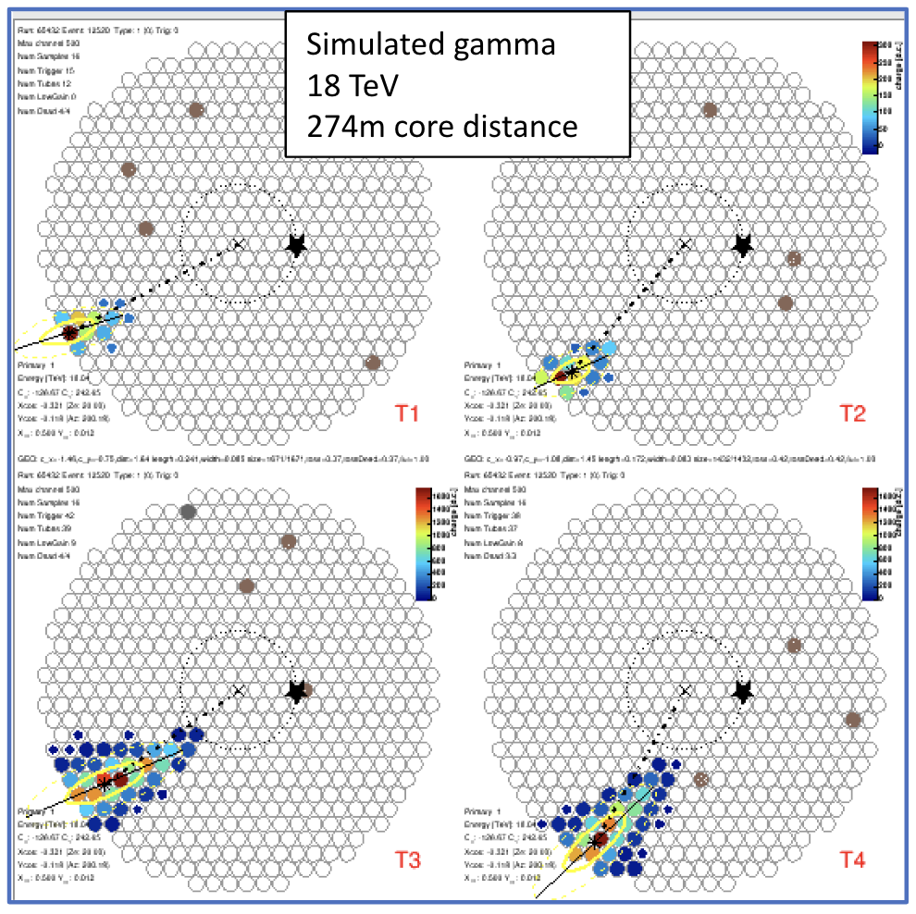
Need for large field of view
At high energies, images at large core distance are truncated by the camera FoV
Conventional IACTs have a FoV ~ 4 deg
Need a large FoV without degradation of sensitivity at large offset angle

Slide 5
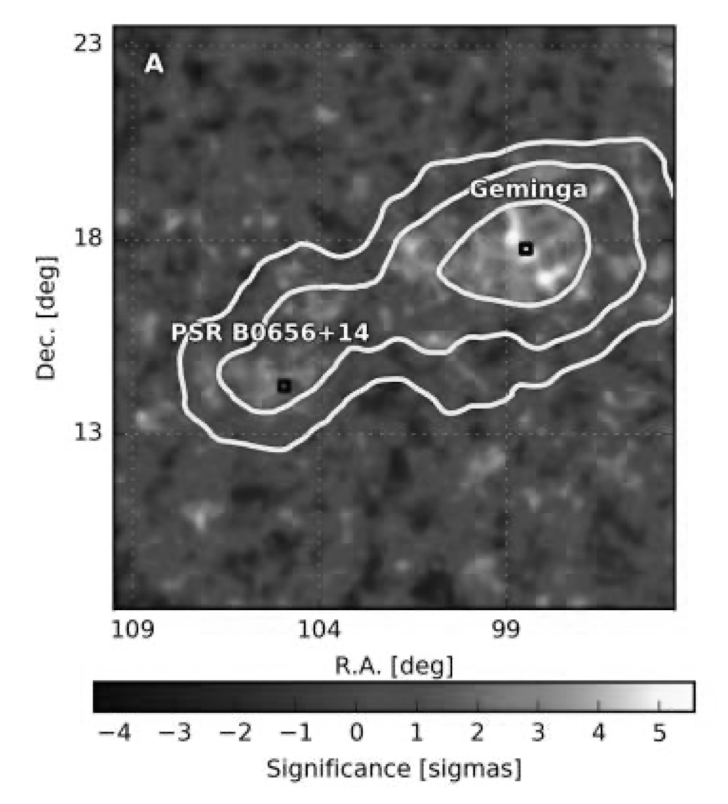
Need for large field of view
Conventional IACTs maintain good PSF up to an offset angle of ~ 2 deg.
For sources with large extension (e.g. Geminga halo radius > 5 deg), analyses are difficult without γ-free background region in FoV.
To improve angular resolution by ~3x and field of view by ~3x:
  A camera with ~${10}^{5}$ pixels
  Current IACTs have ~${10}^{3}$ pixels
Conventional IACT FoV
Science 358 (2017) 6365, 911-914

Slide 6
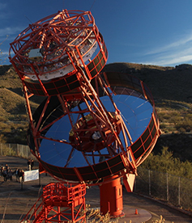
Schwarzschild-Couder telescope (SCT)
Dual-mirror design:
  Correct for spherical and comatic aberrations
  Small plate scale
  Large field of view
  Large telescope aperture
Compact high-resolution camera:
  Silicon photomultipliers
  11328 pixels
  Each pixel 0.067°(6 mm) square (PSF 0.05-0.07 °)
  8° field of view
R&D funded by NSF + international partners happening in the US

Slide 7
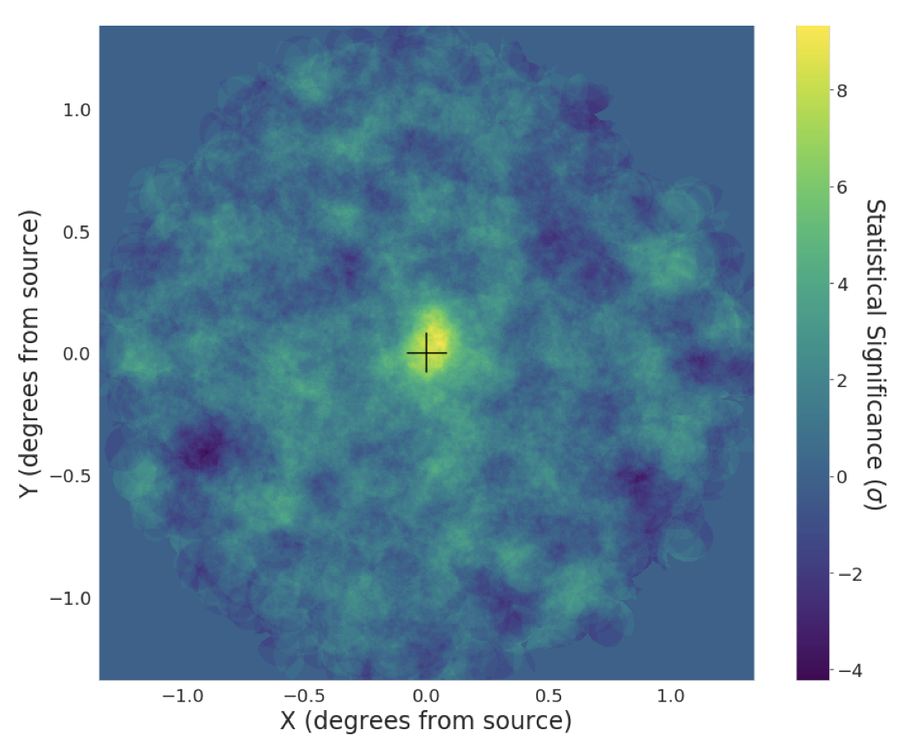
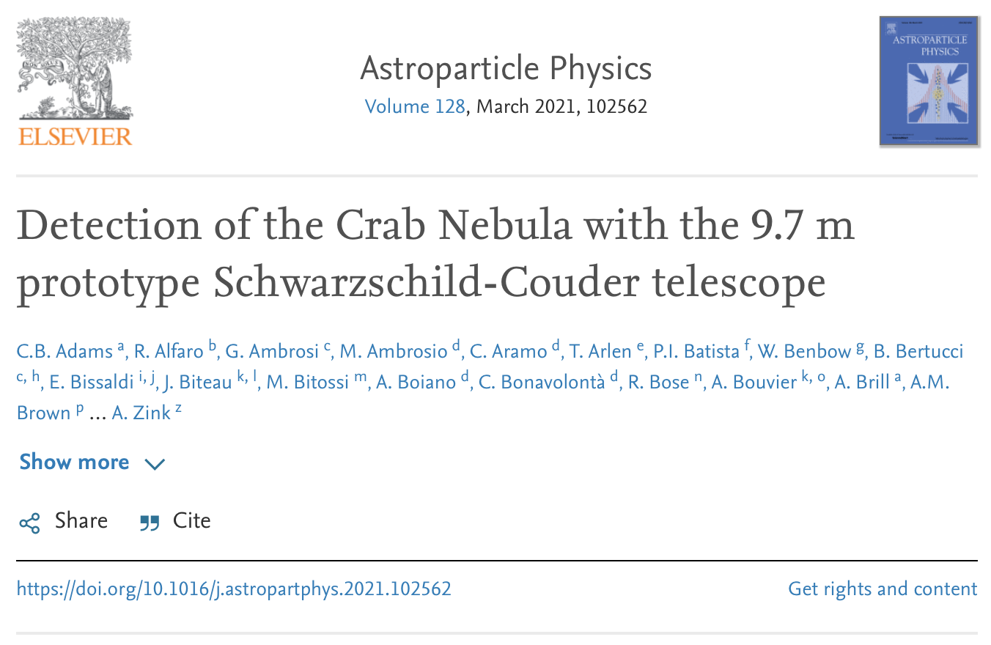
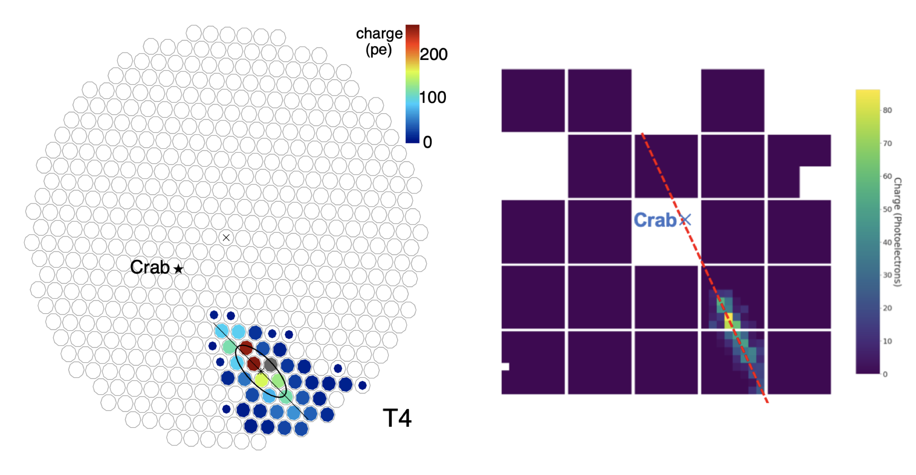
Detection of Crab Nebula
Crab Nebula is detected at 8.6σ in 2019 with a partial camera.
A major milestone for the demonstration of the viability of SCT technology for CTA.
The co-location of SCT project with VERITAS observatory at FLWO and simultaneous operation of both instruments has been critical ingredient of this success!
Shower image seen
by VERITAS
Shower image seen
by pSCT

Slide 8
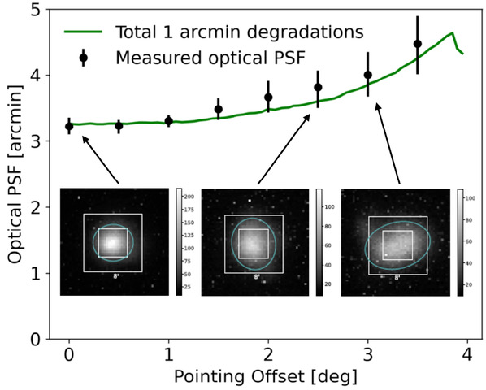
Optical performance
The full alignment of the optical system across the 8-deg FoV was initially completed in 2022
The optical PSF is ~ 3.2 arcmin on-axis and ~ 4.2 arcmin at 3.5-deg off-axis.
Good PSF is maintained across the 8-deg FoV!

Slide 9
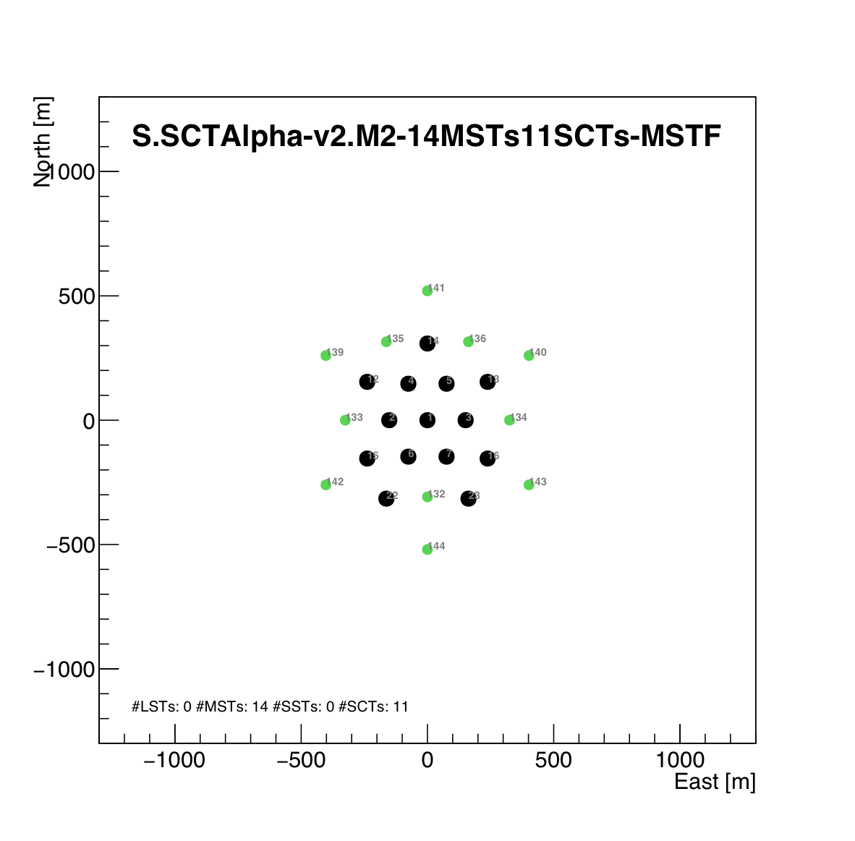
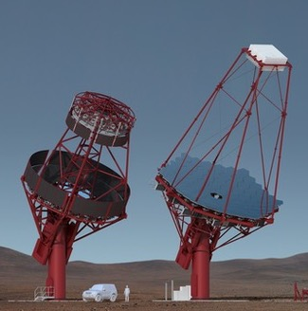
CTA South configuration
Nominal CTA South alpha configuration includes 14 DC-MSTs (black dots)
We consider + 11 SCTs (green dots) configuration as a hypothetical enhancement exercise
DC-MST
SCT

Slide 10
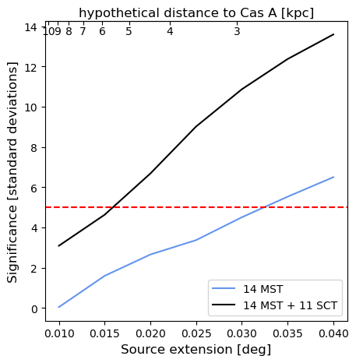
Gamma-ray performance
Hypothetical distance to Cas A [kpc]
The addition of 11 SCTs to CTA will improve the ability in resolving sources with small extensions.
Simulation of γ-ray emission from a source similar to Cas A, placed a different distances, is used to test the capability of detecting the source extension.
The ability to resolve a radius = 1’ source means that CTA and NuSTAR/XMM/Chandra can observe a source at different wavelength with a similar angular-size scale.

Slide 11
Detecting extended sources
TeV halos are key for understanding positron excess.
Analyses for extended sources are difficult without γ-free background region in FoV.
SCT provides good PSF maintained across the 8-deg FoV
  Contain Geminga halo emission in a single pointing
  γ-ray-free region in the FoV available for background modeling
VERITAS FoV
SCT FoV
Science 358 (2017) 6365, 911-914

Slide 12
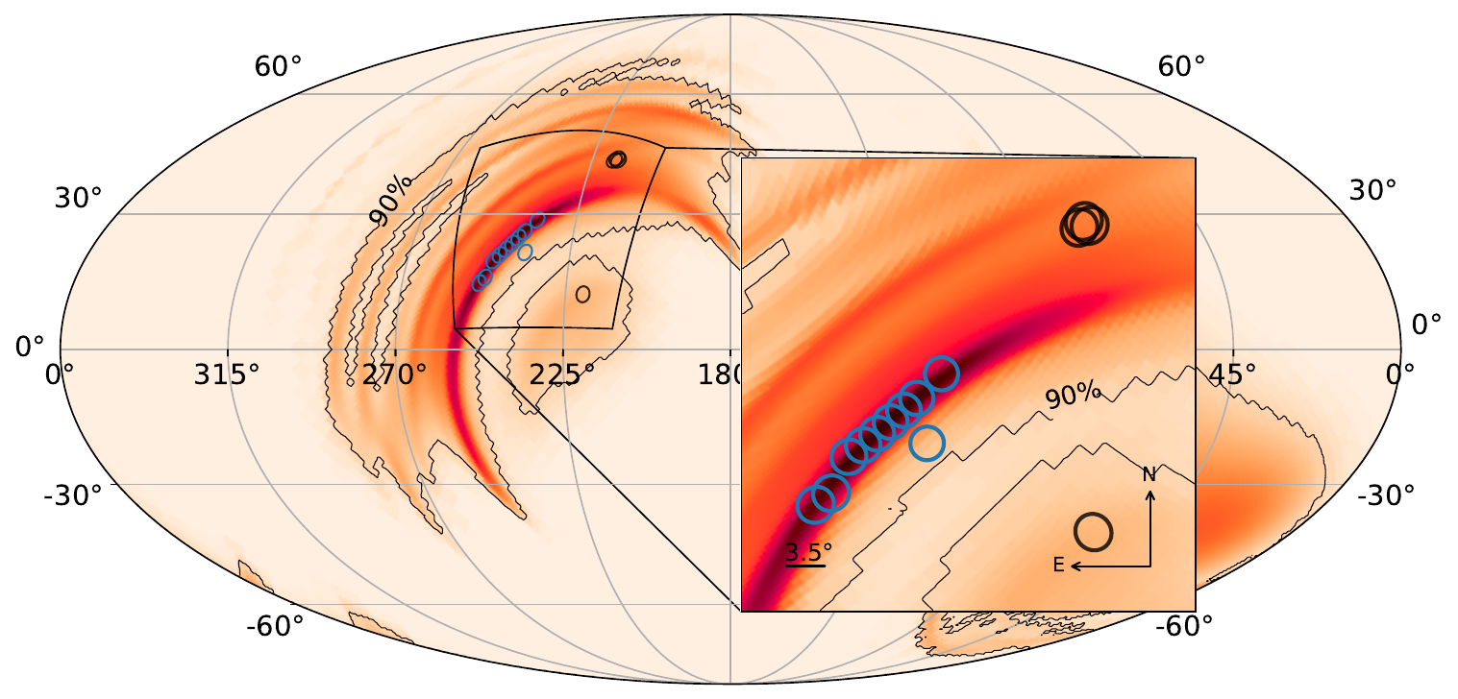
Detecting transient sources
Transient events with poor localizations (e.g. GW and GRB events) require multiple pointings.
SCT with large FoV can cover a large sky region with fewer pointings and shorter time.
Blue circles: Conventional IACT
Yellow circles: SCT FoV

Slide 13
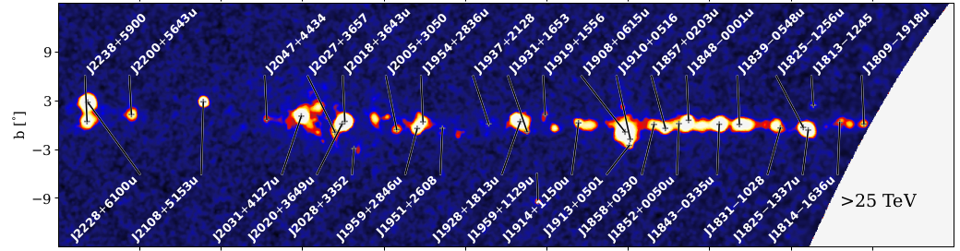
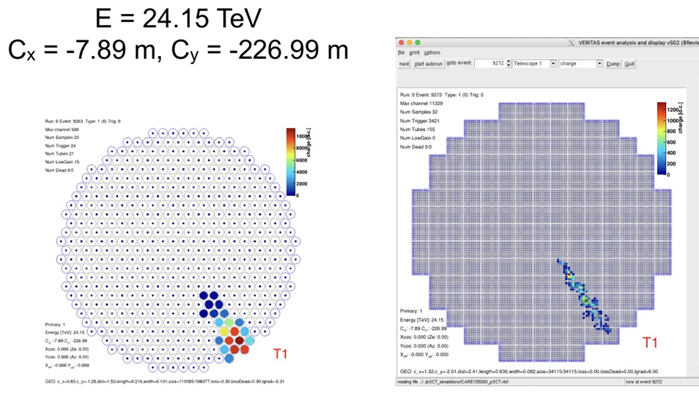
Detecting high-energy sources
First Catalog of LHAASO sources opens a new territory of gamma-ray astronomy with 43 UHE sources (>100 TeV).
Good PSF maintained over 8-deg FoV would allow energy reconstruction of high-energy events (that would be truncated in conventional IACT FoV) and improve high-energy sensitivity.
Astrophys.J.Suppl. 271 (2024) 1, 25
Conventional IACT
SCT

Slide 14
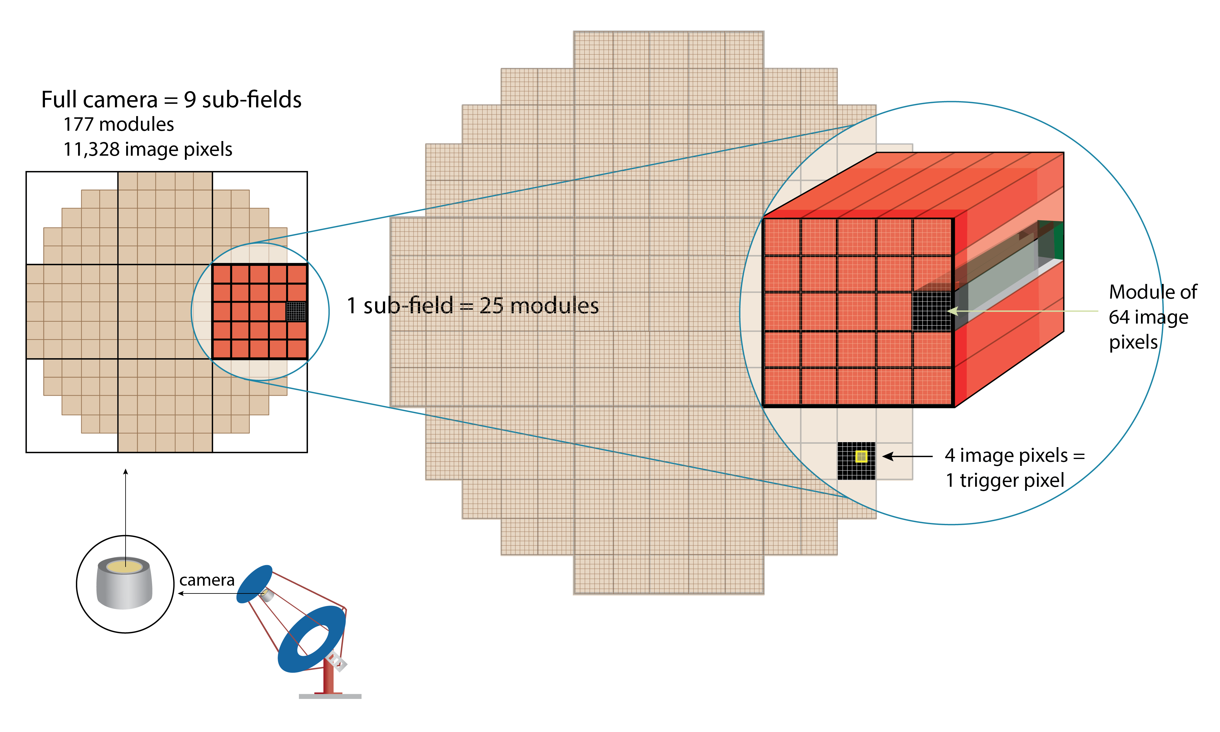
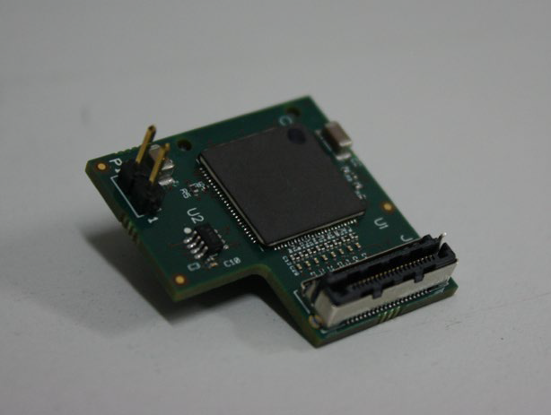
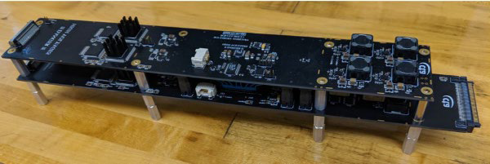
Camera upgrade
Populate all 9 camera sectors: 177 modules, 11328 pixels
  Increase field of view x7
Upgraded electronics
  Improvement in single photon resolution,
  lower minimum threshold and lower noise
Hierarchical, modular design based on silicon photomultipliers and waveform sampling TARGET chips
SMART ASIC:
Integrated preamplifier attached to SiPM boards
CTC+ CT5TEA FEE module:
16 us storage depth
4 trigger pixels per ASIC
Adjustable threshold for each group

Slide 15
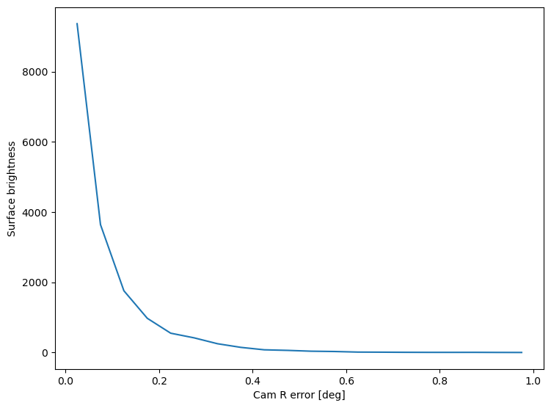
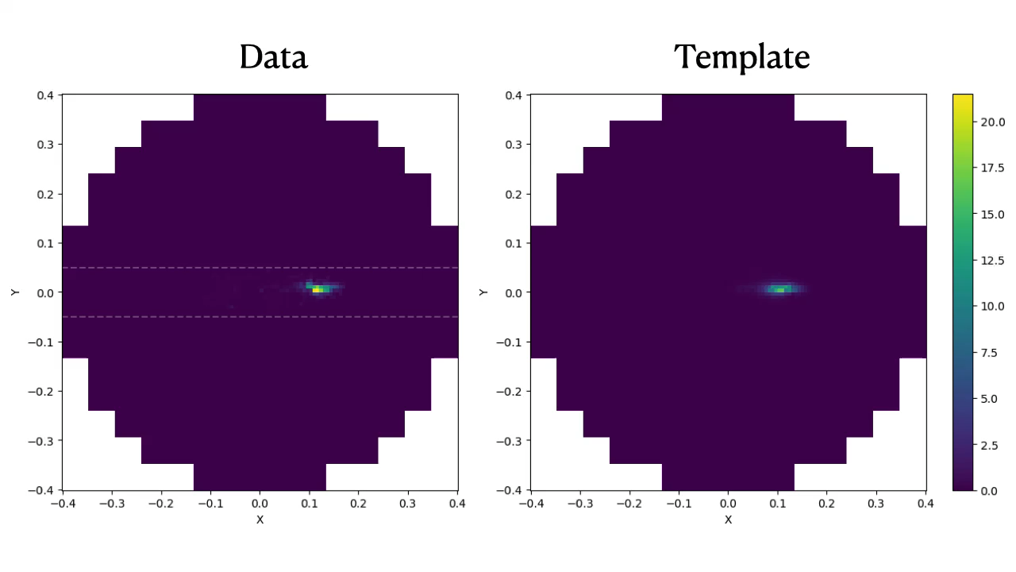
Reconstruction algorithm
Single-telescope performance
Profile fitted with $Aexp\left(\frac{-x^{2}}{2σ^{2}}\right)$
We are developing a new reconstruction algorithm that could maximize the advantage of SCT’s high-angular resolution and timing information.
Idea is to use Single Value Decomposition to analyze γ-ray shower images in simulation and build time-dependent image template using principle components.
The initial result looks promising.
Simulation study with Prod6 in the future to fully characterize SCT performance.
$$σ={0.058}^{∘}±{0.003}^{∘}$$
Angular distance from source [deg]

Slide 16



Conclusion
SCT design achieves 3.2 arcmin optical PSF across 8-deg FoV:
  Dual-mirror optics
  High-resolution SiPM
Expected improvement to CTA includes detecting transient events, resolving source confusion, detecting PeVatron, and large-extent sources
The SCT group has constructed a prototype with functioning optical and camera
  Detected Crab Nebula
  Upgrading to full camera in this year
Thank you to NSF and international partners for their support!

Slide 17
Backup

Slide 18
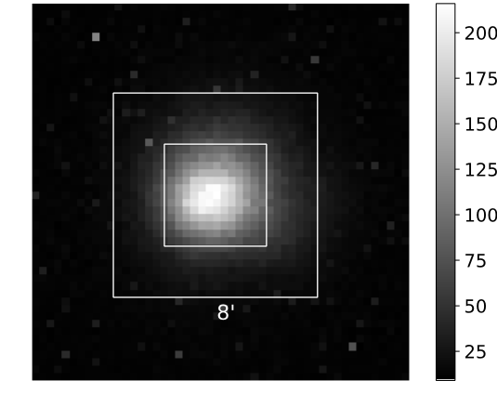
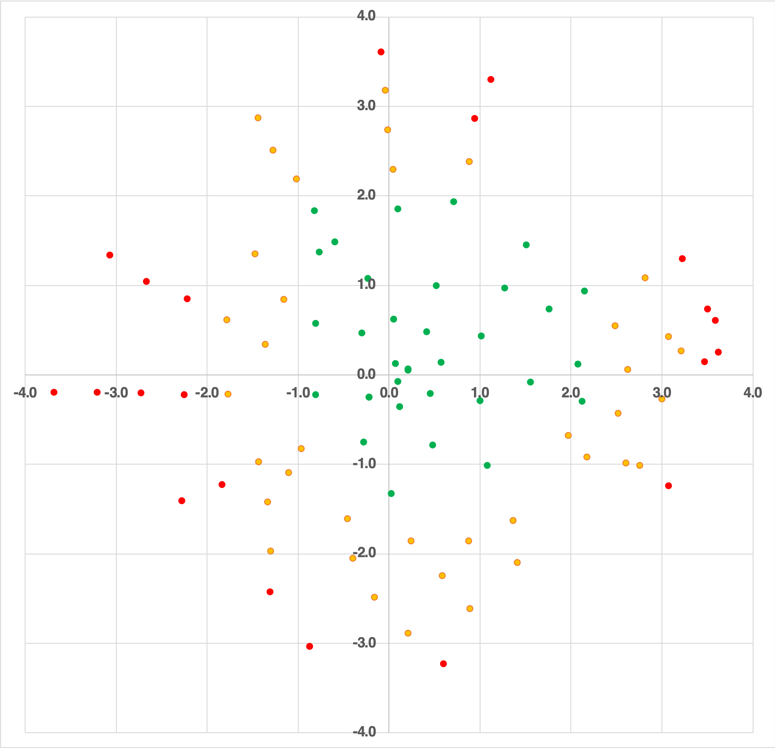
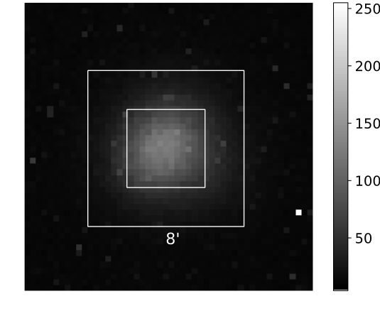
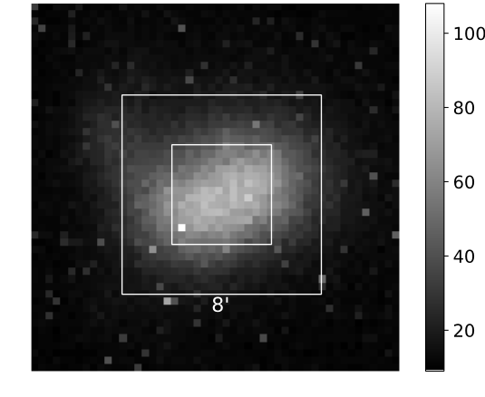
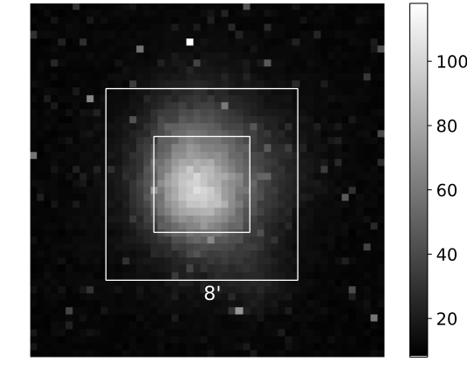
PSF=3.1'
PSF=3.5'
Green:
PSF < 4.0'
Orange:
3.5’ < PSF < 4.0'
Red:
PSF > 4.5'
VERITAS FoV
PSF=5.1'
SCT FoV
PSF=4.0'

