Slide 1
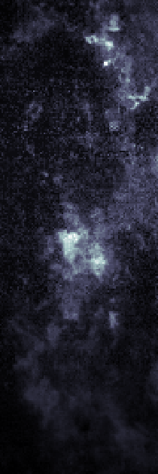
Clustering the Interstellar Medium
To Improve Gamma-Ray Modelling of Galactic Objects
Imogen Barnsley
Supervisor: Dr Sabrina Einecke
30th August, 2022

Slide 2
HESS Galactic Plane Survey
HESS Collaboration et. Al. (2018), AAP
Galactic Latitude
(deg)
Galactic Longitude (deg)
SNR
Notes:
Only galactic plane gamma-ray sources
We want to identify the sources of gamma rays. From surveys such as HGPS, we can see gamma-ray sources.
By referring to radio sources and catalogues, can determine if there are SNRs or pulsars or other sources nearby
So far 78 gamma-ray sources have been determined.
As shown here there are more than half of the sources that are yet to be identified.
Mostly interested in SNR and pulsar wind nebulae as they make up the majority of the percentage and binary …
We are interested in looking for more sources connected to SNRs of which only 16 so far have been determined
Easy to determine if SNR and gamma-ray match up with one other (overlap). However, they may not overlap (lead into to next slide)

Slide 3
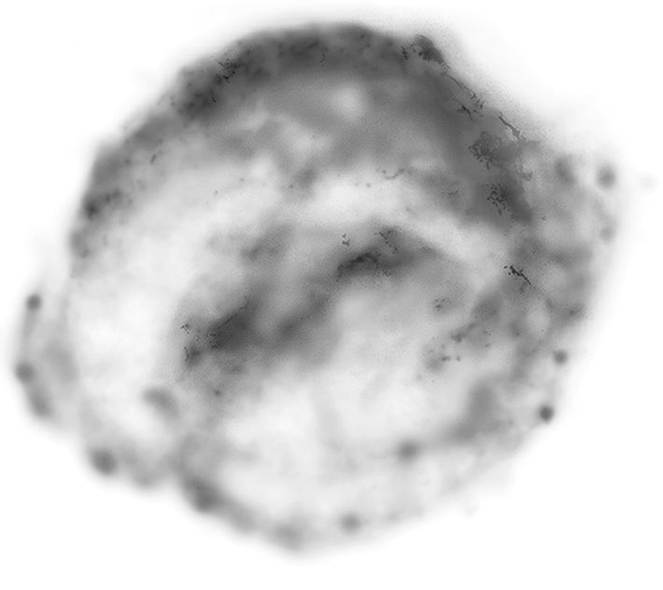


Gamma-Ray Production
Escaping
Cosmic Rays
Hadronic Scenario
Gamma
Rays
Proton
(Hadronic)
Neutral Pion
Interstellar Gas
SNR
Einecke
Notes:
In this hadronic scenario, the SNR releases hadronic particles, protons and neutron .
Considering a proton which released it diffuses through the interstellar medium and interacts with the ISM gas producing pions
Pion decay results in the production of gamma rays
Therefore, the gamma rays are produced a distance away from the SNR
SNR and gamma-ray source are further apart
Modelling needs to take into account this diffusion and interaction with the ISM

Slide 4
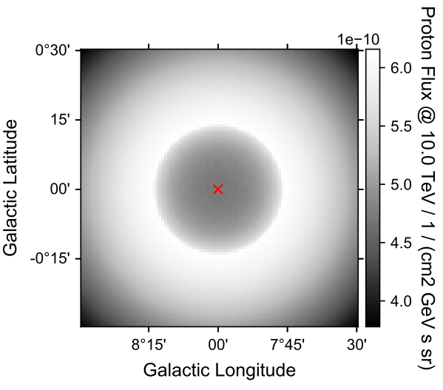
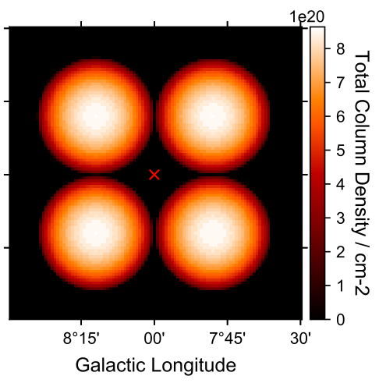
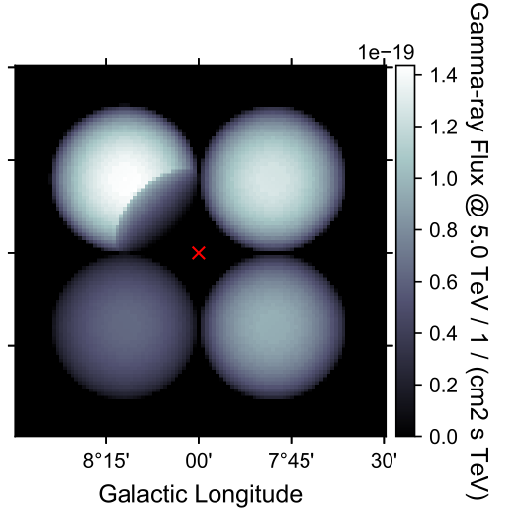
3D Gamma-Ray Modelling
Model protons from SNRs
Measure ISM Gas
Obtain Gamma-ray Model
Einecke
Einecke
Einecke
Notes:
The Gamma ray model must then take this into account
To obtain gamma ray as a result of SNRs need to model the protons from the SNR which escape. The interstellar medium then needs to be measured as the protons diffuse through it. Combining these two components, a gamma ray model can be obtained taking into account that the gamma rays are produced away from the SNRs.
Note: observe data in 3D, integrated over z for illustration purposes

Slide 5
3D Gamma-Ray Modelling
d=d’
d’+25pc
d=d’
d’+25pc
Model protons from SNRs
Measure ISM Gas
Obtain Gamma-ray Model
Einecke
Einecke
Einecke
d’+75pc
d’+50pc
d’+75pc
d’+50pc
Want to know the interstellar gas in 3D
Notes:
What happens with clouds at different distances
4 ISM clouds each at different distances as shown which interact with the proton distribution
- Integrated over z for integration purposes
Why do we need to know the distance?
Gamma ray distribution depends on position of the gas within the z direction
Brighter for the cloud closest to the proton distribution and lighter the further away at is
Important for the distance to the cloud to be considered

Slide 6
Gamma Ray Modelling
Interstellar Gas Distributions
Distributions in position-position-velocity space
Need position-position-position space
First two axes galactic longitude and latitude
Need to translate velocity into position (distance to Earth)
Position
Position
Position
Position
Velocity
Position
Notes:
We want to move around clouds individually
- need all voxels that belong to specific cloud

Slide 7
Interstellar Gas Distribution
Transformation of Velocity to Distance
Possible by applying galactic rotation curve model
Assumes velocity solely due to Milky Way’s rotation
Challenges
Two distances - near and far
Local motions of clouds not considered
Feijen et al (2020), PASA
Large uncertainties in distances
Notes:
Shows velocity due to doppler shifting so there are two distances associated with one velocity
We want to move around clouds individually to determine which position creates observed gamma-ray source
need all voxels that belong to specific cloud

Slide 8
Interstellar Gas Distribution
How can we improve this?
Investigate every cloud by literature reviews
Using maser parallax measurements
How can we include that?
Different clouds have different distances
Need to know which volume pixels belong to cloud
Feijen et al (2020), PASA
Clustering!
Notes:
Improvements
Inclusions
need to know which voxels belong to a cloud to adapt their distances

Slide 9
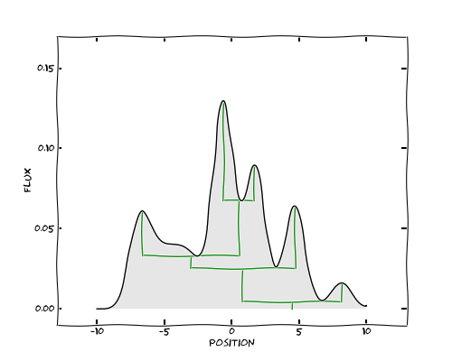
Dendrograms
Why use dendrograms?
Cloud catalogues successfully determined using this method
Python Package astrodendro
Computes dendrograms for astronomical data
Robitaille et al. (2013)
Notes:
This figure shows an example of a 1D dendrogram
Has associated python package astrodendro
Package made to cluster molecular clouds using dendrograms
Extremely useful as computes dendrogram as shown on the right

Slide 10
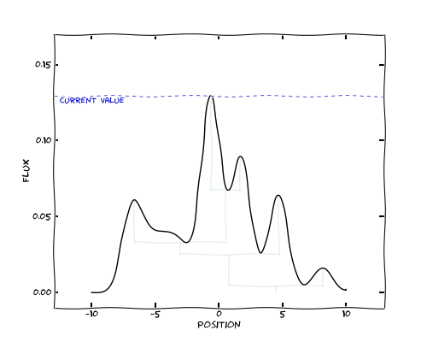
Dendrograms
Robitaille et al. (2013)
Notes:
Considering the general function of the dendrogram algorithm
starts by adding maximum value to the dendrogram

Slide 11
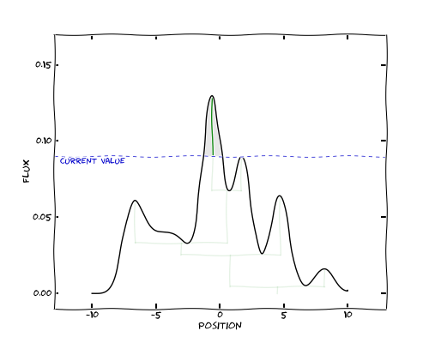
Dendrograms
Robitaille et al. (2013)
Notes:
Adds each near brightest values to the current structure until it reaches a local maximum
The two next nearest points are less than the current point

Slide 12
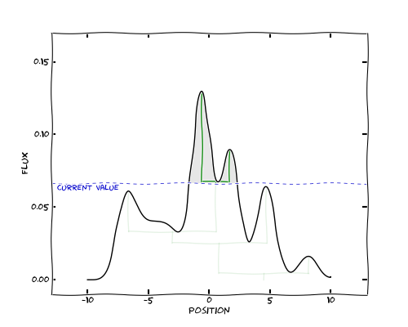
Dendrograms
Robitaille et al. (2013)
Notes:
The second peak is then added to a separate structure form the current leave

Slide 13
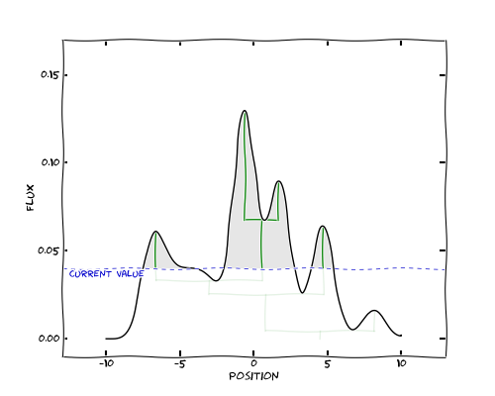
Dendrograms
Robitaille et al. (2013)
Notes:
This continues through the data set adding each success brightest point determining whether it should be added to the current structure or a new structure created

Slide 14
Dendrograms
Robitaille et al. (2013)
Notes:
This continues until there are no more data points
This is the default clustering of the astrodendro package
There are parameters that can be used to make this process quicker and more accurate

Slide 15
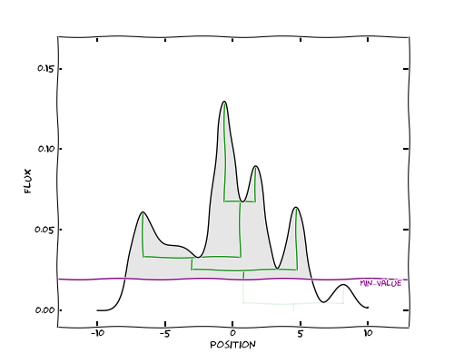
Dendrograms
Settings
min_value
Robitaille et al. (2013)
Notes:
Dendrogram in astrodendro also has settings that can be used to account for noise within the clustering process
min_value sets the minimum value of the dendrogram and can be used to remove noise from the dendrogram
Often it is set to the nose threshold
No data points below this value are included in the dendrogram

Slide 16
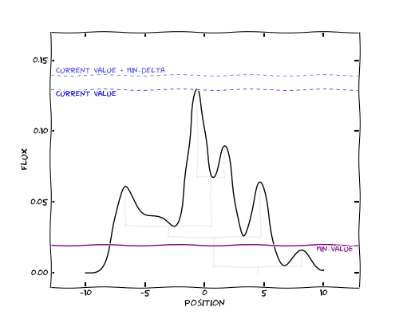
Dendrograms
Settings
min_value
min_delta
Robitaille et al. (2013)
Notes:
Another parameter is min_delta which sets the minimum height of a leaf

Slide 17
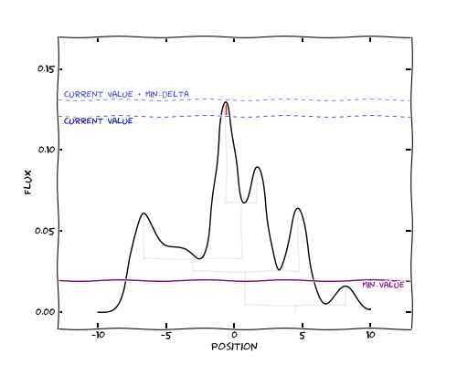
Dendrograms
Settings
min_value
min_delta
Robitaille et al. (2013)
Notes:
A new structure, a leaf, is not included in the dendrogram until it is above this min_delta height
At this point in the search the leaf is red so does not meet the height requirement

Slide 18
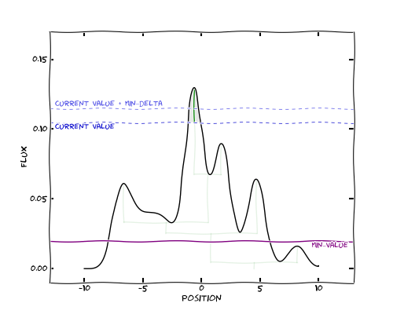
Dendrograms
Settings
min_value
min_delta
Robitaille et al. (2013)
Notes:
If the height of the leaf reaches green, its height is greater than the min_delta and is added to the dendrogram

Slide 19
Dendrograms
Settings
min_value
min_delta
Robitaille et al. (2013)
Notes:
The normal process then continues until all the points have been added as before
The dendrogram here is the same as previously as the all the peaks met the height requirement
However, this would not be the case for a higher minimum height of a leaf

Slide 20
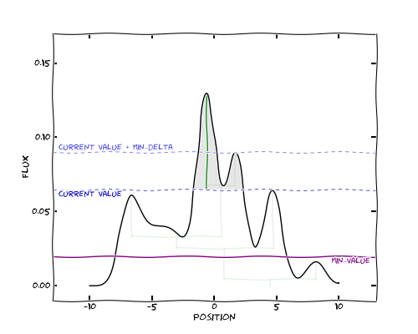
Dendrograms
Settings
min_value
min_delta
Robitaille et al. (2013)
Notes:
If the min_delta is increase as shown here, this peak as shown in red never reaches the minimum height needed
Thus it is added to the green leaf and not considered a separate structure

Slide 21
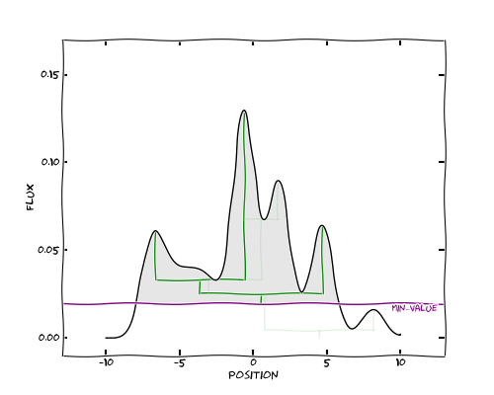
Dendrograms
Settings
min_value
min_delta
Robitaille et al. (2013)
Notes:
The final dendrogram is then different as this peak as shown is not a separate structure

Slide 22
Dendrograms
Settings
min_value
min_delta
min_npix
Robitaille et al. (2013)
Notes:
min_npix is another way to account for noise
Considers the number of pixels in a leaf additional constraint alongside min_delta to account for noise

Slide 23
Cloud Clustering with Dendrograms
Dendrogram settings defines minimum structures
Provides a set of all structures within the data
Need constraints on maximum structures in order to obtain clouds
1
3
4
4
3
2
1
2
Notes:
With current settings a cloud as shown here would return all structures from the dendrogram including main structures and sub structures
Set to only get clouds with overlapping structures
Do this by providing cuts to the dendrogram

Slide 24
Cloud Clustering with Dendrograms
Dendrogram settings defines minimum structures
Provides a set of all structures within the data
Need constraints on maximum structures in order to obtain clouds
3
4
3
2
1
2
Notes:
With current settings a cloud as shown here would return all structures from the dendrogram including main structures and sub structures
Set to only get clouds with overlapping structures
Do this by providing cuts to the dendrogram

Slide 25
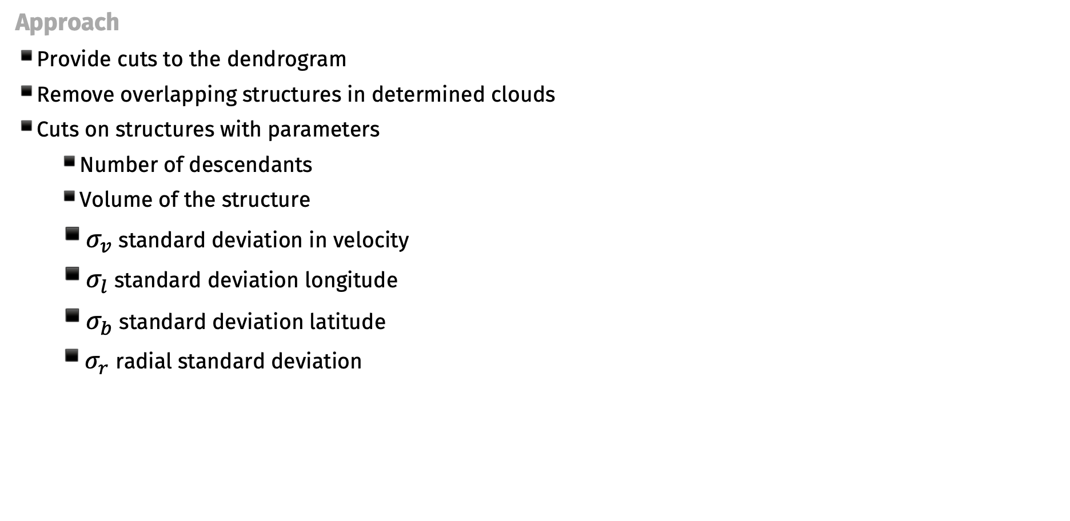
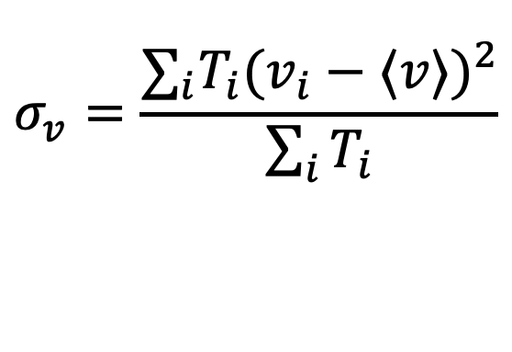
Cloud Clustering with Dendrograms
Approach
Provide cuts to the dendrogram
Remove overlapping structures in determined clouds
Cuts on structures with parameters
  Number of descendants
  Volume of the structure
  $σ_{v}$ standard deviation in velocity
  $σ_{l}$ standard deviation longitude
  $σ_{b}$ standard deviation latitude
  $σ_{r}$ radial standard deviation
$$σ_{v}=\frac{∑_{i}T_{i}(v_{i}−⟨v⟩)^{2}}{\sum_{i}{T_{i}}}$$
Notes:
Cuts used to obtain clusters/clouds
Set a maximum structure and remove overlapping but applying cuts to the dendrogram structures
Number of des and total number of vox obtain values from astrodendro package
Calculate size of structure in each direction using standard deviation

Slide 26
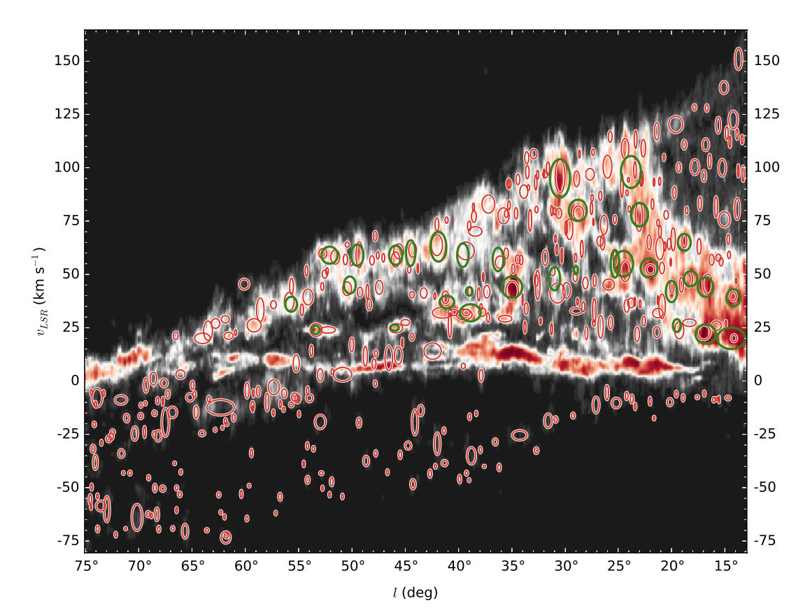
Reproduce other Work
Rice et al. catalogue
Cloud catalogue of molecular clouds in the Milky Way
Includes
  Position
  Size
  Masses
  Distances
  Number of descendants
Uses dendrograms
Rice et al. (2016), ApJ
Notes:
Picture of molecular clouds from quadrant 1, red ellipses are the clouds determined from the Rice catalogue

Slide 27

Reproduce other Work
Rice et al. catalogue
Dendrogram settings
  min_value ~ $σ_{noise}+μ$
  min_delta ~ $σ_{noise}$
  min_pix ~ 20
Dendrogram cuts
  n_descendants ≤ 10
  $σ_{v}$ ≤ 10 km/s
Rice et al. (2016), ApJ
Notes:
Settings from the catalogue are as shown
The sigma_noise value was not given
So needed to be calculated using the distribution

Slide 28
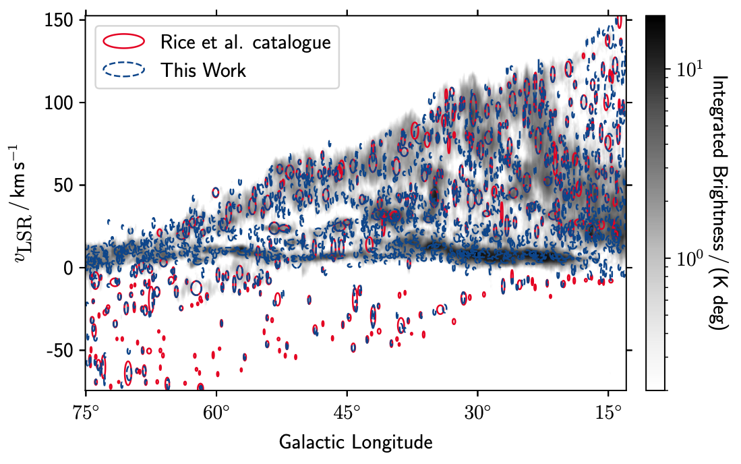
Reproduce other Work
Comparison between Reproduction and Rice et al. catalogue
Reproduction using these settings
Rice et al. catalogue
My Reproduction
389 clouds
1245 clouds
Notes:
Poor agreement suggests that the cuts and dendrogram settings provided by Rice et al. catalogue
Why are there more red structures below 0 and more blue around 0?
Smaller structures are selected more often than expected because of the low noise level

Slide 29
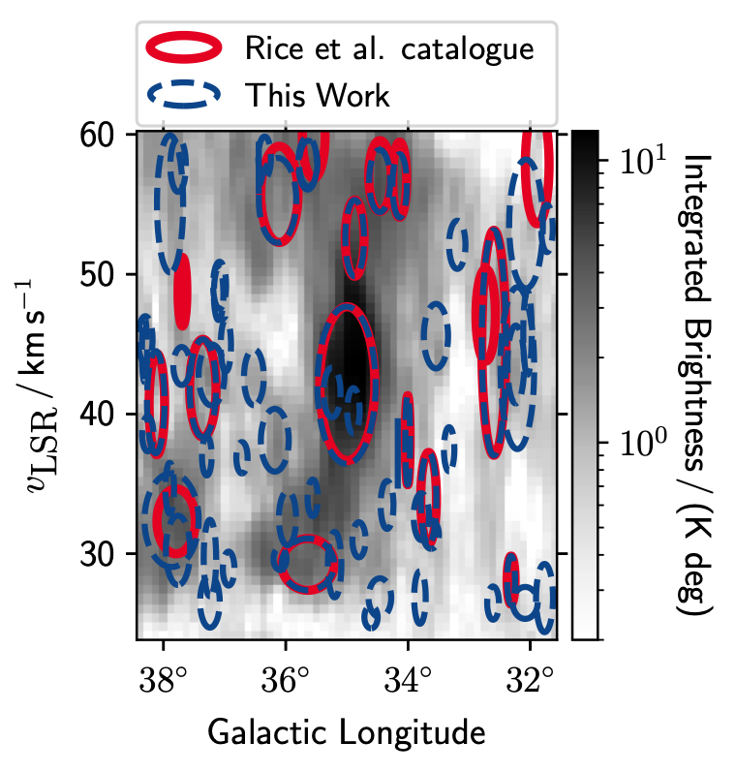
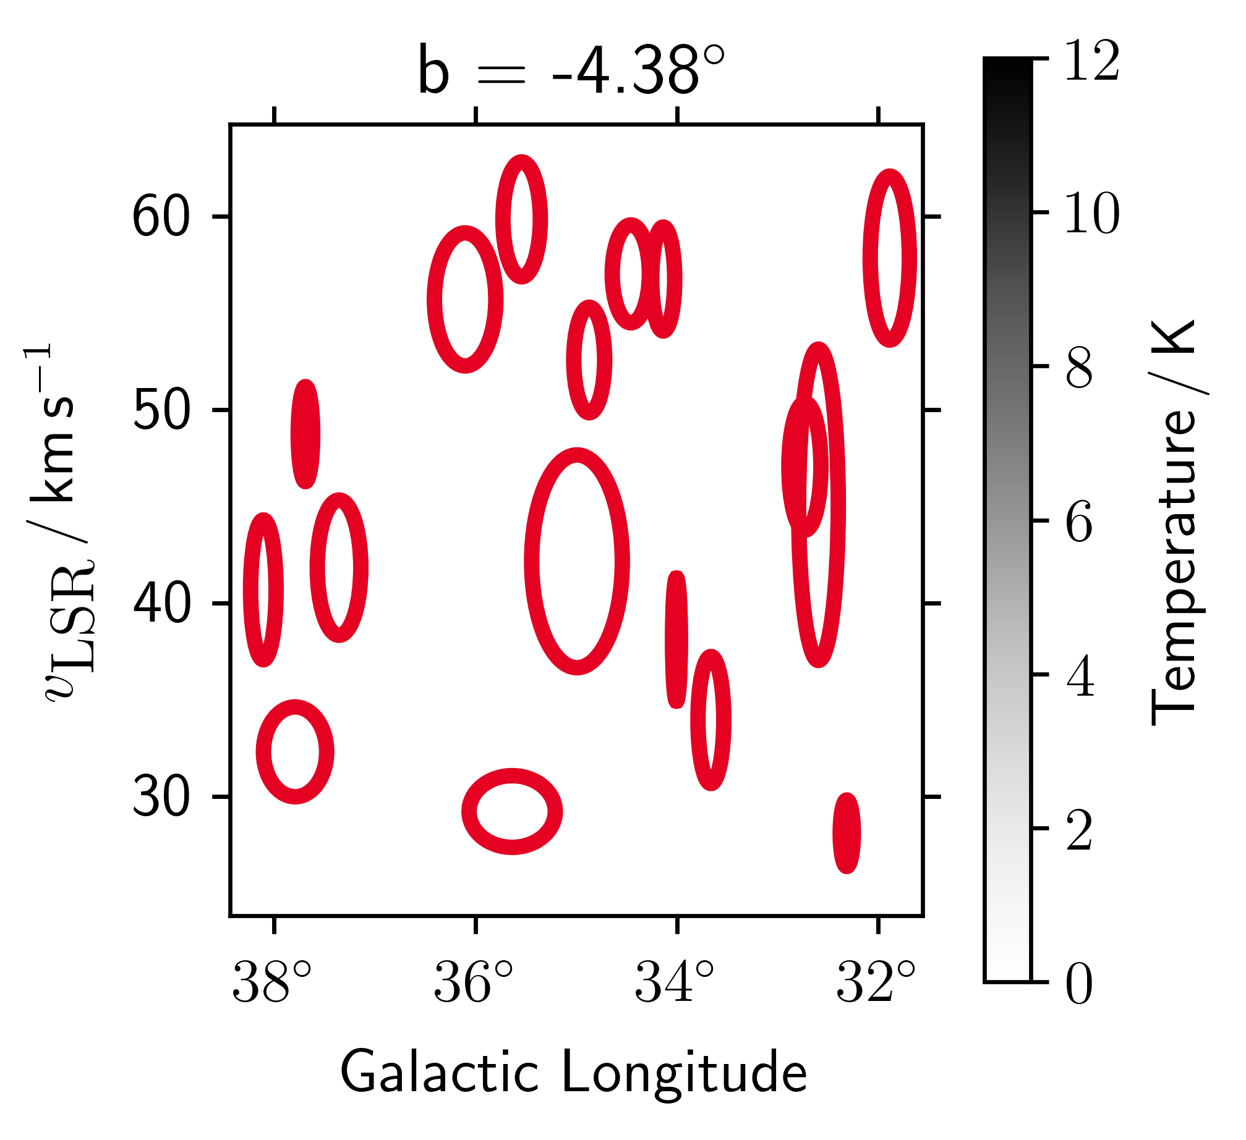
Reproduce other Work
Rice et al. catalogue
17 clouds
My Reproduction 61 clouds
Notes:
picking up more smaller structures than Rice did
Seems like there is some other cut they used
By looking through the slices we can see how the structures appear in 3D and that the clustering is picking up on relevant emission structures
Clouds are shown as ellipses for ease of comparison with rice but are available exactly

Slide 30
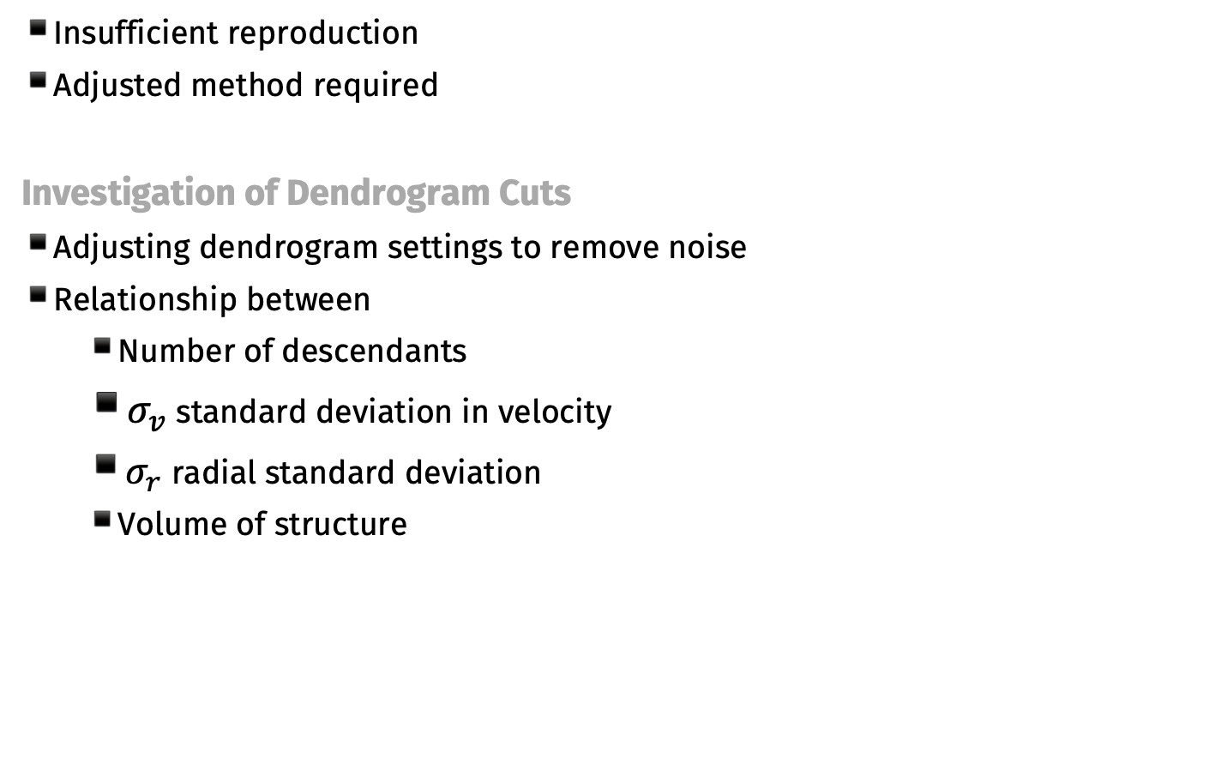
My Approach
Insufficient reproduction
Adjusted method required
Investigation of Dendrogram Cuts
Adjusting dendrogram settings to remove noise
Relationship between
  Number of descendants
  $σ_{v}$ standard deviation in velocity
  $σ_{r}$ radial standard deviation
  Volume of structure
Notes:
Dendrogram settings define the smallest structure included so noise level needed to be increased
Also investigated the relationship between numerous cuts that could be applied to the dendrogram
Investigate relationship between above parameters
Crossmatch clouds from Rice et al. catalogue and from this process
Discrepancies could be used to additional steps in algorithmic selection
In order to remove smaller structures, noise level needs to be increased
Exploration of these values determined that 3 sigma was sufficient

Slide 31
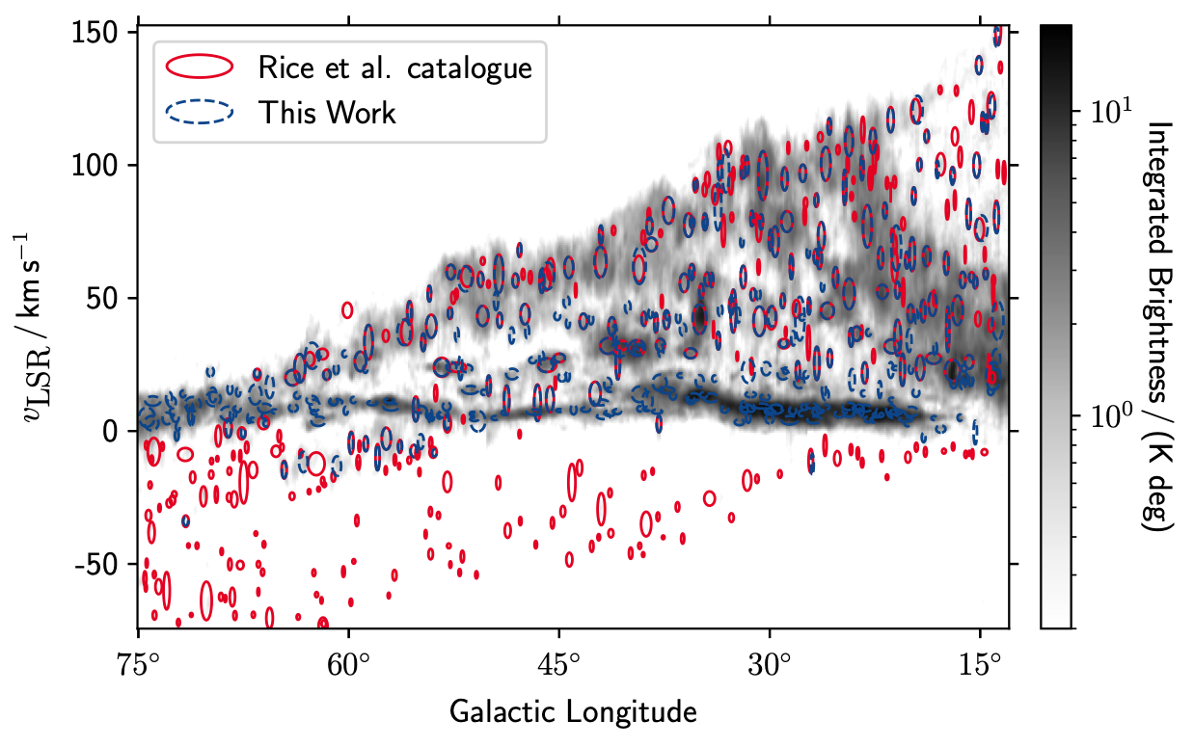
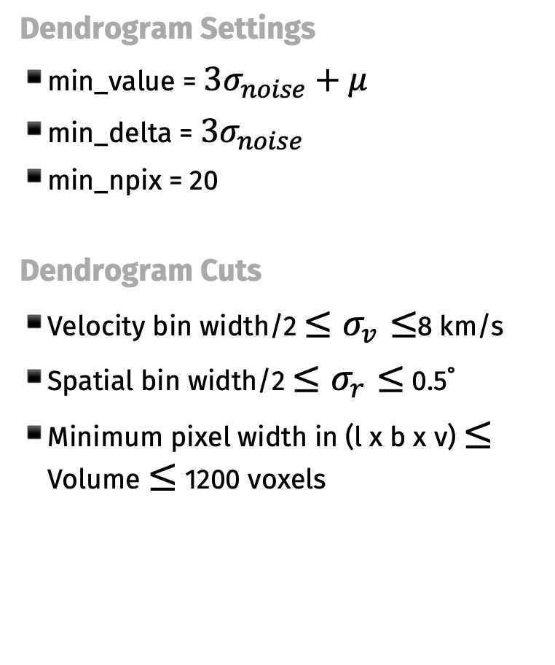
Development of Cloud Selection Algorithm
Dendrogram Settings
min_value = $3σ_{noise}+μ$
min_delta = $3σ_{noise}$
min_npix = 20
Dendrogram Cuts
Velocity bin width/2 $≤σ_{v}≤$8 km/s
Spatial bin width/2 $≤σ_{r}≤$ 0.5˚
Minimum pixel width in (l x b x v) $≤$ Volume $≤$ 1200 voxels
Rice et al. catalogue
389 clouds
My Algorithm
365 clouds
Notes:
The cuts were determined based on looking at the distributions & their relationship with each other
Lower bounds from resolution of the telescope (CfA in this case)
Lots of clouds selected that are below the resolution
Upper bounds for cloud structures determined from the maximum size of the Rice et al. clouds

Slide 32
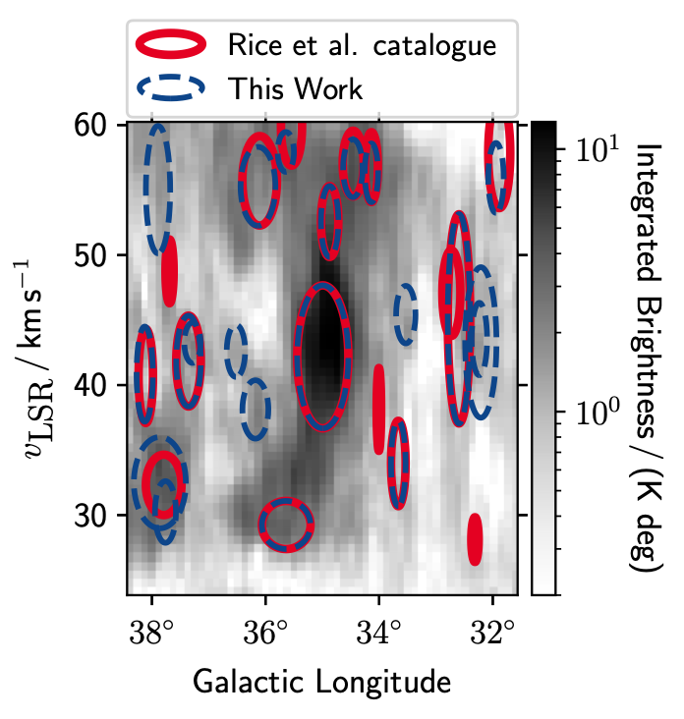
Development of Cloud Selection Algorithm
Rice et al. catalogue
17 clouds
My Algorithm
15 clouds
6 cloud matches
9 new clouds
5 unidentified clouds
Notes:
Mostly larger clouds now and good agreement
Gif?

Slide 33
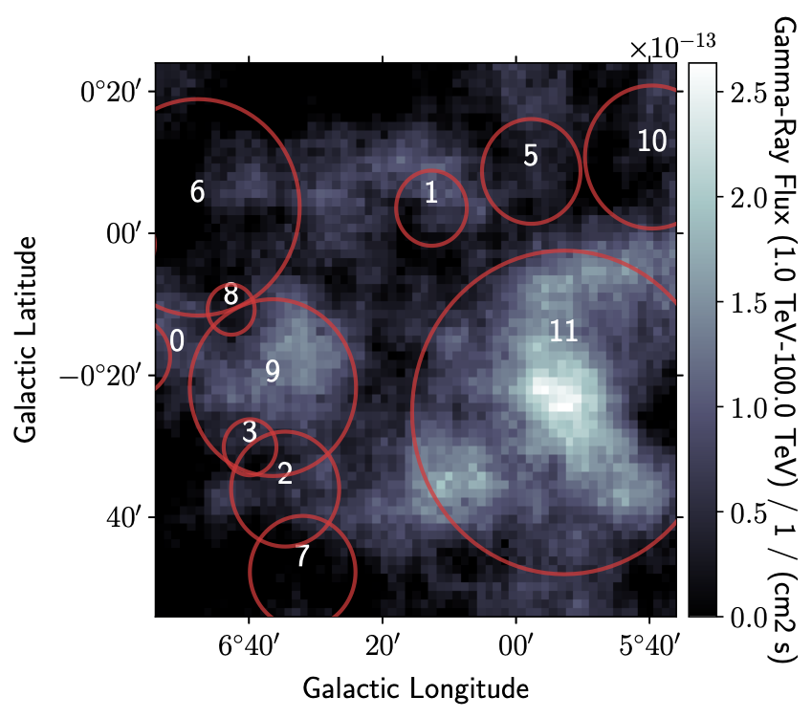
Gamma-ray Modelling of the W28 region
  Famous mature SNR
  Very well studied
Application of Cloud Selection Algorithm
  Using combined 12CO and HI data from Mopra and Parkes
  Used partISM
  Applied determined dendrogram settings
  Cuts used were based on
    Resolution of data
    Maximum structures
Notes:
W28 region has gamma-ray emission overlaps with molecular gas
(mention volume determine on size of gas cube, able to determine structures with a larger volume than the cube)
Maybe add values?

Slide 34
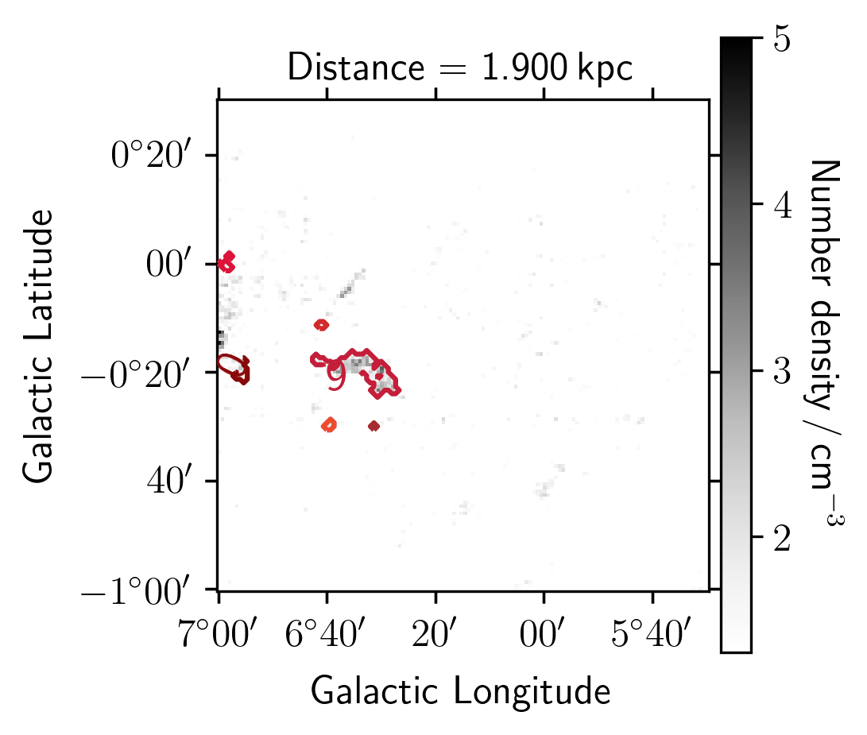
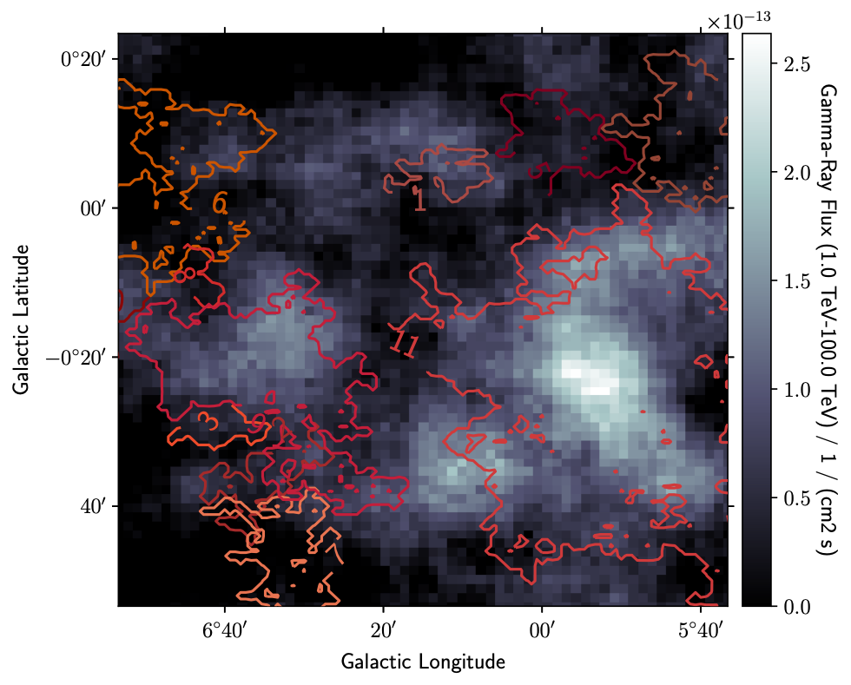
Gamma-ray Modelling of the W28 region
Application of Cloud Selection Algorithm
Notes:
Gif of determined clouds next to clouds?

Slide 35
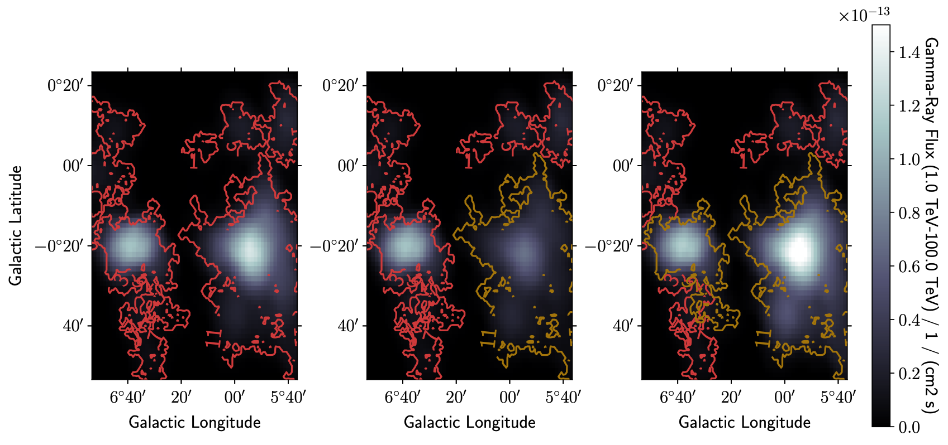
Gamma-ray Modelling of the W28 region
Moved 46 pc
Exploring Gamma-ray Morphology
Moved 34 pc
Moved 144 pc
Initial Position
Lowest Emission
Brightest Emission
Notes:
Generated using partISM Sabrina’s software

Slide 36
Next Steps
Clustering
  Investigate different clustering methods
  Incorporate multiple gas tracers
  Determine more robust algorithm
  Python package for clustering
  Develop cloud catalogue
Gamma-ray Modelling
  Improving modelling
  Optimising model parameters & gas location
Accurate gas cube of all clouds
Accurate gamma-ray model

Slide 37
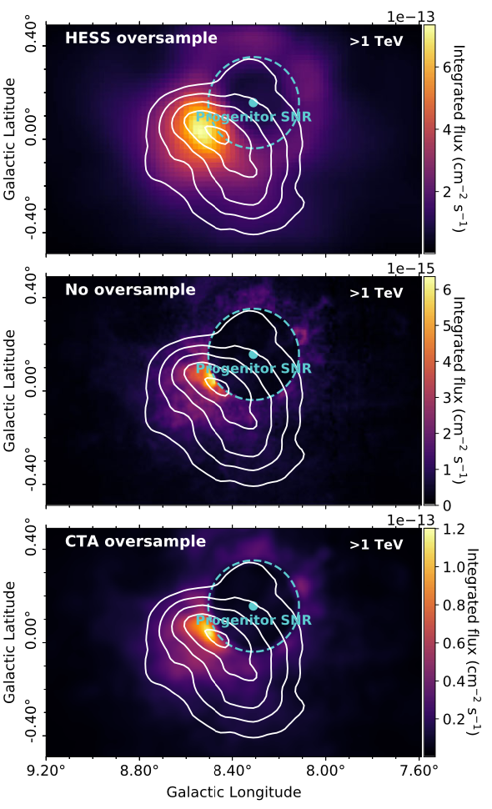
Next Steps
CTA Measurements
  Aim to improve current gamma-ray measurements
  May resolve more detailed features in morphology
  Angular resolution similar to gas measurements
  CTA resolution able to resolve features in gas map resolution
Feijen et al (2022), MNRAS

Slide 38
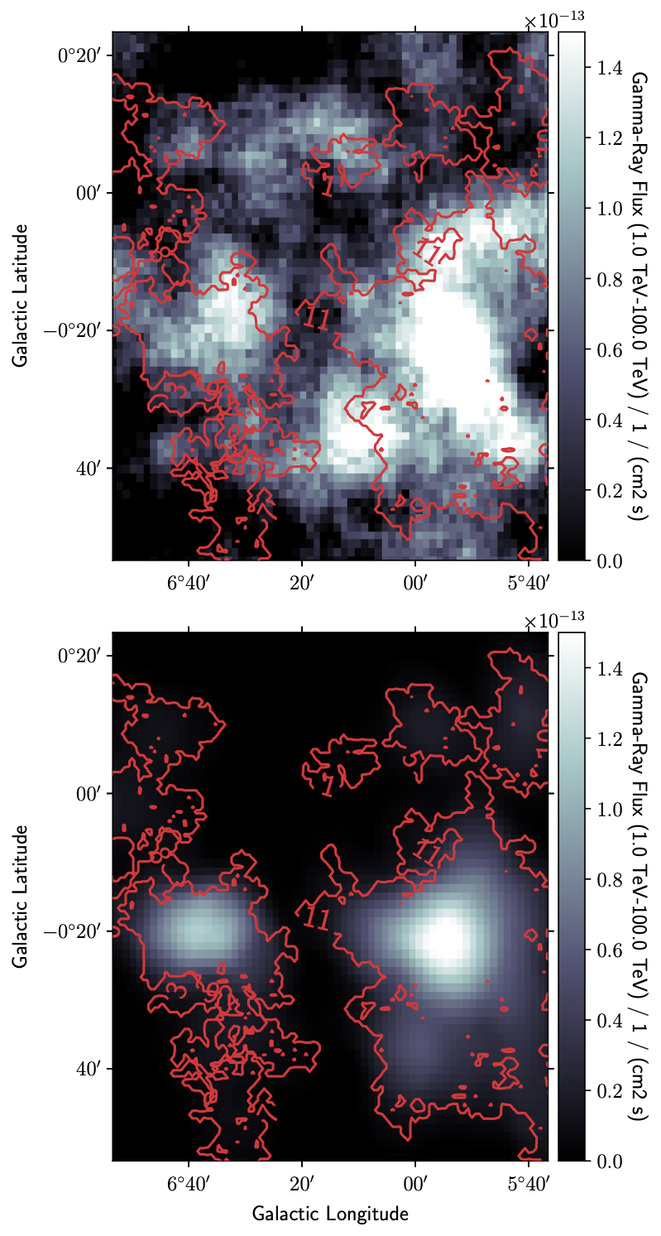
Conclusion
  Need to know which volume pixels belong to clouds to determine gamma-ray models
  Reproduced the clustering from Rice et al. catalogue
  Developed clustering algorithm for cloud selection
  Applied method to W28 region successfully
  Identified clouds within region
  Demonstrated improvement in gamma-ray modelling by moving clouds
Notes:
Plot for my approach with cut ndes < 30
Need to combine with other cuts

