Slide 1

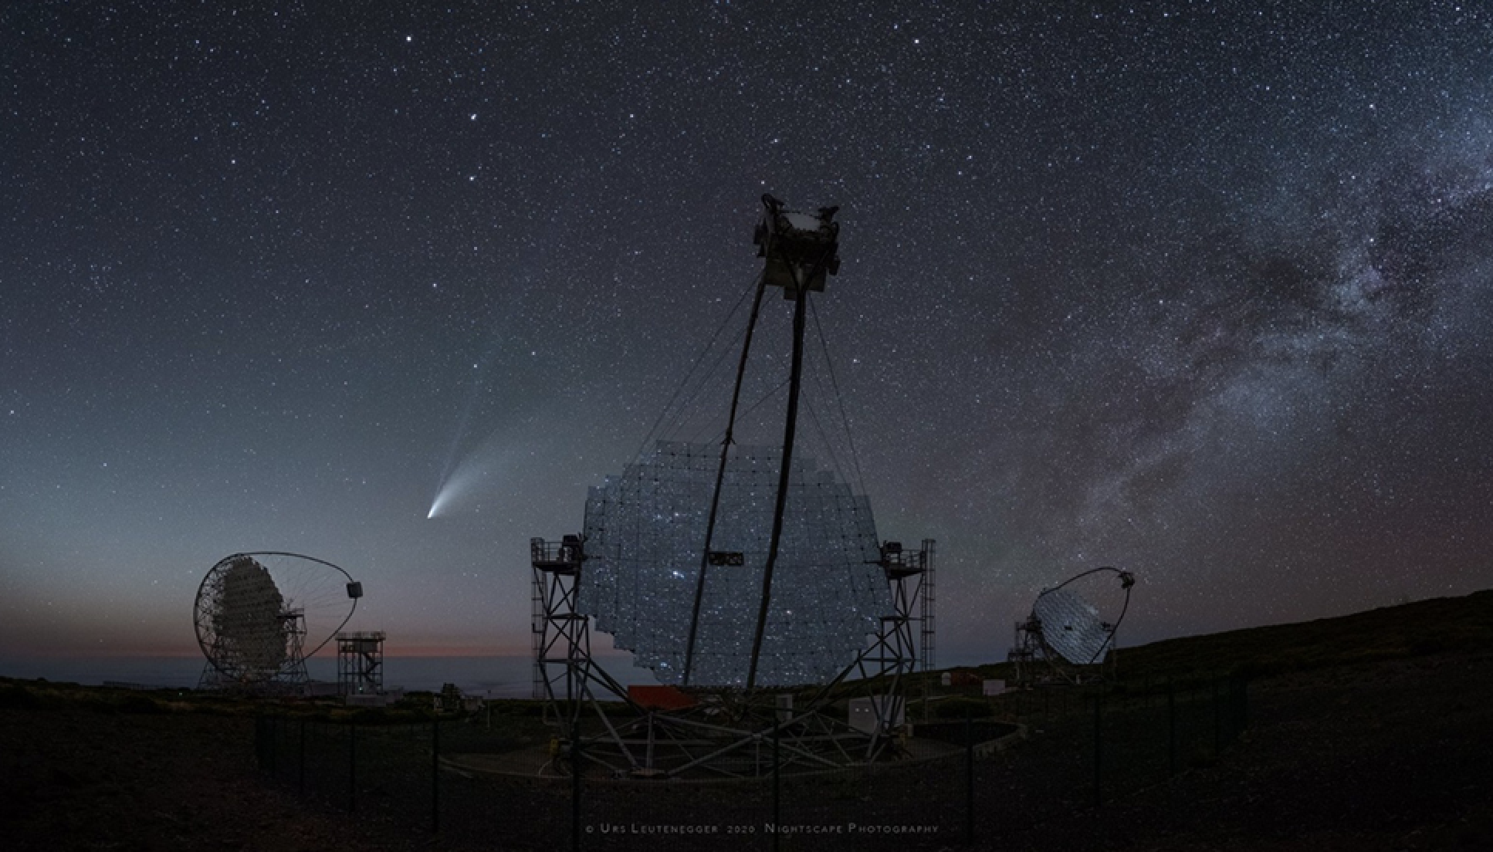
MSTN-15 position: CTAO point of view
David Bristow, Stephen Brown, Paolo Calisse, Stefano Stanghellini, Wolfgang Wild, Nick Whyborn, Roberta Zanin
March 14, 2023
Notes:
Comet NEOWISE. NEOWISE stands for Near Earth Object Wide-field Infrared Survey Explorer. That's the Earth-orbiting satellite used to discover the comet designated C/2020 F3, but you knew that.

Slide 2
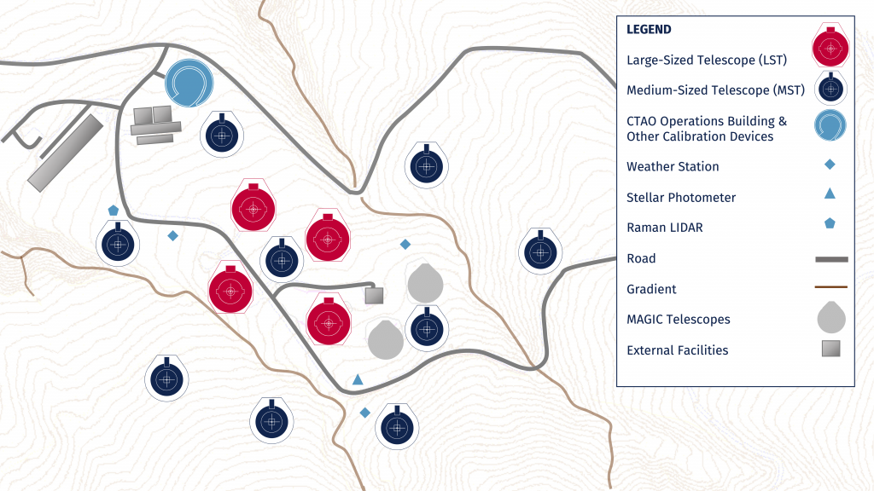
Northern array: as-requested coordinates
MSTN-15 position
needs to be modified because in conflict with
our internal LSTN-04
access road
IAC suggests a position
10 m away in the NW
direction toward LSTN-04

Slide 3
Northern Array: scientific assessment
  When considering the IAC-suggested position
  the MSTN-15 would suffer up to 10% shadowing
  (loss in optical effective area)
    when the LST is pointing both towards the MSTN-15 and along its line of sight or at zenith
    at an MST zenith distance which is 5-8 degree smaller than the one found for the original MSTN-15 position
    → shadowing becomes relevant at 52 deg
  Science-wise. Very limited science cases: the LST and MST sub-arrays operatining independently at specific direction
  Operations-wise. Two options:
  1. the production of the MST-sub-array IRFs will have to take the LST pointing into account, and model the shadowing
  2. implement appropriate scheduling constraints

Slide 4
Compromise solution
With the aim of keeping the best possible symmetry and limited as much as
possible the shadowing, CTAO proposed a compromise solution on
December 24, 2022
  This solution keeps into account the human-made constraints, safety
  regulations
  This solution is acceptable for the MST consortium despite the fact
  that the radius between the swing radius and the fence has been reduced
  to the safety minimum in some area
    Despite the locally limited reduction of the margin between the fence
    and the swing radius, the overall 3m margin generally allows to keep
    a similar level of flexibility for access and maintenance, as demanded
    by MST.

Slide 5
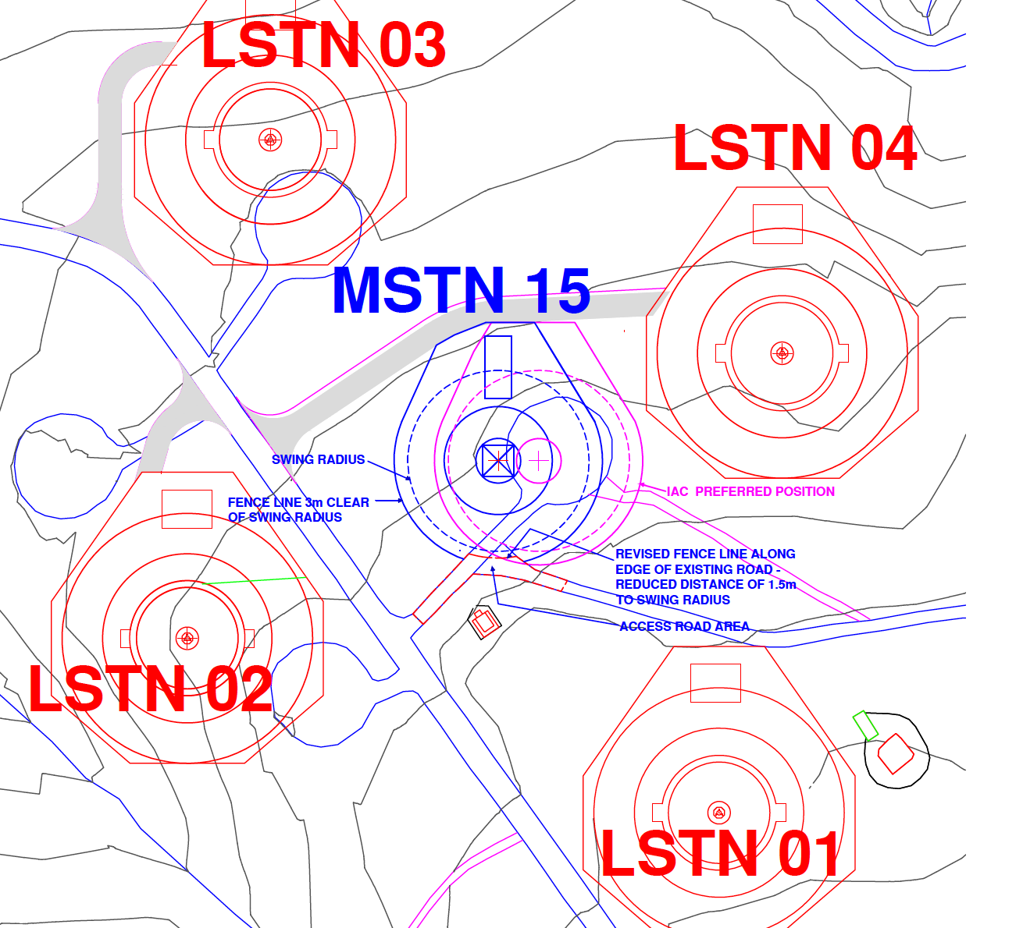
MSTN-15 CTAO-proposed solution

Slide 6
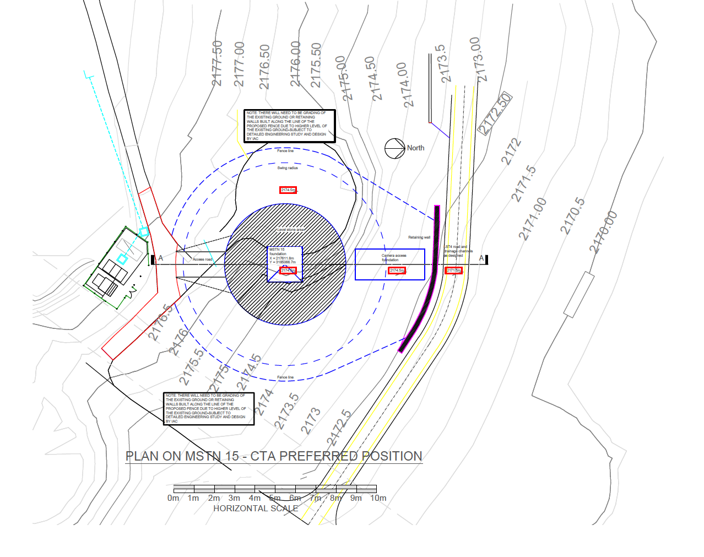
Engineering Concept Study MSTN-15
Plan Drawn for Option 1
Coordinates at Telescope Foundation Centre – X = 217611.8 – Y = 3185066.7

Slide 7
Engineering study on the MSTN-15 position
Section Drawn for Option 1

Slide 8
Concept Study - Option 1
Option 1 - Concept Study based on the preferred position –
  Centre of Telescope Foundation X = 217611.8 – 3185066.7
  Level at top of Foundation 2174.5m against 3metre high retaining wall to the LSTN4 Access road and to each side of the CMS Foundation at a variable height.
  Camera removal from CMS with Mobile Crane from LSTN4 Access road.
  Downside increased quantity of earth removal and extensive Retaining Wall Structure Construction.
  Access to Foundation from LSTN4 Access Road from the North West.
  Note: A detailed Engineering study is required to this Concept Study.

Slide 9
Concept Study – Option 2
Option 2 - Concept Study based on the preferred position –
  Centre of Telescope Foundation X = 217611.8 – 3185066.7
  Level at top of Foundation 2171.5m to Road Level LSTN4 Access Road.
  Improved Access for Camera Removal from CMS from LSTN4 Road.
  Downside increased quantity of earth removal and extensive Retaining Wall Structure Construction.
  Consider this has a major cost implication on current budget.
  Note: A detailed Engineering study is required to this Concept Study.

Slide 10
Concept Study – Option 3
Option 3 - Concept Study based on the preferred position –
  Centre of Telescope Foundation X = 217611.8 – 3185066.7
  Level at top of Foundation 2177.5m. To give access at ground Level from MAGIC Road.
  Downside – 6metre high retaining wall required against the LSTN4 Access road and to each side of the CMS Foundation at a variable height.
  Downside increased quantity of earth fill under the CMS and against retaining wall to LSTN4 road.
  Consider this may have a cost implication of current budget.
  Note: A detailed Engineering study is required to this Concept Study.

Slide 11
Wrap up
The central position of the MST is engineering-wise very complex independently from the exact decided position

Slide 12
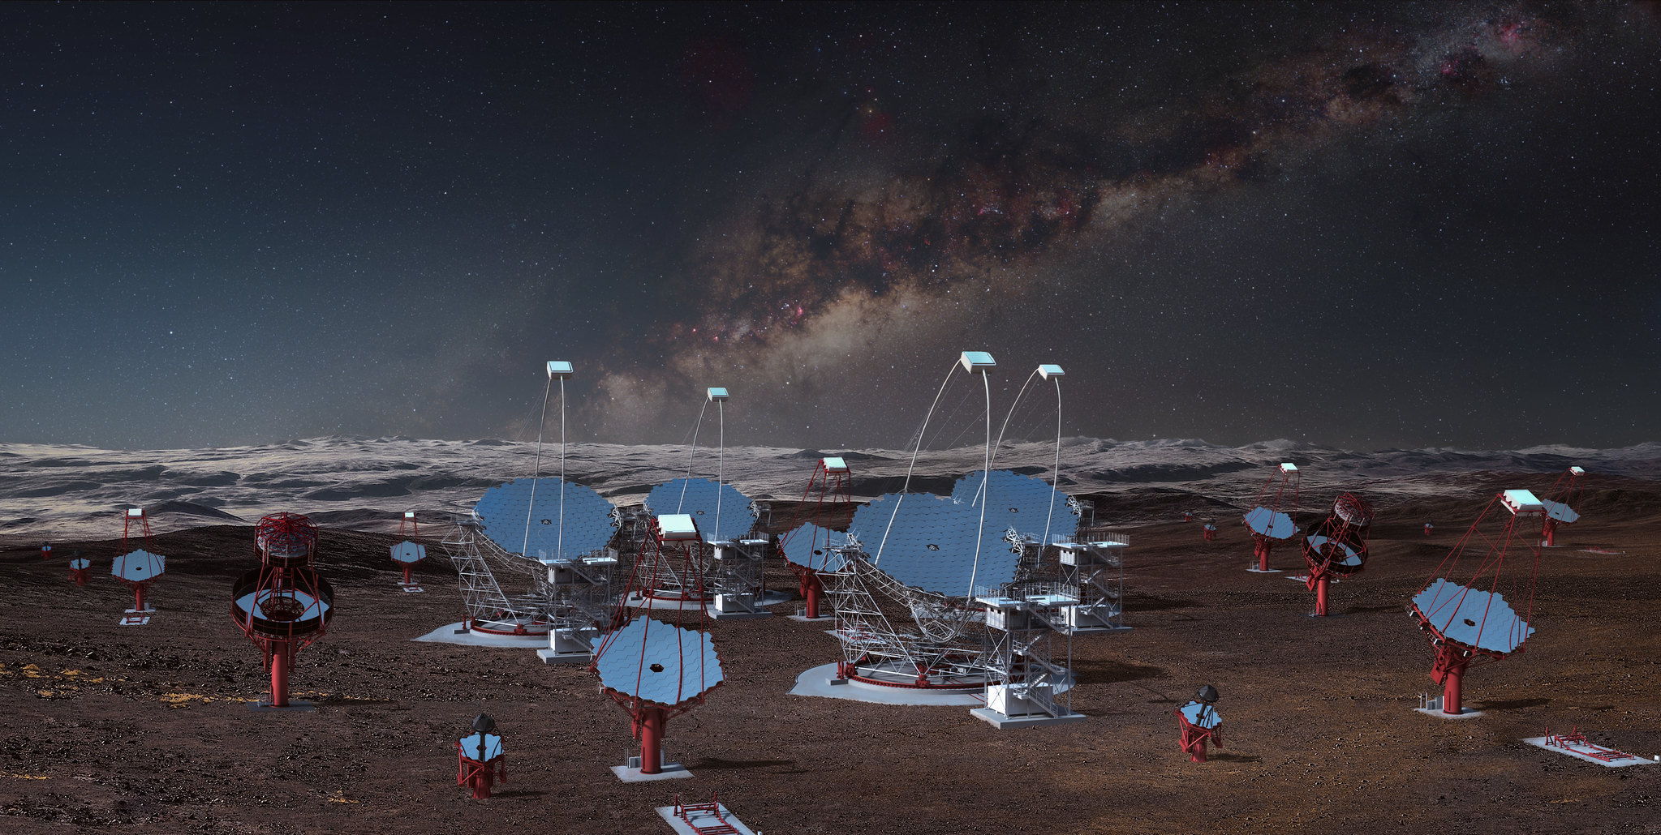
Thank you!
Alpha Configuration
R. Zanin
PC - July 5, 2021

Slide 13
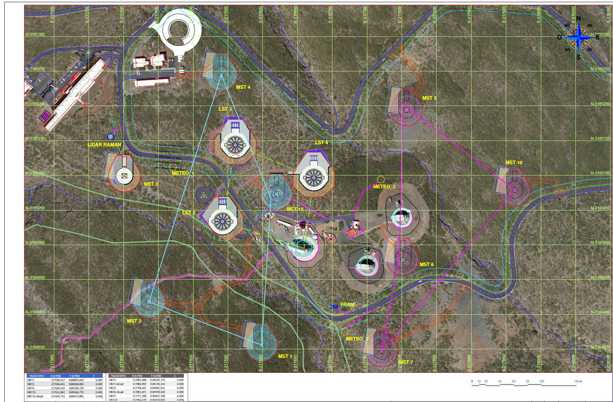
MSTN-15

Slide 14
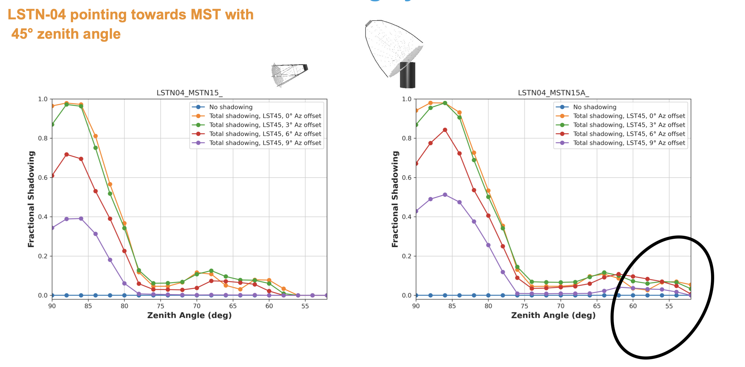
Northern Array: central MST position
Credits to Tobias Kleiner, Orel & Gernot

Slide 15
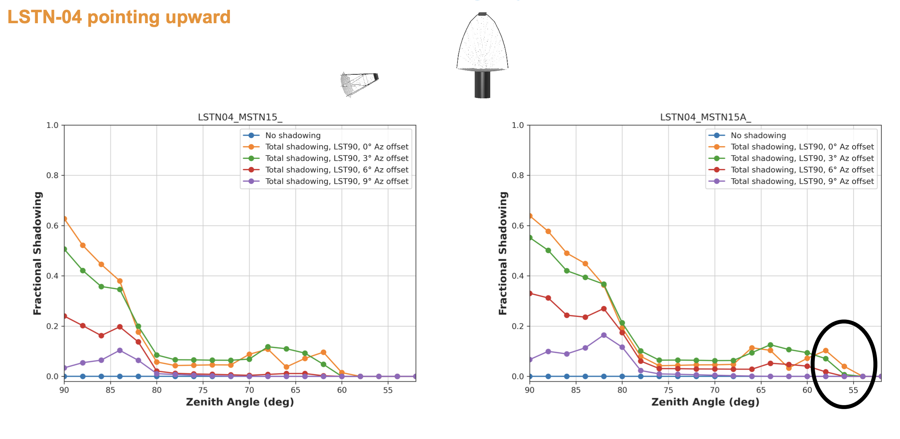
Northern Array: central MST position
Credits to Tobias Kleiner, Orel & Gernot

