Slide 1
NectarCAM Calibration System
Calibration system performance tests and reproducibility

Slide 2
Analysis tools
The design of the calibration screen was finalized.
For the present screen, up to 97% of the screen area is covered by 5 contours of light intensity.
Found the optimum scan positions required to cover all the PMTs.
From raw calibration data, found pixels illuminated by the calibration screen.
Fit the SPE spectra to deduce the gain of the PMT.
97%

Slide 3
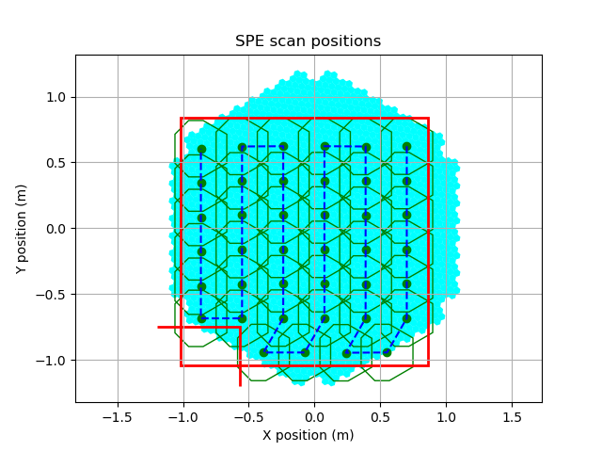
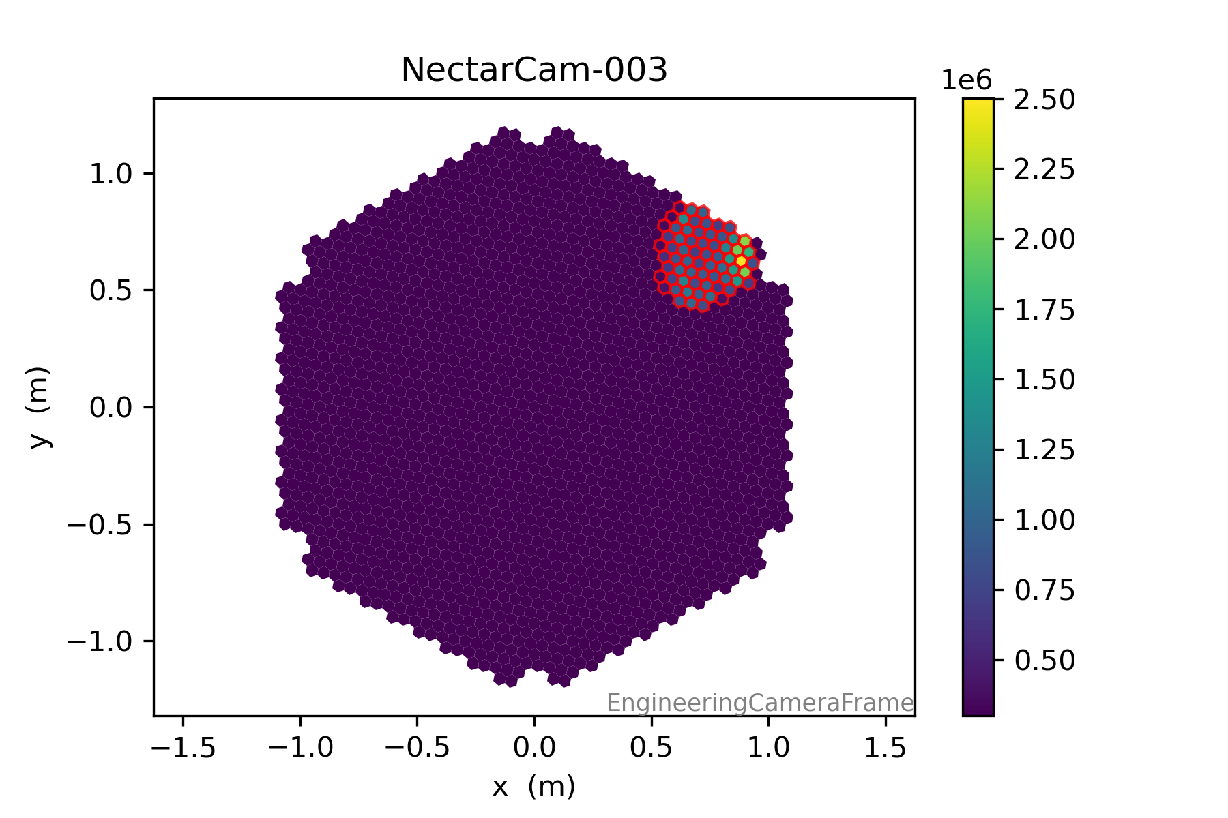
Calibration test at CEA
Algorithms written have been tested at CEA.
Presently only partial camera is accessible by the motors.

Slide 4
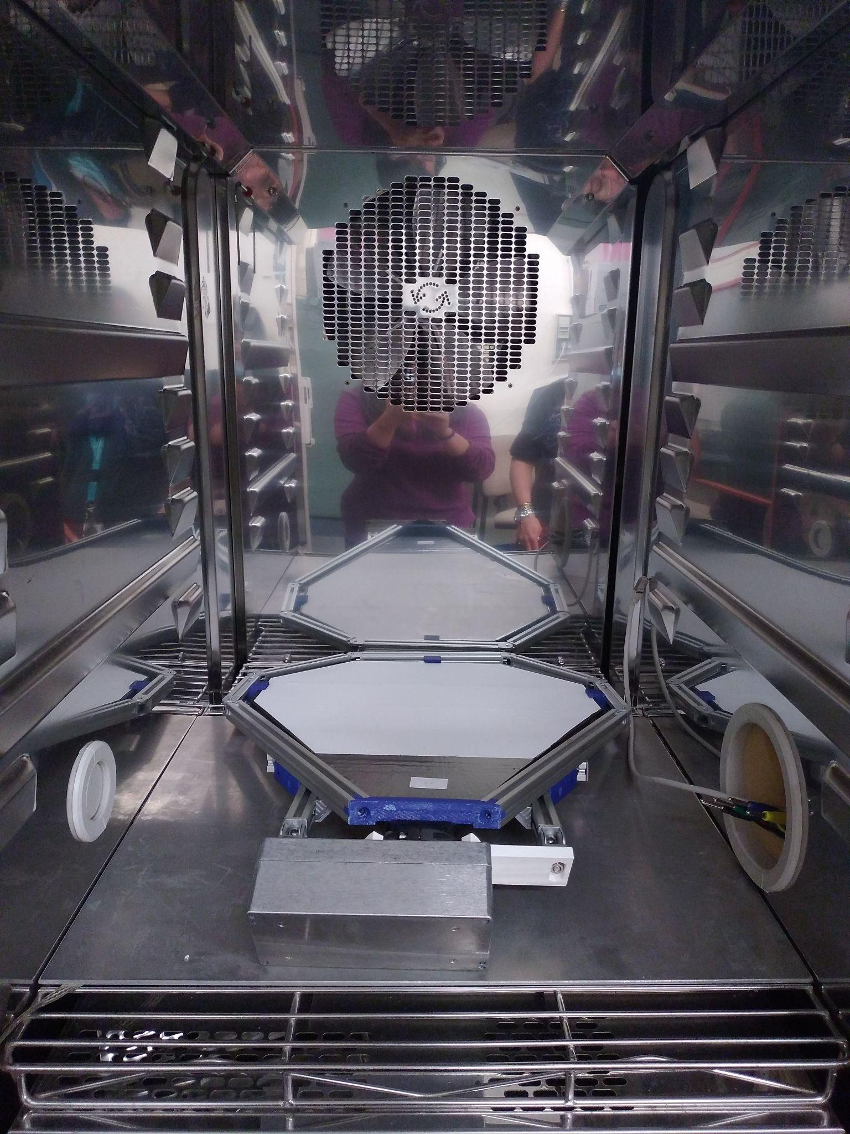
Temperature Tests
(Vtsch Industrietechnik VC4034)
Three temperature models were tested: Low, High and Cycle.
The calibration screen, its frame, optical box, along with the cables, were put inside the climatic chamber for a selected time. We also put a temperature sensor inside the chamber to check if the climatic chamber worked well.
Shown above are the plots of different temperature model in solid blue line and the temperature observations from the sensor in orange/red points.

Slide 5
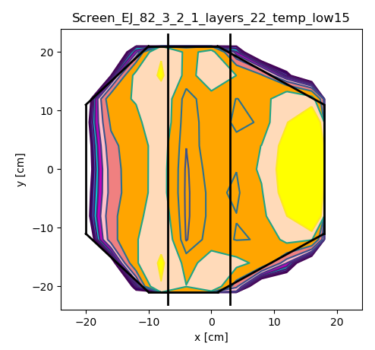
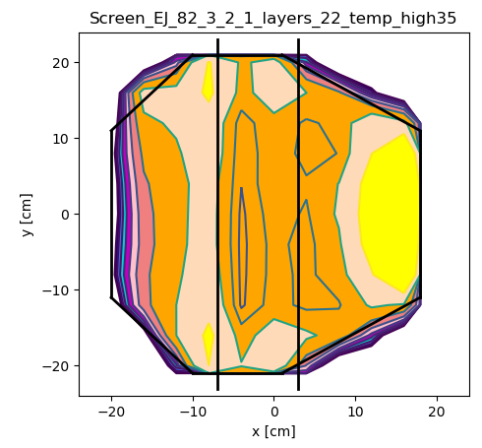
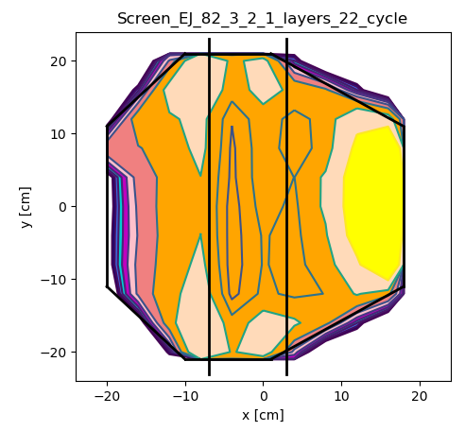
Temperature Test Results
Low High Cycle
98% 99% 98%
After the completion of each temperature test, a homogeneity test was performed on the calibration screen.
Uniformity still lies within 10 contours. Almost similar intensity map - paint and hence screen can withstand temperature variations.

Slide 6
Dip-coating Setup at IJCLab
A fully automated dip-coating machine has been set up at IJCLab.
It consists of a:
Aluminium tank: It is a rectangular container with a ’V-shaped’ bottom used to store the paint.
Rail-belt system: It is a system of trolley onto which the screen is attached
and is used for the vertical dipping of the screen into the tank.
Stepper motor: It is used to drive the rotation of the belt system.
Rubber tube: It is electronically moved with the help of a pump and is used to stir the paint inside the tank.
This entire setup is mounted on a table for mechanical support and is connected to a computer that can control the withdrawal speed, the stirring rate etc.
Need to make minor adjustments before we can start mass production.

Slide 7
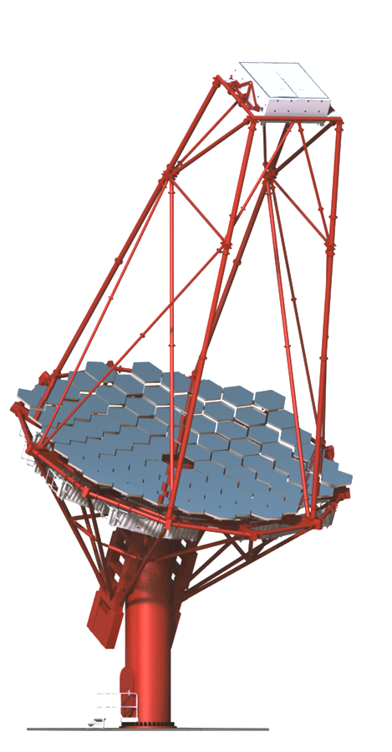
Conclusion
Latest calibration screen gives good homogeneity up to 10 contours.
We have finished testing the algorithm for efficient data acquisition and analysis at CEA for the first MST.
We have performed temperature tests and concluded that the current calibration system can withstand temperature variations within the range provided by CTA guidelines.
We have set up a fully automatic dip-coating machine at IJCLab. Need to make minor adjustments.
To achieve reproducibility, we have ordered 20 calibration screens and will start the testing soon.

