Slide 1



WP 10 “Calibration devices”
XY motion system status for QM
Mechanics (hardware)
Control (software)
Flat-field calibration light source status for QM
Production plan
Mounting and maintenance tools

Slide 2
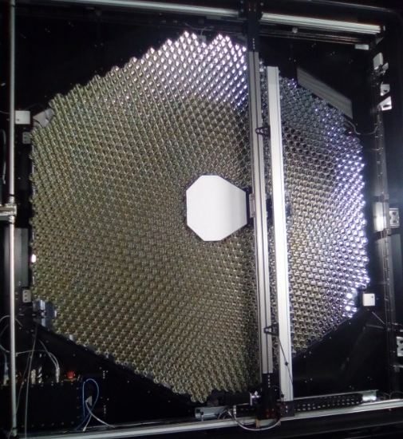
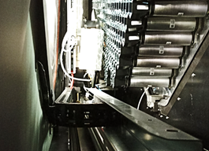
XY motion system status for QM: mechanics
Mechanics reliability: motion with no jolt at every camera elevation. New interfaces allowing a smooth motion along X axis to be integrated at IRFU (more degree of freedom).
Full accessibility to the focal plane:
  Pixels on the right will not be masked anymore in the parking position
  Pixels on the top are now accessible (longer Y cable chain set up in July)
  Pixels on the bottom left corner will be accessible without hitting the MCB.
Horizontal cable chain and protection in the window structure to be designed and integrated to avoid mechanical interference.
Integration from November onwards:
  Camera must be horizontal
  Functionality test first
  Long-term reliability test in spring 2023.
Product assurance with Hensoldt Space Consulting:
  Procurement with sub-contractors
  Certificate before shipment to IRFU
  Test report and procedure
  …
Documentation to be updated: drawings.
No RIXs.

Slide 3
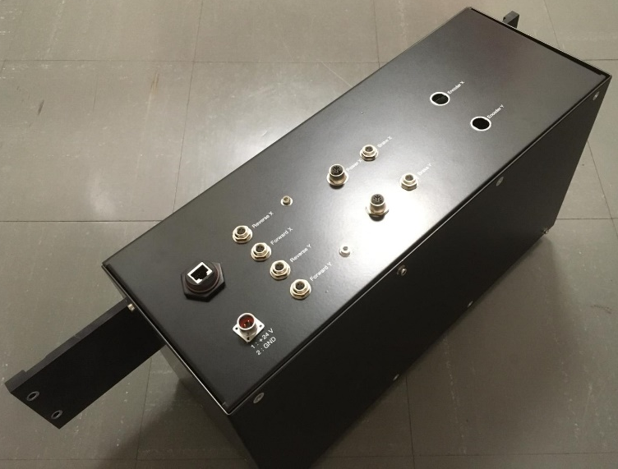
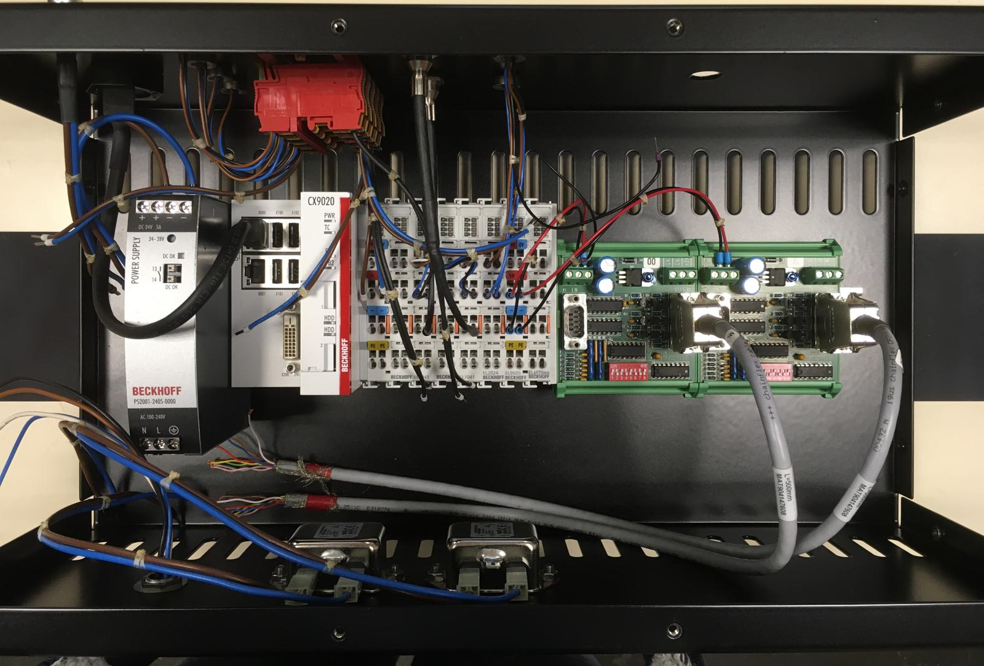
XY motion system for QM: motorization control
Design updates:
  Power supply modularity: 24 VDC from PSB and 230 VAC from PDB (EMC with FPM ?)
  High current for holding torque (in addition of the motor brake)
  No emergency stop
  Y oscillations
  Code already within the OPCUA architecture.
New MCB integration from November onwards:
  Functionality test first
  Long-term reliability test in spring 2023.
Software product assurance?
Documentation to be updated: ICD and design.
No RIXs.

Slide 4
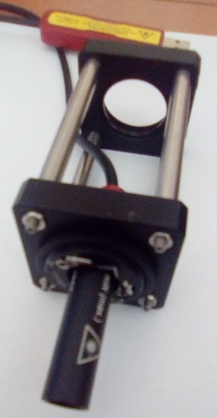
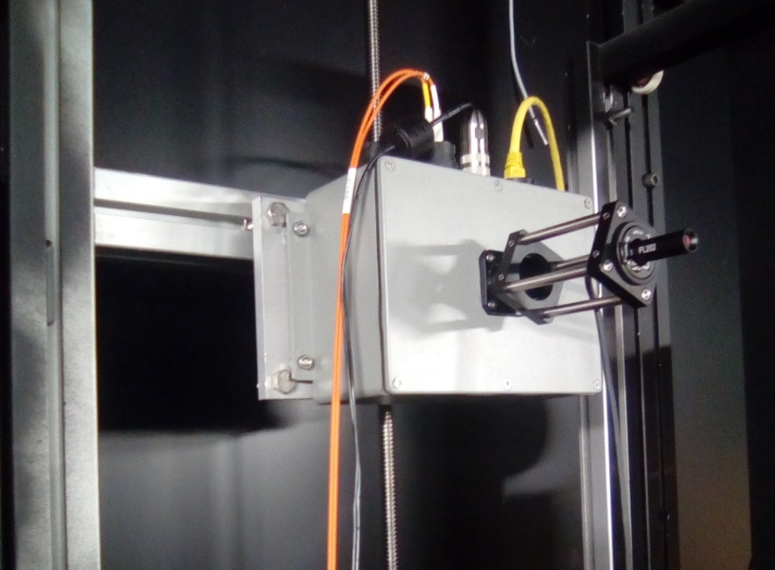
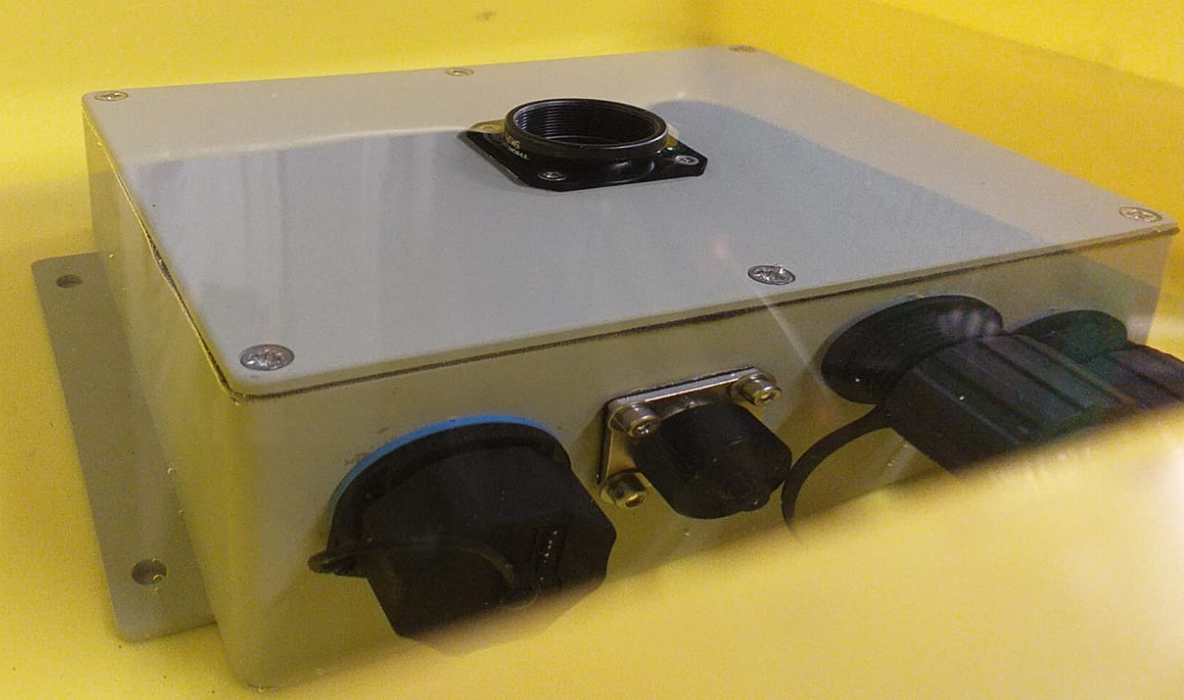
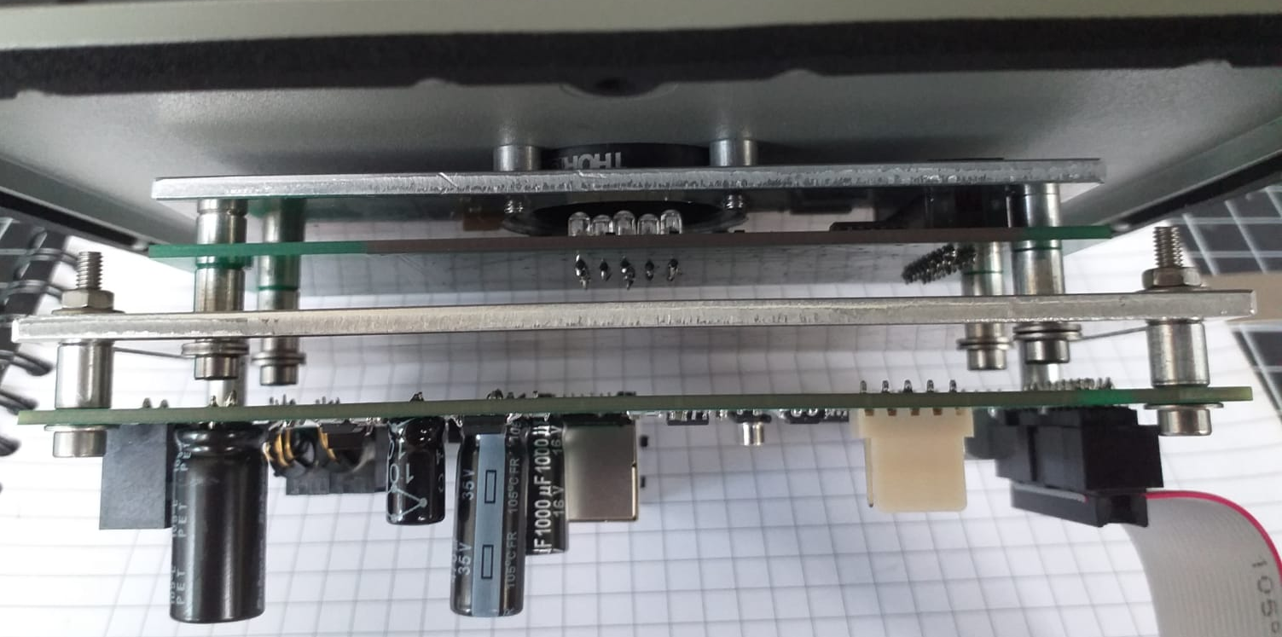
Flat-field calibration light source for QM
Complete redesign since Adlershof prototype:
  Alignment with camera optical axis: laser system
  Mechanics and IP67 validated (Q3 2021)
  Optical board validated (October 2021)
  Ethernet board with humidity sensor to be validated
  New optics (ND filter) to be tested (October 2022)
  Closure of a non-conformity on the prototype
Product assurance implication in the procurement (mass production)
No RIXs.
Connectors in accordance to MST-STR-ICD v1.0b:
  Lumberg 0318 03
  Amphenol Socapex RJF RB 71RA
  CONEC 17-300240 (or similar 14-300710)
Dimensions: 200*140*130 < 300*200*600

Slide 5
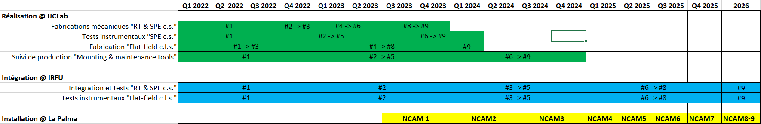
Production planning
IJCLab production planning for calibration devices 2 -> 9 + spare:
  Productions are launched after integration and test validation at IRFU.
  Mechanical pieces will be manufactured at IJCLab in 2022 and 2023.
  Motorization and control components will be procured in 2022-2024.
  MCB will be assembled at IJCLab.
  SPE and FF boards designed at LUPM: production done by June 2022, tests performed at Elecis place.
  Reflective target and light guide in current production. The assembly and painting will be performed at IJCLab.
  SPE calibration system will be characterized before shipment to IRFU.

Slide 6
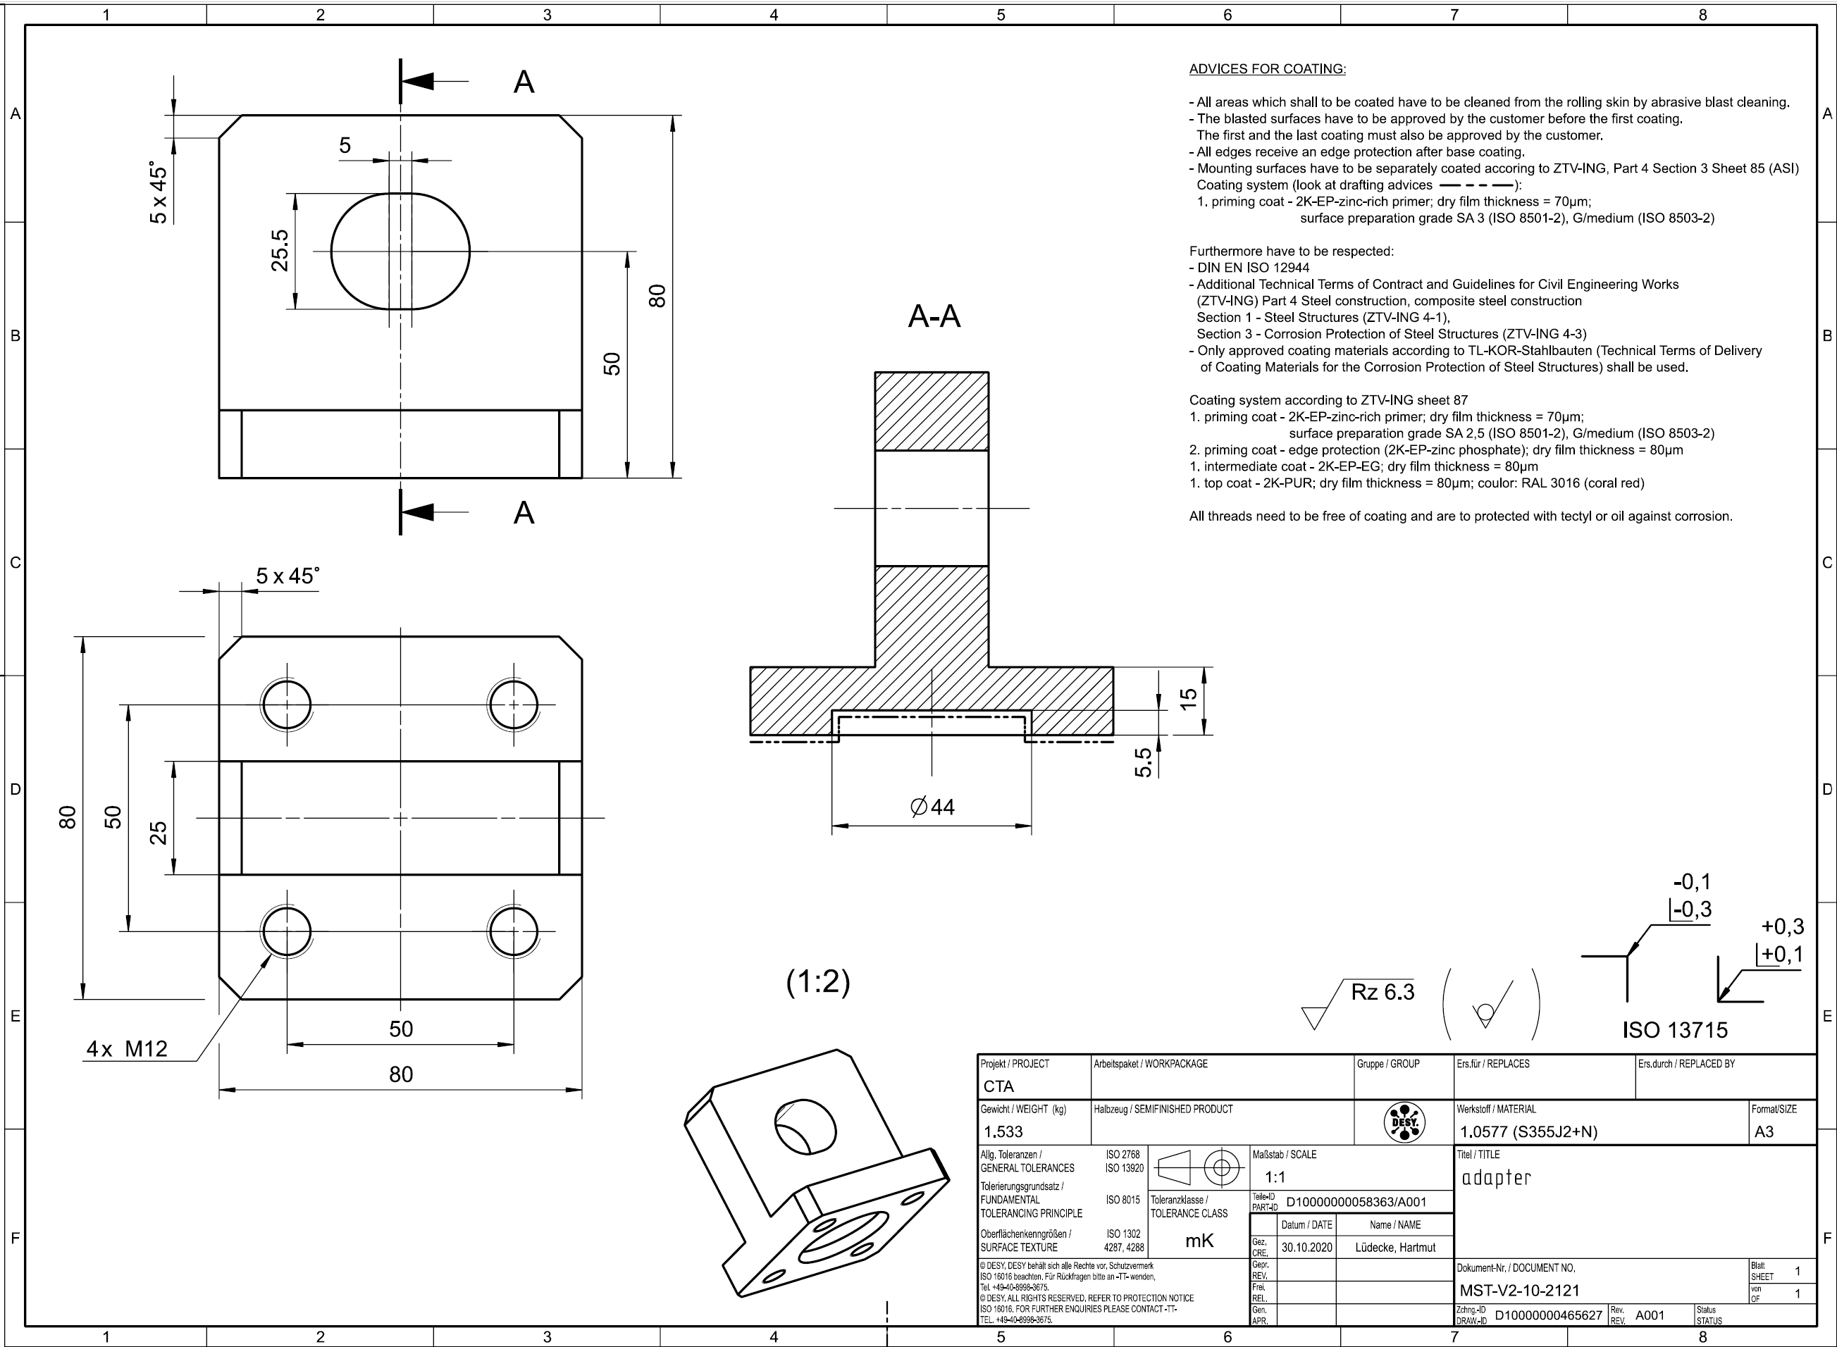
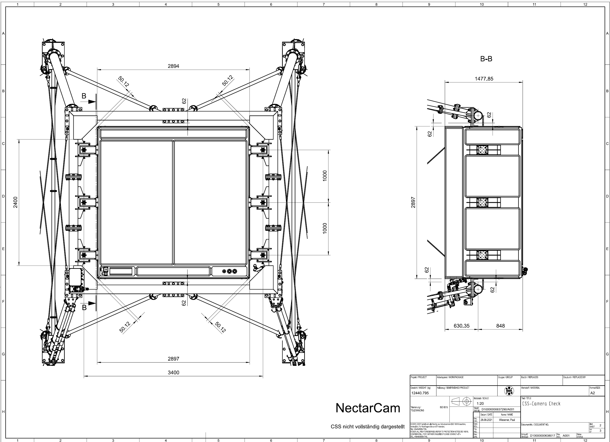
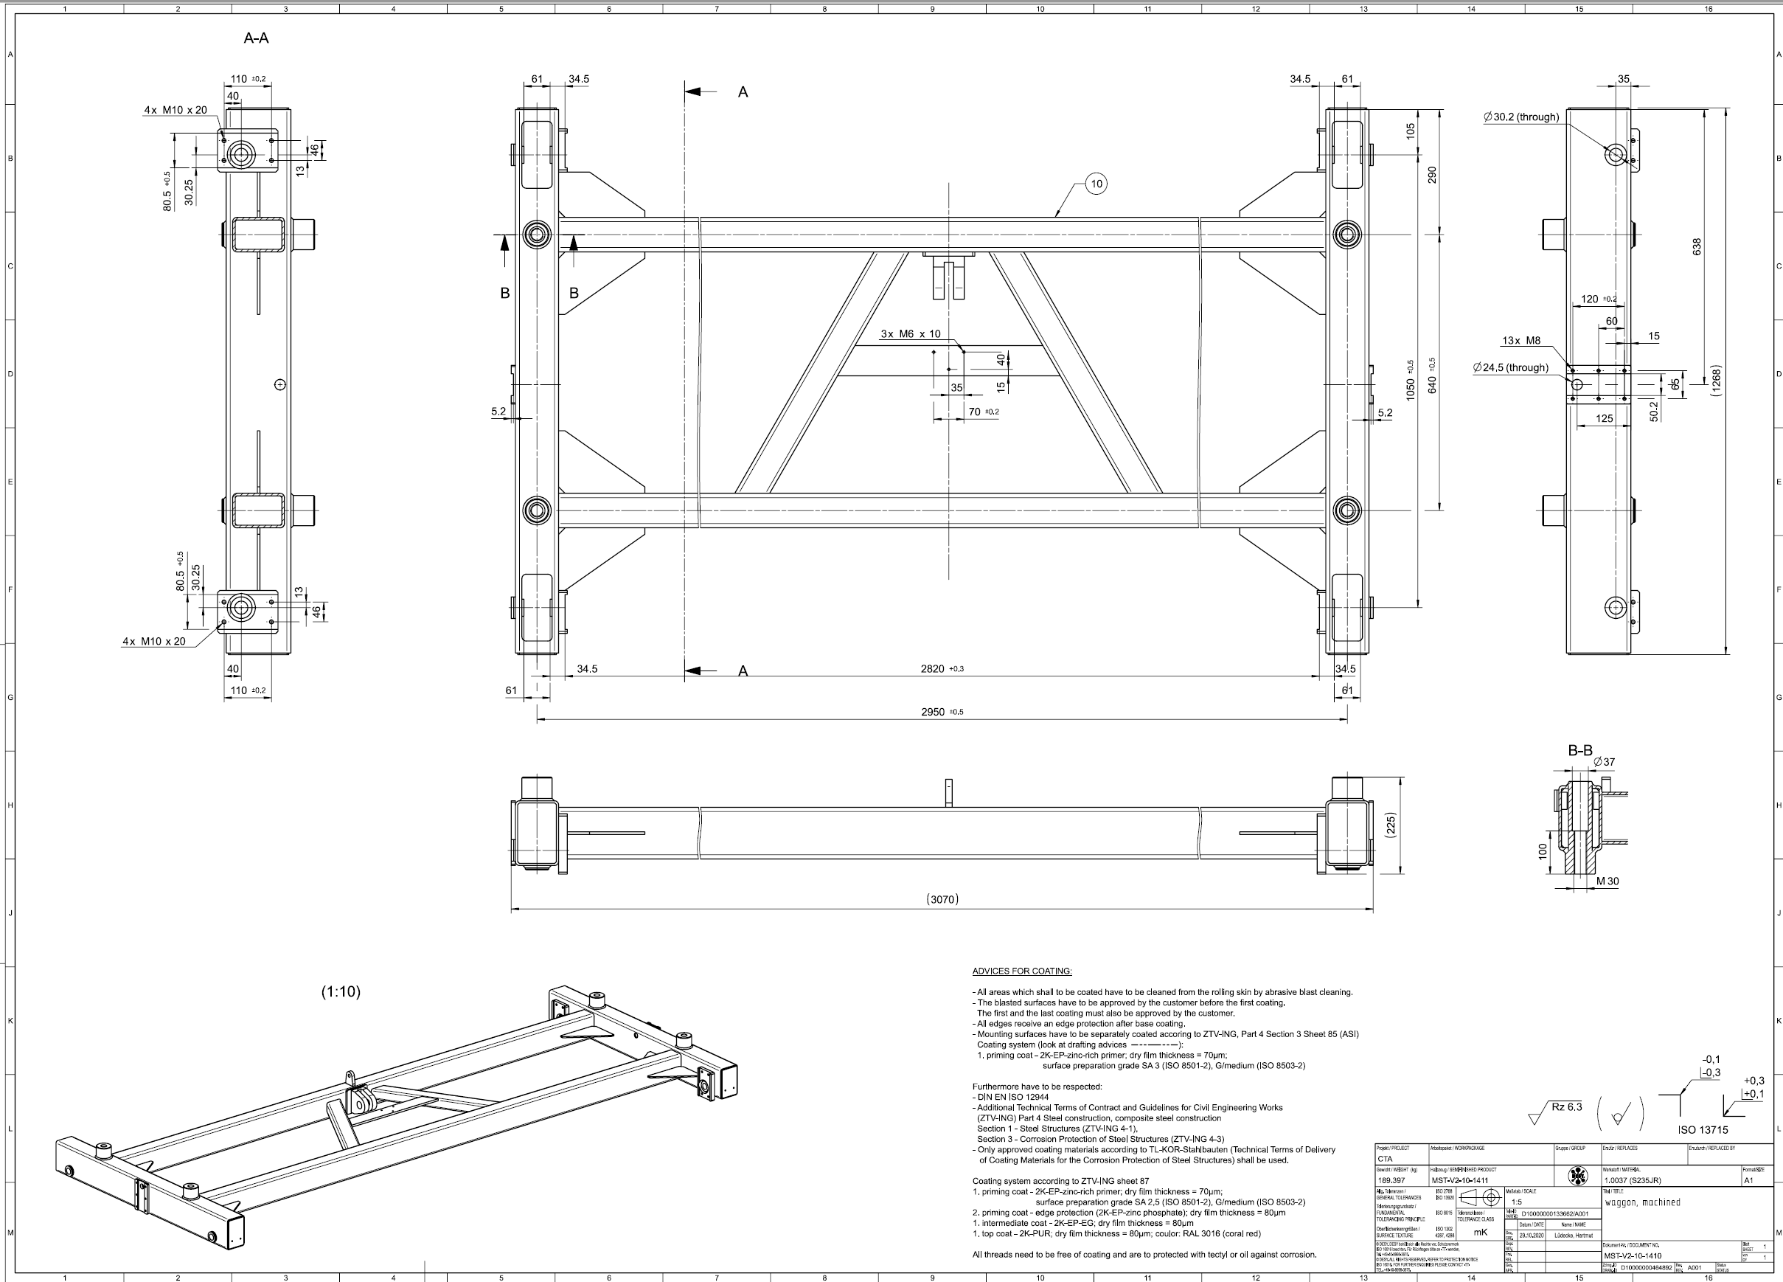
Mounting and maintenance tools
Mounting tool:
  Mechanical design and study performed, following the MST trolley design (MST-STR-ICD v1.0b below).
  Procurement for NectarCAM 1 in early 2023.
  Documentation to be updated: performance verification, drawings, and ICD.

Slide 7
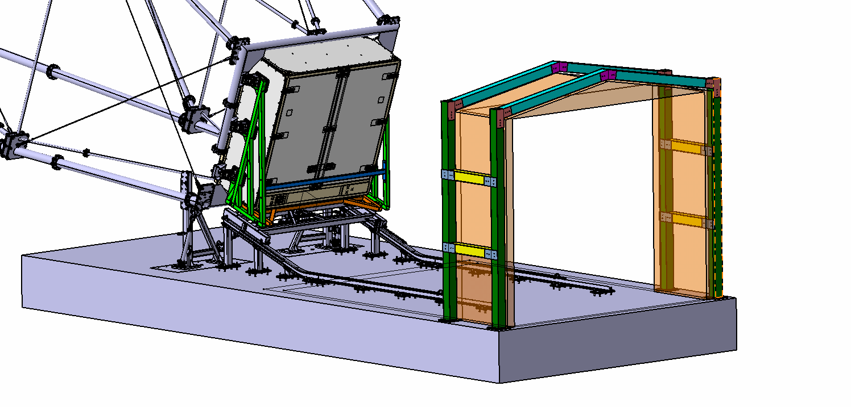
Mounting and maintenance tools
Maintenance tools:
  Light rear maintenance can be performed while the camera is still on the MST structure. Rear doors are opened and a dedicated platform is brought up to the camera.
  Front maintenance and heavy rear maintenance are performed once the camera is dismounted from the MST structure, put onto the trolley and brought up under the tunnel. Platform enables accessibility for maintenance activities.
Mounting tool design to be updated
  Platforms are necessary for operations above 1.5 m from the slab.
  Tunnel to protect from UV and dust. The tunnel has to be protected itself from wind gust with a dedicated steel-based structure clamped to the concrete slab (drills location already taken into account).
  Procurement for NectarCAM 1 in 2023.
  Documentation to be updated (last version November 2020!): design, performance verification, drawings and ICD.
Platforms design to be added
Protective tunnel (folded here)

Slide 8
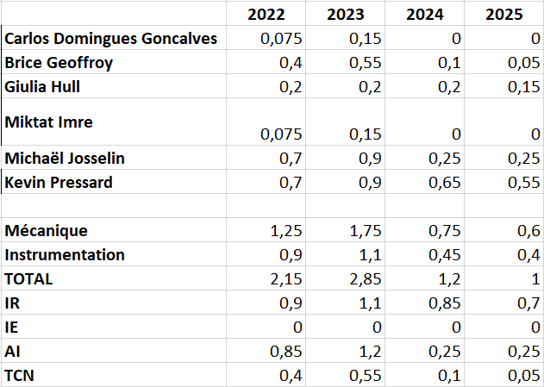
Human ressources

