Slide 1
WP Monitoring & Services
NectarCAM F2F Meeting, 10-12 October 2022

Slide 2
WP Monitoring & Services: Agenda
Power Supply Box (PSB)
Power Distribution Box (PDB)
Embedded Camera Controller (ECC)
Progress status
Production
CDMR RIX status
Fred Louis (IRFU)
Julie Prast (LAPP)

Slide 3
EMBEDDED CAMERA CONTROLLER
NectarCAM F2F, 10-12 October 2022
Julie Prast for the LAPP team

Slide 4
ECC Status
Common component between NectarCAM and LSTCAM
Same hardware
Same software with dedicated camera configuration
Status
LST2-4 cabinets + LST engineering model cabinet were delivered in 2021
LSTCAM1 ECC has been upgraded in September 2022
Old LSTCAM1 ECC will be upgraded to become the LST spare
NectarCAM Adlershöf cabinet has been upgraded early 2022
Includes new NectarCAM mechanics with mounting on rails to ease cabinet replacement
Currently used in NectarCAM1
One additional NectarCAM cabinet includes the same electronic, same software, but first version of mechanics
Used for the NectarCAM testbench (Tower 66)
All these 8 ECC have the same electronics and the same software
The white target control has been removed (IJClab responsibility in NectarCAM)
Any software upgrade (bug correction…) on one side is immediately reverberated on the other camera

Slide 5
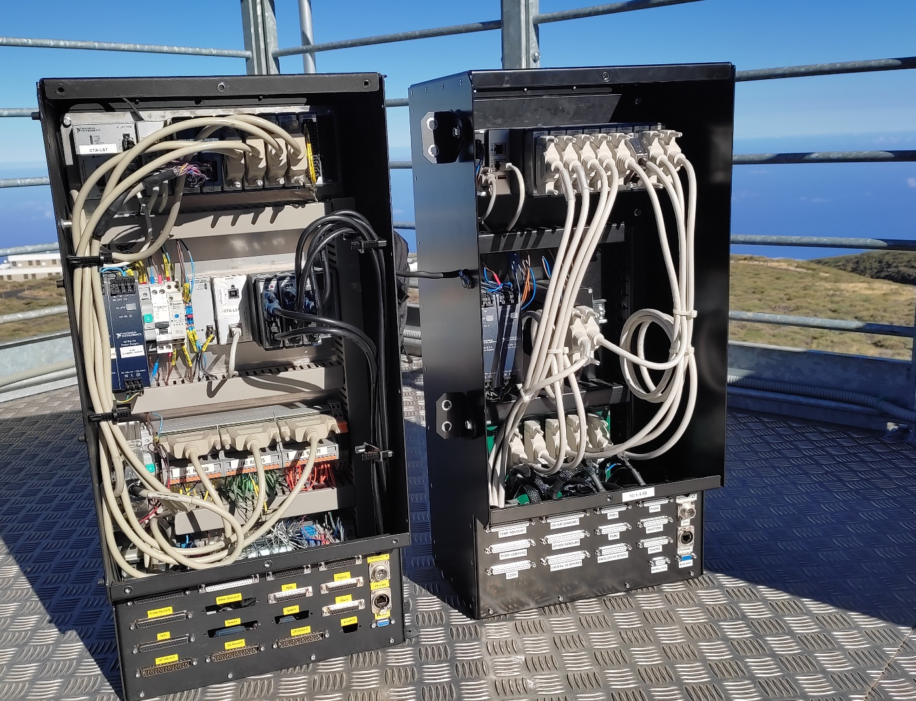
Production Hardware
Optimization of the ECC cabinet for manufacturing
Development of an Interface Board to replace most of the internal cables
White Target control removed
Old LST1 (left) versus new LST1 ECC (right) on the LST access tower

Slide 6
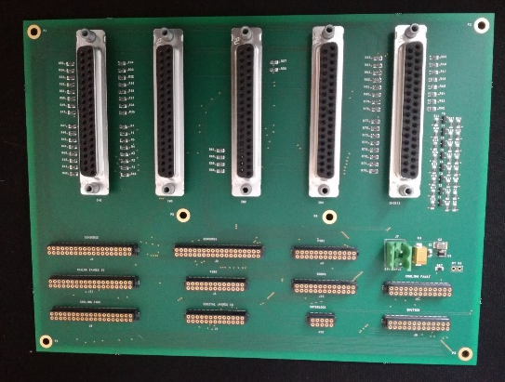
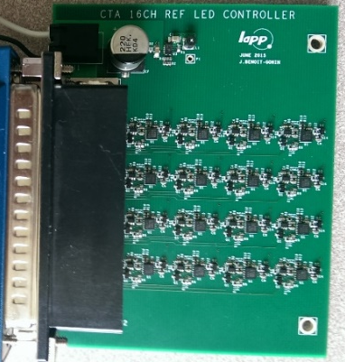
NectarCAM Production
9 cabinets have to be produced (NectarCAM 2-9 +1 spare)
A call for tender has been issued in July
5 + 4 cabinets
4 companies made an offer. Comparison is to be done
The call for tender includes
Mechanical cabinet manufacturing (based on Oscar Ferreira’s drawings)
Purchase of small components and cables
Cabinet cabling
First level tests
The call for tender does not include
The National Instrument components purchase (long delivery time, ordered in advance)
The functional verification
The manufacturing of electronics boards (LEDs and Interface Board) which were already produced
Interface Board
LED Controller

Slide 7
NectarCAM Production (2)
Price is in the order of amount of what was expected
NI components ordered for 5 ECC in December 2021
NI components ordered for 4 ECC in July 2022: ~ + 50% compared to December 2021 !
Delay is in the order of 6 months to receive the 5 first units
The longest is the manufacturing of the mechanical crate
NI components for the 9 units are available
Delay for the 4 additional cabinets is ~5 months
The production can start as soon as the company is selected

Slide 8
ECC Test and Quality Control
ECC test procedures have been written
MST-CAM-TP-0421-LAPP_ECC_Test_Plan
ECC test result sheet templates are available
LMST-CAM-TR-0422-LAPP_ECC_OPCUA_Method_Test Results_Template
LMST-CAM-TR-0423-LAPP_ECC Test Results_Template
NectarCAM1 production cabinet was delivered with the associated Acceptance Delivery Package thanks to our local quality engineer (she has left since)
Production test is foreseen with the current testbench equipped with camera sensors & actuators
If it is ready on time a dedicated testbench will be used
It is based on a compact RIO and dedicated I/O modules to simulate camera sensors/actuators
Emulated from OPCUA interfaces
Errors can be generated
Transportable on site thanks to a plane cabin suitcase format

Slide 9
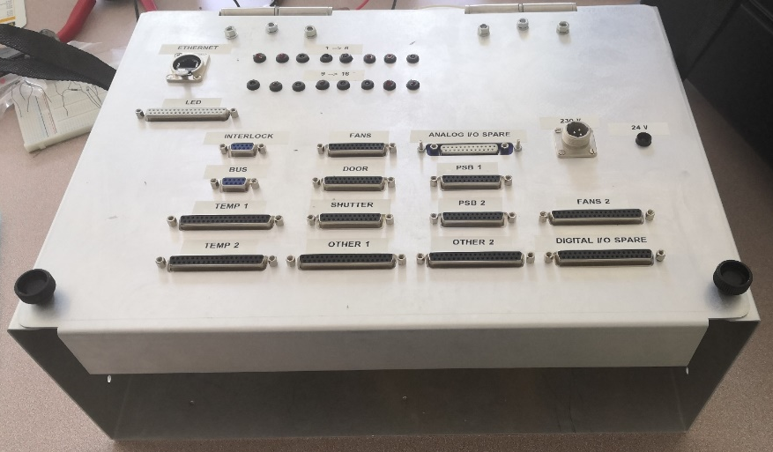
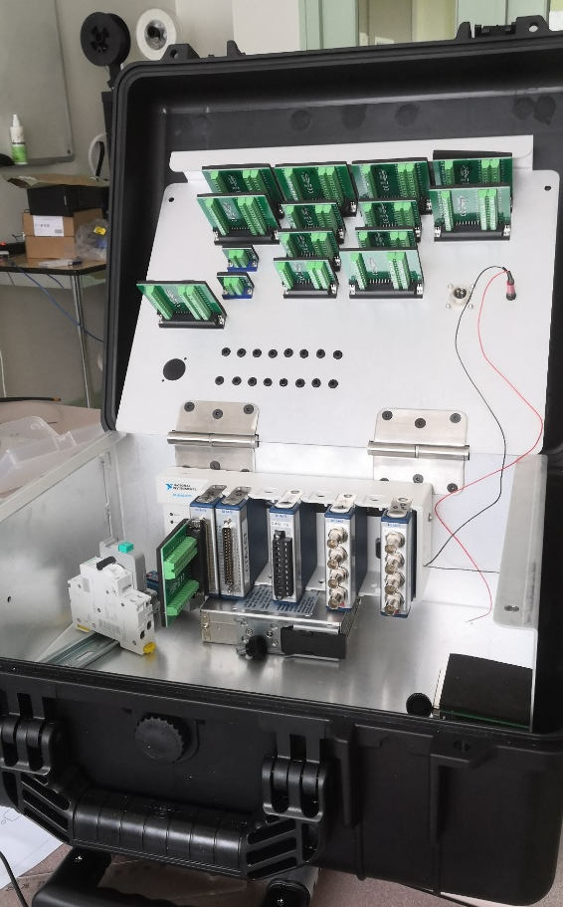
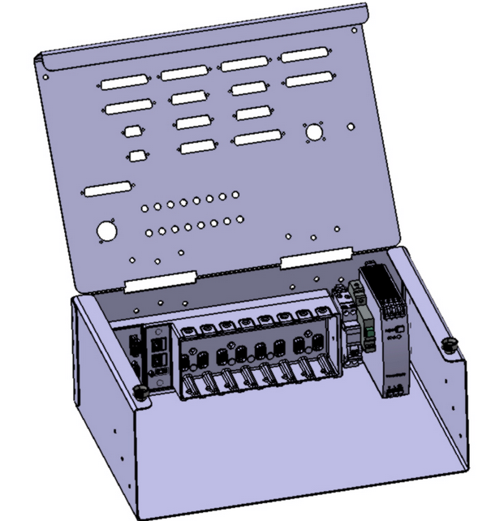
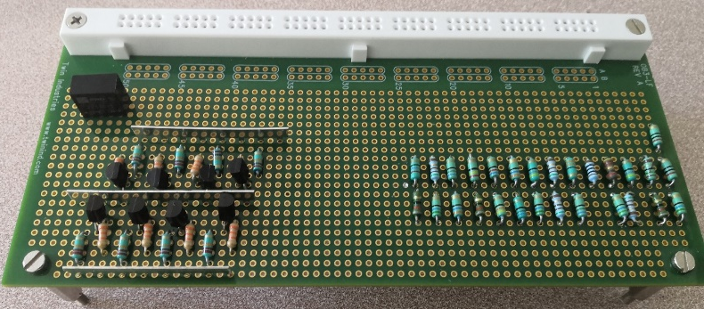
Transportable Testbench
Hardware developed by the student Maxime Boute in S1 2022
Software development ongoing (Nadia)
ECC
Suitcase
LabVIEW test program
Injection, monitoring, comparaison
Simulation of PT100 + 5V Fan tachymeters

Slide 10
Monitoring & Control WP RIX Status
39 Monitoring & Control RIXes were issued
Includes ECC, PSB and PDB matters
36 normal priority + 3 low priority
35 are closed
4 are not closed but assigned to CTAO (2 NW, 1 OS, 1GP)
Zero non-closed RIX are still assigned to NectarCAM

Slide 12
Finalization of Production Software
Completely new version of code
Based on current validated ECC features
New architecture, more compact and better structured
Integrates most of the various review recommendations (CTA, LST, NectarCAM, IN2P3, …)
Based on LabVIEW 2018
Additional features:
State machine transitions improved
Alarm handling & identification improved
Additional monitoring info (ongoing methods, CPU load, ECC versions, debug…)
Additional parameters accessible in the configuration file
Updated chiller & shutter interfaces
Additional sensor & actuator interfaces
Feb 2020: First release installed at IRFU
Feb 2021 : release of ECC Software V5.0

Slide 13
