Slide 1
System Engineering
NectarCAM Collaboration Meeting, 10-12 October 2022
Julie Prast (LAPP)

Slide 2
System Engineering: Agenda
Meeting Organization Overview
Interfaces News
Design Verification
Status of CDMR RIXes
CDMR: Critical Design and Manufacturing Readiness Review
CTAO: CTA Office
ICD: Interface Control Document
IPS: Integrated Protection System
RIX: Review Item comment or question
SE: System Engineering
TRR: Test Readiness Review
WP: Work Package

Slide 3
Meeting Organization

Slide 4
SE Meeting Organization Overview
Interactions with MST teams : MST Technical Coordination Group (MST TCG)
Every Monday at 10 am
MST Structure (Markus & Alex), FlashCAM (German, Miquel) and NectarCAM (Philippe & myself)
+ relevant experts when necessary
Agree on common ICD (MST Structure – Camera ICD), common objects (chiller specifications, UPS)
Share common issues (high wind resistance), prepare interactions with CTAO…
Interaction with CTAO SE team: CTAO – MST SE meeting
Once a month
Common meeting within MST Structure, FlashCAM and NectarCAM teams
Discuss telescope interfaces, telescope requirements, telescope reviews, maintenance issues, technical workshops …
Specific meetings with CTAO on dedicated subjects
Interfaces (software, IPS…), requirements, CTA standards…
With relevant experts on each side
Technical Follow up meetings within NectarCAM
Monitor progress of the implementation of changes, ensure requirement flow down, discuss technical issues
Fred, Philippe G., François T. and me as permanent members + relevant experts

Slide 5
NectarCAM Technical Follow up Meetings
Meeting with IJC Lab hold on Sept 27
Feedback on the white target installation with respect with camera front door
Motor Control Box power supply
Adlershöf Flat Field Calibration Box non conformity
Maintenance tools update
Focal Plane Module production (IRAP) hold on Sept 28th
Follow up procedures with Microtec and associated planning
Call for tenders for production
NectarCAM documentation system hold with Dirk on Sept 29th
Data recovery
Possible NectarCAM site on office365-online Sharepoint in the same way than the CTAO Document Repository
Camera front (LP2I) hold on Sept 30
Feedback on camera front door installation
Shutter status and agenda
Shutter control, shutter flatness
Window production
To come:
Embedded Camera Controller
Digital Trigger Crate
NectarCAM Module Controller
Event Builder
Quality Control
PSB/PDB call for tenders
….

Slide 6
Interface News

Slide 7
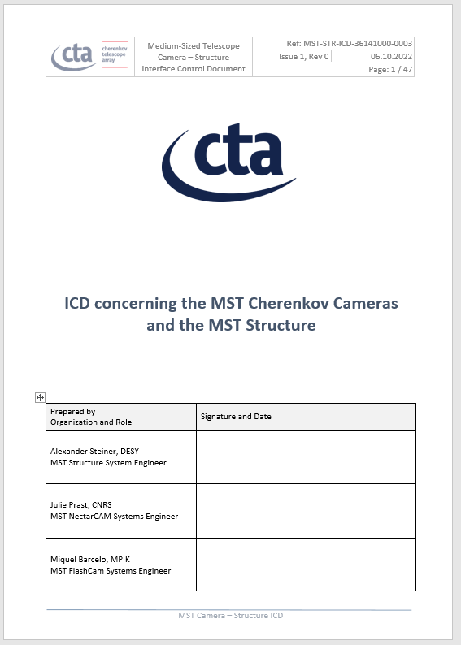
Interfaces News: MST Structure Camera ICD
Updated version of the MST Structure –Camera ICD V1.0
Address points from CTAO reviews (most of them by Stefano)
General cleaning of the document after interface items got better defined
Align the document concerning terms and layout to CTAO standards
Mainly motivated by approaching MST Structure CDMR
No major modification for cameras, except
Max camera weight increased to 2,5T
Specification for shutter flatness (under discussion)

Slide 8
Interfaces News : New CTAO documents
CTAO System Control documents
CTAO System Control Concept
CTAO System Control Standards
CTAO System Control Development guidelines
CTAO Alarm System (for information)
Received in April for review
Most of the NectarCAM comments given by Patrick & me
Each of the MST comments was discussed, clarified and finally agreed in September
The good news is that all these documents are not retroactive, neither mandatory and should be used as possible guidelines for future developments. We pick up what we can !
CTAO Timing Standards
Quite general document distributed early September for review
NectarCAM comments given by Michael & Dirk
More detailed documents are expected in October
Dedicated timing workshop is planned during the CTA consortium at Napoli on Nov 14
IPS concept and interface documents in preparation
Integrated Protection System of the array network
Based on identified hardware and digital IO + transmission by dedicated fibre optics
ICD proposal should be distributed in the coming days
Possible impact on the telescope design to be clarified

Slide 9
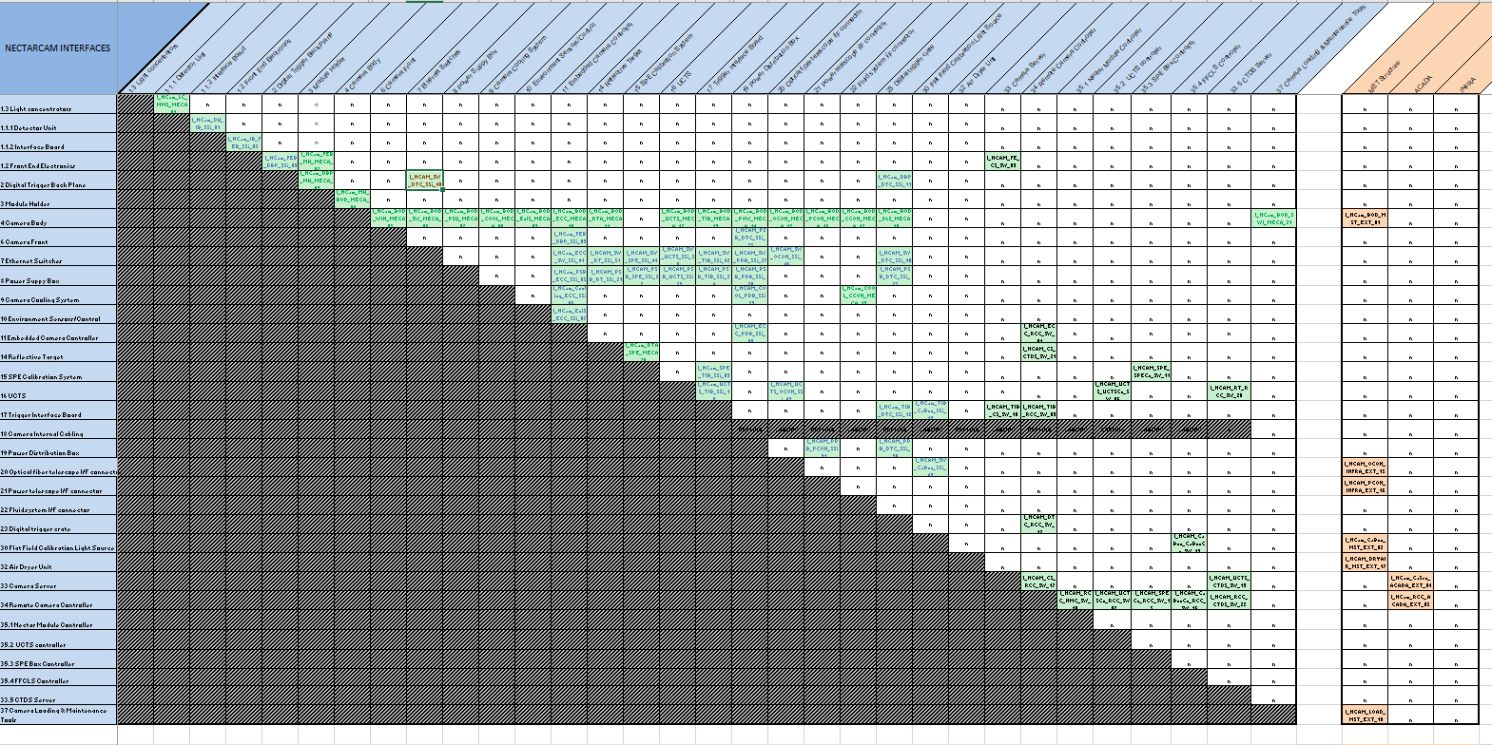
Interfaces News: NectarCAM Interface Matrix
Interface matrix
Summarizes all interfaces of the camera
Based on NectarCAM PBS
Intersection filled = interface identified
Recently updated to fulfill a few CDMR RIXes related to mounting or maintenance tools.
External interfaces added
Internal interfaces are all documented and validated.
External Interfaces
Internal Interfaces

Slide 10
Design Verification

Slide 11
Compliance Matrix & Verification Plan: a Long Process
Key elements in the verification process of the camera.
Verification plan lists all the NectarCAM applicable requirements. For each requirement, the verification methods at each project phase, and the testing procedures are given
Compliance Matrix gives compliance status photography of the camera at a given time
History:
CTAO was contacted several times prior the NectarCAM CDMR to agree on the compliance matrix format (starting from Feb 2019). No answer was received
During the CDMR (Feb 21), reviewers said that the verification plan needs to be released (#42850) and the design compliance demonstrated in an updated verification matrix (#42745)
To clarify the expectations, several meetings were organized in spring & summer 2021 with Vanessa Montes but no agreement was reached
September 2021 : Stefano, as CTA Telescope manager was put in the loop
End of November 21: F2F meeting with Stefano & Nick @ Saclay
Verification Plan & Compliance Matrix formats agreed with CTAO
Request for an update of the compliance documents to reach an “acceptable state for the CDMR closure, with the promise they will be improved for the preshipment and acceptance reviews
Verification procedures delayed to the Test Readiness Review

Slide 12
Compliance Matrix : a Long Process (2)
2021-12-02: agreement presented in NectarCAM PC
Matrix content filled through dedicated calls organized with the WPs in Dec (verification methods for each project phase, test applicability)
Update of some compliance documents to include clarifications or missing information (configuration, testbench description, accessible references, compliance status …)
2022-03-17 : Exchange with Stefano: “A very significant progress has been done”
2022-03-23 Work submitted through the RIX 42745 update
2022-06-21 Meeting with Nick, Stefano, JF, PG, JP related to critical RIXes (architecture document and verification and compliance matrices)
2022-07-04 RIX 42745 is closed by Nick
The requested compliance matrix and verification plan have been provided and reviewed. Therefore, this action is closed. It was not possible to check the linked reports and procedures due to the non-availability of the old SharePoint directories. This will be checked as normal work when a replacement repository is available. We agreed CTAO will support the generation of the verification and inspection procedures and any updates of the verification plan in preparation for the TRR which is targeted for the end of 2022.
2022-07-12 CTA PC : 2 templates documents given as models for other teams

Slide 13
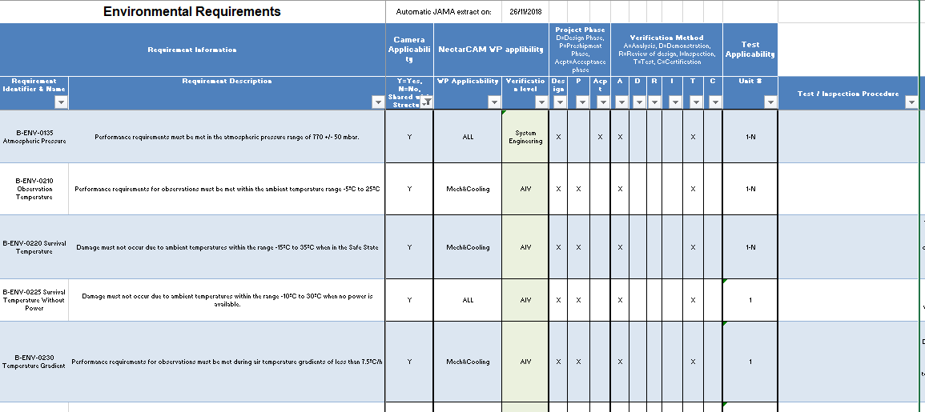
Verification Plan
Lists all the NectarCAM applicable requirements. For each requirement, the verification methods at each project phase, and the testing procedures are given

Slide 14
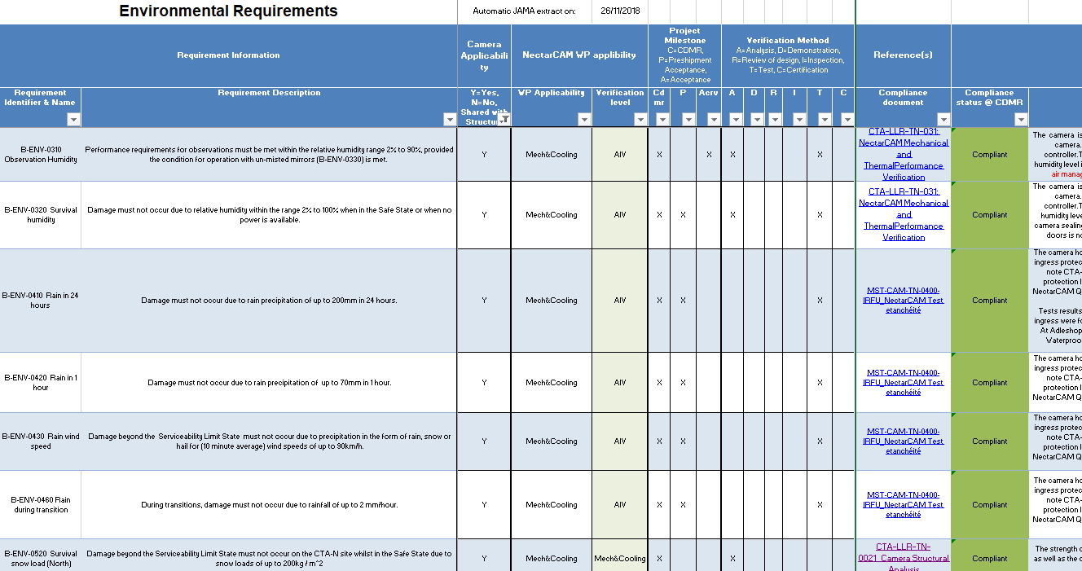
Compliance Matrix
Gives compliance status photography of the camera at a given time. V 3.0 gives the compliance status photography at the CDMR closure.
One compliance matrix will be issued for each project review and all camera units

Slide 15
NectarCAM Verification Status @ CDMR (last Spring)
No particular worry that we will not be compliant with some requirements
2 PC are related to South Earthquakes (not applicable, NCAM goes to North)
1 TBC is now validated by tests from the supplier of the new shutter (opening/closing up to 50km/h)
2 TBC are related to requirements to be clarified with CTAO
Most of the deferred to the preshipment review require the final software (RCC, ACADA, RTA)
3 were linked to missing test facilities (laser). Validated since.
4 are linked to maintenance duration or maintenance documentation
3 require that all errors /alarms/ particular cases are listed and analysed
Those deferred to the acceptance review are linked to the cabling on the telescope or validation from data center
Notes
Waterproofness of the first unit will be re-done soon with the updated camera front design
Thermal tests planned in the dark room in the coming weeks to validate by tests the requirements
….

Slide 16
CTA Requirements
CTA requirements are not yet frozen
Some requirements are still unclear, incomplete or wrong
CTAO intention is to prepare some generic specifications to be mentioned in the IKC agreement
Work complicated by existing advanced designs, and possible conflicts
Some environmental requirements should be relaxed
Forum for revision of telescope requirements set
https://redmine.cta-observatory.org/projects/telescope-requirements/boards
In the last CTAO MST SE meting, it was said that any change in the requirement will be mutually agreed by CTAO and the telescope. Changes should not impact the camera design

Slide 17
Verification : Next Steps
Write verification and inspection procedures
Expected for the Test Readiness Review (TRR)
CTAO should support the generation of these documents
Shall include
Test facilities description
Software and hardware configurations
Description of tests and inspections that will be performed on the camera units
Note that some verifications will be performed only on the first camera(s)
The QM is the ideal place to validate the performances, calibrate the camera and prepare the associated procedures
TRR Target: February / March 2023
“The basic objective of the TRR is to check whether the test item is ready for testing (including a check that there are no open change requests or action items from previous review) and whether the test program and its related facilities are fit to perform the test (i.e. test plans and procedures are available and accepted)” - CTA Management Plan 2020-05-25

Slide 18
Status of CDMR RIXes
for System Engineering WP

Slide 19
System Engineering RIXes: Status
27 RIXes within the category “System Engineering” (6 high priority)
22 are closed
4 non closed RIXes are assigned to CTAO (42381, 42336, 42629, 42511)
1 non closed RIX
RIX 41768
“We have discussed this topic in the monthly SE meeting between MST and CTAO in April 2021. MST agreed to provide the allocation of the MST level B requirements to the camera and structure (AI-210416-01). The allocation of requirements that are only for camera or structure exists / has been provided.“
“The remaining open part of the relevant action is for the MST team to provide a breakdown (budget allocation) for those requirements that have components from both structure and camera. This is currently on hold due to other priorities.”
Status on 2022-10-05

