Slide 1
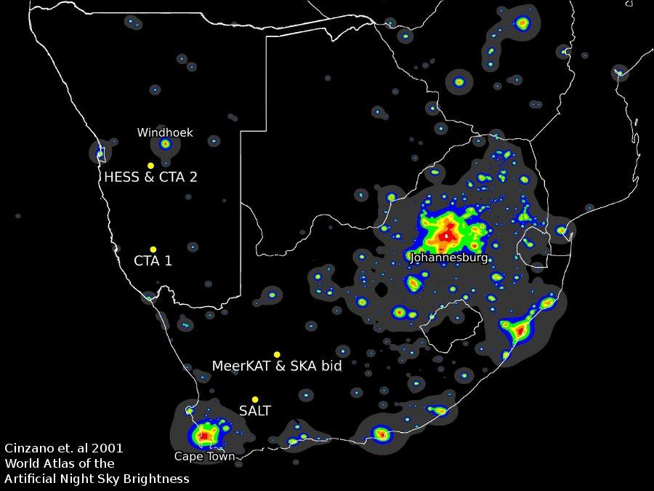
CTA Candidate site(S) in NAMIBIA
Namibia/SA CTA task team
SSC, Heidelberg, 3-5 April, 2013
Presenter: R Steenkamp
Special thanks to: P Krüger, T&S Hanke & I Davids

Slide 2
Introduction
Southern Africa offers
some of the world’s best sites for astronomy
good infrastructure and low risks for scientific investment
a proven track record in hosting and attracting world-class astronomical telescopes (H.E.S.S., SALT, KAT-7, MeerKAT, SKA)
Many excellent sites exist in Namibia – reduced to two sites:
The Aar/Kubub site(s) – from now on only referred to as the `Aar site’
Site(s) close to the H.E.S.S. site – from now on only referred to as the `Göllschau site’
Currently, the Aar site is the focus of investigations since
it is considered to be the superior site by us, and
the characteristics of the Göllschau site are well known

Slide 3
Site Location I (Maps)
Capital
with
Airport
(40km)
Göllschau
Aar
Railway
Station
Harbour
(120km)
&
Airport
(112km)

Slide 4
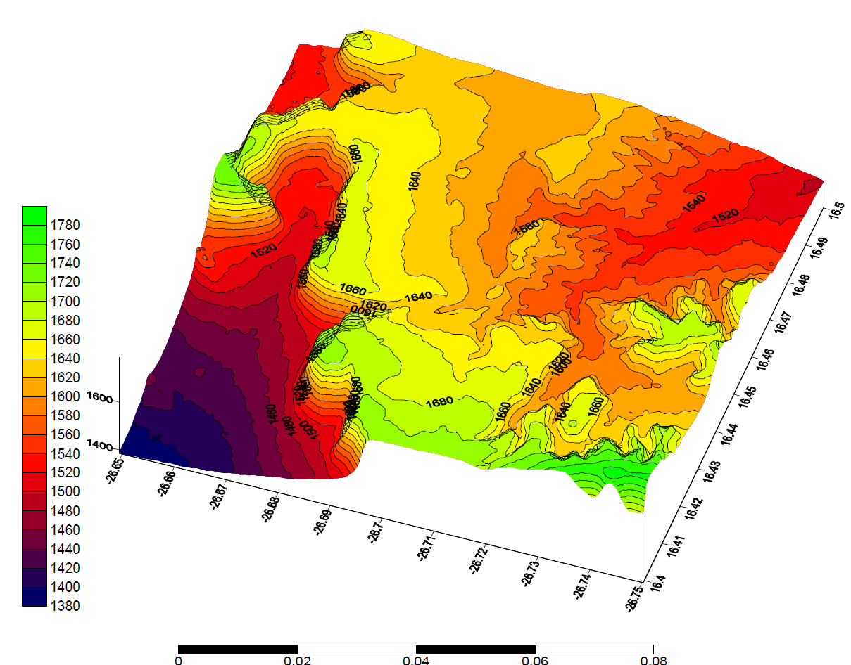
Site Location I (Orography)
Orography of the Aar/Kubub Plateau
Aar (East)
(16.4820ºE, -26.682ºS)
(1637±10) m asl
Aar (West)
(16.4530ºE, -26.691ºS)
(1633±13) m asl
Kubub
(16.4235ºE, -26.704ºS)
(1663±12) m asl

Slide 5
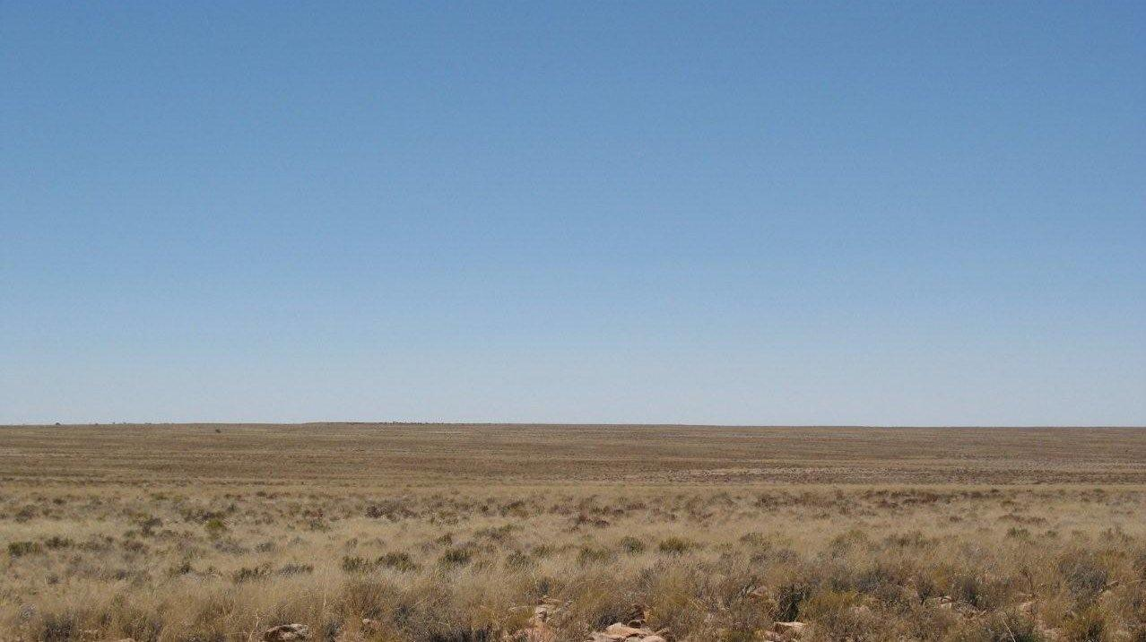
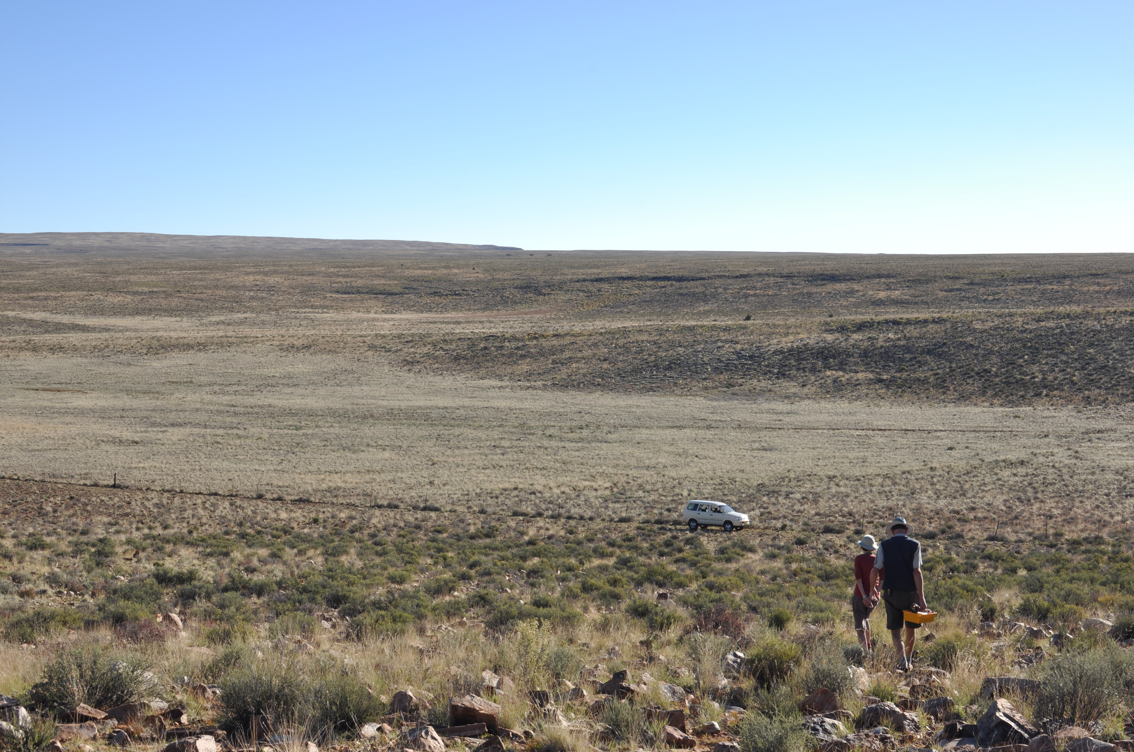
Site Location I (Images: Aar)
Aar site: Farm Kubub
Aar site: Farm Aar

Slide 6
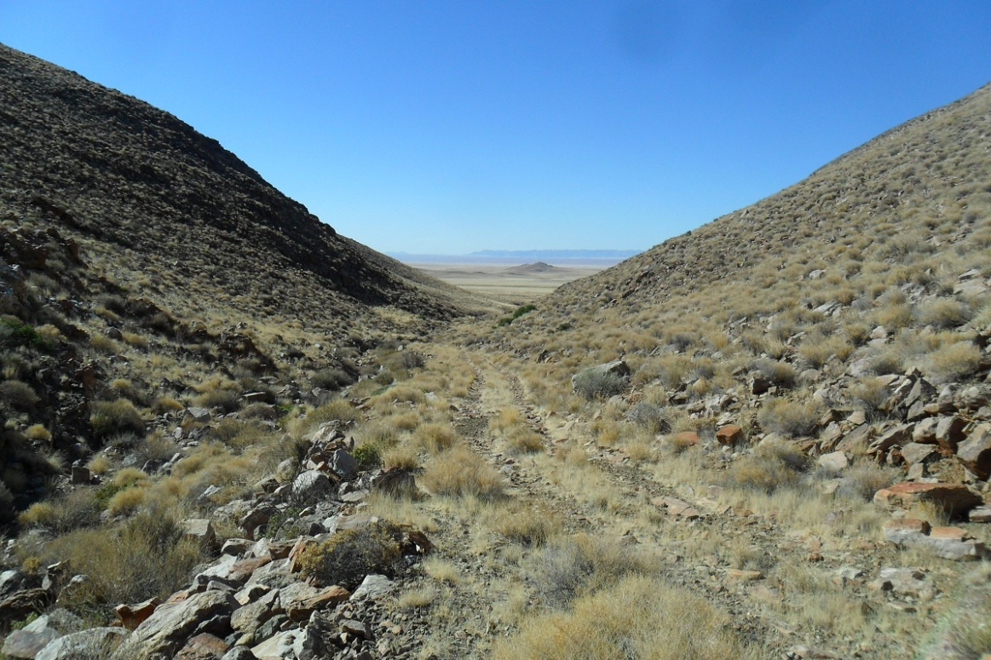
Site Location I (Images: Aar)
Aar site: Valley between the Aar and Kubub plateaus
(suggested location of access road onto the site)

Slide 7
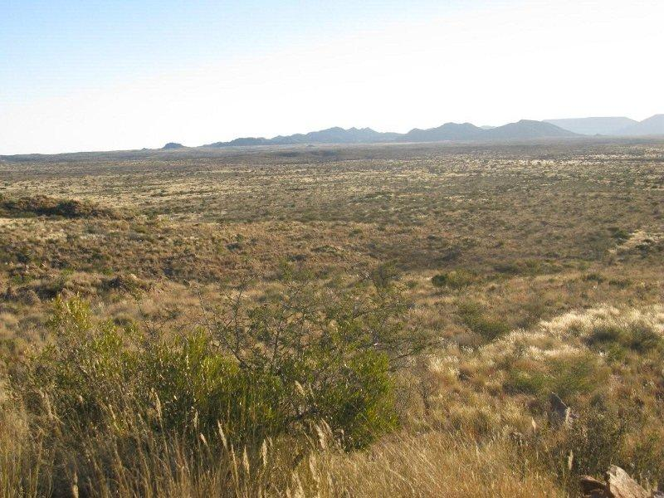
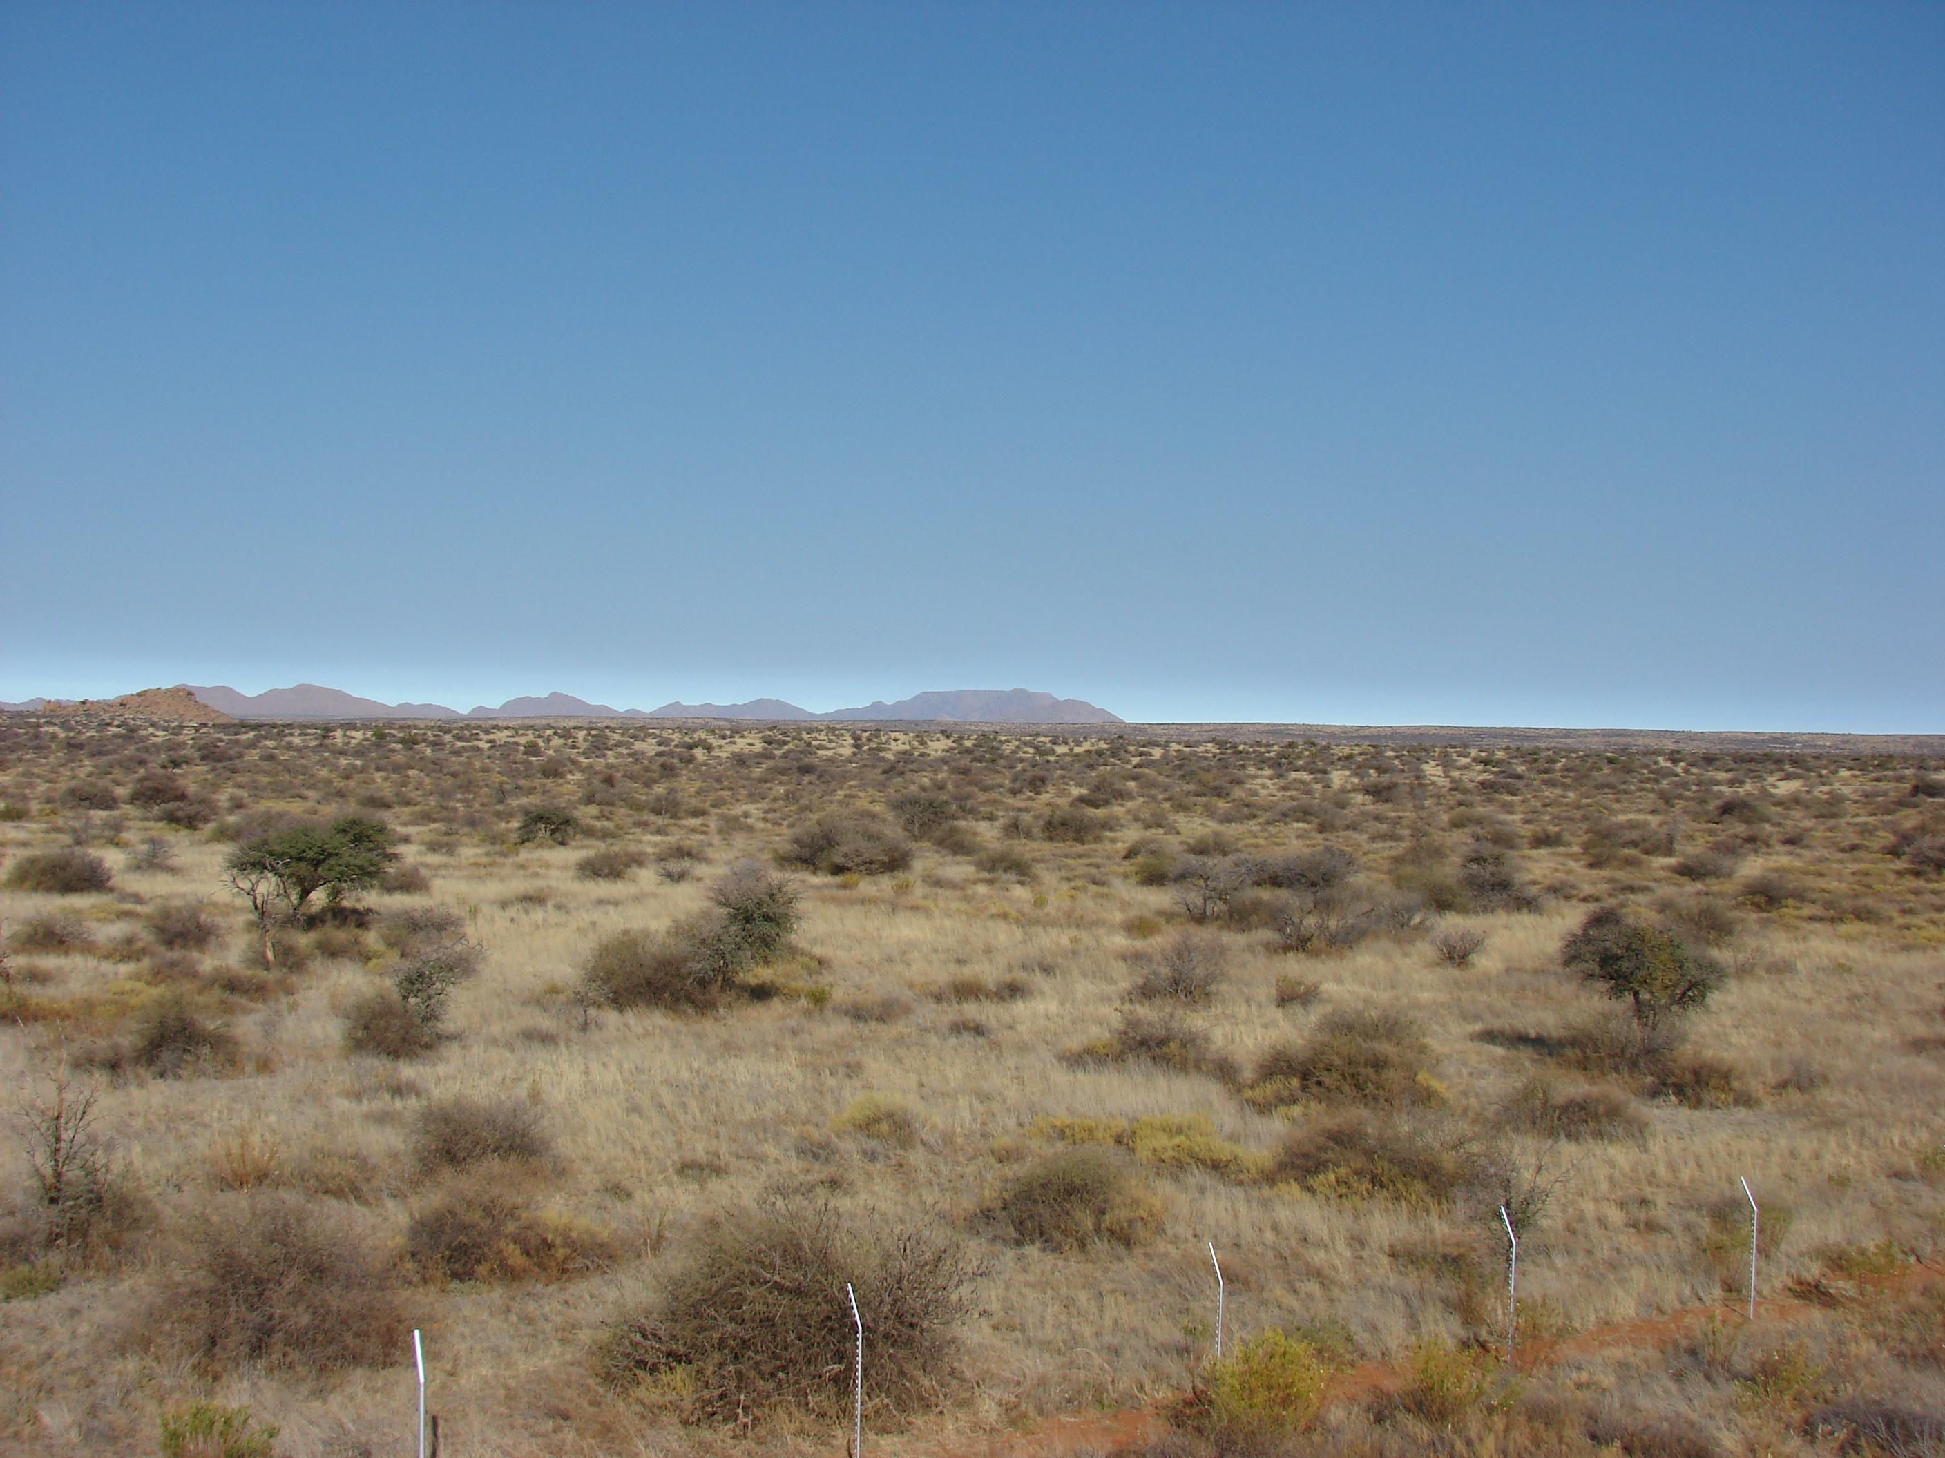
Site Location I (Images: Göllschau)
Göllschau site: Farm Göllschau
View of Mt Gamsberg from HESS site

Slide 8
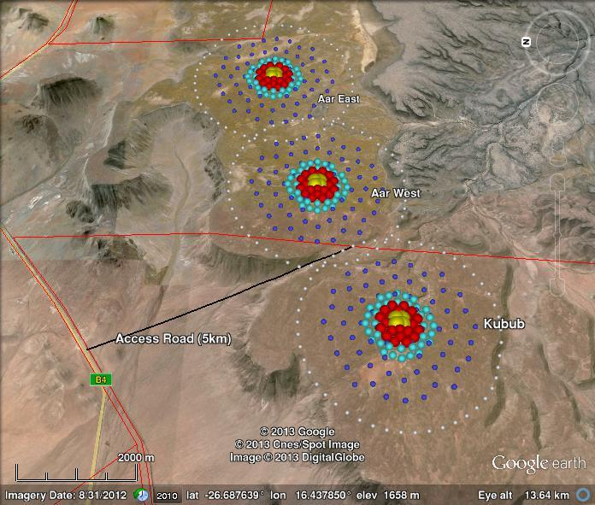
Site Location II
Implantation of CTA array on Aar/Kubub
Aar (East)
(16.4820ºE, -26.682ºS)
(1637±10) m asl
Aar (West)
(16.4530ºE, -26.691ºS)
(1633±13) m asl
Kubub
(16.4235ºE, -26.704ºS)
(1663±12) m asl

Slide 9
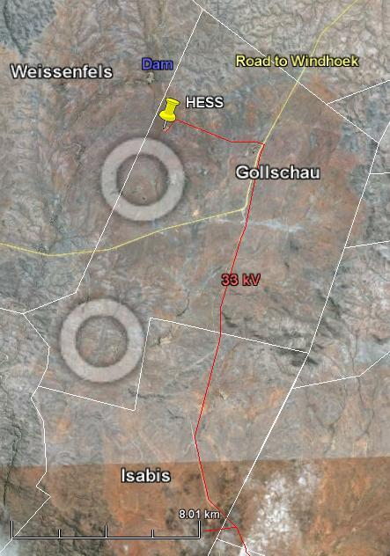
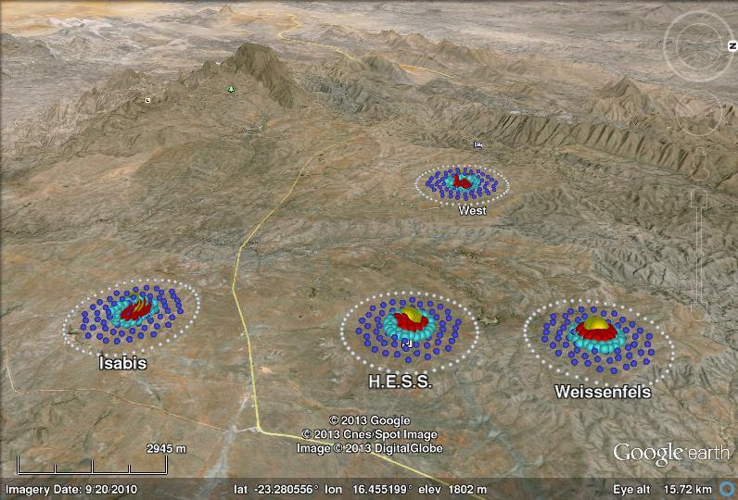
Site Location II
Implantation of CTA array on Göllschau
Göllschau: HESS
(16.4993ºE, -23.2715ºS)
(1815±7) m asl
Göllschau: Isabis
(16.490ºE, -23.340ºS)
(1767±10) m asl

Slide 10
Site Location II
Conformity with (Geographical & Topographical) Requirements:
Layout | Latitude [-40º,-20º] | Height a.s.l (mean±stdev) [1500,3800] m | Area [>10 km²] LinExt [>3 km] | Gradients | Δh between Highest & lowest tel. | Conform
Aar east | -26.682º | (1637±10) m | White dotted circles in previous diagrams represent area > 10 km² and diameters of 3.6 km | Local gradients in area of sites <3.5% Local gradients around telescope & buildings <2% | 48 m | Yes
Aar west | -26.691º | (1633±13) m |  |  | 71 m | Yes
Kubub | -26.704º | (1663±12) m |  |  | 69 m | Yes
Göllschau:HESS | -23.2715º | (1815±7) m |  |  | 34 m | Yes
Göllschau:Isabis | -23.340º | (1767±10) m |  |  | 51 m | Yes

Slide 11
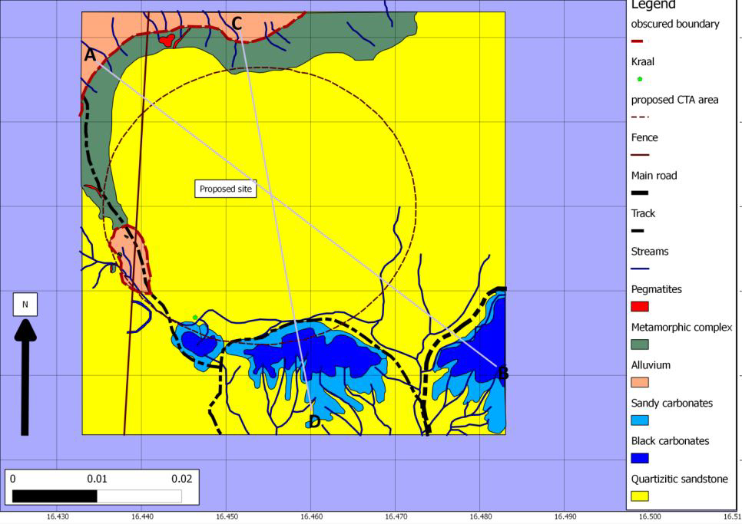
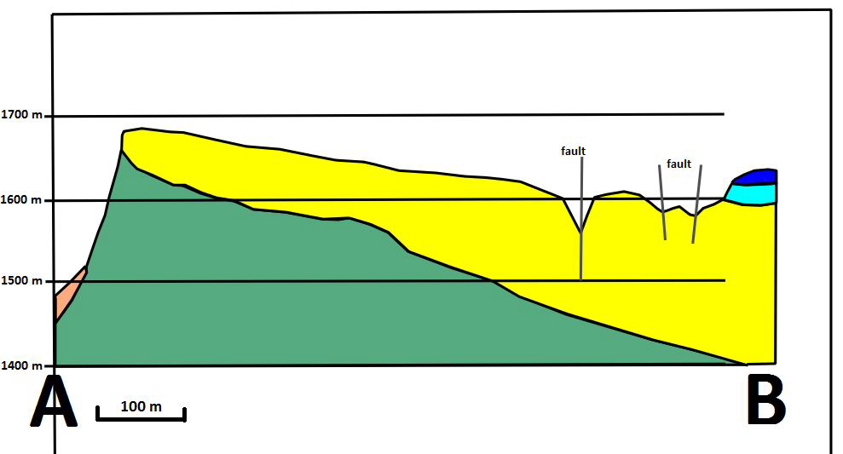
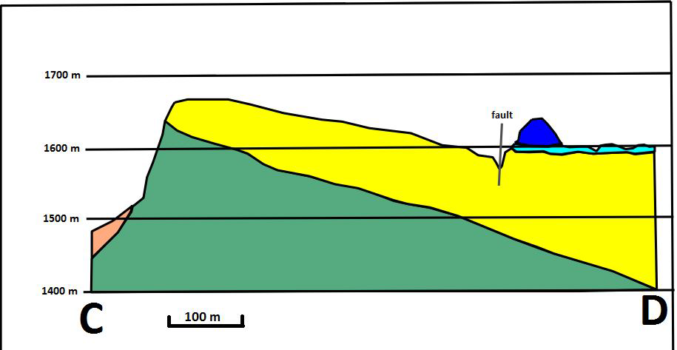
Site Location III
Geotechnical conditions (Aar)
Most of the Aar plateau consists of quartzitic sandstone interlayered with shales (depth ~ 20 m)
Telescope foundations on stable bedrock
Drainage removes water from the proposed site
Special consideration (Kubub)
Sand-filled depression on Kubub → Aar-west/-east implantation more desirable
Aar
(West)

Slide 12
Weather Conditions I : Cloud cover
Percentage of completely clear nights ( 0% cloud cover):
Aar: (80±5)%
Göllschau: (70±5)%
Percentage of partially clear nights (<20% cloud cover):
Aar: (85±5)%
Göllschau: (75±5)%
 | Göllschau |  | Aar
Moonless hours | 1602 |  | 1584
Cloud Cover | <20% | 0% | <20% | 0%
Moonless & cloudless hours | 1202±80 (75±5)% | 1121±80 (70±5)% | 1346±48 (85±5)% | 1267±48 (80±5)%
Hours available for observation* | 1173±80 | 1097±80 | 1275±54 | 1208±53
* Hours with too high humidity, too strong wind and too high temperature subtracted.

Slide 13
Weather Condition II: Wind
Percentage of night hours wind < 36 km/hr (10 min average):
Aar: >97-99%
Göllschau: >99%
Probability of > 200 km/hr gusts (1 sec gusts):
Aar: never
Göllschau: never
WIND | Observation Time Lost
 | Göllschau | Aar
% of night hours win < 36 km/h (10 min average) | < 0.5% | Atmoscope: < 0.2% SENES: 3%
Probability of > 200 km/h (1 sec gust) | never | never

Slide 14
Weather Conditions III: T, RH, precipitation
Percentage of time temperature and humidity within operation range:
Temperature in range >99% of the time at both sites
Humidity condition satisfied when dew point is not too large for observation.
Time loss of clear nights
Aar: (2.2±0.8)% Göllschau: (2.2±1.3)%
Percentage of nights with snow on ground:
Aar: light and sparse (~3h/yr)
Göllschau: never
Conformity with extreme temperature, humidity and precipitation survival requirements:
Temperatures -20 to 40ºC: SENES: -5 to 35ºC for both sites
Humidity 2 to100%: always for both sites
Precipitation in 24h < 200mm: always for both sites

Slide 15
Night Sky Background
Namibia sparsely populated with very little artificial light pollution
Göllschau:
Windhoek to the north-east may have effect at large zenith-angles
Aar:
Site is located in one of the darkest regions of the subcontinent
Shielded from road(s) and village of Aus.
LONS for both sites:
23.5±0.2 mag/arcsec² in B
22.5±0.2 mag/arcsec² in V
NB: sites are exposed to the natural brightness of the Milky Way

Slide 16
Natural Hazard Risks
Earthquakes:
Both sites located in one of the most
seismic stable regions on Earth
Wind storms:
Never occurs at both sites
Hail storms:
Lowest risks for both sites (SENES: none)
Sand storms:
Aar less risk than Göllschau
Recent study by UNAM’s Geology Department:
“There is no evidence for any occurrence of sandstorms…”
“…no ventifacts, sand ramps or sand traps.”
“Man-made structures do not show any signs of abrasion by sandstorms…”

Slide 17
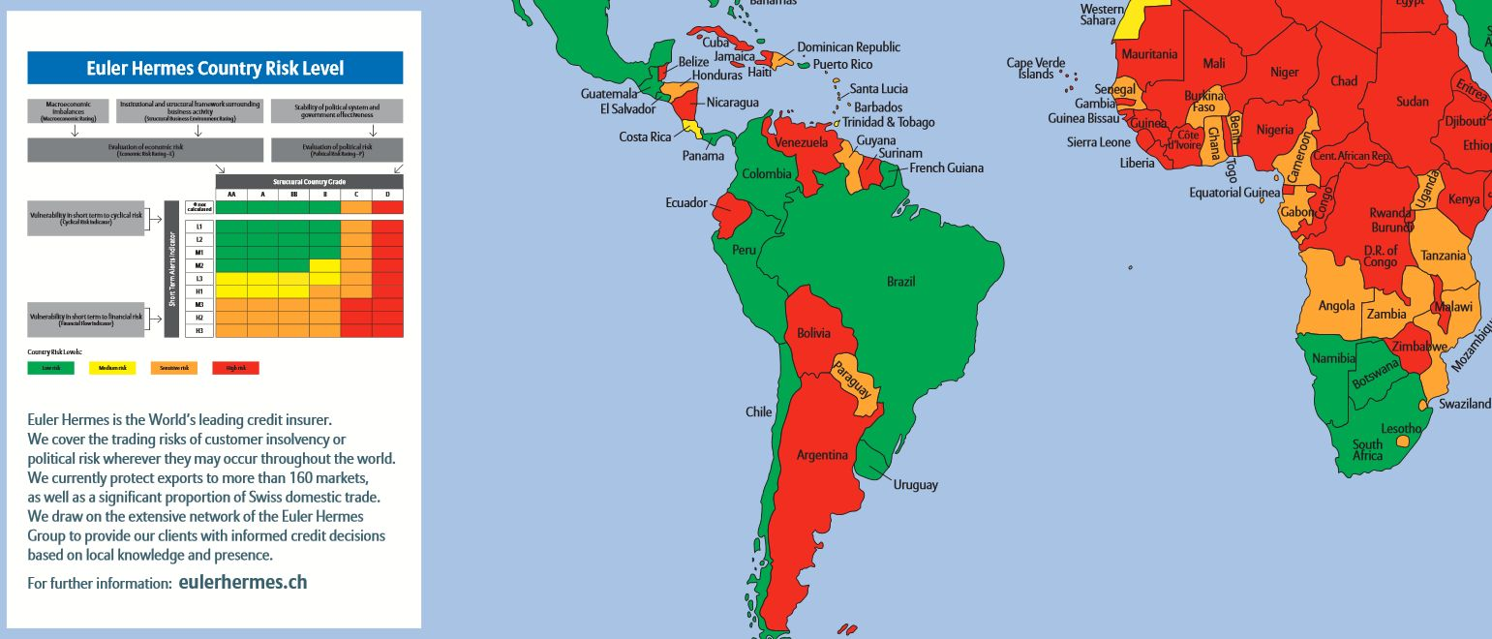
Social/Political Risks I
Political stability of Namibia:
Politically stable – no history of conflict since independence.
All regime changes since 1990 incident free as result of national elections.
“B” Euler-Hermes risk grade – “Low Risk”

Slide 18
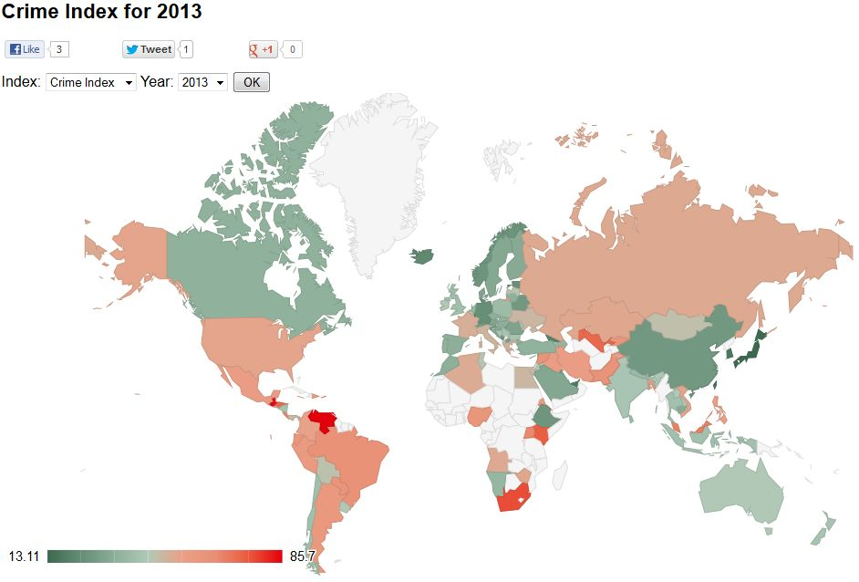
Social/Political Risks II
Crime in Namibia:
The crime rates in the rural areas \quite low – proposes sites very safe
The crime rate in Namibia much lower than most countries around the globe
Numbeo: Namibia has Crime & Safety Indices similar to the Netherlands.
However, precautions against burglary should be undertaken at the sites.
http://www.numbeo.com/crime/rankings_by_country.jsp

Slide 19
Social/Political Risks III
Import regulations:
Import & Export Control Act, Act 30 of 1994 –import permits pre-obtained
All imports subject to importation duties -- unless a rebate/exemption pre-negotiated
Any other important consideration:
Namibian officials at Ministry:
similar concessions extended to H.E.S.S. & SKA possible for CTA…

Slide 20
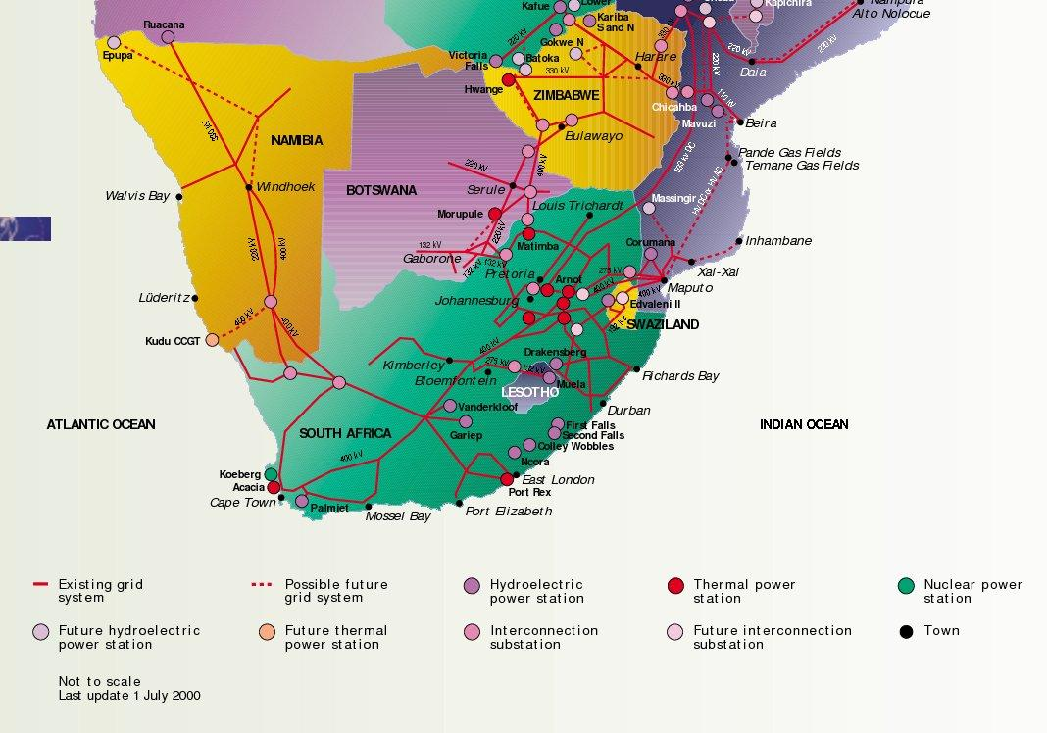
Infrastructure I
Electricity:
Southern African Power Pool
connecting stations in Keetmanshoop and Windhoek.
Detailed quotations requested from NamPower (and paid for) in 2012
still pending
Last week: Ministry officials in contact with NamPower MD
…however, certain estimates can be made:

Slide 21
Infrastructure I
Electricity (Aar):
Two 132kV lines passing the farm Aar.
The closes substation just north of Aus, connecting it with a 33 kV line
A new power line, from Aus to farm Aar would have to be built.
Rough estimate: Such a 20 km line will cost about N$3.6 million (~€360,000)

Slide 22
Infrastructure I
Electricity (Göllschau):
H.E.S.S. is already connected to NamPower via a 33 kV power line
A short power line need to be constructed towards the eventual site

Slide 23
Infrastructure II
Water:
Aar:
Boreholes on Farm Kubub (35 m³/hour) → sufficient water available
needs to be pumped up to the plateau & stored in reservoir
Göllschau:
General use: boreholes can deliver slightly more than 5 m³/day
Construction: Farm Weissenfels has a dam.

Slide 24
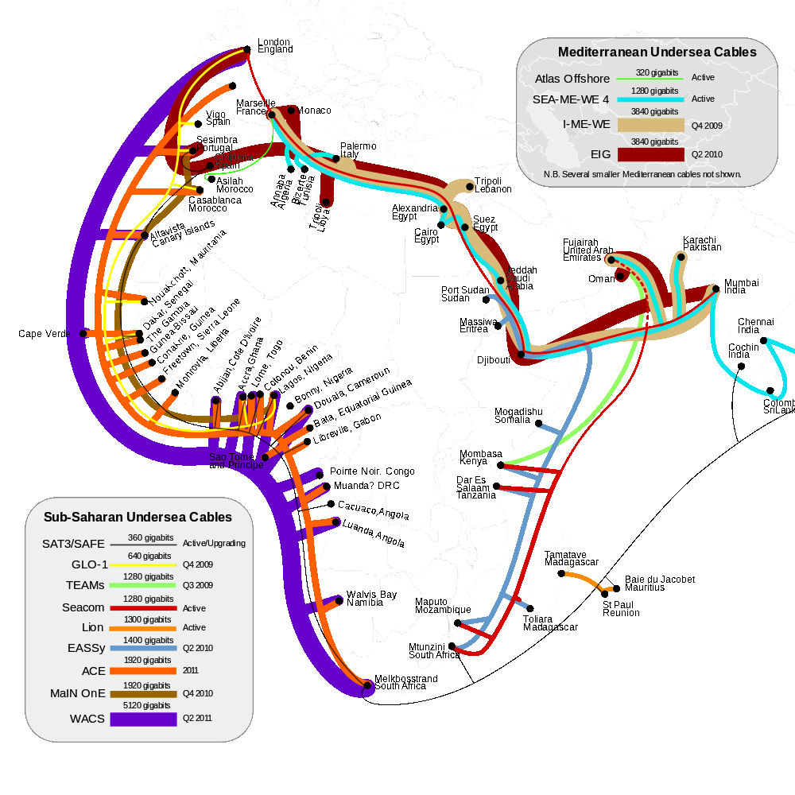
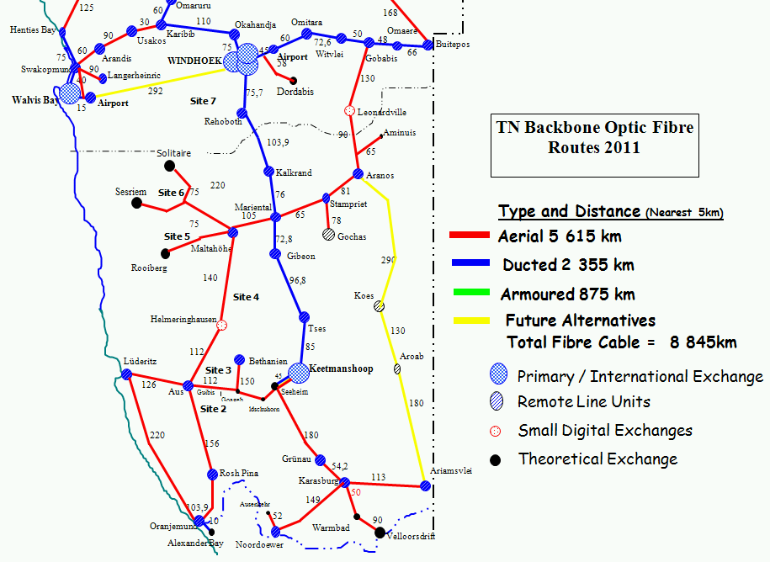
Infrastructure III
Data network:
Namibia has well-developed optical fibre network
International bandwidth supplied by sub-marine cables:

Slide 25
Infrastructure III
Data network (continued):
Telecom Namibia will construct relevant network extension(s):
30 km fibre Aus→Aar and/or 90 km fibre from Rehoboth→Göllschau)
N$805,000 (~€67,000) once-off set-up fee
Telecom Namibia quotations for highly redundant, fully protected 1 Gbps link:
N$5,071,549/month rental (~€423,000/month)
Quotations also for 5 & 10 Gbps links
Cheaper, alternative designs with less guarantees available

Slide 26
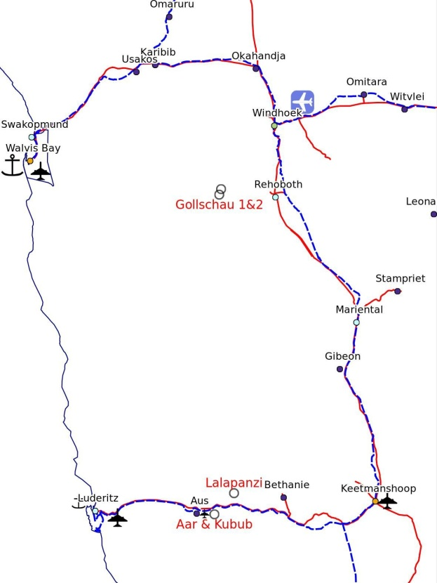
Accessibility
Distance to airport:
Aar: Lüderitz airport (~140 km) – mostly tarred road
Göllschau: Hosea Kutako International airport (~140 km) – mostly gravel
Nearest town to live:
Aar: Aus (~30 km)
Göllschau: Windhoek (~100km dirt road) or Rehoboth (90 km dirt road)
Nearest hospital:
Aar: Clinic in Aus – larger hospitals in Lüderitz & Keetmanshoop
Göllschau: Hospitals in Windhoek & Rehoboth

Slide 27
Site Ownership
Procedure to obtain permission for use:
Lease contract to be negotiated with relevant landowner/farmer
Aar:
CTA can be build entirely on Farm Aar but access road must be through Farm Kubub (owners gave verbal permision)
Göllschau:
CTA can be built on Farm Göllschau or partially also on Farm Weissenfels
Construction permits needed:
No construction permits are needed as all sites do not fall under any municipal areas
Nevertheless, it is advised to adhere to local building codes

Slide 28
Political support of Host Country I
Clear support fexpressed several times by government(s) at regional, national and local levels:
Regionally, the issue of CTA South has been repeatedly discussed between government officials tasked with Science & Technology from Namibia & South Africa.
Nationally, statements of support ranging from the original letter of support by the PS of the Ministry of Education to support stipulated in the inauguration speech of H.E.S.S. II by the Minister of Education.
Officials of the Ministry of Education signed the CTA Declaration of Intent (DoI) in 2012
Public monetary resources was made available for site investigations, and very recently towards the appointment of a Namibian CTA project manager.
Locally, support was expressed by a Namibian regional councillor at a recent meeting of the Namiba/SA CTA team in Aus.

Slide 29
Political support of Host Country II
Last week: I was reminded by officials to mention:
The Namibian government can issue visas at no charge.
The Namibian government is open to discussions vis à vis importation duty & tax concessions
The latter may result in CTA saving millions with the aid of tax concessions

Slide 30
Conclusion
Strong political support exists within Namibian & Region (esp. South Africa)
Well developed transport, power and telecommunications networks
Manpower, especially unskilled and semi-skilled labour is quite cheap
Göllschau site close to capital & already has much of infrastructure in place → lower risk site
Aar site more remote, but has better transport infrastructure, and is a better from astronomical PoV
Both sites: excellent & low risk options to host CTA South
All the proposal documents, reports, presentations, photos etc. are available at https://portal.cta-observatory.org/WG/SITE/SitePages/NamibiaInfo.aspx

Slide 31
Epilogue

