Slide 1
CTA site requirements and environmental conditions
John Carr Centre de Physique des Particules de Marseille and Landessternwarte, Heidelberg

Slide 2
Formal Requirements Policy
Define requirements for all CTA Systems
Impose requirements on all designs, products and sites
Define specification conforming to requirements
Verify conformity of design/site to requirements

Slide 3
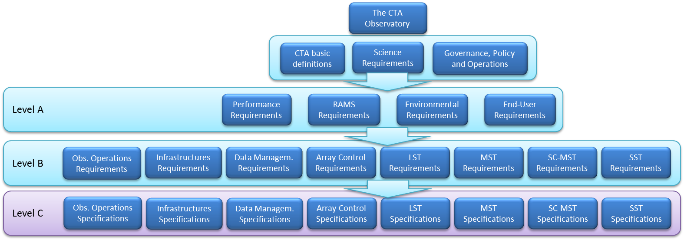
CTA Requirements tree
Requirement with impact of site choice:
Performance
RAMS
Environmental
Infrastructure

Slide 4
Requirement documents on webpage
https://portal.cta-observatory.org/Bodies/SSC/SitePages/Documents%20for%20the%20meeting.aspx

Slide 5
Environmental Requirements (extracts)
A-ENV-0110 | Southern hemisphere site of CTA must have latitude of -40 to -20°.
A-ENV-0120 | Northern hemisphere site of CTA must have latitude of 20 to 40°.
A-ENV-0130 | Altitude of the sites above mean sea level will be 1500 – 3800 m.
A-ENV-0140 | Area available for the deployment of the southern hemisphere site must be 10 km².
A-ENV-0145 | Area available for the deployment of the southern hemisphere site must have a linear extent in all directions of >3 km.
A-ENV-0150 | Area available for the deployment of the northern hemisphere site must be >1 km².
A-ENV-0155 | Area available for the deployment of the northern hemisphere site must have a linear extent in all directions of >0.9 km.
A-ENV-0160 | Local gradients in the area of the sites with roads, after ground levelling, must be <8 %.
A-ENV-0170 | Local gradients in the area around the telescope, for 5 m beyond the structures and after ground levelling, must be 2 %.
A-ENV-0210 | Ambient air temperatures during observations will be-10 to +25 °C.
A-ENV-0220 | Extreme air temperature range where telescopes and buildings must suffer no damage will be -20 to +40 °C.
A-ENV-0230 | Range of air temperature gradient at night time will be ±5 °C/h.
A-ENV-0240 | Natural temperature variations within 24 hours will be less than ±30 °C.
A-ENV-0310 | Relative humidity for observations is in the range 4-90%.
A-ENV-0320 | The relative humidity for survival in safe state is in the range 2-100 %.
A-ENV-0330 | The telescope mirrors must not mist when the dew point temperature is at least 2 C lower than the ambient temperature.
A-ENV-0410 | Maximum rain precipitation in 24 hours is 200 mm.
A-ENV-0420 | Maximum rain precipitation in one hour is 70 mm.
A-ENV-0430 | Assumed wind speed for blowing rain is 90 km/hour.
A-ENV-0450 | No rain will be present during observations.
A-ENV-0510 | No snow will be present on the ground during observations.
A-ENV-0520 | Damage beyond the SL level must not be incurred during safe state for a snow accumulation of the ground of <50 cm.
A-ENV-0530 | All elements of the system must be undamaged in safe positions by the impact of hailstones with diameter <20 mm.
A-ENV-0540 | Sites must have a probability that hailstones with a diameter of >20 mm should occur with a frequency <0.03 per year.
A-ENV-0610 | No ice will be present on any surfaces during observations.
A-ENV-0620 | Damage beyond the SL level must not be incurred during safe state for an ice thickness (on all surfaces) of <20 mm.
A-ENV-0710 | During observations the 10-minute average wind speed is <36 km/h.
A-ENV-0730 | Telescopes must not incur damage beyond the SL level whilst in safe state with 1s wind gust <200 km/h.
A-ENV-1110 | Earthquake Damage Limitation requirement: Peak horizontal ground acceleration <0.25g and peak vertical ground acceleration<0.3g with 10% probability of exceeding these figures within 10 years.
A-ENV-1120 | Earthquake Collapse Prevention requirement: Peak horizontal ground acceleration <0.5g and peak vertical ground acceleration <0.6g with 10% probability of exceeding these figures within 50 years.
A-ENV-1310 | The site will have a fraction of moonless night hours completely cloud free above the site of >70%.
A-ENV-1410 | The median of NSB measurements over time after removing zodiacal light and light from stars brighter than magnitude 20, over at least 90% of the sky above 30° elevation must be >22.40 mag/arcsec² in B', and >21.25 mag/arcsec² in V.
A-ENV-1420 | The ambient light level during observations is expected to be in the range given, with a spectrum of the form shown in Figure 3 of reference [ 6 ], in the wavelength range 300-650 nm.

Slide 6
Infrastructure Requirements (extracts)
B-INFRA-0100 | There must be road access to Observatory sites for cargo transport vehicles (trucks/lorries) up to a maximum load of 40 ton, free passage for a low loader carrying a 12m railway wagon sized load and mobile cranes of up to 100 ton.
B-INFRA-0300 | Peak electrical power required for southern observatory operation is 3 MW
B-INFRA-0305 | Provision must be made for a possible upgrade of the peak power provision to CTA South by an additional 1 MW
B-INFRA-0310 | Average electrical power required for southern observatory operation during observations is 1.3 MW
B-INFRA-0320 | Southern site infrastructure must provide an annual electric energy supply of 3.9 GWh
B-INFRA-0330 | Peak electrical power required for northern observatory operation is 2 MW
B-INFRA-0340 | Average electrical power required for northern observatory operation during observations is 0.7 MW
B-INFRA-0350 | Northern site infrastructure must provide an annual electric energy supply of 1.9 GWh
B-INFRA-0370 | Primary electrical power distribution network of (both sites of) the CTA Observatory must use 32 kV with 3 phases.
B-INFRA-0400 | Both sites of the CTA Observatory must be provided with gigabit communications links to international networks.
B-INFRA-0410 | Both sites of the CTA Observatory must be provided with internal and external telephone communications.

Slide 7
Safety Requirements (extracts)
A-RAMS-0180 | Construction, operation and decommissioning of the CTA systems must comply with European or host country regulations
A-RAMS-0185 | Construction, operation and decommissioning of the CTA systems must comply with applicable regulations on the protection of the environment.
A-RAMS-0190 | No single failure of hardware or software must have either critical or catastrophic consequences.
A-RAMS-0200 | No reasonably foreseeable human error must have either critical or catastrophic consequences.
A-RAMS-0210 | The telescope must never be in the state where it can move in an uncontrolled manner.
A-RAMS-0215 | The ICT systems on site must have an appropriate level of protection against unauthorised access/hacking.
A-RAMS-0220 | Each site must have a lightning protection system in all buildings and structures.
A-RAMS-0225 | Each building and structure must have an appropriate level of fire protection.
A-RAMS-0230 | Each building and structure must have an appropriate level of protection against flooding.
A-RAMS-0235 | Each building and structure must have an appropriate level of protection against earthquakes.
A-RAMS-0250 | Each site must guarantee medical attention at the primary care level.
A-RAMS-0260 | Regulations for work practices on-site must be designed so as to minimise critical and catastrophic risks to personnel.
A-RAMS-0265 | Basic external communications (e.g. telephone line ) must exist from the sites at all times, for the purposes of communicating emergency situations on-site.
A-RAMS-0270 | The time required from the notification of an emergency for the transportation of humans to the nearest hospital must be < 4 hours
A-RAMS-0280 | Hazardous areas must be properly signaled and access to them restricted to workers with adequate skills and certificates.
A-RAMS-0290 | Operators of potentially hazardous equipment, as well as those in charge of abnormally dangerous activities, must be in possession of the appropriate skills and certificates.
A-RAMS-0300 | The entrance control device to restricted areas must not impede the exit from them, nor must this exit be dependent on electric supply or electronic and software systems.
A-RAMS-0310 | Each telescope must have all the safety subsystems and signaling needed to prevent human injuries.
A-RAMS-0320 | Outdoor maintenance operations on site must be performed only during daytime and under safe weather conditions.

Slide 8
Example I: Site topography
Requirements
The area available for the deployment of the southern hemisphere site must be > 10 km²
The area available for the deployment of the southern hemisphere site must have a
linear extent in all directions of > 3 km
The area available for the deployment of the northern hemisphere site must be > 1 km²
The area available for the deployment of the northern hemisphere site must have a
linear extent in all directions of > 0.9 km
The local gradients in the area of the sites with roads, after ground levelling, must be <8 %
The local gradients in the area around the telescope and buildings,
for 5 m beyond the structures and after ground levelling, must be <2 %
Verification and Considerations
Maps
Measurements
Civil Engineering studies: costs

Slide 9
Example II: Hail
Requirements
All elements of the system must be undamaged in their Safe positions by the impact
of hailstones with diameter <20 mm.
The CTA sites must have a probability that hailstones with a diameter of > 20 mm
should occur with a frequency < 3% / year.
Verification and Considerations
Test mirrors with dropped ball bearings of same energy
Data from site
Long term data difficult to obtain, need occurrence < 1 per 30 years

Slide 10
Example III: Earthquakes
Requirements
Damage Limitation requirement: Peak horizontal ground acceleration < 0.25g
and peak vertical ground acceleration < 0.3g
with 10% probability of exceeding these figure within 10 years.
With these conditions, all system shall meet the Damage Control Limit requirement
Collapse Prevention requirement: Peak horizontal ground acceleration < 0.5g
and peak vertical ground acceleration < 0.6g
with 10% probability of exceeding these figure within 50 years.
With these conditions, all systems shall meet the Collapse Prevention Limit state
Verification and Considerations
Design telescope to withstand earthquakes with given parameters
Verify with Finite Element Analysis
Ensure data from site conforms to input to analysis
Estimate incremental costs to design with earthquakes

Slide 11
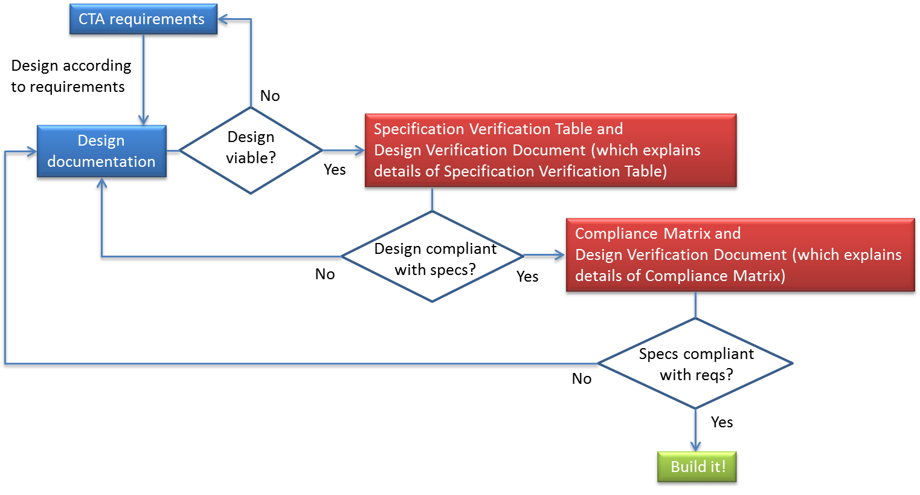
Iterate requirements with design / site
Plan for the possibility of changing requirements
if design / site cannot conform
Produce conformity matrix that design / site do conform

Slide 12
Summary
Chosen sites must conform to final requirements

