Slide 1
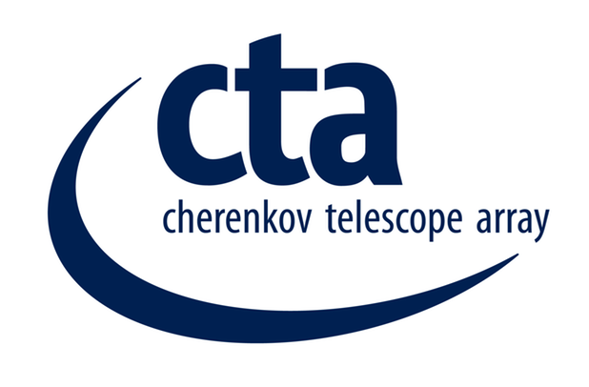
Hazards and risks at candidate sites
John Carr
Centre de Physique des Particules de Marseille
and
Landessternwarte, Heidelberg

Slide 2
Philosophy for risk treatment
Nearly all risks could in principle be mitigated in the design.
Requirements give the “worst case” for conditions on candidate sites
Design the telescope to withstand these conditions.
Implies an extra cost for the structures
Estimates of the incremental costs of construction underway
“Risk” then that the strategy is not applied properly in properly
Must know conditions and must design accordingly

Slide 3
Environment “Risks” considered
Risk | Consequence | Mitigation in design ? | Hazard for personnel ? | Sites potentially with significant risk
Earthquakes | Catastrophic damage to structures | costly | yes | Armazones, Leoncito, San Antonio, San Pedro Martir
Volcanoes | Destruction by lava flow, mirror damage from ash fall | no | unlikely | Teide
Extreme winds | Major damage to telescopes and mirrors | costly | yes | Teide, San Pedro Martir (?)
Dust storms | Degradation of mirrors | difficult | no | Armazones, Leoncito (?)
Hailstorms | Degradation and destruction of mirrors | difficult | no | (?)
Lightning | Damage to electrical systems | done | unlikely | Many
Flooding | Erosion of foundations, cable ducts and roads | some cost | possibly | Leoncito, San Antonio, San Pedro Martir (?)
Excessive rain | Short circuits in electrical systems | possible | no | Many
High humidity | Misting of mirrors, loss of data | some cost | no | San Antonio

Slide 4
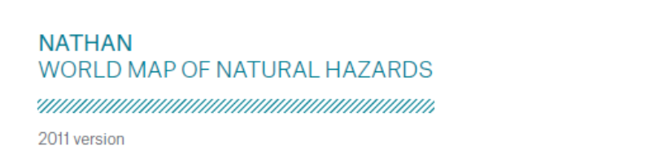
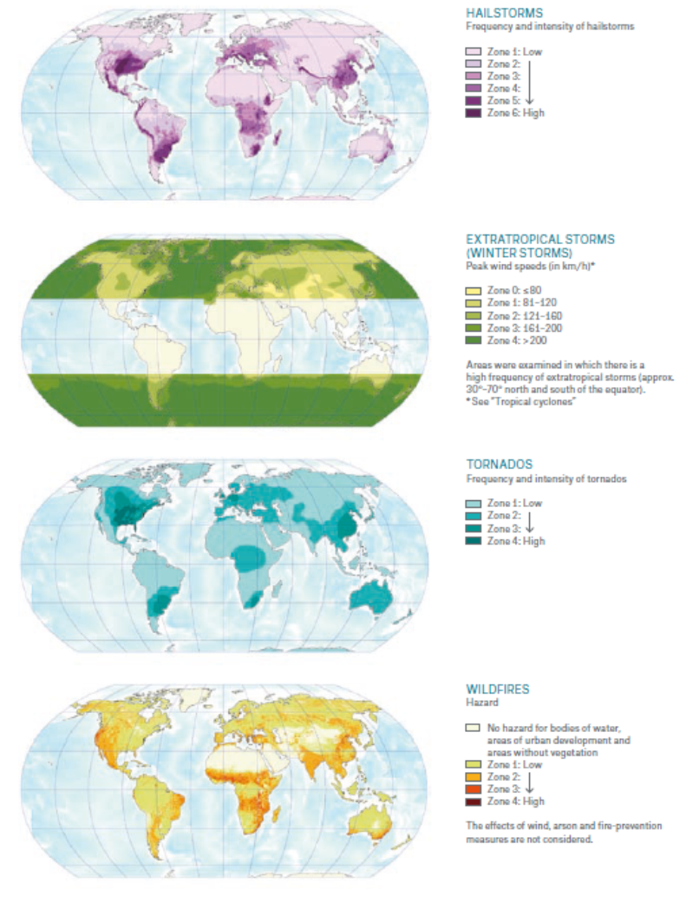
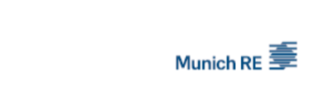
Evaluation of Risk from Munich RE data

Slide 5
Summary of Munich RE Risk Analysis
Site Name | Earthquake | Storm | Cyclone | Tornado | Hail | Lightning | Volcano | Wildfire
Teide | 3 | 3 | 0 | 1 | 1 | 1 | 3 | 2
San Pedro Martir | 4 | 0 | 2 | 2 | 3 | 2 | 0 | 1
Meteor Crater | 2 | 2 | 0 | 1 | 3 | 3 | 0 | 2
Yavapai 9 | 2 | 2 | 0 | 1 | 3 | 3 | 0 | 2
San Antonio | 3 | 0 | 0 | 1 | 2 | 3 | 1 | 1
Leoncito | 4 | 2 | 0 | 2 | 2 | 2 | 0 | 1
Armazones | 5 | 0 | 0 | 1 | 1 | 1 | 0 | 0
HESS | 2 | 0 | 0 | 1 | 1 | 3 | 0 | 1
Aar | 1 | 0 | 0 | 1 | 1 | 2 | 0 | 1
Risk Scale legend | 0 | 1 | 2 | 3 | 4 | 5
Earthquake |  | MM V and < | MM VI | MM VII | MM VIII | MM XI and >
Extratropical Storm * | none | <80 km/hr | 81-120 km/hr | 121-160 km/hr | 161-200 km/hr | >200 km/hr
Tropical Cyclone* | low | 76-141 km/hr | 142-184 km/hr | 185-212 km/hr | 185-212 km/hr | >252 km/hr
Tornado (range 1-4) | none | low | → | → | high
Hail ( range 1-4 ) |  | low | → | → | high
Lightning † |  | 0.2-1 | 1-4 | 4-10 | 10-20 | >20
Volcano ( range 1-3) | None | minor | moderate | high
Wildfire (range 1-4) |  | low | → | → | high
MM= Modified Mercali * Mean exceedance probability of <10% in ten years for peak wind speeds † Global frequency of lightning strokes / km2/year

Slide 6
Earthquake Risk: Summary
Site | Number of earthquakes 1963-2012 (50 years) |  |  |  |  |  | Average depth Distance <50 km Mag >5 | Global Seismic Hazard Peak Ground Acceleration
 | Distance <250km |  |  | Distance < 25 km
 | Mag > 5 | Mag > 6 | Mag > 7 | Mag > 5 | Mag > 6 | Mag > 7
Teide | 1 | 0 | 0 | 0 | 0 | 0 | 23 km | 0.15 m/s²
San Pedro Martir | 84 | 7 | 1 | 0 | 0 | 0 | 16 km | 2.51 m/s²
Meteor Crater | 4 | 0 | 0 | 0 | 0 | 0 | none | 0.60 m/s²
Yavapai | 5 | 0 | 0 | 0 | 0 | 0 | none | 0.72 m/s²
San Antonio | 322 | 18 | 2 | 1 | 0 | 0 | 191 km | 1.77 m/s²
Leoncito | 391 | 21 | 3 | 14 | 2 | 0 | 101 km | 2.92 m/s²
Armazones | 463 | 32 | 6 | 10 | 1 | 1 | 41 km | 4.53 m/s²
HESS | 1 | 0 | 0 | 0 | 0 | 0 | none | 0.31 m/s²
Aar | 0 | 0 | 0 | 0 | 0 | 0 | none | 0.00 m/s²
ANSS Composite Catalogue http://www.ncedc.org/anss/catalog-search.html
Global Seismic Hazards Assessment Program, http://gmo.gfz-potsdam.de/
Requirements: telescopes withstand 0.5 g
If design and requirement correct: no “risk”
but…..

Slide 7
Extreme Wind
Winds affect the telescopes in two distinct ways:
  Data loss due to the average wind speed exceeding the operational value (36km/hr 10 min average)
  Damage to the structure if the extreme wind exceeds the design values requirements to avoid structural damage (200 km/hr gust).
If the numbers and the corresponding design are correct no risks,
but…
To give reassurance on wind values, further estimates will be made from the dedicated studies ordered from the University of Genova.

Slide 8
Some risks not yet well evaluated
CTA Telescopes not in shelters
and
so always exposed to adverse elements
Variety of risks for telescope damage:
        Snow/ice load
        Damage to mirrors from dust and sand
        Damage to mirrors from hail

Slide 9
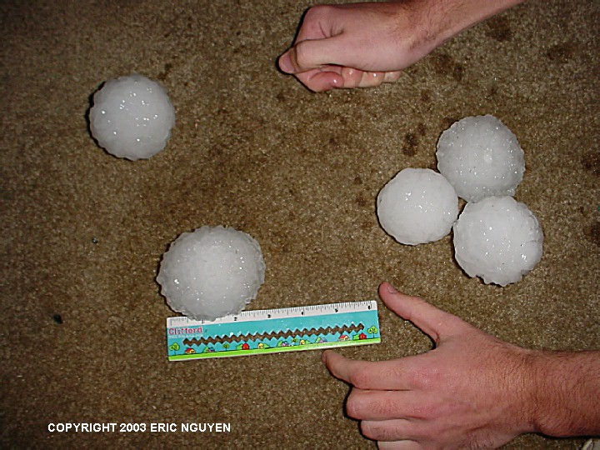
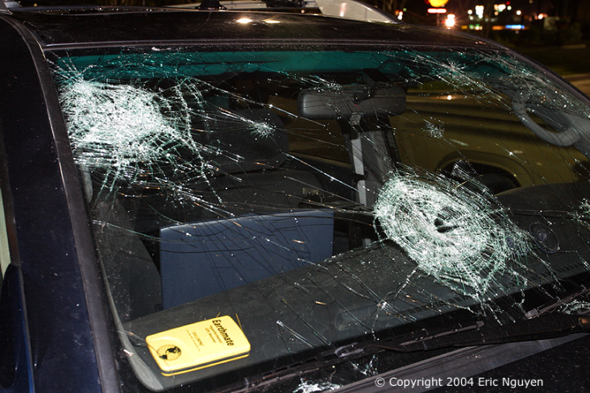
Hail storms
Site | Information on hail
 | SENES 10 year simulation Average hours/year | Proposal
San Pedro Martir | 11 | —
Teide | 4 | 1.5 days/year
Meteor Crater | 0.7 | 0 occurrence in 60 years
Yavapai | 2 | 3 occurrence in 60 years
San Antonio | 54 | —
Leoncito | 3 | —
Armazones | 0.5
HESS | 0 | Very low risk
Aar | 0 | Very low risk
Lacking detailed information
about hail on sites

Slide 10
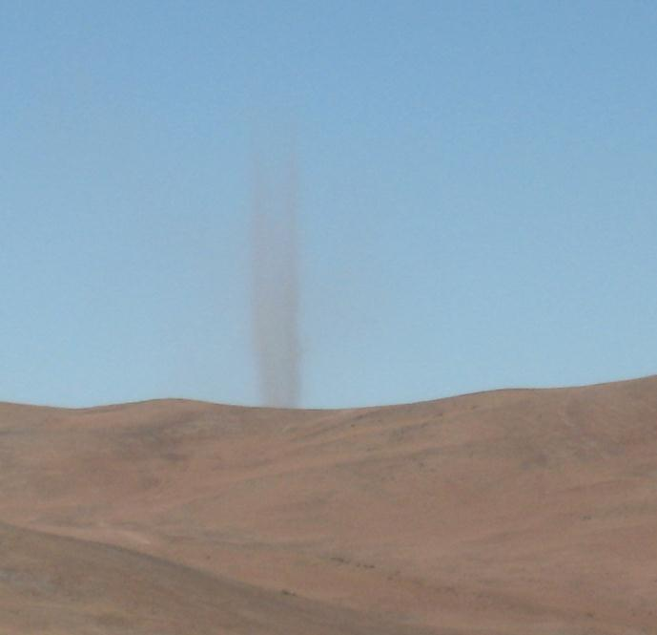
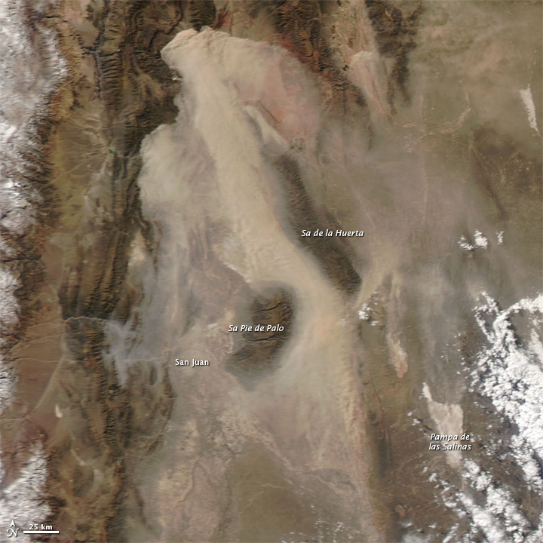
Dust Storms
All sites are in arid regions with little rainfall and so little vegetation
Erodible dust near sites on next slide
To understand if this erodible dust in proximity arrives at the sites the DREAM simulations of SENES is used.
Mirror samples placed on sites evaluate degradation.

Slide 11
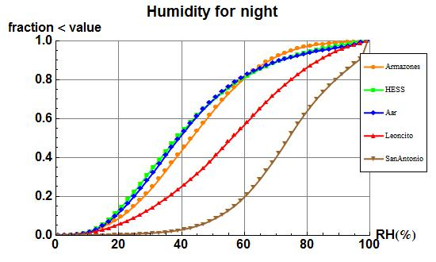
Risk of data loss due to mirror misting
Moisture condenses on mirrors if mirror temperature= dew point
Mirrors cool by radiation to sky
Studies and test indicate misting ambient temperature within 2°C of dew point
Likely misting if relative humidity >90%

Slide 12
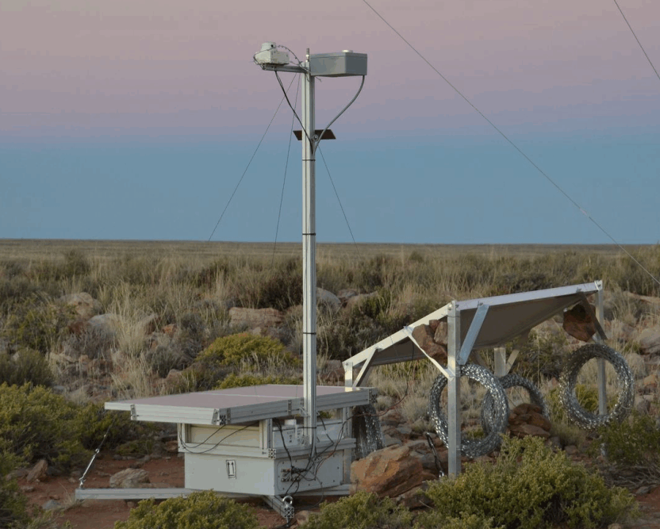
Risk of Crime on site
Risk of theft of Atmoscope subjectively perceived by local contact
very different on remote sites in different countries
Need objective, independent assessment of risk

Slide 13
Summary
Risk evaluation in progress
Most risks can be mitigated if conditions know
Risk for some conditions which are badly know

