Slide 1
Quantifying Potential New Sites for IACTs in Australia
Cross Checks with Data from Siding Spring Observatory
Paddy McGee, Sabrina Einecke
Nov 22nd, 2021

Slide 2
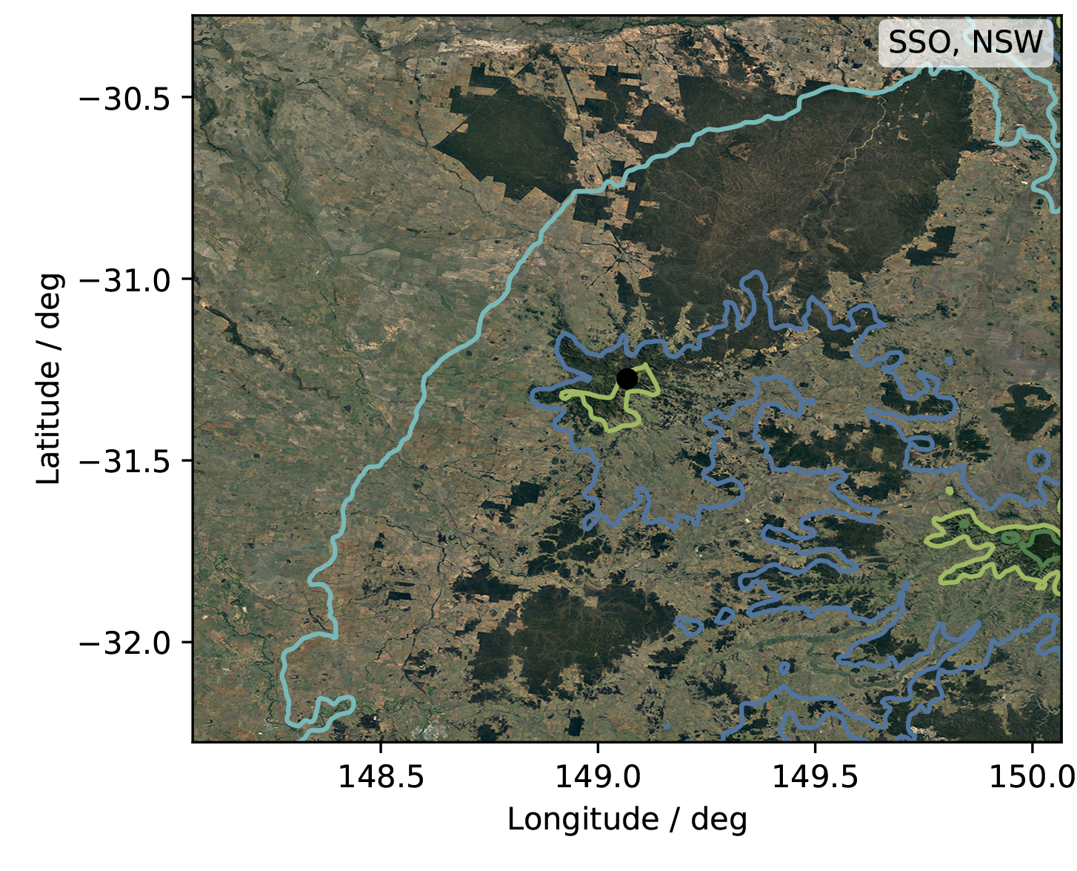
Siding Spring Observatory (SSO)
Located on Mount Woorut (~1160 m)
27 km west of Coonabarabran, NSW
Record of weather data (courtesy of James Cameron, ANU)
2011 - 2020: Temperatures, humidity, rainfall, dew point, pressure, brightness, sky meter temperature (every 10 minutes)
2018: All Sky Camera Images (every 0.5 minutes)

Slide 3
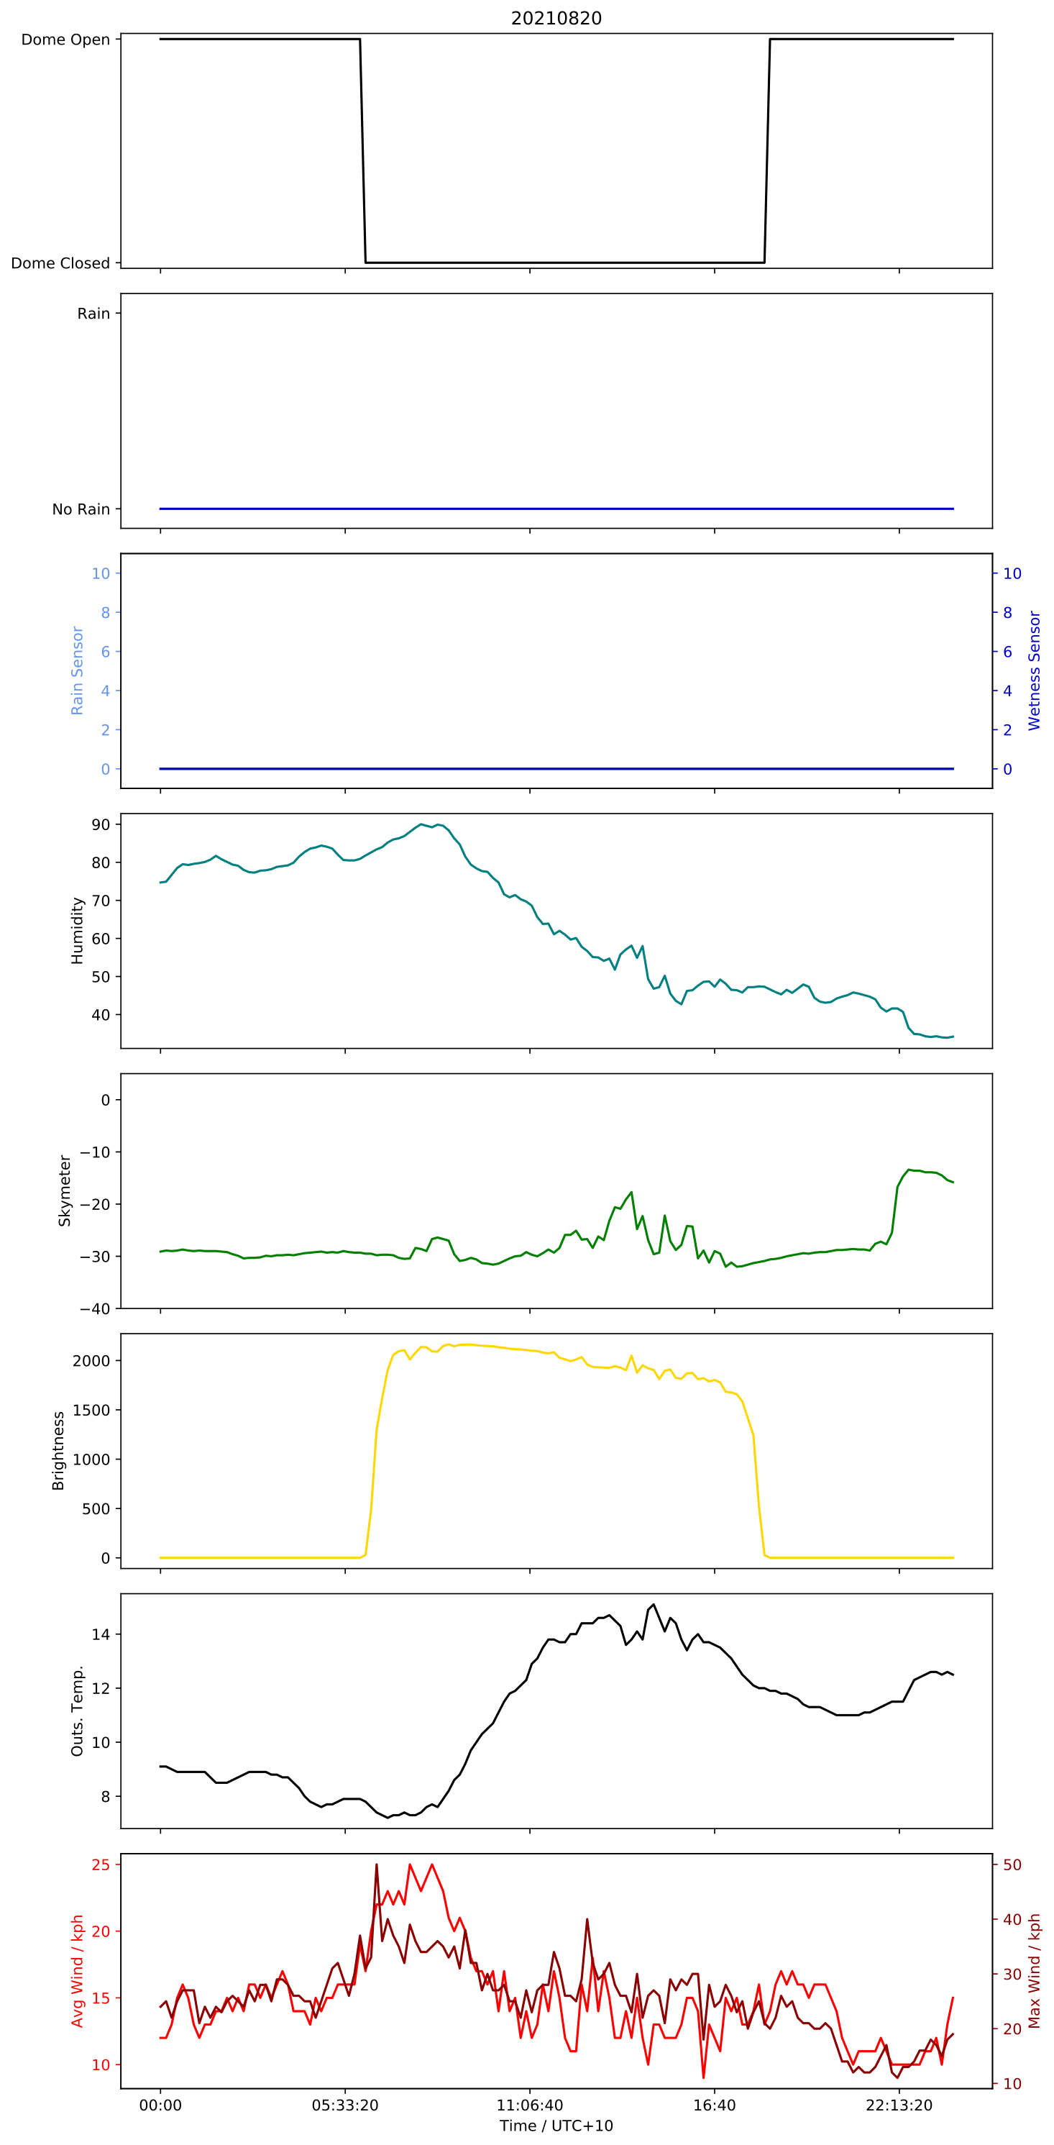
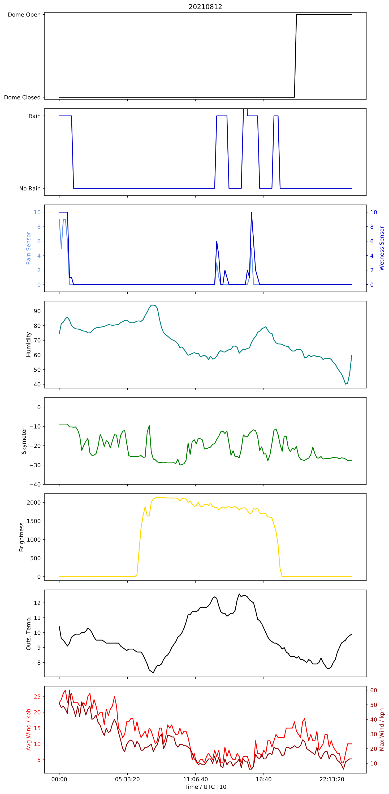
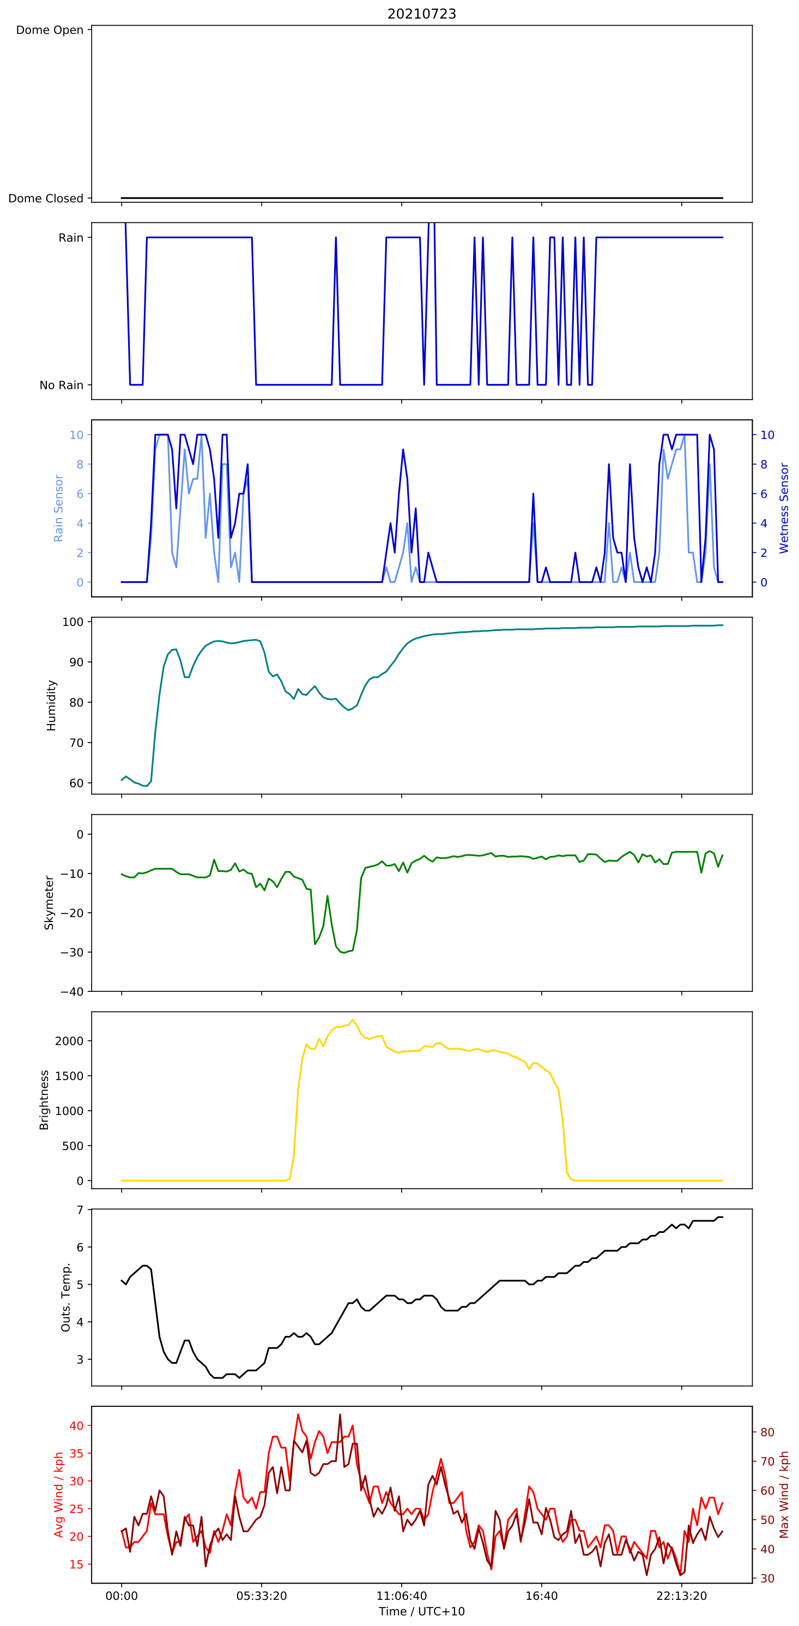
SSO: Nightly Weather Data (selection)
clear or mostly clear, no rain
intermittent
clear, with some rain
mostly cloudy, frequent rain
dome
rain
(weather station)
rain /wetness sensor
Boltwood
humidity
%
sky temp.
° C
brightness
(arbitrary)
outside temp. ° C
ave. & max. wind (kph)
dome
rain
(weather station)
rain /wetness sensor
Boltwood
humidity
%
sky temp.
° C
brightness
(arbitrary)
outside temp. ° C
ave. & max. wind (kph)
dome
rain
(weather station)
rain /wetness sensor
Boltwood
humidity
%
sky temp.
° C
brightness
(arbitrary)
outside temp. ° C
ave. & max. wind (kph)

Slide 4
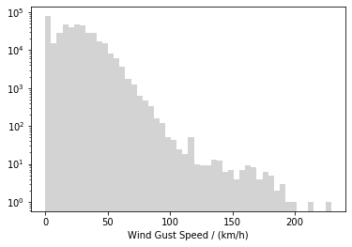
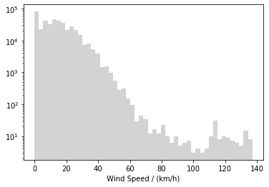
SSO: Wind
Maximum wind gust: 229 km/h (Wind gusts > 170 km/h occurred on 2 nights in 10 years)
CTA requirements
Survival wind gusts: Damage beyond Serviceability Limit State must not occur due to wind gusts of up to 170 km/h
Survival wind speed: Damage beyond Serviceability Limit State must not occur due to 10 minute average wind speeds of up to 100 km/h
Maximum wind speed: 137 km/h (Wind speeds > 100 km/h occurred on 5 nights in 10 years)
(Serviceability Limit State: Damage can be repaired in-situ using available spare parts and a normal level of on-site manpower.)
Notes:
Survival wind speed: Damage must not occur at the CTA-S site due to 10 minute average wind speeds of up to 80 km/h, and damage beyond the Serviceability Limit State must not occur due to 10 minute average wind speeds of up to 100 km/h when in the Safe State
Survival wind gust: Damage beyond the Serviceability Limit State must not occur on the CTA-S site due to wind gusts (1s) of up to 170 km/h
Transition wind speed: During transitions, damage must not occur on-site due to 10 minute average wind speeds of up to 50 km/h and damage beyond the Serviceability Limit State must not occur due to 10 minute average wind speeds of up to 60 km/h.
Precision pointing wind speed: It must be possible to achieve precision pointing on the CTA-S site under 10 minute average wind speeds of up to 11 km/h
Observation wind speed: Performance requirements for observations must be met under 10 minute average wind speeds of up to 36 km/h
Rain wind speed: Damage beyond the Serviceability Limit State must not occur due to precipitation in the form of rain, snow or hail for (10 minute average) wind speeds of up to 90km/h.
(Serviceability Limit State: Damage can be repaired in-situ using available spare parts and a normal level of on-site manpower.)

Slide 5
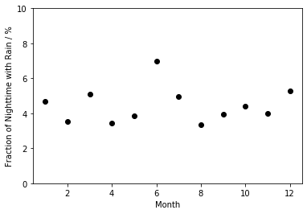
SSO: Rain
monthly average of % of time during the night when rainfall was recorded (for 2018)
96% of night time is dry

Slide 6
SSO: Clouds
Boltwood passive IR cloud monitor (single-channel, pointed slightly off zenith)
8-14 microns
temperature difference relative to the ground temperature
approx. +-40 degree angle of main sensitivity
clear sky cooler than cloudy sky
also has rain/wetness sensor, brightness meter
nominal value sky temperature < -25° C taken to indicate clear skies
manual notes that these limits should be checked/set for each site
slightly inclined from zenith to allow water run-off (manual says 10 degrees)
don’t know in which direction it points
also data from a Unihedron Sky Quality Meter (sky brightness in mag./sq. arc-second)
the main interest is to get a ground-based cross-check of downward-looking MODIS-based cloudiness estimates
how reliably can MODIS-only measurements be used to characterised site cloudiness?

Slide 7
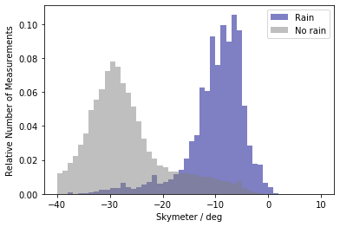
SSO: Clouds (based on Boltwood sky temperatures)
OUR Definition of Cloud Flags
Very cloudy (= 0): > -10 °C
Probably cloudy (= 1): > -25 °C & > -10 °C
Probably clear (= 2): < -25 °C & > -30 °C
Clear (= 3): < -30 °C
generally rains when skies are warmer, i.e. cloudy
but tails to each distribution
variability in nightly conditions

Slide 8
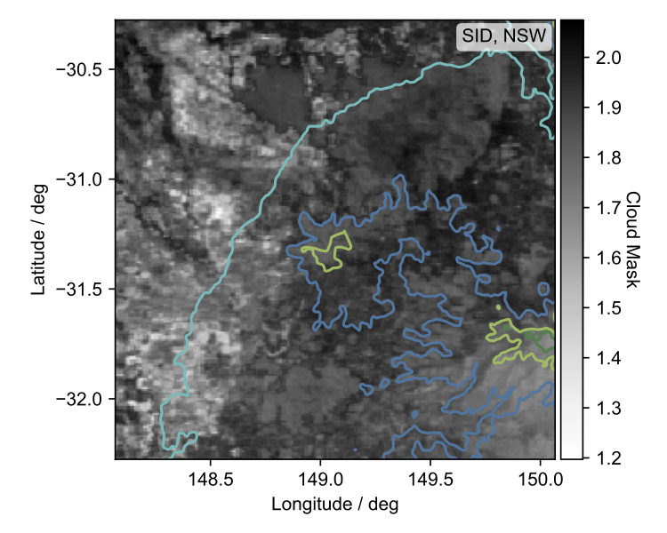
MODIS: Clouds
MODIS data can be used to generate maps of its supplied cloud masks, i.e. maps of cloudiness over an area
a MODIS pixel is 1 km-square
Definition of Cloud Flags (Masks)
Very cloudy: 0
Probably cloudy: 1
Probably clear: 2
Clear: 3

Slide 9
Comparison: MODIS - SSO
(Comparison performed for 2018 : at times of MODIS passes)
MODIS cloud masks: “_avg” = average over 10km-radius circle; “_pix” = single MODIS pixel
perfect agreement = dots follow the lines
most discrepancies = SSO less cloud indicated (by sky temps) than MODIS indicates

Slide 10
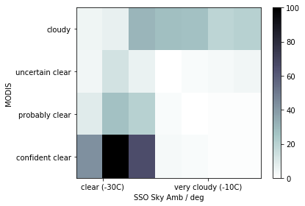
Comparison: MODIS - SSO
good agreement under clear conditions (also high proportion of clear nights)
also agreement for very cloudy conditions
but quite a few “MODIS cloudy” matched by “SSO probably clear”…
# of MODIS
passes in 2018
(Comparison performed for 2018)

Slide 11
Comparison: MODIS - SSO
??
# of MODIS passes
in 2018
(Comparison performed for 2018)

Slide 12
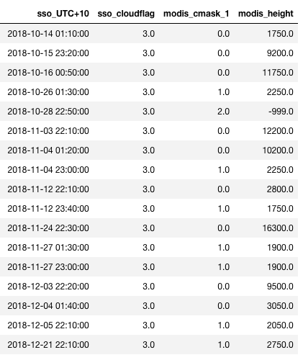
Comparison: MODIS - SSO
SSO sky temp (sso_cloudflag) says “clear”, but MODIS single-pixel cloud mask says “cloudy”

Slide 13
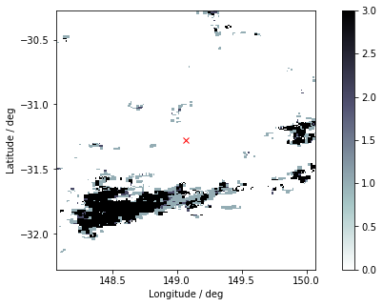
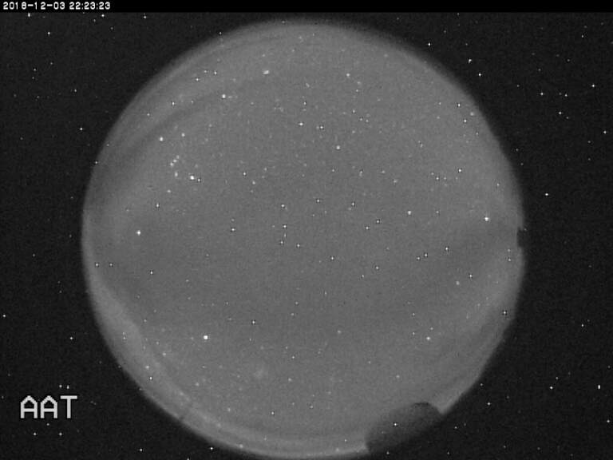
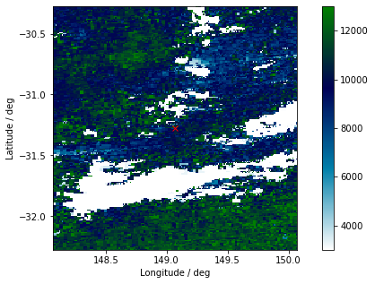
Comparison: MODIS - SSO
white = MODIS cloudy
but is high-level cloud, ~9,000m +
SSO: Cirrus visible in ASC images (but sky temp says clear) MODIS: High clouds —> All good

Slide 14
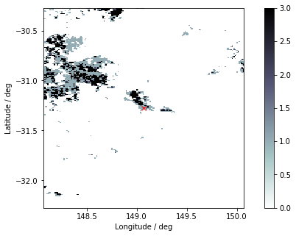
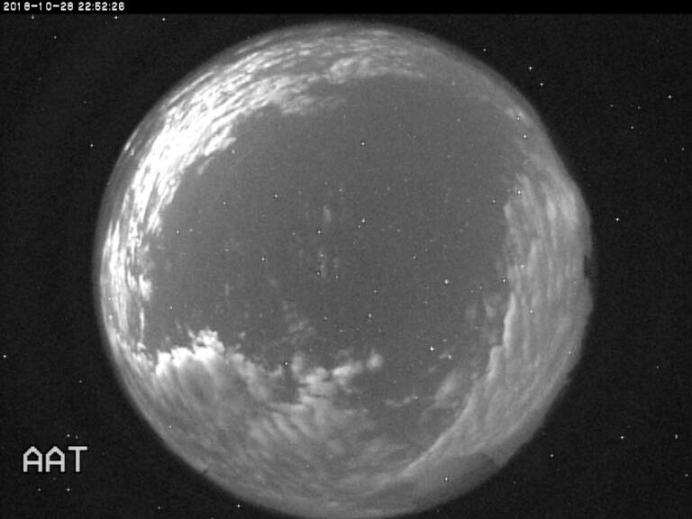
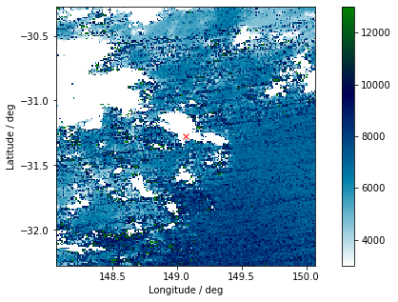
Comparison: MODIS - SSO
white = cloudy around SSO, but with clear patch over SSO
mid-level cloud around SSO, very low cloud height (clear) over SSO
SSO: Clear overhead in ASC image (and sky temp says clear) MODIS: Cloud detected around SSO —> All good

Slide 15
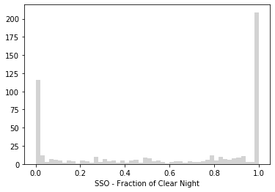
SSO: Cloudiness (based on sky temperatures)
Cloudiness = Fraction of night that is clear (SSO cloud mask >= 2)
nearly twice as many fully clear nights as fully cloudy nights
# of nights

Slide 16
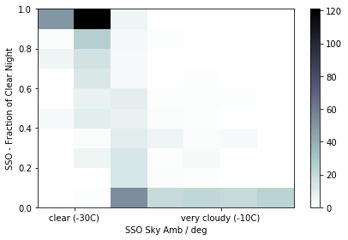
MODIS: Cloudiness
How good is the extrapolation from 1-2 nightly measurements to entire night?
Cloudy nights: 24%
Cloudy nights extrapolated: 39%
Clear nights: 39%
Clear nights extrapolated: 56%
~30% uncertainty from extrapolation
(Cloudy night = fraction of clear night < 10% )
(Clear night = fraction of clear night > 90% )

Slide 17
Caveat about Boltwood cloud sensor “clear” sky temperatures
some MODIS passes showed inconsistencies between MODIS and SSO sky-temperature cloud flags (using Boltwood ground-based passive IR cloud monitor)
e.g. MODIS indicated the presence of cloud, but SSO sky-temps suggested clear skies
the conditions we use for SSO cloud monitor flags are:
very cloudy (0): > -10° C
probably cloudy (1): > -25° C
probably clear (2): < -25° C
clear (3): < -30° C
SSO nominally < -25° C taken as clear skies (stated on the page referred to below)
we adopted < -30° C for clear skies, as looking at the real-time AAT weather page at http://aat-ops.anu.edu.au/AATdatabase/met.html showed some cloud still around on occasions at ~ -25° C

Slide 18
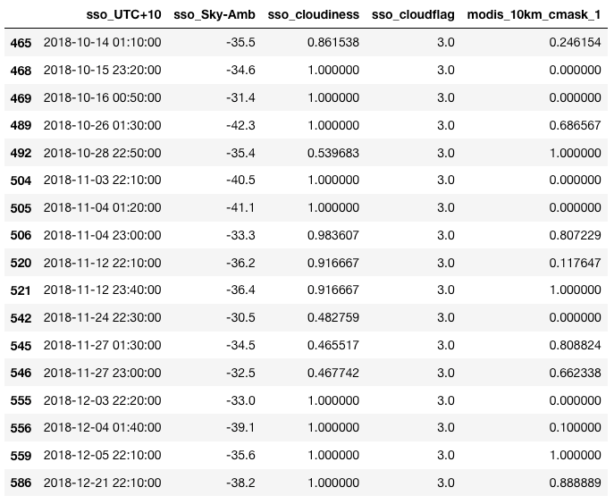
Table of discrepant MODIS/SSO cloud flags : SSO indicates clear, MODIS indicates cloud
sky temp = clear
cloudiness = mostly clear night (based on sky temps)
cloudflag = clear at time of pass (based on sky temps)
cmask = MODIS says cloud around SSO

Slide 19
the numbers after pass ID and time are
sky temp (° C ) : nominally < -30° C taken to be clear skies
sso_cloudiness = fraction of night with temp-derived cloud flag >= 2 (a higher value = more of the night is clear, i.e. 1 is clear all night)
sso_cloud_flag (based on sky temps, as defined earlier)
modis_10km_cmask_1 is an average of the following MODIS cloud flags (a MODIS pixel is 1km-square) taken over a 10km-radius circle centred on SSO, based on the following
0 = very cloudy
1 = probably cloudy
2 = probably clear
3= clear
but, as an average is taken, the value may not be an integer
all values in the table indicate the presence of significant amounts of cloud in the MODIS data

Slide 20
for these passes, the relevant SSO ASC images were checked for the visible presence of cloud
in all cases, it was found that at least some cloud was present in the ASC images
at least cirrus, sometimes very thin (it is known that such cloud may not be picked up by passive IR cloud sensors)
sometimes there is a clear patch overhead (or near overhead) at the time of the MODIS pass, but with cloud otherwise present (this should show up in the sso_cloudiness parameter, or in the MODIS maps)
on nights with very low clear-sky values of sky_ambient, cloud can be present even when the sky temp is at values that are taken to indicate clear skies

Slide 21
465 2018/10/14 | T = -35.5° C | sso_cloudiness = 0.86 (mostly clear night) | MODIS 10km_cmask = 0.25 (lots of cloud)

Slide 22
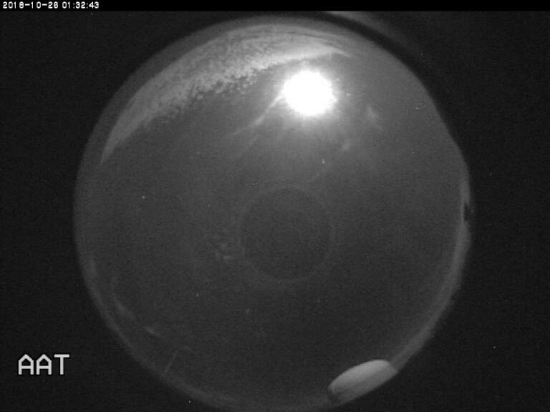
489 2018/10/26 | T = -42.3° C | sso_cloudiness = 1.00 (clear night) | MODIS 10km_cmask = 0.69 (significant cloud)

Slide 23
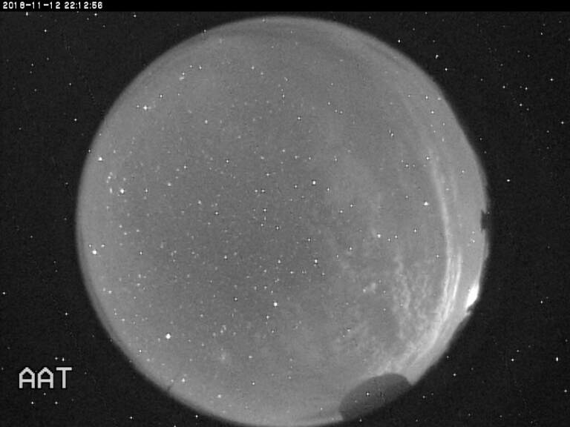
520 2018/11/12 | T = -36.2° C | sso_cloudiness = 0.92 (mostly clear night) | MODIS 10km_cmask = 0.12 (very cloudy)

Slide 24
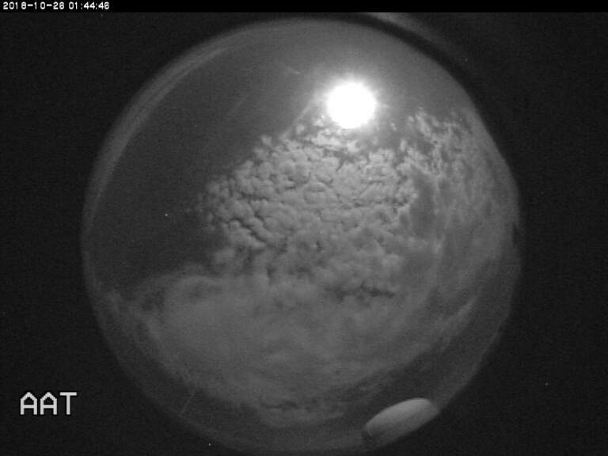
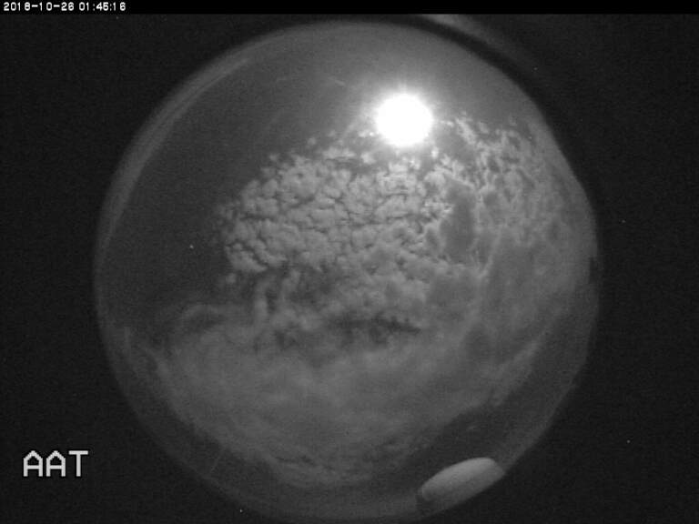
the night of pass 489 ( which was at 20181025 15:30 UT) had very low sky temps, down to ~ -47° C
at the time of the two ASC images below (10 minutes after pass 489), the sky temps were around -37.9° C, well below the nominal clear-sky limit
but there was significant cloud present

Slide 25
so it would seem that (at least for SSO- perhaps there are local variations?) the sky temperature values should be taken with a dose of caution when it comes to assigning clear-sky status
perhaps the usual statement that “sky temperatures below x °C indicate clear skies” might be reworded as
“...in general, it is found that clear skies will have sky temperatures below x °C, but this does not preclude the possibility of some cloud being present for such temperatures”

Slide 26
Summary
There is a generally good agreement between satellite-based MODIS cloud characterisation and ground-based cloud characterisation based on passive IR cloud monitoring (sky temperatures)
extrapolating from one or two MODIS passes on a night, to a classification of the entire night based just on those limited measurements, is not unreasonable- but, of course, not perfect…
nights of very low clear-sky sky temperatures can show periods of significant cloud which still yield associated sky temperatures below the nominal clear-sky limiting temperature
such a limiting temperature is not a 100% guarantee of clear skies below that sky temperature
conclude that cloudiness characterisation based on MODIS-only data is a useful approach when no ground-based data are available, or as another mode of charcterisation when such data are available

