Slide 1
CTA Sites and Telescopes
J. Carr
Meeting on Earthquakes
MPP Munich, 28 Jan, 2013

Slide 2
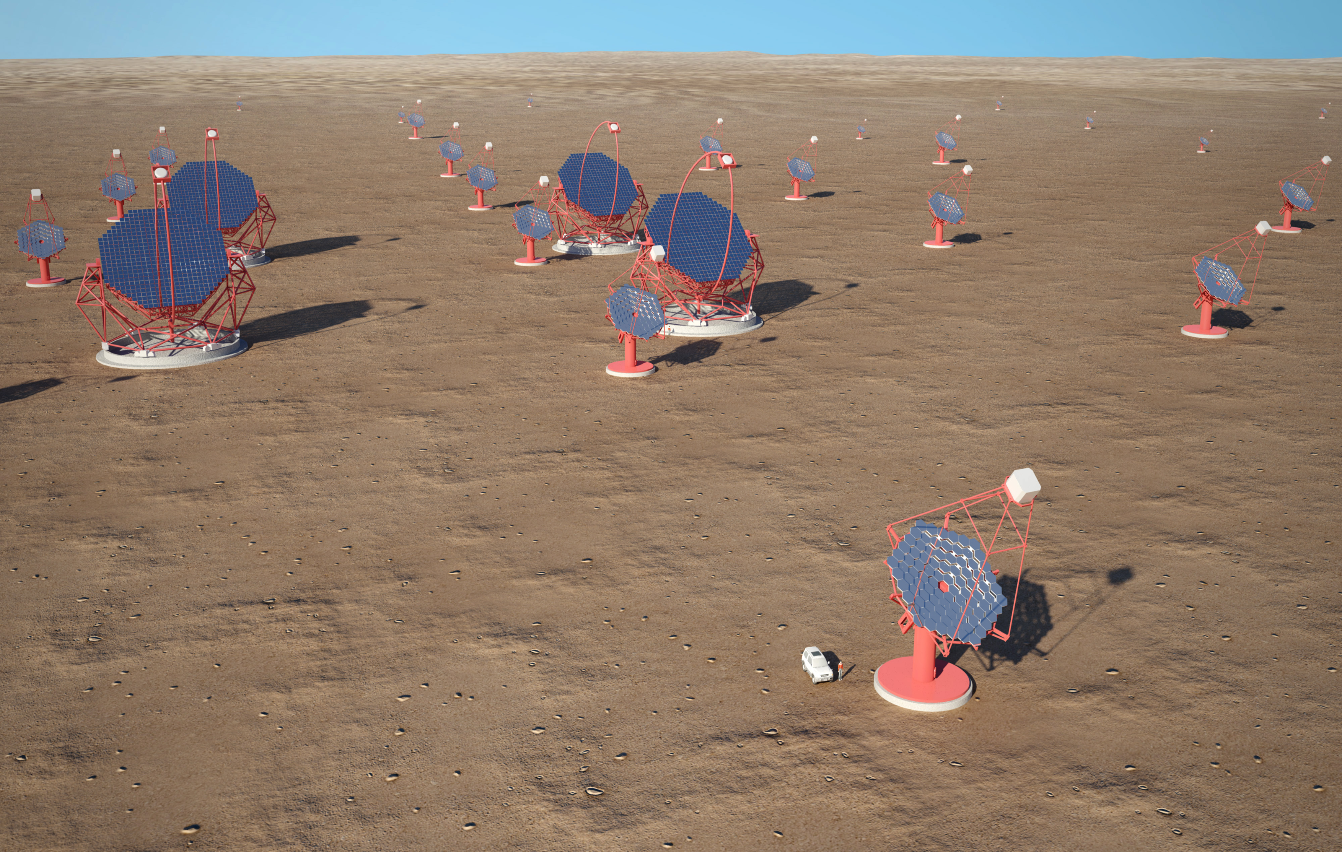
CTA Observatory
Southern Hemisphere Array 10 km²
4 LST
25 MST (+ extension 36 SCT)
70 SST
Northern Hemisphere Array 1 km²
4 LST
15 MST

Slide 3
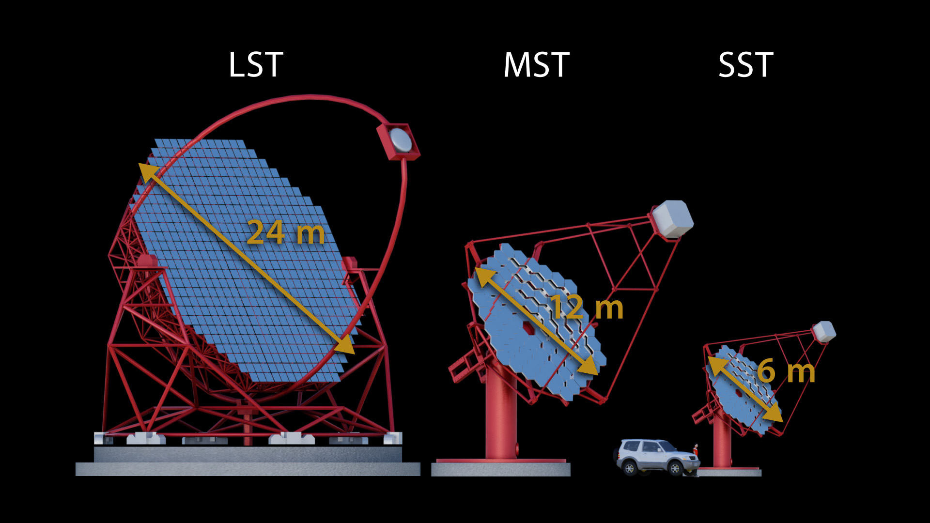
Different sized telescopes

Slide 4
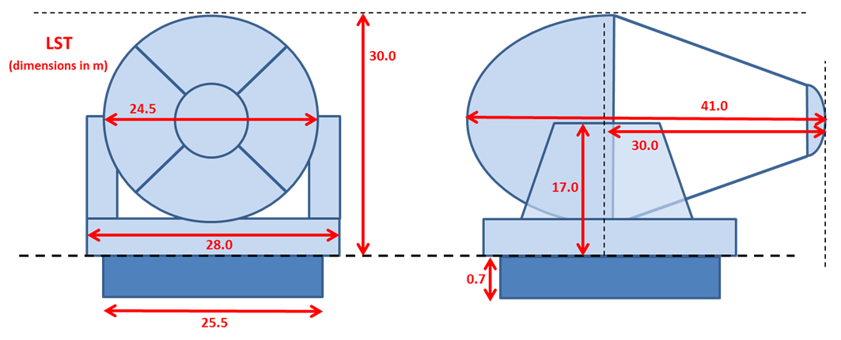
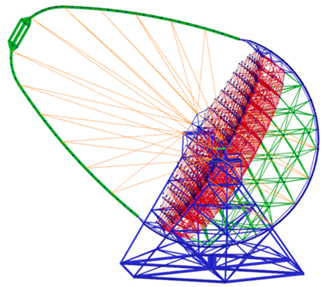
Large-Sized Telescopes

Slide 5
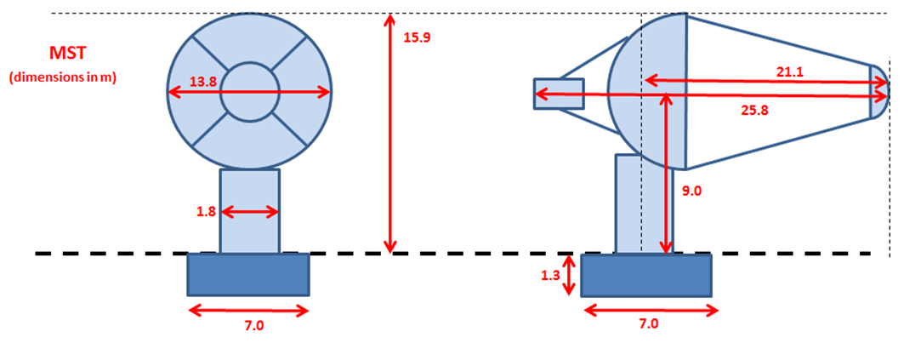
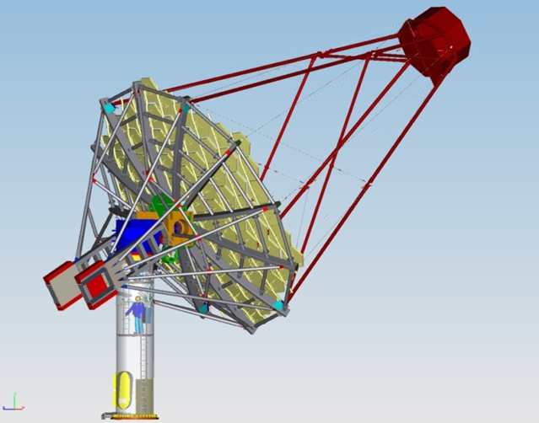
Medium-Sized Telescopes

Slide 6
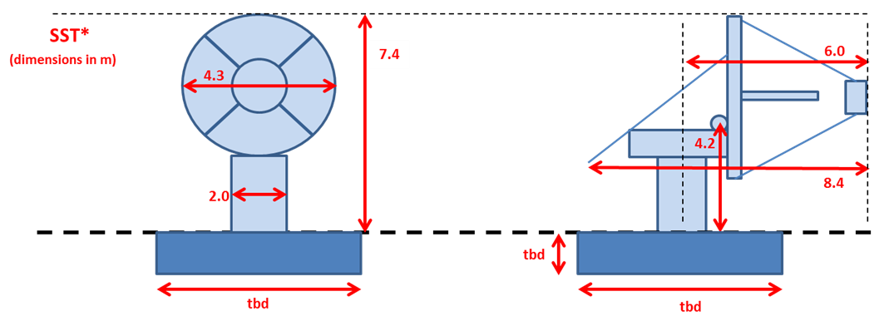
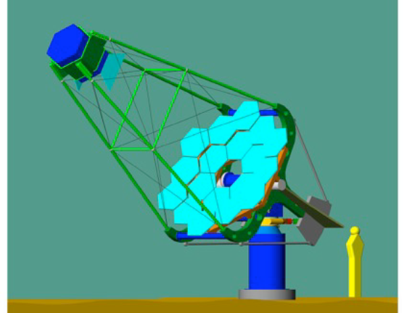
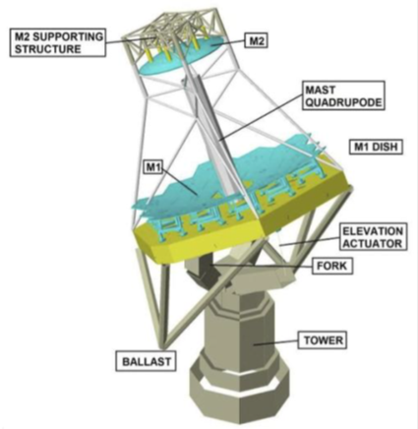
Small-Sized Telescopes

Slide 7
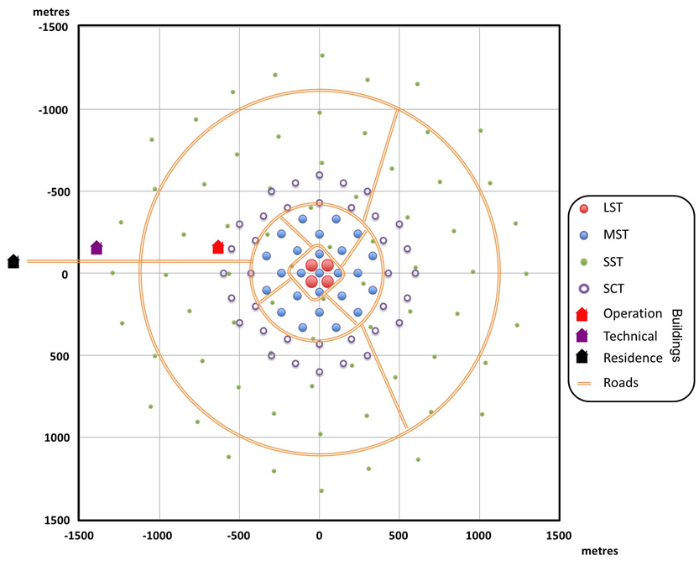
CTA Site Layout

Slide 8
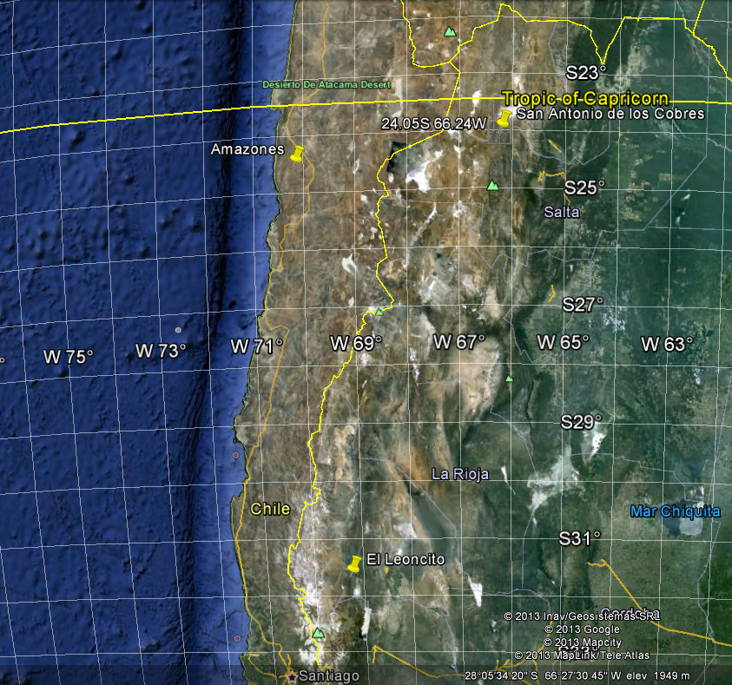
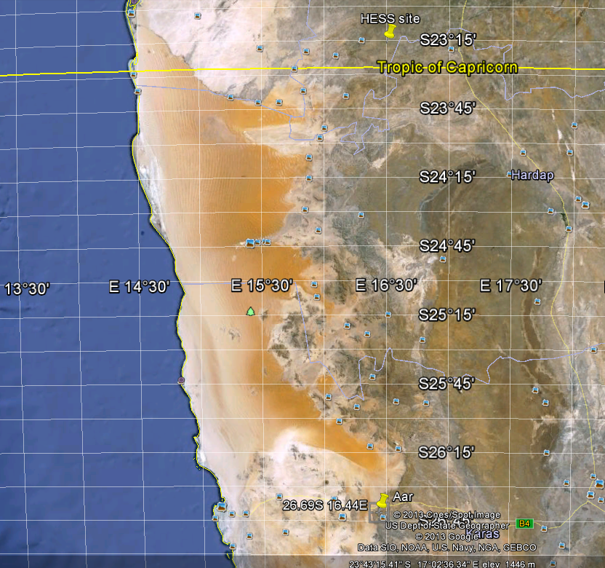
CTA SITES in Southern Hemisphere
Chile
Argentina
Namibia

Slide 9
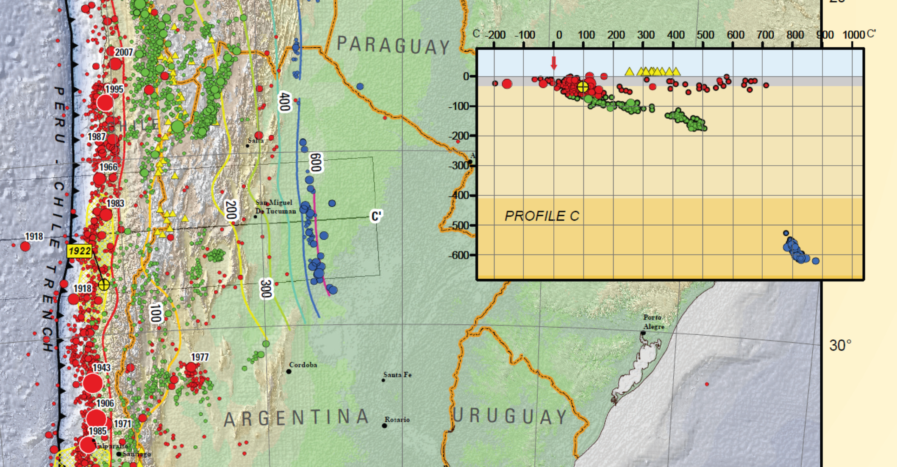
Earthquakes in South America

Slide 10
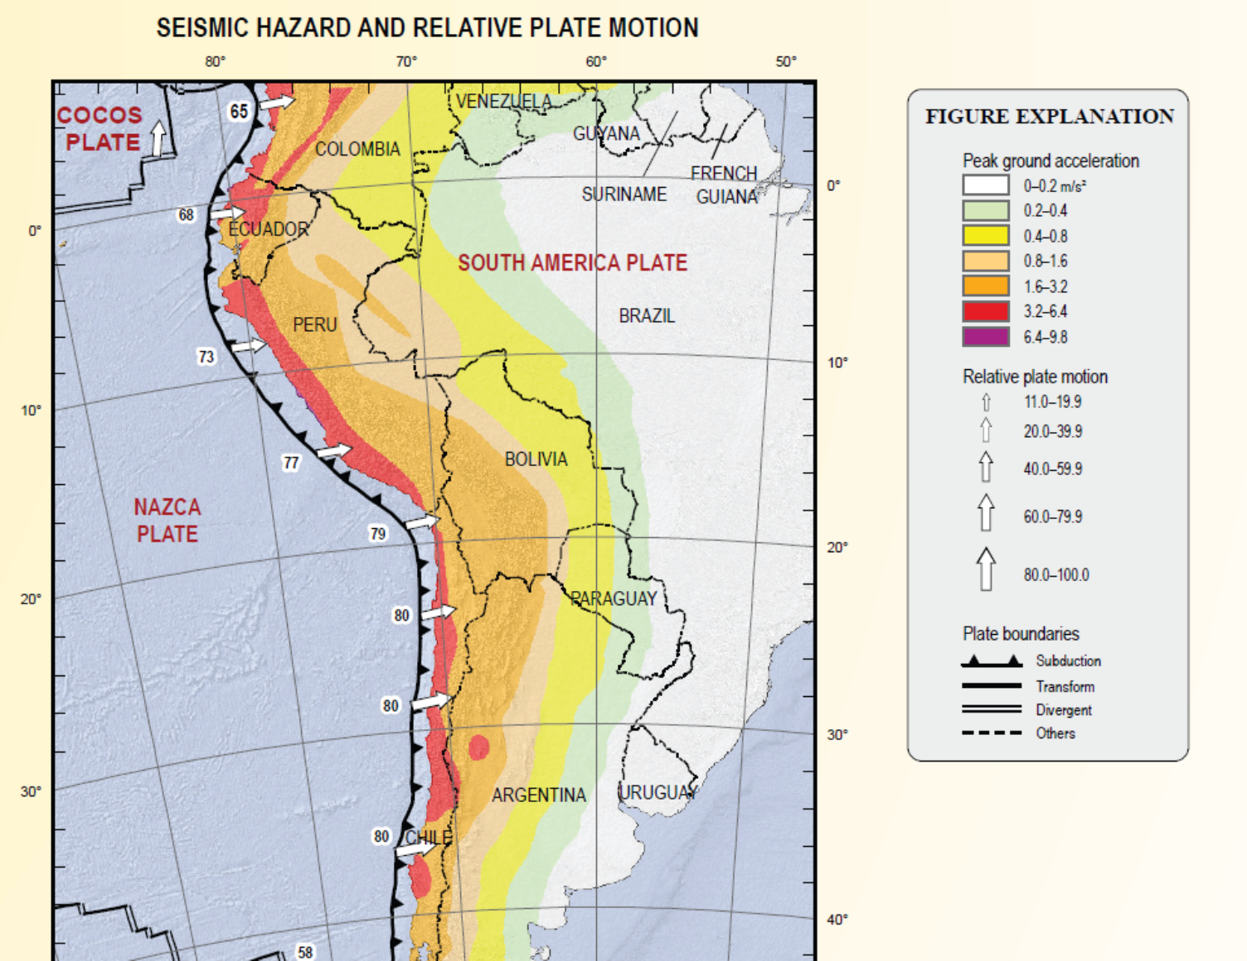
Seismic Hazard in South America

Slide 11
Objectives for meeting
Understand how CTA should ensure telescopes survive in earthquakes
Understand how to find seismic parameters for Southern Candidate sites
Understand how to calculate relative cost of building on different sites

Slide 12
Proposed steps for actions
CTA telescope teams explain what has been done so far
FK gives opinions on whether this is correct approach

Slide 13
Discussion ?

Slide 14
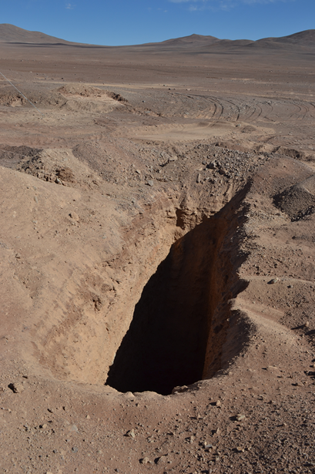
Soil conditions?
Chile Amazones site, 2.8m sand

