Slide 1

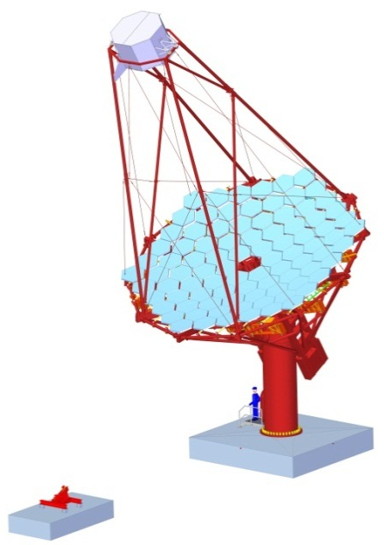
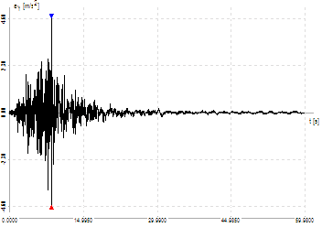
CTA, MST – seismic calculation
Roland Platzer, ZM1 DESY Hamburg
Munich, January 28th, 2013

Slide 2

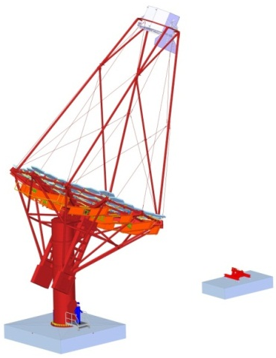
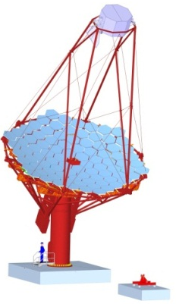
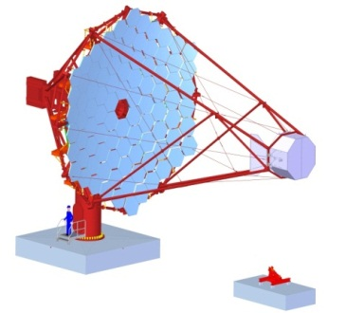
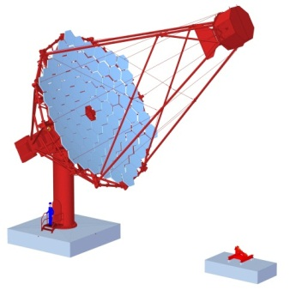
CTA, MST – seismic calculation
Topics
Calculation program
Calculation model
Calculations before
Assumptions for earthquake
RSTAB calcualtion
Program output
Calculation results

Slide 3

Calculation program
RSTAB 7
Ing. Software Dlubal, Structural Analysis and Design Software (www.dlubal.de)
German-Czech company, since 1987
Software from civil engineering, support structure planning
3D-Models, statics and dynamics
Only Beam elements (FEA-module also available -> RFEM)
Method of analysis
  Linear Static Analysis
  Second-Order Analysis (Non-linear)
  Large Deformation Analysis (Non-linear, Newton-Raphson)
Definition of load cases/groups/combinations with superimposing
Results as deformations, inner forces and reaction forces
as well as stresses (from module Steel)
RSTAB Module Dynam:
  Basis: natural frequencies, eigenmode
  Addition I: forced vibration analysis, external excitation (tabular loads, harmonic functions, accelerogram)
  Addition II: generation of equivalent seismic loads (DIN 4149, EC 8, IBC)

Slide 4
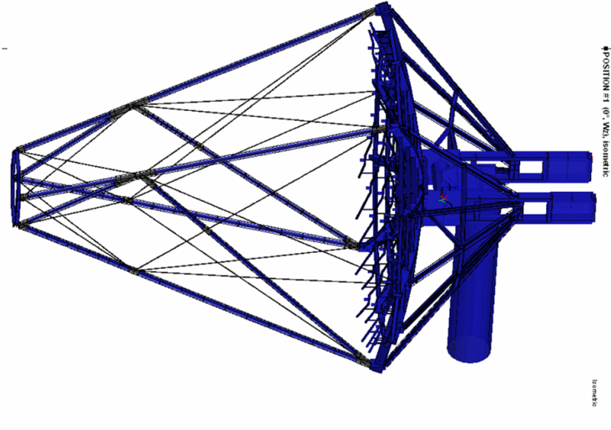
Calculation model
Model restrictions
All members are described by beam elements
Significant cubic bodies and plates are described by girder, grids or rigid connections
Elements support all forces and moments in the three dimensions
All connections (nodes of the system) were modelled as rigid
  exceptions are
    tie rods = beam type rope
    partly degrees of freedom for bearings
Large Deformation Analysis (Newton-Raphson)
Non perfect system
  slag of tie rods of about L/500
  misalignment of tubes (angle L/350 [~45 mm in total], bow L/350)
Only midpoints of mirrors, simplified clamps
No foundation implemented

Slide 5
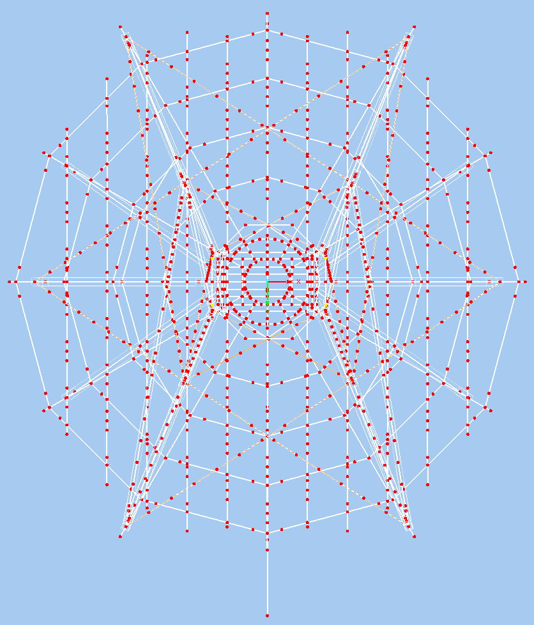
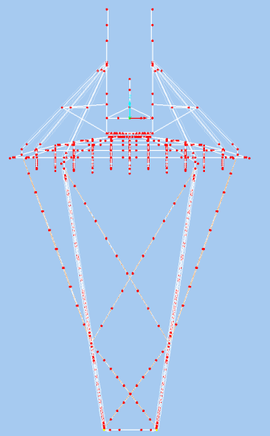
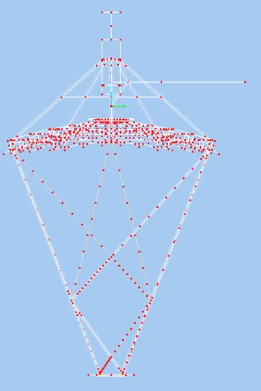
Calculation model
Model properties
Geometry based on
MST prototype 1 status 02.07.2012
  1294 nodes, 1617 members
Used material is steel S 355:
  Yield strength 355 MPa
  E = 210000 MPa
  Thermal expansion 12 10⁻⁶ 1/K
  Density 7850 kg/m³
Structural weight considered
considered additional weights
  mirrors: 35 kg/m²
  (43.6 kg per mirror, including AMC and support triangle)
  camera: 2.5 t
  (distributed on 4 nodes)
  counter weight:
  2 times 8.131 t => in total 16.262 t

Slide 6
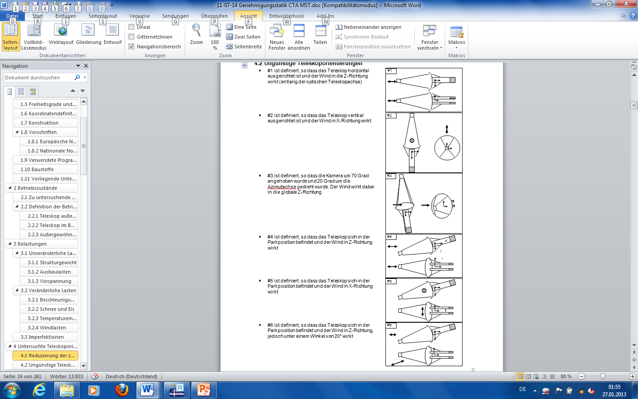
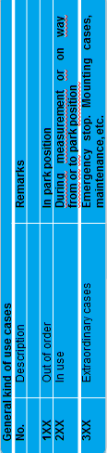
Calculation before
Use cases, orientations and load combinations
no. | Wind | Orientation | Load Combination
1 | 50 km/hr | # 1 | 1.0 G
2 |  |  | 1.0G + 1.0W +1.0 T_{+30/-50}
3 |  |  | 1.35(G+Ga₁₀₀) + 1.5W +1.35 T_{+30/-50}
4 |  |  | 1.35G + 1.5I +1.35 T₋₅₀
5 |  |  | 1.35G + 1.35I + 1.5Wi +1.35 T₋₅₀
6 |  |  | 1.35G +1.5I + 1.35Wi +1.35 T₋₅₀
7 |  | # 2 | 1.0G
8 |  |  | 1.0G + 1.0W +1.0 T_{+30/-50}
9 |  |  | 1.35(G+Ga₁₀₀) + 1.5W +1.35 T_{+30/-50}
10 |  |  | 1.35G + 1.5I +1.35 T₋₅₀
11 |  |  | 1.35G + 1.35I + 1.5Wi +1.35 T₋₅₀
12 |  |  | 1.35G +1.5I + 1.35Wi +1.35 T₋₅₀
13 |  | # 3 | 1.0G
14 |  |  | 1.0G + 1.0W + 1.0 T_{+30/-50}
15 |  |  | 1.35(G+Ga₁₀₀) + 1.5W +1.35 T_{+30/-50}
16 |  |  | 1.35G + 1.5I +1.35 T₋₅₀
17 |  |  | 1.35G + 1.35I + 1.5Wi +1.35 T₋₅₀
18 |  |  | 1.35G +1.5I + 1.35Wi +1.35 T₋₅₀
19 | 65 km/hr | # 1 | 1.35(G+Ga₇₀) + 1.5W +1.35 T_{+30/-50}
20 |  | # 2 | 1.35(G+Ga₇₀) + 1.5W +1.35 T_{+30/-50}
21 |  | # 3 | 1.35(G+Ga₇₀) + 1.5W +1.35 T_{+30/-50}
22 | 80 km/hr | # 1 | 1.35(G+Ga₁₀) + 1.5W +1.35 T_{+30/-50}
23 |  | # 2 | 1.35(G+Ga₁₀) + 1.5W +1.35 T_{+30/-50}
24 |  | # 3 | 1.35(G+Ga₁₀) + 1.5W +1.35 T_{+30/-50}
25 | 150 km/hr | # 4 | 1.35G + 1.35I + 1.5Wi +1.35 T₋₅₀
26 |  |  | 1.35G + 1.5I + 1.35Wi +1.35 T₋₅₀
27 |  | # 5 | 1.35G + 1.35I + 1.5Wi +1.35 T₋₅₀
28 |  |  | 1.35G + 1.5I + 1.35Wi +1.35 T₋₅₀
29 |  | # 6 | 1.35G + 1.35I + 1.5Wi +1.35 T₋₅₀
30 |  |  | 1.35G + 1.5I + 1.35Wi +1.35 T₋₅₀
31 | 180 km/hr | # 4 | 1.35G + 1.5W + 1.35 T_{+50/-50}
32 |  | # 5 | 1.35G + 1.5W +1.35 T_{+50/-50}
33 |  | # 6 | 1.35G + 1.5W +1.35 T_{+50/-50}

Slide 7
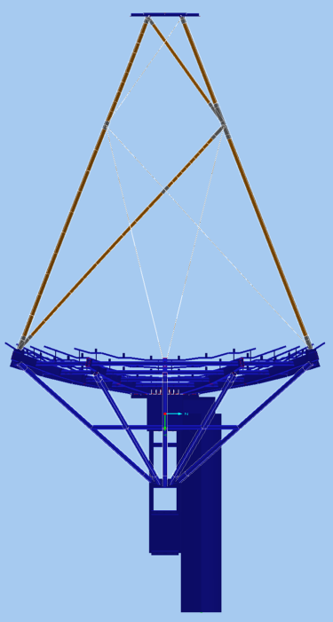
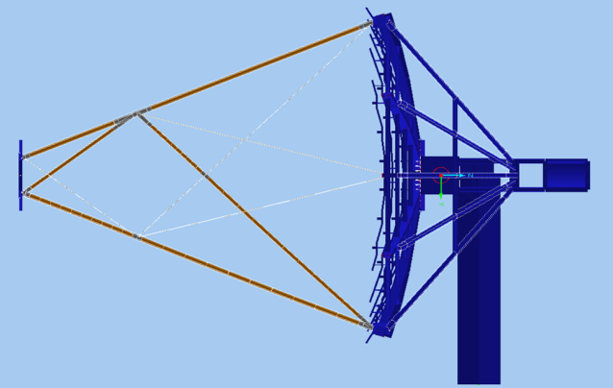
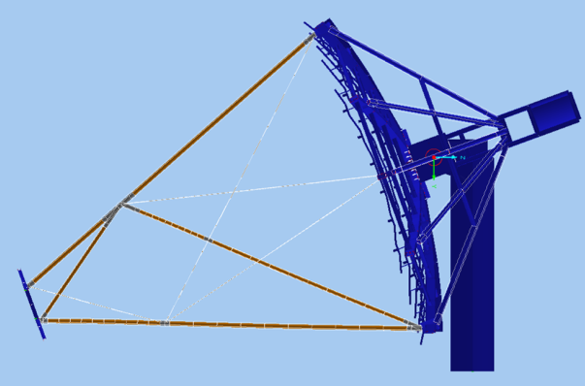
Assumption for earthquake
Load combinations
no. | Wind | Orientation | Load Combination
34 | 200 km/hr | # 4 | 1.35G + 1.5W + 1.35 T_{+50/-50}
35 |  | # 5 | 1.35G + 1.5W +1.35 T_{+50/-50}
36 |  | # 6 | 1.35G + 1.5W +1.35 T_{+50/-50}
37 | No wind, Earthquake | # 1 | 1.0 G + 1.0 E
38 |  | # 2 | 1.0 G + 1.0 E
39 |  | # 4 | 1.0 G + 1.0 E
General Question: How react the MST main structure under seismic loading?
Not included in that investigations are the behavior of equipment like mirrors, AMCs or electronic devices.

Slide 8
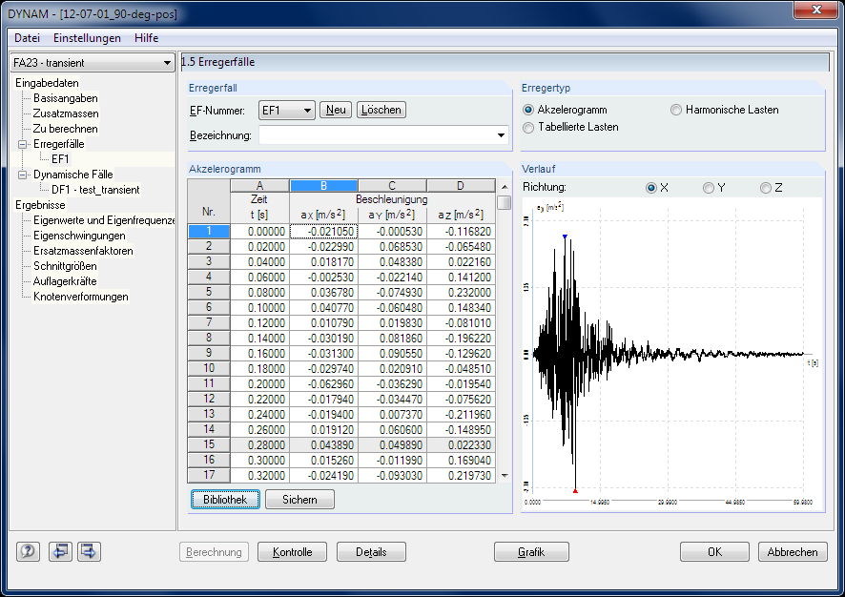
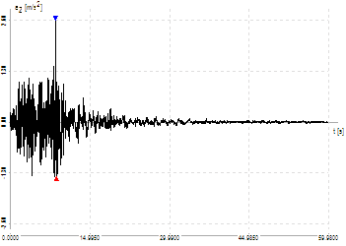
Assumption for earthquake
Chosen earthquake
As a scenario was chosen an earthquake in California (17.01.1994, 4:31) with a magnitude of 6.7 and a maximum horizontal acceleration of 4.646 m/s² (= 0.47 g). The details are listed below.
Place Northridge
Country California
Latitude 34.215 °
Longitude 118.538 °
Depth 18 km
Name of monitoring station Los Angeles - UCLA Grounds
Land of monitoring station California
Latitude of monitoring station 34.068 °
Longitude of monitoring station 118.439 °
Distance of monitoring station to epicenter 19 km
Underground marine deposit
Amount of measures 3000
Measure steps 0.02 s
Measure time 59.980 s
Maximum acceleration in X-direction -2.724 m/s^2
Maximum acceleration in Y- direction 4.646 m/s^2
Maximum acceleration in Z- direction 2.606 m/s^2
Space wave-magnitude Mb 6.700
Local magnitude Ml 6.600
Surface wave magnitude Ms 6.700

Slide 9
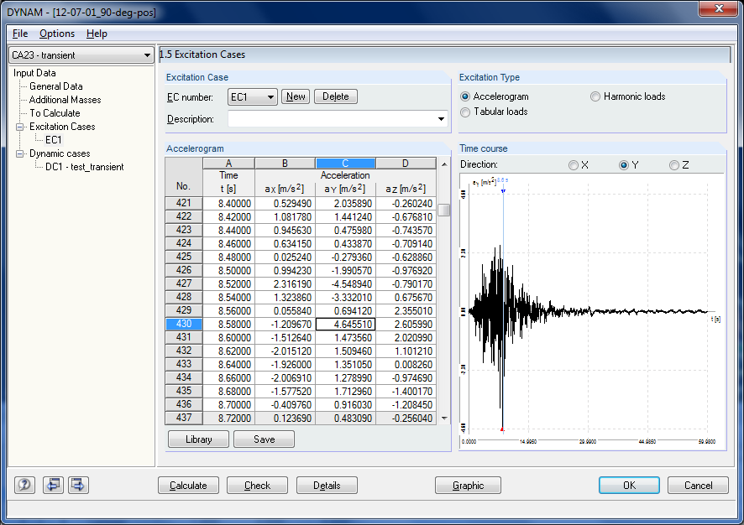
Assumption for earthquake
Listed accelerations due to RSTAB-library

Slide 10

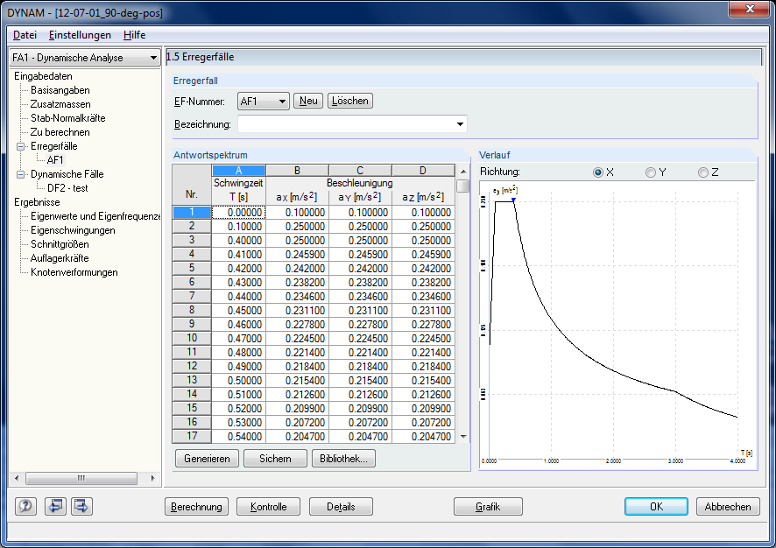
RSTAB calculation
Assumptions in the input data
Time history analysis
Additional masses
Forces in members not considered yet
Damping Di = 0,01 (rough and low (?) estimation of “Lehrsches Dämpfungsmaß”)
No foundation and soil influence (soil bedding value) considered yet
Response spectrum method
also possible
DIN 4149, EC 8, IBC
Classes/Categories, Ground ?
Ratio horizontal and vertical accelerations ?
(e. g. 50 %)
Damping ?

Slide 11
Program Output
Data reached from RSTAB calculation
Time history analysis chosen
Results as function of time and max/min
  Natural frequencies
  Eigenmodes
  Inner forces
  Reaction forces
  Displacements, velocities and accelerations
  Equivalent mass factors for validation
Disadvantage: huge data (1.2 GB) with timeline (could be reduced to min/max values)
Response spectrum method also possible
Only maximum values
Superposition as square root of sum of squares (SRSS rule)
or complete quadratic combination (CQC rule)

Slide 12
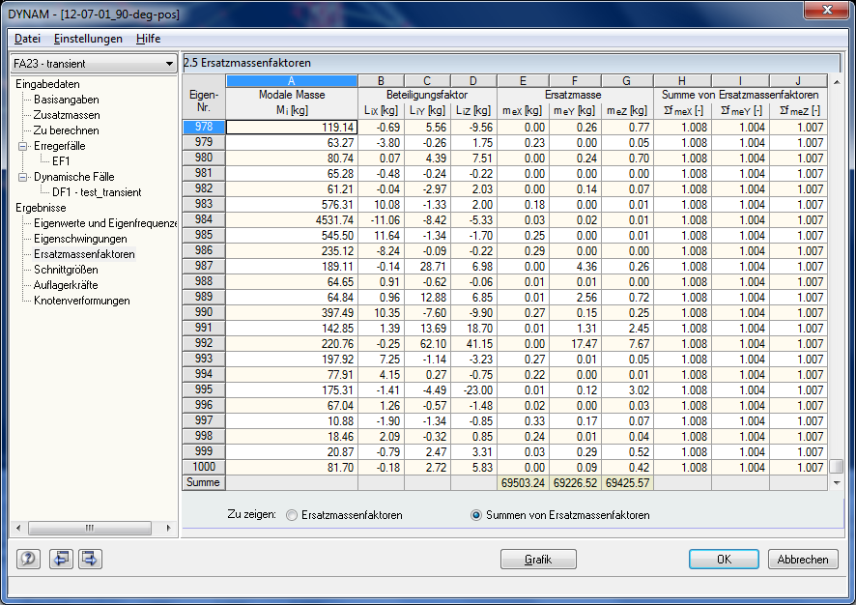
Program Output
Equivalent mass factors

Slide 13
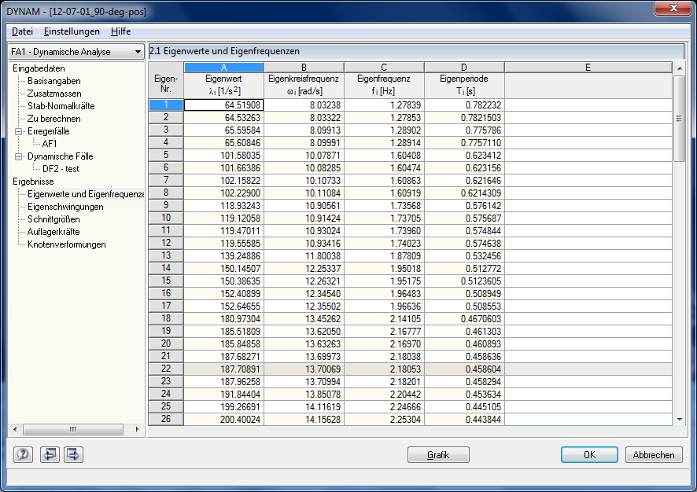
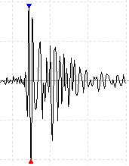
Program Output
Natural frequencies

Slide 14
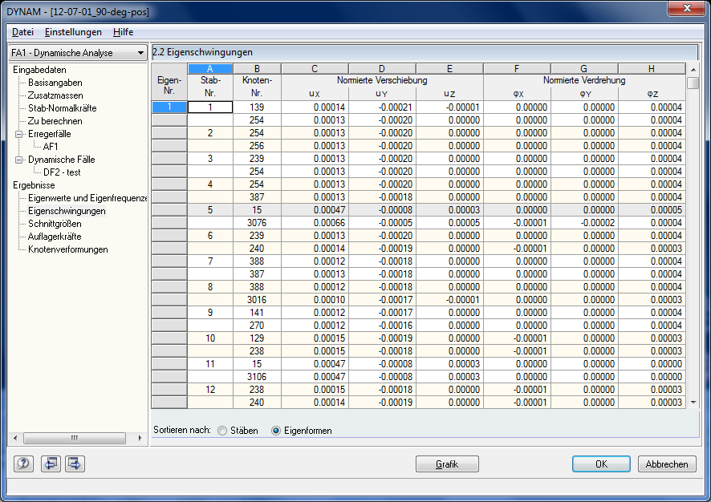
Program Output
Eigenmodes

Slide 15
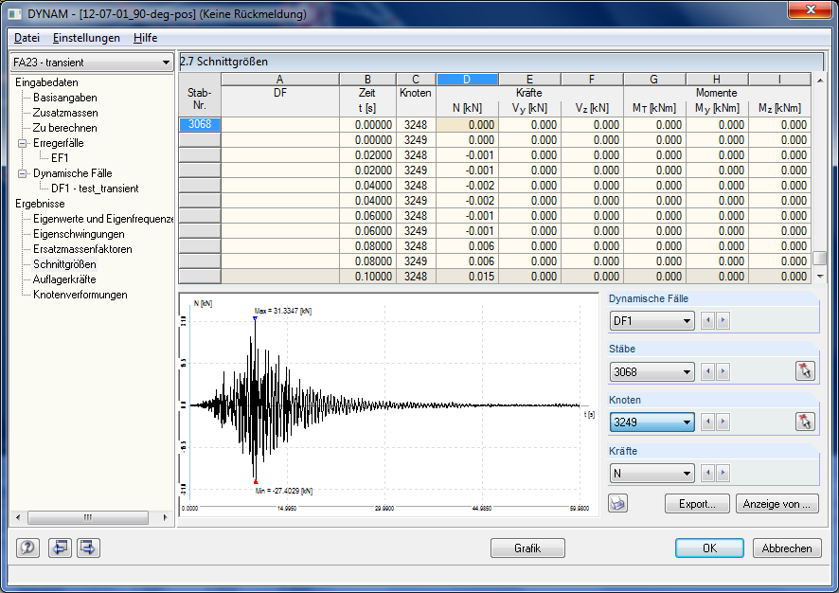
Program Output
Inner forces

Slide 16
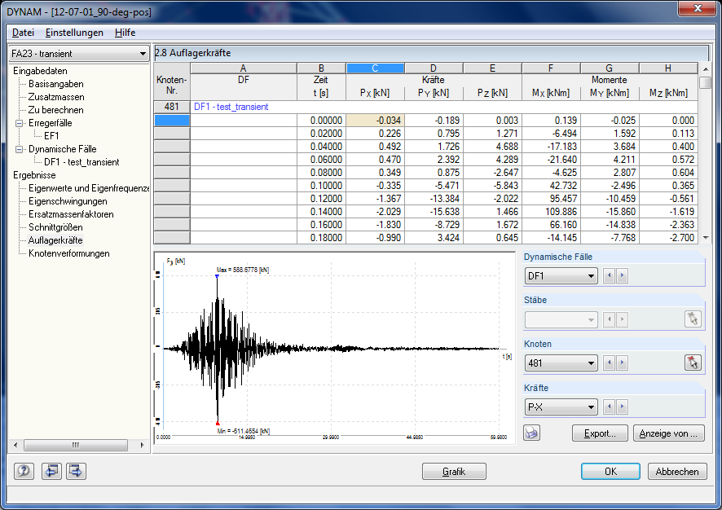
Program Output
Reaction forces

Slide 17
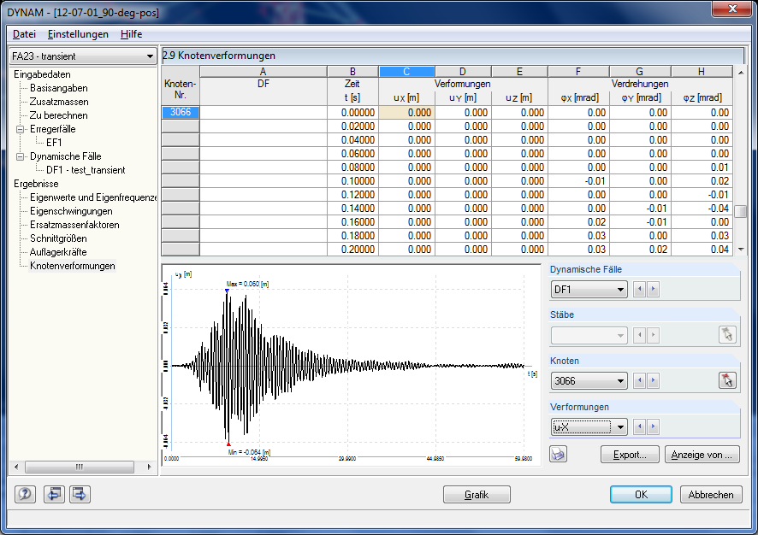
Program Output
Displacements (velocities and accelerations also possible)

Slide 18
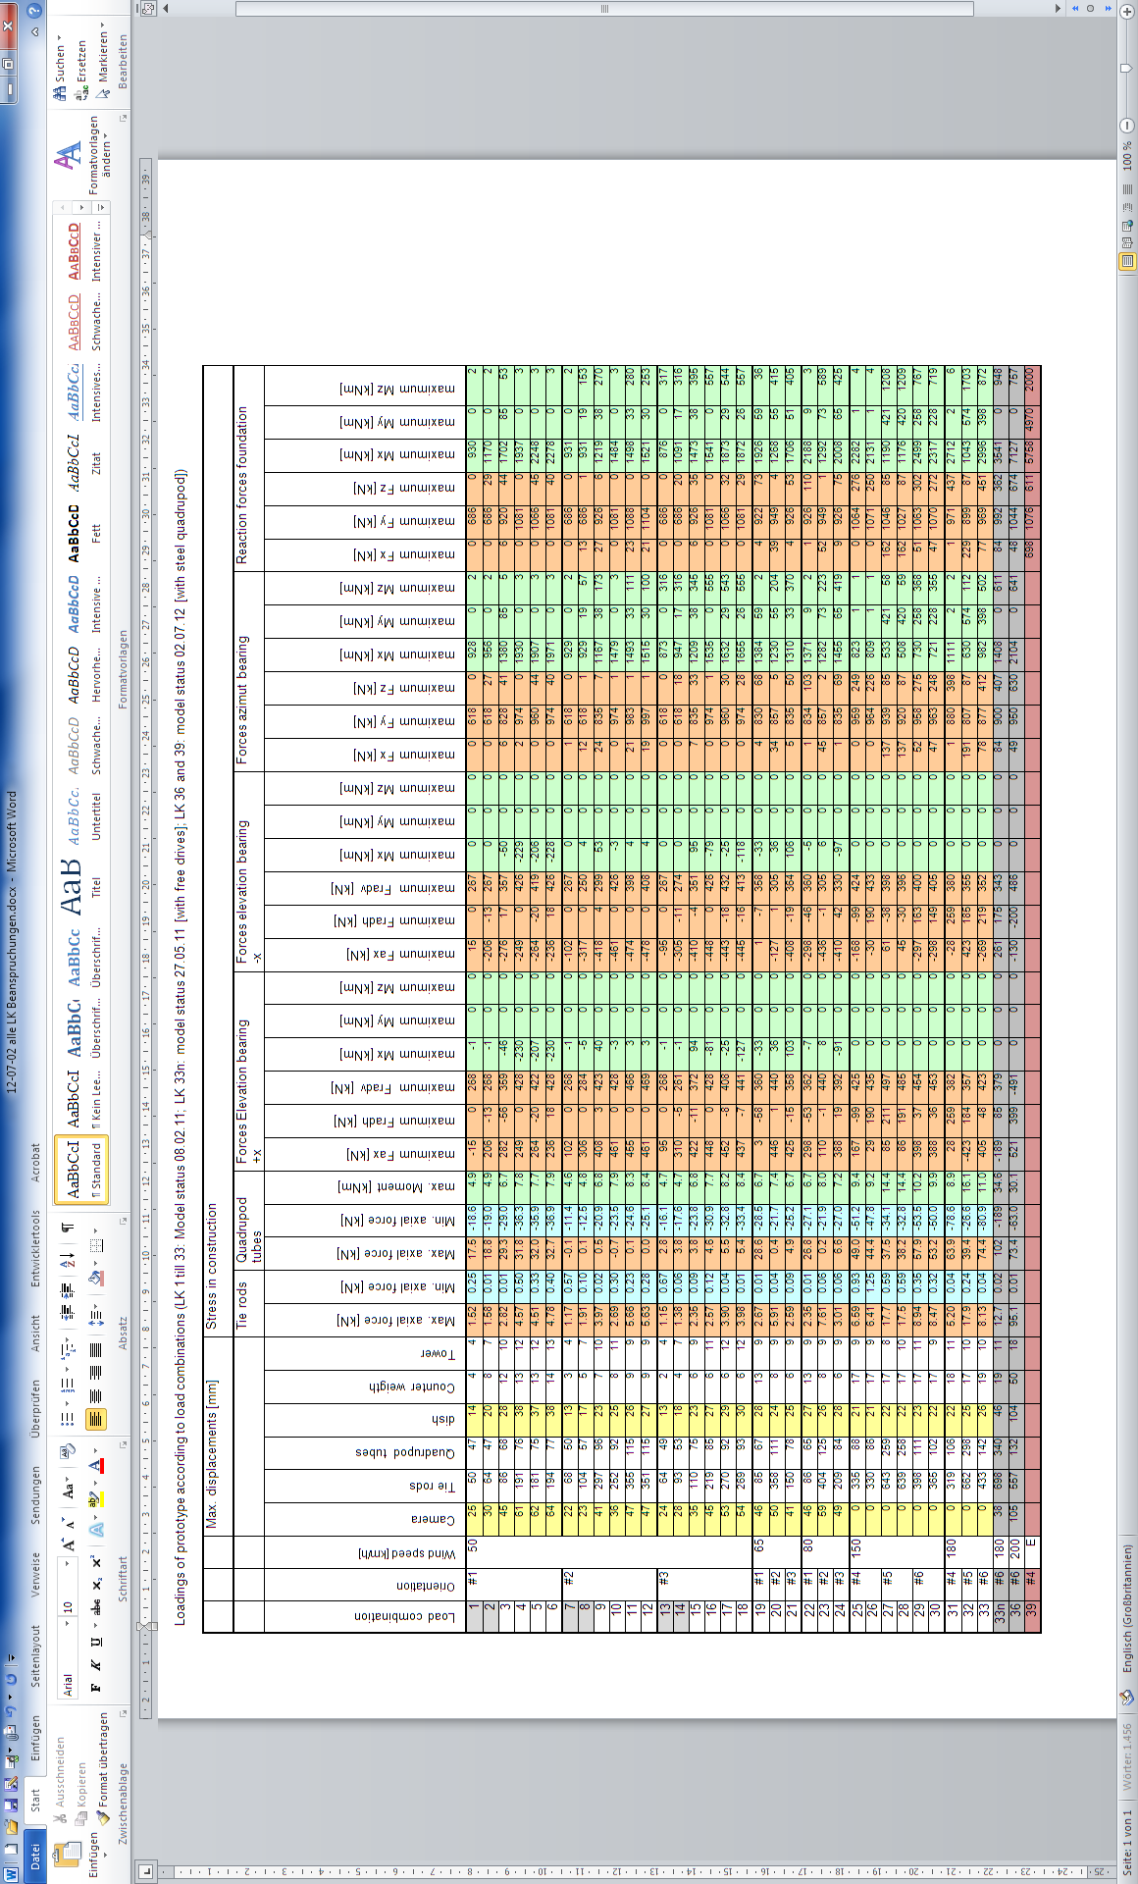
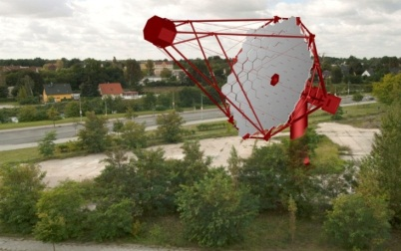
Calculation results
Results regarding strength of MST prototype 1

Slide 19
Calculation results
Results regarding strength of MST prototype 1

Slide 20
Calculation results
Results regarding strength of MST prototype 1

Slide 21
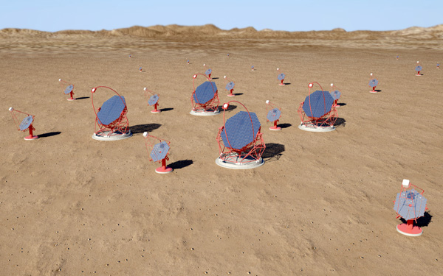
Seismic calculation
Thank you for listening

