Slide 1
FEM analysis of Current Dissipation in Lightning Strike Protection Systems
UCM-ELEC
Madrid, 24th July
Silvia Ronda, Clara Oliver, Oibar Martinez, Patricia Marquez and Jose Miguel Miranda
UCM-ELEC
July 2020

Slide 2
Main topics
The importance of lightning protection an earthing
Finite Element Simulation basics
Simulation of a lightning strike in LST Earthing System actual design

Slide 3
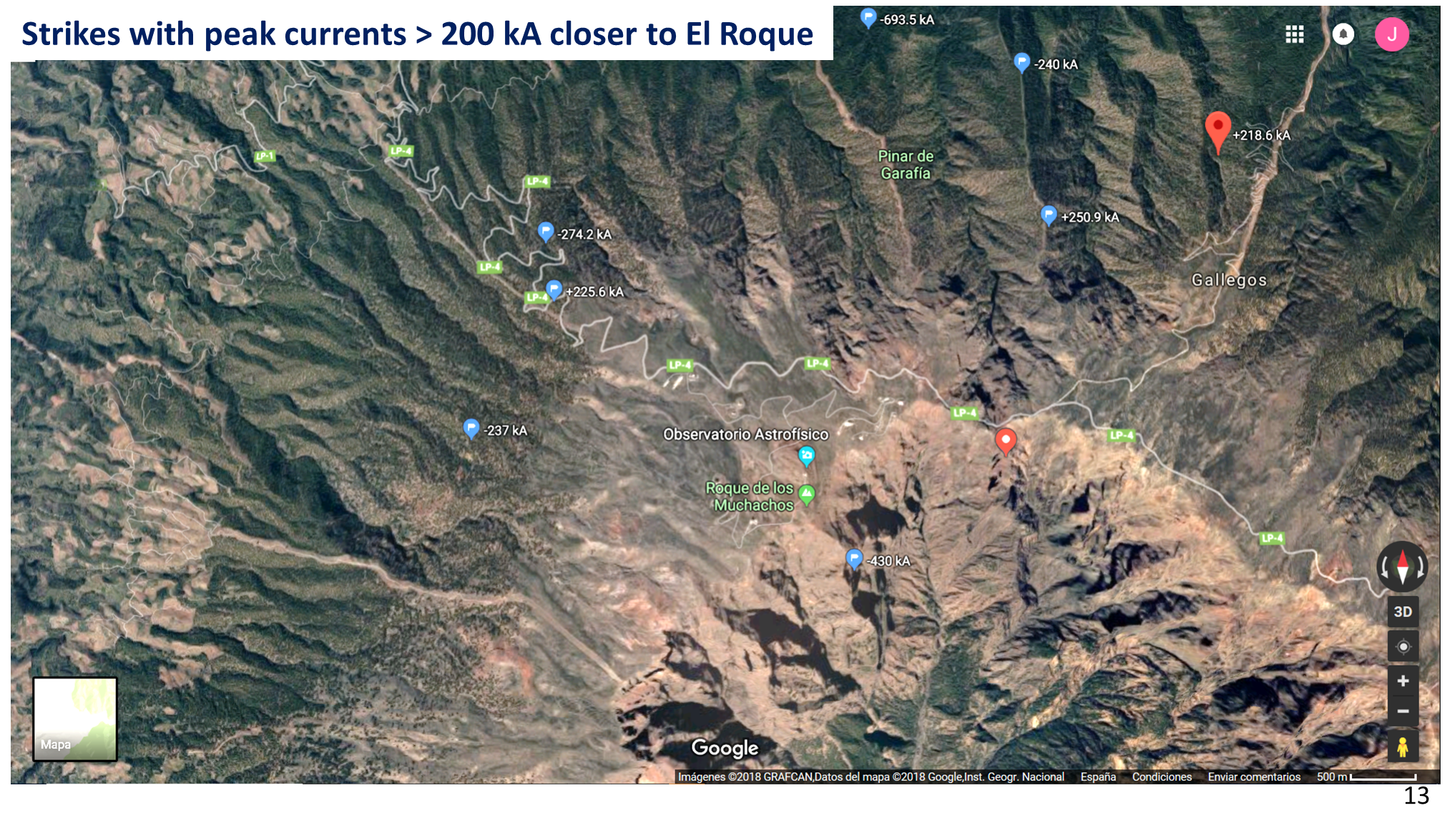
Lightning
Lightning: “Natural phenomena that can discharge currents of the order of hundreds of kiloamps in a fraction of a second” This can have devastating effects.
Lightning is an imperative for modern structures

Slide 4
Ligthning protection system design
IEC 62305-1 | General Principles
IEC 62305-1 | Risk Management
IEC 62305-3 | Physical Damage to Structures and Life Hazard
IEC 62305-4 | Electrical and Electronic Systems
IEC 62305: International Lightning protection standard
62305-1: General Principles
62305-2: Risk
62305-4: Electronic
62305-3: Human damage

Slide 5
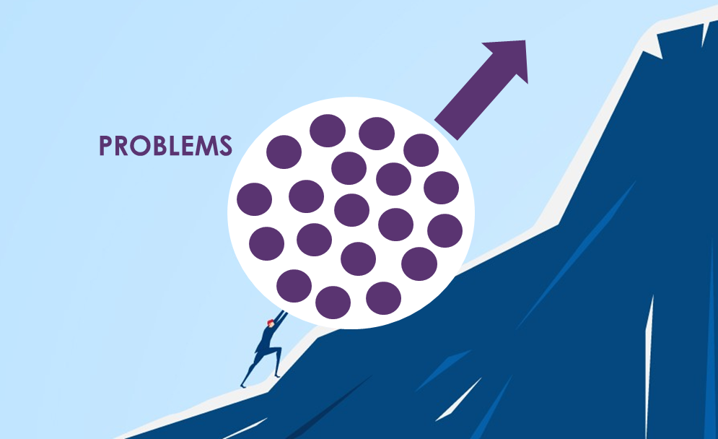
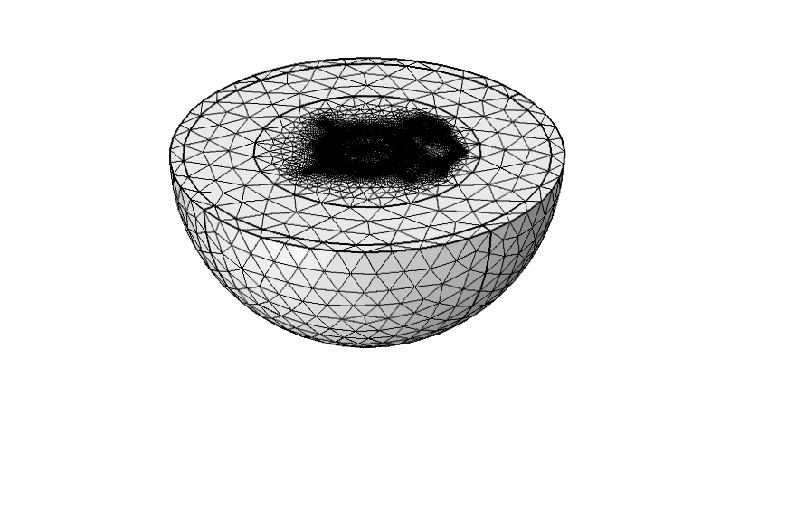
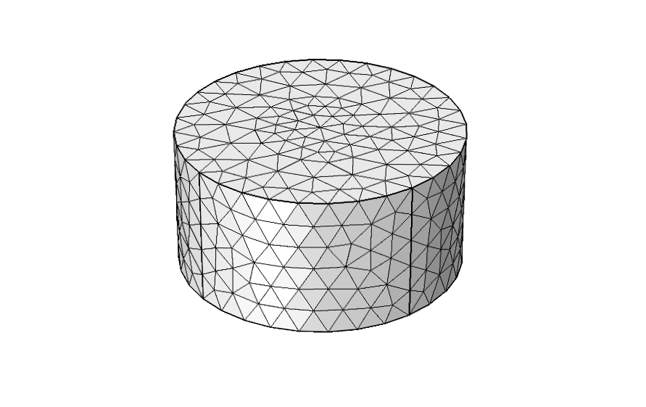
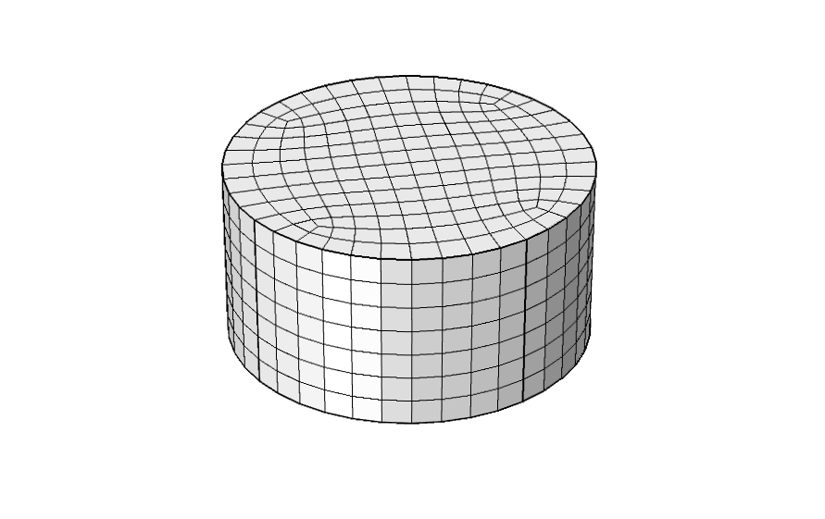
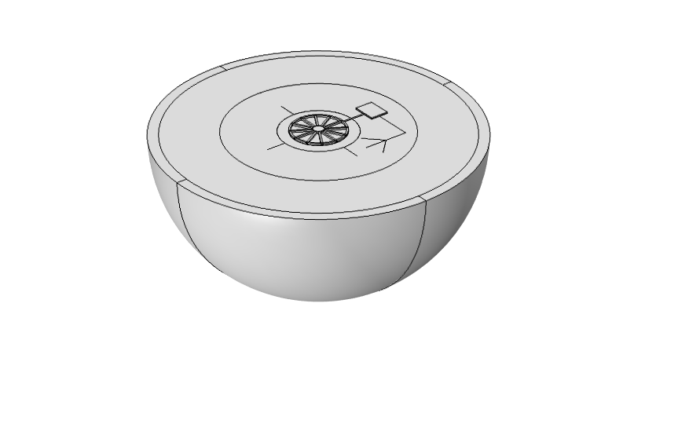
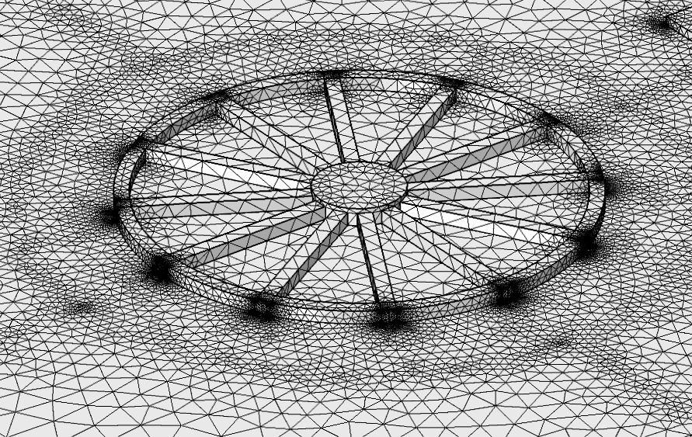
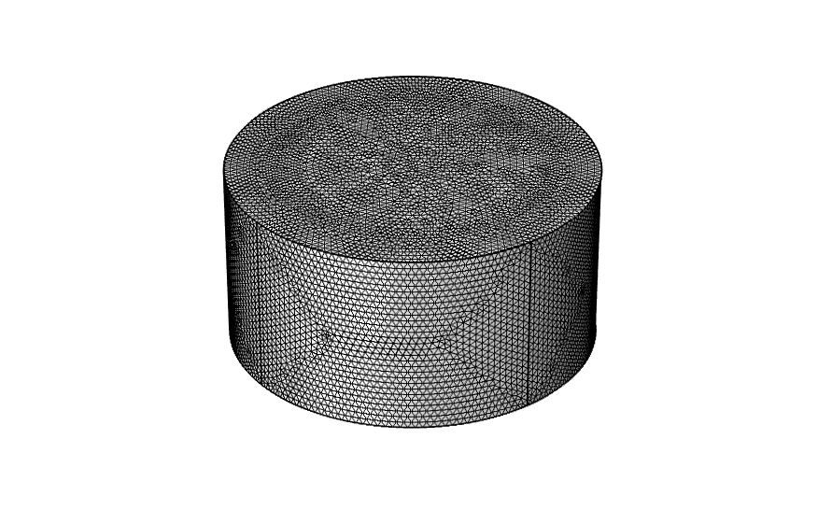
Finite Element Method basics
Software to simulate multiphysics processes
Subdomains: Meshing
Our design for LST Earthing System
Tetrahedral
Cubic
m and mm present
12 573 elements versus 850 346
Specific mesh by parts

Slide 6
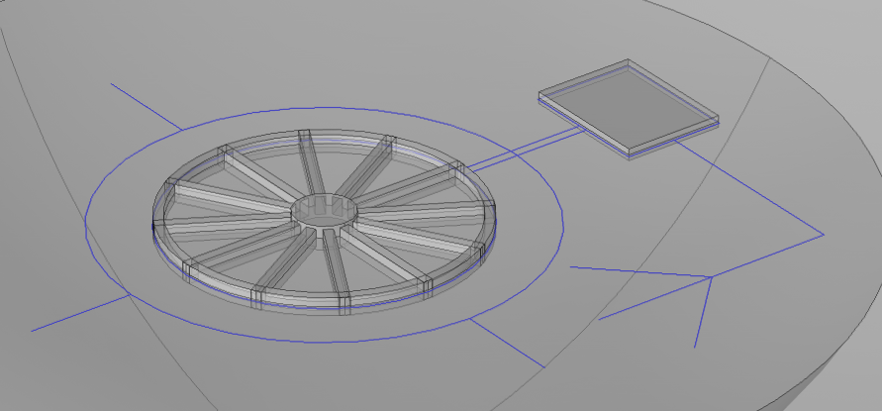
Finite Element Method basics
Reference design
(1) (2) Steel* solid blocks. They correspond to the metal grid of the reinforce concrete.
(3) Metal plates (Steel*)
2
3.5 mm
1
30 mm
3
*Material properties of Steel: conductivity of $1.12 {10}^{7} S/m$
Soil resistivity: 1$.5 kΩ∙m (LST1 reference)$

Slide 7
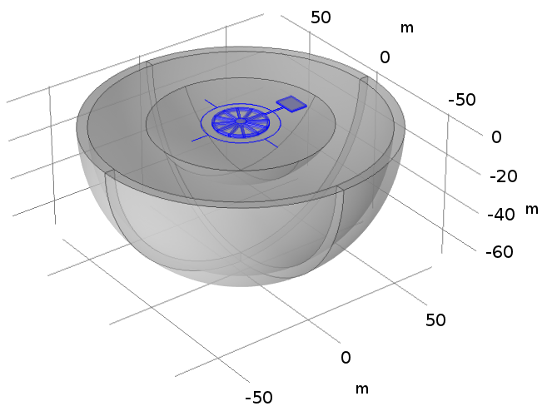
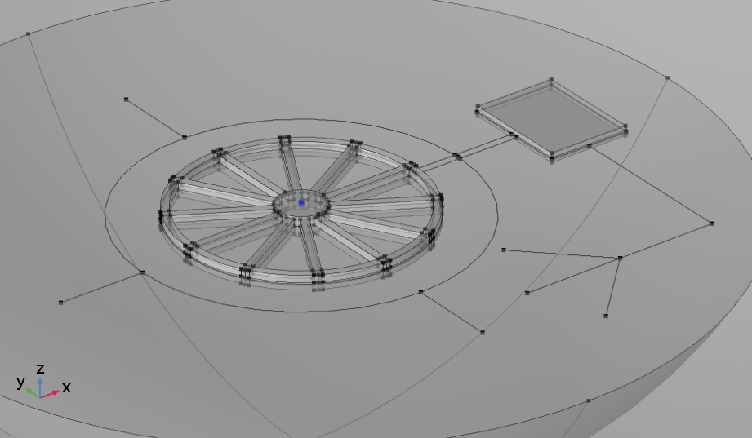
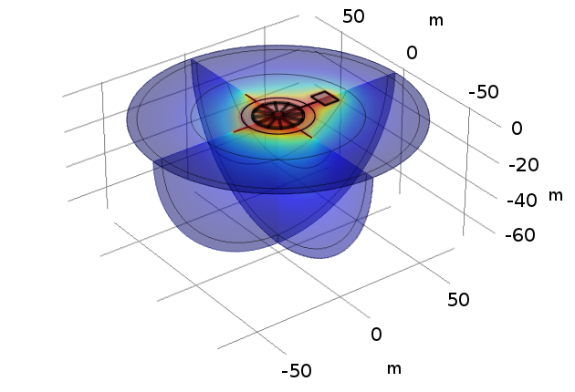
Finite Element Method basics
Design
Conditions
Results
u.r
Point source of current
Voltage distribution
Soil and ER structure
Ground Surface (at the infinite)

Slide 8
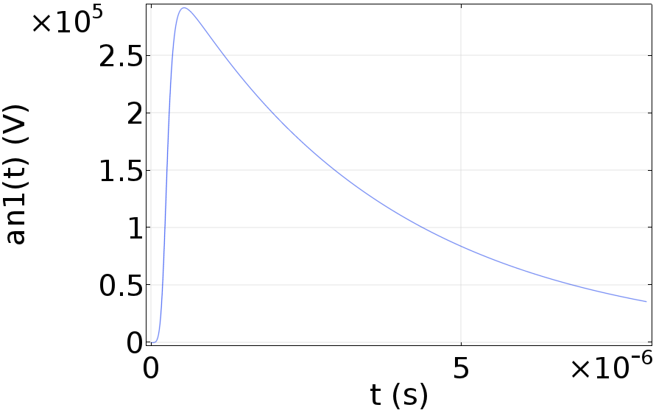
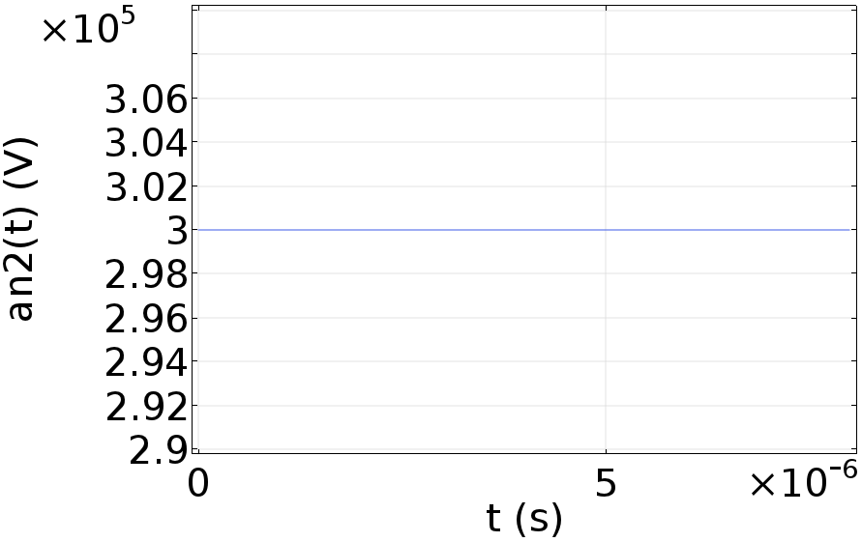
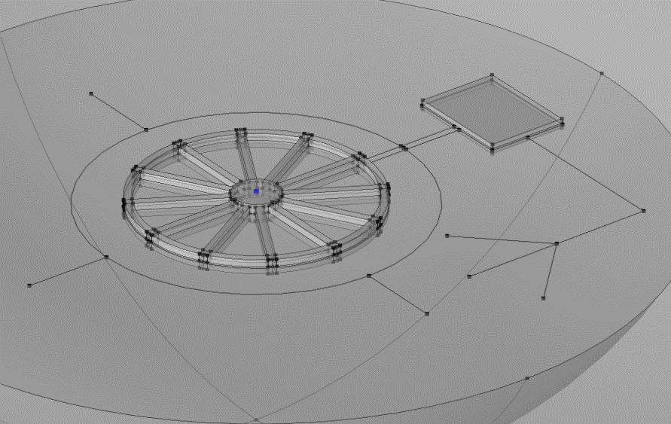
Simulation of a lightning strike in a Earthing system
I(t) = $\frac{I_{peak}}{η} \frac{{(\frac{t}{t_{1}})}^{n}}{1+ {(\frac{t}{t_{1}})}^{n}}\exp{(\frac{t}{t2})}$
Heidler equation
Real
t1: current rise time ̴0.27 μs
t2: current decay time ̴3.5 μs
I (Amps)
$I_{peak}$: current peak ̴300 kA
η: correction factor
n: exponent ̴̴5
Continuous current
Simple recreation of the injection of a continuous point source in the center of the strucuture
I (Amps)
I(t) = $300 kA$

Slide 9
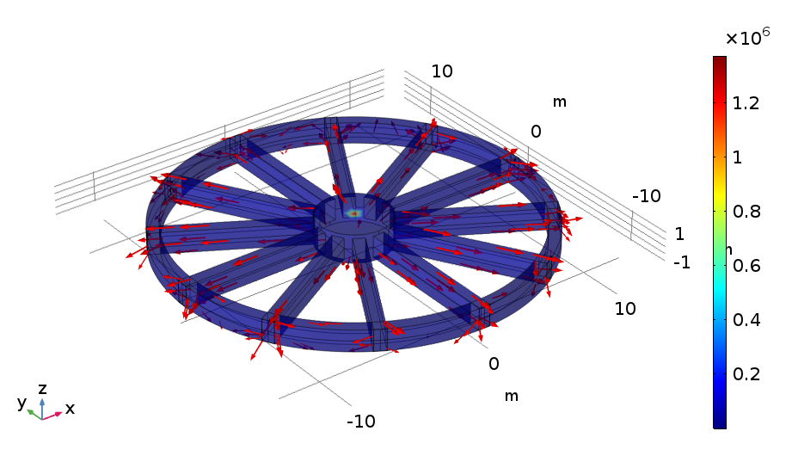
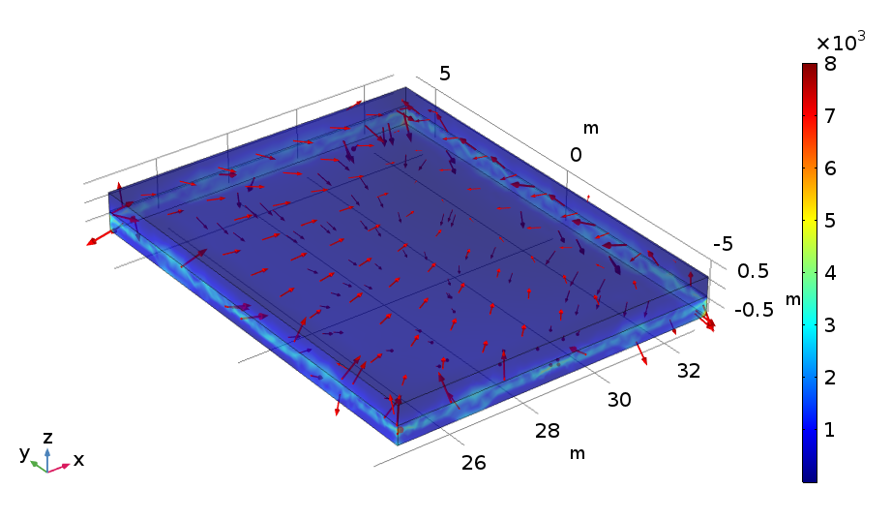
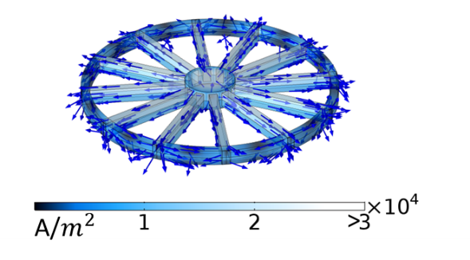
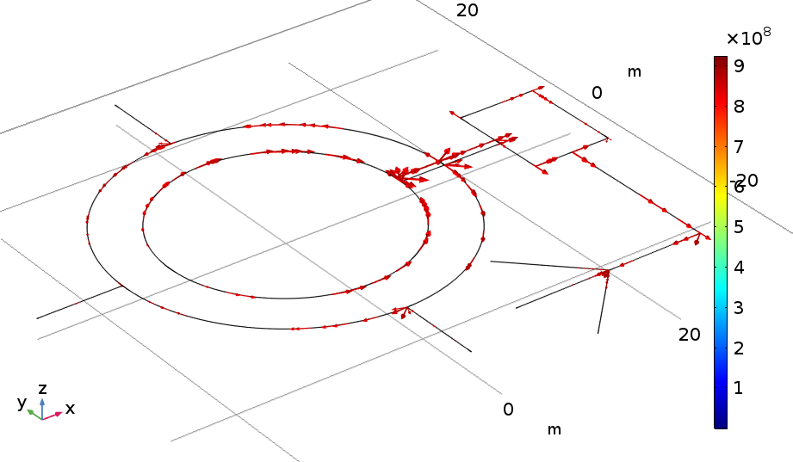
Simulation of a lightning strike in a Earthing system
Surface current density and its direction

Slide 10
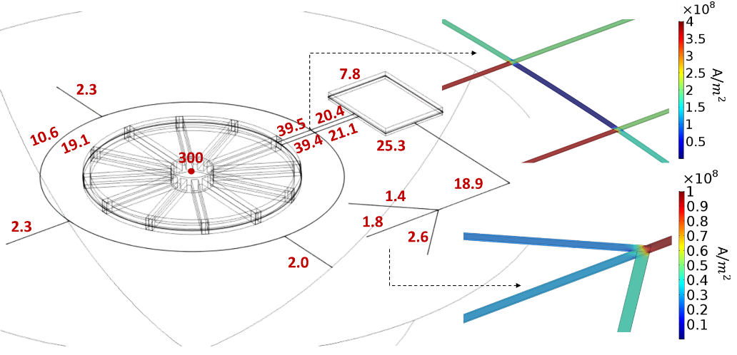
Simulation of a lightning strike in a Earthing system
High risk of strong magnetic coupling !!
Averaged current in kA within the plates
Reduction of one order of magnitude between the current injected and the one that flows through the plates

Slide 11
Conclusions
Lightning strikes or electrical discharges can cause damage or injury so need to be considered.
Lightning protection structure channel the lightning strike in a safe and controlled manner to the earth termination network if it is well designed.
We have evaluate with Finite Element the amount of current expected in the case of a high punctual current threat. Reduction of at least one order of magnitude is obtained for LST Earthing system.

Slide 12
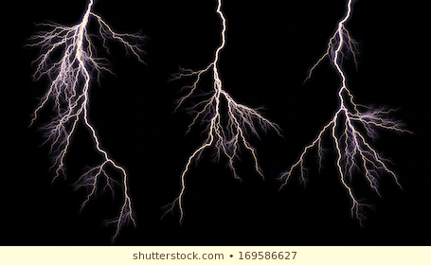
Thank You

