Slide 1
Earthing Issues at El Roque de los Muchachos Observatory
UCM-ELEC
Madrid, 24th July
Silvia Ronda, Oibar Martinez, Clara Oliver, Patricia Marquez and Jose Miguel Miranda
UCM-ELEC
July 2020

Slide 2
Main topics
Why Earthing?
The importance of soil resistivity and its influence in earth resistance value
Representative situations in ORM
How to improve Earthing systems

Slide 3
Earthing
Earth Resistance: “Resistance between the electrode and the point of zero potential (the infinite earth)”
Earthing System: Conducting connection between an electrical circuit and the Earth to prevent damage in the case of high discharges. It should be AS LOW AS POSSIBLE. Standards recommend < 10 Ω (low frequency) [IEC-62305-3]. It is influenced by:
Resistance of the electrodes
Contact resistance between electrode and soil
Resistivity of the soil
$$R≠ρ ‼$$
$$R=ρ\frac{ℓ}{S}=\frac{ℓ}{σ S}$$
[$ρ$]=Ohm·m
[R]=Ohm
Depends on the material only
S
$$ℓ$$
Depends on the material and geometry

Slide 4
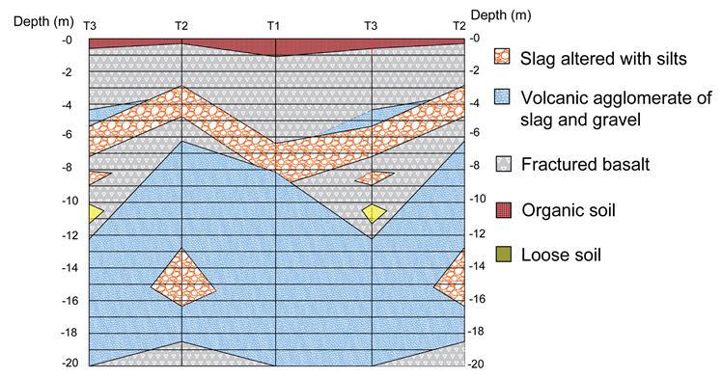
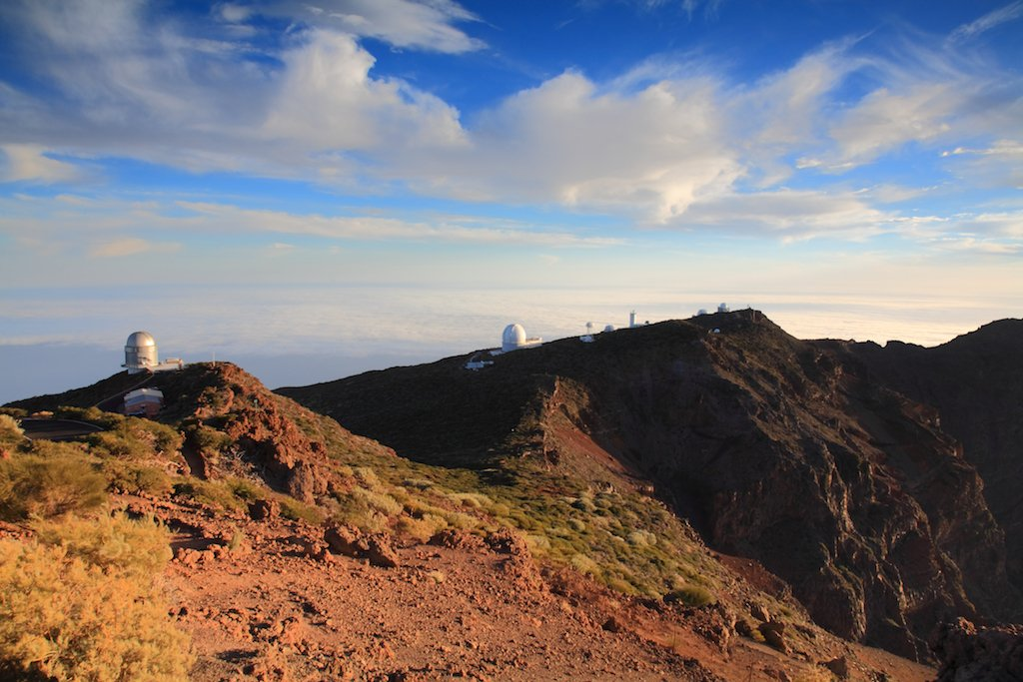
Soil resistivity
Resistivity depends on the type of soil
Volcanic terrain
Geotechnical studies
ORM

Slide 5
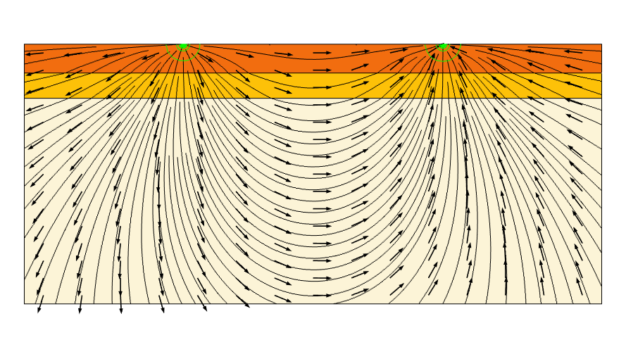
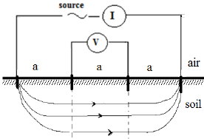
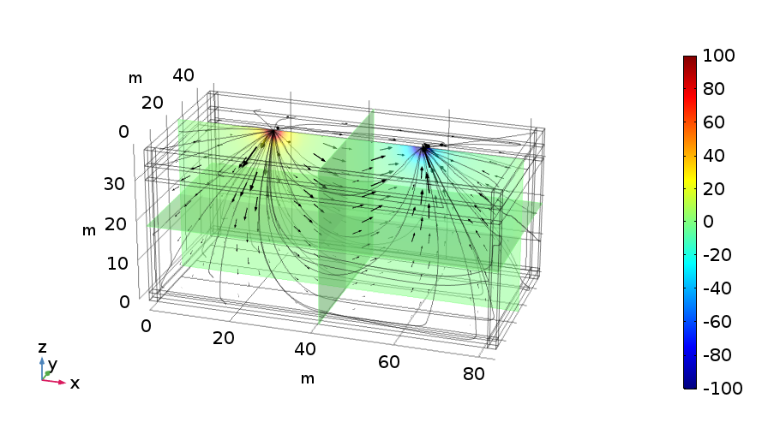
Soil resistivity measurement: Wenner Method
4 electrodes method
Simulations with COMSOL
Layer 1 | σ=1e-3
Layer 2 | σ=2e-3
Layer 3 | σ=3e-3
Equipotential surfaces
Current density lines and direction
Voltage
$$ρ\left(a\right)=2 π a R=2 π a\frac{V}{I}$$
Equipotential surface
Current density lines
5

Slide 6
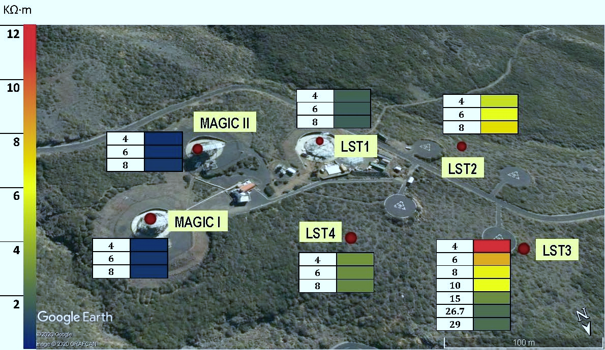
Soil resistivity measurement in ORM
Soil resistivity measurements made in ORM. The numbers correspond to the interelectrode distance in m.
Soil resistivity measurements made in ORM. The numbers correspond to the interelectrode distance in m.
Site | $\overline{ρ}$ (kΩ m)
MAGIC I | 0.57 | Homogeneous
MAGIC II | 0.53 | Homogeneous
LST1 | 1.44 | Homogeneous
LST2 | 4.3-6.1 | Non-Homog.
LST3 | 1.7-11.5 | Non-Homog.
LST4 | 2.45 | Homogeneous
Soil resistivity measurements made in ORM. The numbers correspond to the interelectrode distance in m, roughly equal to depth.

Slide 7
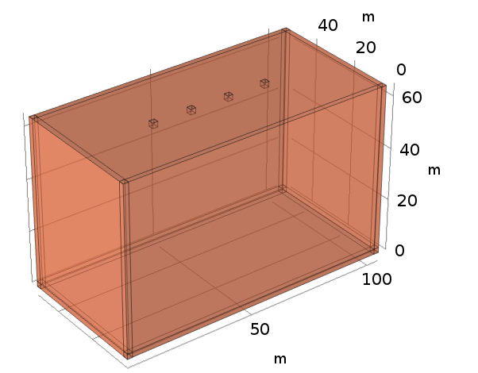
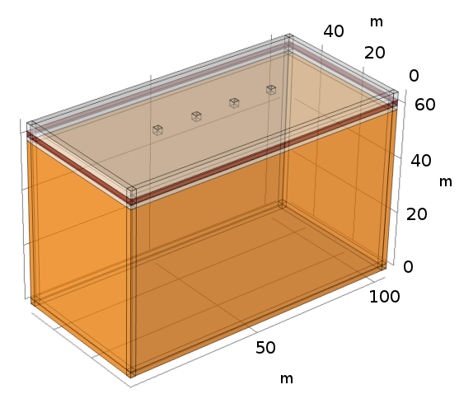
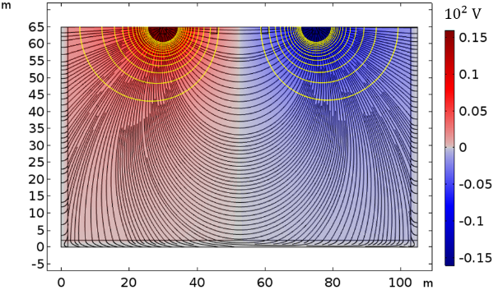
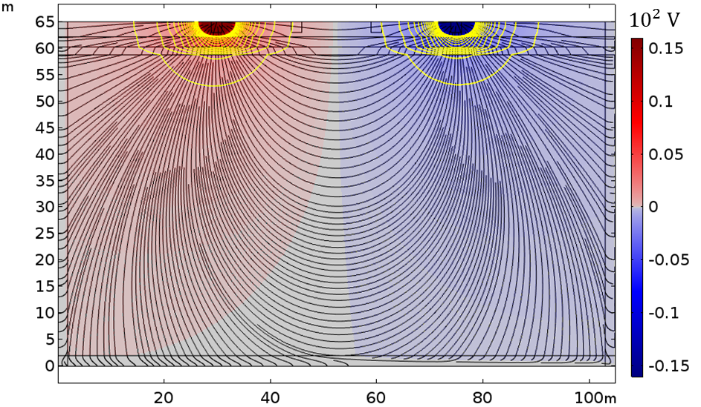
Representative situations in ORM
HOMOGENEOUS HIGH RESISTIVITY SOIL
NON HOMOGENEOUS SOIL WITH VERY HIGH RESISTIVITY LAYERS
LST1
1.44 kΩ m
LST3
18.4 kΩ m
3.5 kΩ m
15.4 kΩ m
1.5 kΩ m
Voltage distribution when resistivity is measured with Wenner method

Slide 8
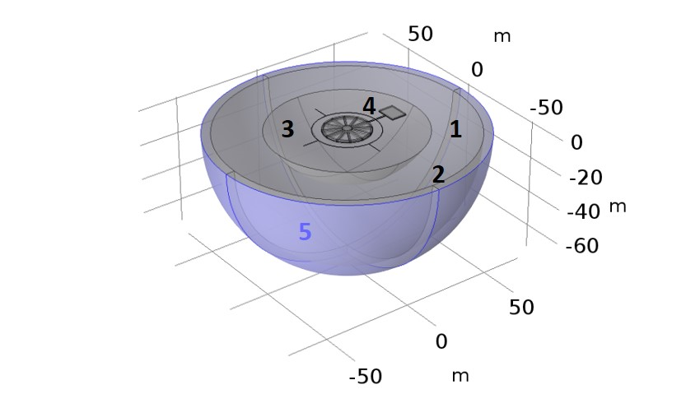
Possible solutions to reduce earth resistance
Chemical treatment of soil or use low resistivity materials
Burying metal grids plates (horizontal)
Electrodes driven vertical into the ground
Electrodes or Earthing Systems interconnection
Design in COMSOL for optimizing the telescopes Earthing
(1) Soil
(2) Infinite Element Domain Layer
(3) Extra fine mesh zone surrounding earth resistance structure
(4) Earth resistance structure
(5) Ground

Slide 9
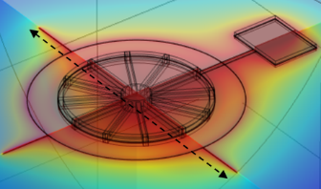
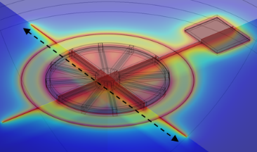
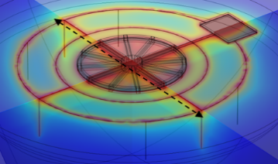
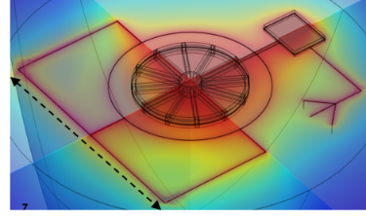
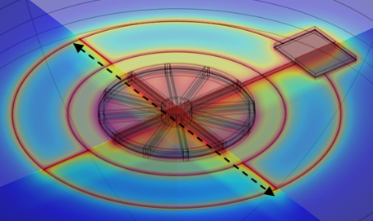
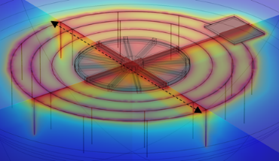
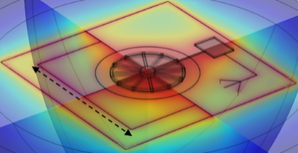
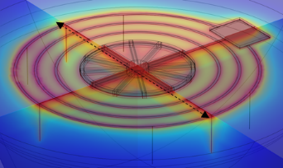
Burying metal plates (horizontal and vertical)
Voltage distribution
max
HOMOGENEOUS SOIL
NON HOMOGENEOUS SOIL
53.5 m
 | 15.2 Ω
 | 11.0 Ω
 | 7.1 Ω
 | 69.2 Ω
 | 53.5 Ω
 | 25.5 Ω
 | 27.9Ω
 | 23.6 Ω
7 vertical electrodes
22 vertical electrodes
53.5 m

Slide 10
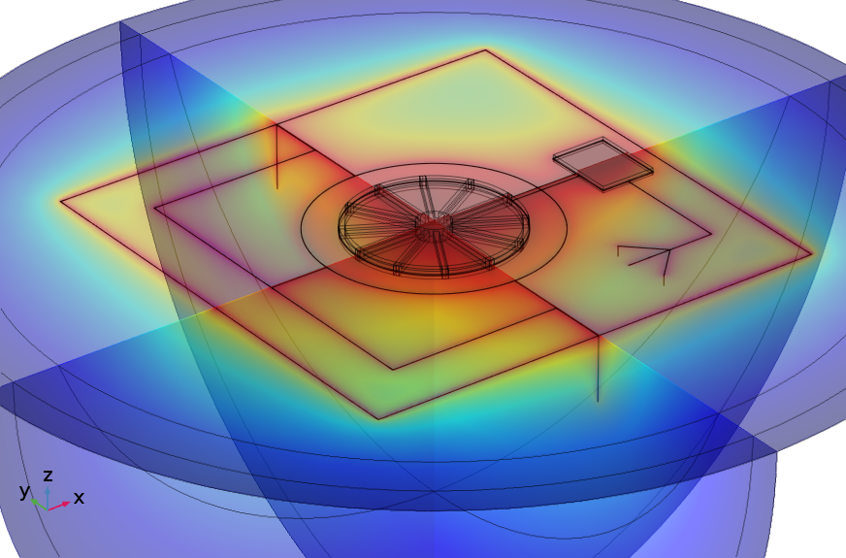
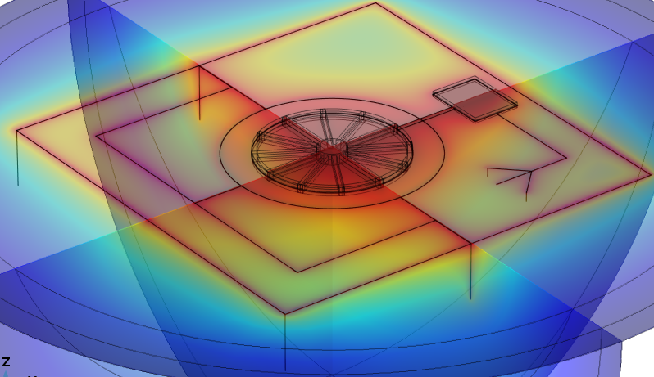
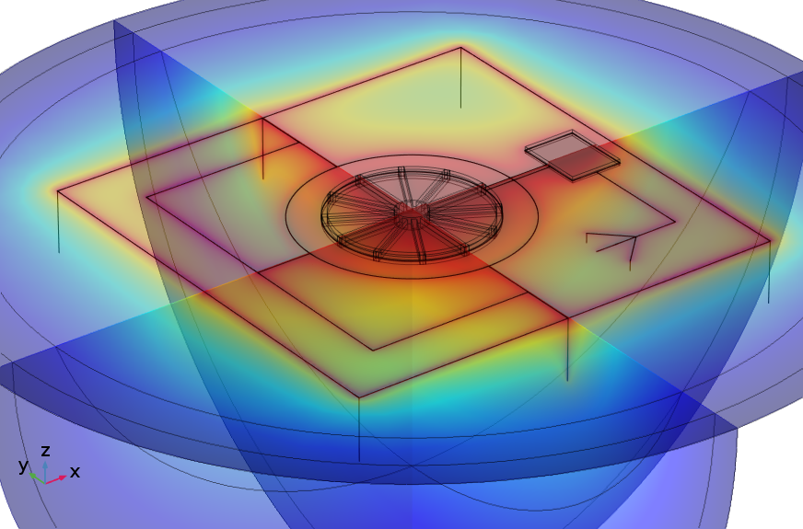
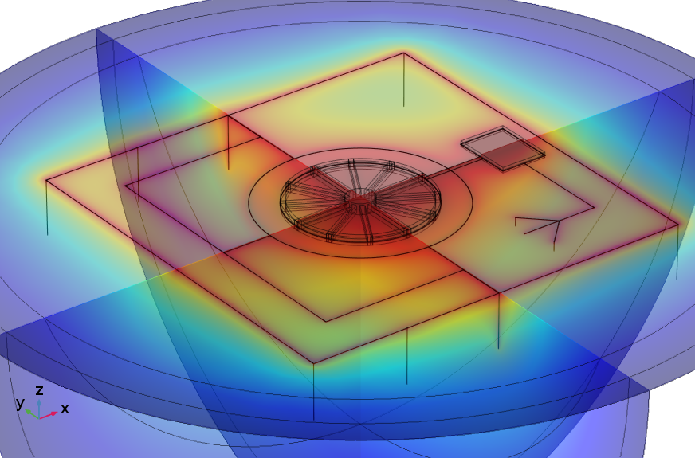
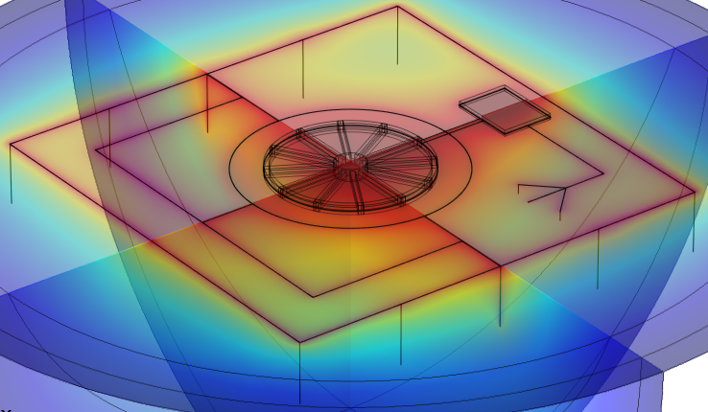
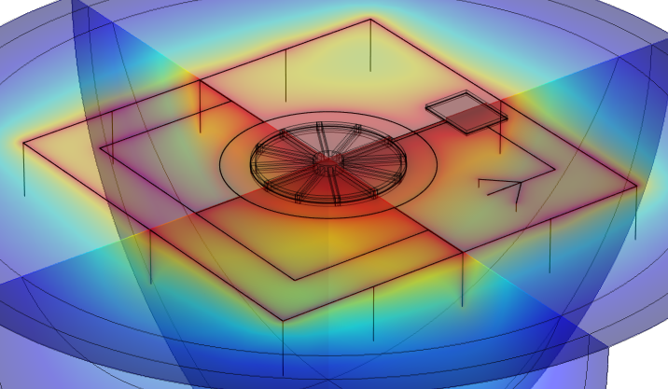
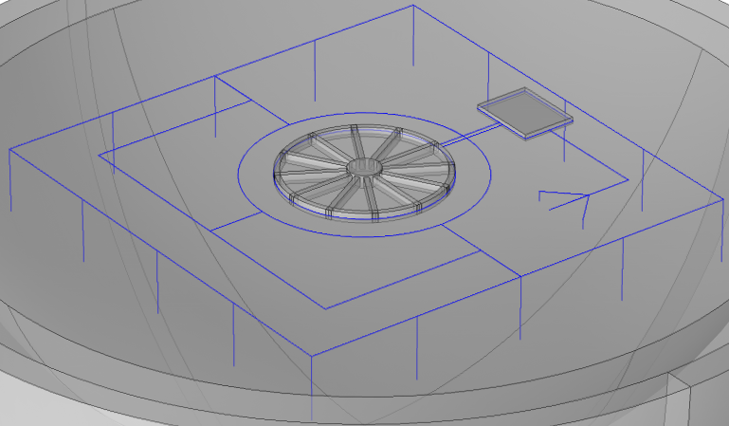
Burying vertical electrodes in homogeneous soil
HOMOGENEOUS HIGH RESISTIVITY SOIL
R= 7.14Ω
R= 7.06Ω
R= 6.79Ω
R= 6.54Ω
R= 6.43Ω
R= 6.31Ω
R= 6.21Ω
R= 6.01Ω
53.5 m
10 m

Slide 11
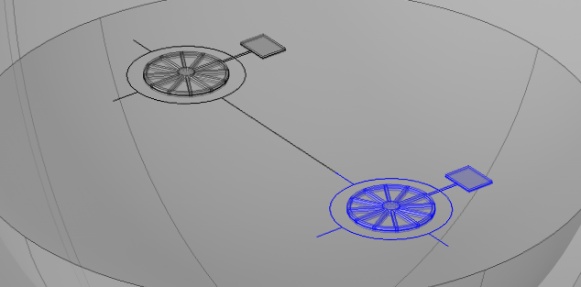
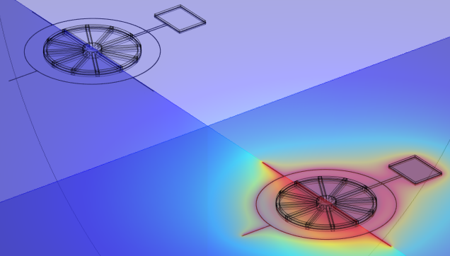
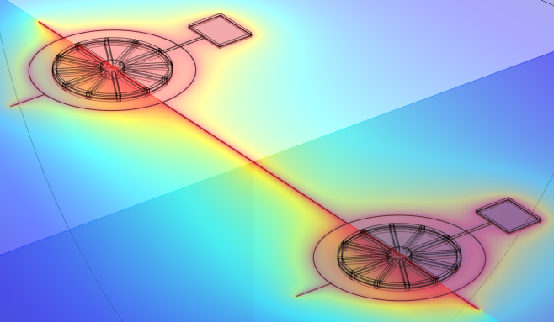
Electrodes or Earthing Systems interconnection
Earthing systems connected
If the resistances work as if they are pararell connected the value expected if we interconnet two LST1 is:
$\frac{1}{R}=\frac{1}{R_{1}}+\frac{1}{R_{2}} ≅\frac{2}{15.2} →R ≅7.59$Ω
This is verifyed with simulation in LST1 (homogeneous soil)
R= 16.64 Ω
R= 8.58 Ω
No connected
Connected

Slide 12
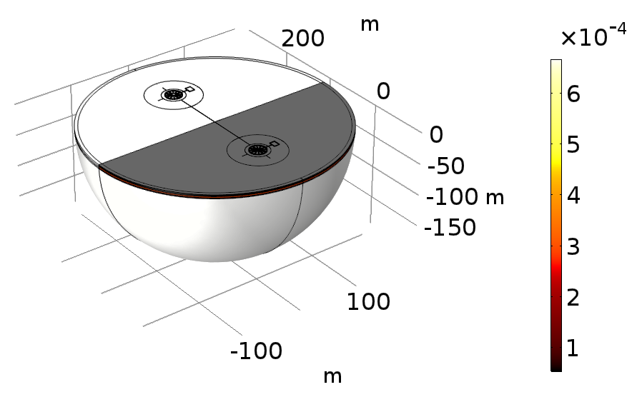
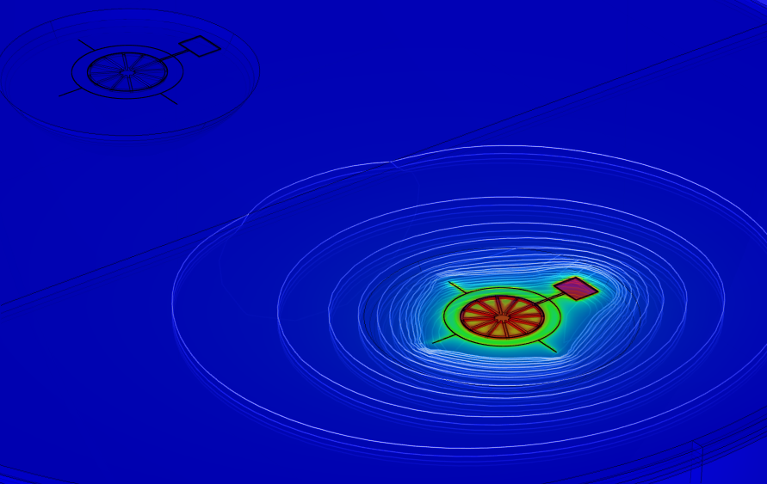
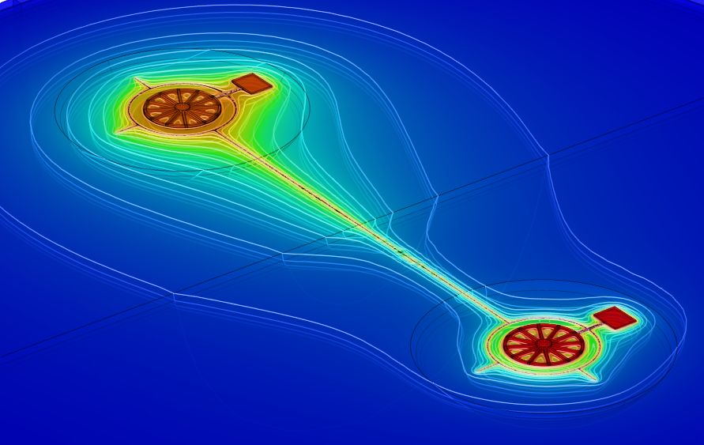
Electrodes or Earthing Systems interconnection
No connected
Expected value for earth resistance of LST1-LST3 interconnection:
LST1
LST1
̴15.2 Ω
LST3
̴69.2 Ω
$\frac{1}{R}=\frac{1}{R_{1}}+\frac{1}{R_{2}} →R ≅12.5$Ω
LST3
Simulation of the resitance in LST3
No connected
Soil conductivity
Connected
70.7 Ω
11.6 Ω

Slide 13
Possible solutions to lowering earth resistance
Soil resistivity is necessary when determining the design of the grounding system for new installations.
Poor soil conditions (high resistivity) can be overcome with specific grounding designs.
Our findings might help to efficiently design the future ground structures for the installations under construction and are applicable to other similar sites with soils of volcanic nature.
Solution | Homogeneous soil (LST1) | Non- homogeneous soil (LST3)
Low resistivity materials or chemical treatment
Burying metal grids or plates (horizontal)
Vertical electrodes buried into the ground
Electrodes or earthing systems interconnection

Slide 14
Thank You

