Slide 1
Auxiliary systems – Maintenance

Slide 2
Auxiliary systems
Calibration box
OARL
Inclinometer
Distance Meters
Starguider
CDM + NUC
Energy Container
Cabling
Cable chains
Diagnostic SW tools centralized
Regular inspection of all dish center elements
Cabling
Protections
Dust/humidity on windows
Regular inspection
Thermographic measure on cabinet and
Water check
Longer term electrical connection verification

Slide 3
Dish Center Elements
Calibration box
OARL
Inclinometer
Distance Meters
Starguider
CDM + NUC
Action – grouped for all systems
Cleaning of exit window for each box & distance meter
Check of humidity inside windows
Check of cabling integrity
Amount of preventive interventions expected per year
2 per year
Number of persons and hours needed
1 person – 2 hours
Type of personnel required: Expert/Local Engineer/hired company
Local engineer / technician (CTA / hired company - similar work as for other telescopes)
Is it possible to hire lab for expert interventions?
X
Is it possible to estimate the cost?
400 Euros
Notes:
3

Slide 4
Calibration Box
Specific actions:
check if no water infiltration - this can be done by checking the trend of moisture (by software) and visually the alluminium tape and the window laser exit (expert).
refill the nitrogen bottle connected to the box (we have no yet time scale about this procedure)
No feedback from Mic & Mau so far

Slide 8
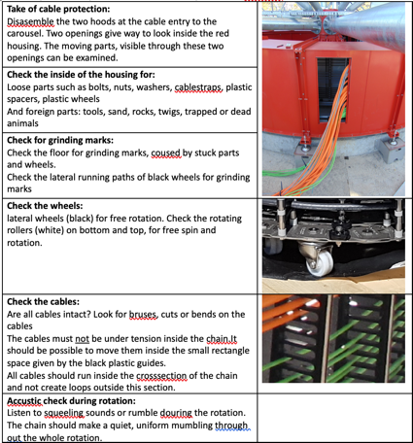
Cable chains
C. Jablonski
2-Year Visual Examination of the Cable Carousel through cable entry
In a 2 year term a, visual examination of the cable caroussel should be performed.
If possible, perform a 540° rotation to check the full range of motion.
This is only possible if weather conditions allow rotation: no sun, windspeed less than 45 km/h
Trained personal, capable to move the telescope must be available
Needed time / manpower / downtime
Manpower: 1 mechanics, 1 person for movement.
Time: 3-4 hours
Downtime: none
Type of personal:
1 Supervisor (CTA: local Engineer or Mechanic) + 1 local worker (from CTA or from a hired company)
Is it possible to hire MPP-Munich?
MPP can do it for a certain set of time. On the long term, CTA engineer or mechanic. Not to a local company without direct supervision from CTA side.
Is it possible to estimate the cost?
Small inspection: 0,5 Days = 400€

Slide 9
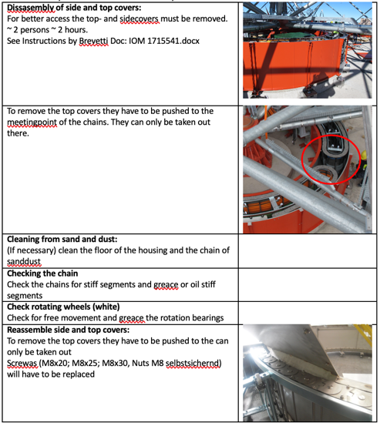
Cable chains
C. Jablonski
5-Year inspection of the Cable Carousel
In a 5 year term the housing of the cable carousel should be opened. The system should be examined thoroughly, including the elements described above. If the cable carousel proves reliable the term of 5 years could be extended to 10 years.
Needed time / manpower / downtime
Manpower: 2 mechanics, 1 person for movement.
Time: 1 day
Downtime: none
Type of personal:
1 Supervisor (CTA: local Engineer or Mechanic) + 1 local worker (from CTA or from a hired company)
Is it possible to hire MPP-Munich?
MPP can do it for a certain set of time. On the long term, CTA engineer or mechanic. Not to a local company without direct supervision from CTA side.
Is it possible to estimate the cost?
Big Inspection (Opening the housing): 1 day work for two people. With 800€ / Day / Person: 2x800 = 1600€

Slide 10
Cabling
6 month inspection of cabinet
All telescope cabinet should be opened to check there is no water ingress inside. This operation can be mutualised with inspection of dish centre elements.
Needed time / manpower / downtime
Manpower: 2 person (work at height).
Time: ½ hours
Downtime: None
Type of personal:
Local worker (from CTA or from a hired company) – similar work to other telescope
Is it possible to hire lab?
X
Is it possible to estimate the cost?
200 Euros

Slide 11
Cabling
2-Year inspection of cabling
The cabling should be inspected every 2 year. A visual inspection has to be done on all ducts to verify there is no visible damage on unprotected cables. All cabinet should be opened and electrical connection should be verified to check there is no loose connection. Thermographic measurement.
Needed time / manpower / downtime
Manpower: 2 person (work at height).
Time: ½ day
Downtime: system power cut during day time
Type of personal:
Local worker (from CTA or from a hired company) – similar work to other telescope
Is it possible to hire lab?
X
Is it possible to estimate the cost?
400 Euros

Slide 12
Summary
Action | Freq /year | Pers. & Time | Pers. type | Lab? | Cost
Dish center cleaning | 2 | 1 persx2h | Local eng./tech | X | 400E
Calib box nitrogen + | ? | 1 persx1day? | Expert | ? | ?
UCs | 1or2 |  | Expert | X | 40000 /year
Fire alarm | 4 |  | Expert | X | 450 E/year
Air cond. UC | 2 |  | Expert | X | 2000 E/year
Genset | 1 |  | Expert | X | 5000 E/year
Cable chain short | .5 | 2 pers 4h | Local eng. | First action | 400E
Cable chain long | .2 | 2 pers 1 day | Local eng. | First action | 1600E
Cabling | 2 | 1 pers 2h | Local eng./tech | X | 200E
Cabling | 0.5 | 1 pers 4h | Local eng./tech | X | 400E

