Slide 1

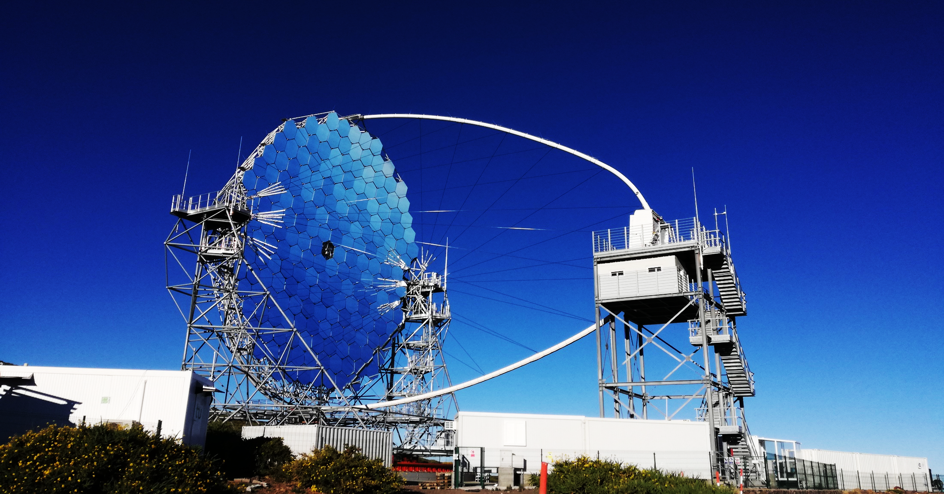
TRACKING CURRENT MAINTENANCE NEEDS
              LST1

Slide 2
LST1 - MAINTENANCE
LST1 MAINTENANCE
INFRA ONSITE (ORM)
FIRE EXTINGUISHERS
ATS
GENSET
OTHERS
INFRA OFFSITE (MIRCA)
FIRE EXTINGUISHERS
OTHERS
LST1 TELESCOPE
ALS
BOGIES
RAIL
ENERGY CONTAINERS
LIFE LINE
OTHERS
COMPUTING

Slide 3
LST1 - INFRA MAINTENANCE (ONSITE AND OFFSITE)
INFRA MAINTENANCE
Fire Extinguishers
A/C
Pest control
Plant control
Safety equipment *
Cherry Picker
ATS
GENSET
IT container
Insurances
Cleaning
Alarm by Securitas Direct
PLANNING OF ACTIVITIES
* Life Line is not INFRA

Slide 4
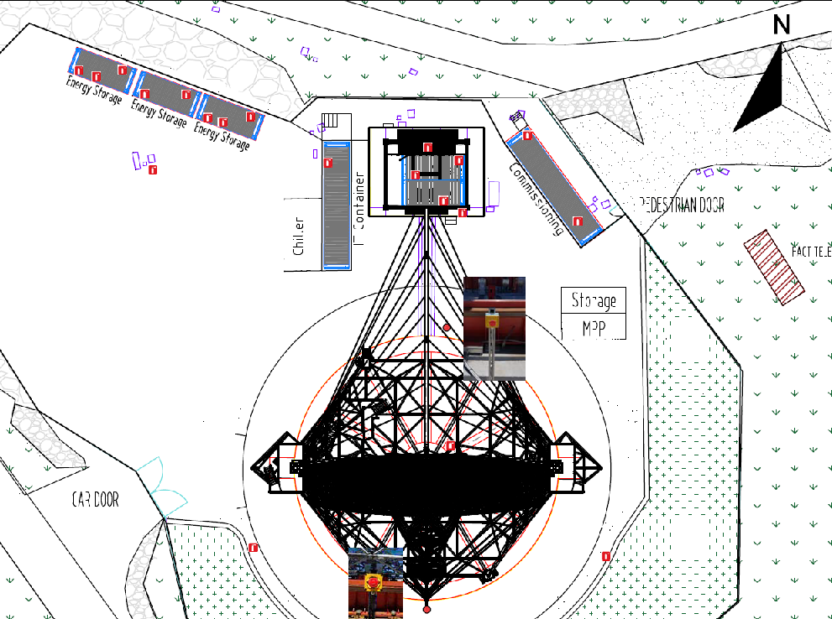
LST1 - INFRA ONSITE MAINTENANCE
Fire Extinguishers (2 batches)
NAME |  | LAST INSPECTION
 | PURCHASE | Cost | Manpower | Duration (min) | Date | Certificate
BATCH 1 (8)
TOTAL | 18/09/2018 | 72.00 € | 1 person | 80.00 | 27/09/2019 | 909128
BATCH 2 (12)
TOTAL | 2017 | 108.00 € | 1 person | 120.00 | 15/01/2020 | 1033
Hired company: Extinpalma
1 inspection/year
Do we need to stop the telescope? NO
Preventive maintenance
Payment per visit
Standard: REAL DECRETO 513/2017, of 22nd May

Slide 5
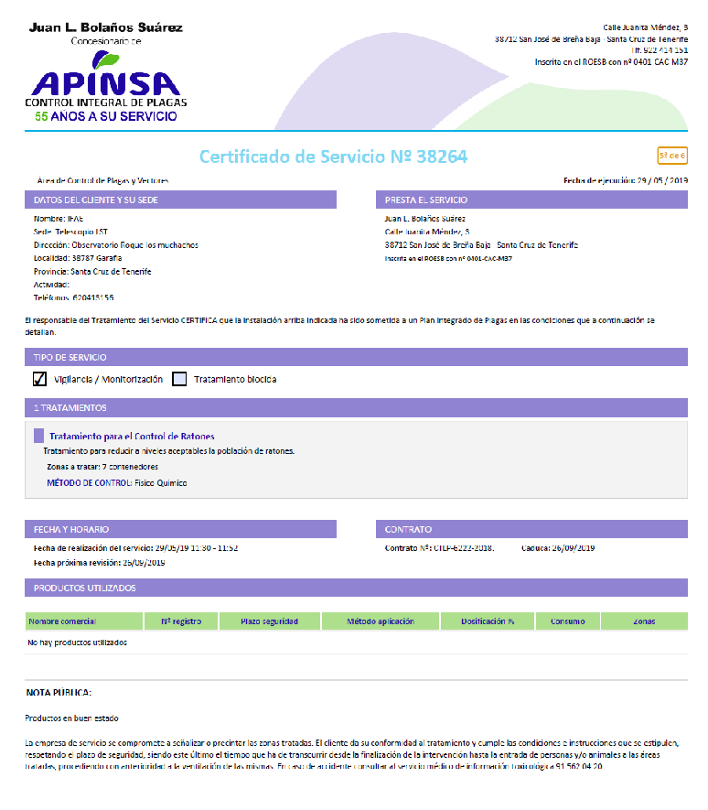
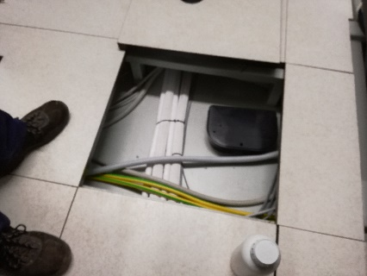
LST1 - INFRA ONSITE MAINTENANCE
PEST CONTROL
Preventive maintenance

Slide 6
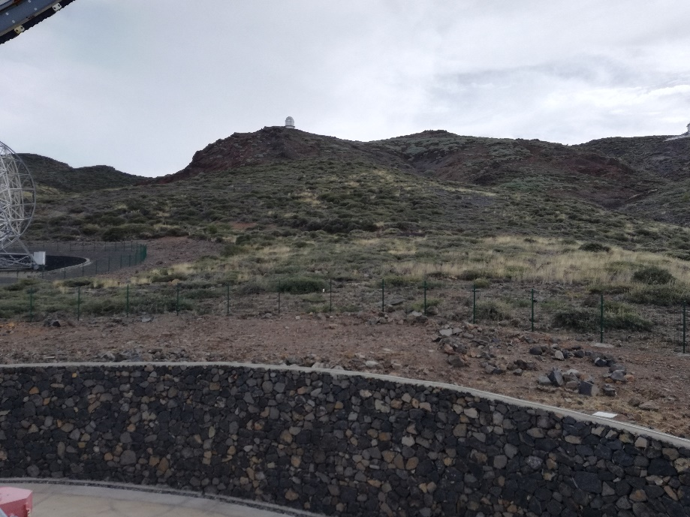
LST1 – INFRA ONSITE MAINTENANCE
PLANT CONTROL
We don´t need to stop the telescope
Preventive maintenance (fire control)
Next activity: this summer

Slide 7
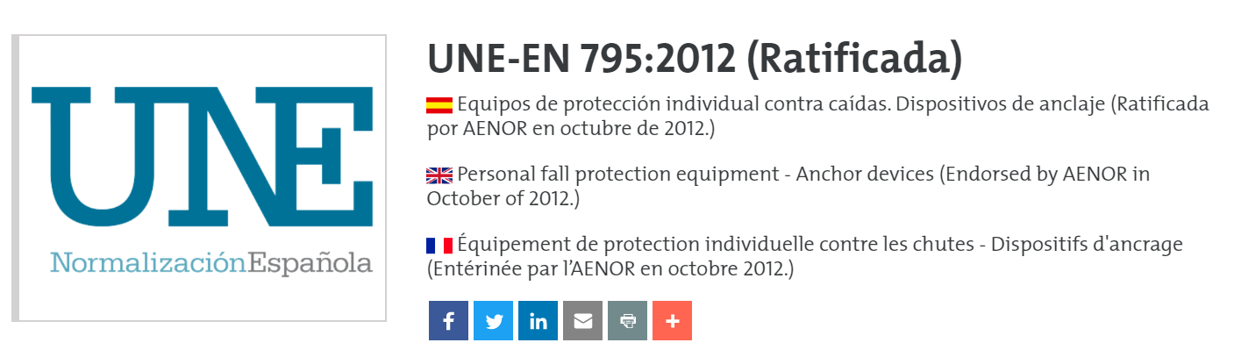
LST1 - INFRA ONSITE MAINTENANCE
PPE-EPIS
ITEM |  | Serial Nº | Manufacture date | Purchase date | First use | Inspection 1
 |  |  |  |  |  | INSPECTOR | COST | STATUS
HARNESS AVAO® BOD CROLL®FAST versión internacional. Size 0 |  |  |  | 2018 SEP | 2018-DEC | Arquitectura Vertical | € 14,00 | OK (14-10-2019)
 | HARNESS (PATRICIA) | 17H0083573514 | 2017 AUGUST
 | CROLL | 17E0078115371 | 2017 MAY
HARNESS AVAO® BOD CROLL®FAST versión internacional. Size 1 |  |  |  | 2018 SEP | 2018-sep | Arquitectura Vertical | € 14,00 | OK (14-10-2019)
 | HARNESS (DANIEL M) | 18G0141994570 | 2018 JULY
 | CROLL | 18F0141879151 | 2018 JUNE
ABSORBICA Y 80 MGO |  |  |  | 2018 SEP | XXX | Arquitectura Vertical | € 9,00 | OK (14-10-2019)
 | Rope | 17E0080730094 | 2017 MAY
 | Hook | 16298J7758 | 25-oct-16
 | Hook | 16298j7774 | 25-oct-16
ABSORBICA Y 80 MGO |  |  |  | 2018 SEP | 2018-oct | Arquitectura Vertical | € 9,00 | OK (14-10-2019)
 | Rope | 17E0080730101 | 2017 MAY
 | Hook | 16298J7958 | 25-oct-16
 | Hook | 16298J7957 | 25-oct-16
GRILON |  |  |  | 2018 OCT | 2018-oct | Arquitectura Vertical | € 8,80 | OK (14-10-2019)
 | ROPE | 18G0146863772 | 2018 JULY
 | POLEA | 18F0144490430 | 2018 JUNE
Eslinga. ANNEAU 80cm |  | 18073GK8399 | 14-mar-18 | 2018 SEP | 2018-oct | Arquitectura Vertical | € 3,00 | OK (14-10-2019)
Eslinga. ANNEAU 80cm ANNEAU |  | 18073GK8400 | 14-mar-18 | 2018 SEP | 2018-oct | Arquitectura Vertical | € 3,00 | OK (14-10-2019)
Eslinga. 150 cm ANNEAU |  | 17311GS8329 | 07-nov-17 | 2018 SEP | 2018-oct | Arquitectura Vertical | € 3,00 | OK (14-10-2019)

Slide 8
LST1 - INFRA ONSITE MAINTENANCE
PPE-EPIS
ITEM | Serial Nº | Manufacture date | Purchase date | First use | Inspection 1
 |  |  |  |  | INSPECTOR | COST | STATUS
CARABINER OK | 18E0136072 530 | may-18 | 2018 SEP | 2018-oct | Arquitectura Vertical | € 5,00 | OK (14-10-2019)
CARABINER OK | 18E0136072 493 | 01-may-18 | 2018 SEP | 2018-oct | Arquitectura Vertical | € 5,00 | OK (14-10-2019)
CARABINER OK | 18E0136072 583 | may-18 | 2018 SEP | 2018-oct | Arquitectura Vertical | € 5,00 | OK (14-10-2019)
CARABINER OK | 18E0136072 449 | 01-may-18 | 2018 SEP | 2018-oct | Arquitectura Vertical | € 5,00 | OK (14-10-2019)
CARABINER OK | 18E0136072 407 | may-18 | 2018 SEP | 2018-oct | Arquitectura Vertical | € 5,00 | OK (14-10-2019)
CARABINER OK | 18E0136072 424 | 01-may-18 | 2018 SEP | 2018-oct | Arquitectura Vertical | € 5,00 | OK (14-10-2019)
CARABINER OK | 18E0136072 484 | may-18 | 2018 SEP | 2018-oct | Arquitectura Vertical | € 5,00 | OK (14-10-2019)
CARABINER OK | 18E0136072 534 | 01-may-18 | 2018 SEP | 2018-oct | Arquitectura Vertical | € 5,00 | OK (14-10-2019)
Rope 60m, Industrie 10.5mm | B01L109818 | 2018 | 2018 SEP | XXX | Arquitectura Vertical | € 15,00 | OK (14-10-2019)

Slide 9
LST1 - INFRA ONSITE MAINTENANCE
PPE-EPIS
ITEM | Serial Nº | Manufacture date | Purchase date | First use | Inspection 1 |  |  | Inspection 2
 |  |  |  |  | INSPECTOR | COST | STATUS | INSPECTOR | COST | STATUS
Helmet 1 - VERTEX BEST | 18E0136758714 | 01/05/2018 | 2018 JUNE | 18 JUNE | LST TEAM | LST TEAM | OK (9-8-19) | LST TEAM | LST TEAM | ok 18-6-20
Helmet 3 - VERTEX BEST | 18E0136758644 | 01-may-18 | 2018 JUNE | 18 JUNE | LST TEAM | LST TEAM | OK (24-6-19) | LST TEAM | LST TEAM | ok 18-6-20
Helmet 4 - VERTEX BEST | 18E0136758673 | may-18 | 2018 JUNE | 18 JUNE | LST TEAM | LST TEAM | OK (24-6-19) | LST TEAM | LST TEAM | ok 18-6-20
Helmet 5 - VERTEX BEST | 18E136758645 | 01-may-18 | 2018 JUNE | 18 JUNE | LST TEAM | LST TEAM | OK (24-6-19) | LST TEAM | LST TEAM | ok 18-6-20
Helmet 6 - VERTEX BEST | 15182IA7353 | 01-jul-15 | ???? | 2018-may | LST TEAM | LST TEAM | OK (31-5-19) | LST TEAM | LST TEAM | ok 18-6-20
JAG SYSTEM |  |  | 2018 OCT | 2018-nov | Arquitectura Vertical | € 30,00 | OK (14-10-2019) |  |  | OK/NO OK Date: Sign:
ANTICAIDAS | IRUDEK-01-4136-225-00A | 2018 MARCH | 2018 SEP | 2018-nov | Arquitectura Vertical | € 24,00 | OK (14-10-2019) |  |  | OK/NO OK Date: Sign:
Helmet 7 - VERTEX VENT | 19H0206262454 | 2019 AUG | 01/09/2019 | 01/09/2019 |  |  |  |  |  | OK/NO OK Date: Sign:
Helmet 8 - VERTEX VENT | 19H0206262499 | 2019 AUG | 01/09/2019 | 01/09/2019 |  |  |  |  |  | OK/NO OK Date: Sign:
Helmet 9 - VERTEX VENT | 19H0206262427 | 2019 AUG | 01/09/2019 | 01/09/2019 |  |  |  |  |  | OK/NO OK Date: Sign:
Helmet 10 - VERTEX VENT | 19H0206262428 | 2019 AUG | 01/09/2019 | 01/09/2019 |  |  |  |  |  | OK/NO OK Date: Sign:

Slide 10
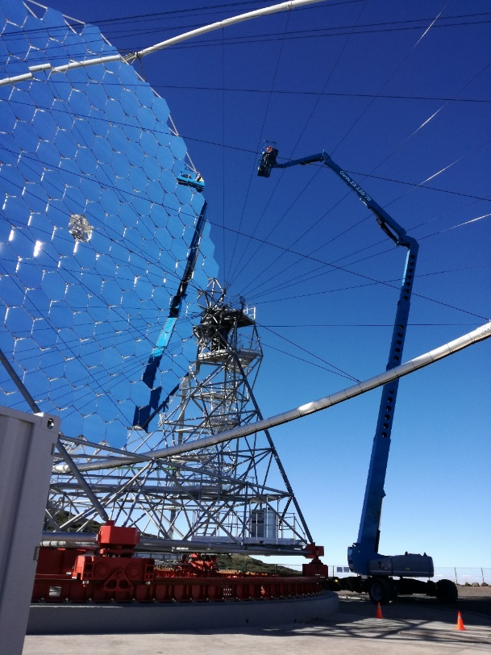

LST1 - INFRA ONSITE MAINTENANCE
CHERRY PICKER
Four PREVENTIVE inspections per year by in 2018
Cost: ~1900 € /year
Opein is the authorized service company of Genie in Canary Island
CTA is going to do a new maintenance contract this year

Slide 11
LST1 - INFRA ONSITE MAINTENANCE
GENSET, ENERGY CONTAINERS (4) AND ATS
OCT-2018 JUNE-2020 JULY-2020
GENSET + ENERGY CONTAINERS* by HITACHI
ABB
PEDRO BRITO
EXTINPALMA
ENERGY CONTAINER* by
GENSET by ERGA
ATS by IAC
* It is not INFRA

Slide 12
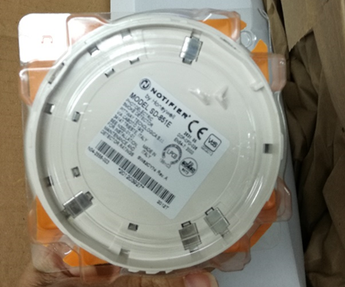
LST1 - INFRA ONSITE MAINTENANCE
IT CONTAINER
SCHNEIDER maintenance contract
PREVENTIVE and CORRECTIVE maintenance (if applicable) → ~20 k€/year
  Visual, electronic, power and ambient inspection (1 visit/year)
  Cooling system (2 visits/year)
  Fire extinguisher system (4 visits/year) by Tyco
  EcoStruxure Asset Advisor
  Technical assistant 24/7
FUJITSU maintenance contract
PREVENTIVE and CORRECTIVE maintenance (if applicable) →~17 k€/year
This week
Last week

Slide 13


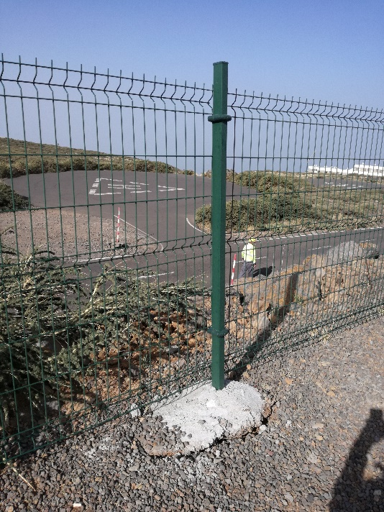
LST1 - INFRA ONSITE MAINTENANCE
INSURANCE, CLEANING and OTHERS
All included insurance by
One incident and they worked very well
Cleaning Company
They clean the commissioning container once/week
A/C from commissioning container by local staff
Puntual corrective maintenance
INSURANCES LST1
COMPANY | CHUBB
DURATION | 14-10-19 to 14-10-20
TYPE | COST
ALL INCLUSIVE | 18,575.10 €
CIVIL RESPONSABILITY | 3,386.19 €
TOTAL | 21,961.29 €

Slide 14
LST1 - INFRA OFFSITE MAINTENANCE (MIRCA)
Fire Extinguishers
Batch 4: MIRCA STORAGE BUILDING
Hired company: Extinpalma
Do we need to stop the telescope? NO
Preventive maintenance

Slide 15


LST1 - INFRA OFFSITE MAINTENANCE (MIRCA)
INSURANCE and OTHERS
Insurance by
Alarm by
Other maintenance from the owner of the building (e.g. to paint the building)
INSURANCE MIRCA STORAGE BUILDING
COMPANY | MAPFRE
TYPE | MULTI RISK
DURATION | 18-7-20 to 18-7-21
COST | 4,863.63 €
ALARM
COMPANY: | SECURITAS DIRECT
LOCATION: | MIRCA STORAGE BUILDING
COST
INSTALATION | 647.35 €
MANTEINANCE/MONTH | 45 €

Slide 16
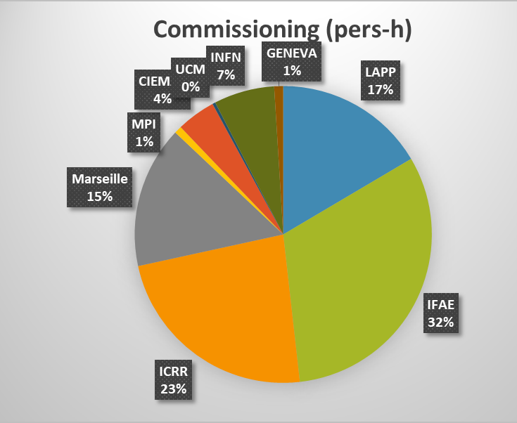
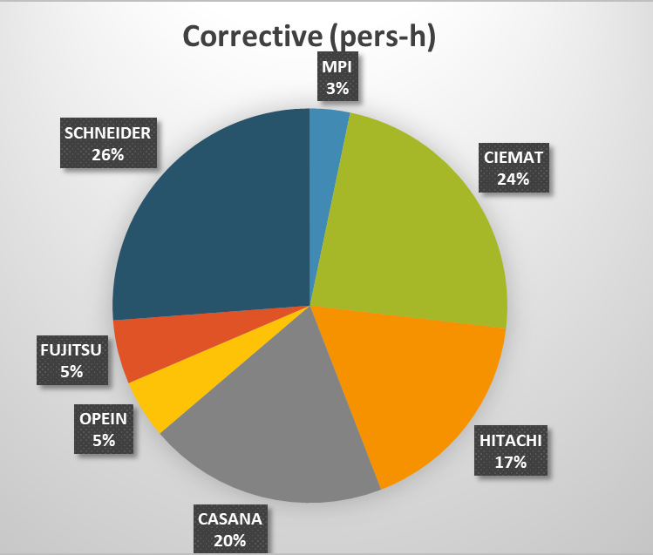
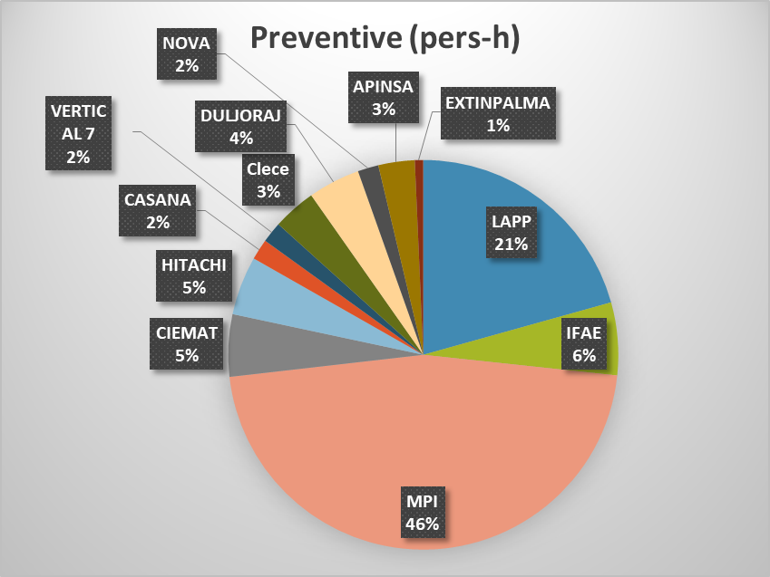
LST1 - MAINTENANCE
Activities in 2019
Telescope manager and shifters time is not included here.
Neither most of the work done on remote.
Information from LST1 Commissioning Excel file

Slide 17
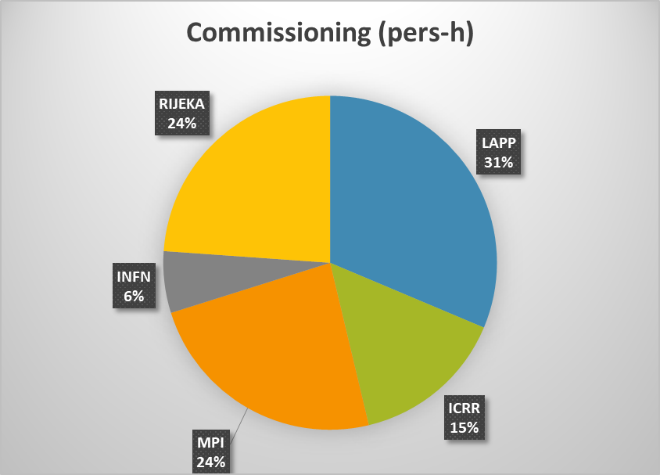
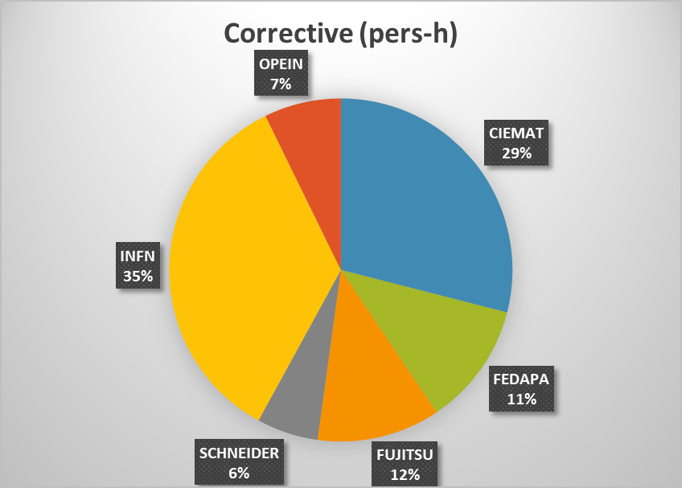
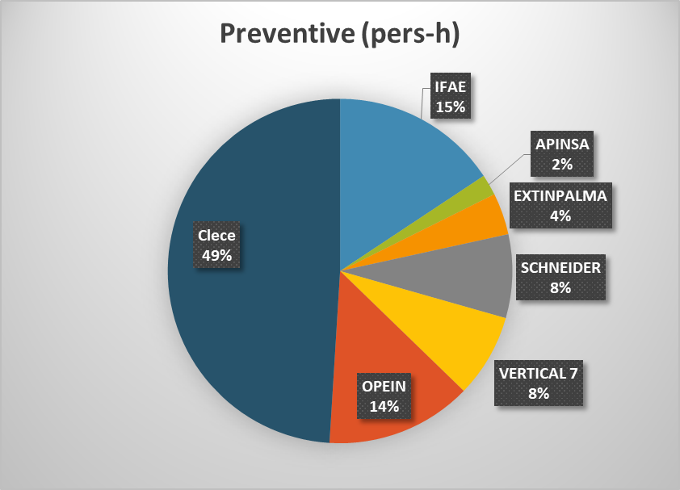
LST1 - MAINTENANCE
Activities in 2020
Information until July 2020
Covid-19: no activities during 2 months
Telescope manager and shifters time is not included here.
Neither most of the work done on remote.
Information from LST1 Commissioning Excel file

Slide 18
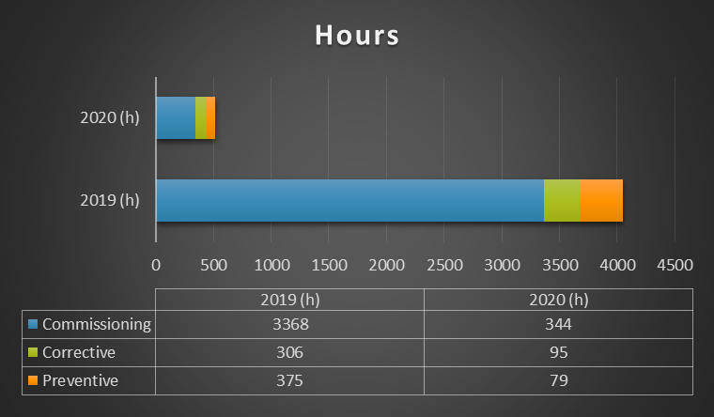
LST1 - MAINTENANCE
Activities in 2019 Vs 2020
2019 | 2020
12 months | 7 months
No incidents | Storm incident (feb)→ corrective activities Covid-19 (during 2 months, no activities)
First year of commissioning | Several activities of commissioning are finished
Information from LST1 Commissioning Excel file

Slide 19

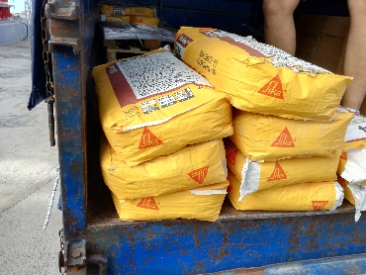
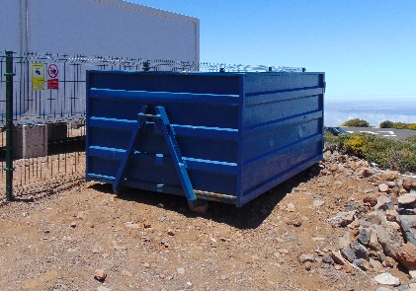
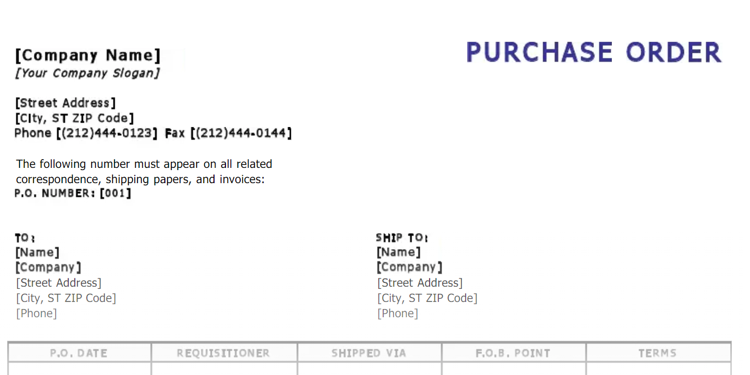
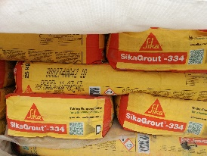
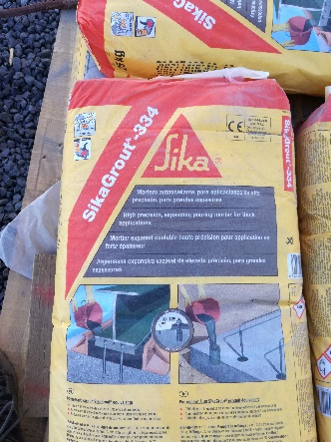
LST1 - MAINTENANCE
Tracking and traceability
WASTE MANAGEMENT PROCEDURE
PURCHASE
Materials
Spares
Tools
Others
STORAGE
OR
INSTALLATION
OR
CONSUMPTION
RECEPTION ON SITE
WASTE
INVENTORY
Items
Qty
Location
Destination
Reference documents
……..

Slide 20
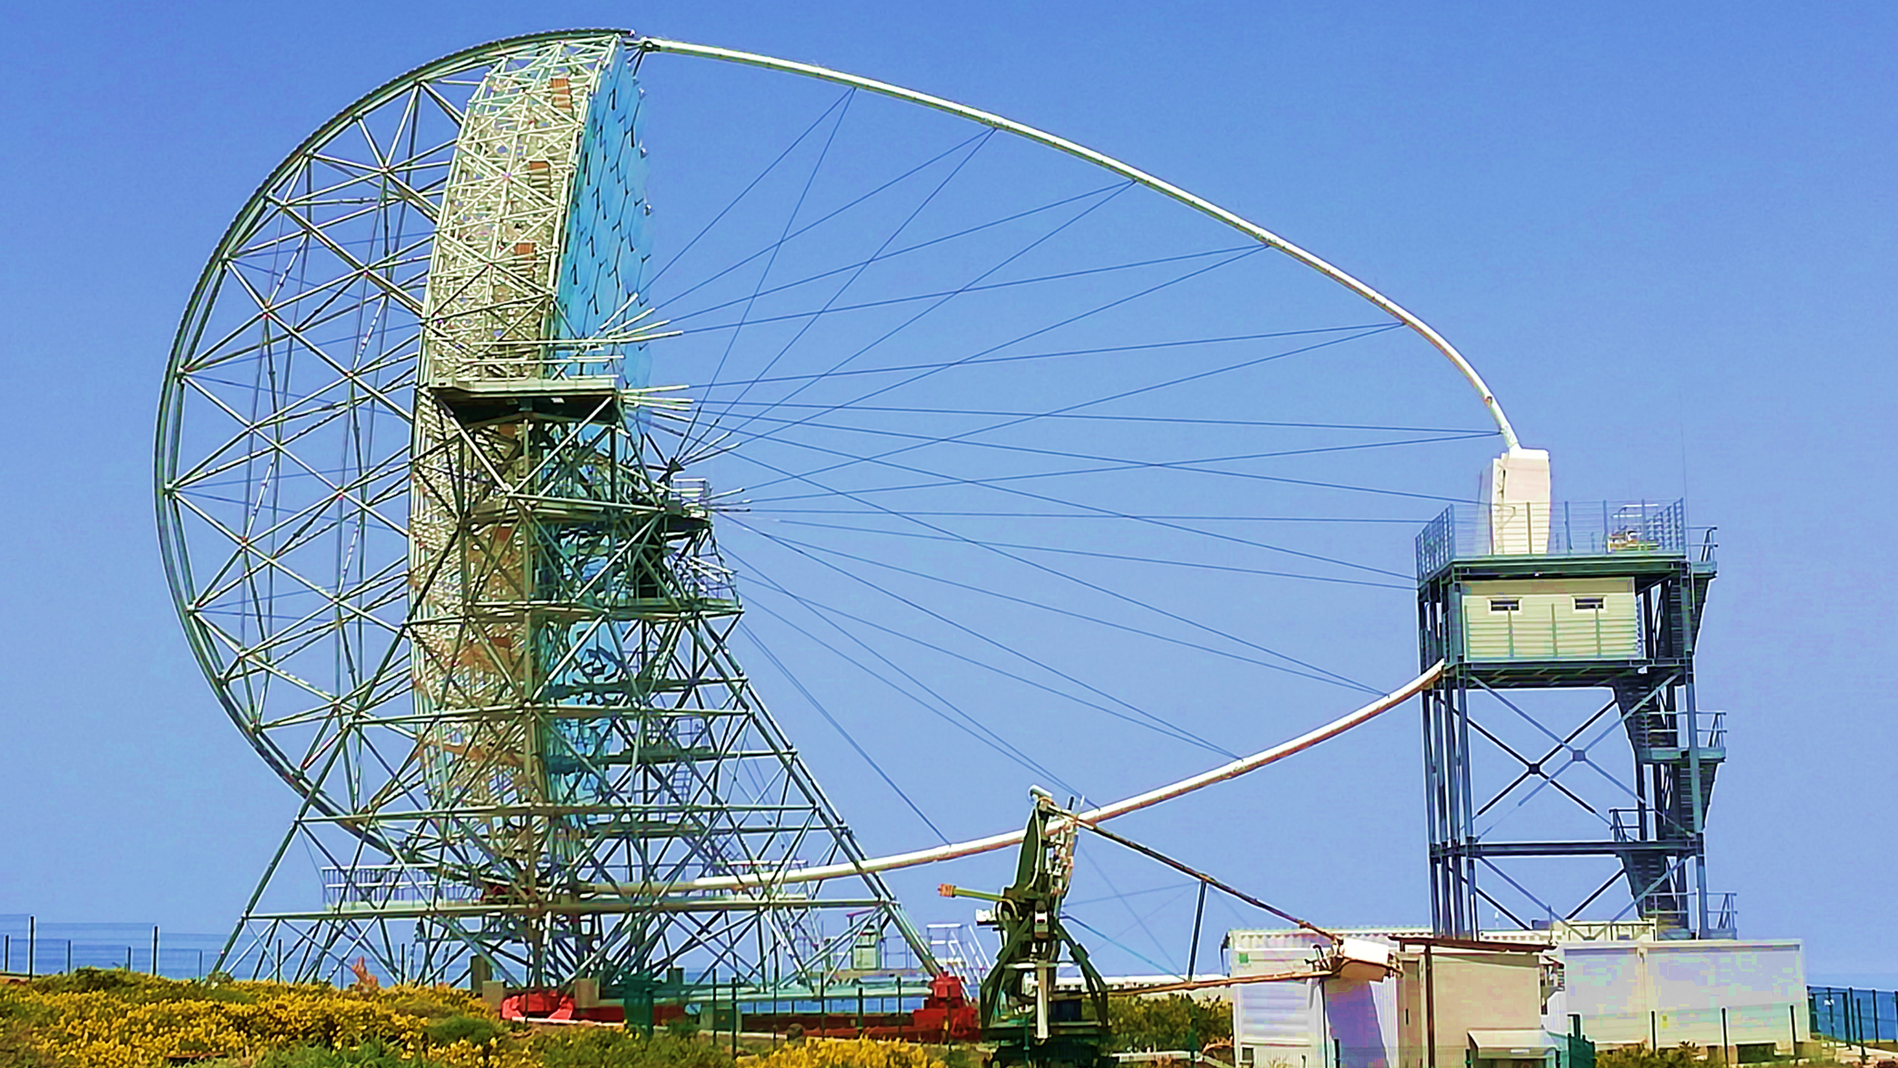
THANK YOU

