Slide 1
Mapping the Milky Way and Magellanic System
in Hi and OH
Katie Jameson
GASKAP Hi Project Manager
Bolton Fellow, CSIRO Astronomy & Space Sciences
CTA Oz 2020
Image credit: ESO/S. Brunier

Slide 2
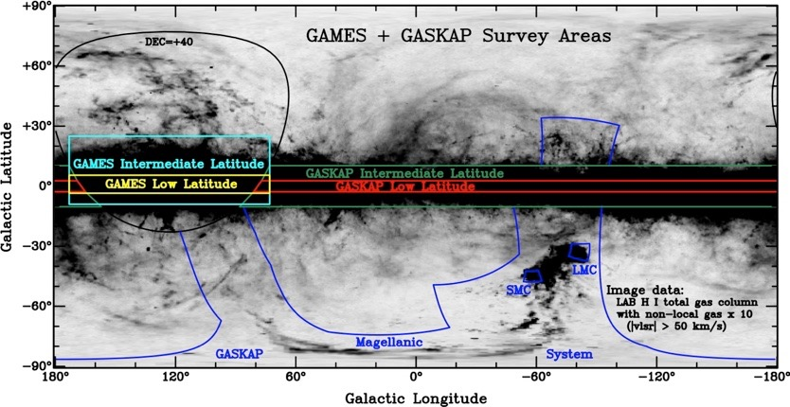

GASKAP: The Galactic ASKAP Survey
Aim: To study the evolution of the Milky Way and Magellanic Clouds through their interstellar gas and star formation
Survey of the Galactic plane and Magellanic System
Hi 21 cm and OH 18 cm emission and absorption
More than an order of magnitude more sensitive than previous surveys
Dickey+ (2012)
K. Jameson, CTA Oz 2020

Slide 3
GASKAP: The Galactic ASKAP Survey
Dickey+ (2012)
K. Jameson, CTA Oz 2020

Slide 4
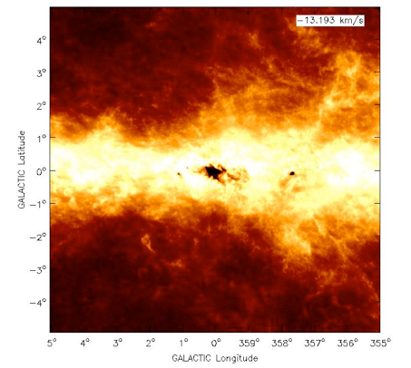
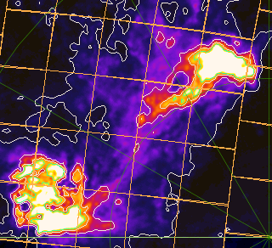
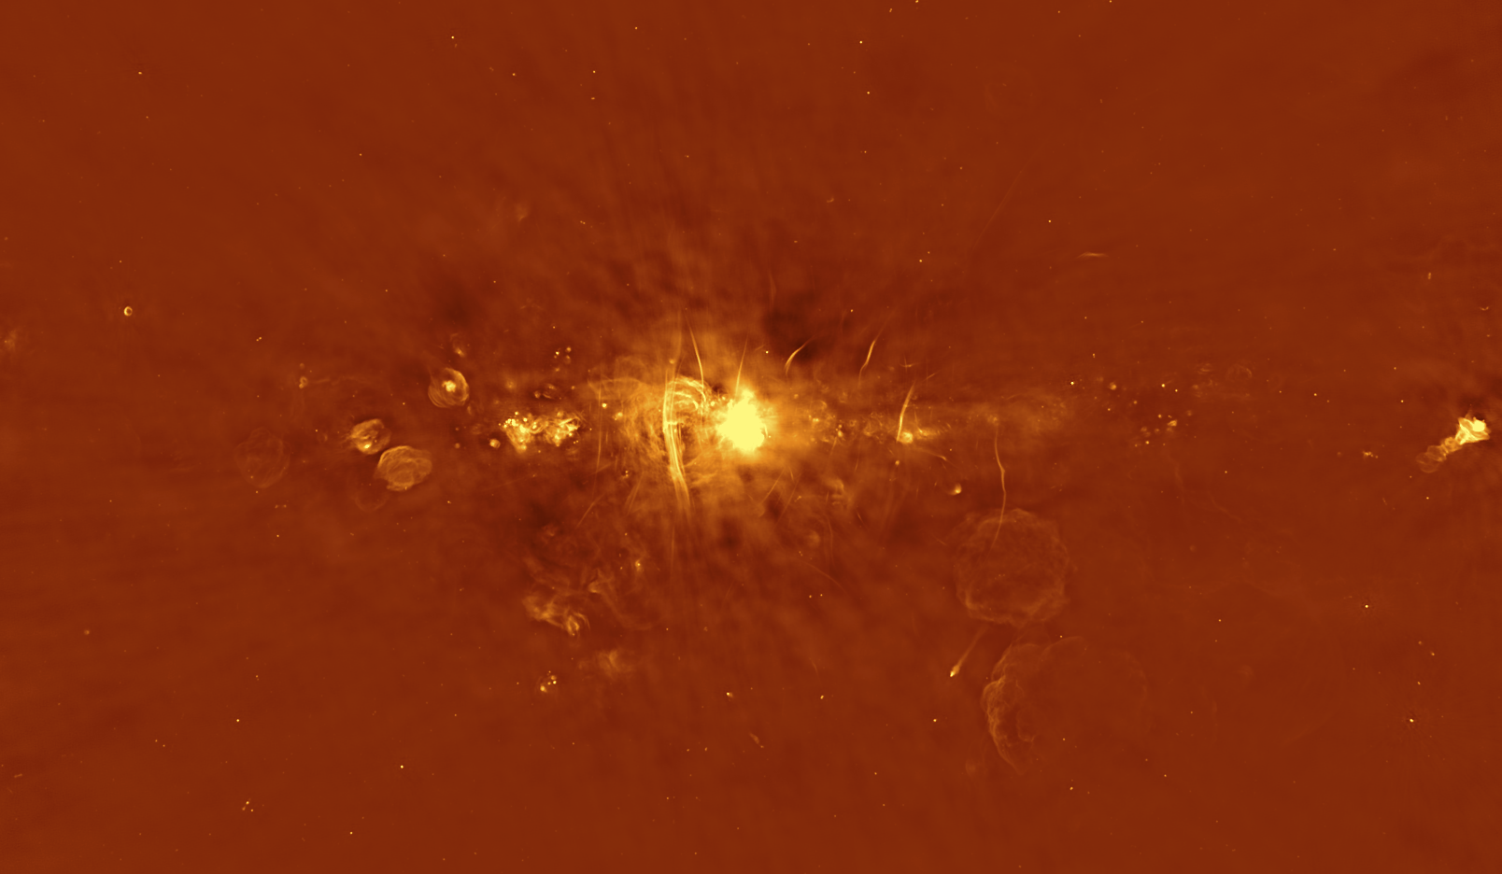
The GASKAP Pilot Survey
Galactic Plane (l=340)
(Hi 16 hrs, OH 8 hrs)
Galactic Centre
(Hi 8 hrs, OH 8 hrs)
SMC, Stream, and Bridge
(Hi 60 hrs)
ATCA Hi
McClure-Griffiths+ (2012)
20 hr
20 hr
20 hr
ASKAP continuum
(commissioning)
K. Jameson, CTA Oz 2020

Slide 5
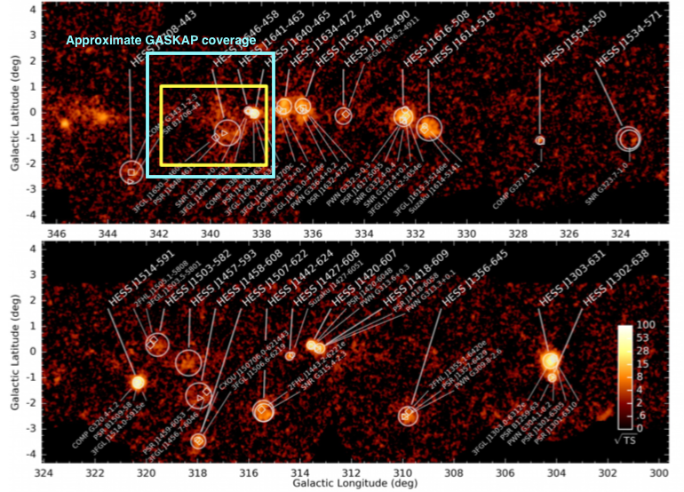
The GASKAP Pilot Survey
Galactic Plane (l=340)
(Hi 16 hrs, OH 8 hrs)
Collaboration with Gavin Rowell, Pilot field covers:
HESSJ1646-458 (associated with Westerlund 1 cluster)
HESSJ1641-463 (unidentified))
K. Jameson, CTA Oz 2020

Slide 6
The GASKAP Pilot Survey:
Status Update
Galactic Plane (l=340)
(Hi 16 hrs, OH 8 hrs)
Galactic Centre
(Hi 8 hrs, OH 8 hrs)
SMC, Stream, and Bridge
(Hi 60 hrs)
ATCA Hi
McClure-Griffiths+ (2012)
10/16 hrs Hi observed
2 x 8 hr OH observed
0/8 hrs Hi observed
2 x 8 hr OH observed
20/60 hrs Hi observed
2 x 10 hrs on SMC
CASA imaging pipeline in place on OzStar, developed by Nick Pingel (Hi Scientist)
4300 pix x 4300 pix x 210 channels, 20GB cube per Hi field
~10 hrs on 5 CPUs with 20GB RAM
K. Jameson, CTA Oz 2020

Slide 7
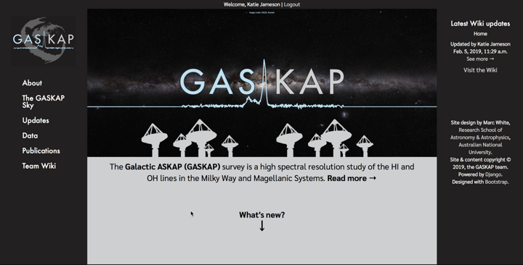

Be on the look out for updates: gaskap.anu.edu.au
contact: gaskap@anu.edu.au
K. Jameson, CTA Oz 2020

