Slide 1
Array Trigger for CTA-US MSTs
John Anderson
Karen Byrum
Gary Drake
Frank Krennrich
Amanda Weinstein
Feb. 25 2012 CTA-US Meeting, SLAC Frank Krennrich
Notes:
The focus of my talk is on detection techniques of relativistic cosmic particles.
Cosmic particles include cosmic rays (p, He, … heavier nuclei), cosmic ray electrons/positrons, gamma rays & neutrinos.
These particles are scientifically linked through their production processes in astrophysical environments either through acceleration, particle decay and annihilation processes.
and may also hold clues about the origin of dark matter.
The origin of cosmic particles in one of the big questions in physics/astrophysics: 2012 marks the 100 centennial of their discovery by Victor Hess in 1912.
These particles cover a wide range in energy, a wide range in fluxes, and thus require an arsenal of detection techniques.
These range from relatively small detectors as payloads on balloons, space based instruments all the way to detectors at ground that use the Earth’s
atmosphere as a major component of the detector (calorimeter) → Cherenkov light & fluorescent light produced by large air showers.

Slide 2
Purpose and Concept of the Array Trigger
Layout and Implementation.
Specifications and Interfaces.
Technology.
Feb. 25 2012 CTA-US Meeting, SLAC Frank Krennrich
Notes:
First I will provide you with a flavor of the experimental challenges and some of the science motivations for going after cosmic particles.
Then I will discuss a selection of detectors and instrumentation used, followed by some of the discoveries with these telescopes.
Finally, I will tell you about the plans for next generation observatories that are currently in the planning stages.
(This is maybe a good time to start paying attention, as these are also relevant for future job seekers in HEP instrumentations.)

Slide 3
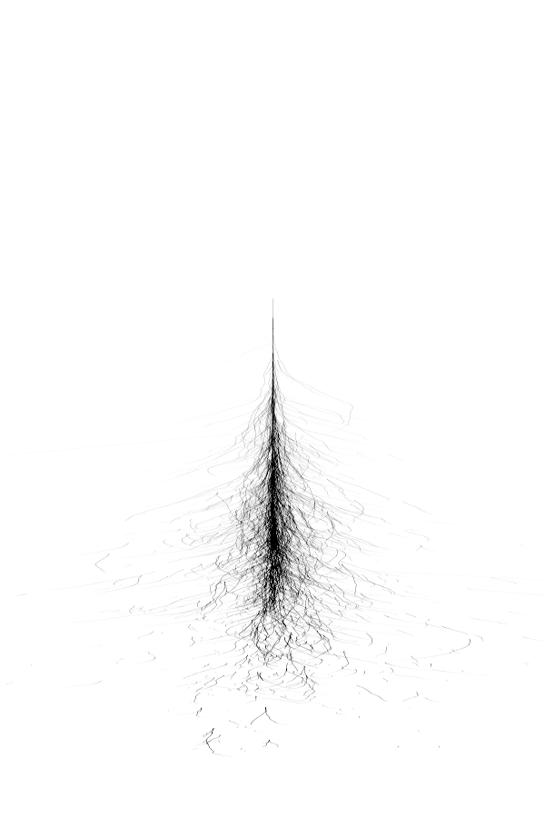
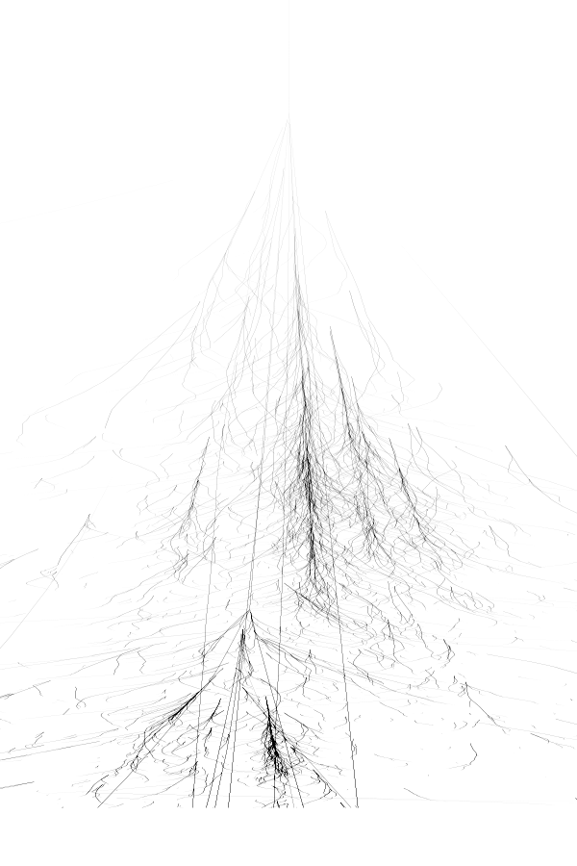
Cosmic-Ray Shield
proton
γ-ray
d_{i}

Slide 4
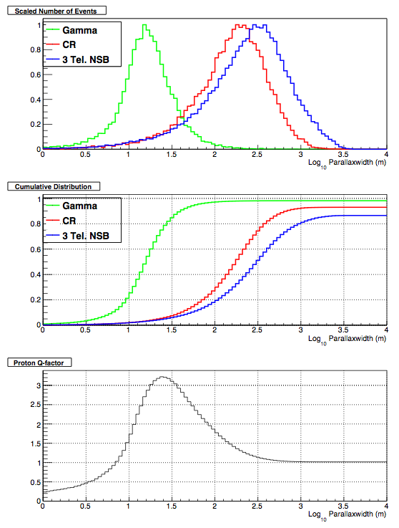
Cosmic-Ray Shield
Cut
proton
γ-ray
d_{i}
Credit: M. Schroedter

Slide 5
Cosmic-Ray Shield
- 36 telescope array
- FoV = 8 deg.
- analysis based on trigger map
Proton rejection ~ 90%
γ-ray acceptance ~ 90%
Cut
Conclusion:
An order of magnitude cosmic-ray rate reduction at the hardware trigger level, while keeping 90% of γ-rays, makes for an attractive option to deal with dead time & data rates!

Slide 6
Array Trigger: Do we need it?
depends on:
- dead time of readout system
- success of other techniques to reduce data
partial readout (Colibri)
zero suppression
data (pulse shape) fitting
compression techniques
But may not be sufficient or undesirable:
- factor of 10 suppression at the trigger level (soft cut) will alleviate
dead time problems, minimally affect calibration data and may allow
a more complete recording of γ-ray events.
- allow to use large effective area of MST array at low energies, thus
provide synergies with LST array (50 – 200 GeV).
- bright regions of sky may cause large telescope rate fluctuations
- yet allow pre-scaling and pass-through of muons.
- allow in-situ performance tests of individual cameras (Amanda’s talk)

Slide 7
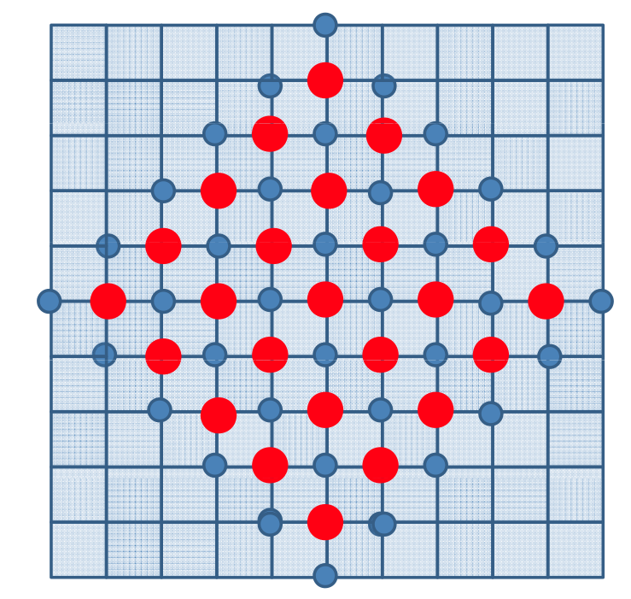
Array Trigger Concept: strawman
possible MST array
spacing d = 150 m
each telescope is
part of a sub-array
of 9 telescopes
each telescope
decides on its own
to issue a trigger
considers trigger
information from its
neighbors!
<telescope multiplicity> ≈ 5

Slide 8
Array Trigger Concept
Latency Δτ:
Assumption: horizontal shower

Slide 9
Array Trigger Concept
Camera
L4
Coincidence
with at least N-neighbor
telescopes
L1.5
L2
L3
Time Stamps
Corrected
(up to 9 tel.)
Pixel Data
Image Data
Data
collector
timing
corrections
- n-fold
coincidence
of neighbor
pixels
L2’
- Pattern
Trigger
Image
calculations
Disc.
Time Stamp
L5
Initiate
analysis
Time Stamp
Clock Distrib.
Clock Distrib.
Image Data
stereo analysis
e.g., parallaxwidth
calculation
Image Data
Interface with
camera
backplane
Time Stamp
Clock Distrib.
Telescopes
Feb. 25 2012 CTA-US Meeting, SLAC Frank Krennrich

Slide 10
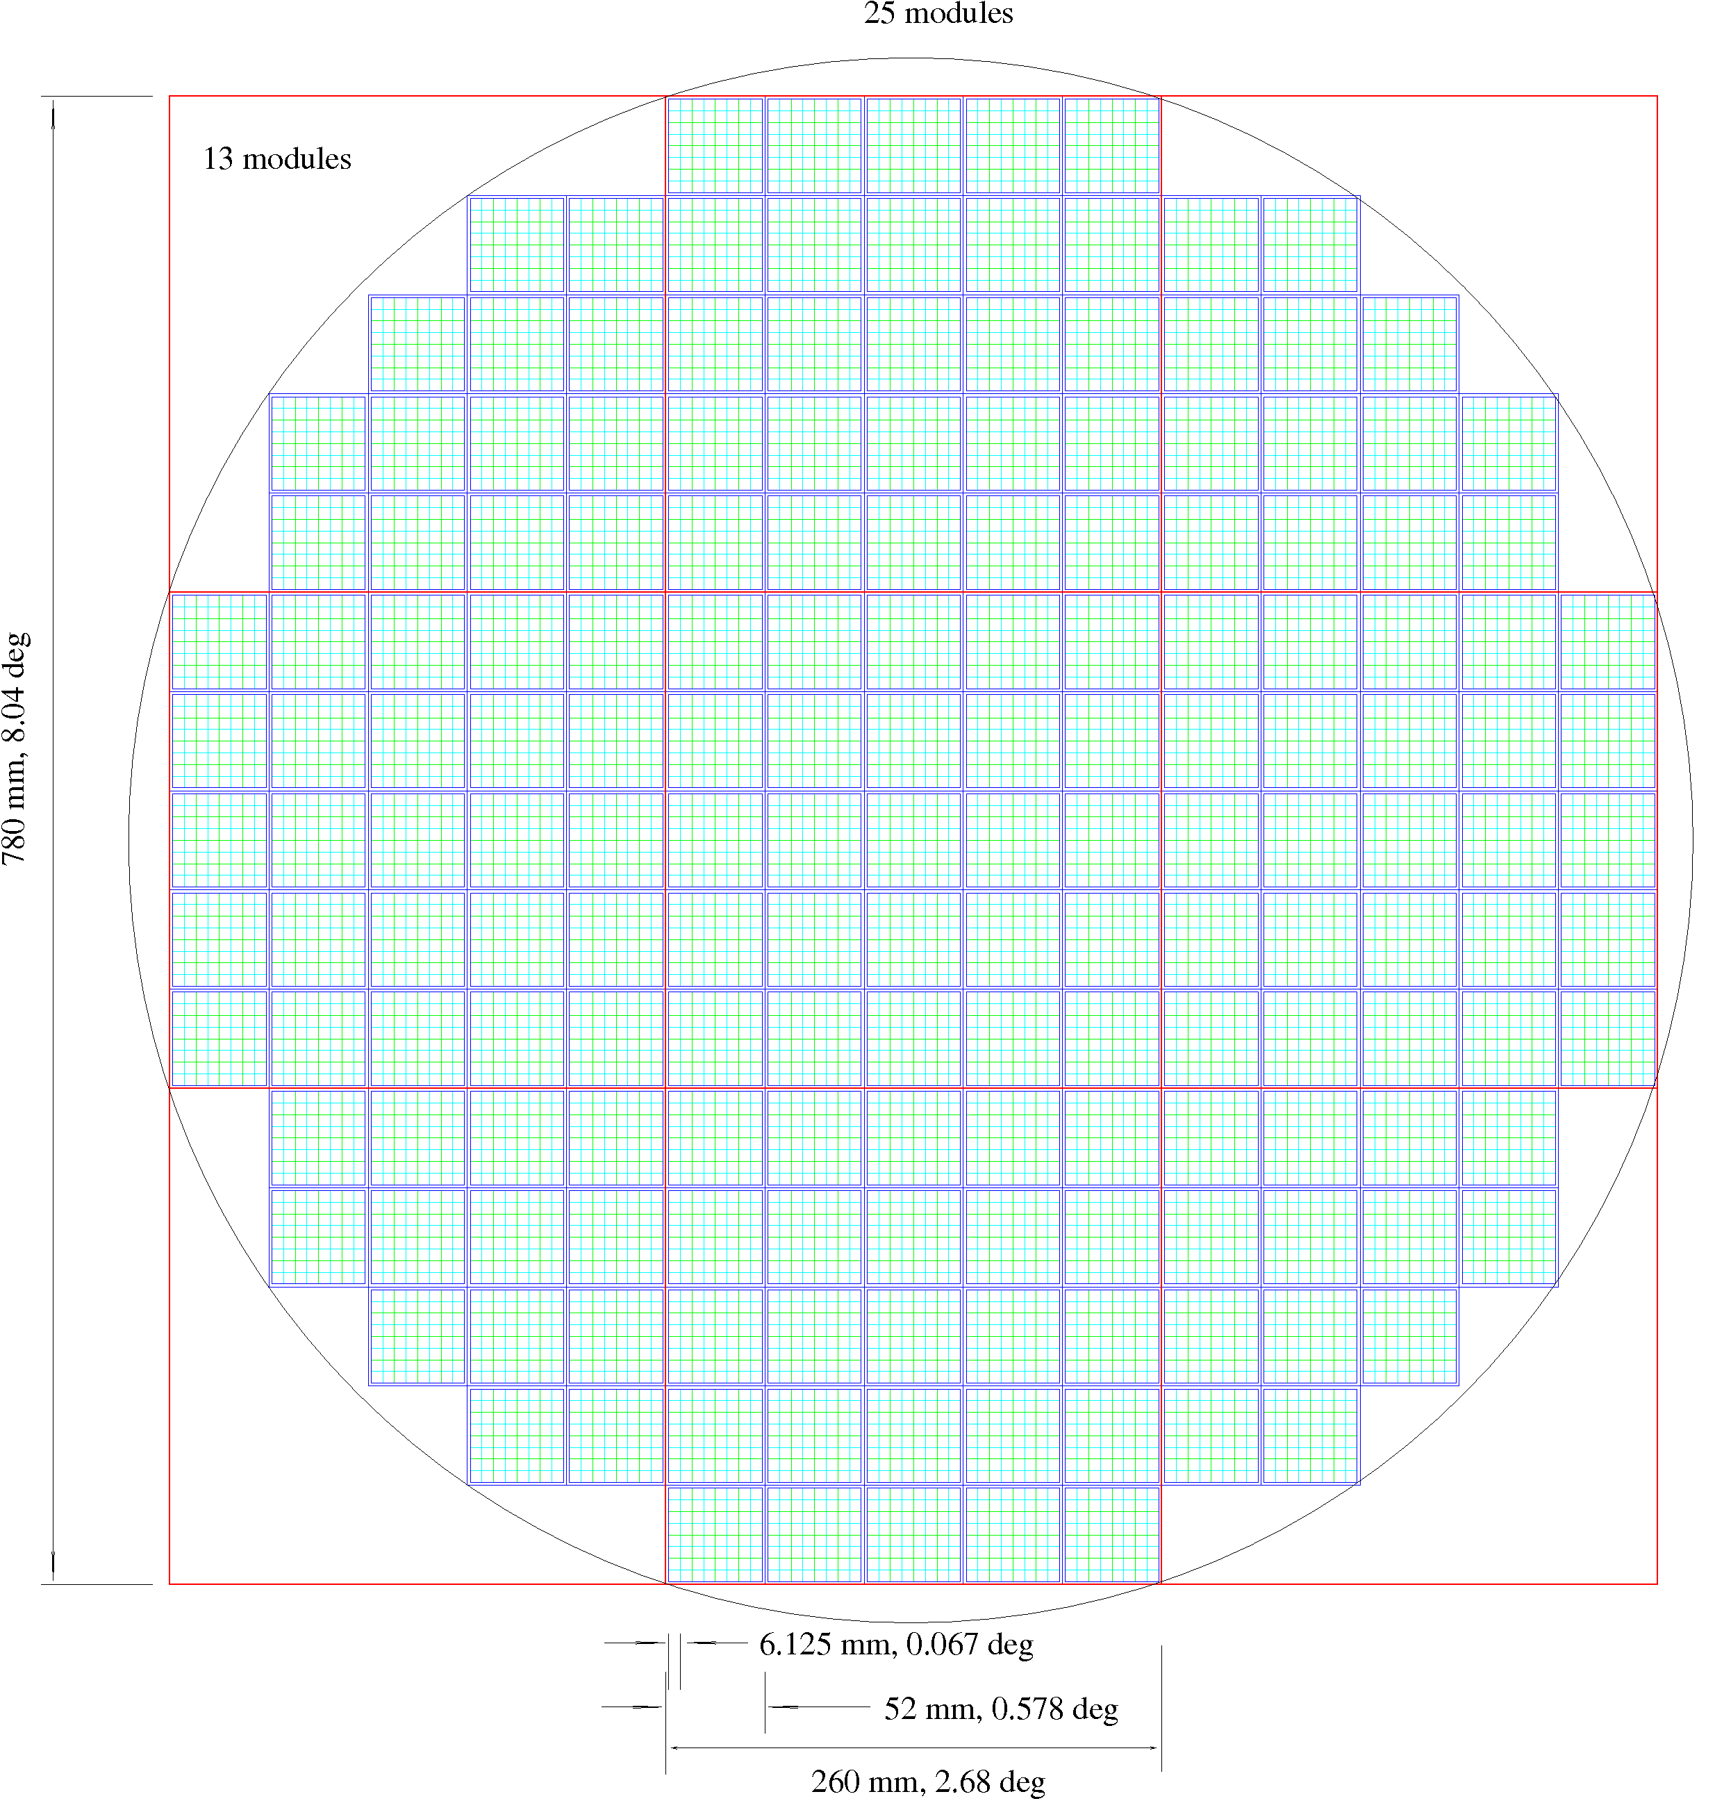
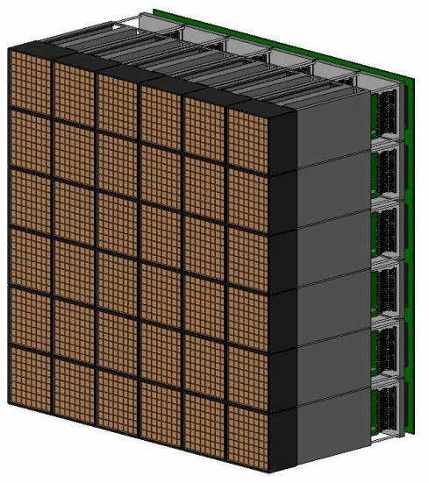
Array Trigger Implementation
Modular camera concept
Trigger sub-field
DATA
(MOMENTS)
NEIGHBOR
DATA
NEIGHBOR
L1.5
TRIG
L2
TRIG
Array Trigger
BACKPLANE Sect. 1
CLK
READ
NEIGHBOR
8 deg / 80cm / 11328 pixels
0.067 deg/pixel (4 arcmin)
177 MAPMTs / camera
CLK
NEIGHBOR
…
approx. 12k pixels
Target ASIC with 1 Gsps
memory depth 16 μsec
maximum readout rate 10 kHz
single telescope trigger rate < 10 MHz
Array trigger module
Feb. 25 2012 CTA-US Meeting, SLAC Frank Krennrich

Slide 11
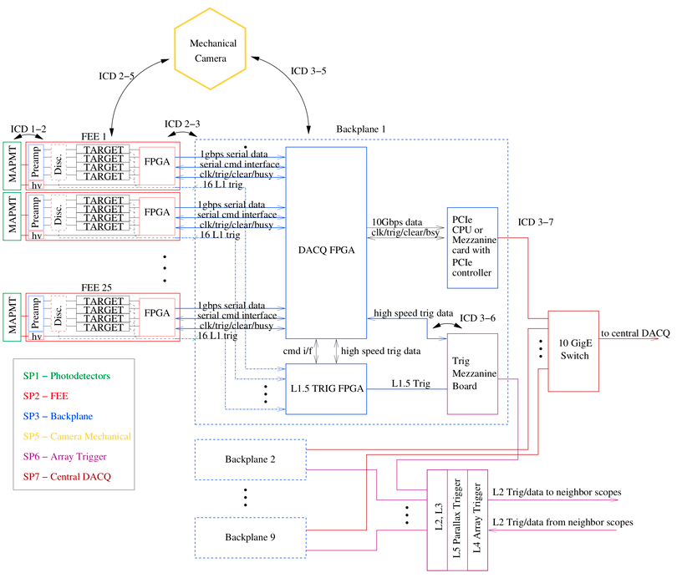
Array Trigger Implementation
Credit: Jim Buckley

Slide 12
Array Trigger Implementation
DACQ FPGA
TRIG
Mezzanine
Board
L1.5
TRIG FPGA
L4
Array
coincidence
L2
Camera
Pattern
trigger
& image
parameters
L3
Data collector
T-corrections
L5
Stereo
Analysis

Slide 13
Array Trigger Implementation
Backplane
DACQ FPGA
ARRAY TRIGGER
TRIG
Mezzanine
Board
L1.5
TRIG FPGA
L1.5 TRIG Info
T-stamp
Pixel #
Camera/
Array
Trigger
L1.5 TRIG Info
L2 Test data
L4
Array
coincidence
L2
Camera
Pattern
trigger
& image
parameters
L2 TRIG data
L3
Data
collector
T-correct.
L5
Stereo
Analysis
L2 TRIG data tel. n

Slide 14
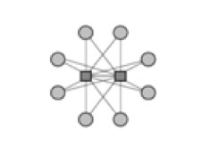
Basic Architecture
L1.5
array trigger module
Tel. …
L1.5
L1.5
L4
L1.5
L1.5
L2
L3
L1.5
L5
L1.5
L1.5
L1.5
L4 & L5 occupy hub
positions while the L3
occupies payload positions
of a dual-star ATCA backplane.
Links via high speed serial, e.g.,
Gbit Ethernet.
L1 Discriminator
L1.5 Coincidence of
discriminator bits
L2 moments calculation
L3 Data collector/t-corrections
L4 Pattern/Multiplicity
L5 Parallax of sub-array

Slide 15
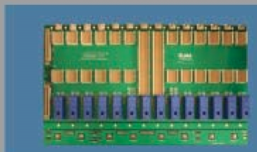
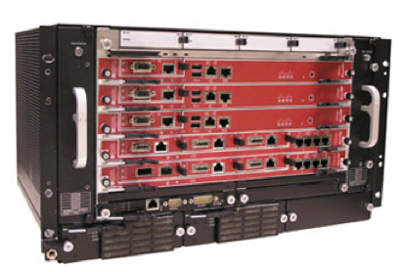
Array Trigger Hardware
Advanced Telecommunications Computing Architecture.
used in LTE/4G wireless infrastructure, 3G, radio Network,
datacenter/network operations, …
Storage Blade
Processor Blades
Backplane:
- bus architecture: dual star, full mesh, …
- redundant power connections
Power:
- dual redundant PEM modules
- hot-swappable through Intelligent
platform manager controller
Fabrics:
- Gbit Ethernet, PCI Express, …
Switch Blade
Feb. 25 2012 CTA-US Meeting, SLAC Frank Krennrich

Slide 16
Array Trigger Interfaces
clock distribution across array:
- L1.5 – L2 – L3 (digital L4, L5)
- precision
- calibration procedures
trigger testing procedures:
- L1.5 → L2 → L3 → L4 → L5
- injection of test patterns locally and across array
- parasitic tests of L2 (physics data)
communications protocol:
- L1.5 – mezzanine card – L2 – L3
- coordinate with CTA-EU MST cameras
Camera segmentation:
- deal with boundaries
- simulate
DACQ:
- array trigger info: tel. ids, time stamps (tel. ids), trigger maps (tel. ids), …
Telescope mechanical:
- optical fiber paths

