Slide 1
Simulation Studies of CTA Reconstruction Performance
Matthew Wood
Jim Chiang
Stefan Funk
Tobias Jogler
Jon Dumm (UMN)

Slide 2
Scope of Study
Evaluate performance of a CTA-like instrument using CORSIKA-generated gamma-ray showers (30 GeV - 3 TeV)
Idealized Detector Model – allows telescope characteristics influencing array performance to be more easily disentangled
Focus on ‘contained’ events and configurations that most closely correspond to the proposed designs for the Medium-Sized Telescope (MST)
Schwarzschild-Couder (SC-MST)
Davies-Cotton (DC-MST)
Performance Metrics
Gamma-ray Angular Resolution – 68% Containment Radius (R₆₈)
Energy Resolution
Point-Source Sensitivity (relative signal-to-noise) in background-dominated regime
Uncontained Events
Array Footprint
Contained Events

Slide 3
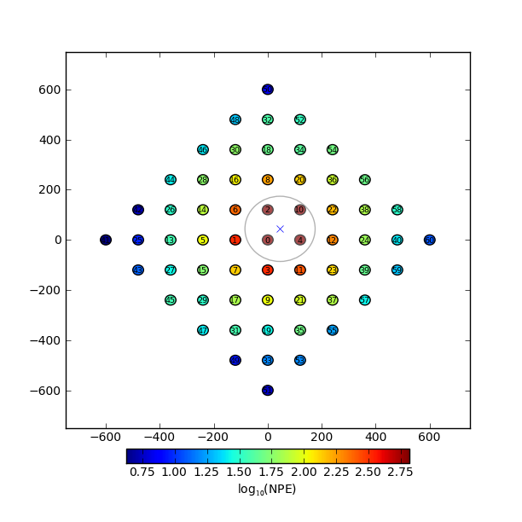
Idealized Detector Model
Array of 61 MSTs (10 m aperture)
Constant Gaussian Optical PSF across FoV (no ray-tracing)
Light losses modeled with standard QE and reflectivity
Simplified Electronics Model
Infinite integration gate
Single PE Charge Resolution: σ_{q}= 0.4
Electronics Noise: σ_{b} = 0.1
Night-sky background photons with constant density across the FoV (100 PE/deg²)
Trigger simulated with a threshold on true image amplitude (60 PE)

Slide 4
Gamma-ray Reconstruction
Reconstruction Parameters
Trajectory – Direction/Core Position
Energy
Interaction Depth
Likelihood-based Reconstruction
Find the trajectory, energy, and interaction depth that maximize the likelihood for the image intensity in each pixel as computed from an image template model
Computationally slow but better performance than standard geometric reconstruction (Naurois et al. 2009)
e_{x,y}
λ
E
R_{x}
R_{y}

Slide 5
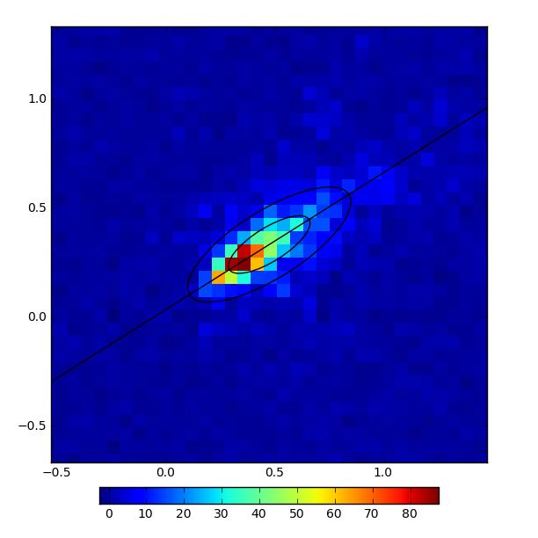
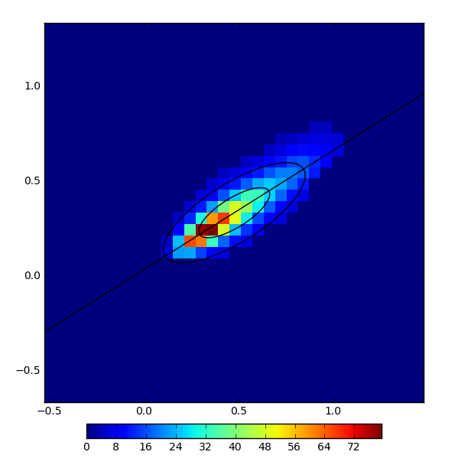
Likelihood Reconstruction
Library of image templates accumulated by averaging over many simulated showers
Array log-likelihood computed by summation over image pixel log-likelihoods in each telescope
Maximize array likelihood in 6D space of reconstruction variables
Data
Model

Slide 6
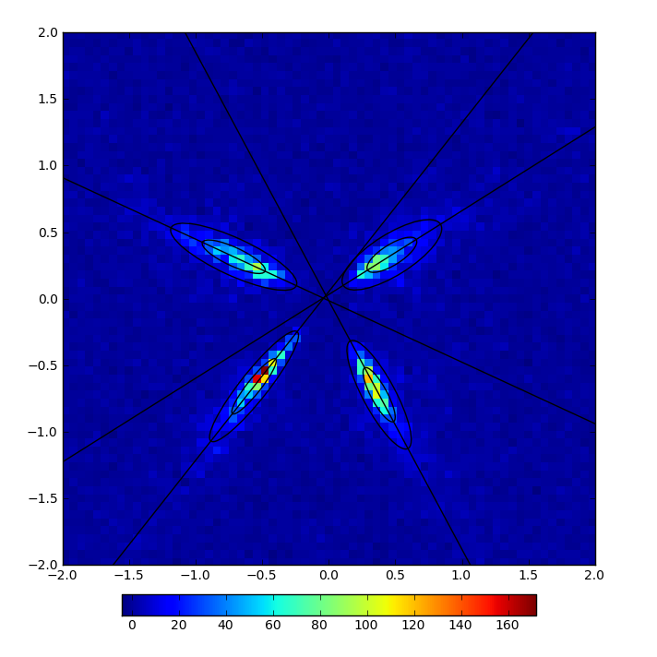
Likelihood Reconstruction: Seeding
Reconstruction seeded with MC values
Insensitivity of likelihood reconstruction to parameter seeds was verified by randomizing seed values
Cleaning
Geometric Reconstruction
Likelihood Cleaning
Likelihood Reconstruction
MC

Slide 7
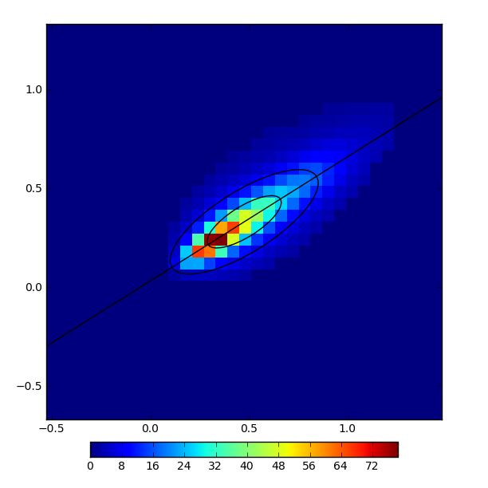
Likelihood Reconstruction: Cleaning
f = 0.5
f = 0.6
Use seed parameters to compute list of pixels encompassing a fraction f of the model image intensity
Likelihood reconstruction is only weakly dependent on f for f >0.6
f = 0.7
f = 0.8

Slide 8
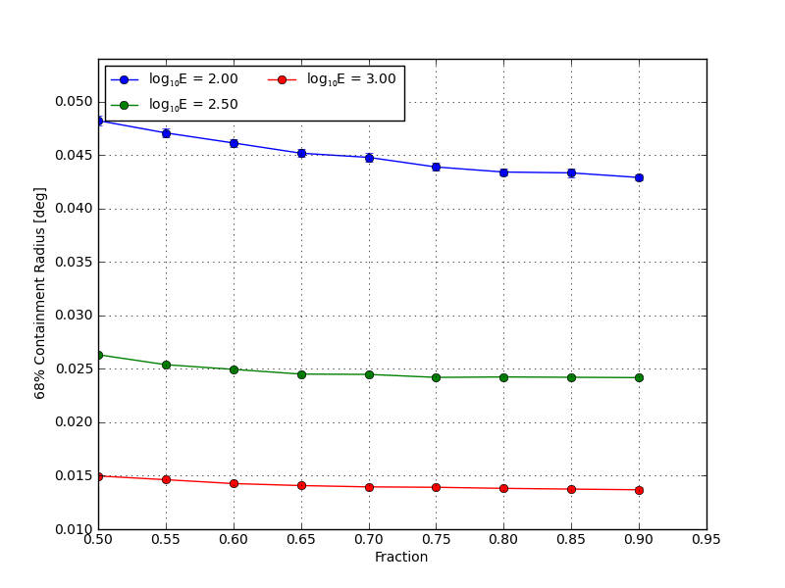
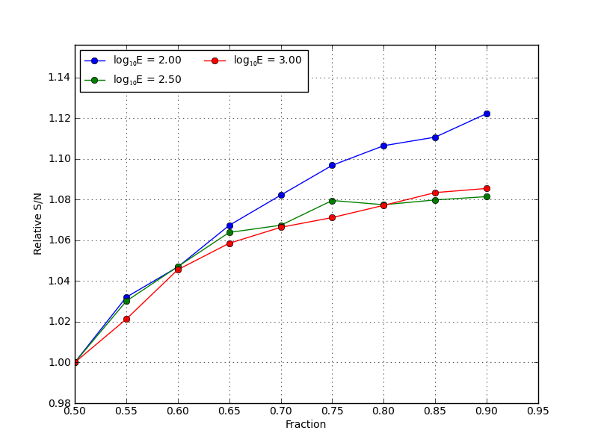
Likelihood Reconstruction: Cleaning
Angular Resolution
Signal-to-Noise
E = 100 GeV
E = 316 GeV
E = 1 TeV
0.5
0.9
0.5
0.9
Fraction (f)
Fraction (f)

Slide 9
Pixel Size/Optical PSF Studies
Intrinsic transverse angular size of a Cherenkov shower is ~1 arcminute – imaging resolution on this scale is needed for best reconstruction performance
Need good PSF to realize full benefit of small pixels – ideally R_{pix} < R_{psf}
Range of simulated pixel sizes and optical PSFs
D_{pix} = 0.02-0.18 deg
R₆₈ = 0.01-0.08 deg
SC-MST
D_{pix} = 0.067 deg
DC-MST
D_{pix} = 0.18 deg

Slide 10
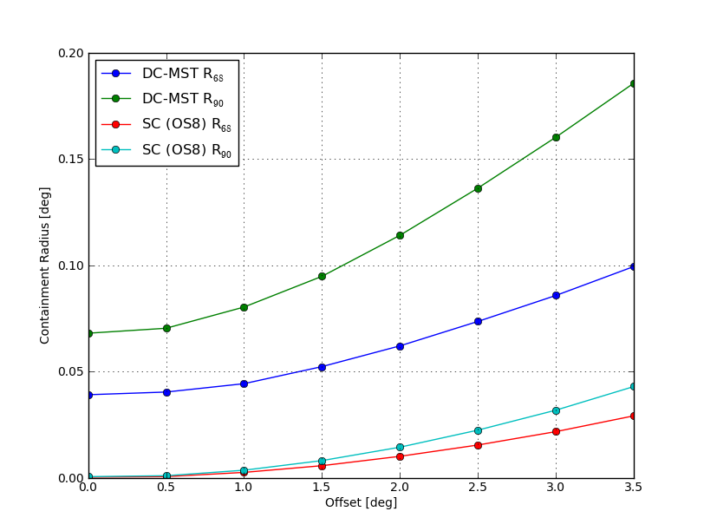
Optical PSF
DC R₉₀
DC R₆₈
DC PSF Range
0.08
0.04
0.02
0.01
SC R₉₀
SC PSF Range
SC R₆₈
0.0
Field Angle [deg]
3.5

Slide 11
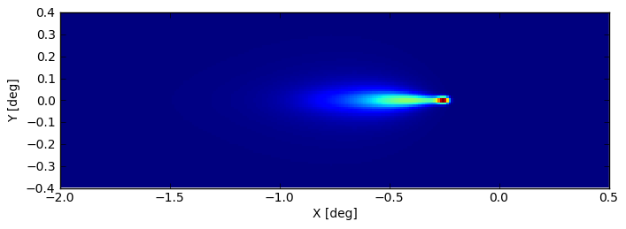
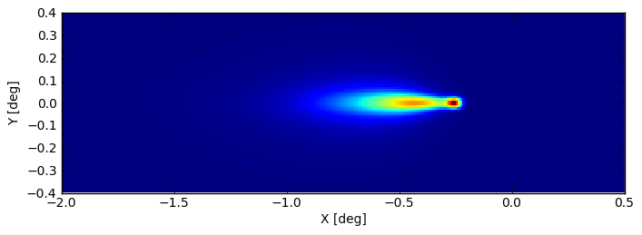
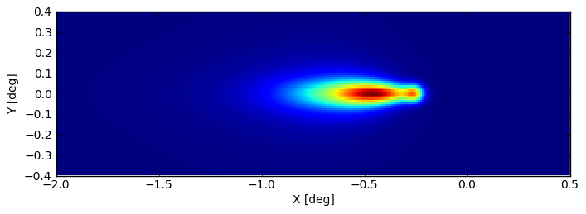
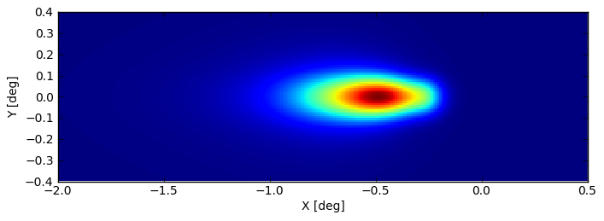
Optical PSF
E = 100 GeV λ= 0.5
R₆₈ = 0.01 deg
R₆₈ = 0.02 deg
R₆₈ = 0.04 deg
R₆₈ = 0.08 deg

Slide 12
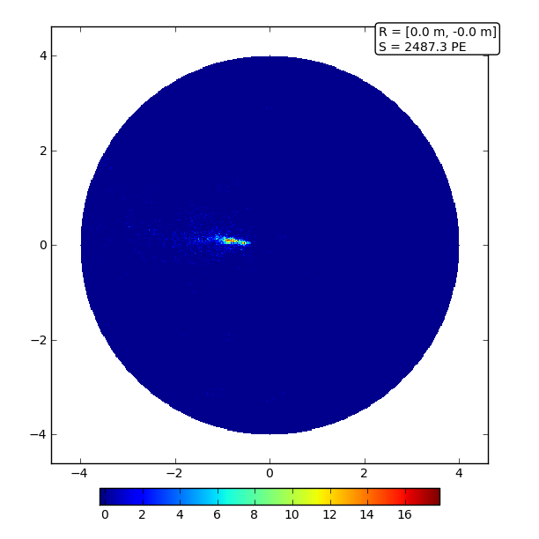
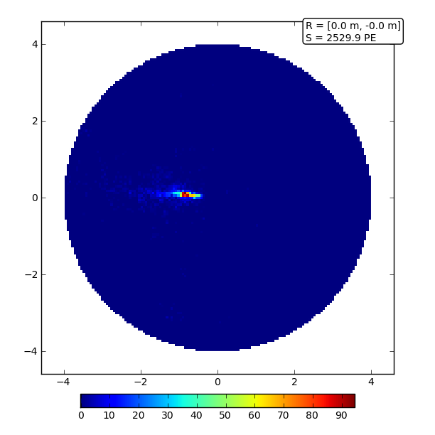
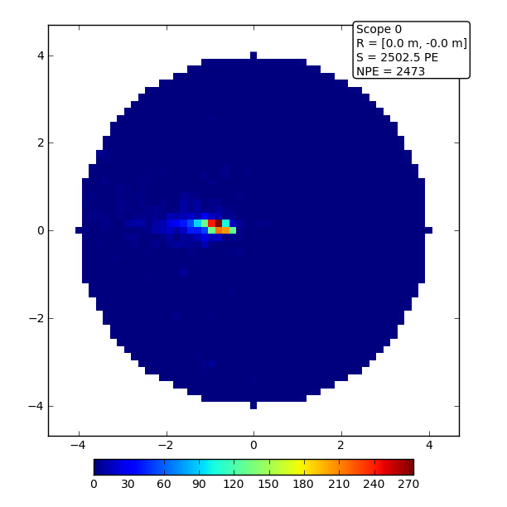
Pixel Size
D_{pix} = 0.02 deg
N_{pix} = ~100k
D_{pix} = 0.06 deg
N_{pix} = ~10k
D_{pix} = 0.16 deg
N_{pix} = ~2k
SC-MST
DC-MST

Slide 13
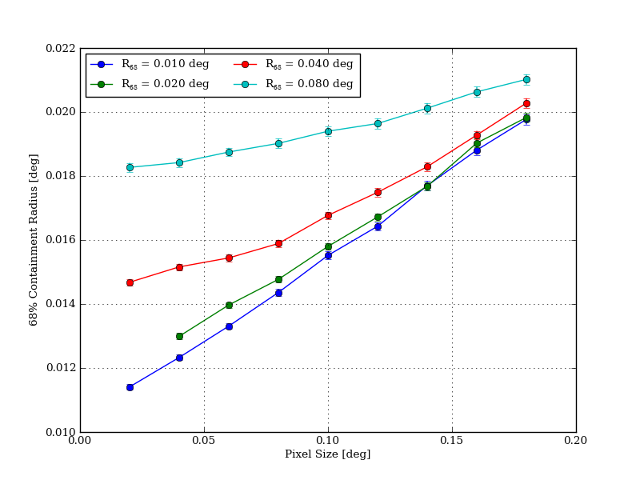
Pixel Size/PSF: Angular Resolution
E = 1 TeV
DC-MST
Factor of 1.5 improvement in angular resolution between DC-like and SC-like configuration
SC-MST
Diminishing improvement for PSF < 0.02 deg

Slide 14
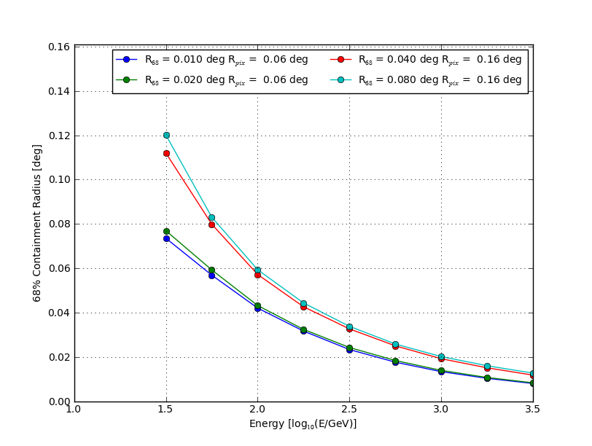
Pixel Size/PSF: Angular Resolution
DC-MST
SC-MST
30 GeV
3 TeV

Slide 15
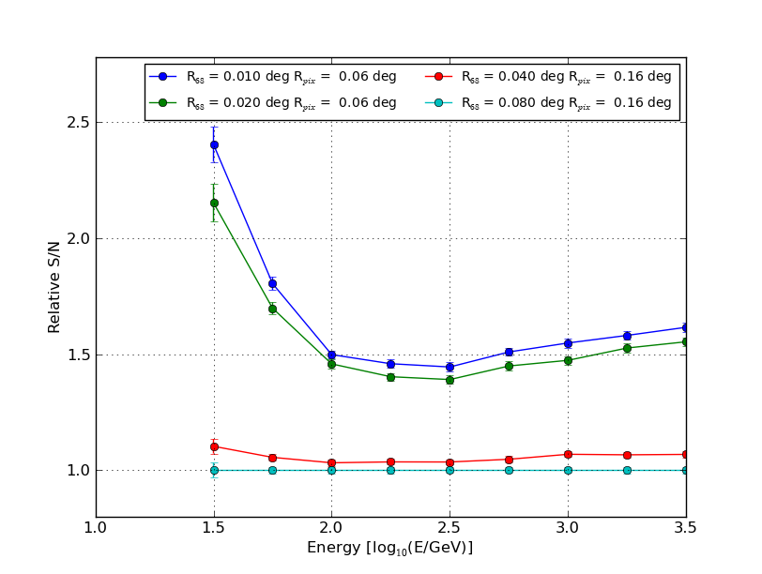
Pixel Size/PSF: Sensitivity
SC-MST
DC-MST
30 GeV
3 TeV

Slide 16
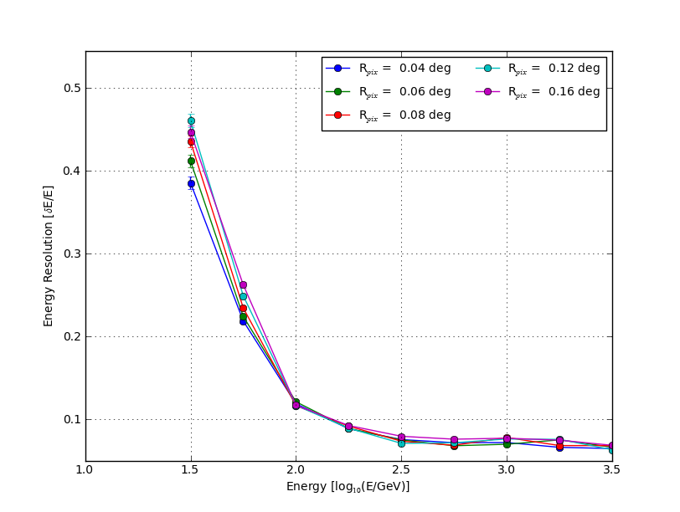
Pixel Size/PSF: Energy Resolution
Minimal impact on energy resolution above 100 GeV
30 GeV
3 TeV

Slide 17
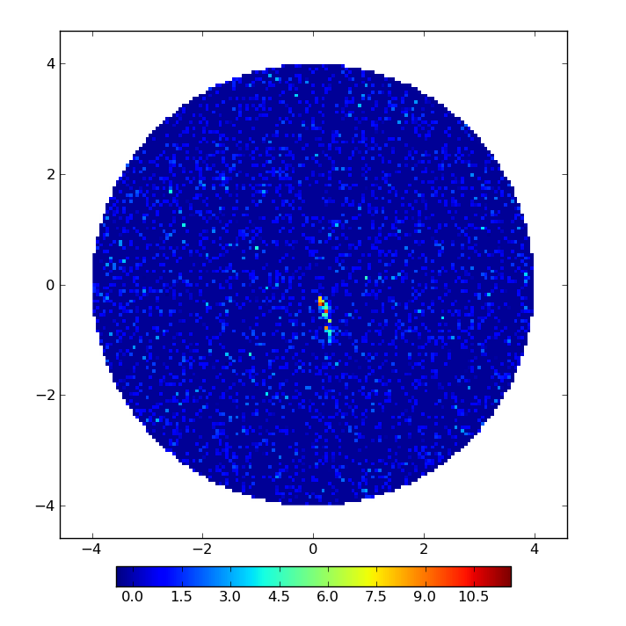
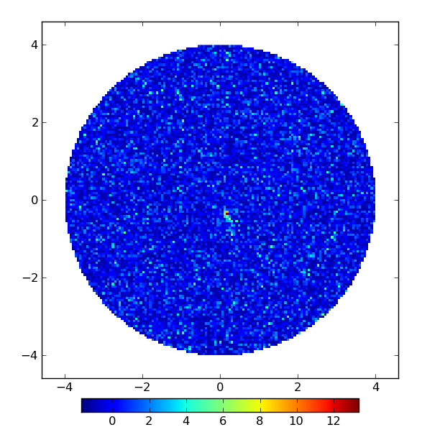
Pixel Size/PSF: NSB
Extragalactic Field
NSB = 100 PE/deg²
Galactic Field
NSB = 300 PE/deg²
E =100 GeV Shower Image

Slide 18
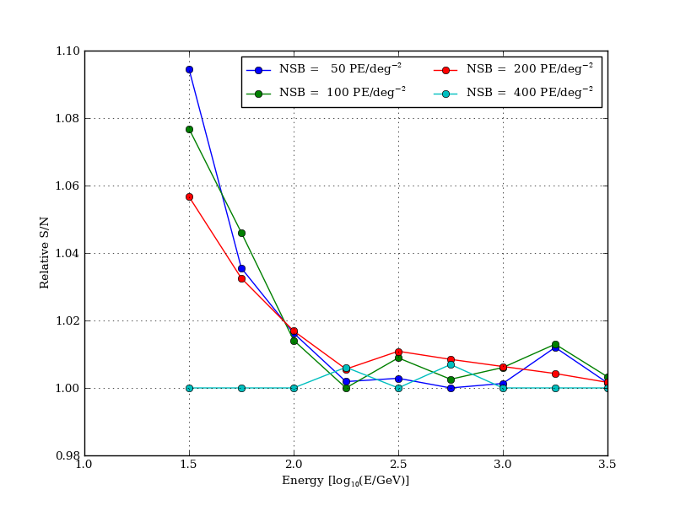
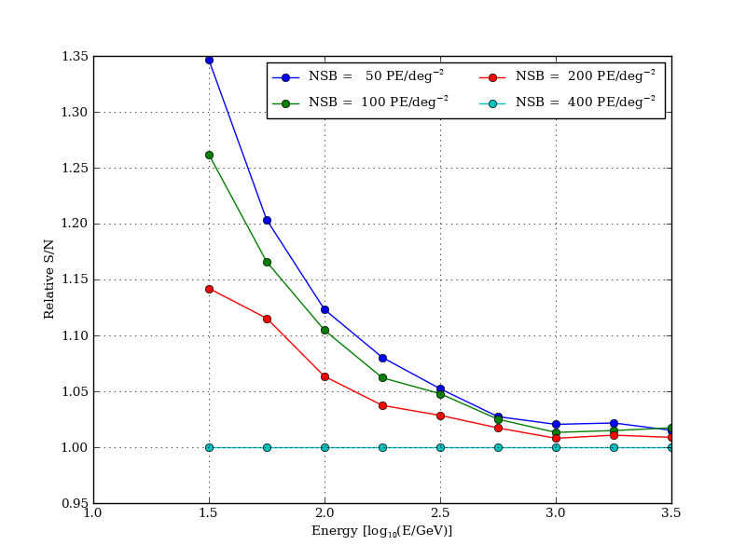
Pixel Size/PSF: NSB
SC-MST
(R_{pix} = 0.06 deg R₆₈ = 0.02 deg)
DC-MST
(R_{pix} = 0.16 deg R₆₈ = 0.08 deg)
Smaller pixel size/PSF mitigates impact of NSB on reconstruction performance

Slide 19
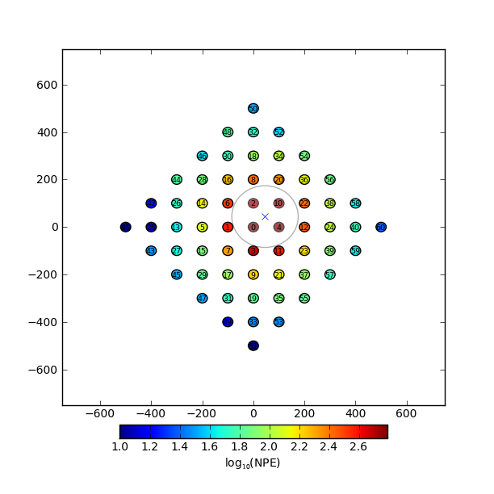
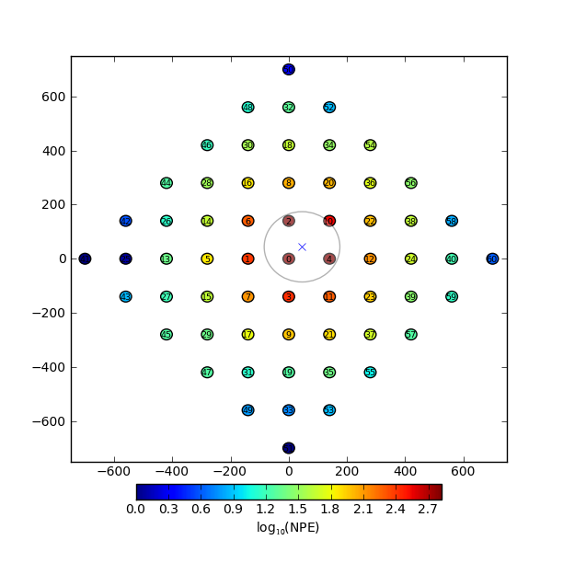
Telescope Baseline
A more densely packed array will generally have better reconstruction performance at the expense of collection area
A natural scale for the baseline is ~120-140 m (~4 telescopes in Cherenkov light pool)
B = 100 m
B = 140 m

Slide 20
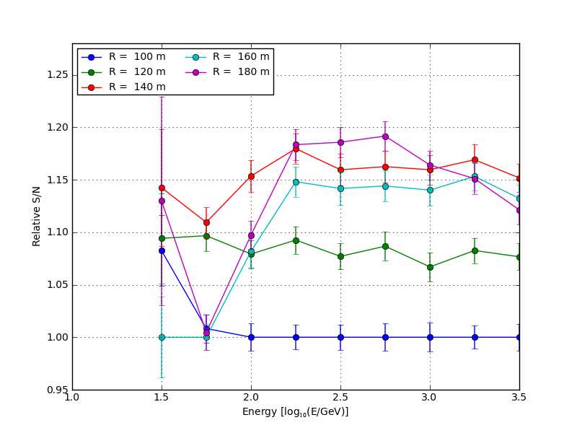
Telescope Baseline
Baselines ≥ 140 m are preferred

Slide 21
Light Collection Area
Effective Light Collection Area
Mirror Area
Focal Plane Efficiency (deadspace, lightcones, etc.)
Photosensor PDE
All factors contributing to light collection are folded into a single efficiency scaling (1.0 = canonical 78.5 m² MST)
 | Effective Area (250-700 nm) [m²] | Scale Factor
DC-MST | 16.2 | 1.45
Reference MST | 11.2 | 1.0
SC-MST (ASTRI SiPM) | 9.2 | 0.82
SC-MST (Hamamatsu MPPC) | 8.3 | 0.74
SC-MST (MAPMT) | 5.0 | 0.45

Slide 22
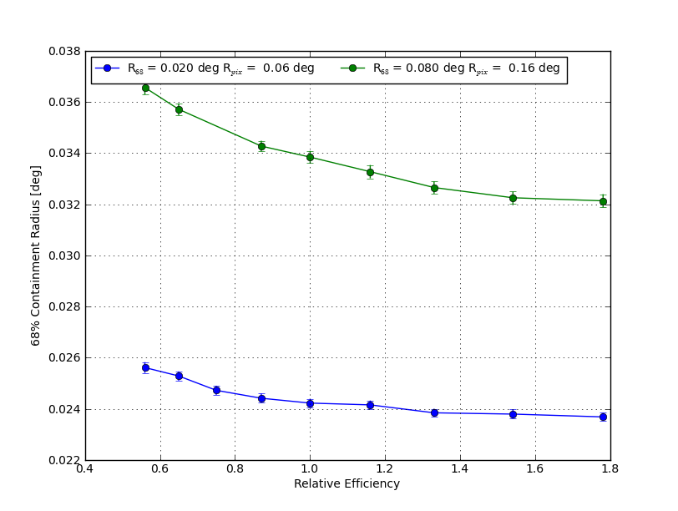
Light Collection Area: Angular Resolution
E = 316 GeV
DC MST
~3x
SC MST
(MAPMT)
SC MST
(SiPM)

Slide 23
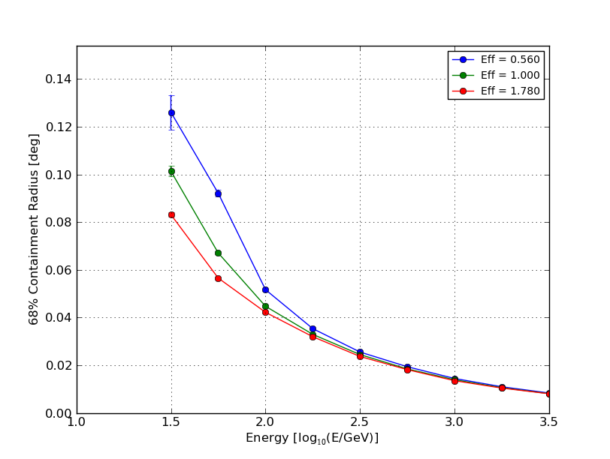
Light Collection Area: Angular Resolution
R_{pix} = 0.06 deg R₆₈ = 0.02 deg
ε=0.56
Trigger threshold (60 PE) increases impact of light collection area at low energies
ε=1.0
ε=1.78

Slide 24
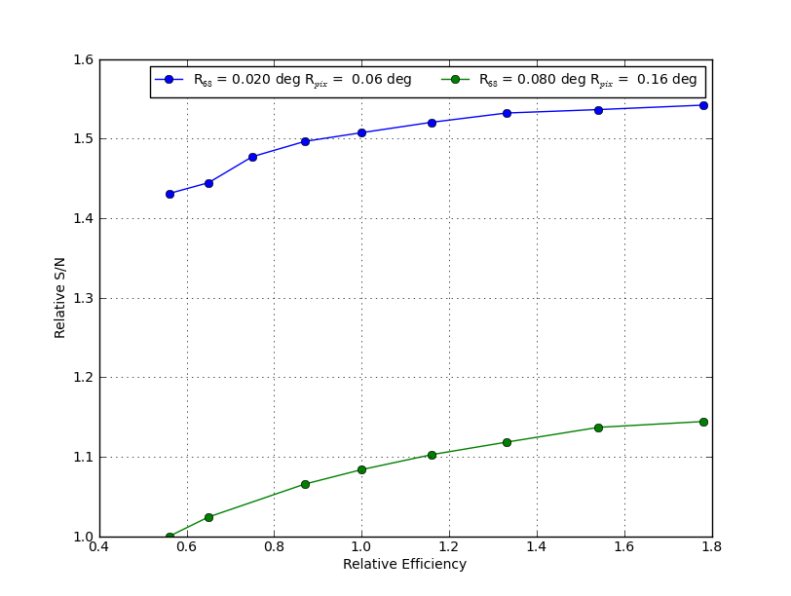
Light Collection Area: Sensitivity
E = 316 GeV
SC MST
(SiPM)
SC MST
(MAPMT)
~30%
DC MST

Slide 25
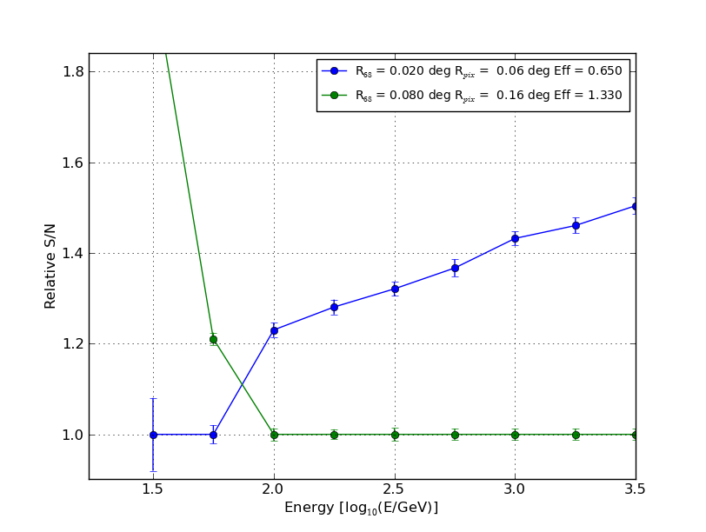
Light Collection Area: Sensitivity
SC MST
DC MST

Slide 26
Geomagnetic Field
All simulated performance shown thus far generated with B-Field switched off
Influence of geomagnetic field is expected to degrade reconstruction performance for low energy showers
Compare reconstruction performance for showers simulated with and without B-Field
Equatorial B-field configuration |B| = 31.3 μT
Analyze with image templates generated with and without B-Field

Slide 27
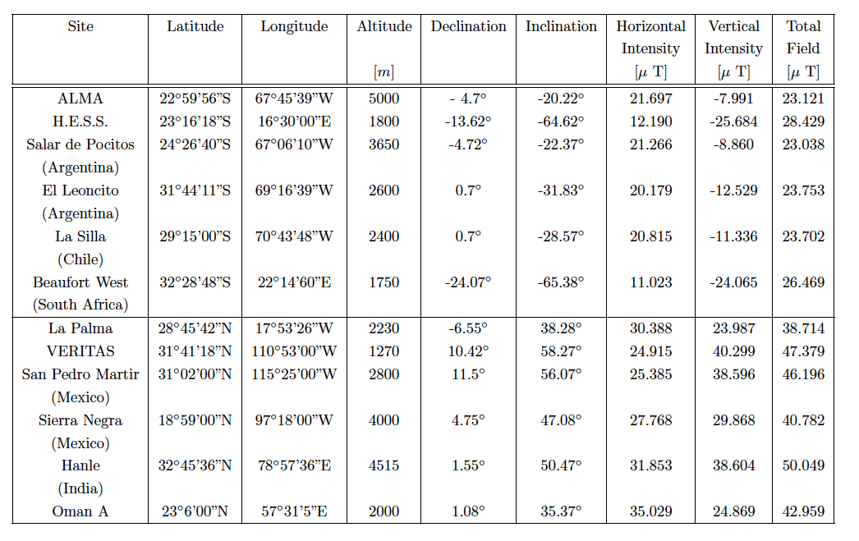
Geomagnetic Field
B-Field used for these studies:
|B| = 31.3 μT (B_{x} =27.5 μT, B_{z}=-15.5 μT)

Slide 28
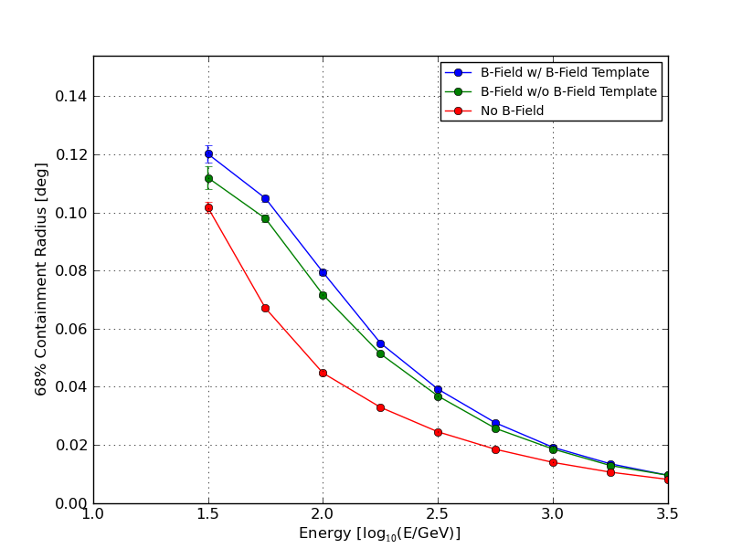
Geomagnetic Field: Angular Resolution
R_{pix} = 0.06 deg R₆₈ = 0.02 deg
B-Field w/ Phi-Averaged Template
B-Field w/ B=0 Template
No B-Field

Slide 29
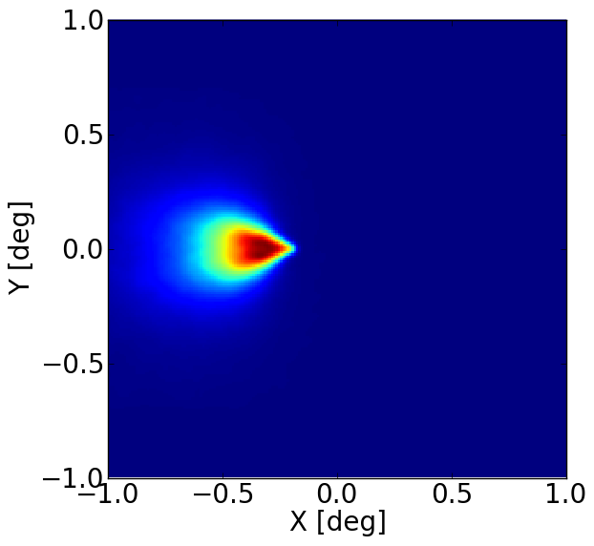
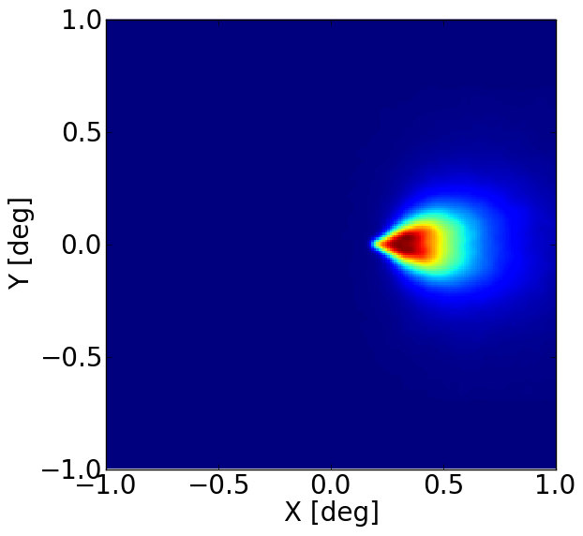
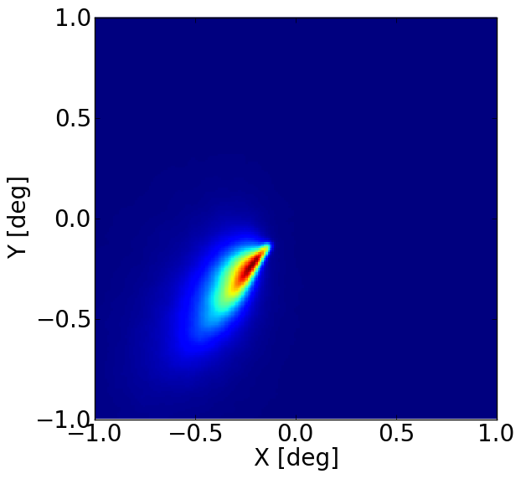
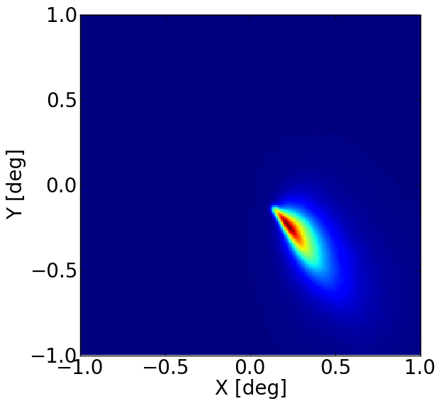
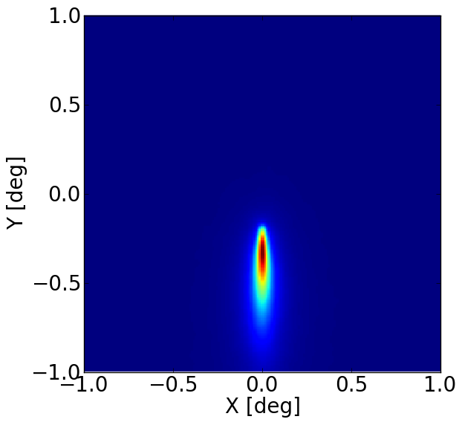
Geomagnetic Field
Φ=0°
Φ: Viewing angle relative
to magnetic field
Φ=180°
E = 100 GeV
R = 80 m
λ=0.5
Φ=45°
Φ=135°
Φ=90°

Slide 30
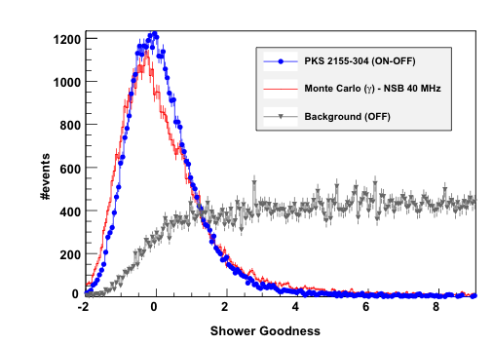
Background Rejection
Likelihood model can also be used for background rejection by comparing log-likelihood with its expected value – “goodness of fit”
Work currently underway to study background rejection as a function of pixel size, light collection, etc.
Naurois et al. 2009

Slide 31
Conclusions
Image Resolution
A small pixel size in conjunction with good optical PSF (R₆₈ ≤ 0.02 deg) can improve angular resolution/point-source sensitivity of a CTA-like array by as much as ~40-60%
An optical PSF of R₆₈ = 0.02 deg (SC-MST PSF at ~3 deg) is sufficient to gain most of the improvement in angular resolution for R_{pix} ~ 0.06 deg
Improved image resolution reduces impact of NSB on reconstruction performance
Image resolution has minimal impact on energy resolution
Light Collection Area
Imaging resolution is more important for angular resolution than light collection area at high energies (> 100 GeV) – SC-like configuration will have superior angular resolution to MST-like configuration regardless of light collection area of the respective telescopes
Light collection area becomes relevant below 100-200 GeV due to impact on trigger threshold
Geomagnetic field
Strong influence on reconstruction performance below 1 TeV
Critical consideration for evaluating sites and studying array performance at low to intermediate energy

Slide 32
Future Work
Study performance of likelihood analysis using image templates with viewing angle dependence
Develop simplified version of read_hess (slim_read_cta) incorporating likelihood reconstruction and density-based image cleaners
Explore background rejection and generate differential sensitivity curves for the configurations under study using both idealized detector and sim_telarray (i.e. Hybrid sims) simulation frameworks

Slide 33
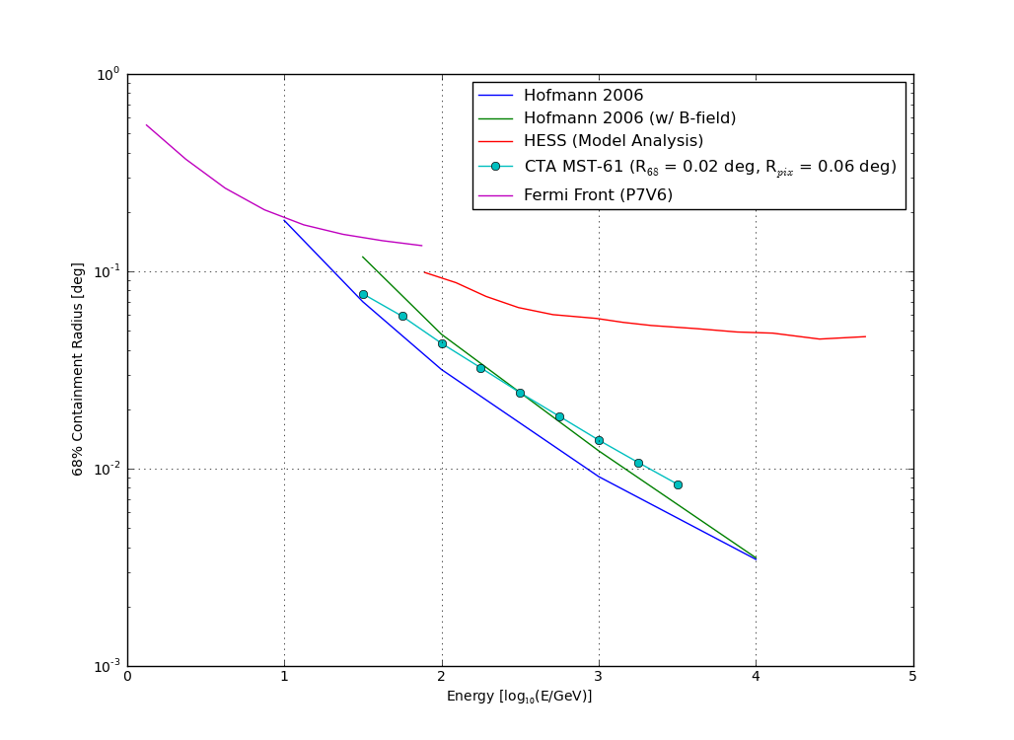
Conclusions/Next Steps

Slide 34
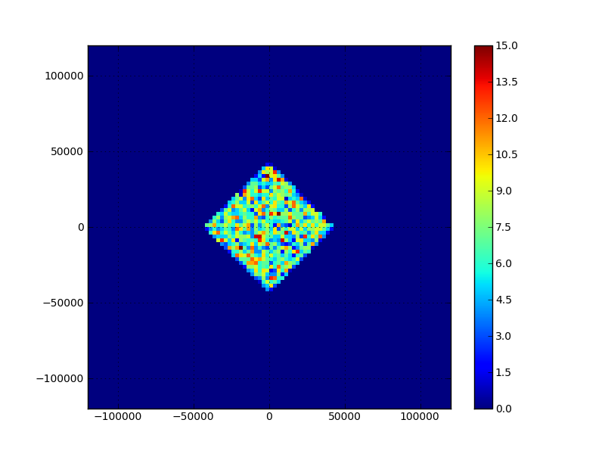
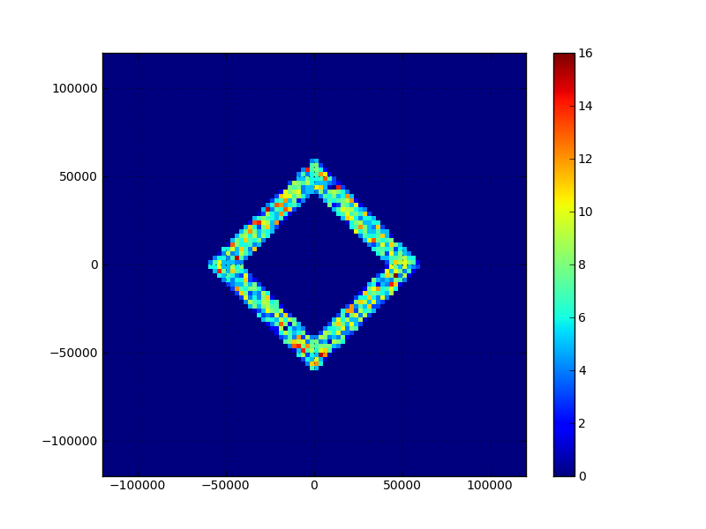
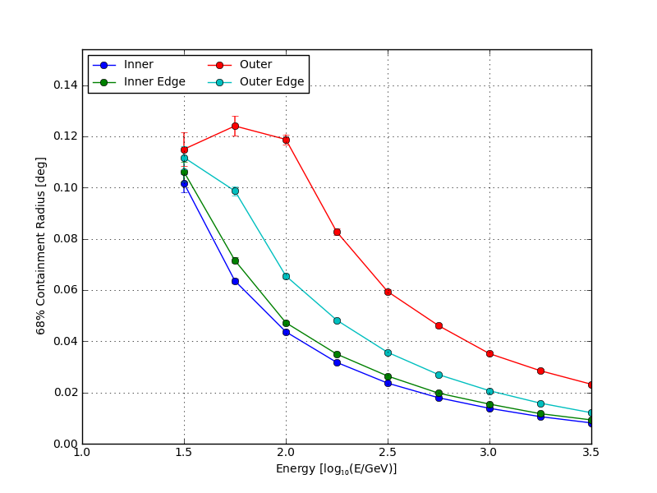
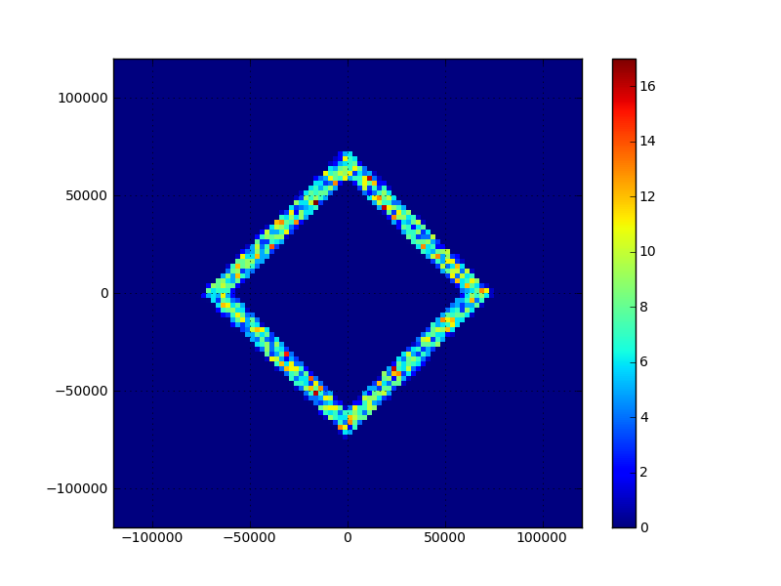
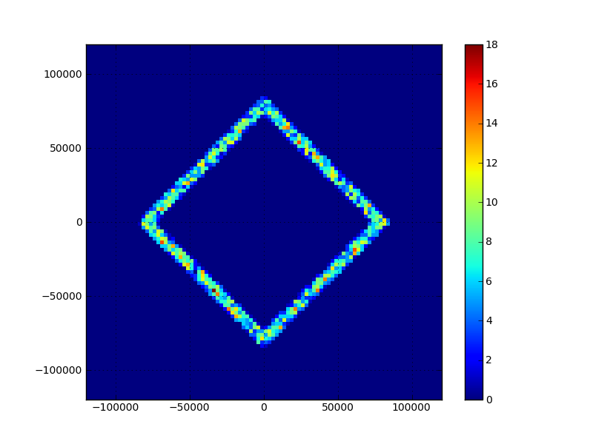
Event Containment
Inner
Inner Edge
Outer Edge
Outer

