Slide 1
Image cleaning and moments reconstruction (for small pixels)
Tobias Jogler, Jon Dumm & Matthew Wood

Slide 2
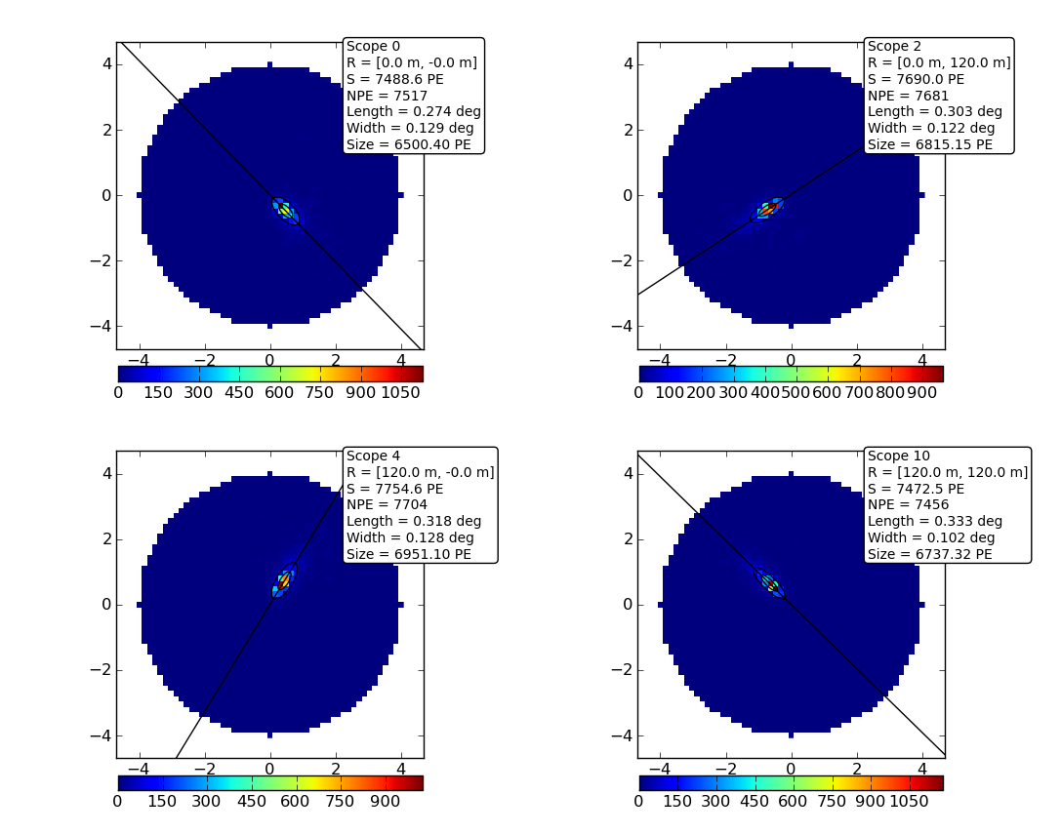
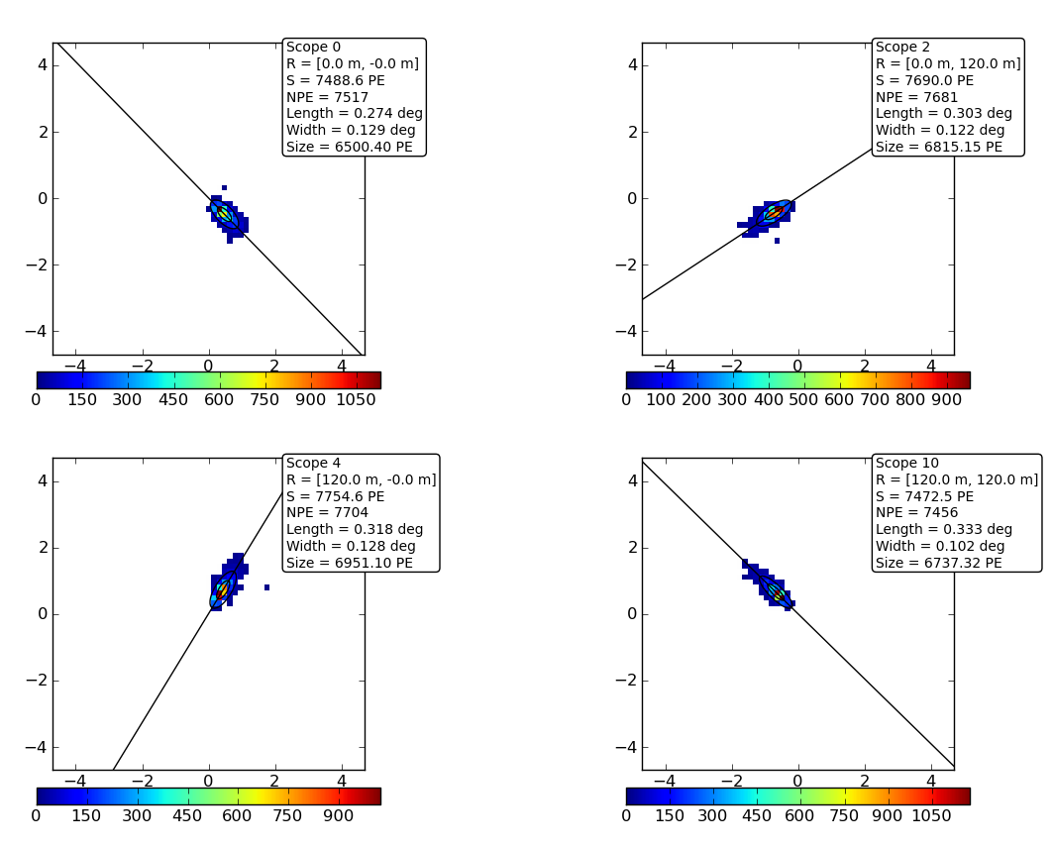
Image cleaning
Image cleaning, ideally removes all pixels containing only noise from a shower image

Slide 3
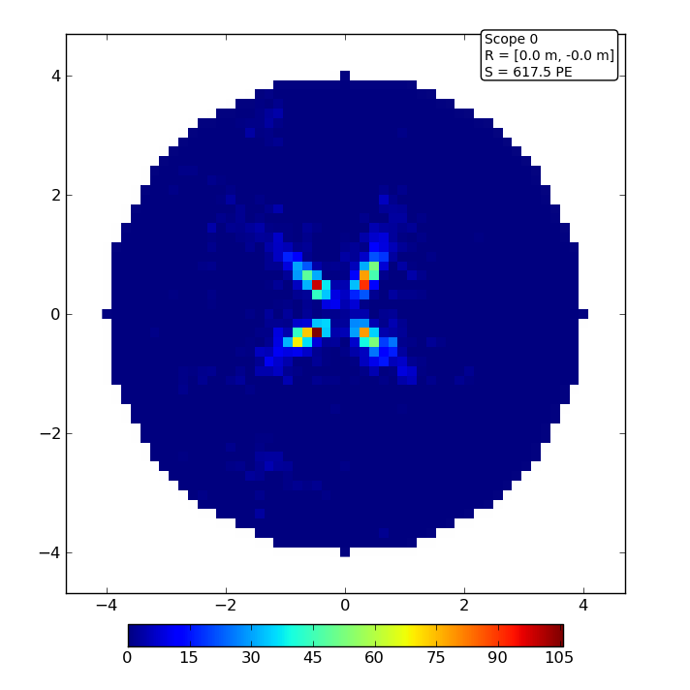
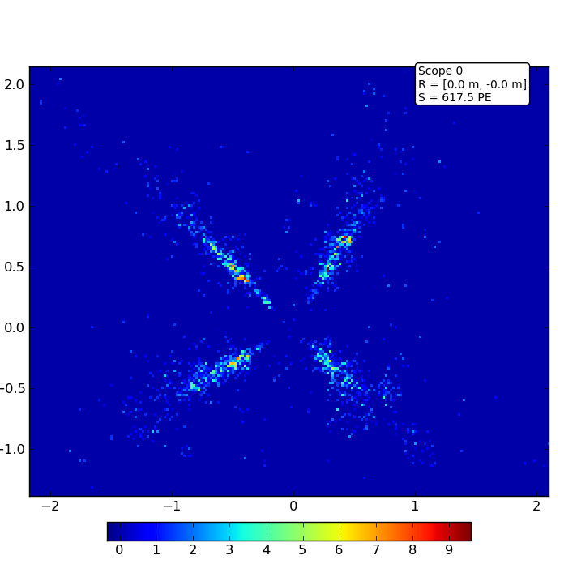
The cleaning algorithms
Pixel 0.16 deg
Pixel 0.02 deg
Use the photon density around a pixel to determine if it contains shower information

Slide 4
The cleaning algorithms
Aperture cleaning:
Sums the weighted charge of all pixels inside a ring
Accounts for pixel fractions

Slide 5
The cleaning algorithm II
Gaussian Cleaning :
Integrates the weighted charge of all pixels inside a gaussian
Accounts for pixel fractions
Might preserve hadronic subshowers in the image

Slide 6
Test Telescope Array
61 MSTs with 120 m spacing
Tested only gamma-rays
Schwarzschild-Couder Telescope
Small pixels: 0.06 deg diameter and psf 0.02 deg (SCT)
Davis-Cotton Telescope
Large pixels: 0.16 deg diameter and psf 0.08 deg (DCT)
Optimizing the angular resolution by tuning the image cleaning Equal to optimizing point source sensitivity

Slide 7
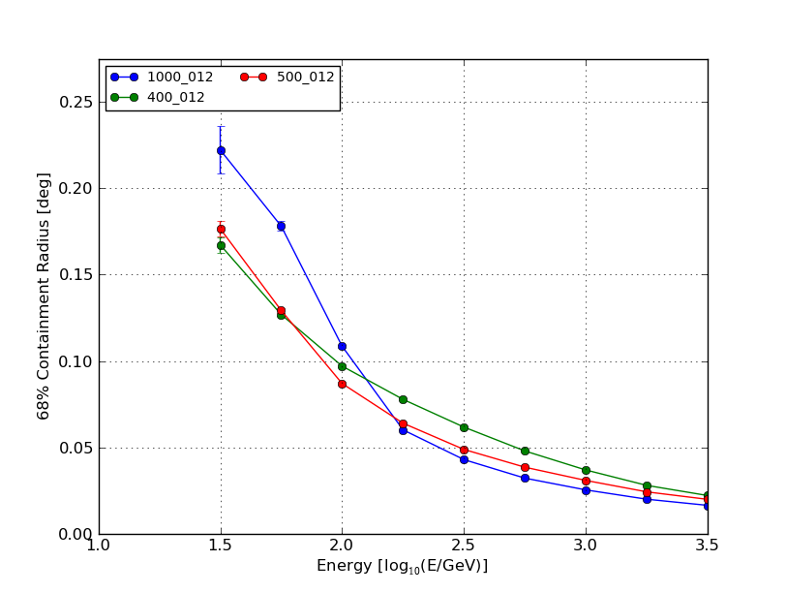
Aperture Cleaning
Search for best cleaning density
CD 1000 phe/deg²
CD 500 phe/deg²
CD 400 phe/deg²
Cleaning density must be function of energy (~ image intensity)

Slide 8
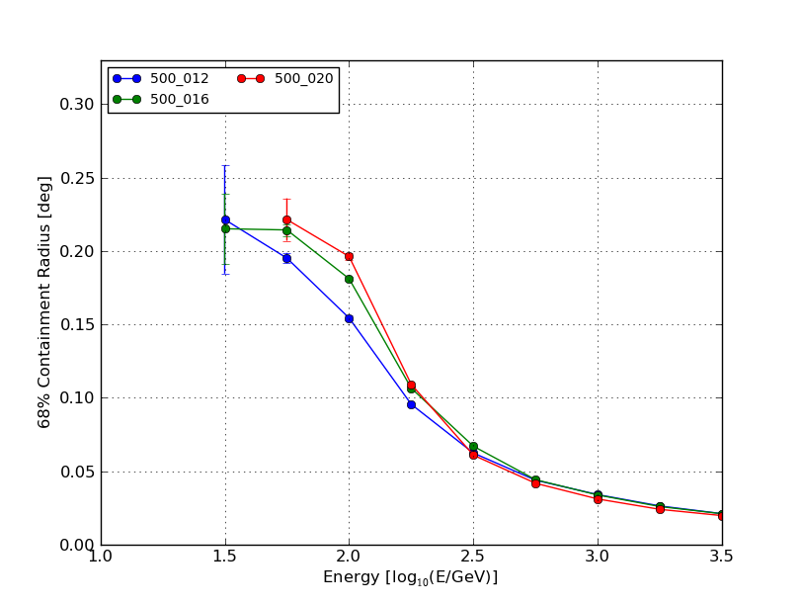
Aperture Cleaning
Search for best cleaning radius
CR 0.12 deg
CR 0.16 deg
CR 0.20 deg
Cleaning radius of 0.12 deg seems to be the best

Slide 9
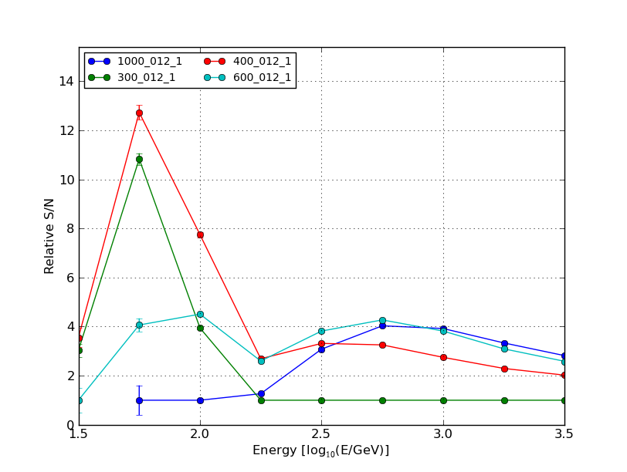
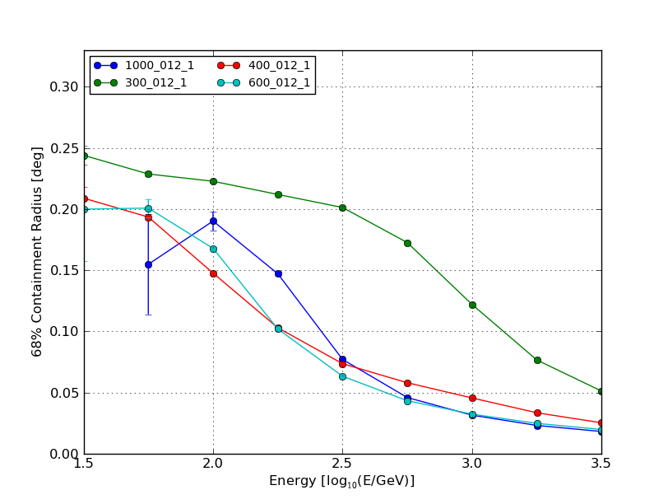
Gauss Cleaning
Scanning cleaning density parameter
Pixel 0.16 deg
CD 1000
CD 600
CD 400
CD 300
Pixel 0.16 deg
CD 1000
CD 600
CD 400
CD 300
To get optimal performance in the whole energy range the cleaning must be a function of energy (~ image intensity)

Slide 10
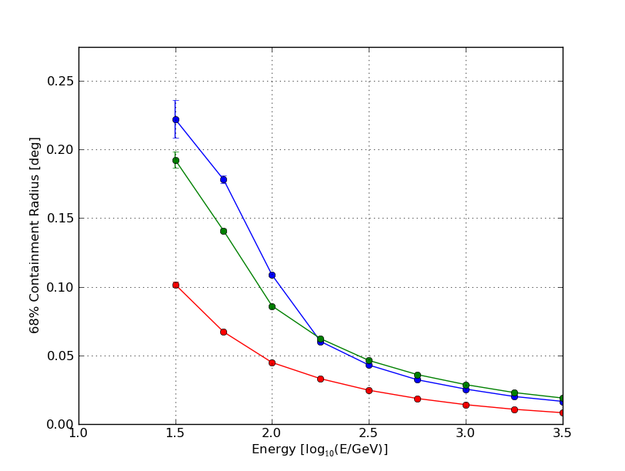
Comparison
Model improves by a
Factor of 2 @ E > 1 TeV
Low energies: Softer cleaning required
Model reconstruction
CD 600 phe/deg²
CD 1000 phe/deg²

Slide 11
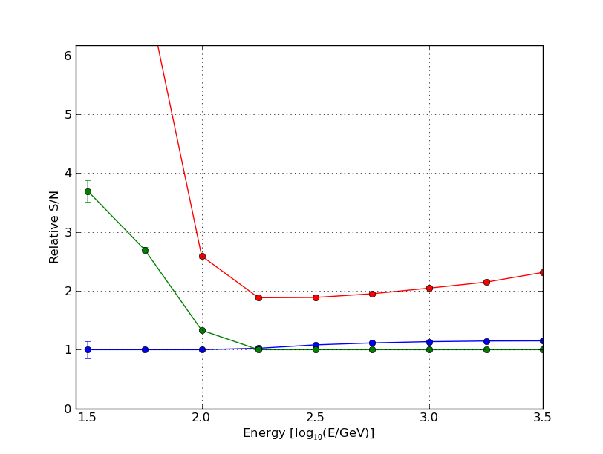
Comparison
Model improves by a
Factor of 2 @ E > 1 TeV
Low energies: Softer cleaning required
Model reconstruction
CD 600 phe/deg²
CD 1000 phe/deg²

Slide 12
Future Improvements
Implementing cleaning strength depending on the image intensity Requires two cleaning procedures
Find optimal cleaning parameters for gamma/hadron separation
Implement the new cleaning methods in the CTA-EU framework to cross check our results and produce a comparison sensitivity curve

