Slide 1
On SCT Documentation Development
Vladimir V Vassiliev, UCLA

Slide 2
Content
Lessons from writing proposals and work on PTDR
How can this meeting help to remedy problems
SCT AOB

Slide 3
Recent Lessons Learned
Preparation of multi-million dollars R&D and MRI proposals was clearly lacking adequate level of technical and cost documentation and was only possible because of the “page limit” requirement (my opinion).
If by the time when we receive MRI funds we do not have improved level of documentation, we will likely fail due to very aggressive MRI schedule and significantly underfunded manpower.
Our attempt to develop PTDR during last few weeks has demonstrated glaring documentation problems, lack of available technical information, need for definition of “dependencies” between different subsystems, and significant amount of work required to define technical design.
Currently available level of documentation is far insufficient for the SCT prototype construction readiness review.

Slide 4
Documentation Development
Strategy
The project is not yet funded but further progress is slowed down and in some cases is even compromised due to the lack of available organizational, technical, and cost documentation.
In this view our approach to the development of the project documentation should be balanced and mostly focused on immediate goals such as preliminary design of the prototype SCT and critical inputs for planning CTA-US participation in CTA.
The time scale for the development of minimal set of documentation is a few months (before next CTA meeting in May, 2012) and extensive set of documents for SCT prototype needs to be in place earlier than project start date of MRI (August 1st, 2012).
What documentation do we need?
PBS + Specs -> WBS -> ICDs -> PTDR

Slide 5
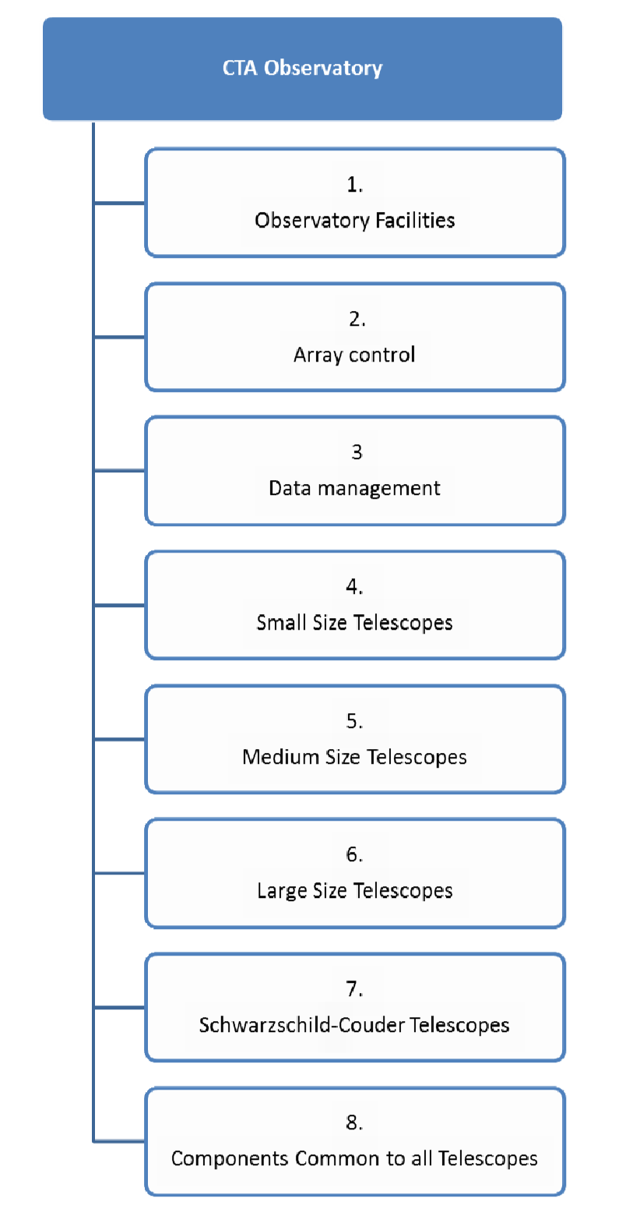
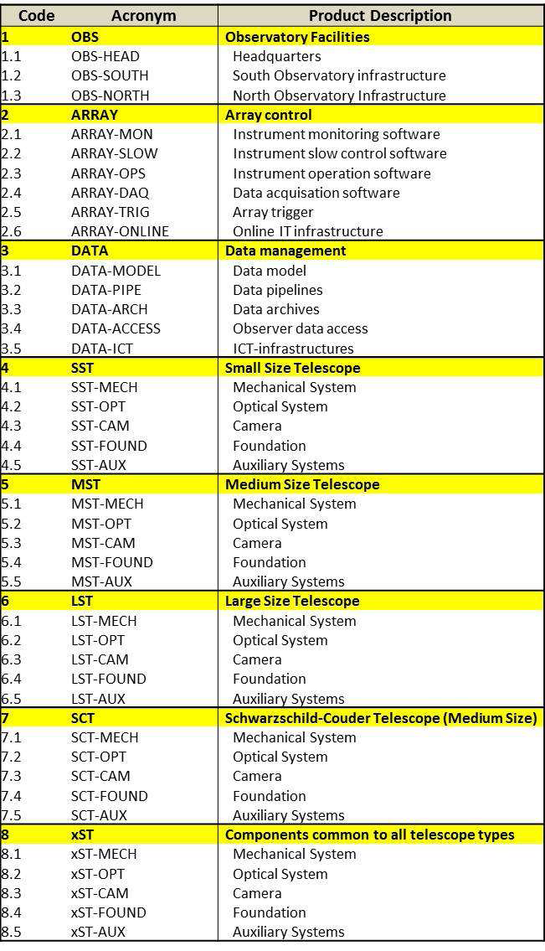
Product Breakdown Structure
Approved by PC on 31 Oct. 2011
Management Plan
For the various branches of the PBS a hierarchy of responsible people would be defined. Initially names
would need to be identified for the highest level PBS and then later for all further structures.
CTA Ref: MAN-PO/111031

Slide 6
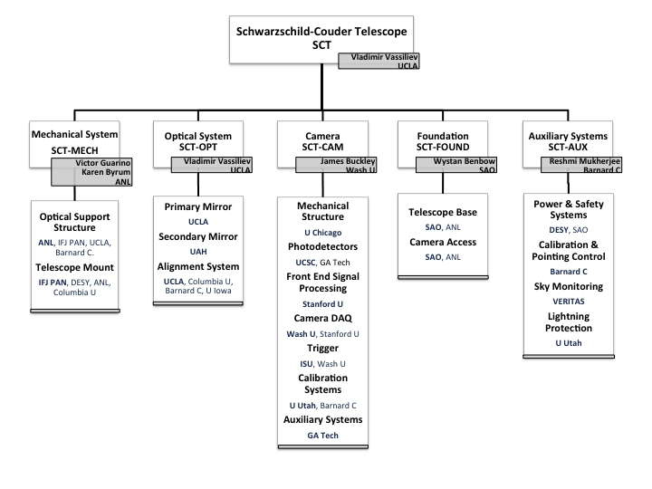
PBS in MRI
Example
PBS levels down to level 3 are approved by the Project Committee. Level 3, however, may have some specifics not common to all telescopes.
The approved PBS structure is more or less preserved in MRI

Slide 7
PBS
Request 1
Define PBS level 3 and 4, if necessary, and identify responsible people
SCT (V. Vassiliev)
SCT-MECH (V. Guarino)
SCT-OPT (V. Vassiliev)
Primary Mirror (…)
Secondary Mirror (…)
Alignment (…)
Mirror Panel Stewart Platform (…)
Mirror Panel Edge Sensors (…)
Mirror Panel Controller Board (…)
Focal Plane Alignment (…)
Global Alignment (…)
Stray Light Control (…)
SCT-CAM (J. Buckley)
SCT-FOUND (…)
SCT-AUX (…)
PBS at CTA- https://portal.cta-observatory.org/internal/SitePages/PBS.aspx

Slide 8
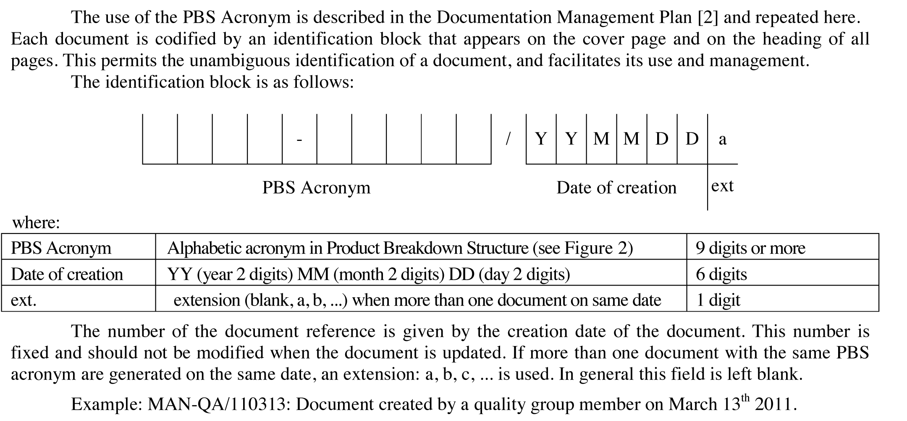

Referencing Documents
https://portal.cta-observatory.org/internal/SitePages/Documentation.aspx

Slide 9
WBS
Request 2
Develop WBS down to level 5 (not necessarily with all cost info)
Example:
Level 1 SC- Telescope
Level 2 Optical System (SCT-OPT)
Level 3 Alignment System
Level 4 Focal Plane Stewart Platform (hexapod)
Level 5 Hexapod components, machine shop labor, software development, etc

Slide 10
Interface Control Documents
Request 3
Define list of required ICDs but not necessarily define full content
Example (by M. Errando) :
Stray Light Control:
ICD 1 with SCT-CAM (Photosensors)
Angular acceptance curve of the chosen photo-sensor
ICD 2 with SCT-CAM (Camera mechanical structure & Aux)
Definition of camera entrance window and camera mechanical support
ICD 3 with SCT-MECH
Position of baffles, weight, material, etc.
ICD 4 with OBS-SOUTH
Background light distribution as function of solid angle (snow, etc.)

Slide 11
Specs Level A
Preliminary CTA System Performance Requirements

Slide 12
Specs Level B
Preliminary CTA Sub-System Performance Requirements
CTA Requirements Review
Scheduled for March 27-28
https://portal.cta-observatory.org/internal/SiteAssets/SitePages/GH_test/CTA_PP_Deliverable_201.1.pdf

Slide 13
SCT Specs
Request 4
Define list of SCT specifications sufficient to produce preliminary SCT design (Level “B-C”)
SST Requirements
Example:
Define list of specifications for
SCT-MECH, SCT-OPT, SCT-CAM
Identify specifications requiring
further justifications (sims, interaction
with industry etc.)
Plan (e.g. sim study, memo, who, when, etc.)

Slide 14
PTDR outline & status
10.1 SCT: Introduction (1 page)
10.2 SCT: Justification & simulations (<8 Pages)
Coordinator: Brian Humensky
10.3 SCT Optical System Overview (1 page)
10.3.1 Primary mirror
10.3.1.1 Segmentation (2 pages)
10.3.1.2 Specifications (2 pages)
10.3.1.3 Mirror panel technologies (1 page)
10.3.1.4 Coating and overcoating (0.5 page)
10.3.1.5 Cost (… later)
10.3.2 Secondary mirror
10.3.2.1 Segmentation (2 pages)
10.3.2.2 Specifications (2 pages)
10.3.2.3 Mirror panel technology (1 page)
10.3.2.4 Coating and overcoating (0.5 page)
10.3.2.5 Cost (… later)
10.3.3 Stray light control (2 pages)
10.3.4 Alignment System
10.3.4.1 Overview (1 page)
10.3.4.2 Panel-to-panel alignment system (2.5 pages)
10.3.4.3 Global alignment system (1.5 page)
10.3.4.4 Cost (… later)
Coordinator: Vladimir Vassiliev
10.4 SCT Mechanical System Overview (1 page)
10.4.1 Optical Support Structure
10.4.1.1 Overview (P, S, and C) (5 pages)
10.4.1.2 Mirror panels support (1 page)
10.4.1.3 Cost (… later)
10.4.2 Telescope positioning system
10.4.2.1 Mechanical system & foundation (4 pages)
10.4.2.2 Electrical system (3 pages)
10.4.2.3 Safety (1 page)
10.4.2.4 Cost (… later)
Coordinator: Victor Guarino
10.5 SCT Camera
10.5.1 Overview (1page)
10.5.2 Mechanical structure (2 pages)
10.5.3 Photosensors (2 pages)
10.5.4 Front-end electronics (5 pages)
10.5.5 Camera DAQ (data flow backplane) (3 pages)
10.5.6 Trigger (full concept) (2 pages)
10.5.7 Calibration System (1 page)
10.5.8 Auxiliary Systems (1 page)
10.5.9 Cost (… later)
Coordinator: James Buckley
Desired due date: March 1 (first draft of contributions was due on February 20)

Slide 15
PTDR
Request 5
Discuss status of PTDR
Definition and changes of the outline & content
Remaining uncertainties and dependencies
Identify relevant memos to be written
Plan work (sims, etc.) needed for completion
Define responsibilities
Establish due dates
PTDR is expected to evolve into TDR which is the main document containing all technical details required for construction of SCT
CTA PTDR - https://portal.cta-observatory.org/internal/SitePages/PTDR.aspx

Slide 16
CTA-SCT
Home Page
Documentation Example
https://portal.cta-observatory.org/WG/SCT/SitePages/Home.aspx

Slide 17
SCT-X discussions
Suggested Template
PBS (structure and responsibilities)
WBS
ICDs
Specs
PTDR
Focus on items requiring collective input or decisions

Slide 18
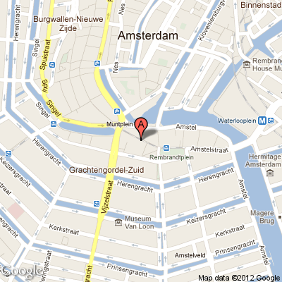
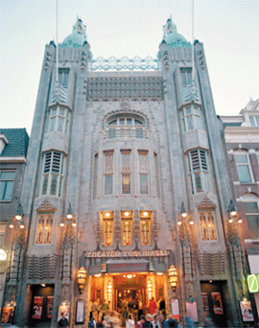
SCT AOB
CTA Consortium meeting
Input needed for schedule planning
How many people plan to go?
Do we need special session for SCT WP?
If yes, how many people plan to attend it?
What time should be allocated for
SCT session, if we request one?
14-18 May 2012,
Amsterdam

