Slide 1
ARIZONA / LOWELL OBS. AS CTA HOST
JEFFREY HALL
LOWELL OBSERVATORY, FLAGSTAFF, AZ
CTA-US Meeting / SLAC
FEBRUARY 24, 2012

Slide 2
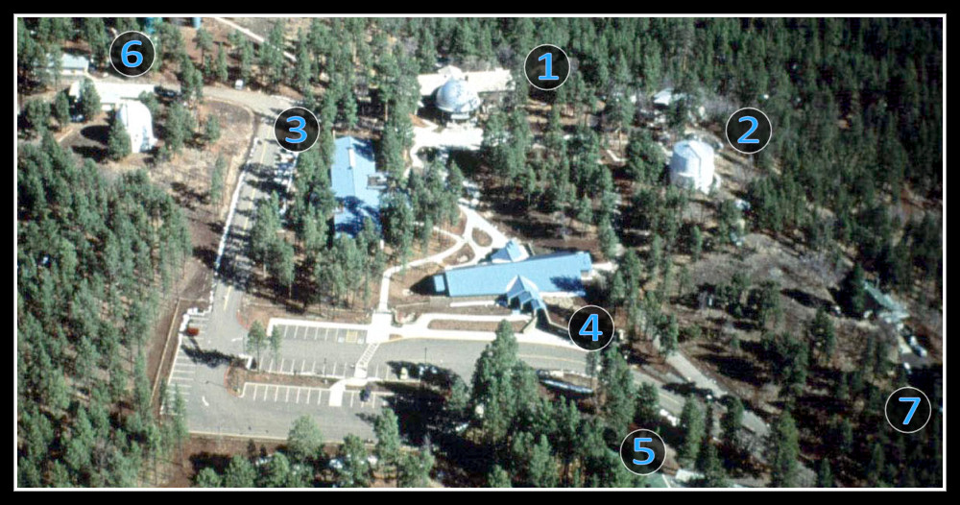
OVERVIEW
Private, non-profit research institution
20 PhD staff
20 instrument builders and engineers
30 outreach and fundraising
20 administrative, IT, and support

Slide 3
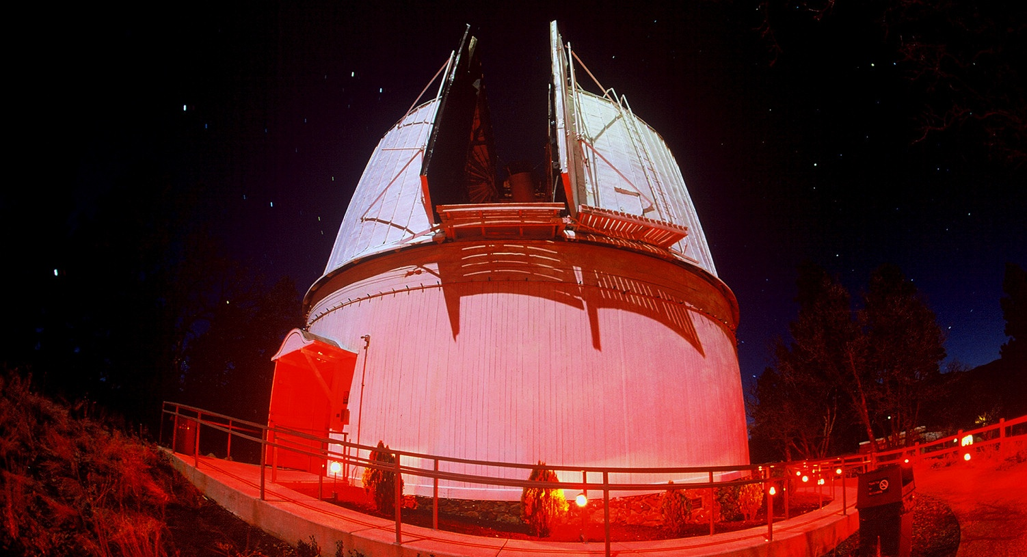
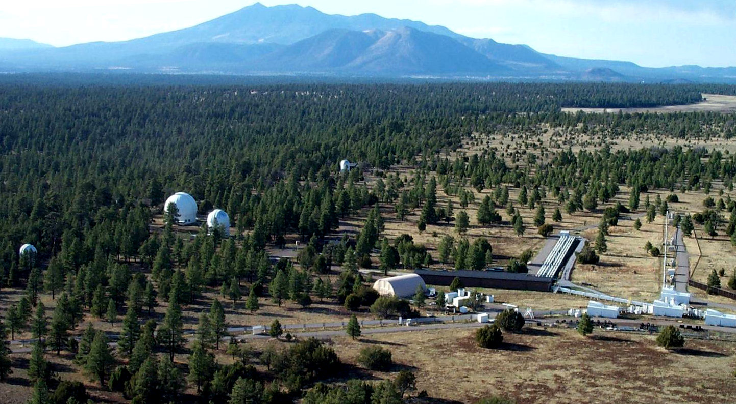
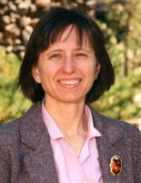
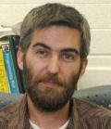
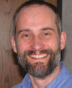
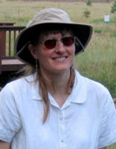
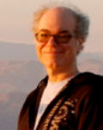
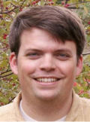
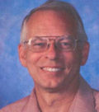
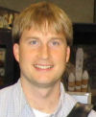
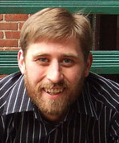
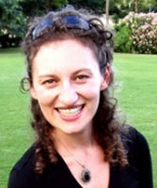
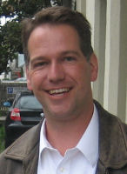
LOWELL RESEARCH
1894… 2011…
MARS HILL
0.6-m
1.8-m
1.1-m
0.9-m
NOI
EXTRAGALACTIC - EXOPLANETS - STELLAR - ICY MOONS, PLUTO, KUIPER BELT

Slide 4
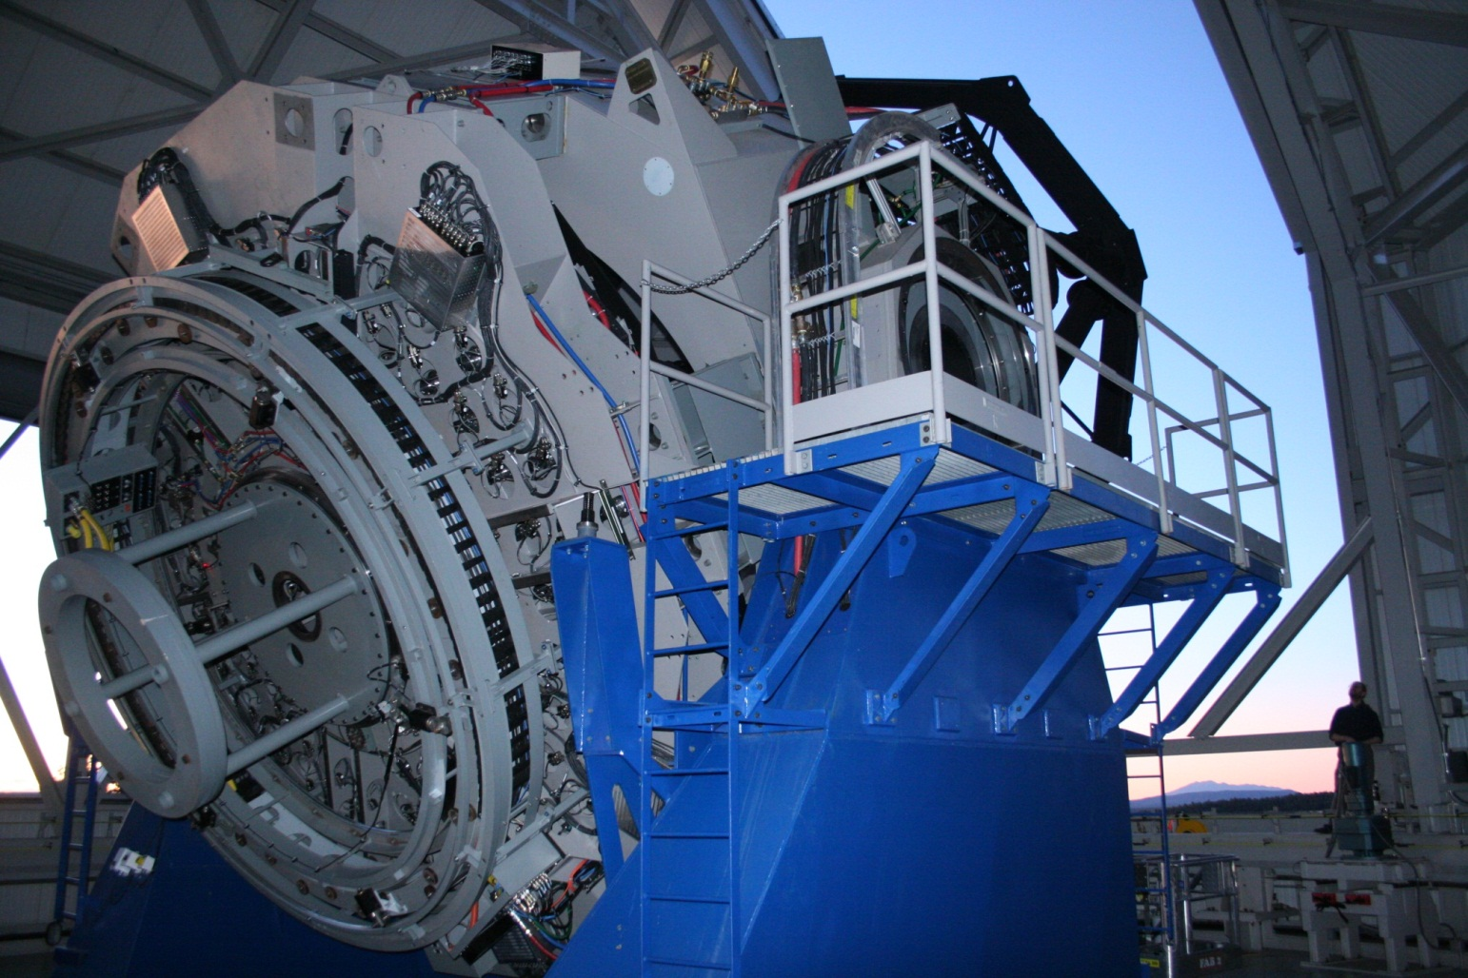
LOWELL RESEARCH
≥ 2012…

Slide 5
LOWELL RESEARCH
≥ 2012…
Capital cost to build and commission DCT $53M
Discovery Communications $16M
First rights to educational use of data in programming
University partners $15M
Per-night or long-term buy-ins in return for access
Instrument suite
Built mostly in-house at Lowell
Includes 13’ FOV optical imager, near-IR spectrograph

Slide 6
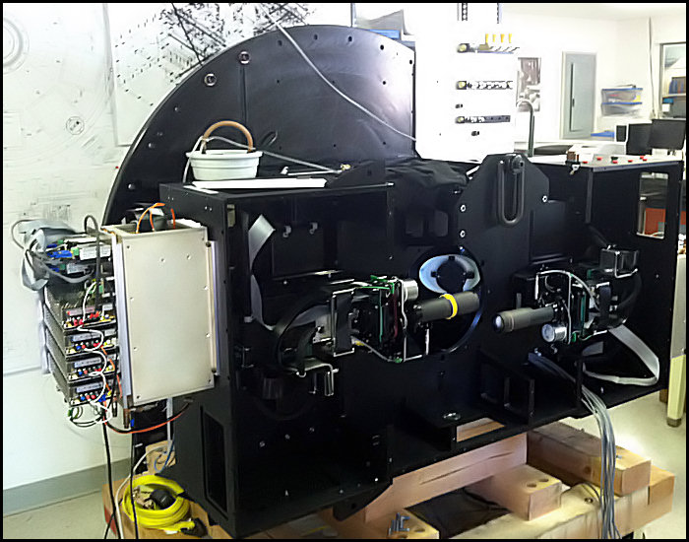
LOWELL INSTRUMENT SHOP

Slide 7
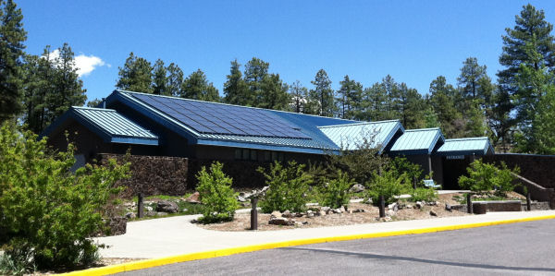
LOWELL OUTREACH
80,000 onsite visitors per year
Includes ~10,000 K-12 students, also many private programs
“Discovery Era”
DCT research broadcast to 99M in USA, 1.5B worldwide
Major expansion of outreach efforts, including partners
Substantial broader impact benefit in proposals already

Slide 8
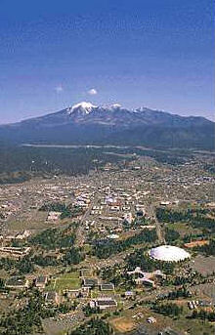
LANDSCAPE - FLAGSTAFF
Northern AZ regional hub
population ~75,000 incl. nearby
developments
largest city in roughly 50K square mi
75 mi to Grand Canyon
50-year lighting ordinance
“dark-sky city”
U S Naval Obs. Flagstaff Station (NOFS)
~20 astronomers
Timekeeping & positional services
Navy Optical Interferometer
U S Geologic Survey (USGS) station

Slide 9
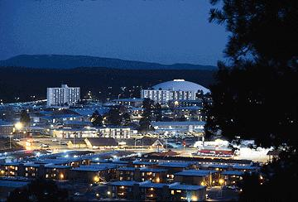
LANDSCAPE - FLAGSTAFF
Northern Arizona University
~25,000 students
~48M/year in
grants/contracts
Expansion / diversification
due to State-level
budget pressures

Slide 10
LANDSCAPE - COCONINO COUNTY
Coconino and Yavapai Counties
County governments development-oriented
Renewable energy projects underway
ECoNA (Economic Collaborative of N AZ) specifically
wants to leverage critical mass of astronomical assets
in the area
Long-standing County-wide lighting ordinance
like Flagstaff, includes restrictive exclusion zones

Slide 11
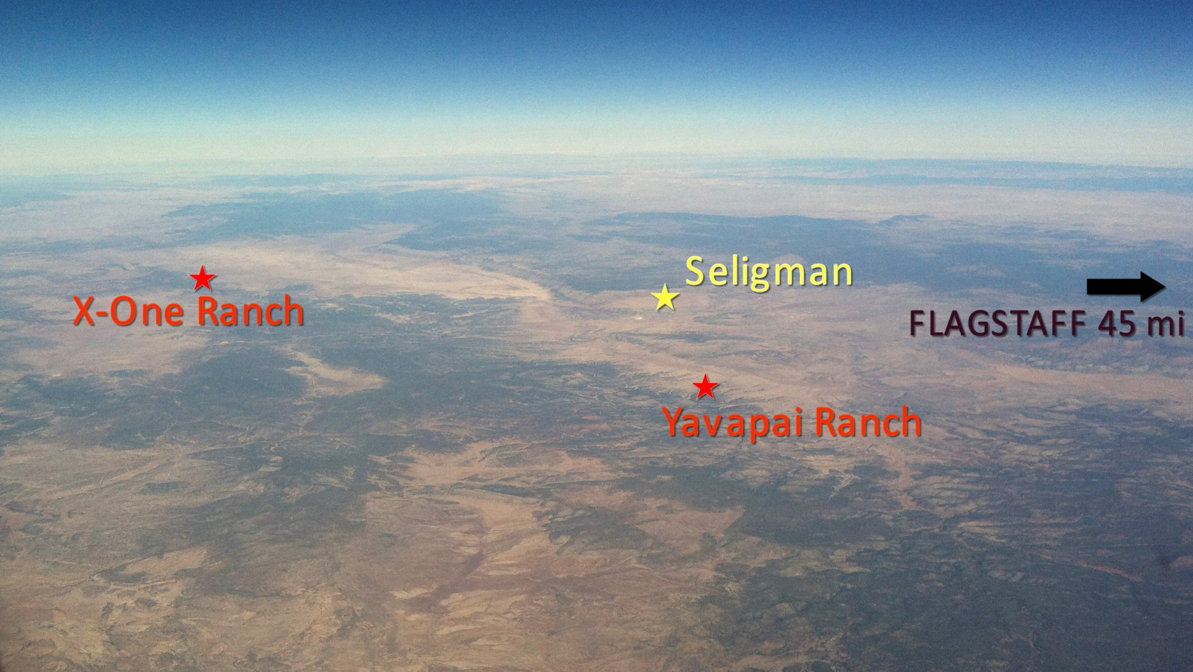
LANDSCAPE - ARIZONA
Statewide lighting protection
Recent interest from State agencies (e.g., AZ Commerce Authority)

Slide 12
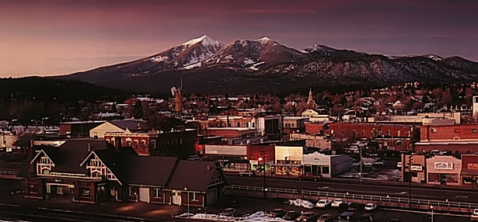
← TO LOWELL 1 MI
DOWNTOWN FLAGSTAFF
TO CTA 40 MI? →

