Slide 1
The ASTRI prototype:
a pathfinder Dual-Mirror telescope for the CTA-SST array
An overview on the optical design, telescope structure & mechanics and mirrors
Rodolfo Canestrari for the ASTRI collaboration
INAF-Astronomical Observatory of Brera

Slide 2


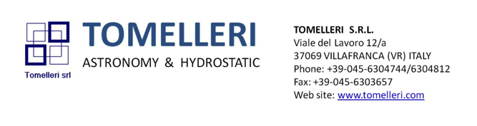

This work has been performed by INAF in collaboration with:

Slide 3
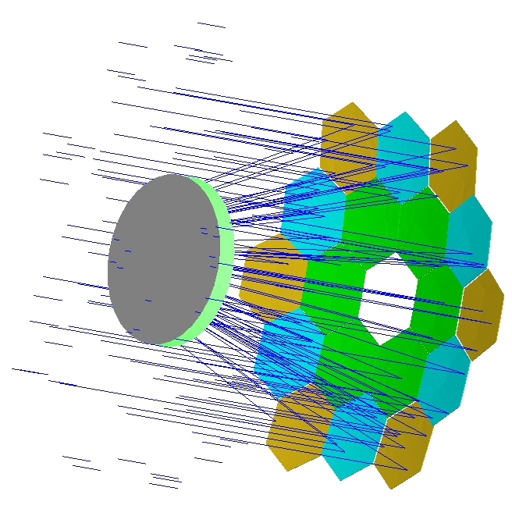
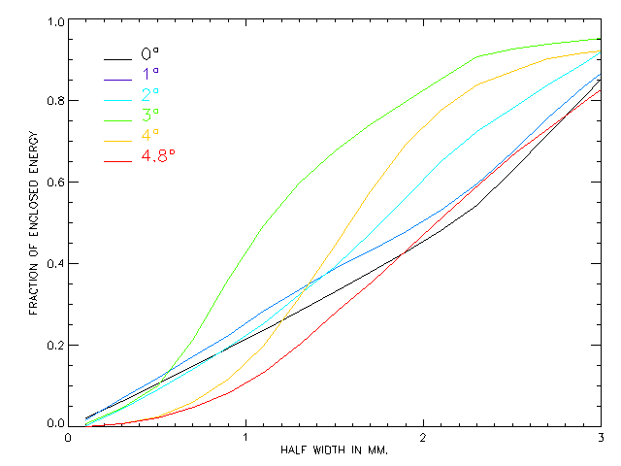
The optical design
F#: 0.5
f: 2.15 m
Pixel: 0.16°
FoV: 9.6°
Plate-scale: 37.5 mm/°
PSF: EE80% < 6 mm
Effective area: 6.5 m²
M1 radius: 8.2 m
M2 radius: 2.2 m
DET radius: 1 m
1.8 m
3 m
4.3 m

Slide 4
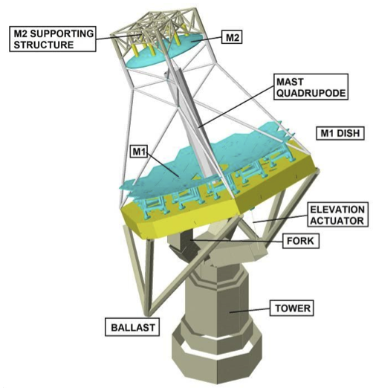
The telescope
Preliminary mass budget
Item | Mass [kg]
M1 dish | 4.000
Mirrors and supports | 555
M2 dish | 550
M2 mirror | 200
Camera | 50
Mast | 560
Ballast structure | 800
Counterweight | 4.400
Fork and tower | 4.000
Total | 15.115

Slide 5
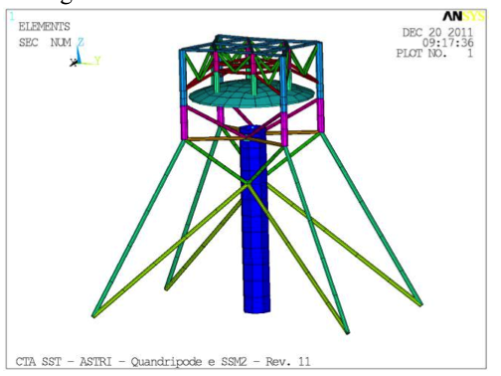
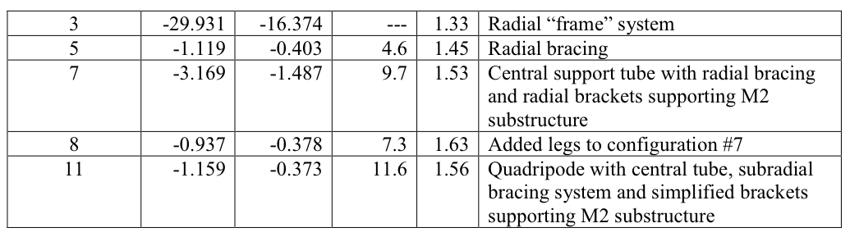
Structural analyses
The quadrupod
The quadrupode legs with the radial bracing counteract the lateral deformations while the central tube increase the torsional stiffness.

Slide 6
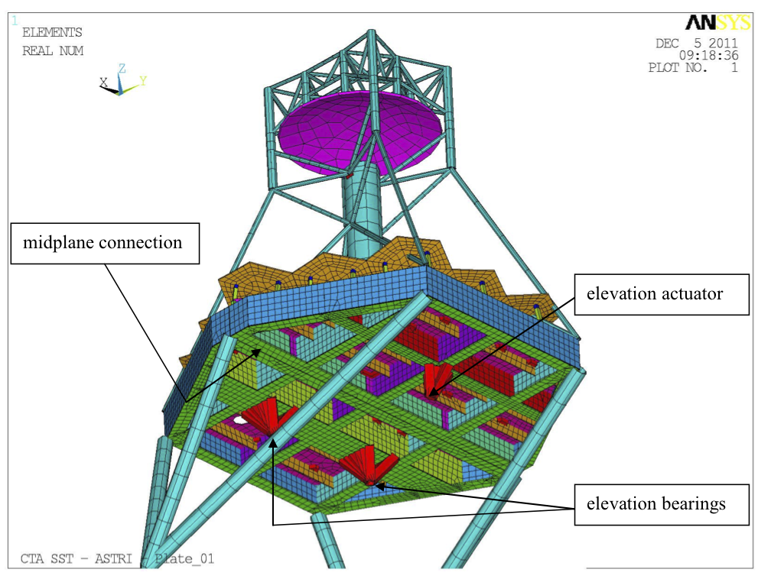
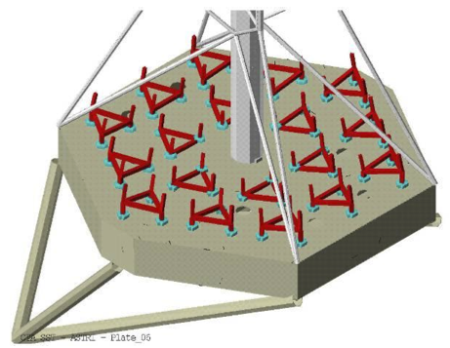
Structural analyses
The dish – RIBBED PLATE
400 mm thick steel plate composed of two halves. Easy manufacturing and assembly.
1st natural frequency: 8.5 Hz

Slide 7
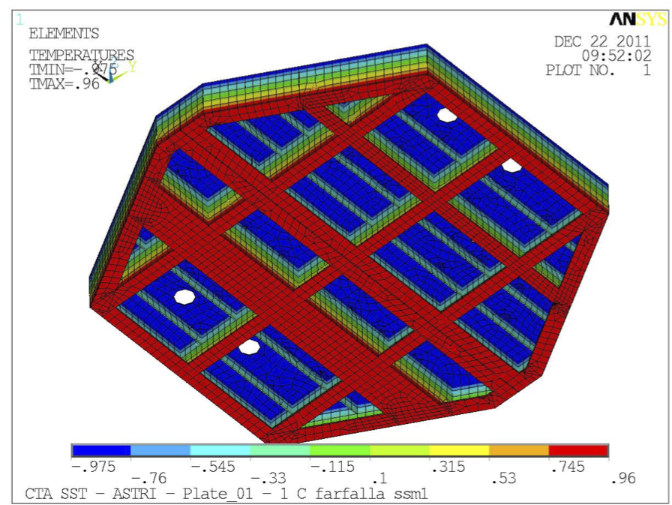
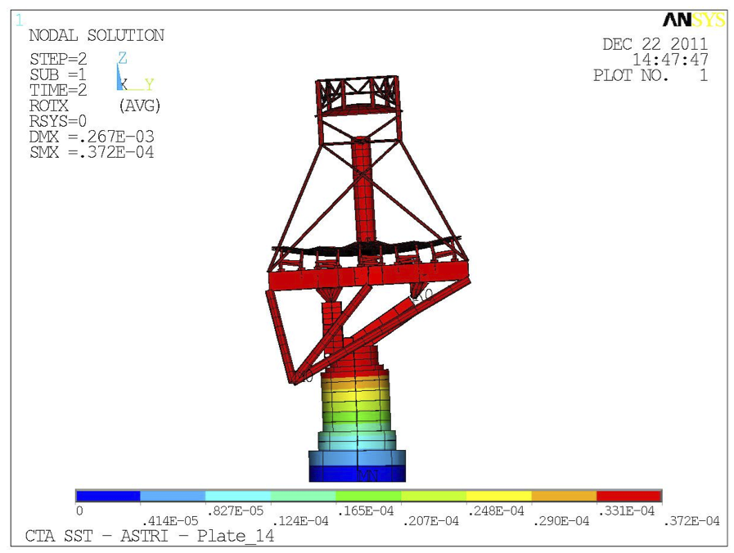
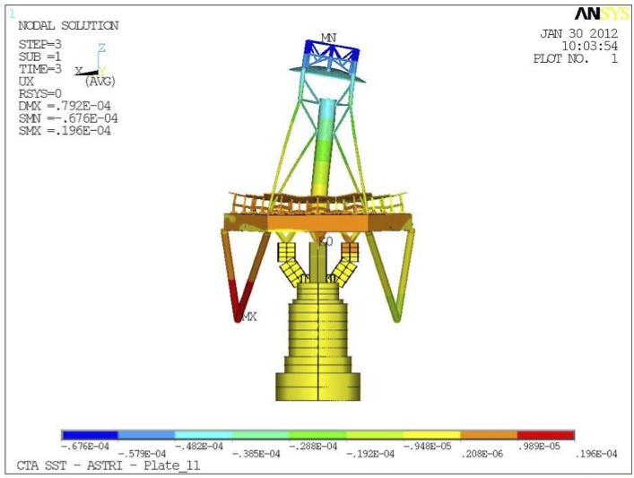
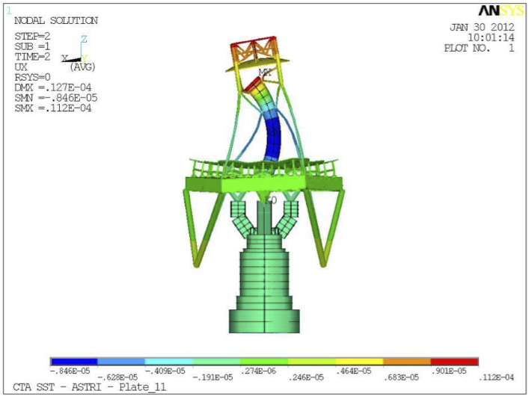
Structural analyses
Sensitive analyses to understand the thermo-elastic behavior:
±1°C linear gradient along dish thickness
±1°C linear gradient along tower
±1°C linear gradients along central tube
±1°C linear gradients along mast
Important contribution to mirrors misalignment
Significant contribution to telescope pointing
Negligible overall effects
Negligible overall effects
2
1
4
3

Slide 8
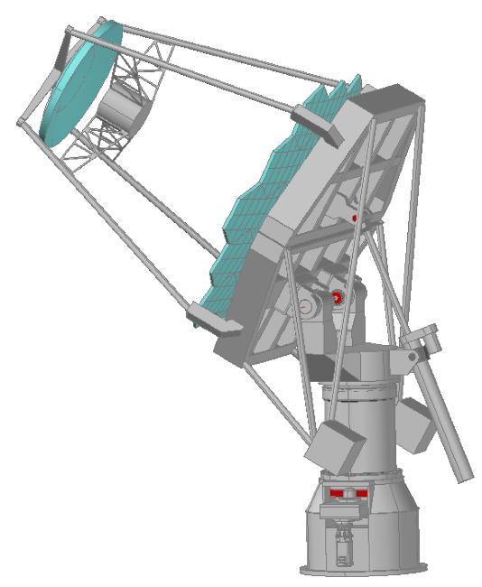
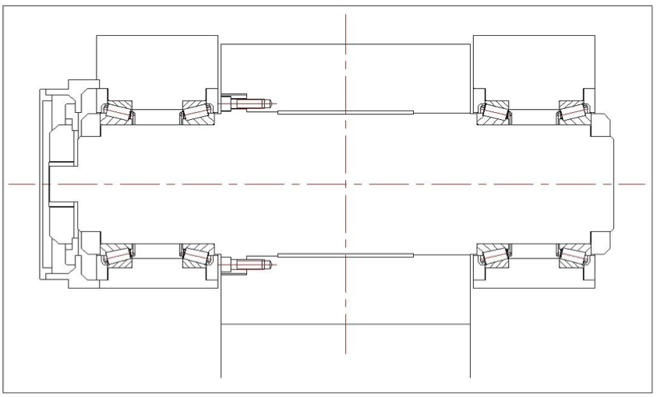
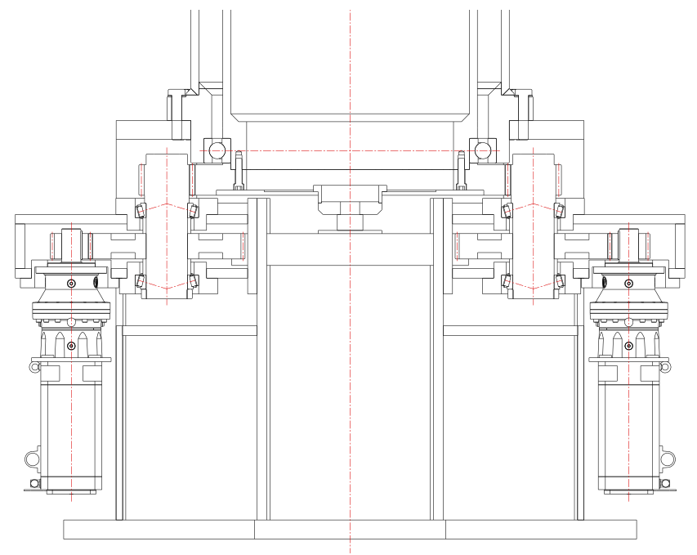
Mechanicals systems - driving
The elevation assembly is composed by two shafts with preloaded tapered roller bearings.
The driving system is done with a linear actuator with a gear box and preloaded ball screw.
The azimuth assembly is composed by two ball bearings axially preloaded.
The driving system is done with two pinions coupled with a rim gear.

Slide 9
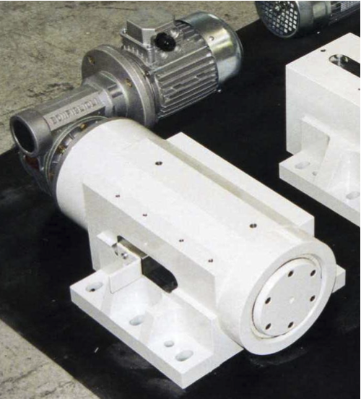
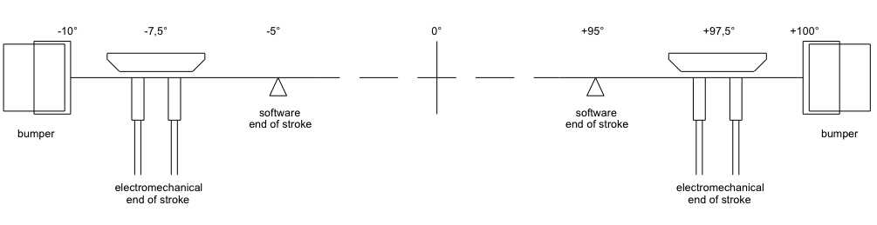
Mechanicals systems - measuring and safety
Electromechanical stow pins
Absolute encoders (HEIDENHAIN RON 786) interfaced with GALIL controller (with adjustable PID parameters)
-275°
-270°
0°
+270°
+275°
azimuth
altitude
Safety system concept

Slide 10
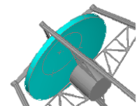
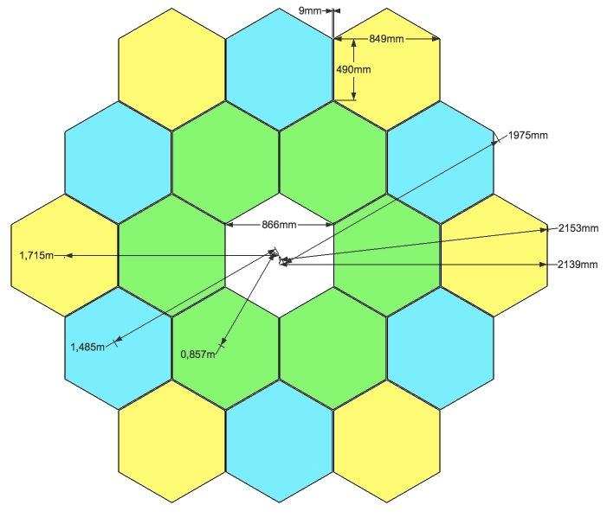
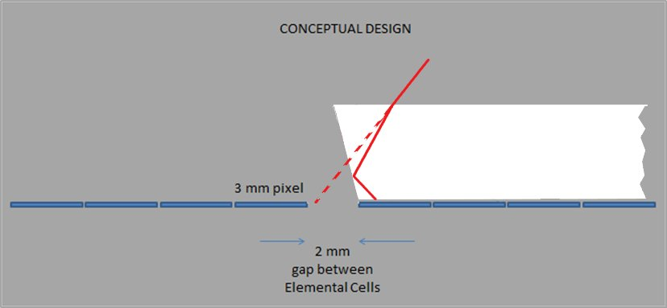
The optical surfaces
Primary mirror (M1)
18 hexagonal shaped mirrors (11.2 m²)
850 mm face-to-face, 1 m diagonal
3 types of segments
2 actuators + 1 fixed point
Secondary mirror (M2)
1 monolithic mirror, 1.8 m diameter (2.5 m²)
3 actuators + 3 lateral constrains
Reimaging system (CAM)
500 a-symmetric pyramids, 14x14x2.5 mm³
Coatings
CAM

Slide 11
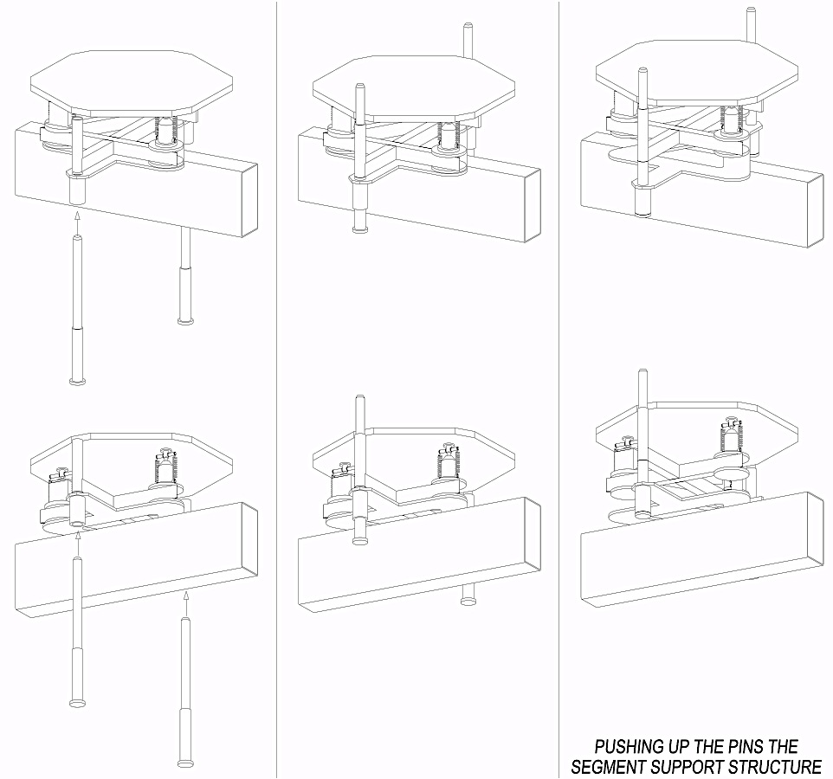
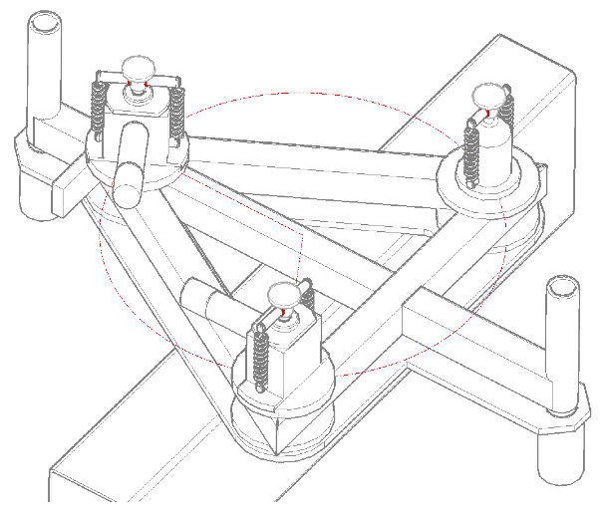
The optical surfaces - support and alignment
Primary mirror segments
2 actuators designed to minimize the cost:
  Eccentric shaft
  Encoder
  Stepper motor
  Gear box
Mounting/dis-mounting safe procedure

Slide 12
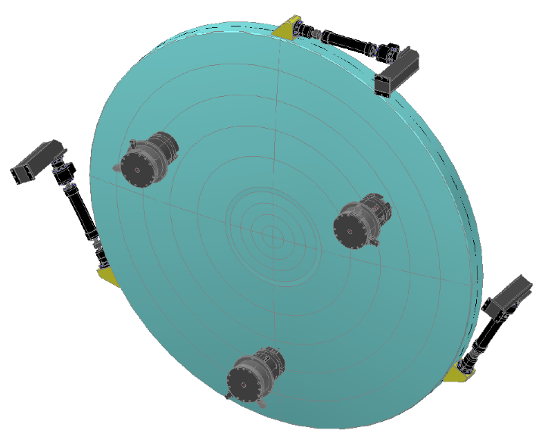
The optical surfaces - support and alignment
Secondary mirror (monolithic)
3 lateral constrains support the lateral component of the mirror’s weight (varying with the elevation)
3 actuators connected to the mirror with load spreader (whiffletree)

Slide 13
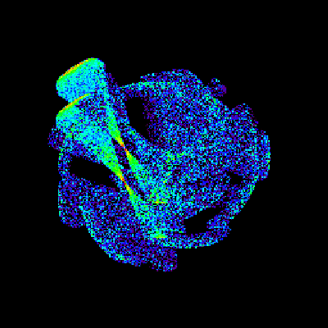
The optical surfaces - support and alignment
Example of M1 segments alignment procedure
Take a picture of the star
Move one M1 segment of a known amount
Take a picture of the star
Subtract the two images in a “smart Conconi way”
(See the picture on the side)
Find the barycenter
Repeat for each segment

Slide 14
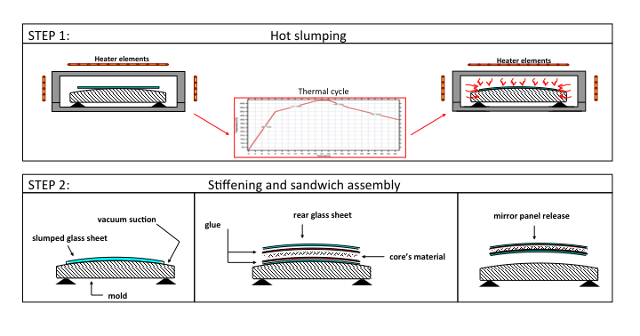
The optical surfaces - mirrors
Manufacturing process: “Cold slumping 2.0”: hot pre-shaping + cold
Structural implementation: sandwich panel with thin glass skins

Slide 15
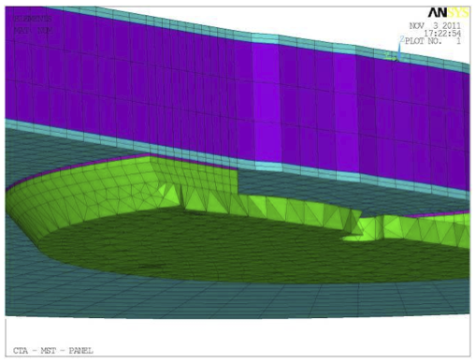
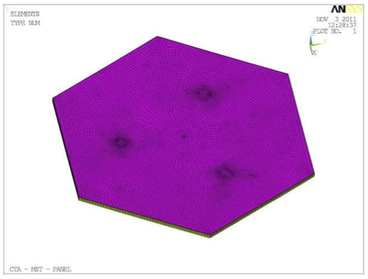
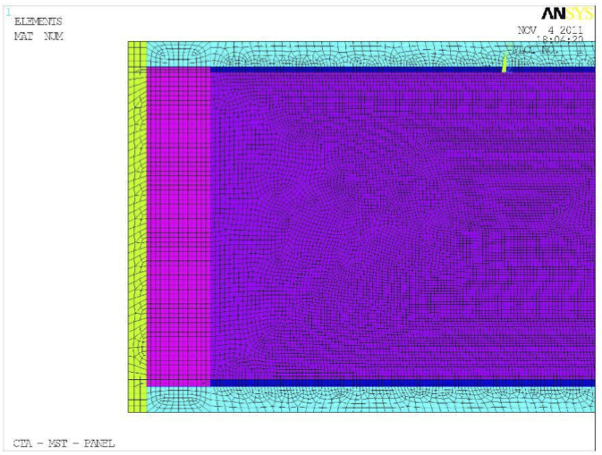
The optical surfaces - mirrors
Mirror’s interfaces
The mirror design is being evaluated by very detailed FEA
Mirror’s edge

Slide 16
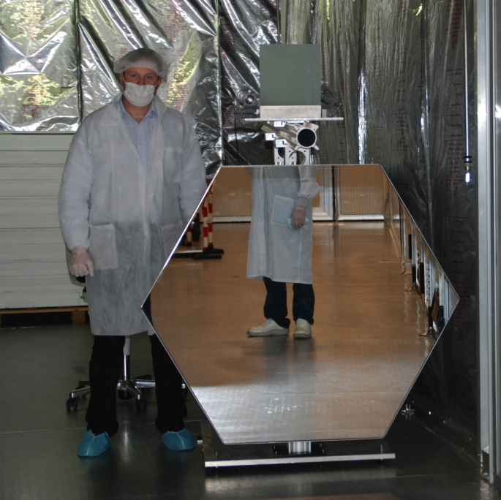
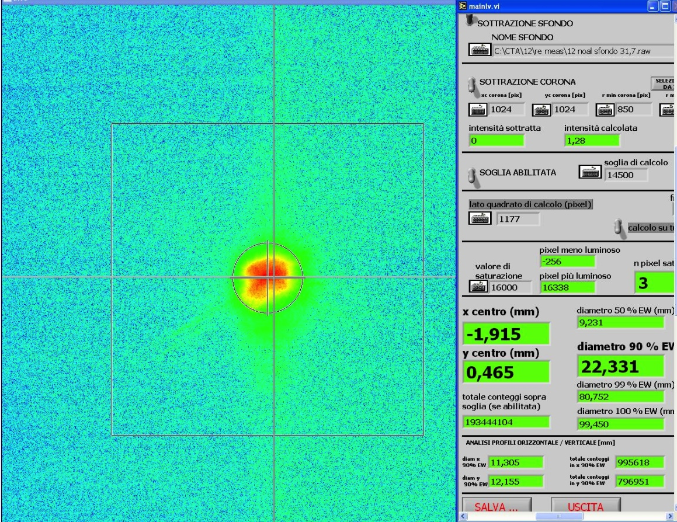
The optical surfaces - mirrors
Cold slumping technology
20 mirrors panels have been successfully produced in less then 1 month (Dec 2011)
Weight: 11.75 kg
Panels Results
Radius of Curvature | 32 ± 0.1 m
Surface accuracy | 80% energy in < 0.5 mrad
Reflectivity | > 80% range 300 to 600nm
Coating | Al + SiO₂
All mirrors have been measured with 2f method → D90 < 1 mrad
Now, under repetition after the coating

Slide 17
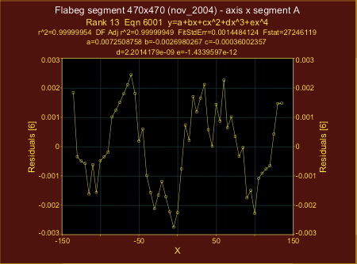
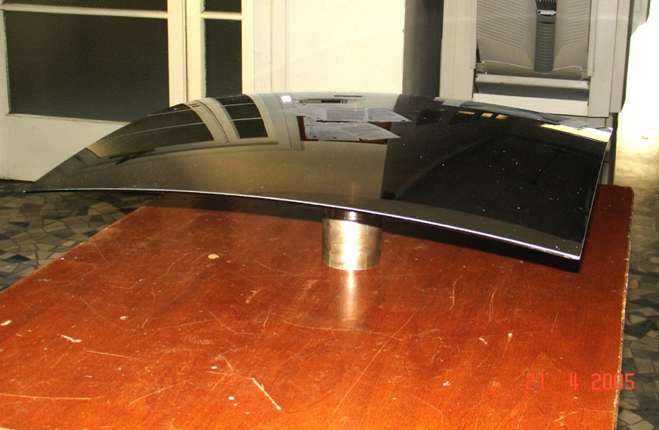
The optical surfaces - mirrors
Hot slumping technology
Some preliminary results coming from previous developments with FLABEG:
Very good performances on spherical profiles, 300 mm scan length.
PV error wrt best sphere = 6 μm
Capability of very short radii (down to 1.5 m)
Microroughness has been measured:
[5.2mm÷100μm] → σ = 1.6 nm rms
[600÷10] μm → σ = 0.4 nm rms

Slide 18
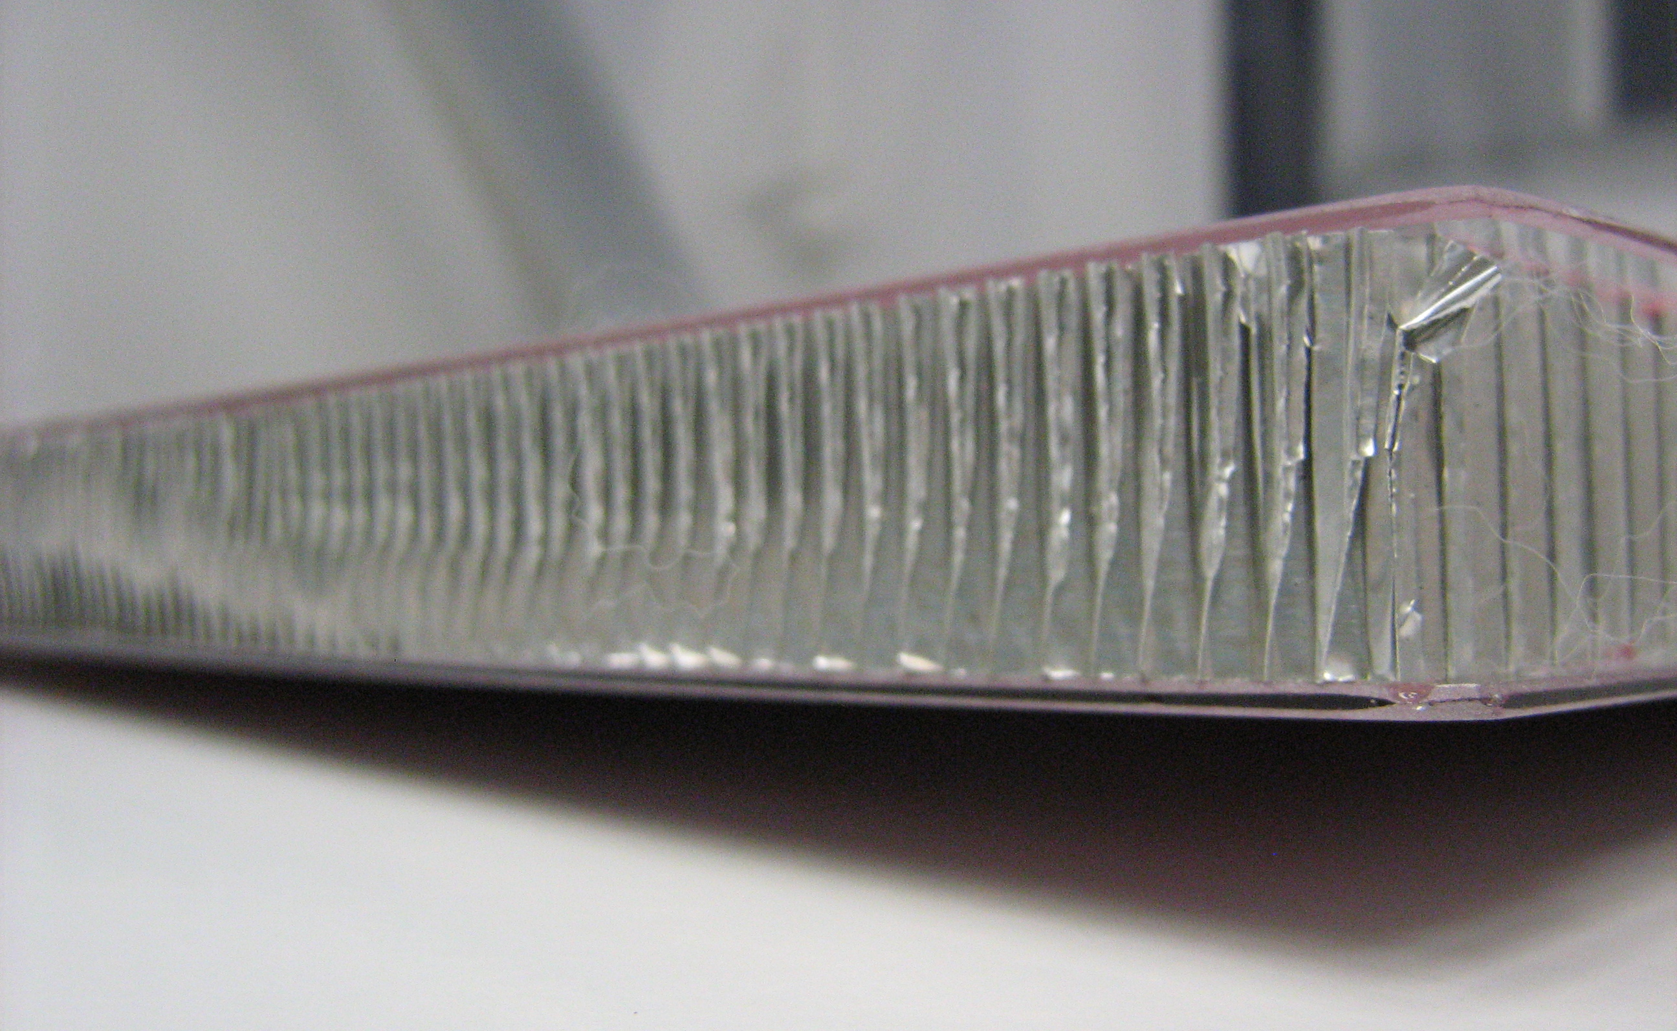
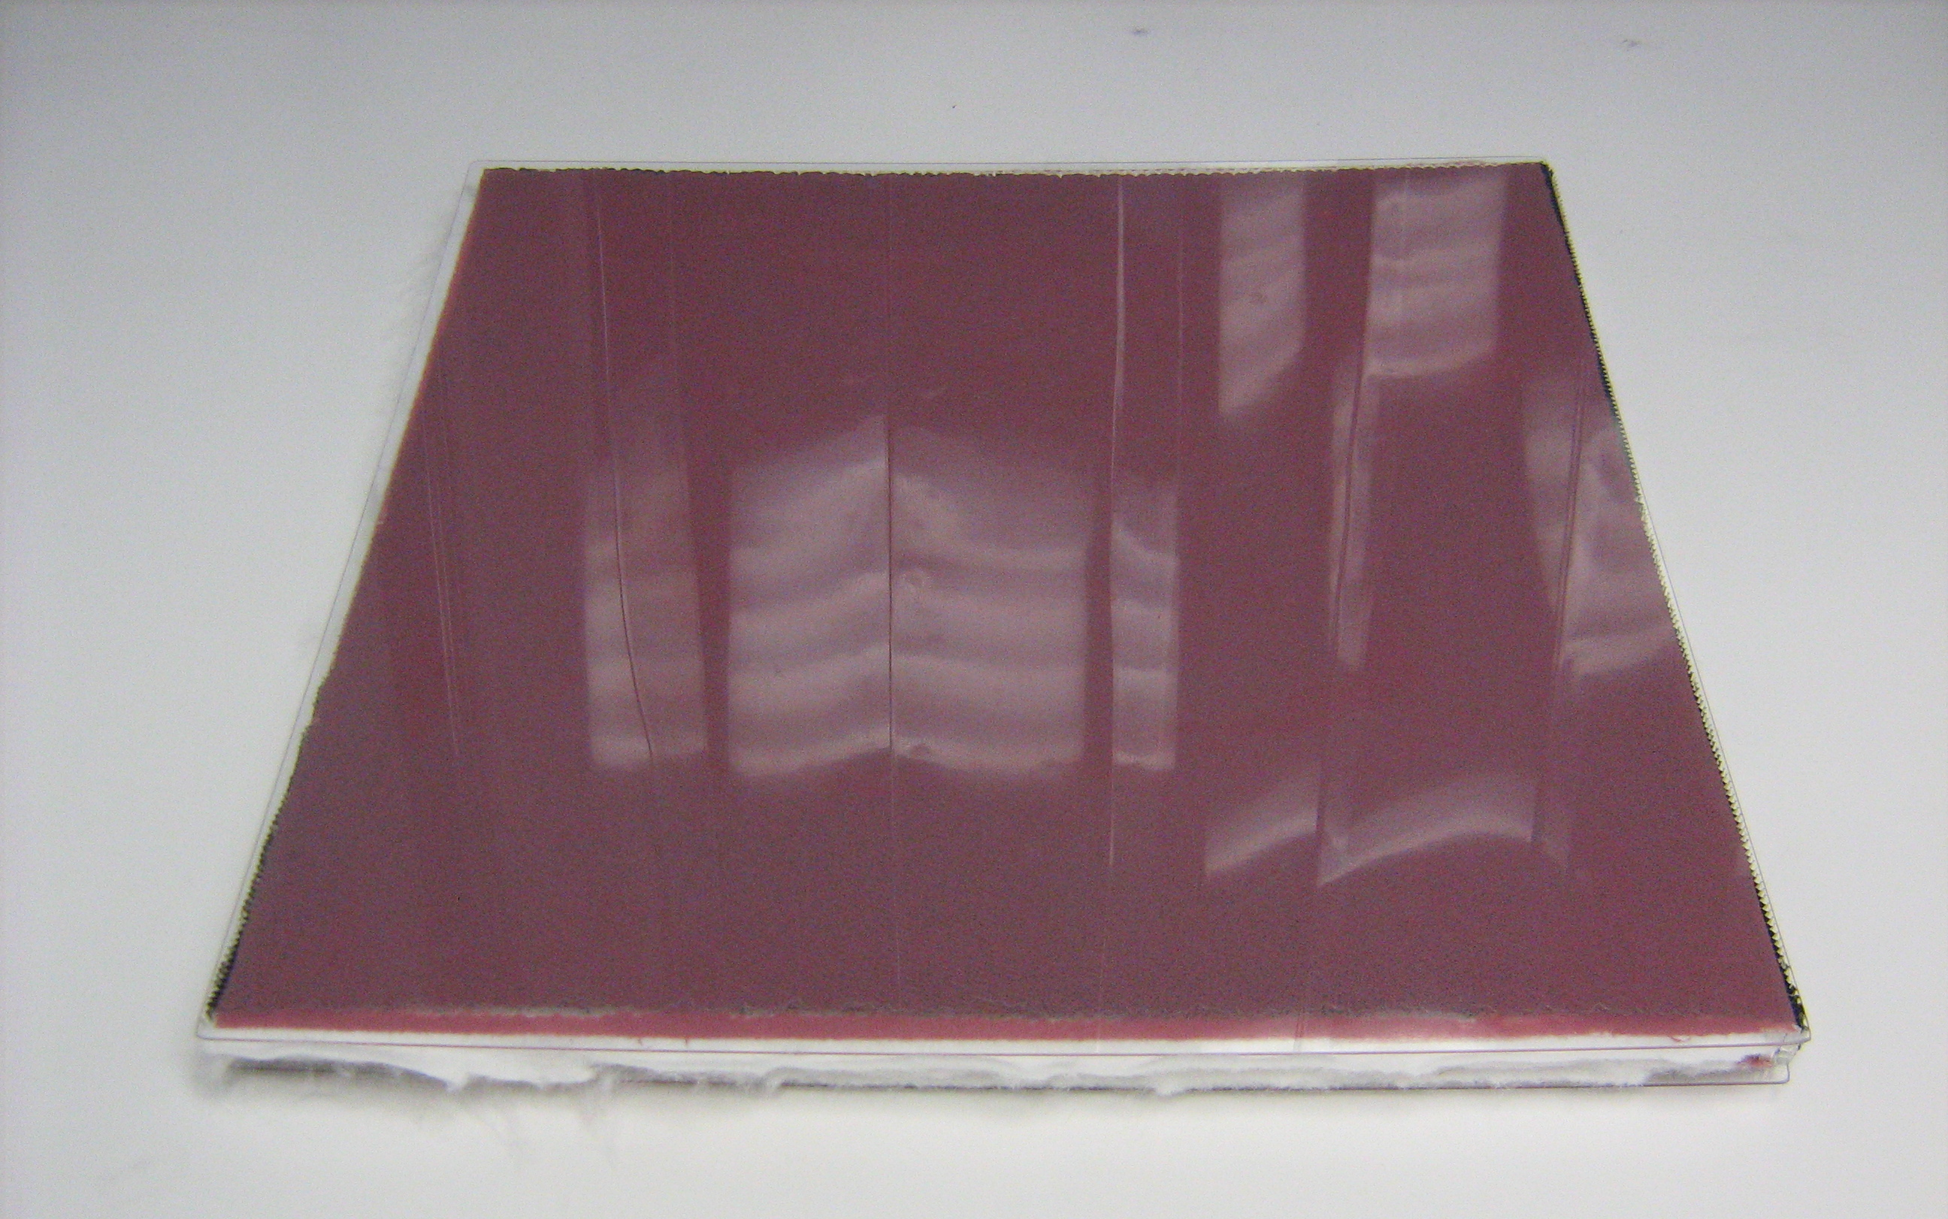
The optical surfaces - mirrors
Cold slumping 2.0 technology
RoC 5 m
20 mm
14 mm
530 x 530 mm mirror segment, 5 m RoC assembled with standard Al honeycomb is possible.
Standard honeycomb cut in proper way to accommodate the curvature, but astigmatic deformations may occur.
Special honeycomb under evaluation to minimize deformations.

Slide 19
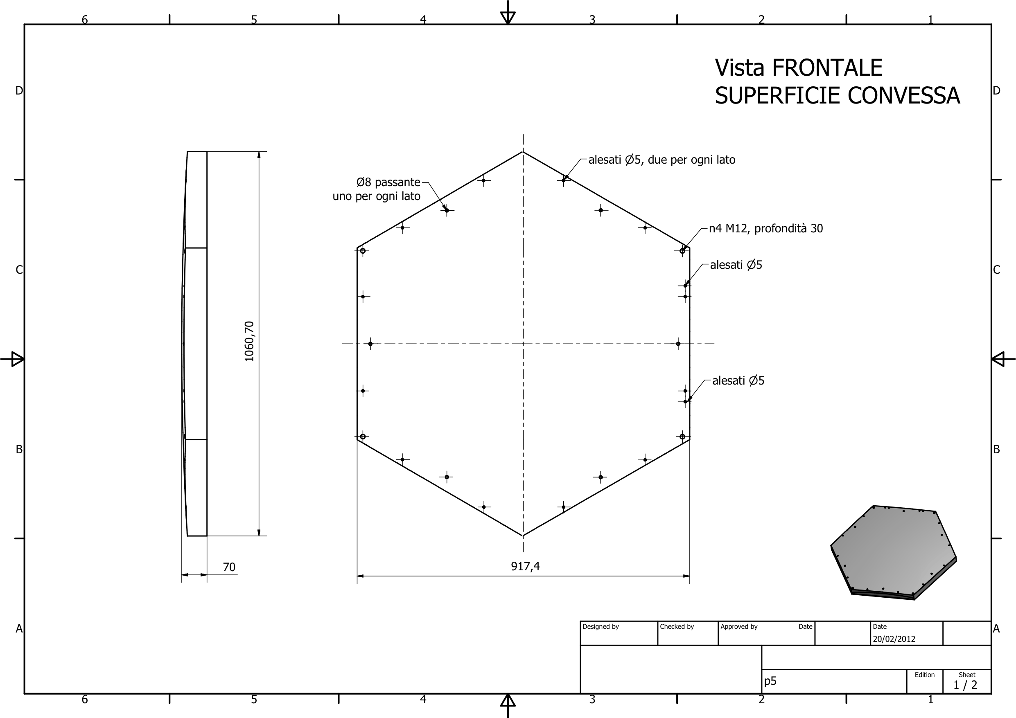
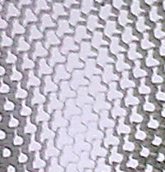

The optical surfaces - mirrors
Bended glass from FLABEG has been realized. The delivery is foreseen in these days.
Design of the master for the mirror integration ready.
Offer for “special honeycomb” obtained. It is done upon purchase order → 11 weeks for the delivery!!

Slide 20
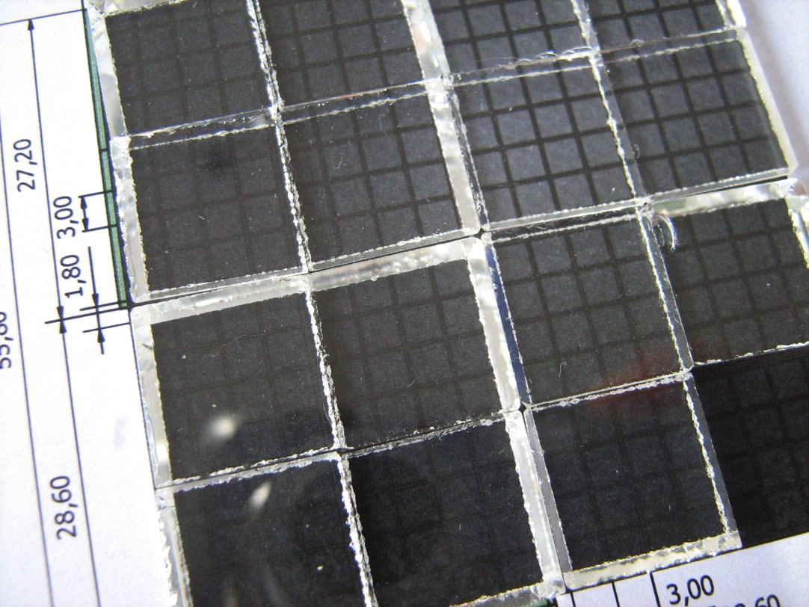
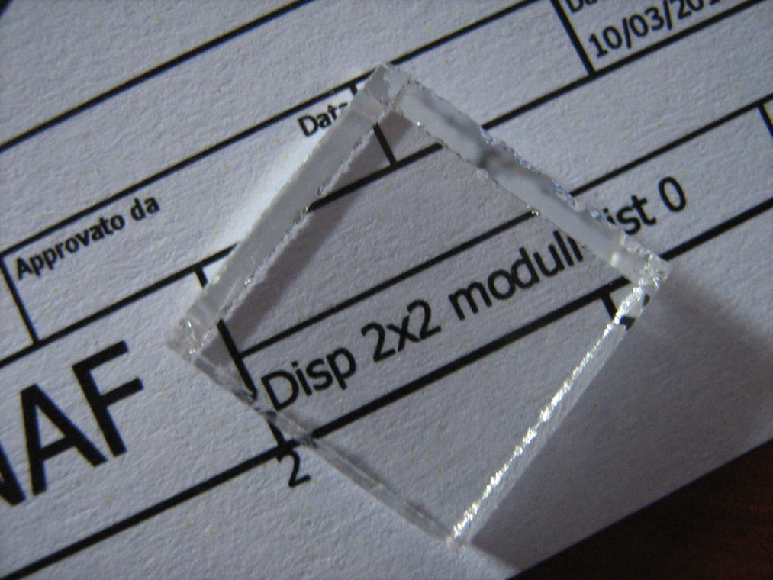
The optical surfaces - light guides
2 sets of engineering models delivered on December 2011.
12 pyramids with only 2 surfaces polished
15+ pyramids with all 6 surfaces polished
Material: glass BK7
1st set of engineering models for measurement tests delivered on January 2012.
All 6 surfaces polished!
Material: glass LAKN9

Slide 21
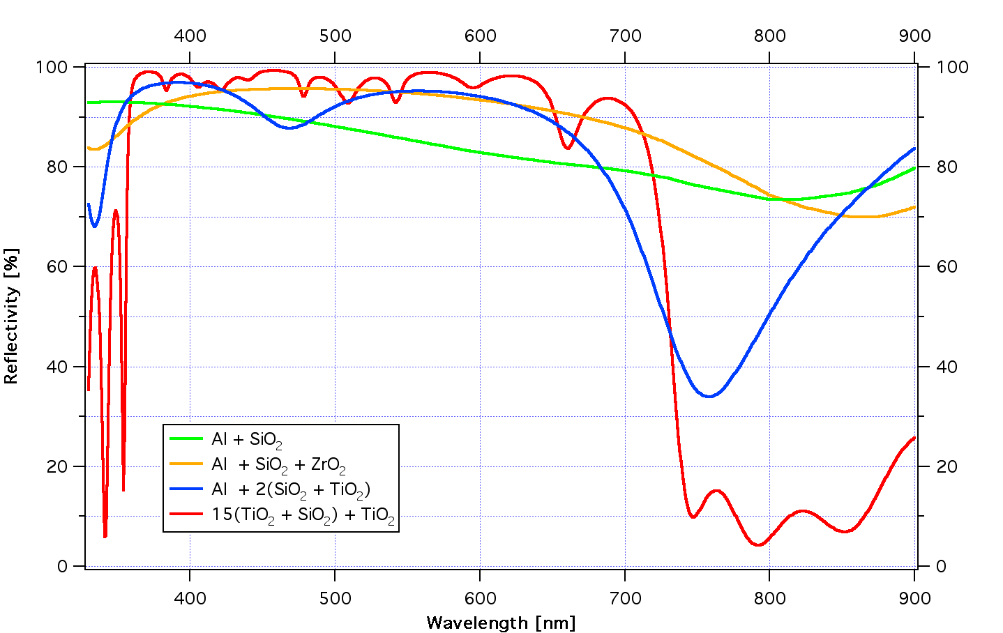
The optical surfaces - coatings
Enhanced reflectivity for M1
2 layers: Al + SiO₂
3 layers: Al + SiO₂ + ZrO₂
5 layers: Al + 2(SiO₂ + TiO₂)
31 layers: 15(TiO₂ + SiO₂) + TiO₂
Simulated reflection

Slide 22
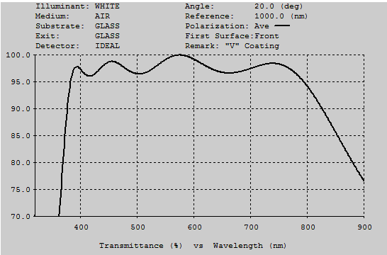
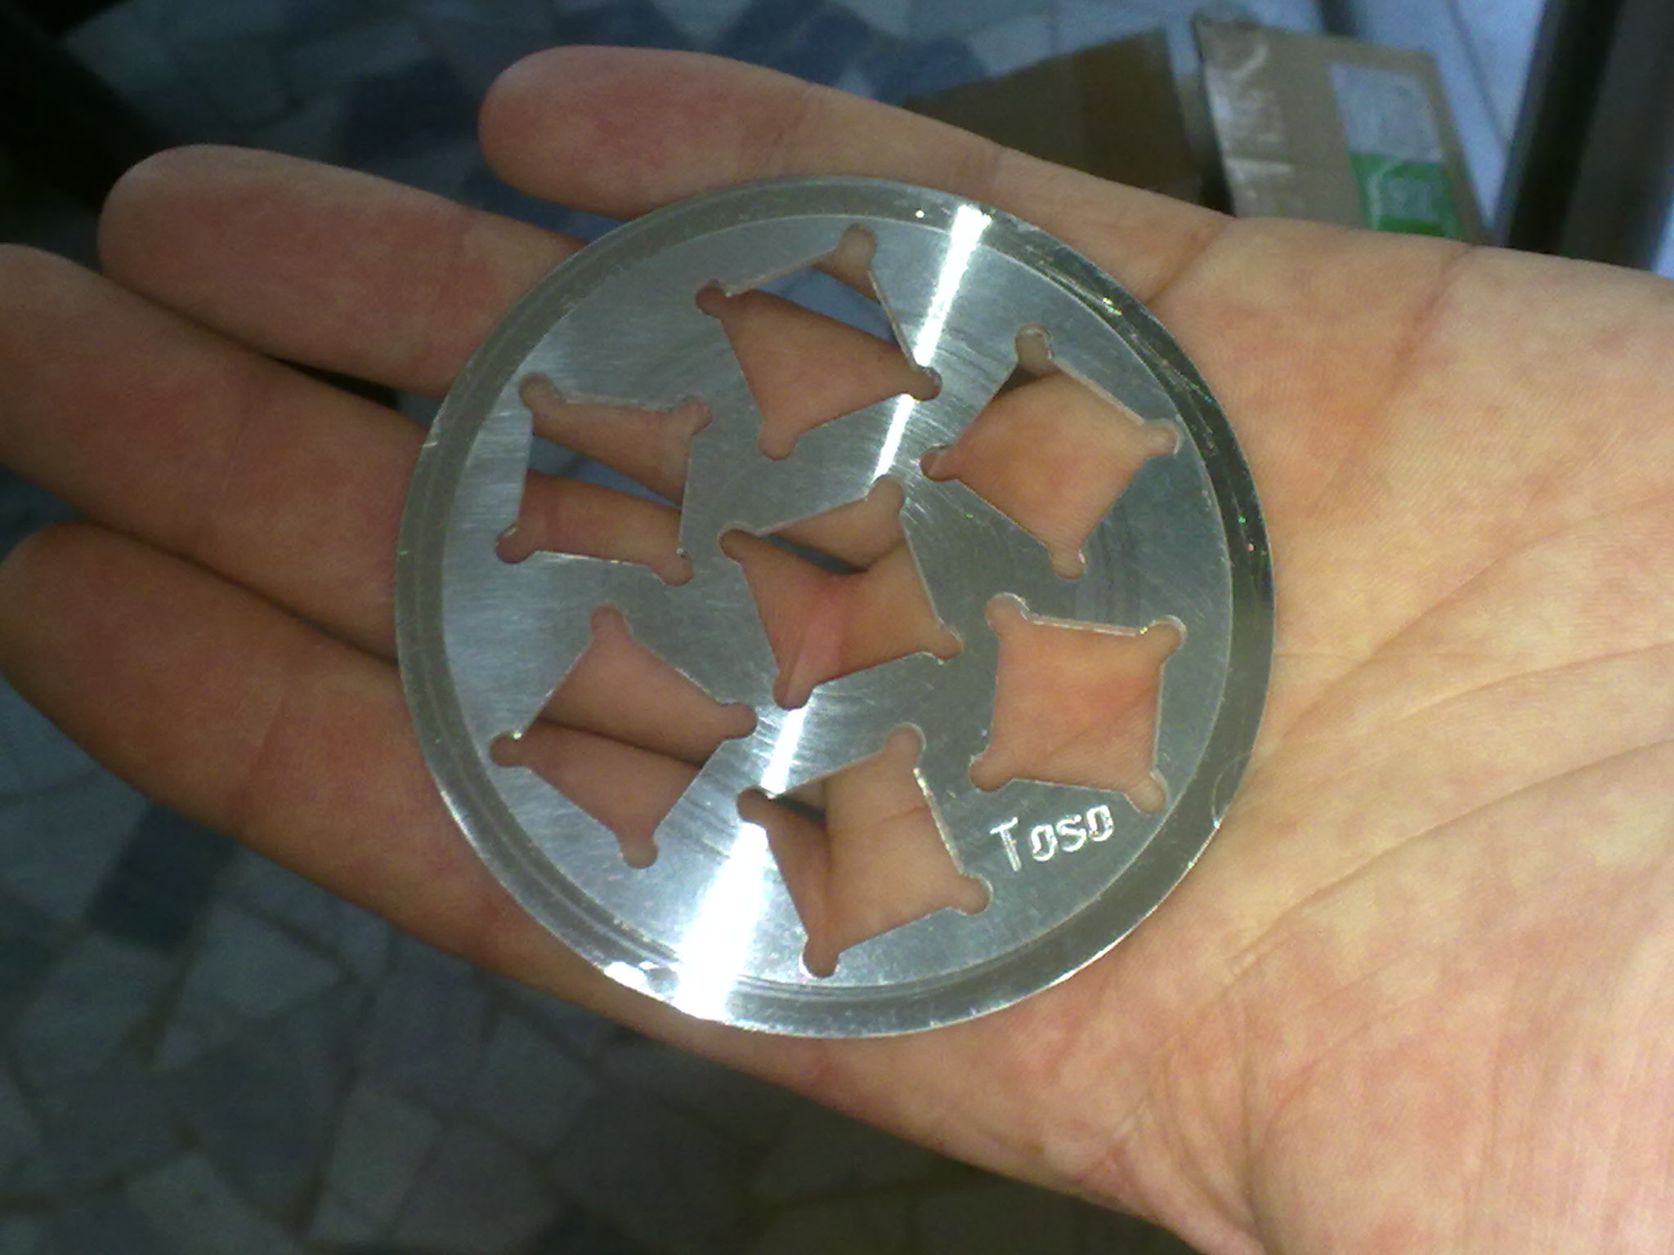
The optical surfaces - coatings
Anti-reflection for light guides:
  4 layers: 2(ZrO₂ + SiO₂)
Simulated transmittance
Handling tool for deposition

