Slide 1
SCT-OS Discussion Notes
Vladimir Vassiliev, UCLA

Slide 2
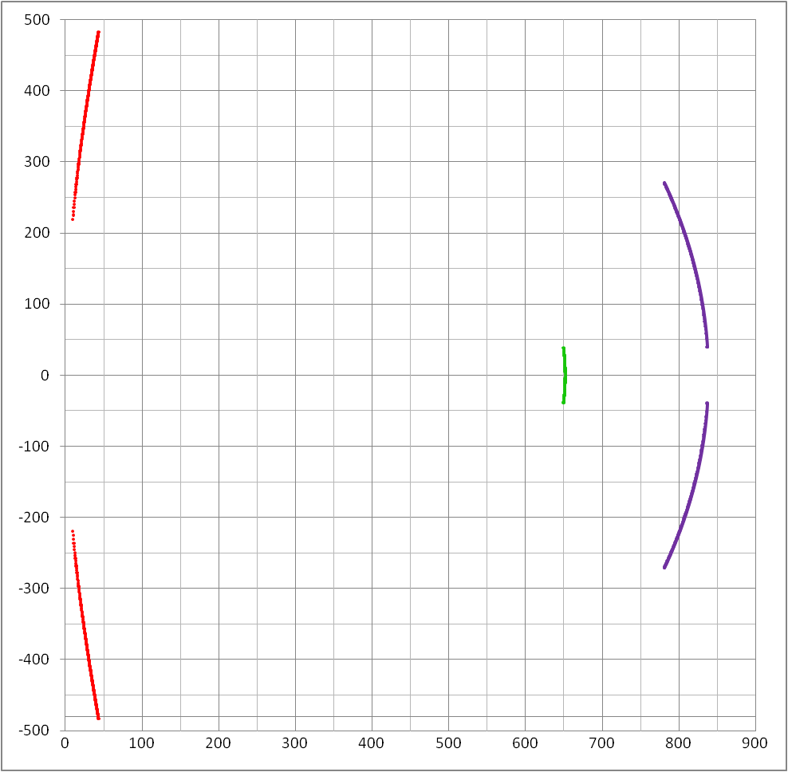
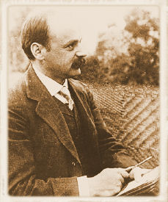
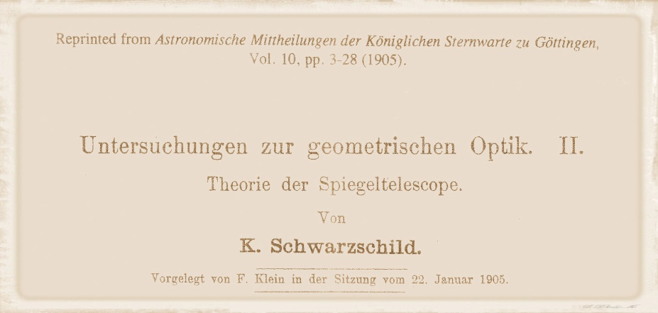
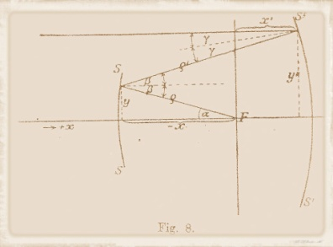
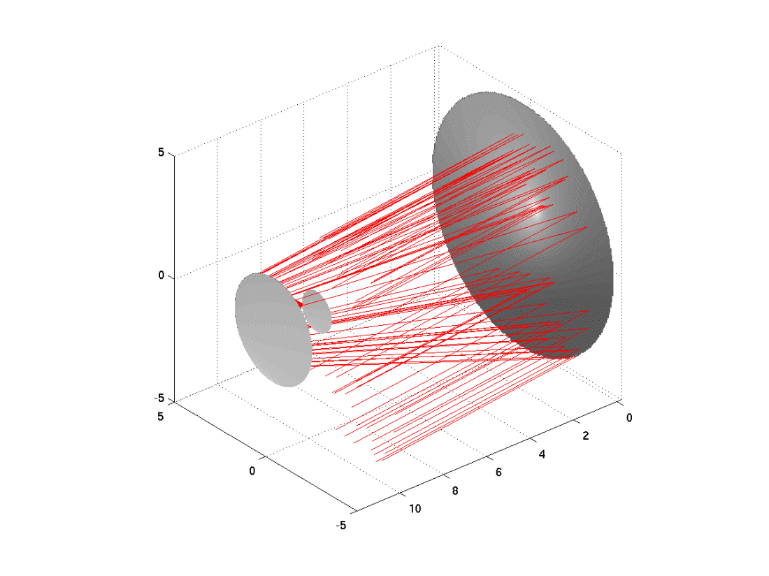
Schwarzschild –type OS
Aplanatic Solution (2/3, 2/3)
3/2 F
(1905)
1/3 F
“de-magnifying” telescope

Slide 3
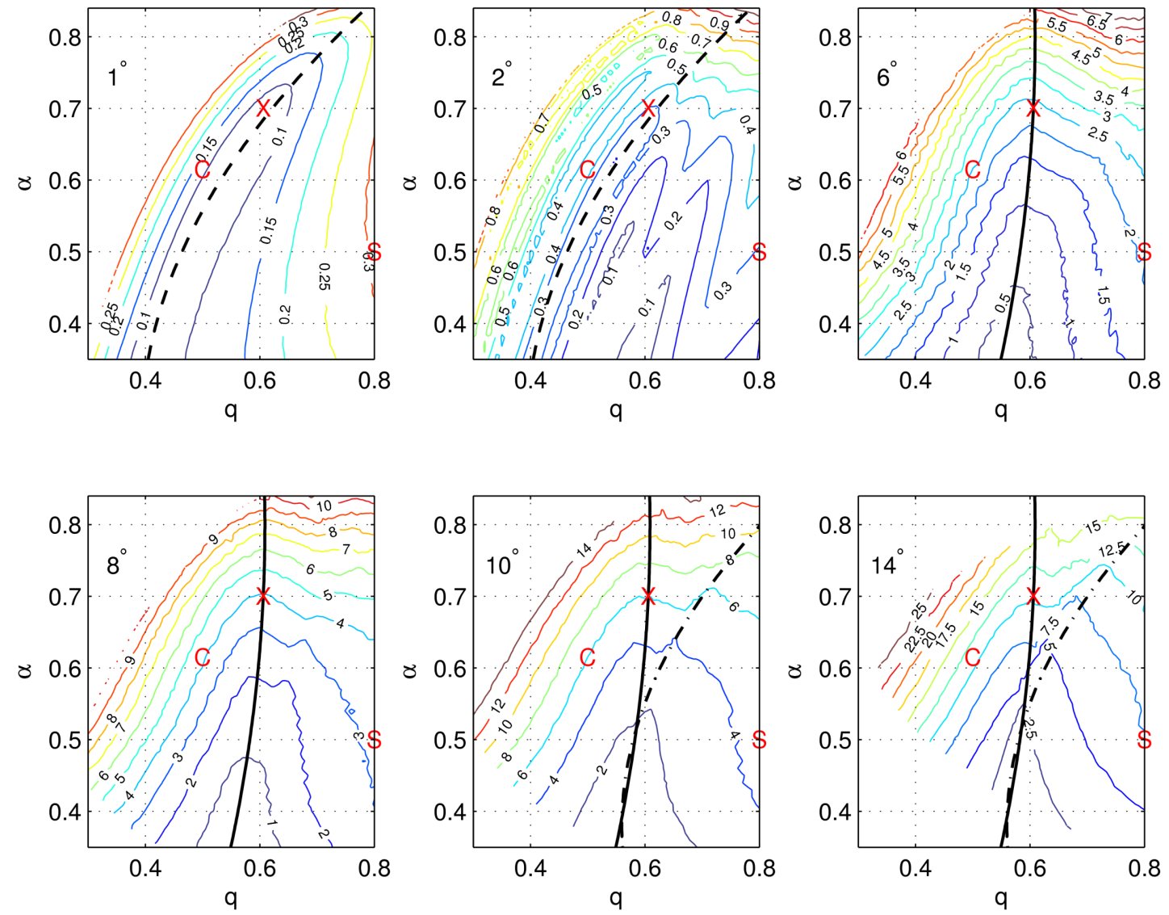
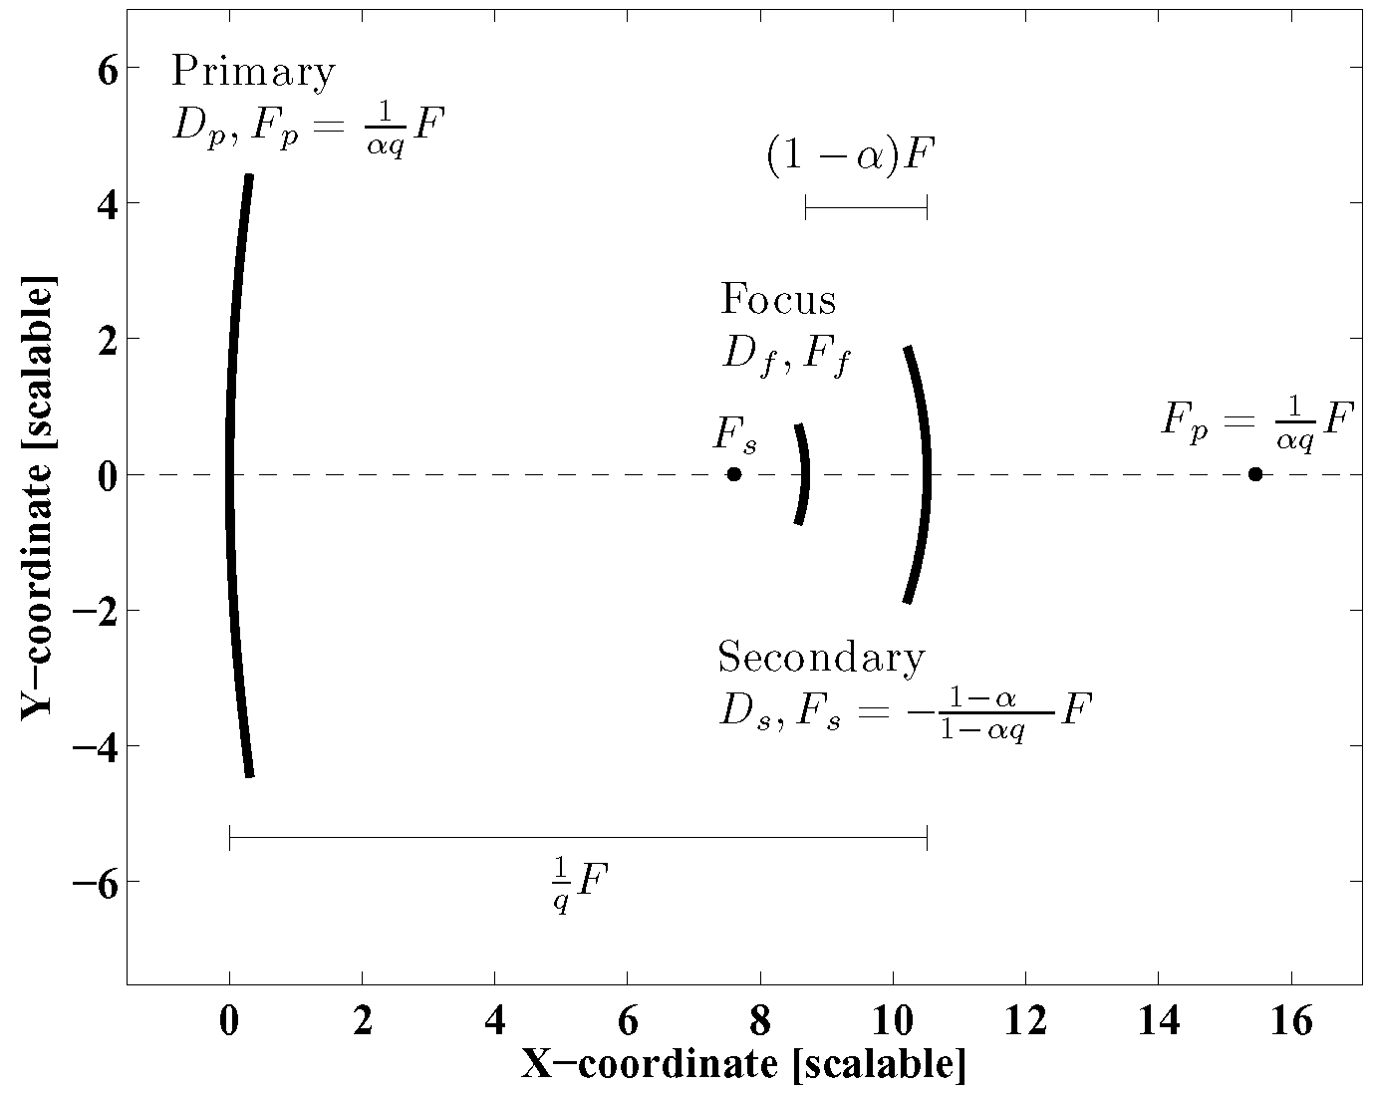
Point Spread Function
The lines show OSs
with minimal
astigmatism
for a given
value of α
Preferred solution for use in ACT applications has α=2/3, q=2/3

Slide 4
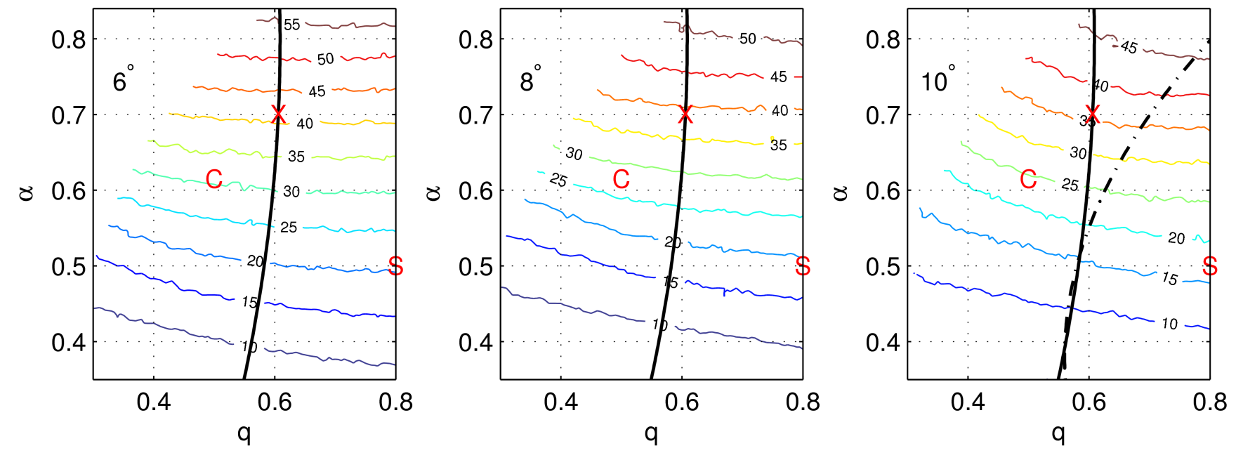
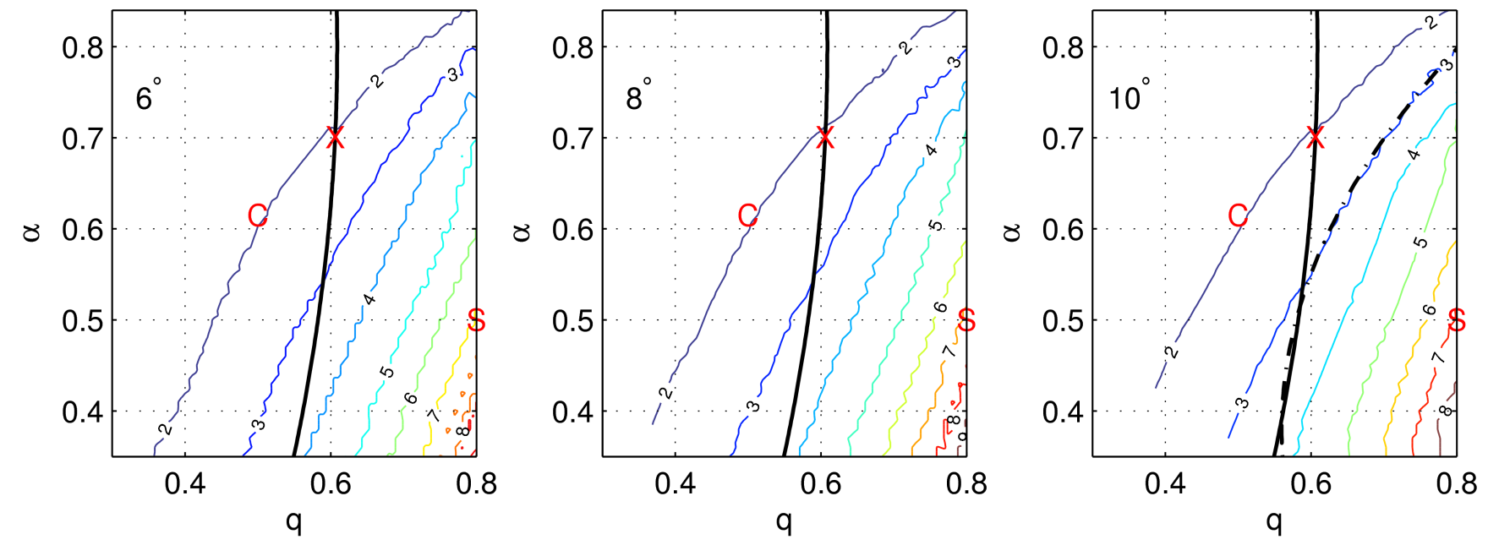
Collecting Area and FP Curvature
Light
Collecting
Area
Focal
Plane
Curvature
R650=2.6m
dZ650=3.9 cm
at 45 cm.
Example for
F=500 cm

Slide 5
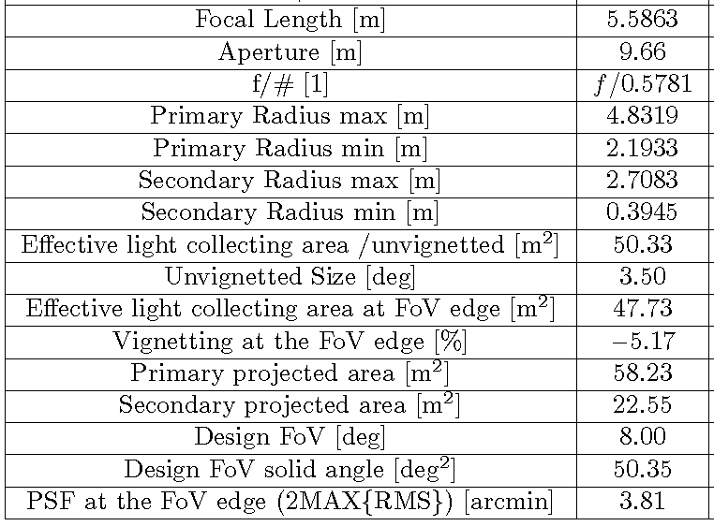
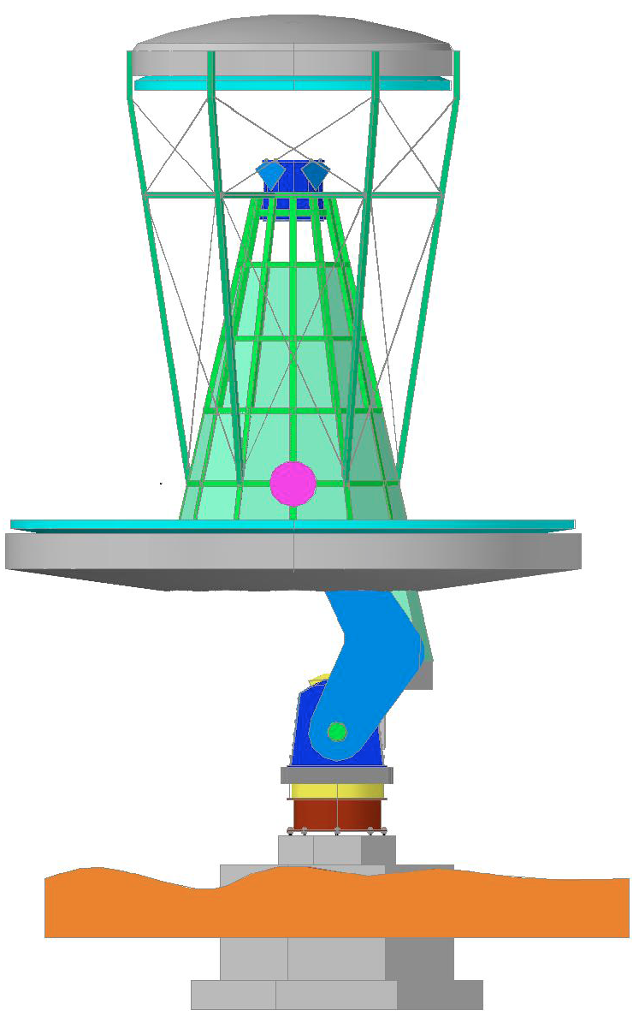
OS Specifications

Slide 6
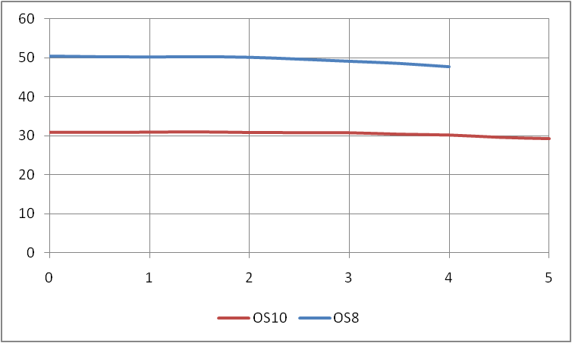
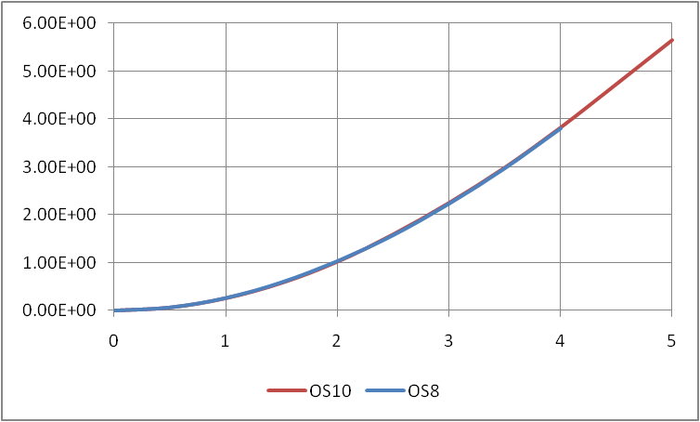
Vignetting and PSF
Effective light collecting area [m²]
PSF=2MAX{ σ_{x}, σ_{y}} [arcmin]
Field angle [deg]
Field angle [deg]
Vignetting at 4deg field angle: -5%
PSF < 4 arcmin within 8deg FoV

Slide 7
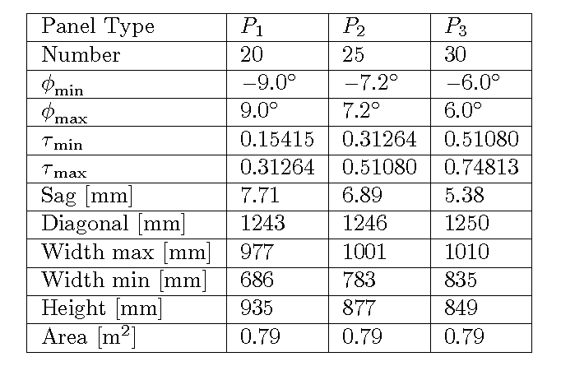
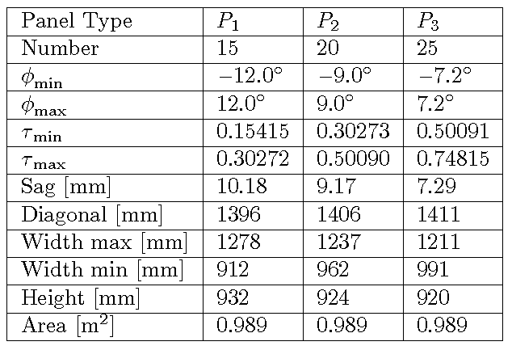
Primary Segmentation
Segmentation Scheme A (75 panels)
Segmentation Scheme D (60 panels)
5-fold symmetry

Slide 8
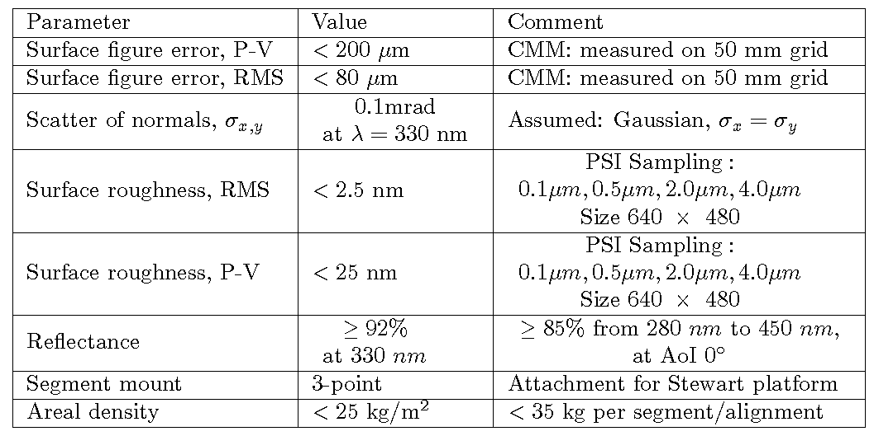
Primary Panels
Specifications
Notes:
Phase Measuring Deflectometry or another non interferometric method

Slide 9
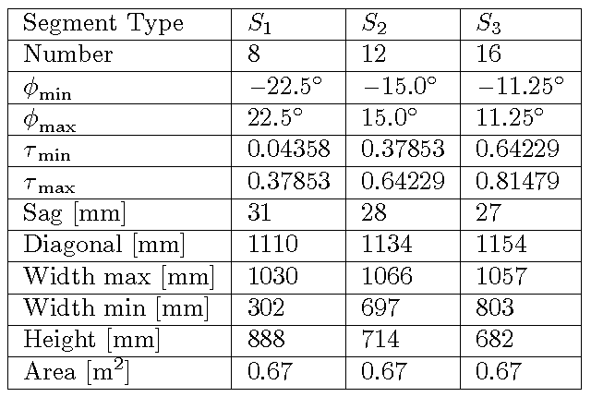
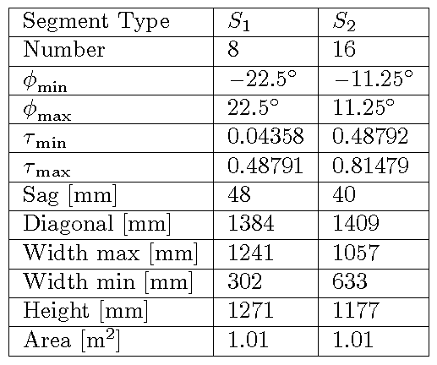
Secondary Segmentation
Segmentation Scheme F (36 panels)
Segmentation Scheme H (24 panels)
4-fold symmetry
8-fold symmetry

Slide 10
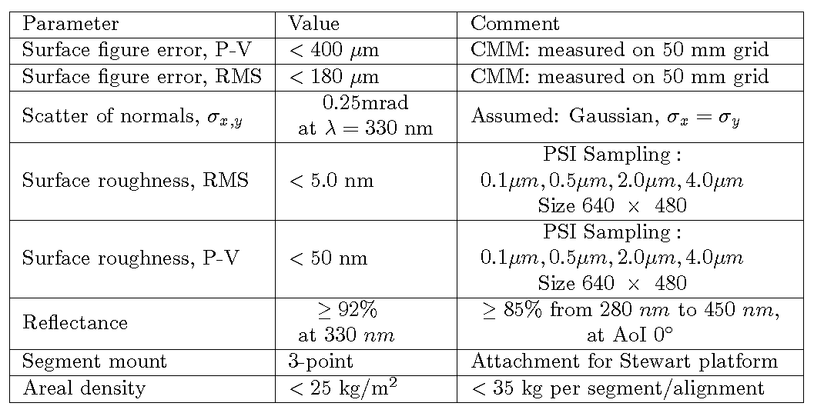
Secondary Panels
Specifications

Slide 11
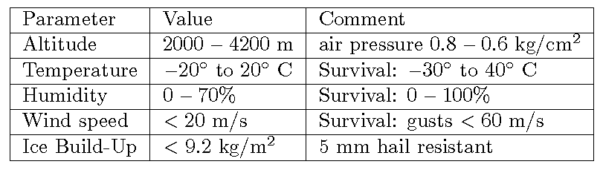
Environmental Specifications I

Slide 12
Environmental Specifications II
The tests designed in this report have been designed to conform to ISO (International Organization for Standardization) and American Military (MIL) standards where possible, although these have been tuned where necessary to assess the suitability of mirrors for IACTs, given the permanent exposure to the environment over a period of years. Differences between the tests described here and the ISO/MIL specifications are highlighted.

Slide 13
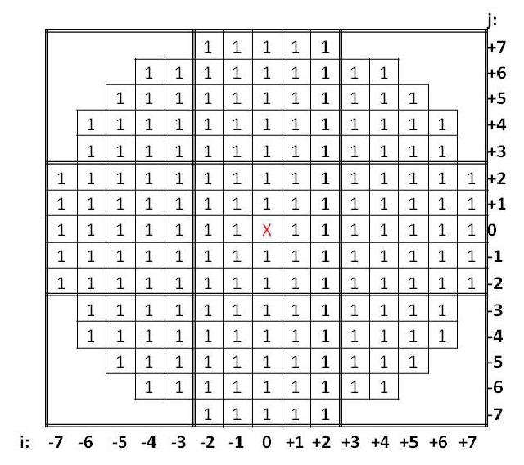
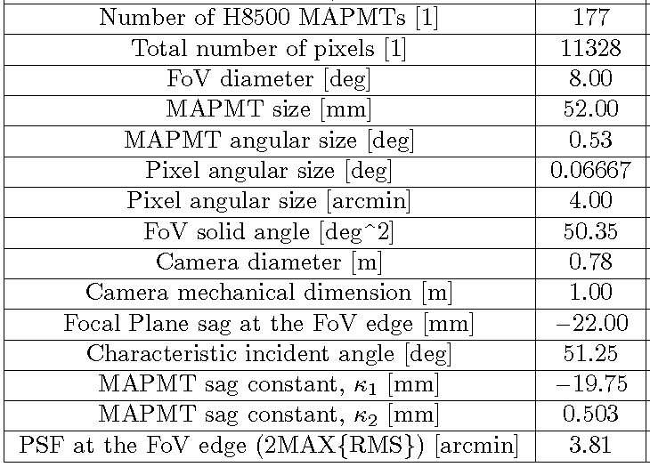
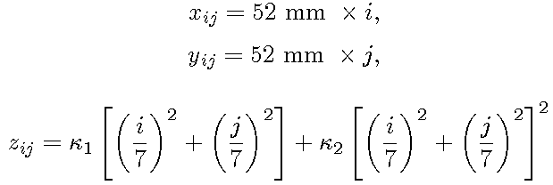
FP Specifications
MAPMT implementation (8x8 image pixels, 4x4 trigger pixels)

Slide 14
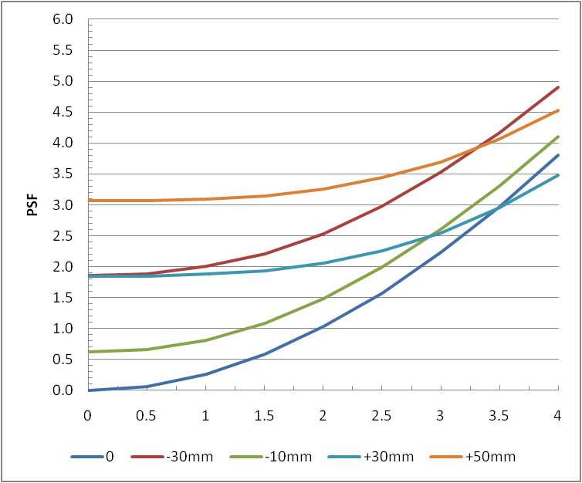
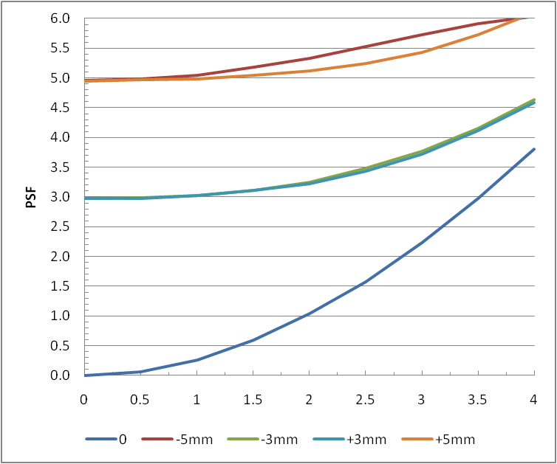
Tolerances
Translational d.f.
Primary displacement
Secondary displacement

Slide 15
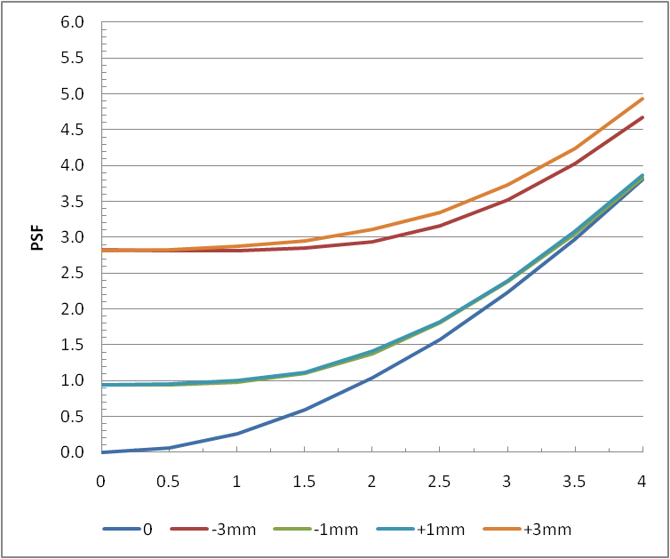
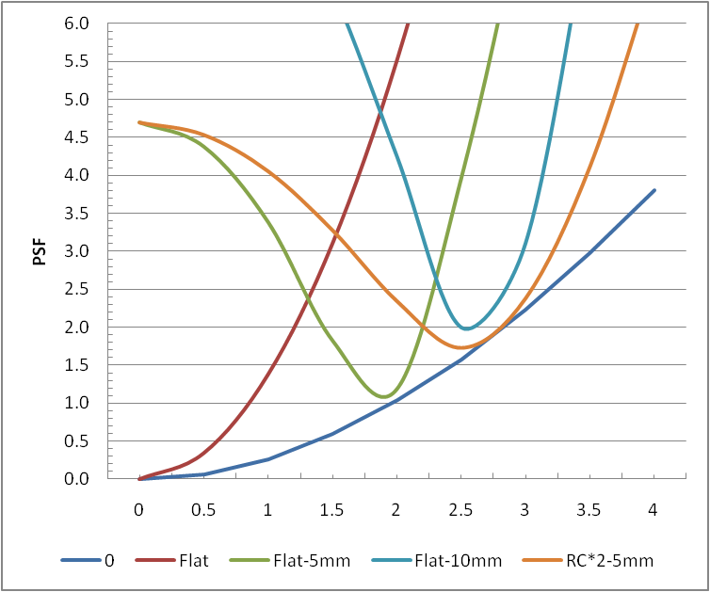
Tolerances
Translational d.f.
Focal Plane displacement
FP curvature & displacement
Focal Plane sag at the FoV edge is -22.67 mm
Delta (MAPT center to edge) – 2.9 mm
Delta (SiPM trigger pixel) – 0.73 mm

Slide 16
Tolerances all d.f.
Detailed work is in progress
Error budgets, etc.

Slide 17
OS PBS, WBS, & ICDs
Later…

Slide 18
Alignment Notes

Slide 19
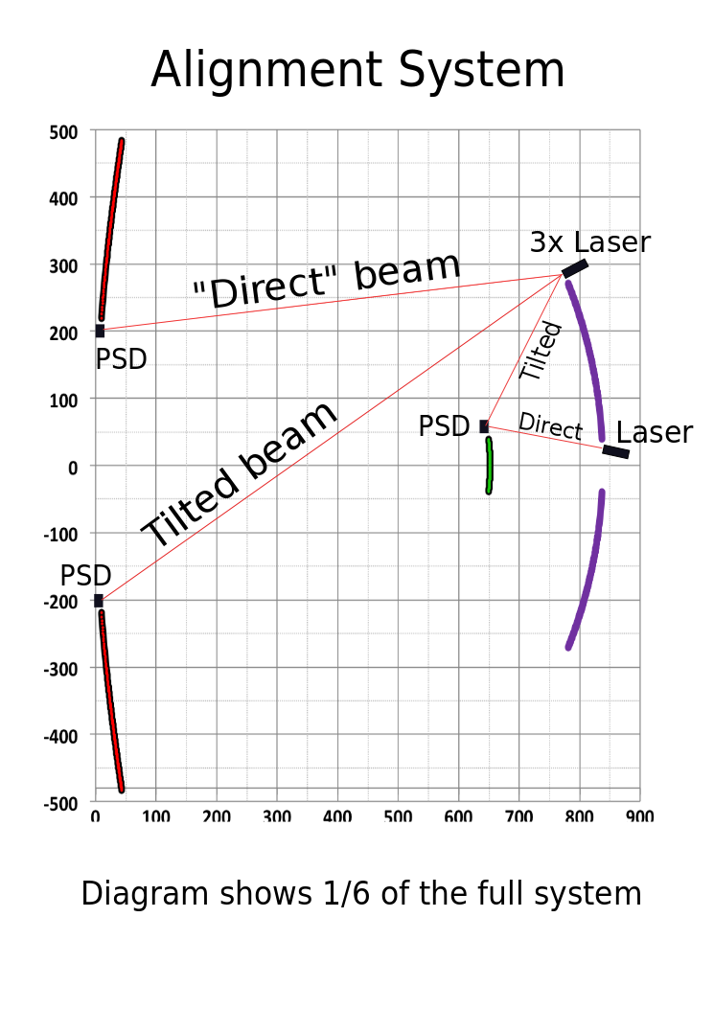
Global Alignment System
Two CCDs
Viewing sky and focal plane
Utilize images of stars and auxiliary laser system
Relative alignment of mirror surfaces
Removal of low spatial frequency modes in figures of both mirrors
s
CCD C
CCD S
by Phil Kaaret

Slide 20
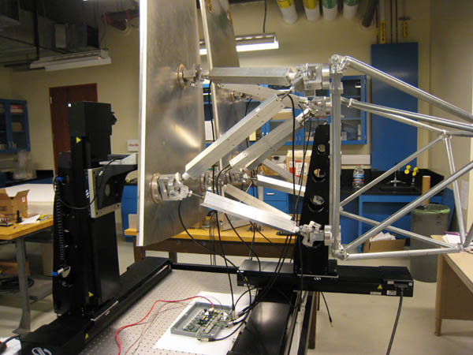
Panel-to-Panel
Alignment System
Stewart Platform 6 df of which 3 df are critical
UCLA Lab

Slide 21
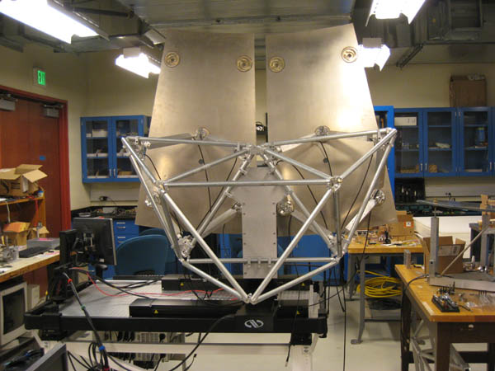
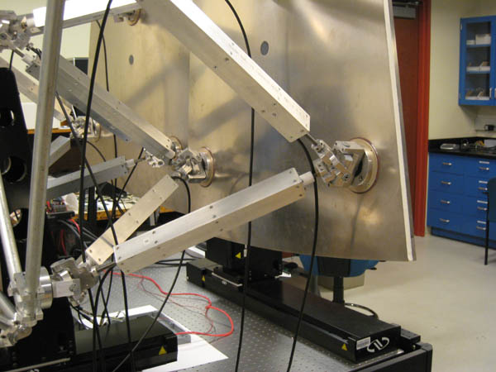
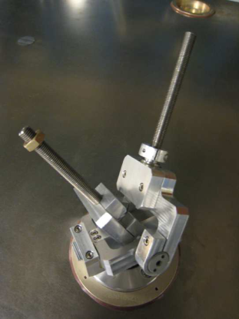
Alignment Syetem Prototyping
Prototype segment of OSS for SC telescope with Stewart Platform mounted on ALMA mirror. Assembly is made with the 5 degrees of freedom inexpensive joint design developed at UCLA Machine Shop. Individual actuators can be positioned with ~1.5 μm

Slide 22
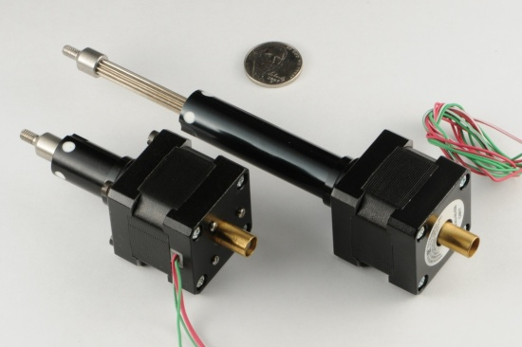
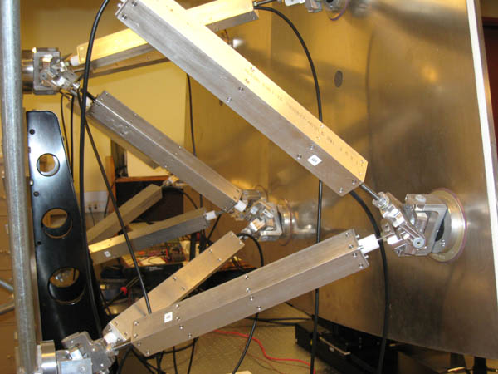
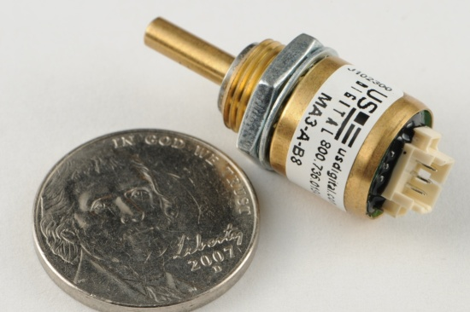
Actuators and angle encoders

Slide 23
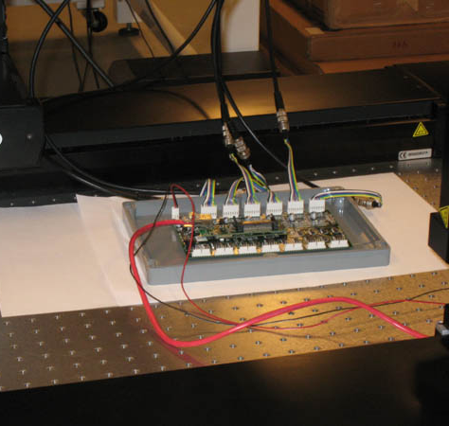
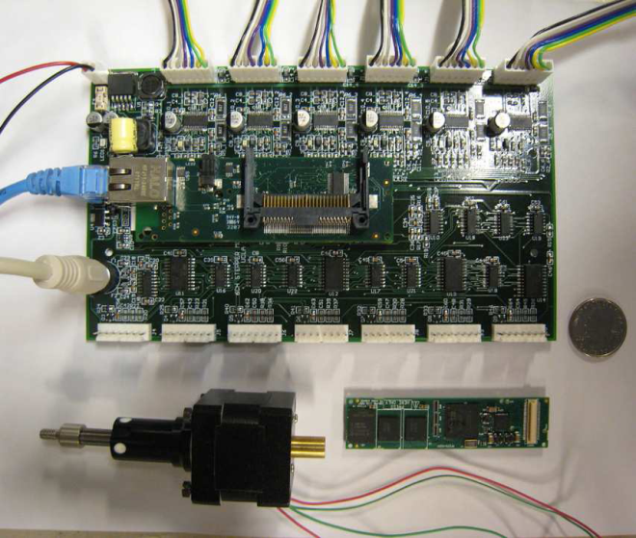
Controller
Controller board
Embedded computer with OS
Ethernet, wireless Ethernet, Bluetooth etc…
Substantial on-board processing power available
Can be aware of and apply calibration
Large (or multiple) software applications possible

Slide 24
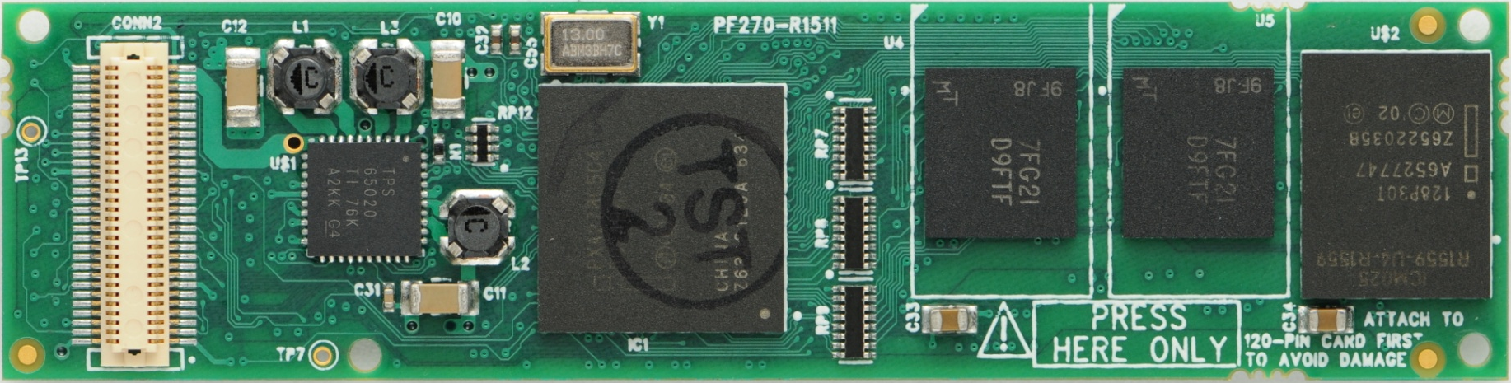
Gumstix Verdex XM4
60-pin Hirose I/O connector.
General purpose I/O (GPIO)
and alternate functions
Simple Gumstix I/O
expansion boards
or custom board
64MB RAM
Actual size: 8cm × 2cm
16MB Flash
Marvell (Intel) XScale PXA270
400MHz ARM based CPU
$129.00 (1 unit)

Slide 25
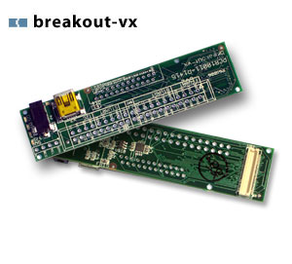
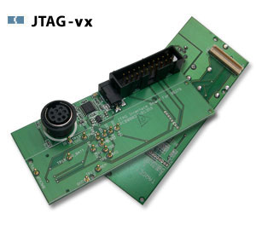
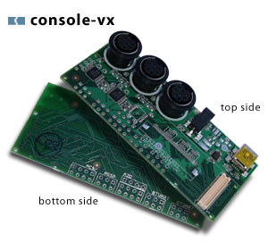
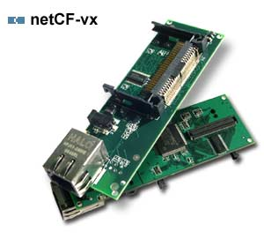
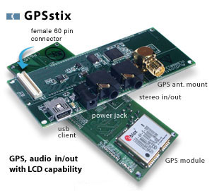
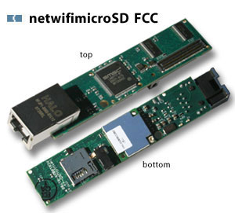
Gumstix expansion boards
$25.00
$27.50
$40.00
$130.00
$65.00
$99.00
Single unit prices shown

Slide 26
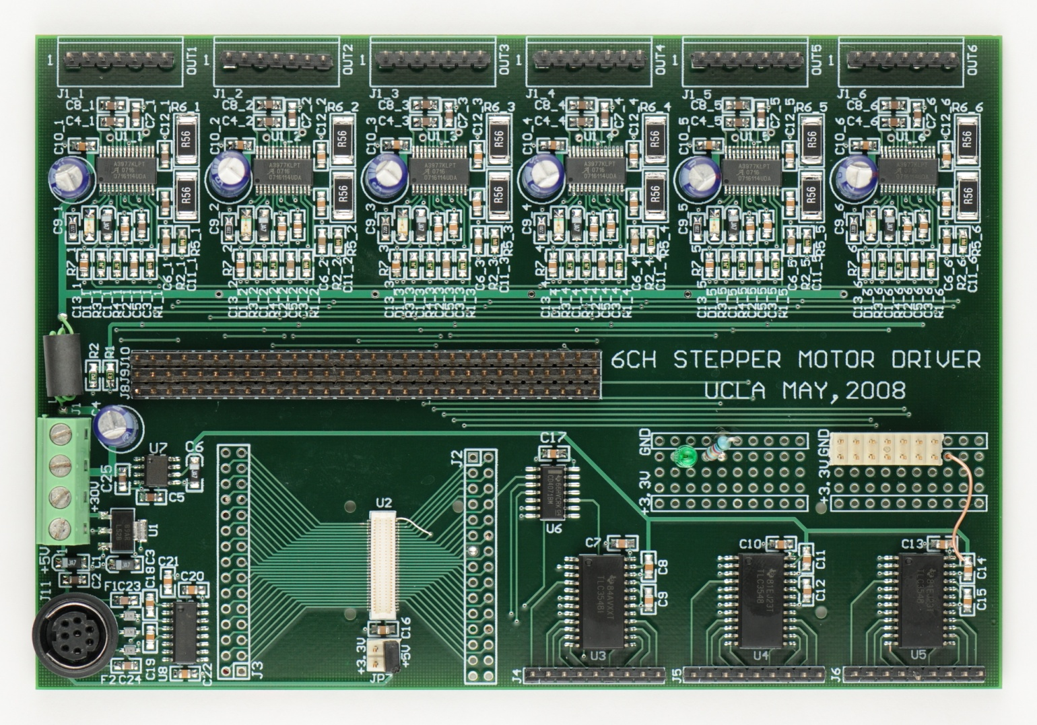
Mirror control board
Stepper motor drivers
Console
serial
port
60-pin Hirose connector
ADCs for encoders and position sensors

Slide 27
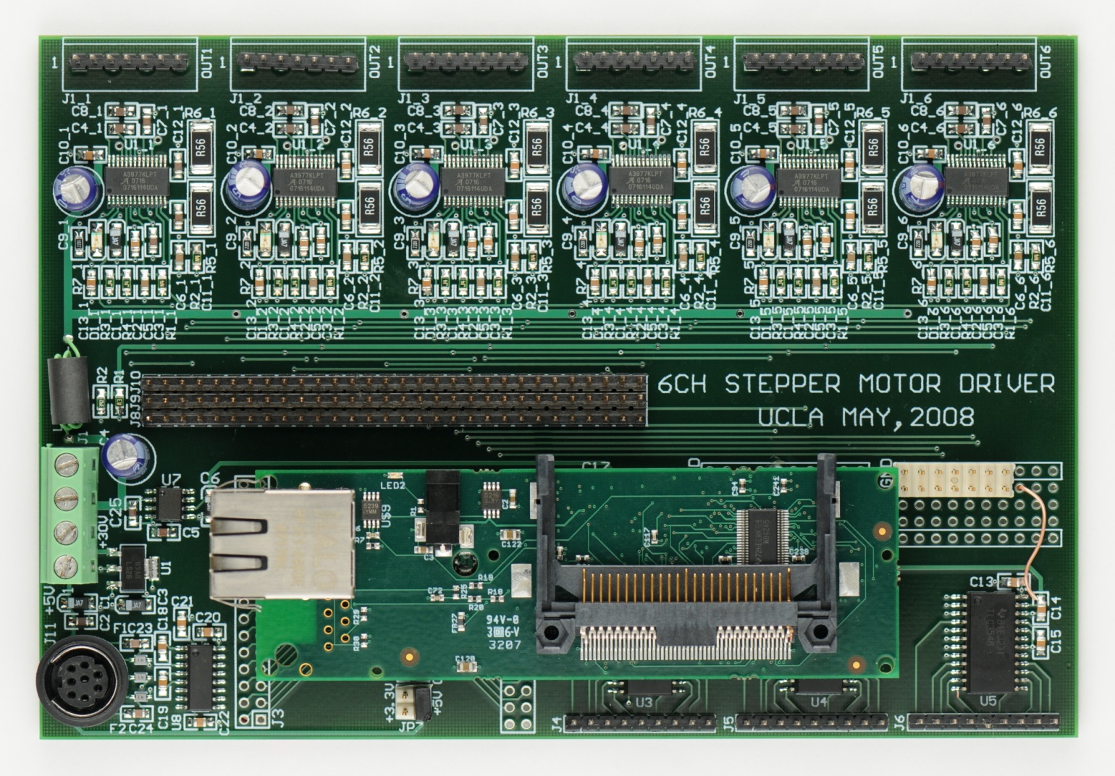
Mirror control board w/CPU & E-net

Slide 28
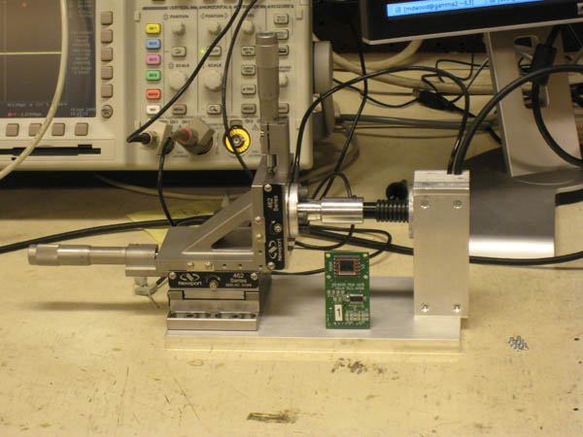
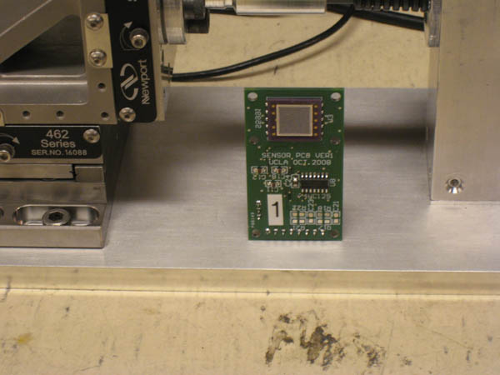
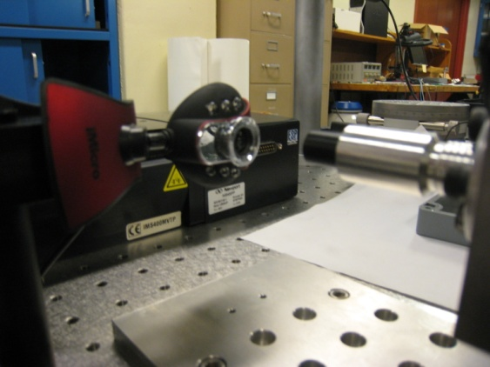
Edge Sensors
Non-imaging PSD or WebCam
Number of sensors per mirror: 4-6
Provide redundancy and over-constrain system to tolerate possible failures of sensors

Slide 29
Mirror control software
On-board software:
  CORBA interface with central computer – respond to commands, store/retrieve state data in central database
  Move mirrors by pulsing motor controllers
  Monitor encoders during motion – guard against collision
  Sample PSDs and temperature (?) as necessary
  Assist in calibration of PSDs and Stewart platform
Central control software:
  Monitor star images (focal plane CCD)
  Calculate required facet motions based on elevation and temperature, and input from CCD & PSDs if necessary
  Coordinate motion of mirror facets
by S. Fegan

Slide 30
Newspaper Ad
The 9m diameter original Schwarzschild IACT is an inexpensive, high-performance telescope that is easy-to-use, maintenance-free, and completely portable. Its wide field of view, beautiful images and ease of use make it an excellent telescope for beginner and expert optical and gamma-ray astronomer alike.
just a dream… (1st AGIS Meeting, UCLA)

