Slide 1
The Camera Mechanic
Scott Wakely
University of Vengeance

Slide 2
General Features/Assumptions
Modular Configuration:
Nine 5x5 subsectors, 144 tubes.
52mm square tubes/SiPM assemblies
Size: ~1 m diameter and depth
Mass ~ 1 ton
Power < 5 kW
Open Design Drivers:
Focal Plane alignment requirements
Focal Plane cooling requirements`
Shutter complexity

Slide 3
General Characteristics
Nested twin enclosure design
ORIENTATION
HARDWARE
LID
THERMAL
WALL
FP
FE ELECTRONICS
COOLING
SYSTEM
OUTER ENCLOSURE
LID

Slide 4
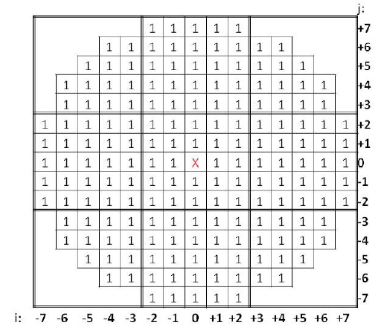
Internal Structure
Goals:
Modular hardware configuration
Keep readout electronics close to focal plane
Questions:
Ideal unit size?
Release process?
Z-registration?

Slide 5
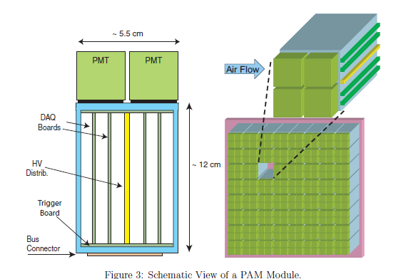
Internal Structure
A few ideas explored…

Slide 6
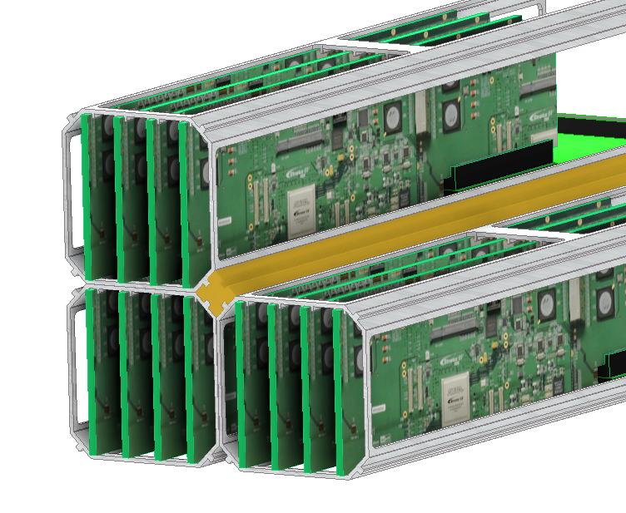
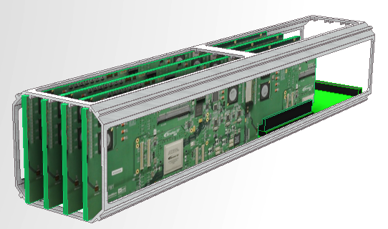
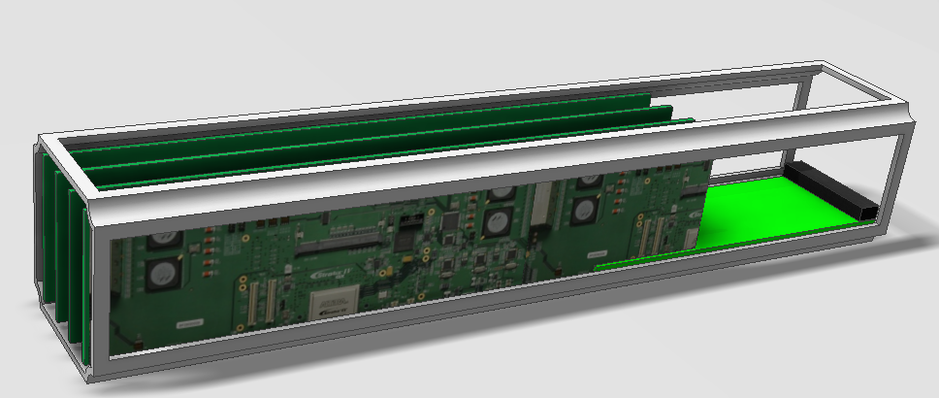
Internal Structure
A few ideas explored…

Slide 7
Internal Structure

Slide 8
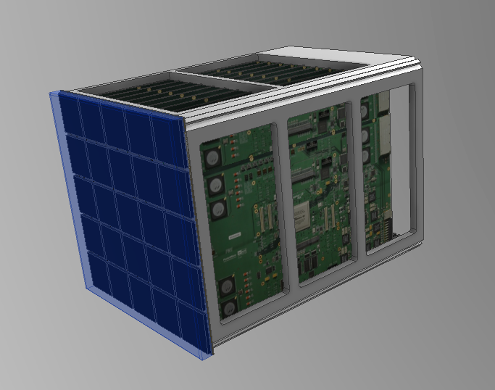
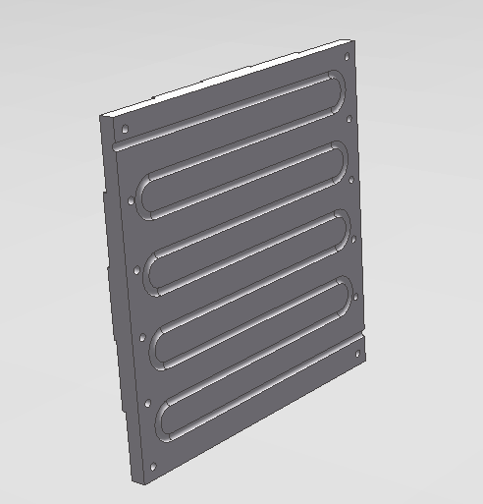
Internal Structure
Unit Size
Single Tube vs Five by Five
Locking
Thru-feed back access
Thru-feed front-access
Spring-loaded latch mechanism

Slide 9
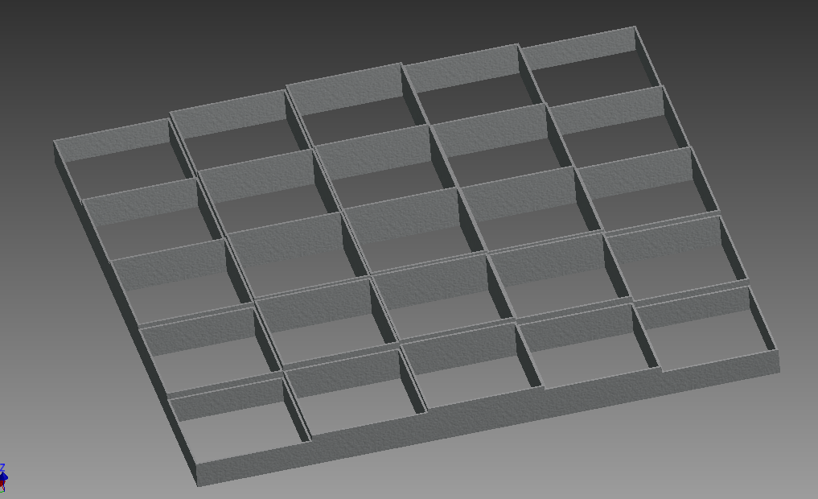
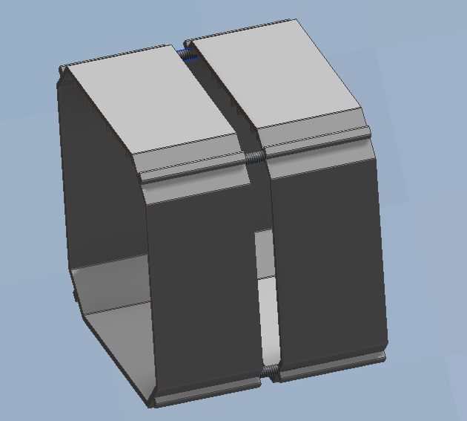
Internal Structure
Z-axis Registration
Back-end vs Front End
Fixed vs adjustable

Slide 10
External Structure
Backplane structural plate
X/Y Registry posts
Front-end connector mates
Insertion/Extraction Forces?
Backplane electronics
Interior Enclosure
Environment controlled
Alignment system
Exterior Enclosure
Exterior shell & mount mechanics

Slide 11
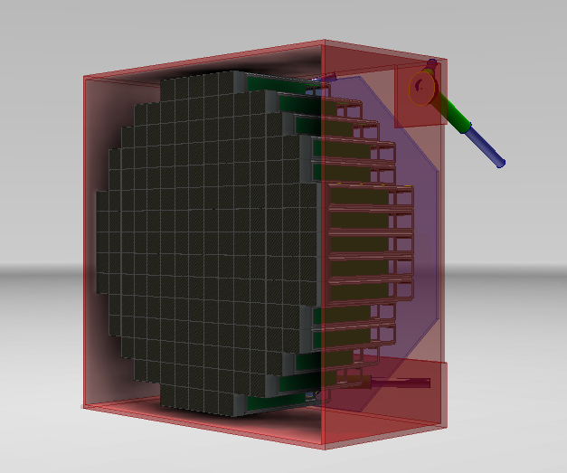
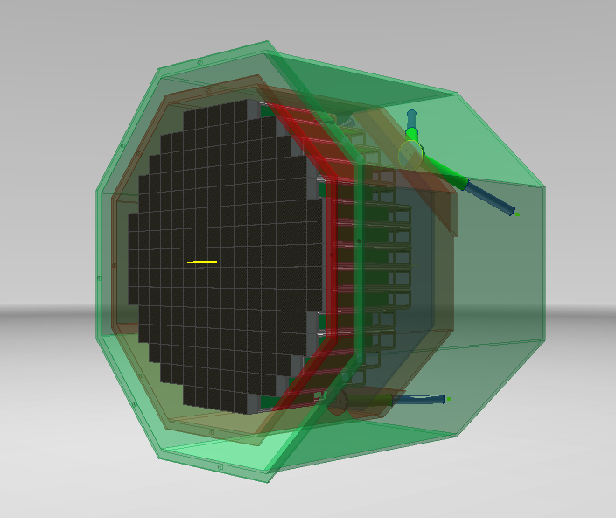
External Structure

Slide 12
External Structure

Slide 13
Shutter Technology
2-4 pedal flip-top?
VERITAS-type rolling shutter?
Built-in functionality?

Slide 14
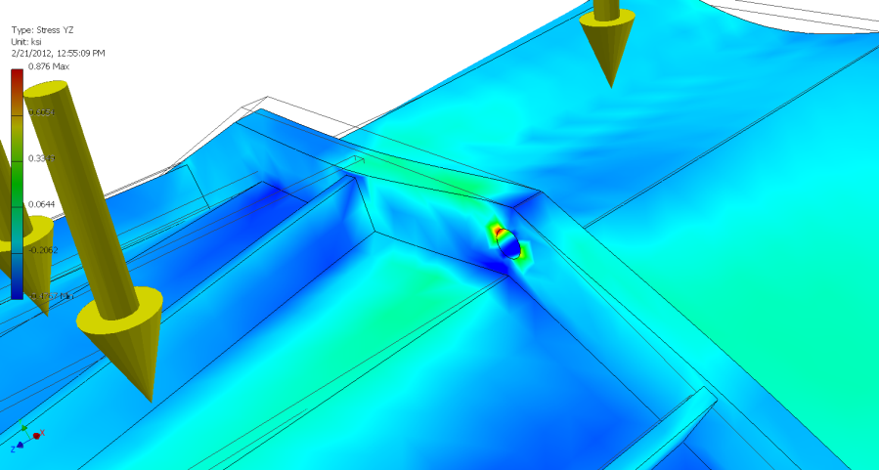
Camera Mounting
Details require a mature telescope design, but baseline is a center-located flange+mount ring

Slide 15
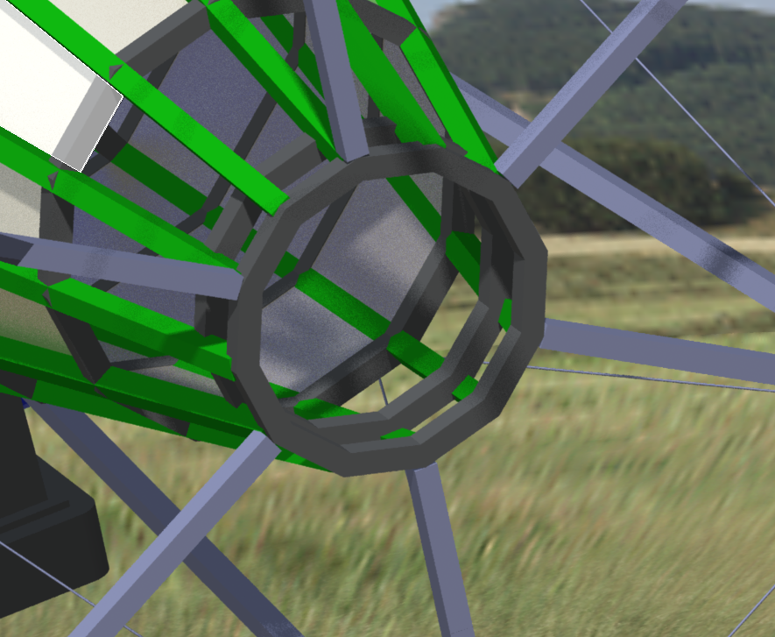
Camera Mounting
Installation access
How to lift it in
Servicing access
Rear panel?

